Slide 1
Big Data Analysis System
for Medicare Data
CS8674 - Prof. Ian Gorton
Timothy Cowley, Brian Gillespie, Zheyu Jin,
Hunter Jorgensen, Doyle Ravnaas, Joshua Shaham

Slide 2
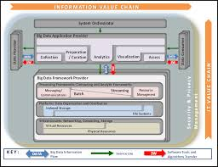
Basic Aims
National Institute of Standards and Technology (NIST) Big Data Reference Architecture
Develop a use case on public data set to test/validate NIST Reference Architecture
Chose Medicare Part B Data Analysis
Public data sets
Considerable scope for creative analysis
Sufficient data size to explore ‘big data’ technologies and cloud-based distributed systems

Slide 3
Medicare Data Sets
Raw data on medicare providers and procedures performed
Locations, costs (median, std), number and type of procedures
Spreadsheet format (xls, easily converted to csv)
Size of data:
Raw: 10 Million rows of data in CSVs for 2012
Solr index: ~2 Gig
Cassandra tables: ~4 Gig
Notes:
Doyle

Slide 4

Collection/Preparation
Visualization/Access/Analytics
Medicare Provider data, 2012 (.xls/csv)
Annual Data
Ingest & Cleaning
Web
Browser
Batch
Interactive
Data Consumers
Cluster computing
Web site and service
Spark Client
Cassandra/Solr Client
External Reference data sets, eg: zip to county
Processing Layer
Cassandra
Solr
S3
Data Providers
Data Layer
Infrastructure: AWS {EC2, S3, EBS}
Notes:
Doyle
A three tier system (client, server, database), with batch ingestion
Batch mode flow - Get the CSV, run ingestion to get info into the system
cluster computing can be as fancy as using Spark or as simple as running a java app against a cloud hosted cluster
Web site = consumer goes to our web site hosted by Amazon
front end = jsp and javascript
middle tier = tomcat and spring mvc hosted war file
back end = solr, cassandra, S3 storage

Slide 5
Analysis of Medicare Data
A few example use cases:
Density of providers/procedures per county
Show top (or given “slice”) of procedures based on relative patient payment responsibility
“Ripoff” - did you pay too much for a procedure?
...and more
Notes:
Hunter
In addition to some basic queries, we added some higher level analysis options for picking out interesting trends in the data
(original note from Ian) To do – list a few you will demo? Make them easy to explain (maybe example query?)

Slide 6
Demo time!
Notes:
Demo the fancy use cases, then go into deep dives

Slide 7


User Interface

Slide 8
Developing a UI from Scratch
No previous UI/web experience!
Choosing a visualization software
D3 vs Tableau
D3 -> lightweight, free, endlessly modifiable
Tableau -> great enterprise software, not-free, easy to work with
Getting our webpage to work
Understanding RESTful methods/API
Importing libraries to do heavy lifting for us
Making UI attractive
Dealing with UI issues: authorization, validation, error handling and more
Notes:
last bullet: all of these had common patterns, we just had to look them up and apply them to our project

Slide 9
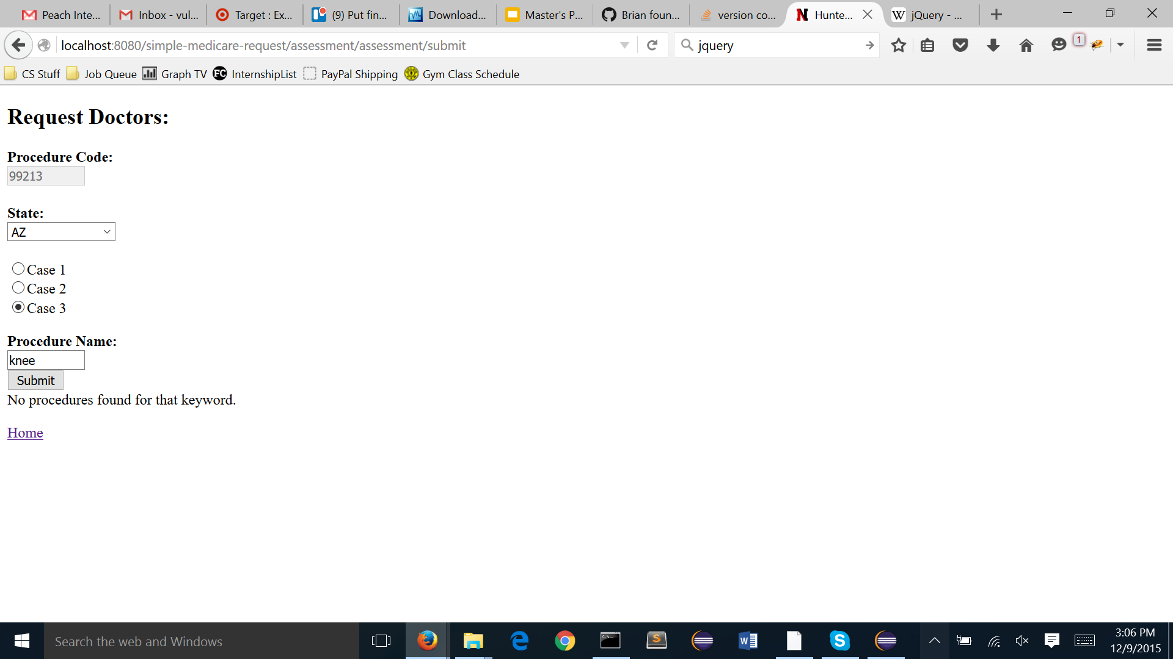
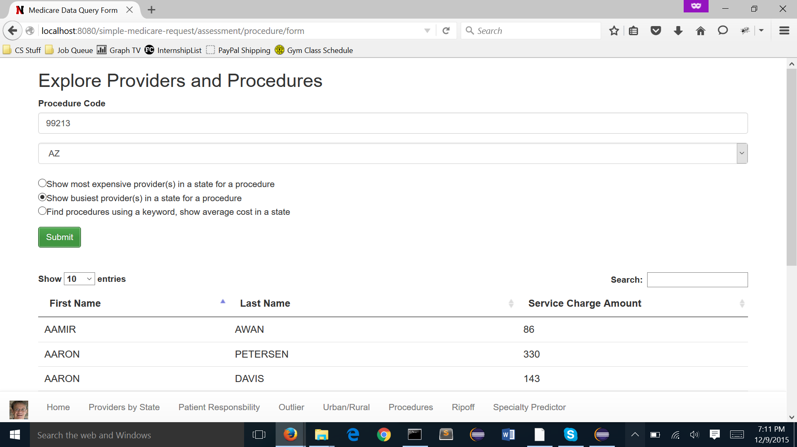
Developing the UI
Libraries and what they do
jQuery
Bootstrap
DataTables
New UI features over time
Consistent UI across all pages
Easy navigation
Validation and error handling
Authorization

Slide 10
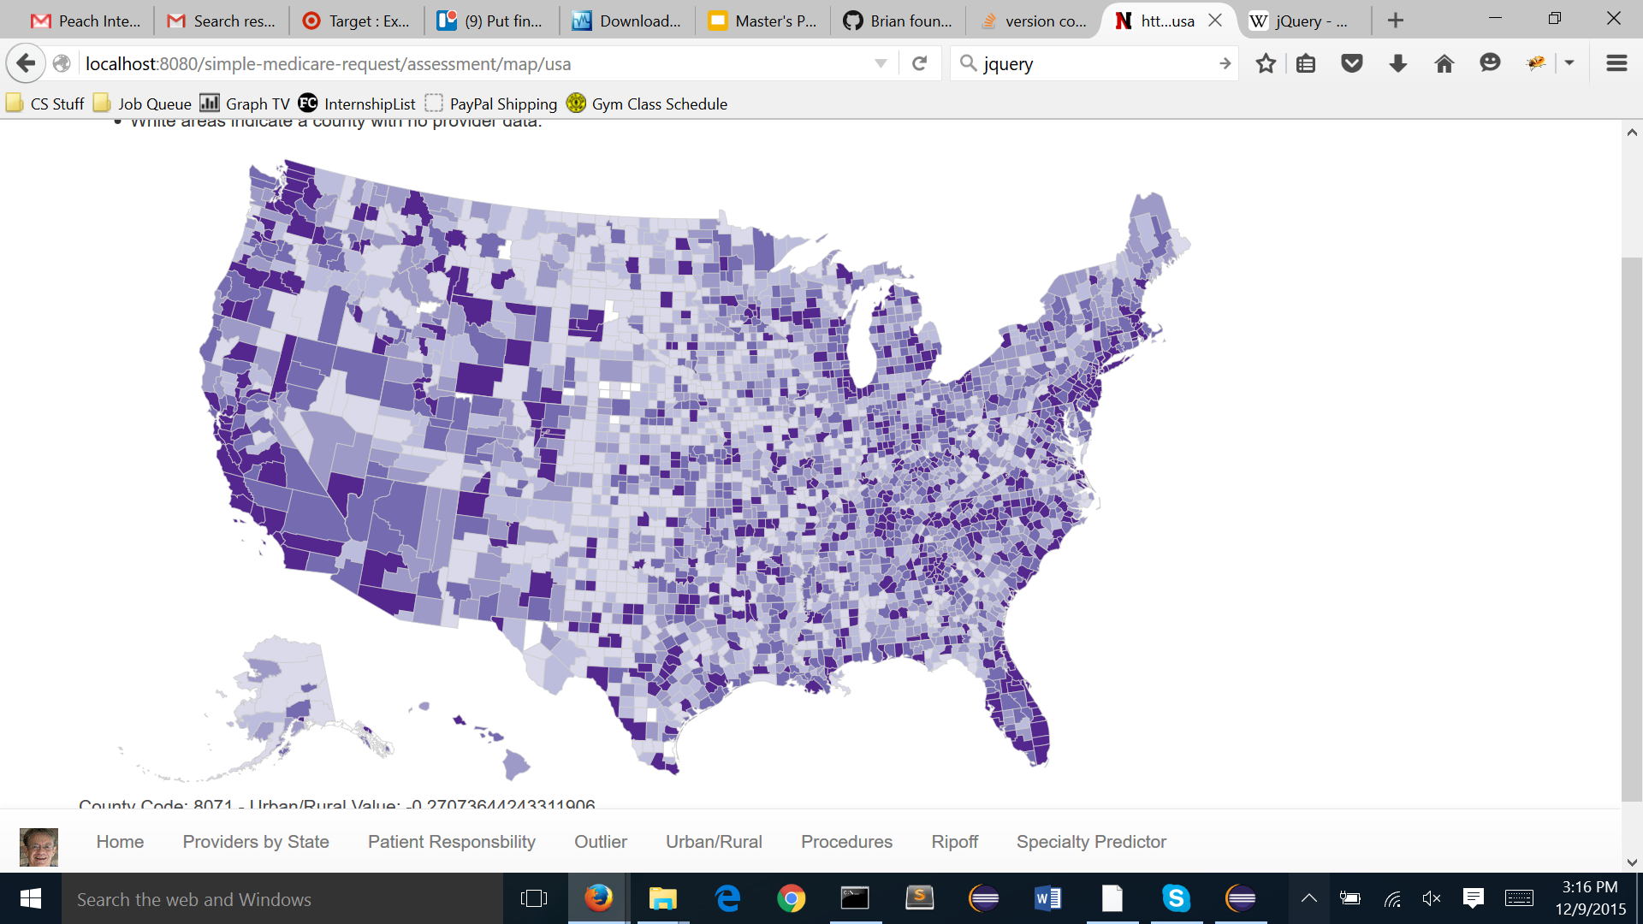
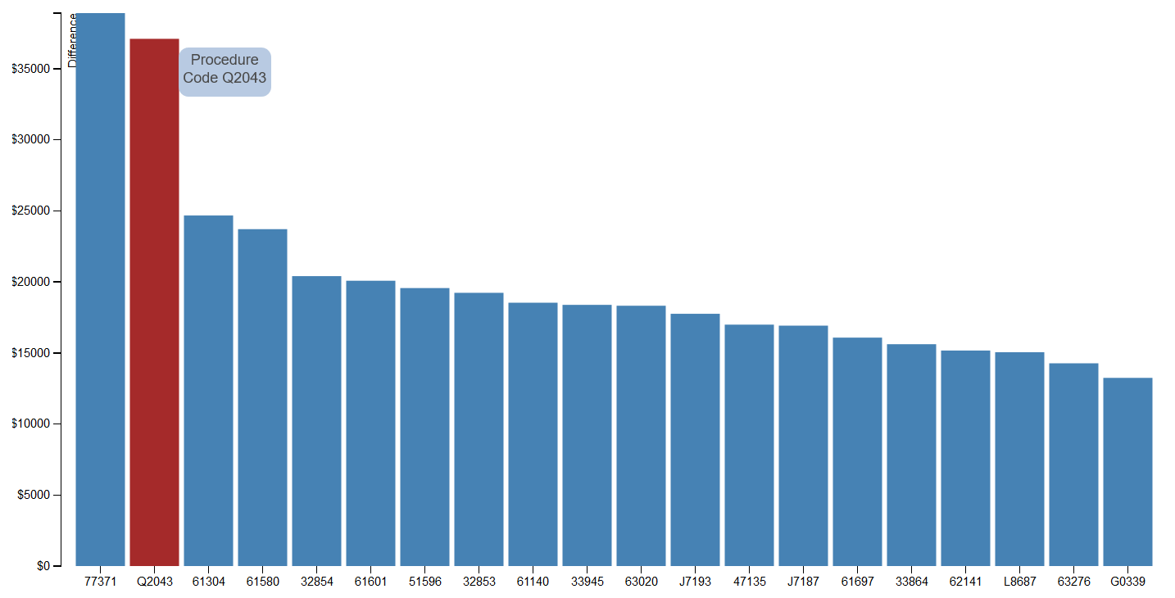
Visualizing Our Data
D3
Uses SVG, HTML 5, and CSS
Portable! Interactive! Free!
Constructing the map
Creates map and adds color on the go
Constructing the chart
Build every piece, left to right

Slide 11

Distributed, scalable, full text search
Notes:
Doyle

Slide 12
Solr in a nutshell
Why Solr?
Good for ad-hoc queries and faceting on a large set of data
Free, pretty good wiki and stack overflow coverage of topics
Easy to install, easy to ingest/experiment, good admin UI
How we used Solr:
Sample data ingest done via admin ui (cut/paste csv rows)
Larger ingest done via Java/SolrJ/opencsv
Solr schema defined (= fields, types and how it is indexed/queried)
Included a “bag of words” defined by “keyword rich” fields (description, provider type, code, etc)

Slide 13
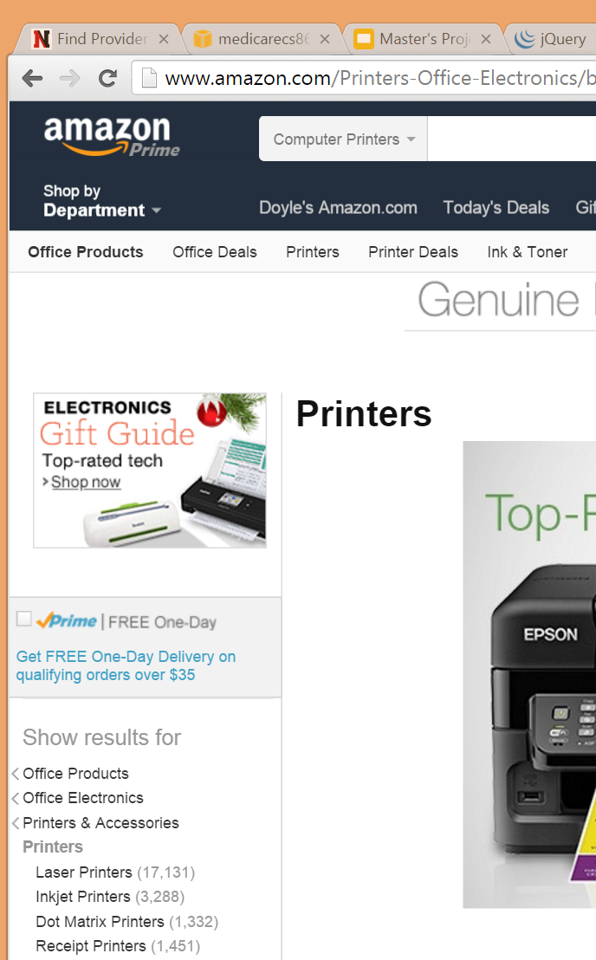
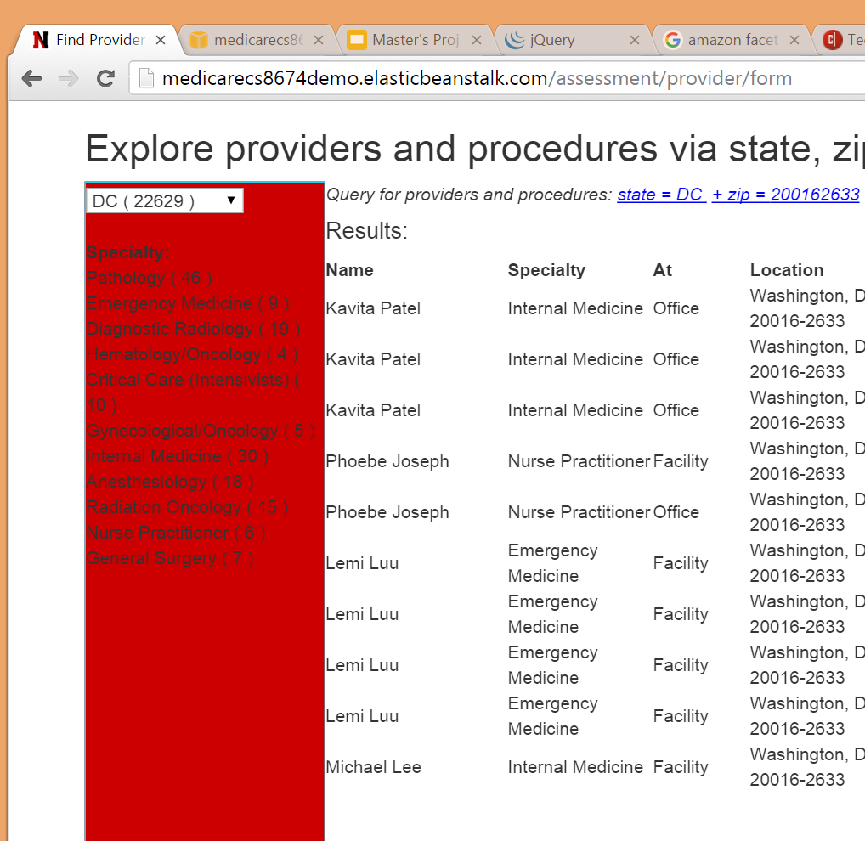
Solr faceting as a navigation aid
Notes:
Common search scenario = query solr for a keyword found in a particular field or bag of words
The next step up is facets
Used commonly on commerce sites (Amazon) or anywhere you have categories or a hierarchy that help navigate your data
Example in our project - find a provider and procedure using facets
First level = state
Second level = zip (could have done city)
Third level = specialty
Solr makes this easy and fast

Slide 14
Solr - looking back
What was easy?
Create a new index in “cloud” mode
Building an index from csv rows
Basic search queries
What was relatively easy?
Faceting
Advanced queries
What was hard?
grouping, aggregation
“true” fault-tolerant cloud configuration

Slide 15
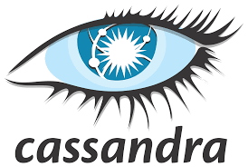
Notes:
Tim
image is pixelated, can we get another one?
subtitle?

Slide 16
What is Cassandra?
Description
Open source non-relational (NoSQL) Database
Column-oriented
Distributed
Advantages
Scalability (distributed, near linear, node symmetry)
CQL (SQL-like query language)
SELECT, FROM, WHERE, ORDER BY (sort of)
but no JOIN, GROUP BY, etc
secondary indexing
Cassandra Java Driver (modeled after JDBC)
Notes:
Introduced by comparing to realtional databases (SQL) -
Column-oriented : primary key is the row key and that two rows need not have the same number of columns

Slide 17
How to use Cassandra (1 of 2)
It’s all about the table design
Goal: Find the Most/Least Expensive Providers in a given state for a given procedure
CREATE TABLE main.mv_providers_cost (
hcpcs_code text,
nppes_provider_state text,
average_submitted_chrg_amt float,
nppes_provider_last_org_name text,
nppes_provider_first_name text,
npi text,
PRIMARY KEY ((hcpcs_code, nppes_provider_state), average_submitted_chrg_amt, nppes_provider_last_org_name)
) WITH CLUSTERING ORDER BY (average_submitted_chrg_amt DESC, nppes_provider_last_org_name ASC)

Slide 18
How to use Cassandra (2 of 2)
What we learned
Experimented with different table designs
materialized view - flattened tables
benchmarking of 3 tables vs 1 table design
clustering order and primary keys
What could be improved
Should find a more efficient data ingestion method
More clever usage of secondary indexes and ordering could further reduce the number of tables we utilize

Slide 19


Slide 20
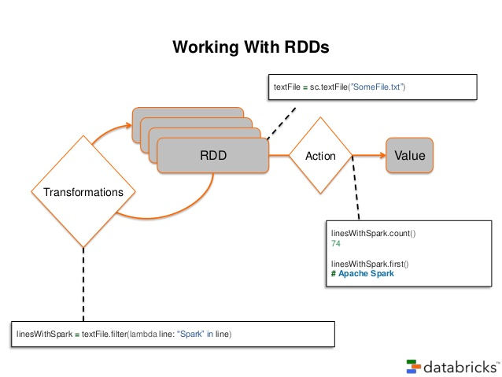
What is Spark?
Distributed computation engine for “big data” processing
Supports in-memory computing
Well-supported, with a wide variety of compatible libraries
MLlib, GraphX, Streaming, SparkSQL, and many more
Easy-to-use syntax, available in Scala, Python, and Java
Data model based on Resilient Data Structures (RDDs)
Goal is to introduce fault-tolerance to in-memory processing
Allows spilling to disk when memory is exceeded
RDDs store a lineage which allows any RDD to build itself in case of failures
The set of available transformations (map, filter, etc) operate lazily, and can only reference and RDD that has not failed
Notes:
In-memory computing: Can run up to 100x faster than Hadoop, allows caching of data to cut down on reloading. Very mem-intensive, however, enough mem means one data ingest then everything else is lightning fast

Slide 21

Notes:
Brian, Jin, Joshua

Slide 22
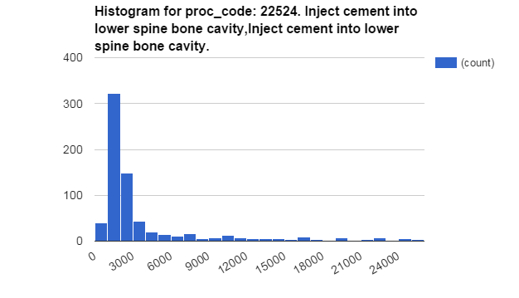
Technique used for ripoff detection
Question to answer: how many others paid less than me, for a certain procedure?
Observation on data: charges fits into normal distribution
Notes:
Questions to anser:
if 50% others paid less than me, fine, avg price.
if 5 % others paid less than me, fantastic.
But if 95 % others paid less than me, it’s a ripoff!
Observation on Data;
Charged price histogram is similar with Normal distribution.
You can imagine the point near 3000 is the mean of Normal distribution.

Slide 23
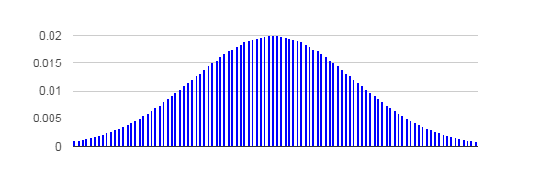
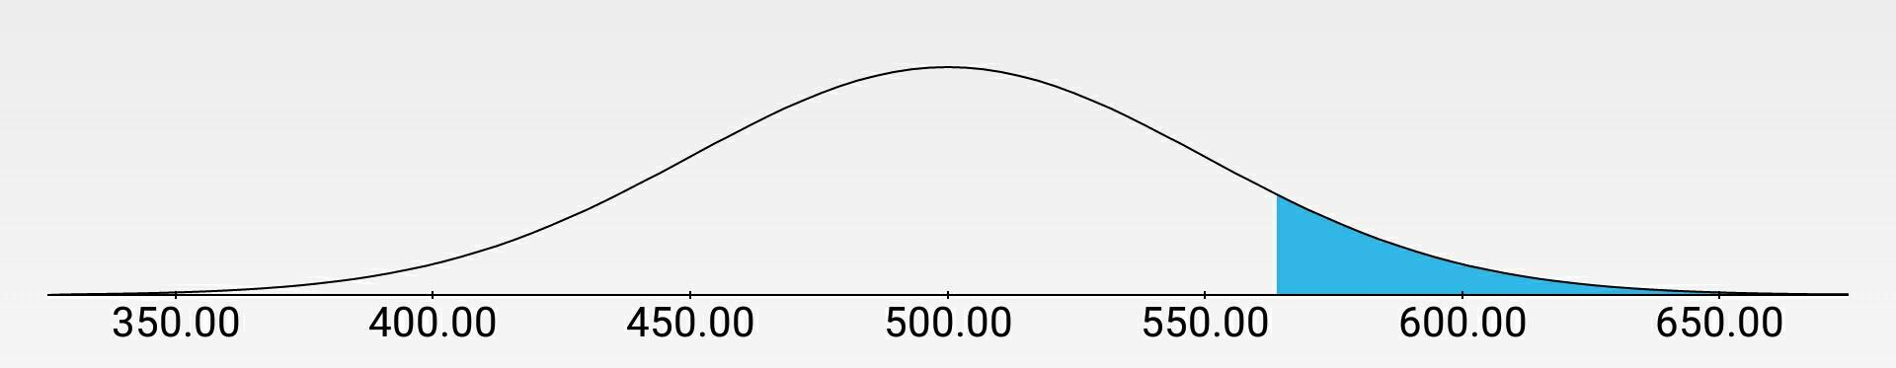
Technique used for ripoff detection (cont’d)
Model training
calculate mean and stdev for each proc_code
alternative: Spark Mlib GaussianMixture, k = 1
Answering query
calculate CDF(cumulative distribution function) function for the given price
Notes:
430 , 90% others paid less .

Slide 24
Naive Bayes Text Classifier
Question: Given some text describing a medical procedure, can we determine the type of doctor that provides this service?
Solution: Train a Text classifier using the HCPCS Descriptions in our data
Text Classification: Given a “bag of words,” each with a label. Which of the words in the bag best predict that label?
Model: Term Frequency - Inter-Document Frequency (TF-IDF)
Weigh the frequency of words in a single document, with their frequency across all documents in the corpus

Slide 25
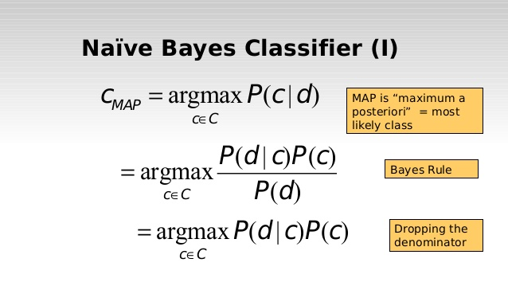

What is Naive Bayes
What’s so naive about it?
Assumes independent events
Bayes Theorem:
Key component is the numerator
It is proportional to Posterior probability
Classifier needs a decision rule
Maximum A Posteriori (MAP),
Pick the maximum probability (maximize the numerator)
Multinomial Naive Bayes
Each record is a “histogram” of occurrence frequencies (e.g. word counts)

Slide 26
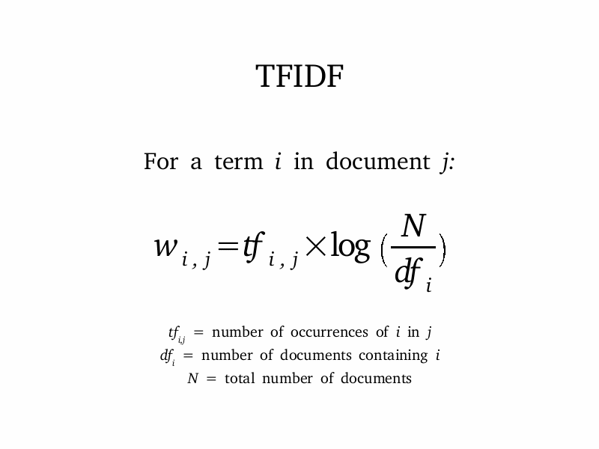
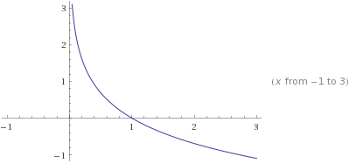
The TF-IDF Model
Two Steps
First, compute term frequency for each document
Next, using the entire corpus of TF documents, fit them to the IDF model
TF-IDF values are computed for each word in each document, generating a sparse matrix over all documents
Posterior probabilities are computed for this Matrix
The max probability is used to determine the predicted label for a given Vector of TF-IDF values
Notes:
How’d it go?
Somewhat well for a “naive” (pun intended) implementation. Naive Bayes is very easy to implement and is usually the first choice for classifiers due to that
In our case, the initial Naive Bayes approach hit about 50% acc (i.e. on sparse vectors of HCPCS codes)
TF-IDF adds significant complexity, especially when considerations are taken for proper tokenization
We did not use a tokenizer, just basic regex replace
Tokenizing, key word processing, gram, n-gram, etc can significantly help
The data has some pretty large limitations
Only a handful of labels, some very generic
Labels are ascribed by the majority of procedures done by a doctor
This means any two provider types can have some of the exact same text
Significant words are still not very prevalent
Aggregation helps, but the uniformity of descriptions boosted the effects of
basic words like “and”, “by”, “but”, etc.
Next steps, implement more advanced NLP, compare results of aggregation vs no aggregation,
filtering of “bad words”, compare multinomial vs binary multinomial
Could see an increase in efficiency here

Slide 27

Urban vs Rural Intrigue
Given only medicare data, can we discern more interesting socioeconomic phenomena
e.g., urbanity vs rurality
Notes:
*image from: http://www.bls.gov/opub/btn/volume-2/images/2-5-image.jpg

Slide 28
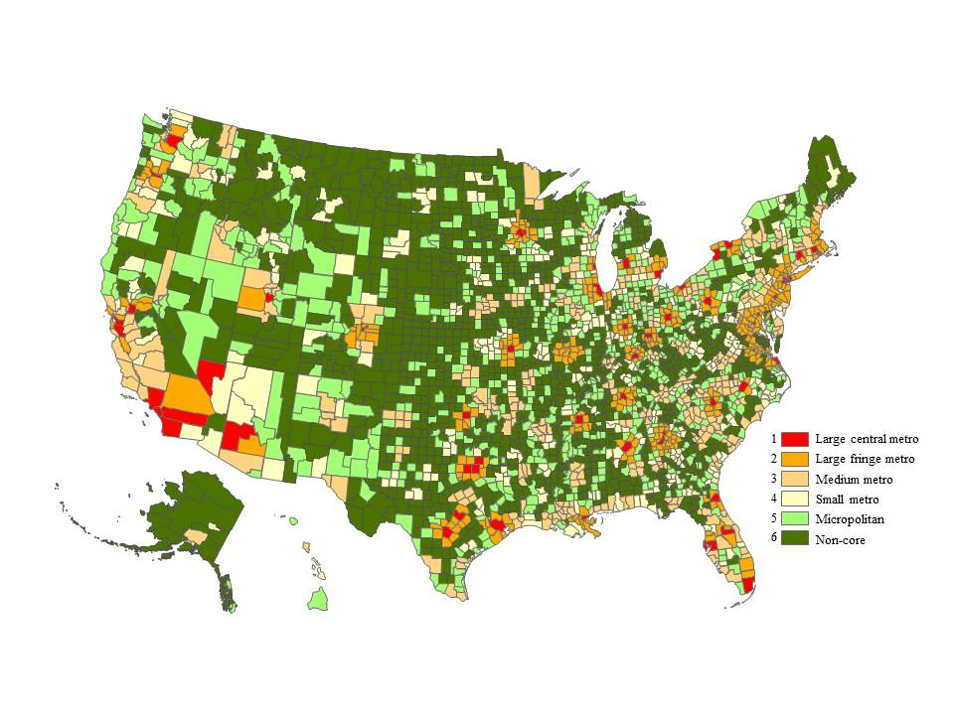
Our Map vs Gov Map
(inverse colors)
Notes:
*image on the right from: http://www.cdc.gov/nchs/images/popbridge/URv3.png

Slide 29
Distribution Prediction
-Naively assume a normal distribution about the mean
-For normal distributions
-> 65% of population in 1 std dev
- 1 std to the left gives negative providers!!
=> Use a chi-squared distribution!

Slide 30
Chi-Squared

Slide 31

Suite of deployment tools, data tools, and more for deploying code on the Amazon cloud
For our project, we utilized:
S3: Simple Storage Device
Data storage on the cloud
EC2: Elastic Compute Cloud
Cluster Computation on the cloud
EBS: Elastic Block Store
Fully portable “disk” storage to store Cassandra and Solr instances
Elastic Beanstalk
Cloud hosting environment for web apps

Slide 32

S3: Simple Storage Service
Amazon cloud storage service
Directly accessible file system through EC2 clusters (s3://<BUCKET-NAME>/…)
Spark, Hadoop, etc can access s3, making this a great place to store raw data, logs, etc.
Elastic Block Store
Mountable, persistent “drive” storage
Used as a hard disk which can be mounted directly to an EC2 instance
For our purposes, we loaded our Solr and EC2 instances onto and EBS volume
This volume could be transferred to new clusters and persists after cluster termination

Slide 33


EC2: Elastic Compute Cloud
EC2 is Amazon’s cloud based server architecture
Allocate clusters pre-loaded with distributed computing technologies
Pre-built with Hive, Hadoop, Spark, etc.
Allows cost-effective deployment and development of big data driven applications
EMR: Elastic Map Reduce
Computation-focused, based on EC2

Slide 34
Scalability
What did we do? What did we skip?
Notes:
Hunter: Not much scalability on UI? Portable/reactive, testing for more edge cases
Internal files organization
Handling visualization, esp the map, and deciding whether that should be handled front end/back and the implications thereof
UI and web site/service: stateless (so should scale well),
Scalability at web server layer: Elastic Beanstalk’s auto-scaling option , increase instance counts + load balancing when needed.
not sure if this counts - putting Solr on a shareable EBS ?
Ideas for next steps:
could have a periodic warm up query to cassandra and solr to warm up connection
Don’t render map each time? Could cache image?
Solr: caching queries for common queries, “full” fault tolerant config (= 3+ solr instances, 3+ zookeeper instances)

Slide 35
Scalability (cont’d)
Replication of Solr and Cassandra
Cassandra configuration .yaml

Slide 36
Next steps
(all)
Notes:
Hunter’s Next: OAuth, Mobile/Portable, Waiting on long term processes

Slide 37
Next Steps (cont’d)
Better Ingestion
add more years (and compare?)
more useful basic use cases
Notes:
Unit testing?
OAuth2 & hook up Solr/Cassandra authorization (differentiate who can write versus who can read)
Spark for ingestion?
“Async” flow for longer queries (ie: query via spark, create temp table, then tell user minutes later that it’s done)
Solr - synonyms for procedure keywords?
plenty more analysis scenarios

Slide 38
Questions?

