Slide 1
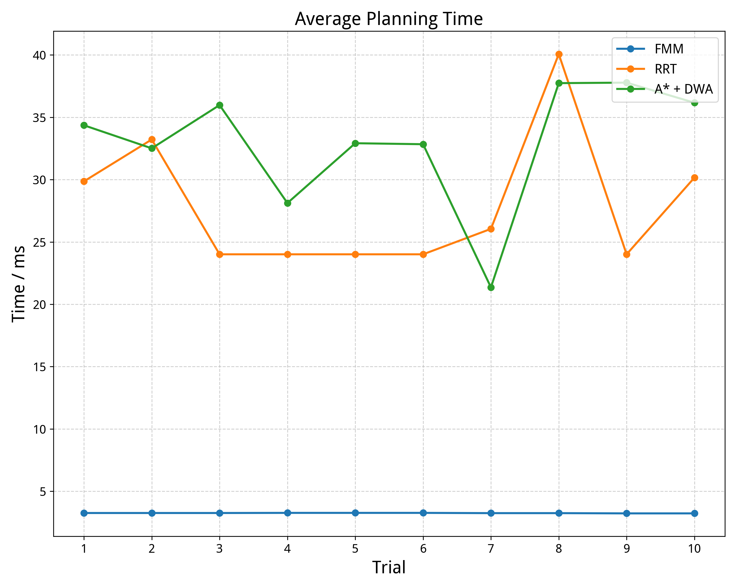
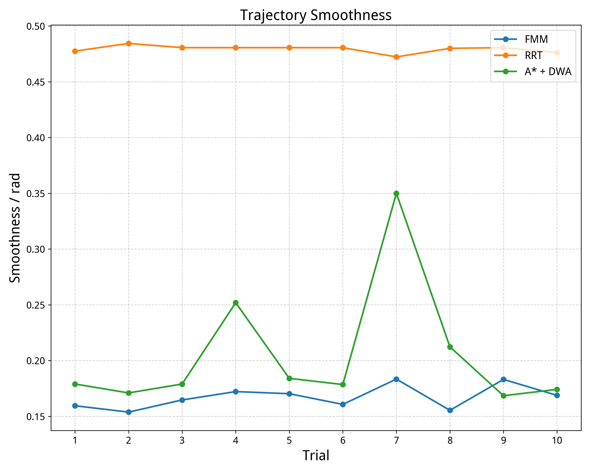
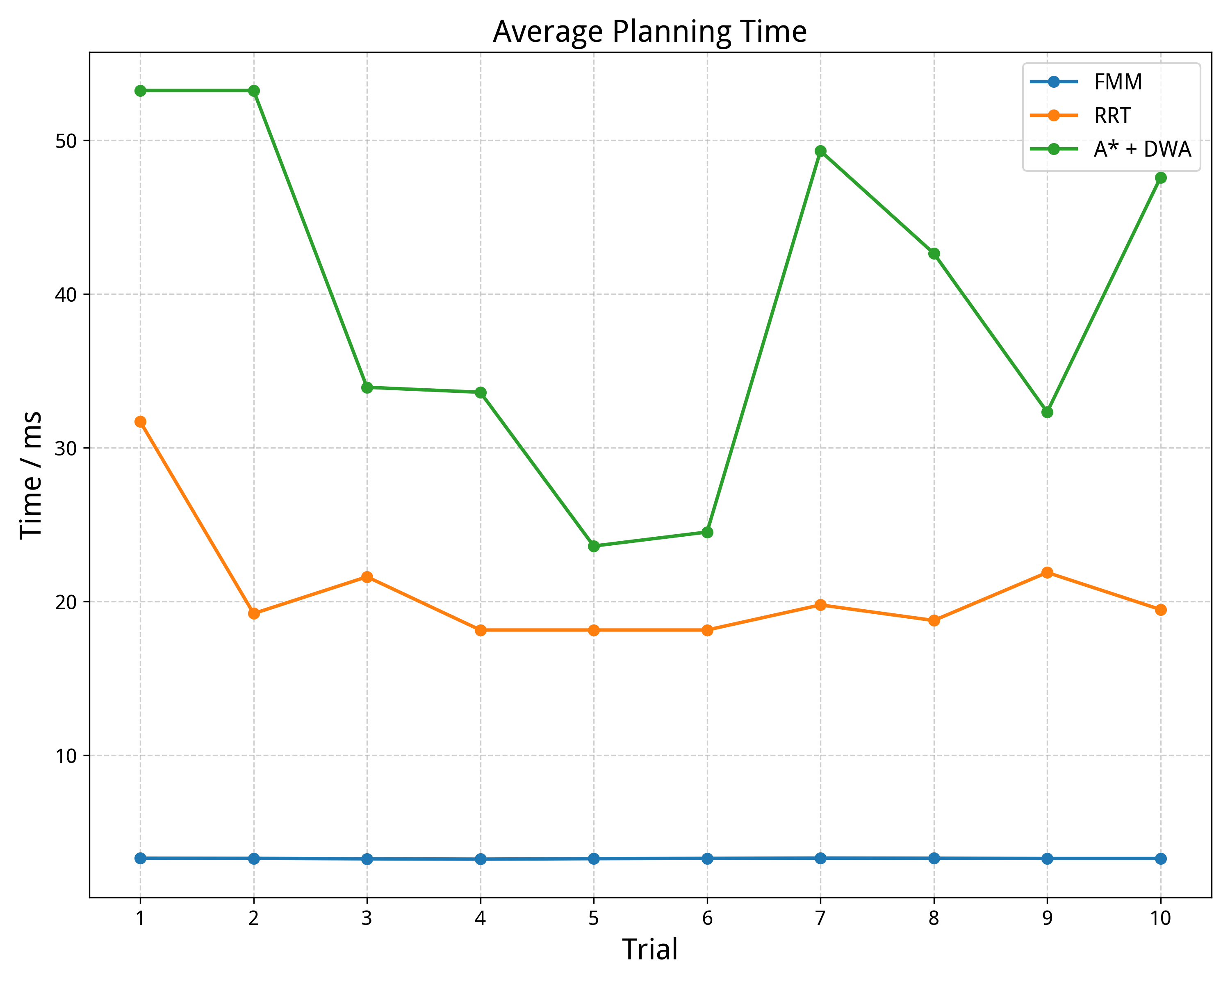
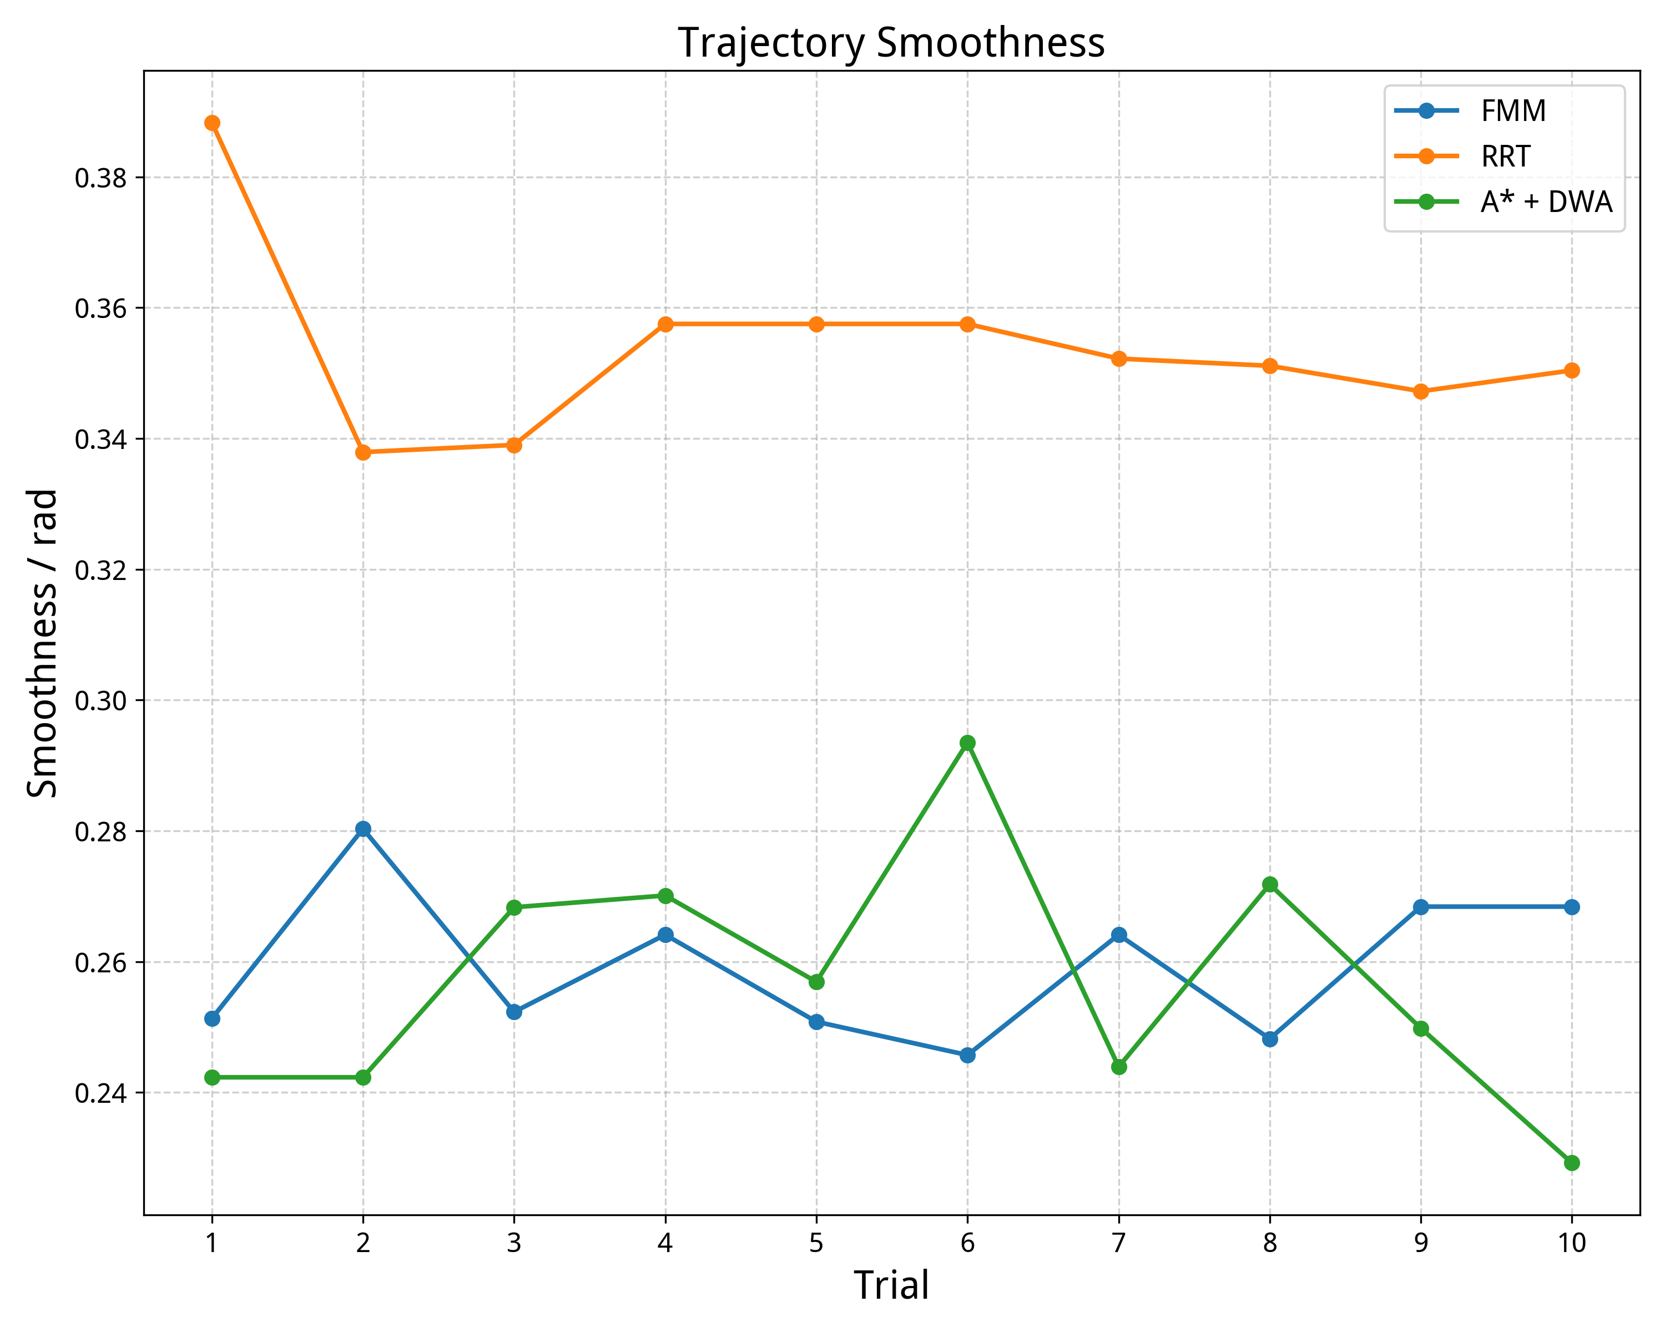
(a)
(b)
(a)
(b)

Slide 2
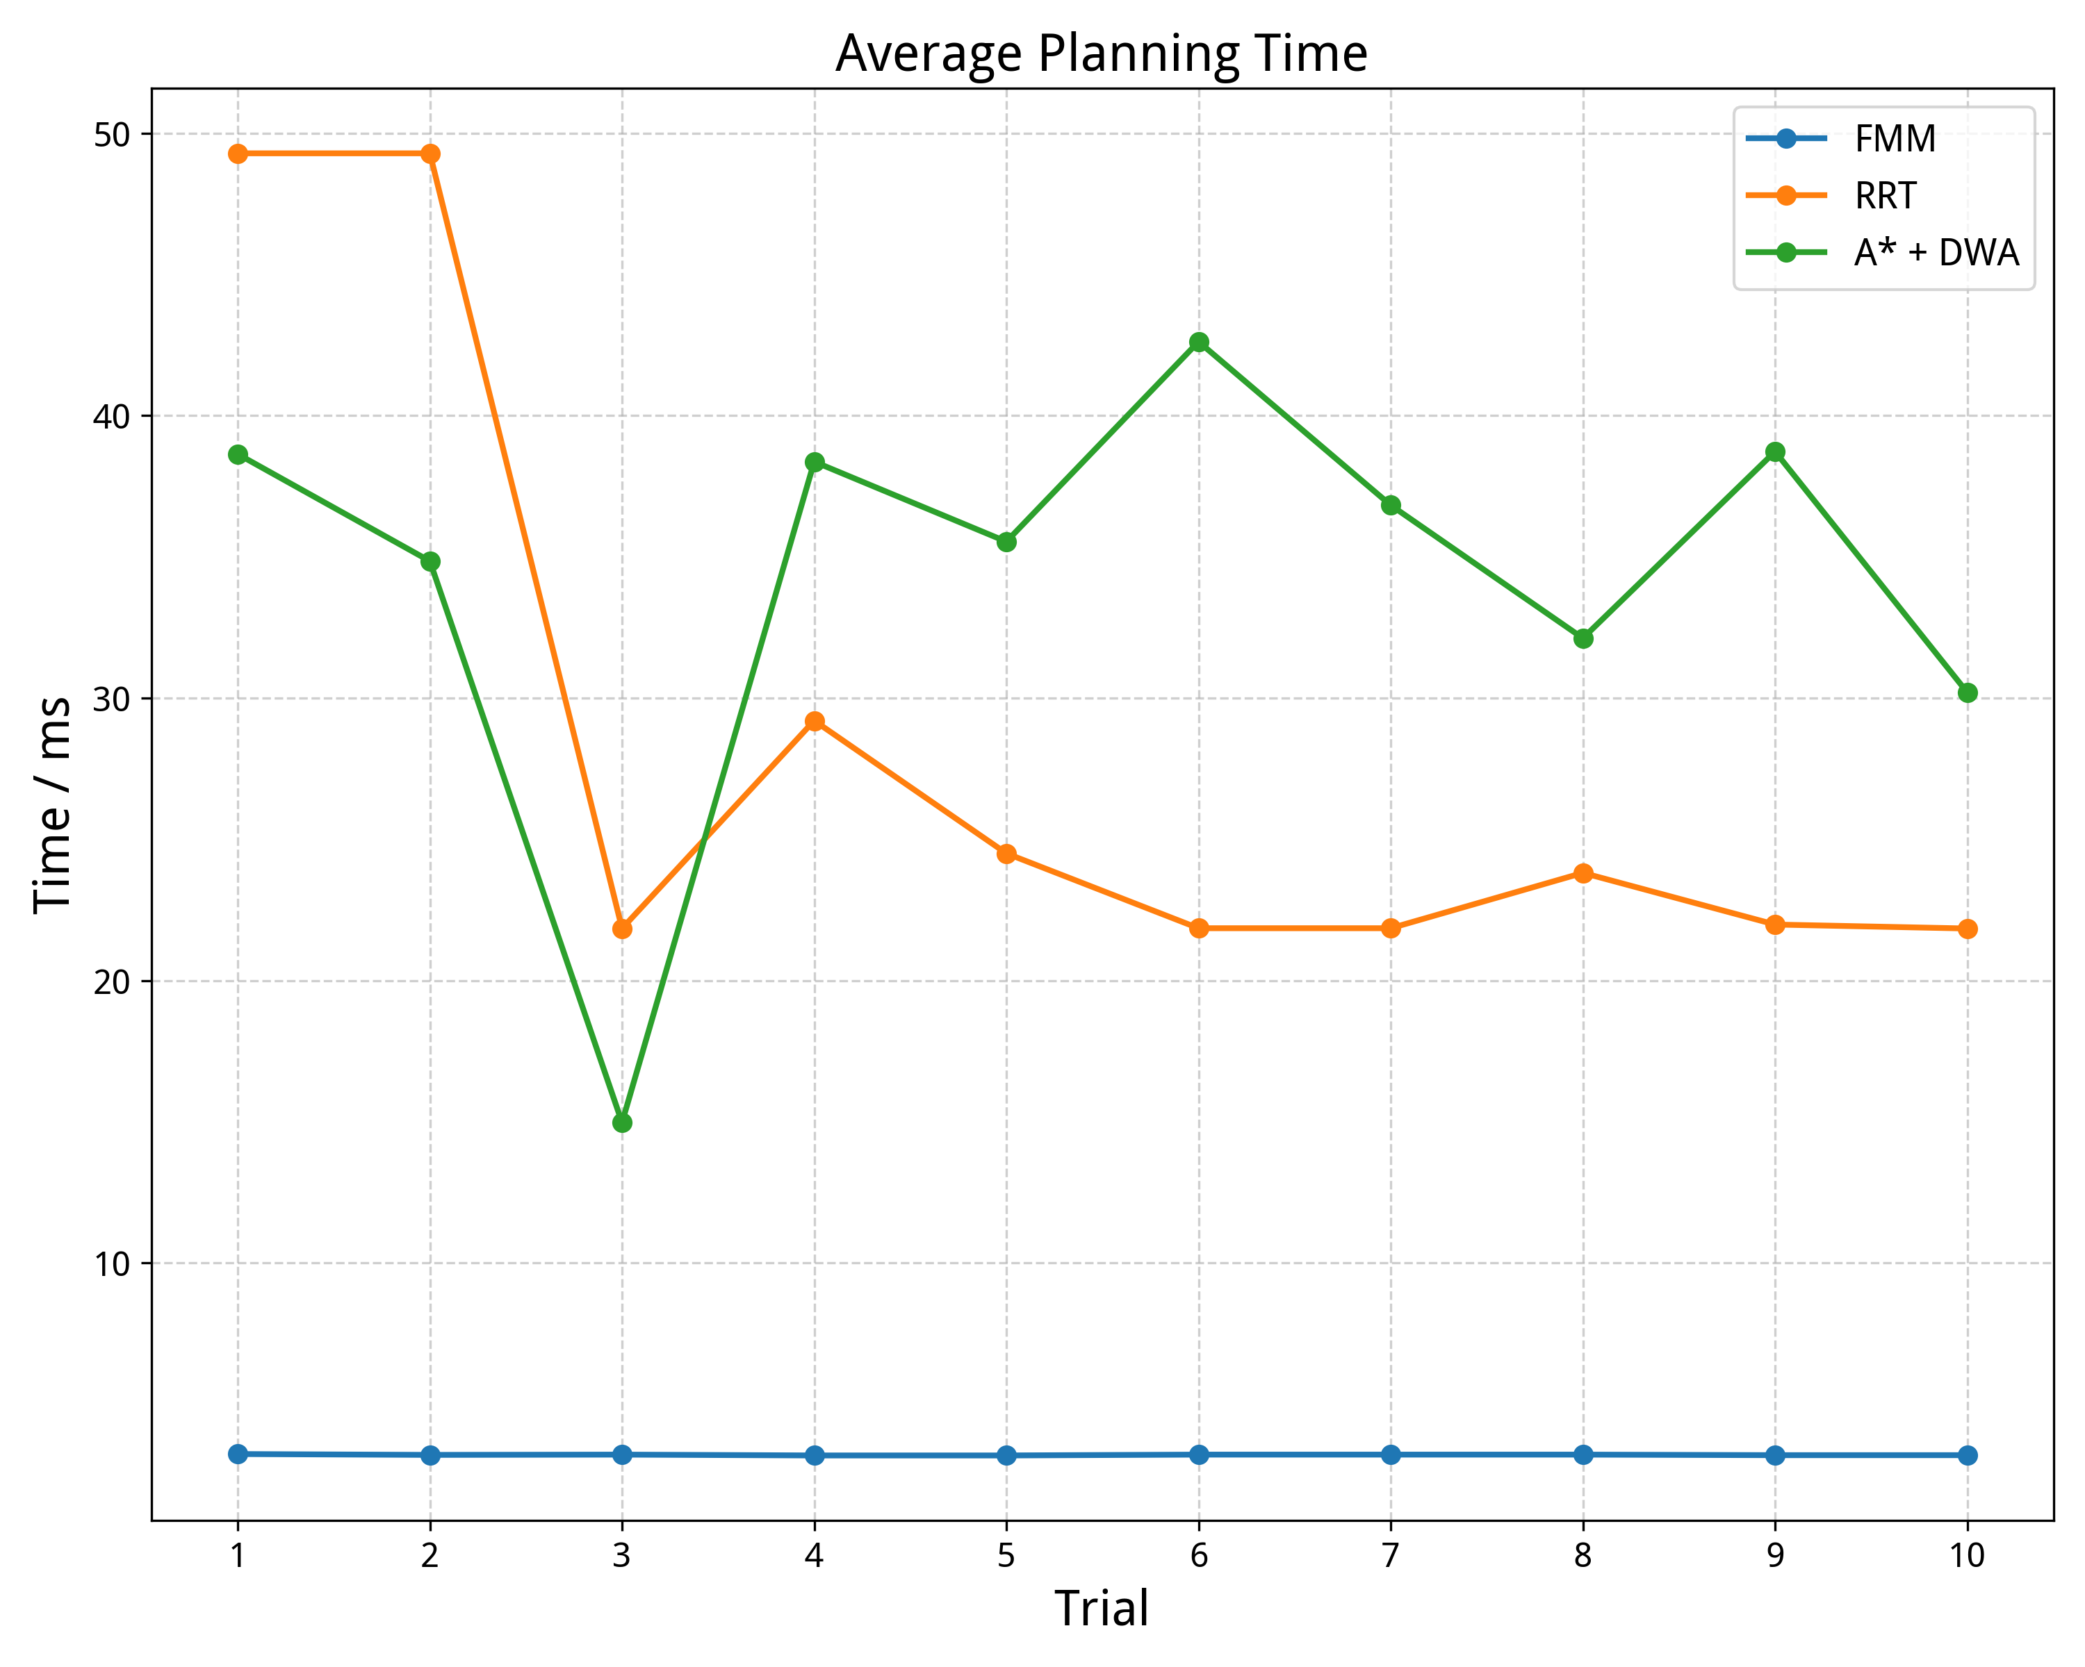
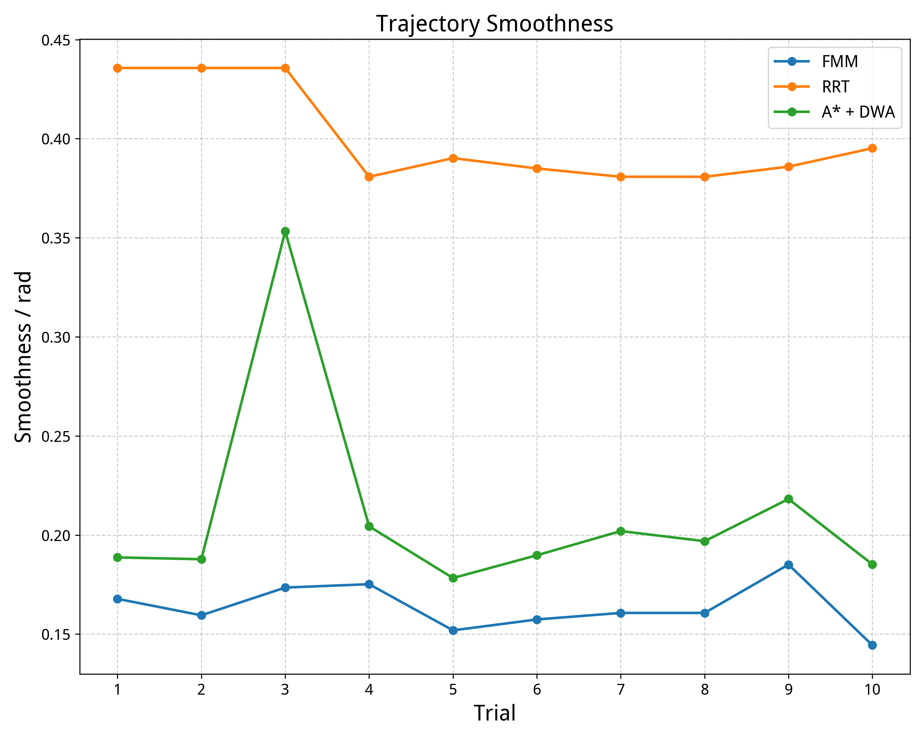
(a)
(b)
(a)
(b)

Slide 3
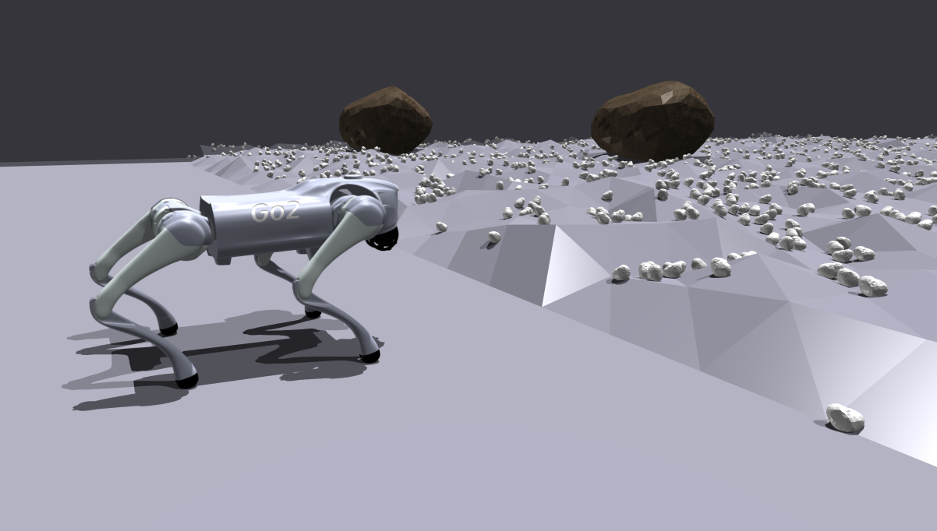
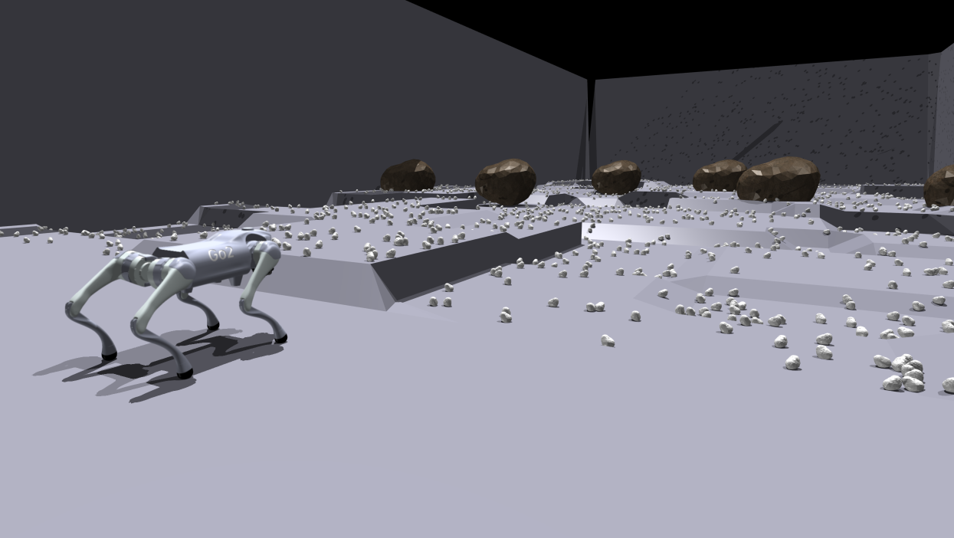
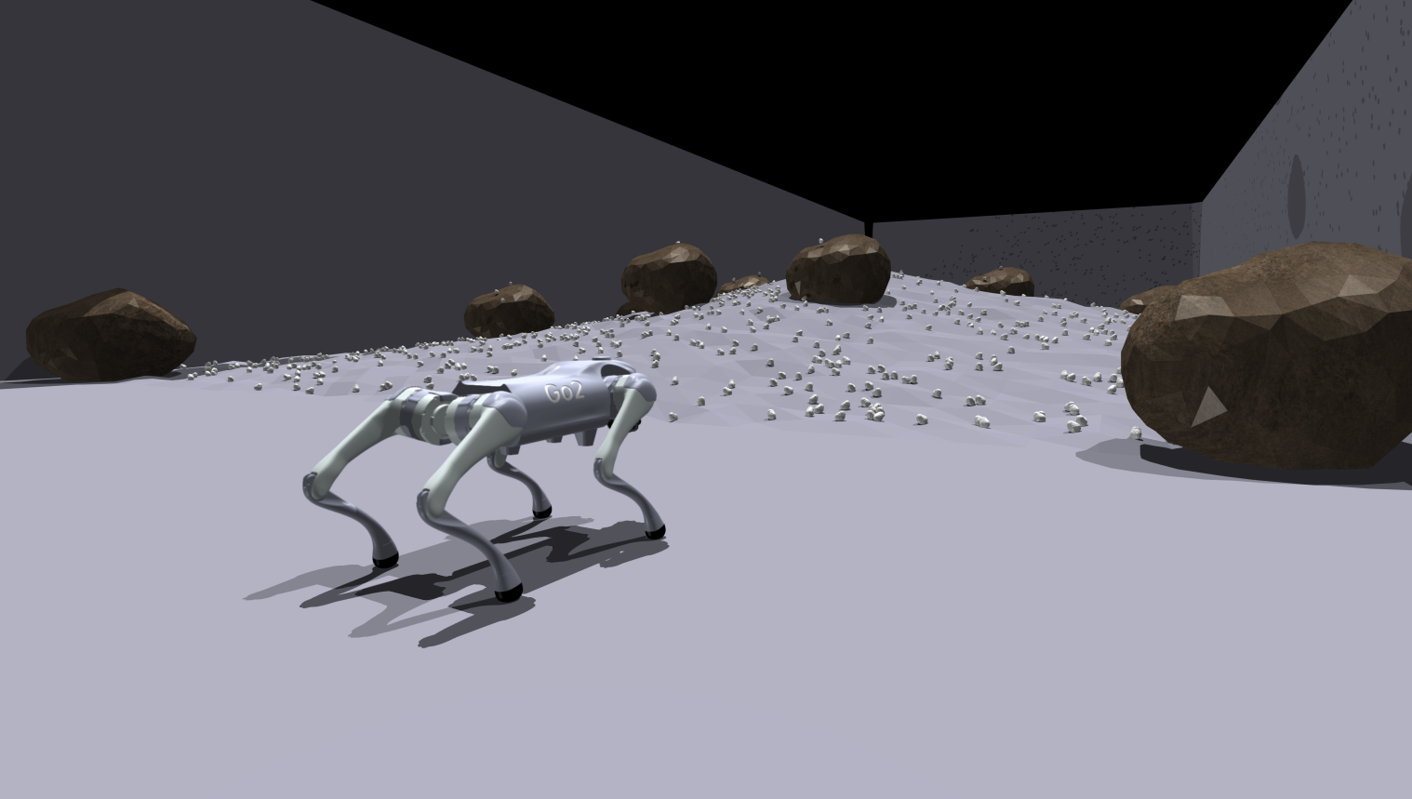
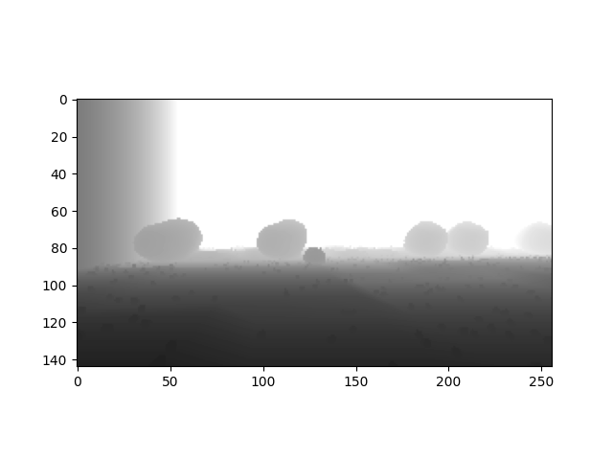
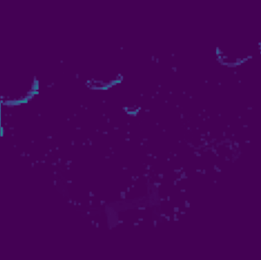
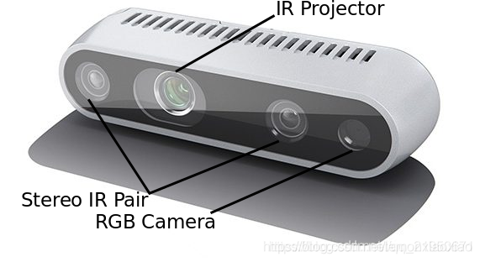
(a) Rough Slopes
(b) Discrete Obstacles
(c) Rough Flat
(a) Depth Image
(b) BEV Image

Slide 4
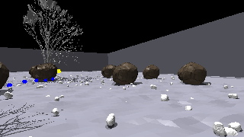
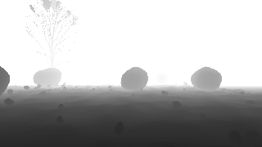
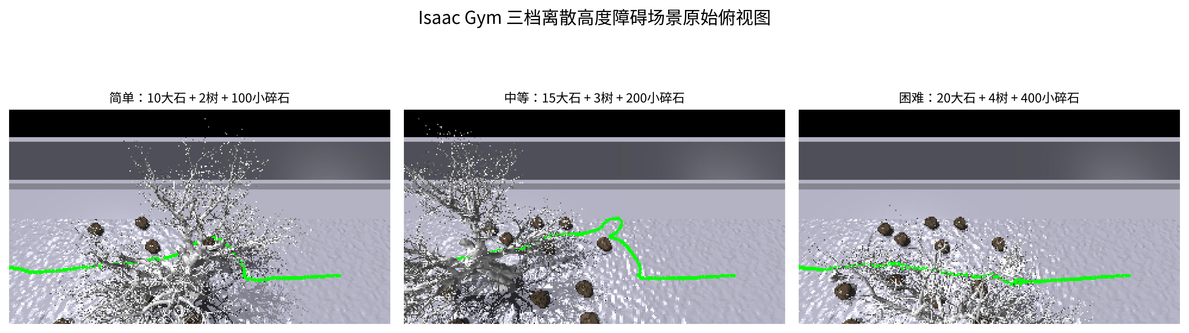
Hierarchical Visual Navigation and Locomotion Framework
Completed Chapter 3 system and evaluation pipeline
Perception Inputs
Local Perception and Planning
Completed Experiments
RGB-D Projection
Point Cloud to BEV
Local BEV
Height / Obstacles
Dual-layer Cost
Hard + Soft Safety
D435i RGB
D435i Depth
VIO Pose
(ideal or noisy)
Three difficulty levels
30 fixed seeds per method
FMM Reference
Corridor
Footprint MPPI
Trajectory Optimization
Velocity Command
(vx, wz)
Local Goal
Internal ablation
Fixed FMM, Dual-layer FMM,
Footprint MPPI
External comparison
iPlanner, PS-DWA, SAPF
Locomotion Inputs
HIMLoco Locomotion Controller
Desired Base Velocity
VIO robustness
ideal, mild, medium, severe
HIMLoco
Policy Network
Proprioceptive State
State and History
Encoder
Joint Position
Targets
750 formal closed-loop trials
Historical Observations
Shared locomotion policy for all navigation planners

Slide 5
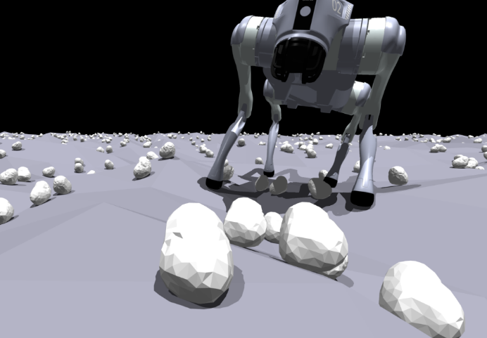

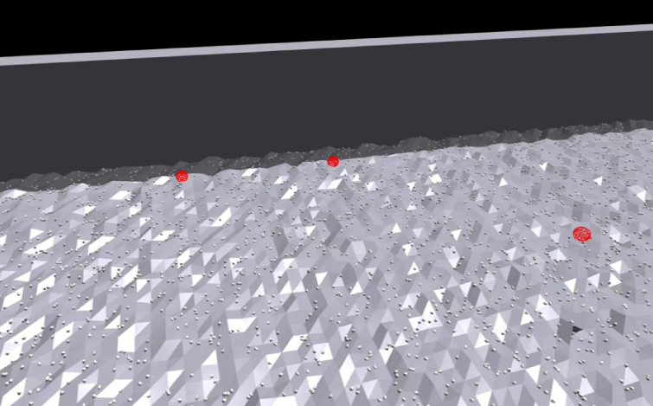
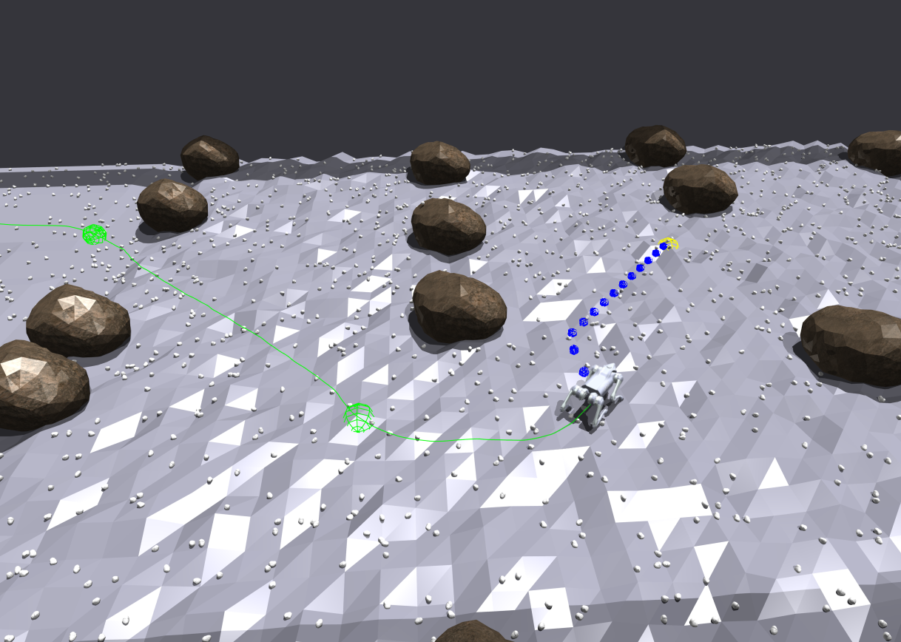
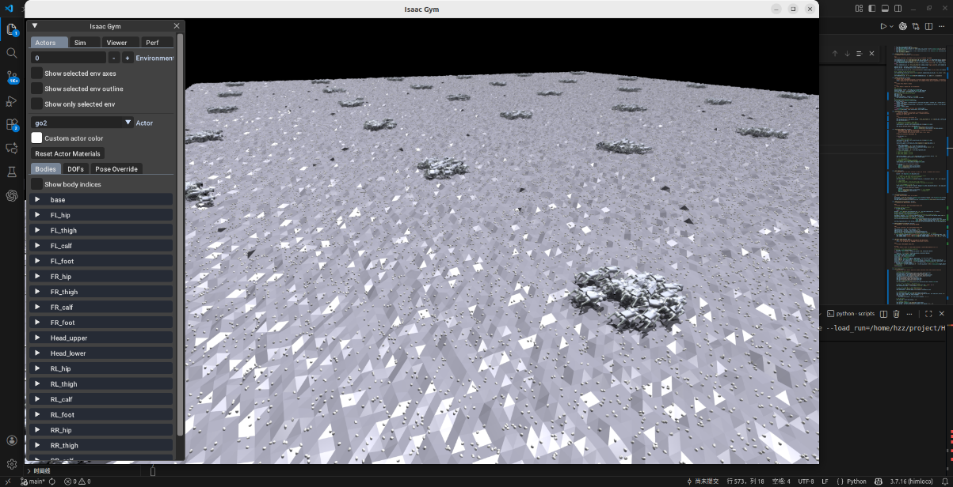
Navigation Controller
Trajectory Planning
Gait Controller
Joint Position Commands
Depth Camera Perception Driving
Reinforcement Learning
Reward Function Driving
Autonomous Navigation

Slide 6
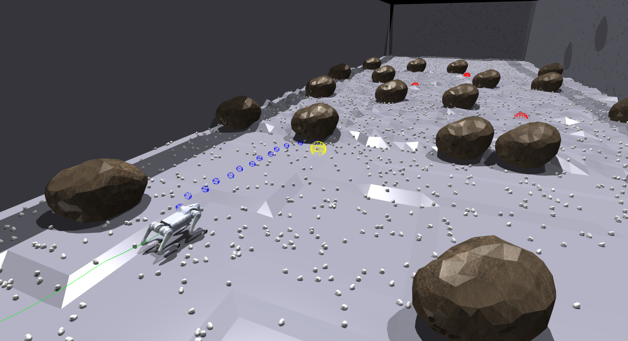
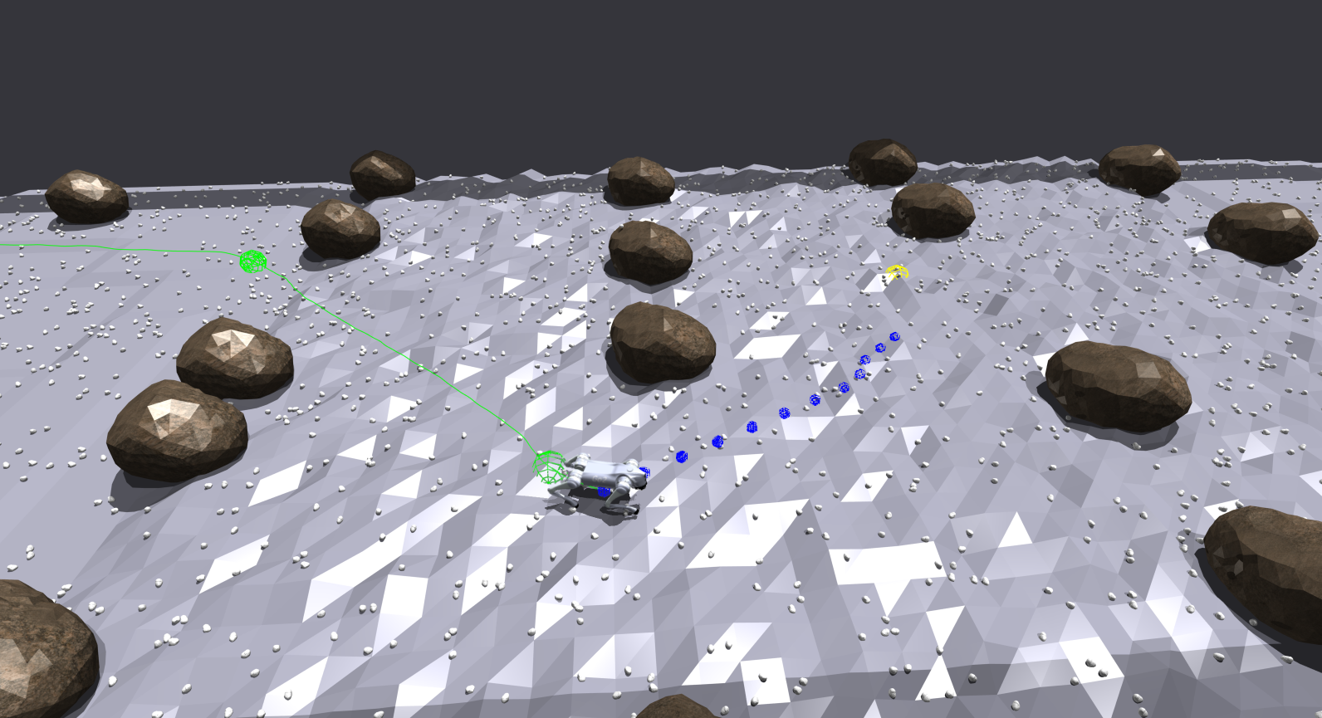
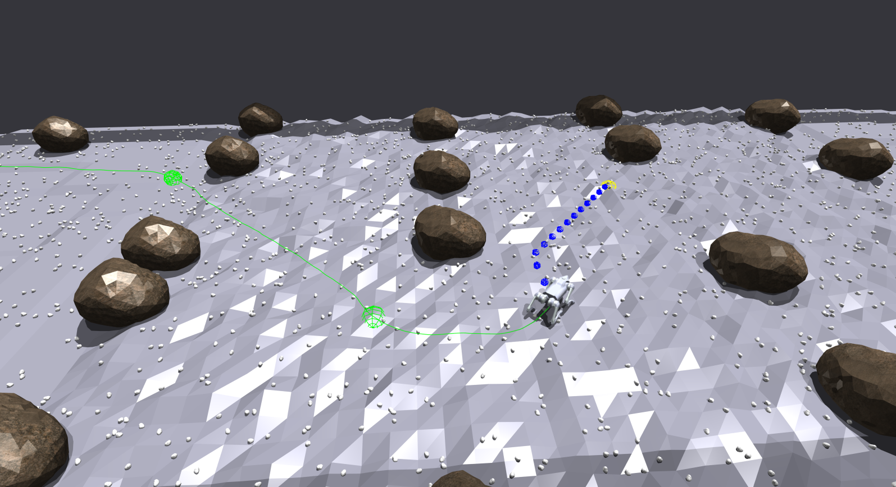
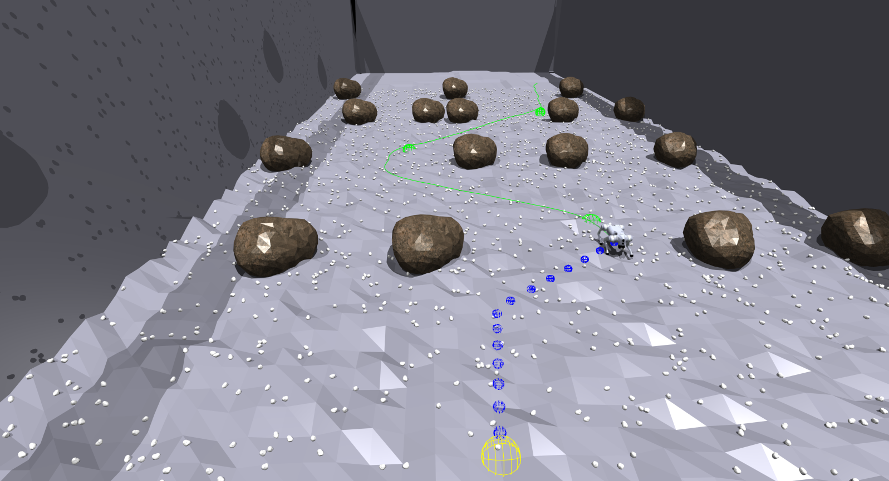
(a)Start Point — Waypoint A
(b) Waypoint A — Waypoint B
(c)Waypoint B — Waypoint C
(d)Waypoint C — End Point

Slide 7
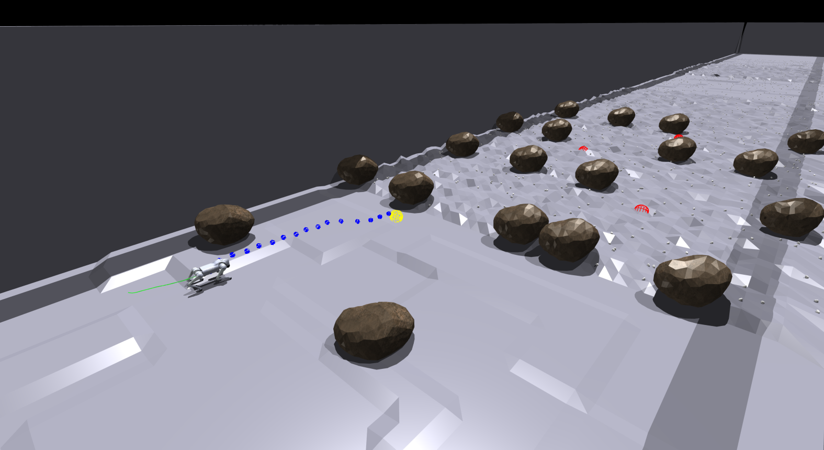
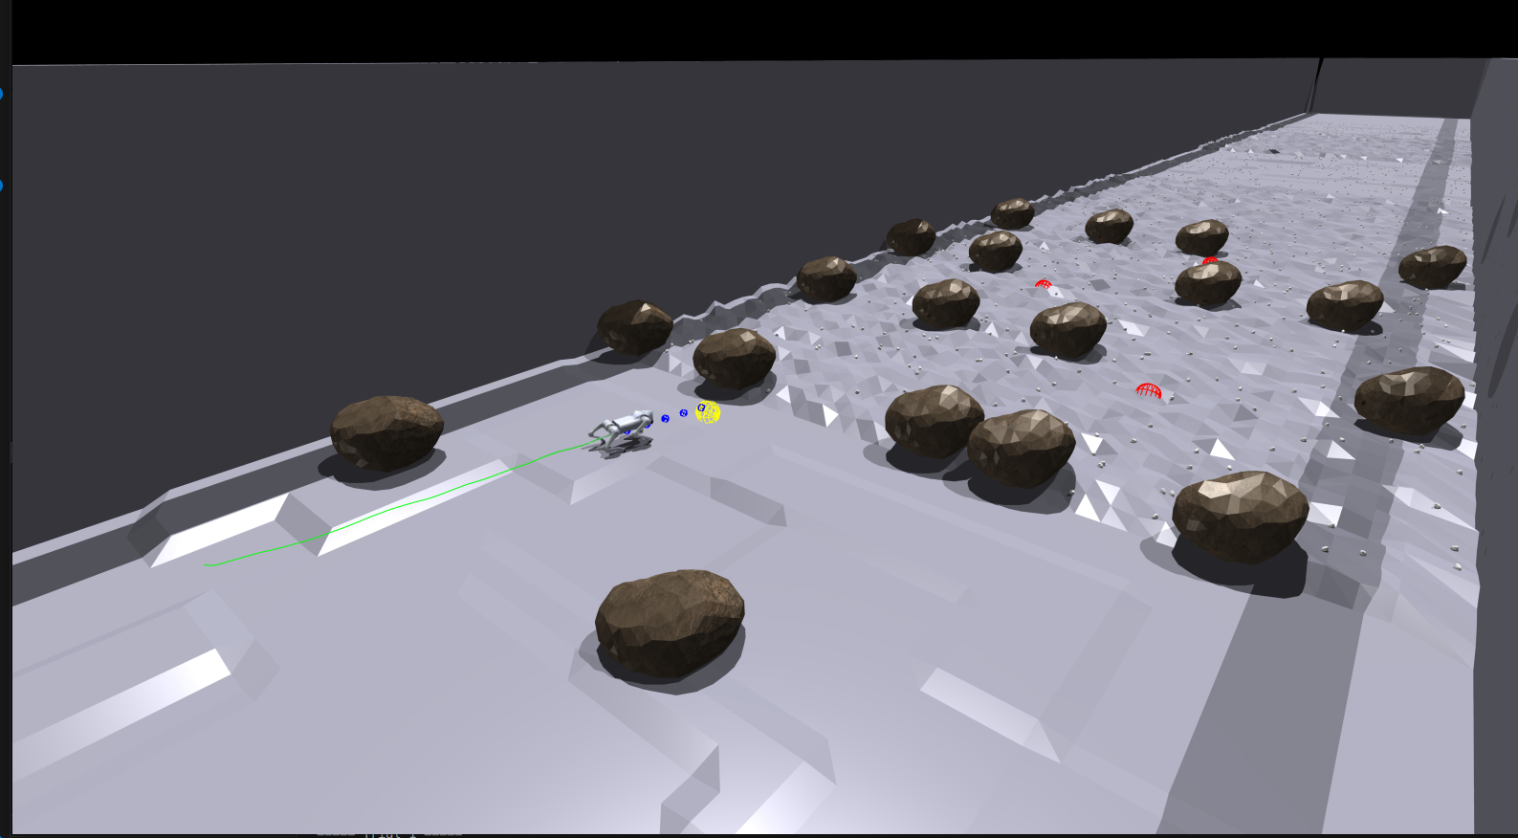


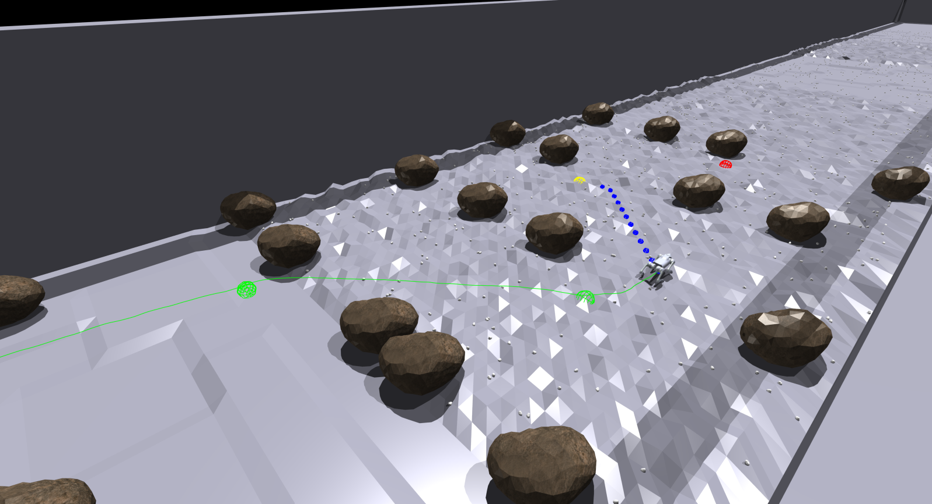

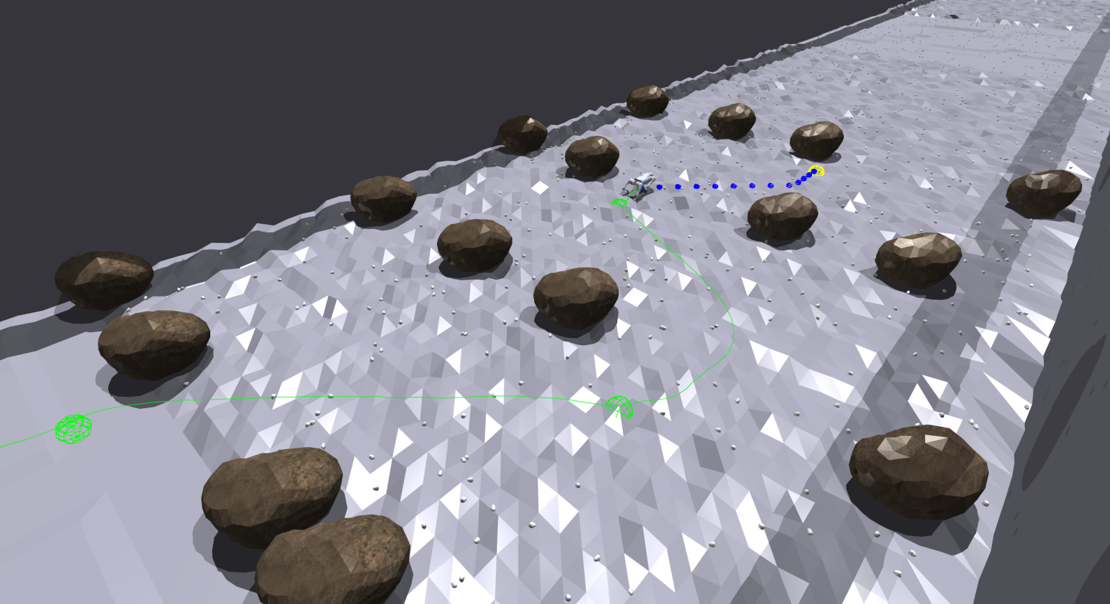
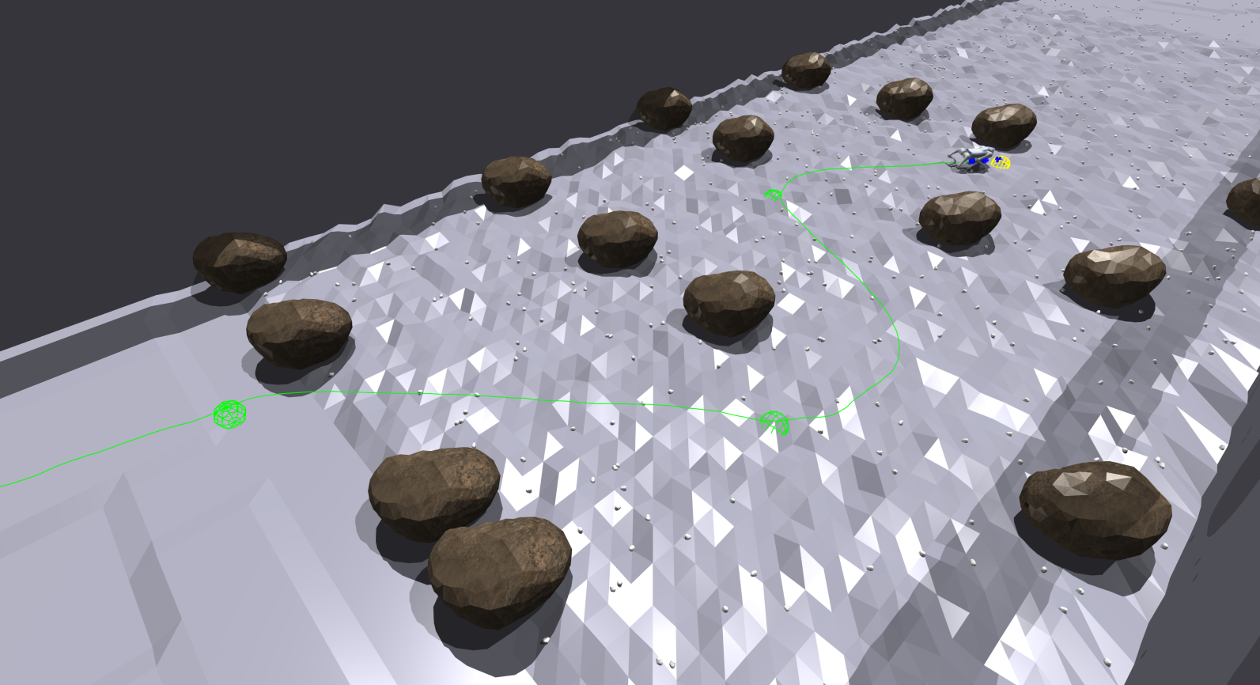

Slide 8
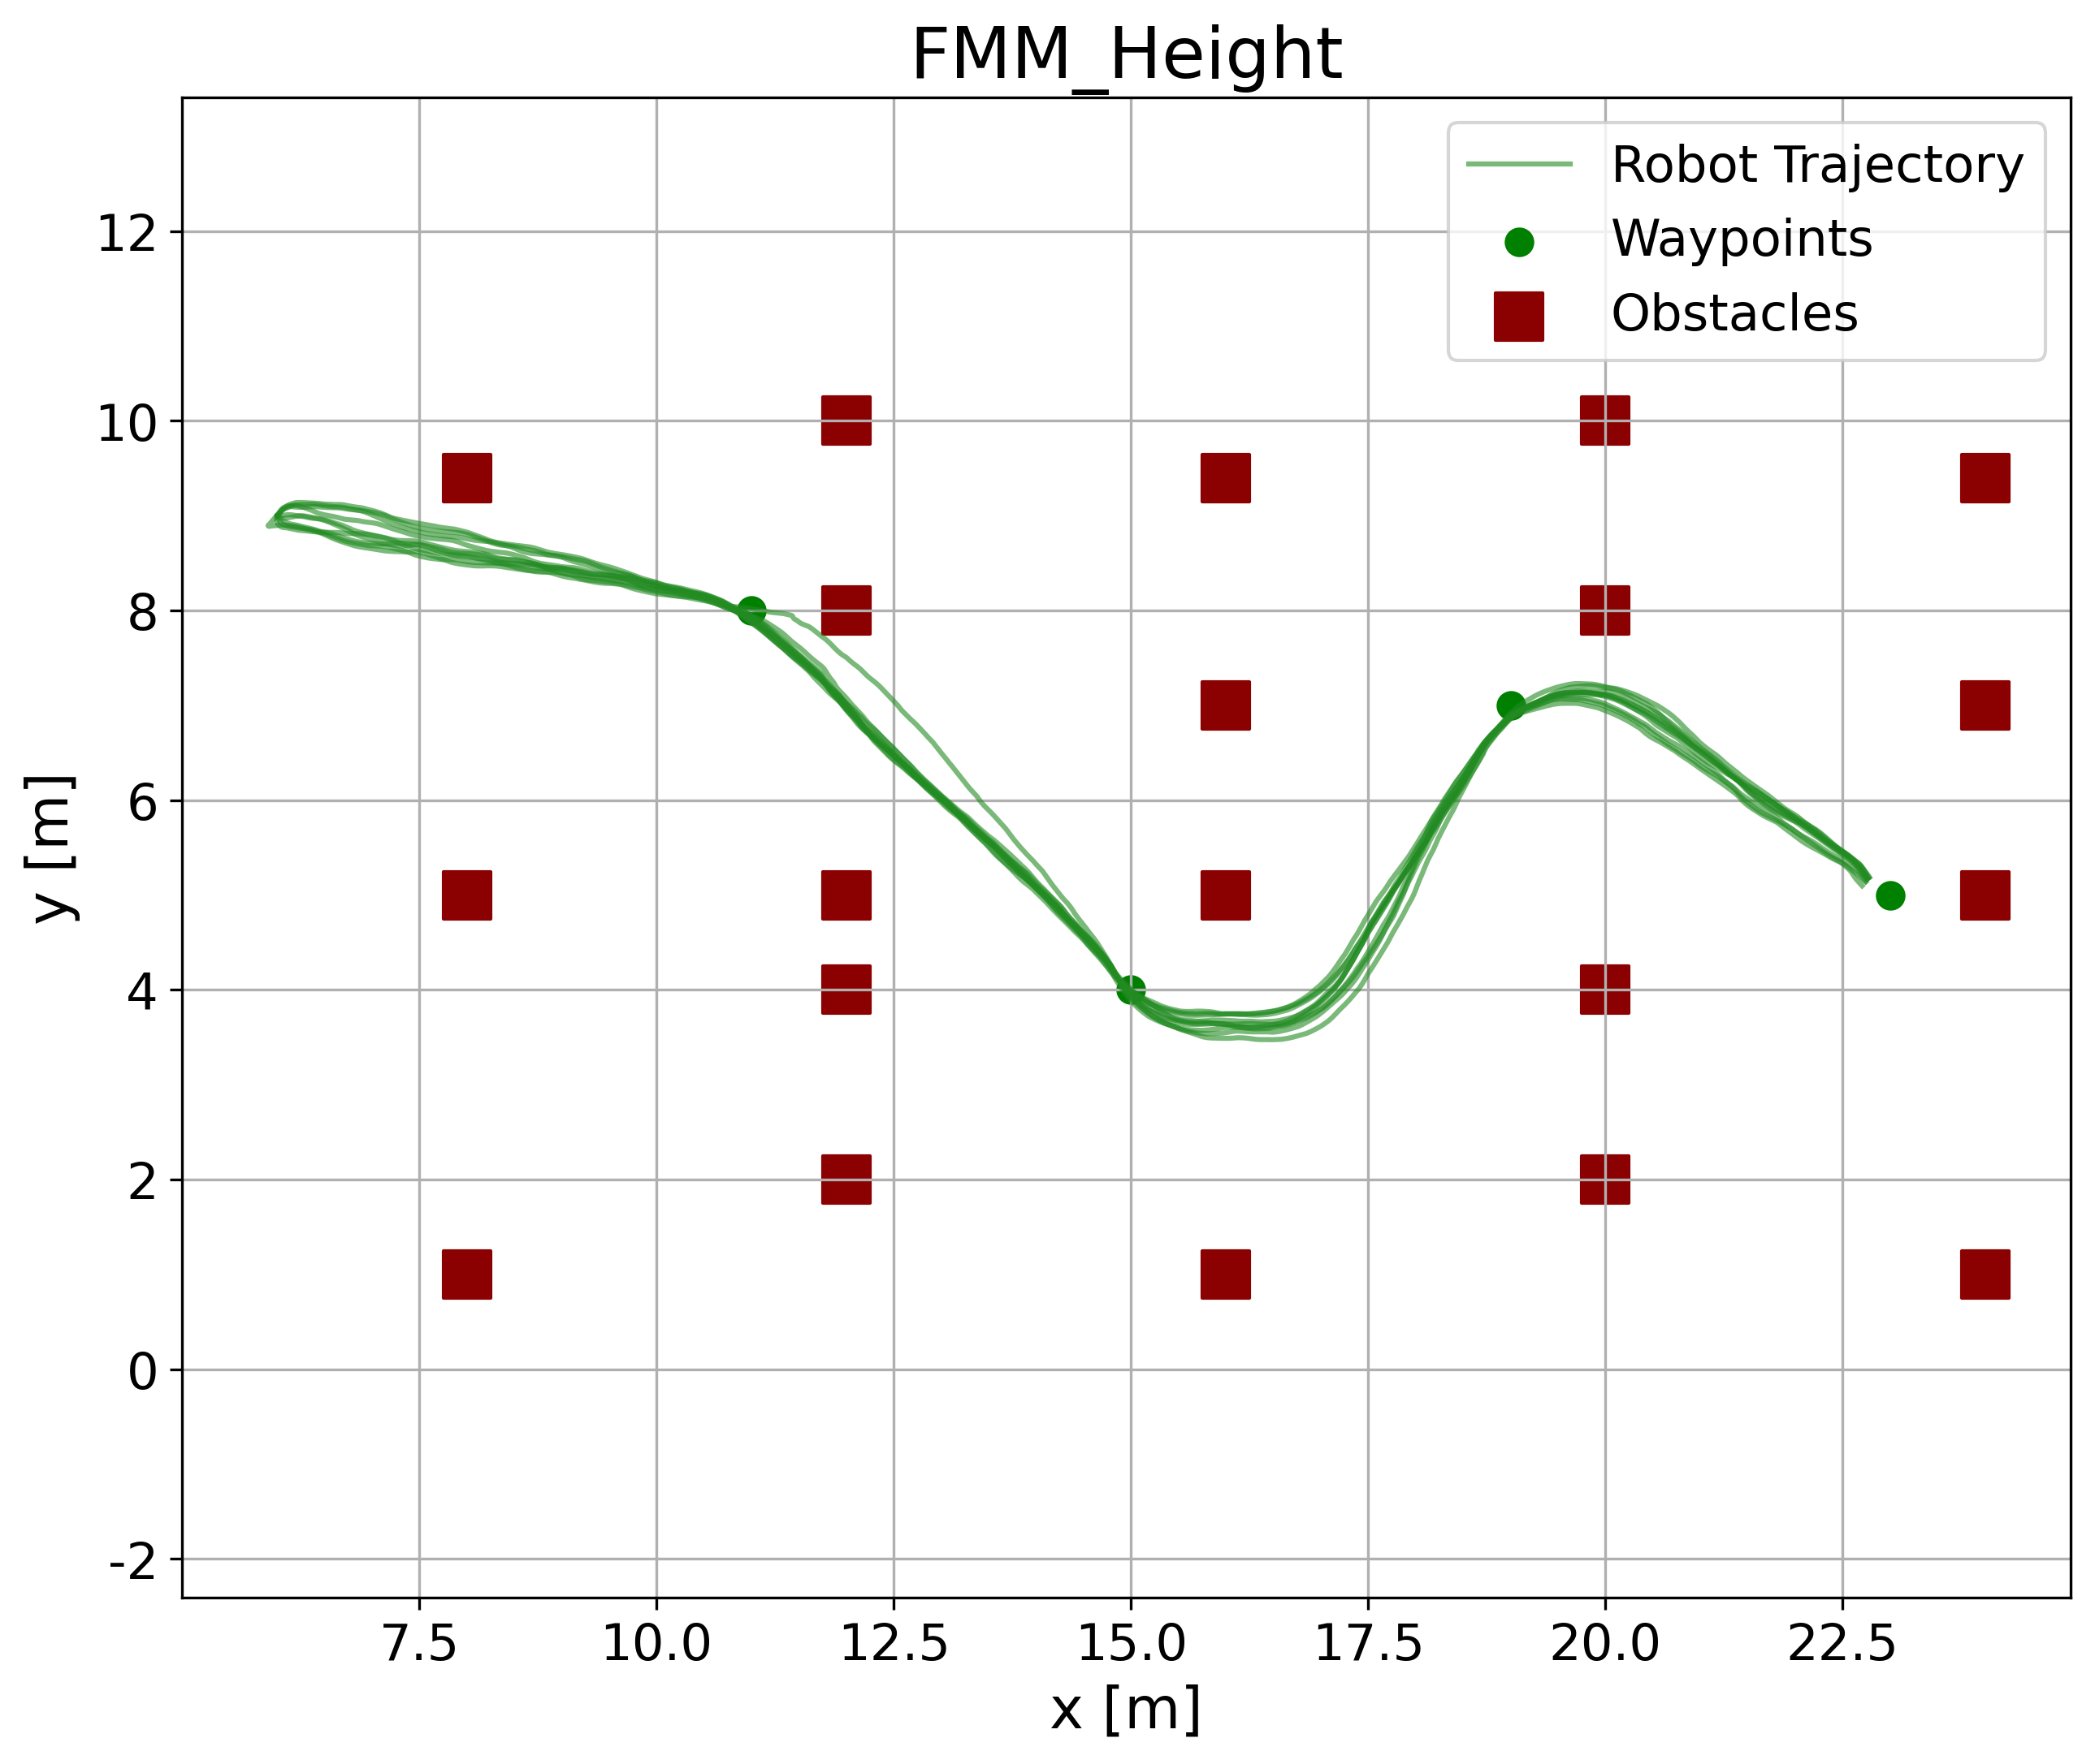
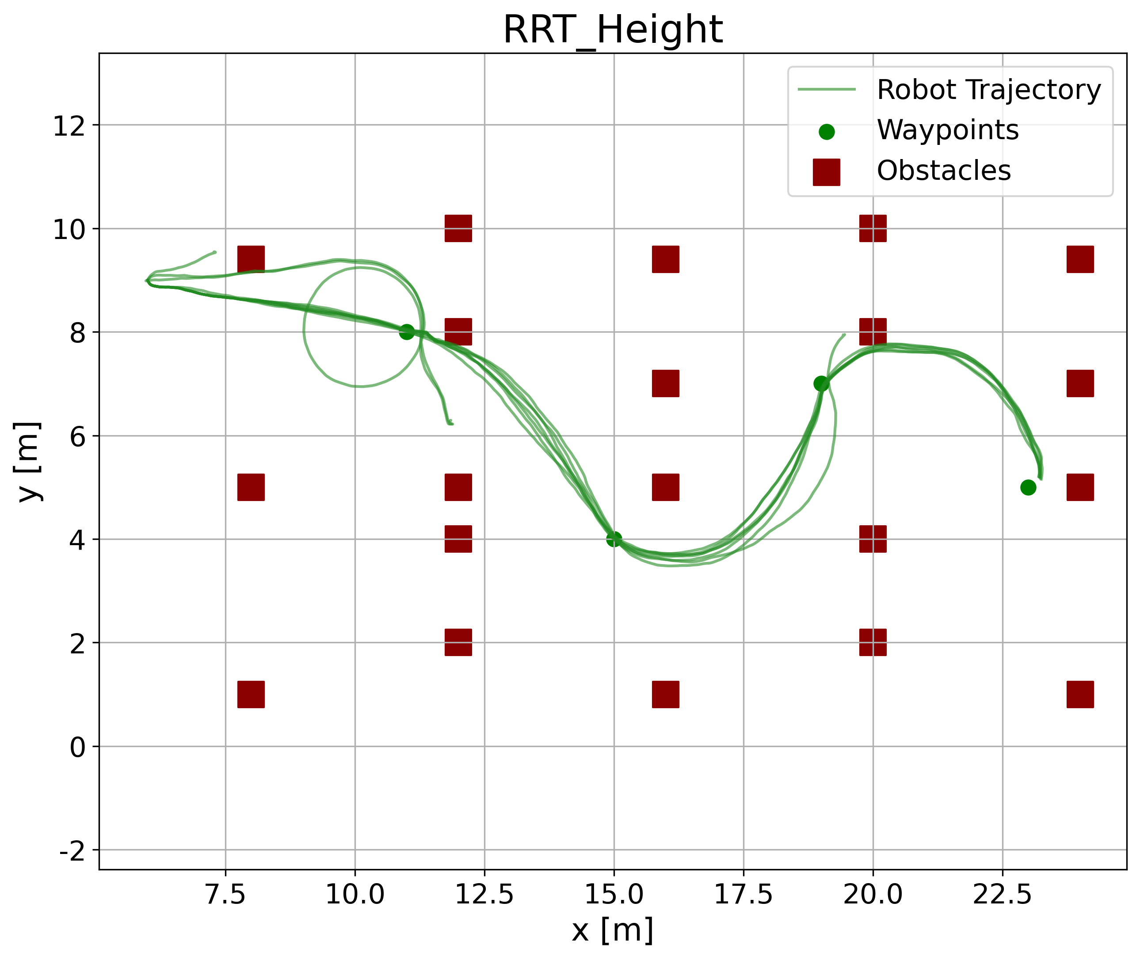
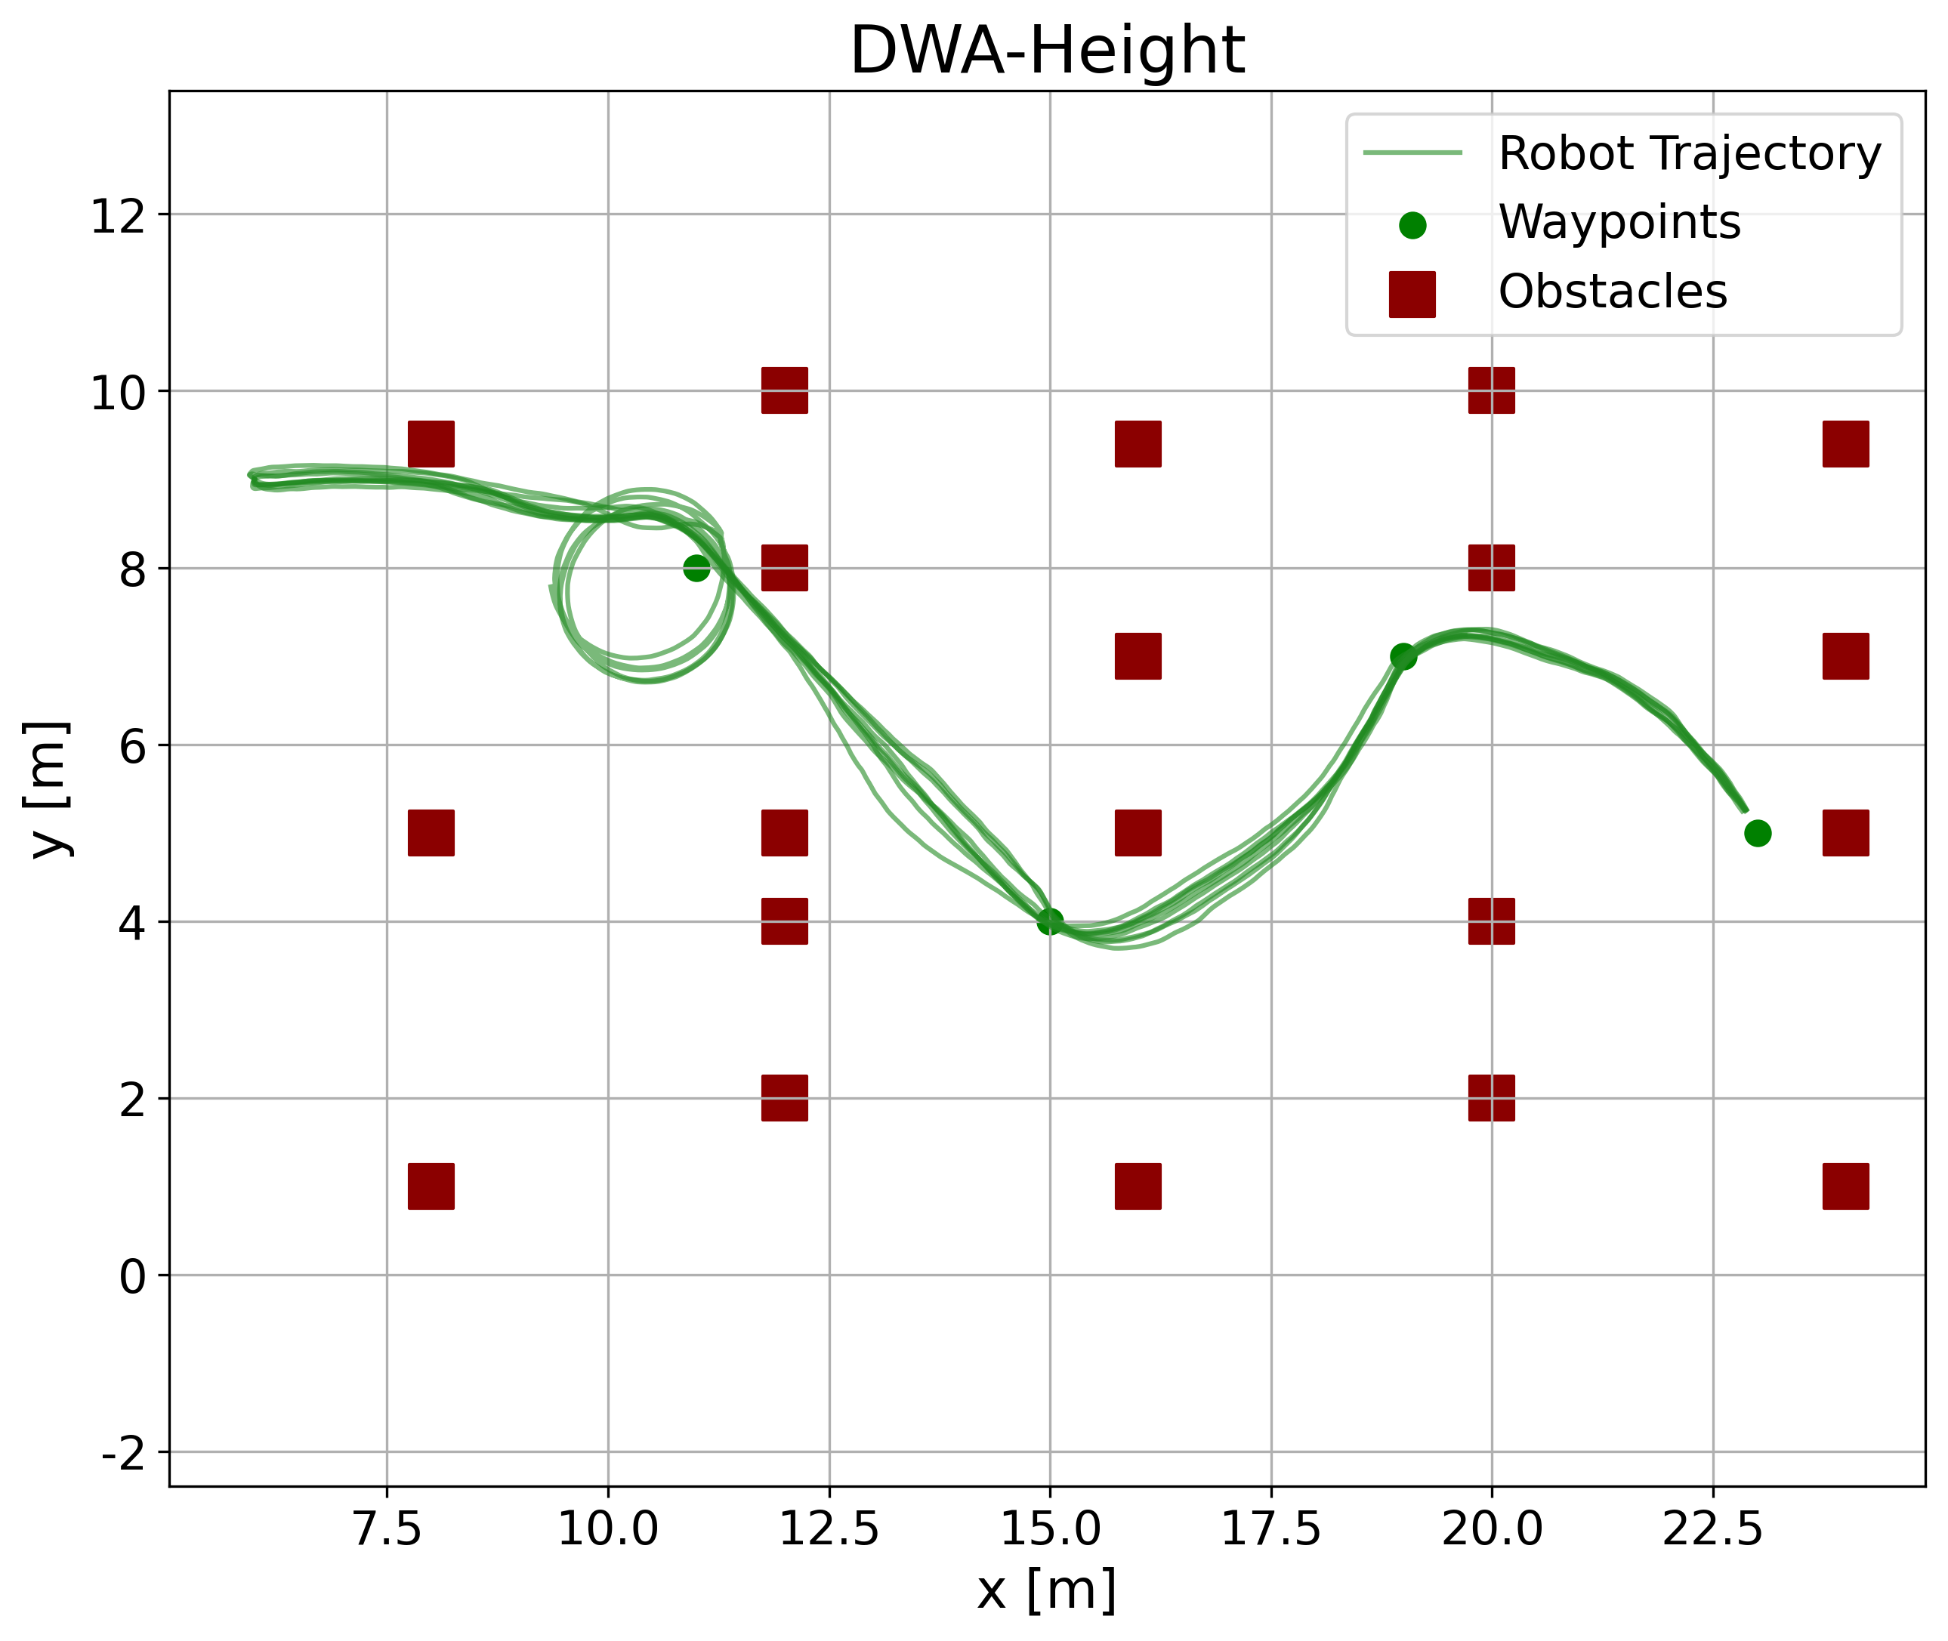
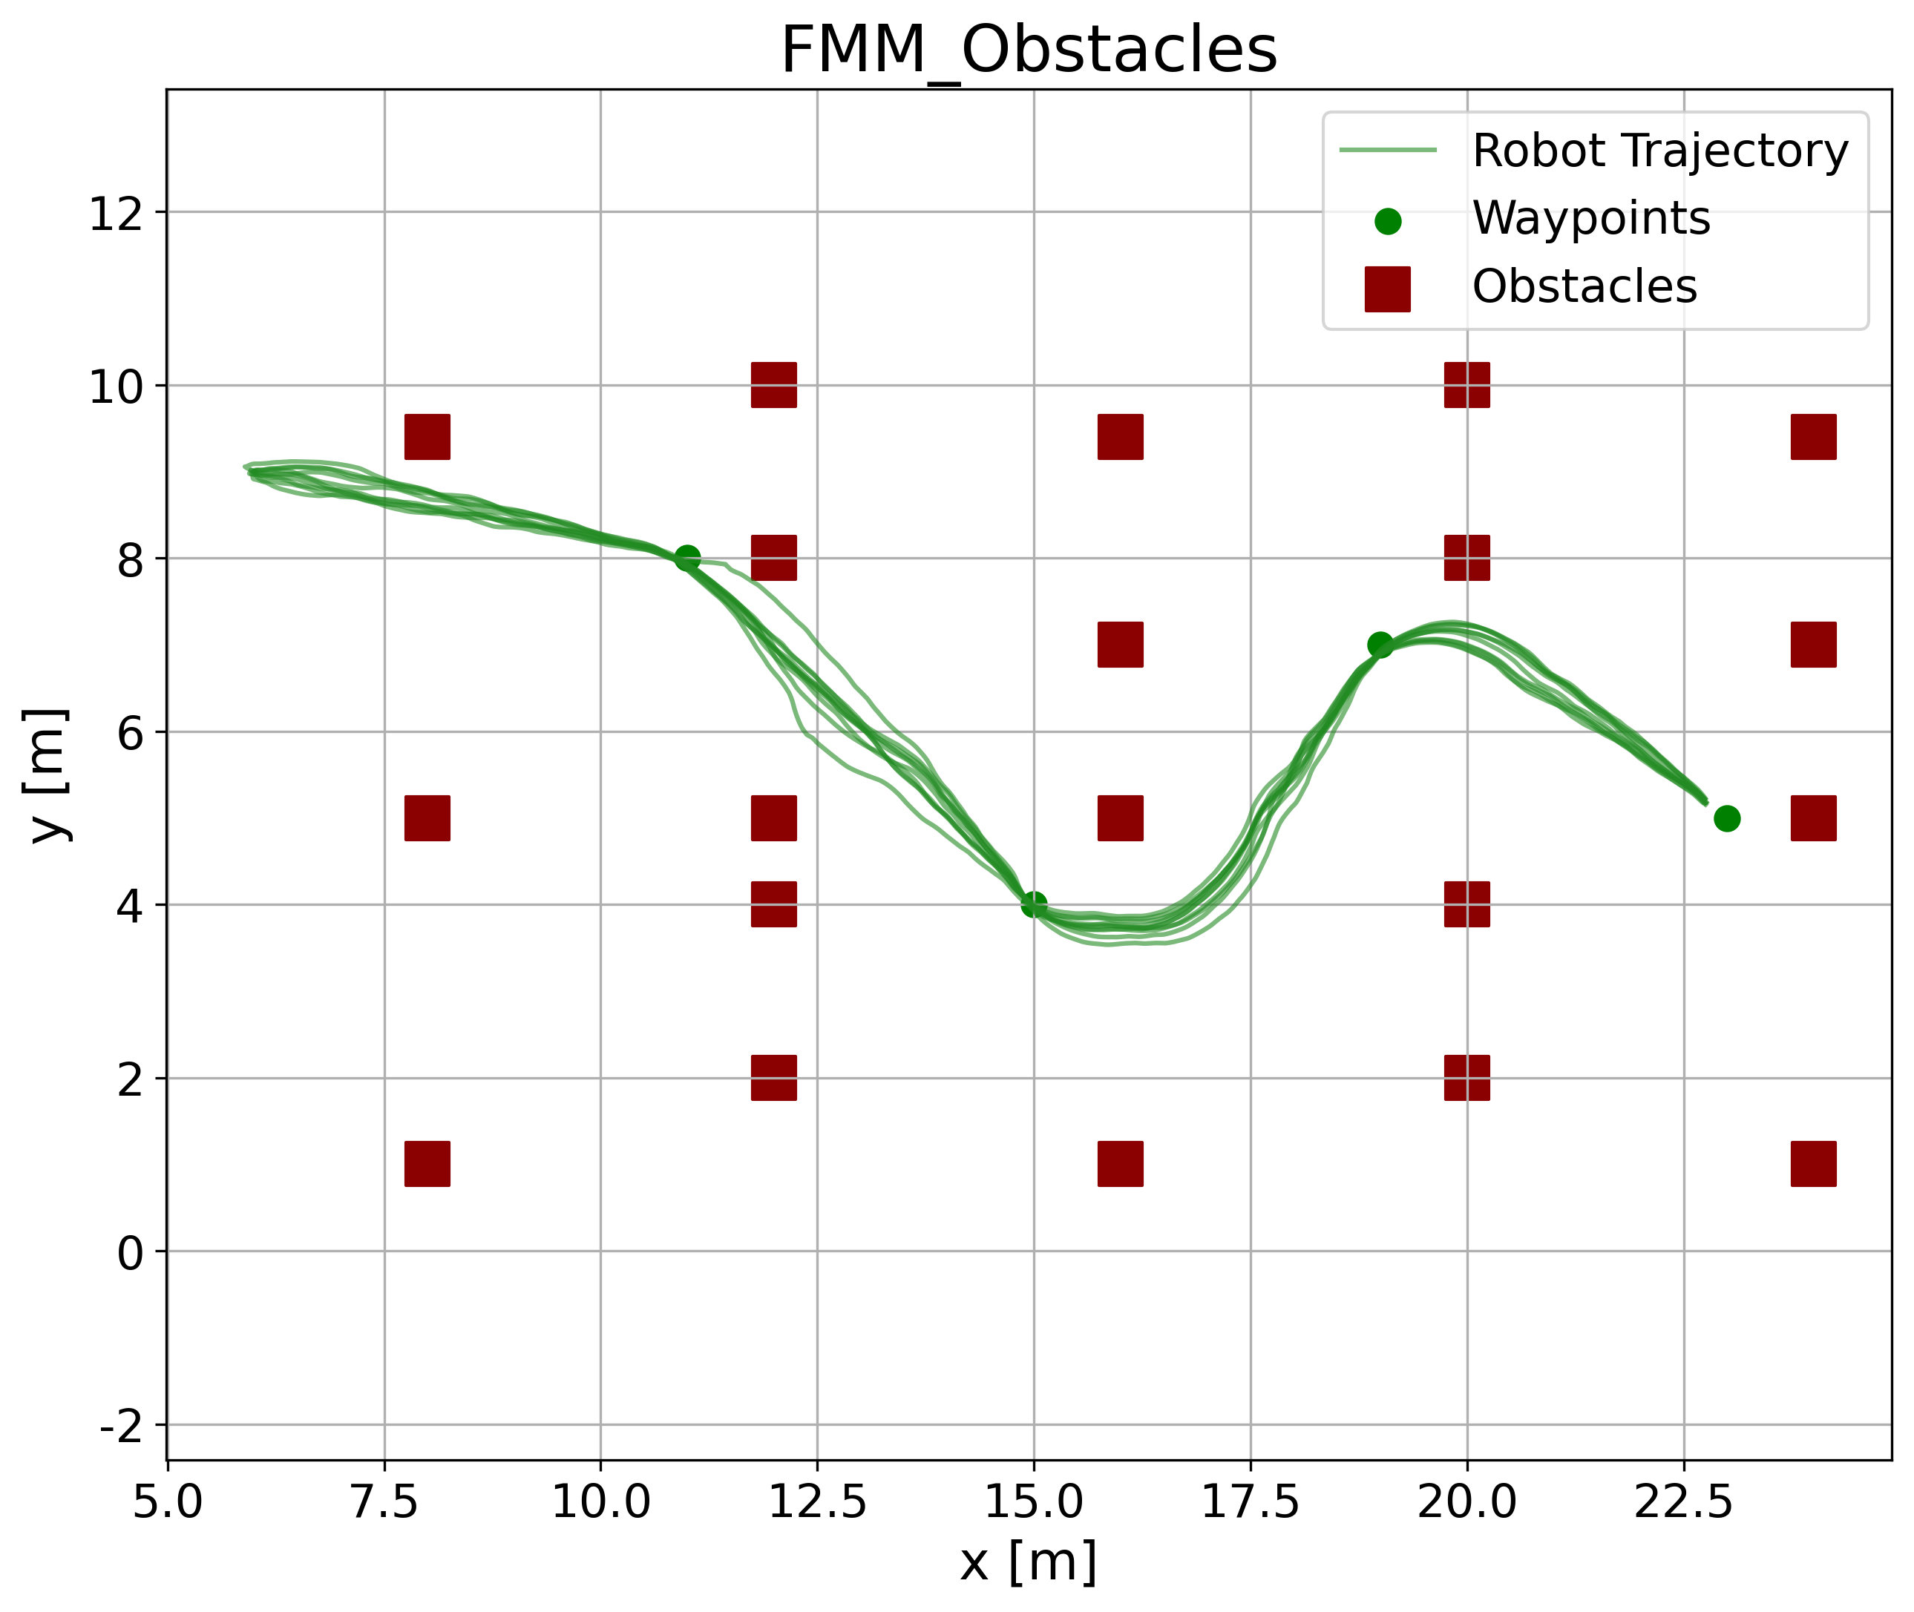
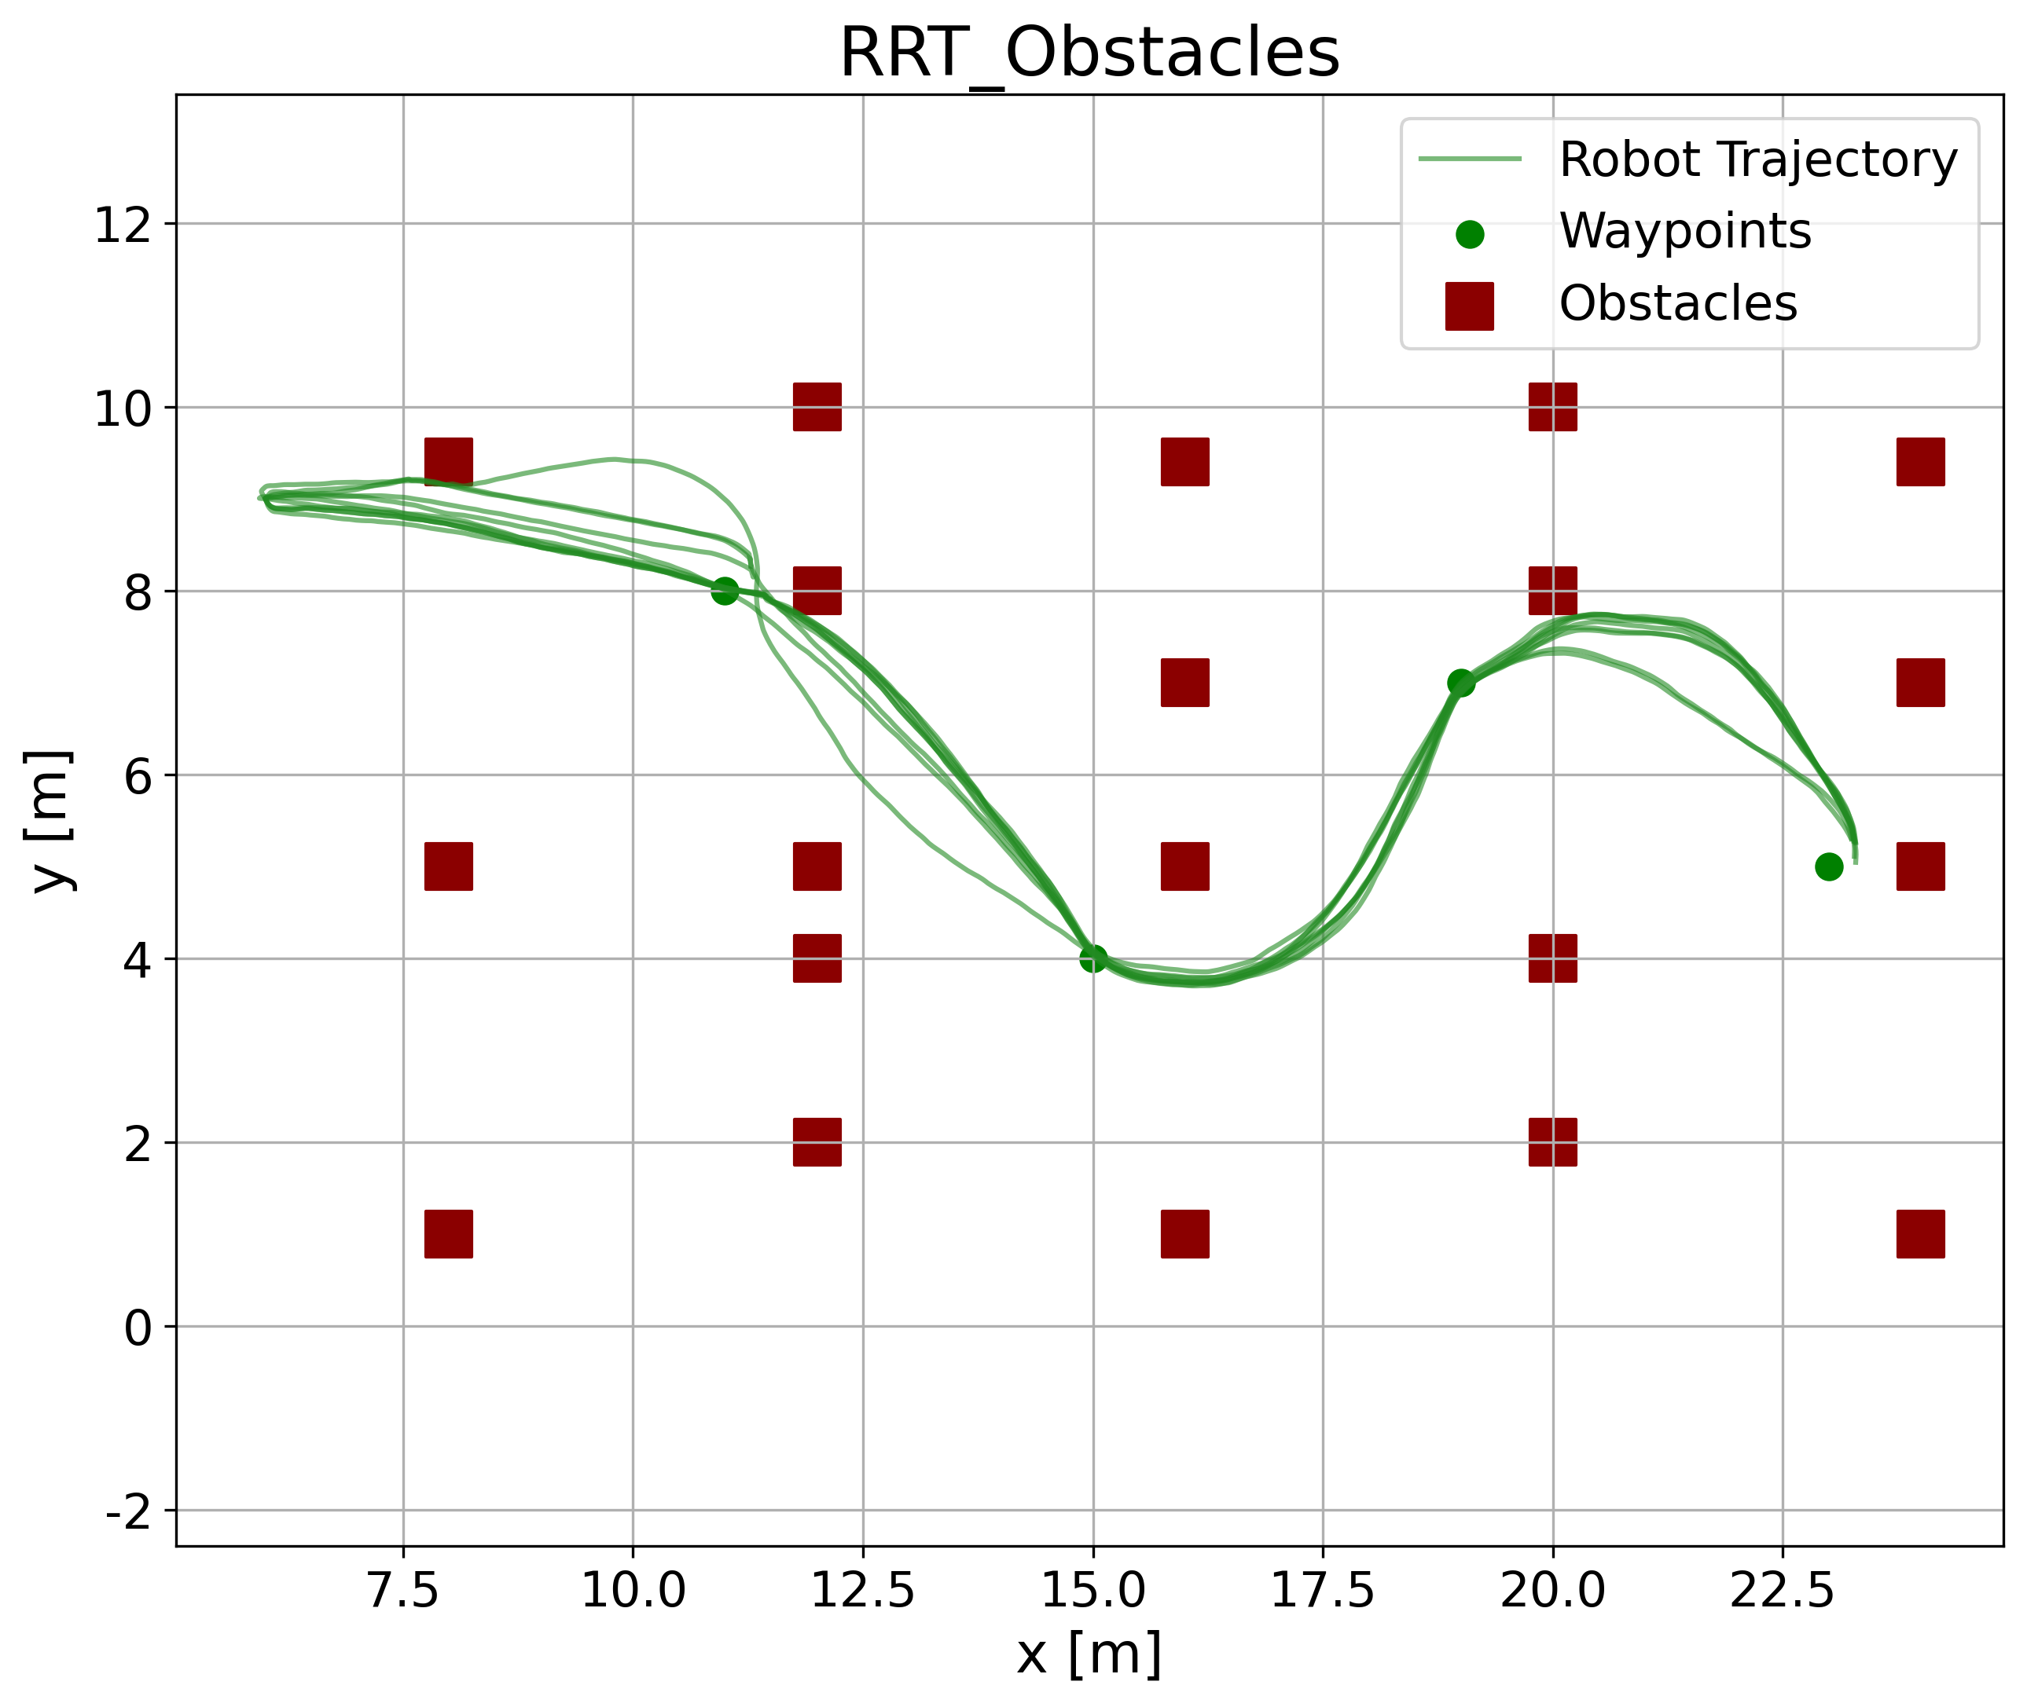
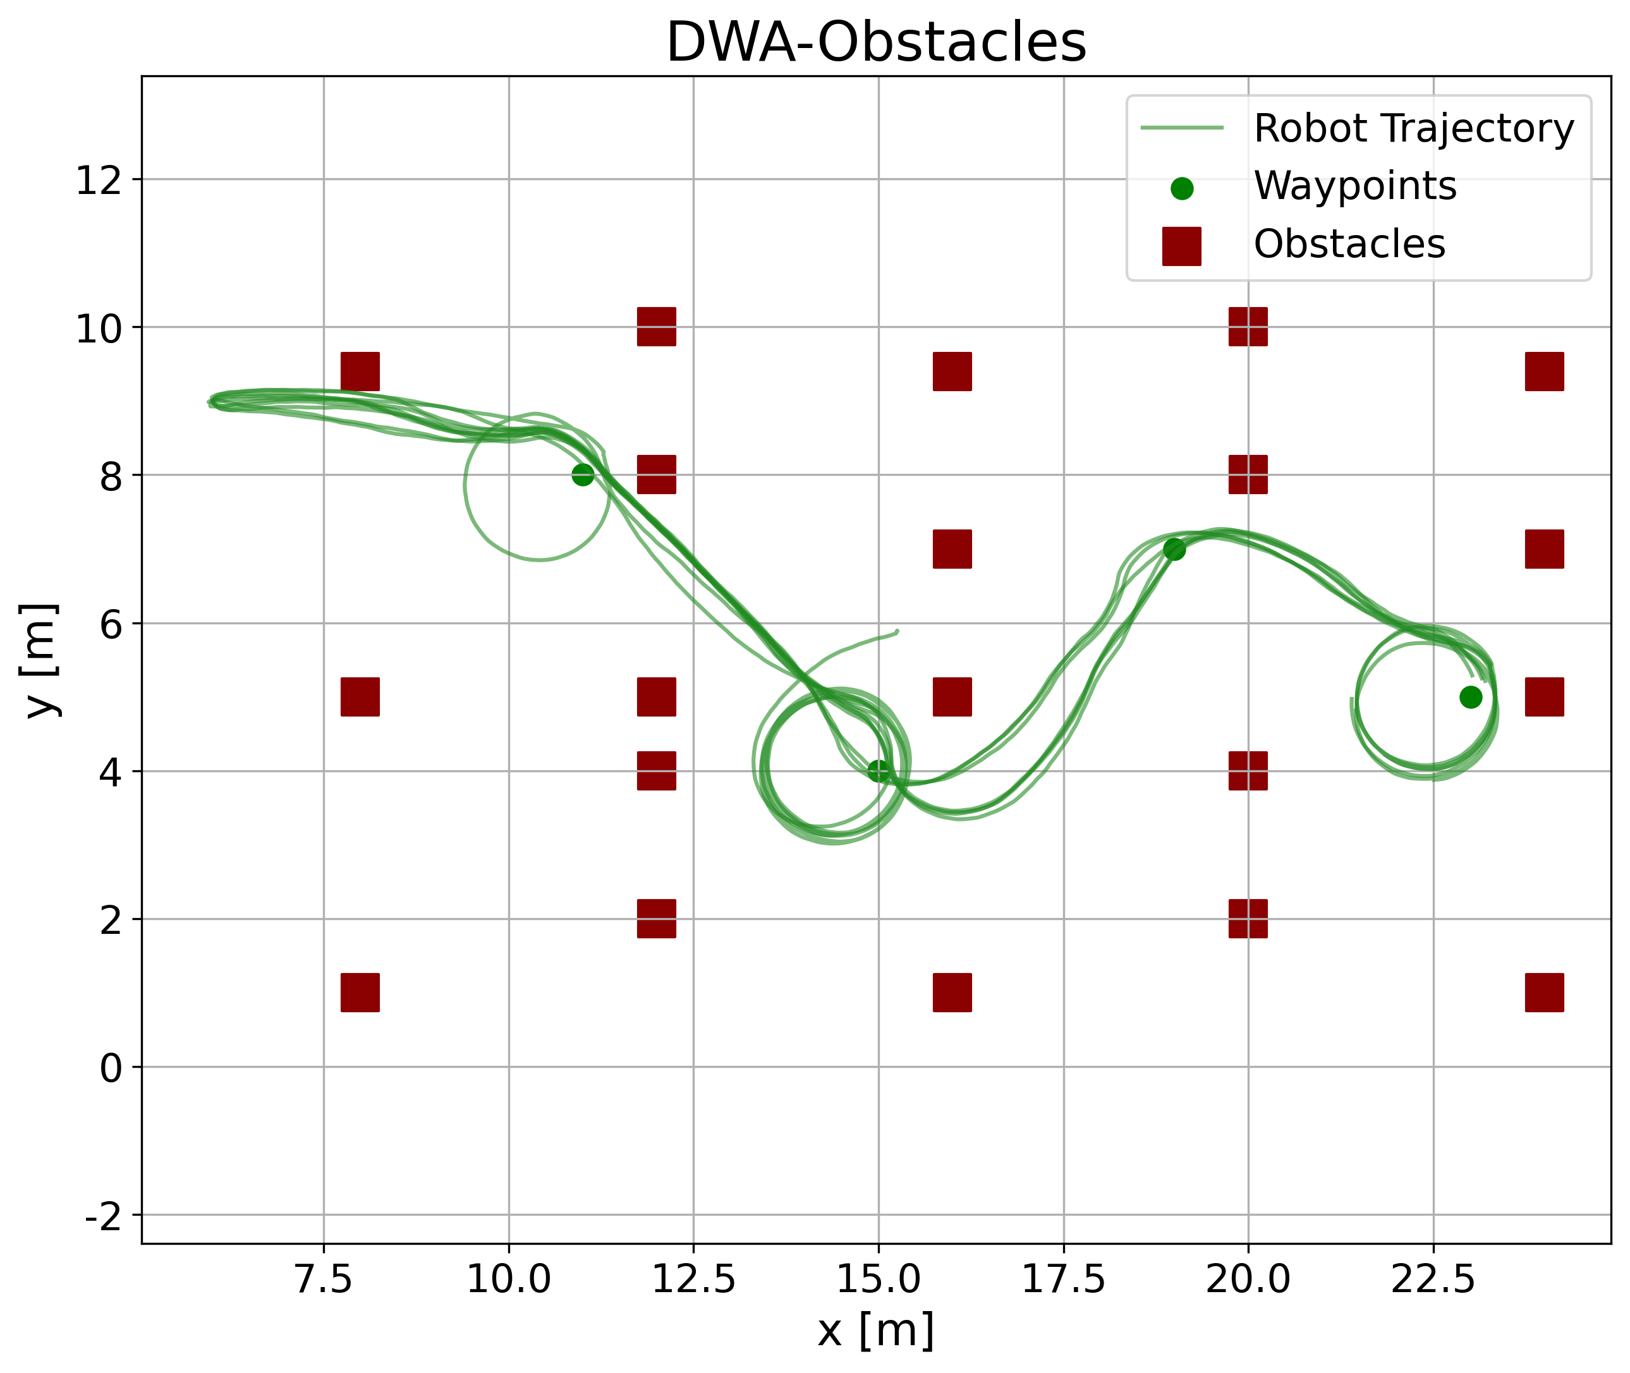
(a)
(b)
(c)
(a)
(b)
(c)

Slide 9
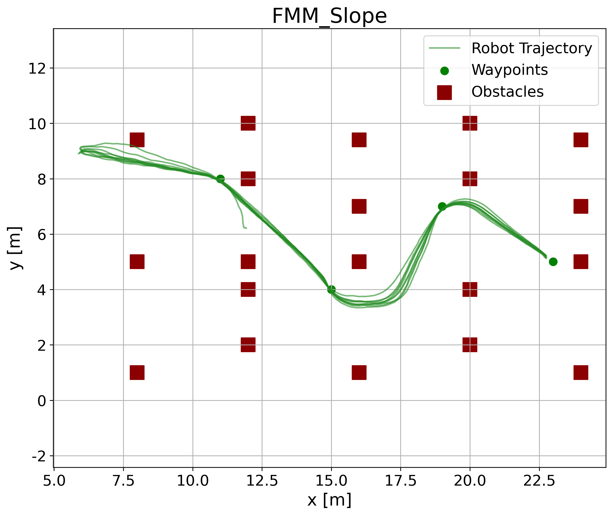
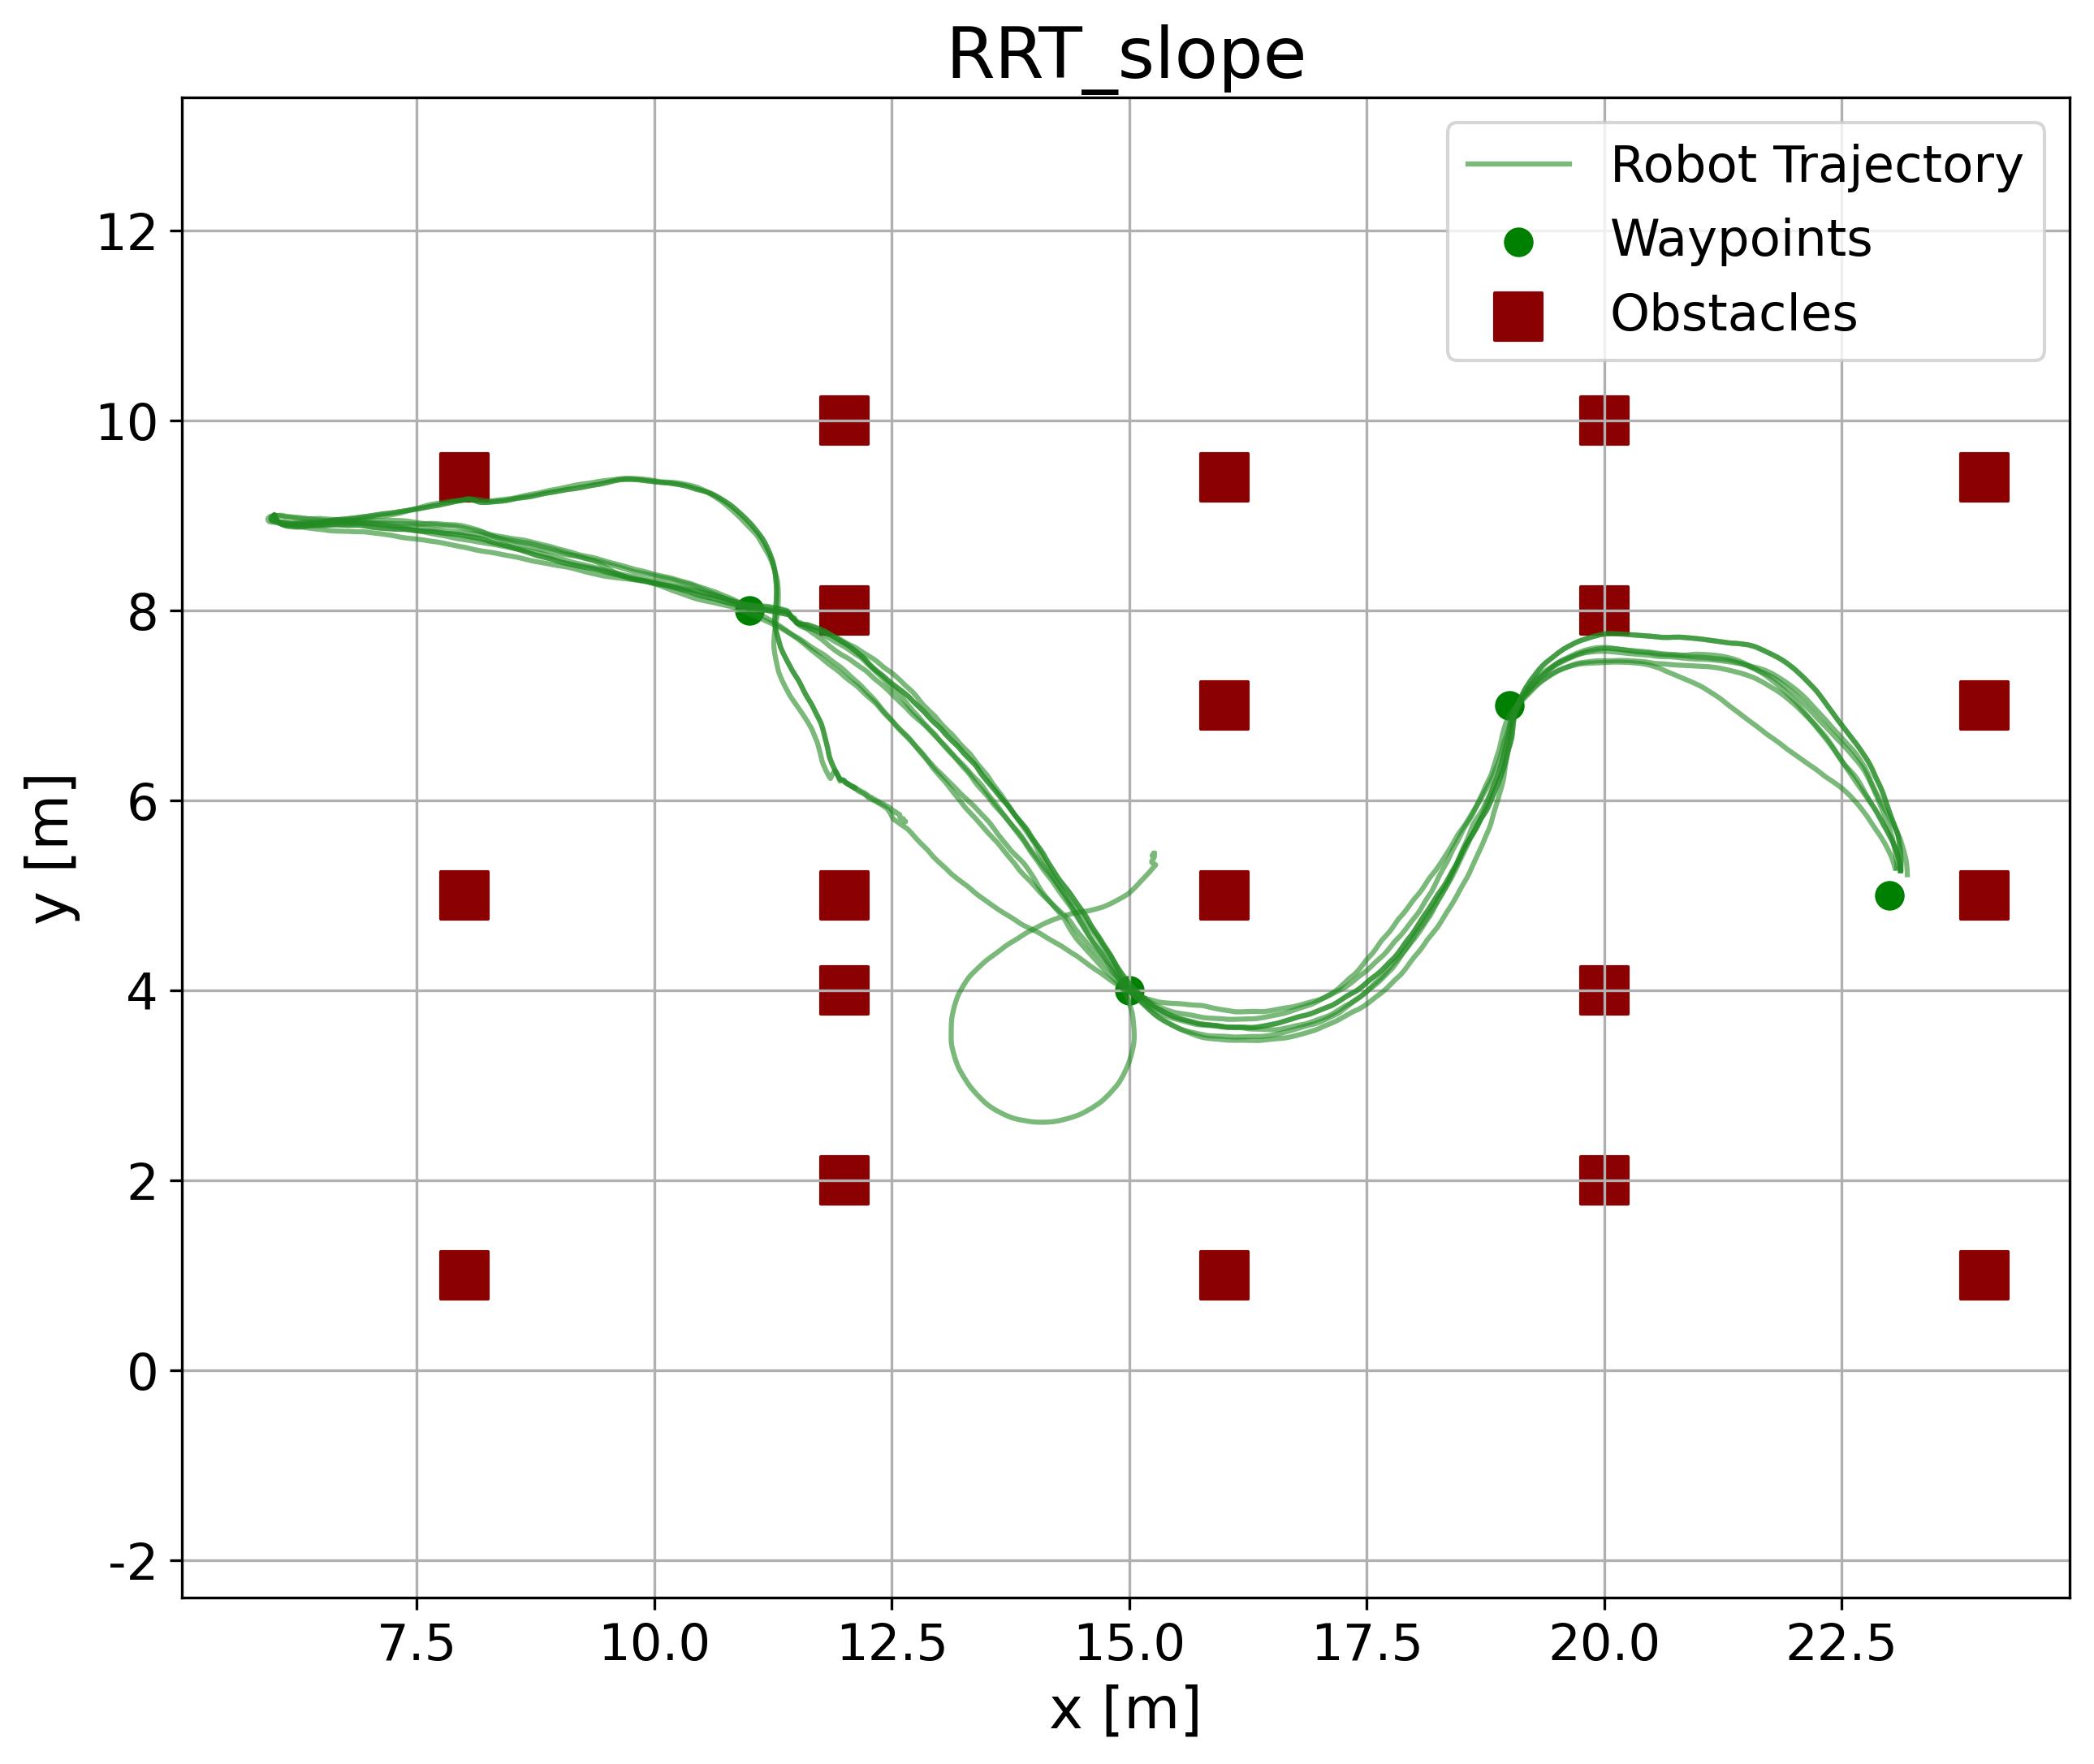

(a)
(b)
(c)
(a)
(b)
(c)

