Slide 1
Assignment1 Code Refactoring
Zhezheng Wang

Slide 2
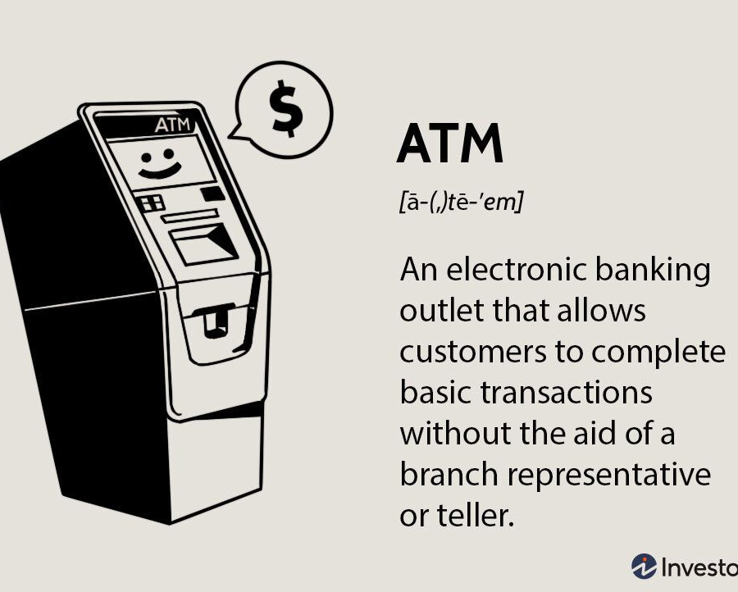
Story about the original code
I learned the code in a coding class about four years ago, At that time, the teacher asked us to write a banking system that can perform user login, query, logout, deposit and withdrawal operations, user password modification and account cancellation functions.

Slide 3
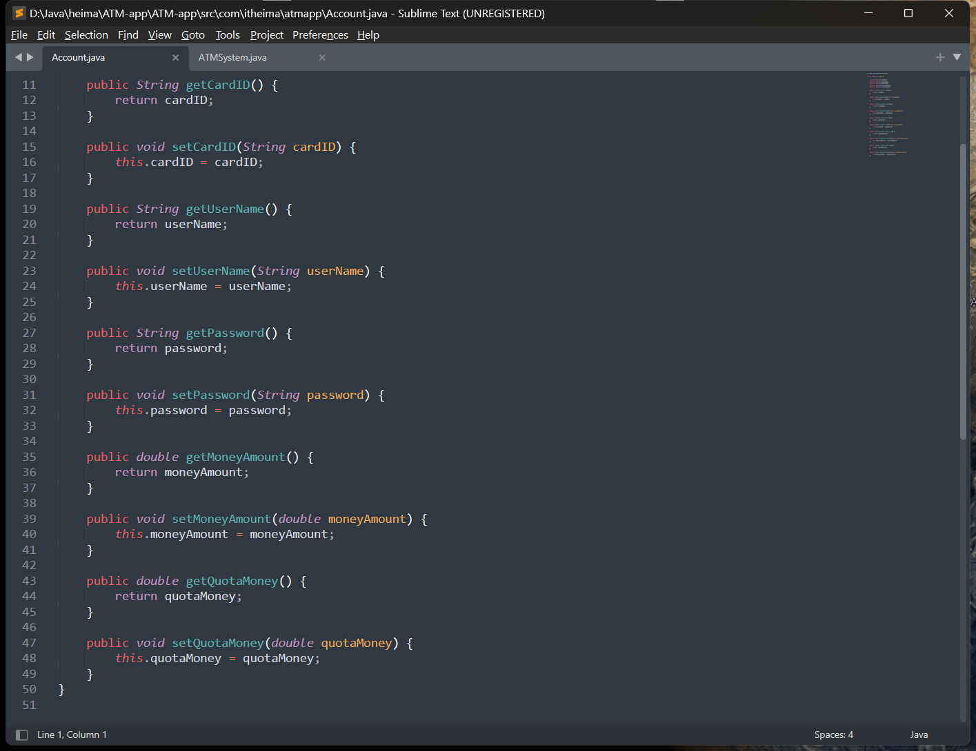
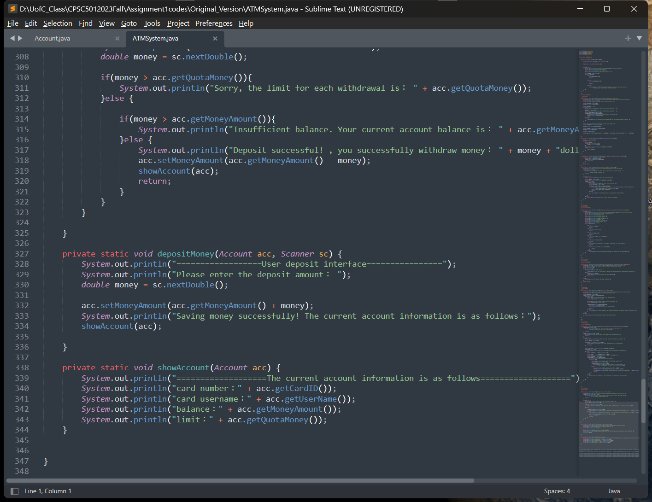
Original code:

Slide 4
In the original code, I identified several issues and poor coding practices(bad smell):
Duplicated Code
Long Function
Global Data
Shotgun Surgery
Bad Loops
Large Class
No Comments

Slide 5

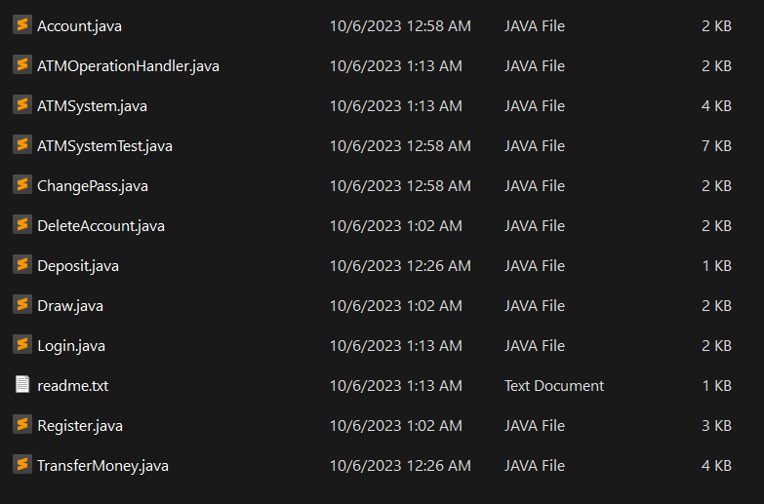
Fix duplicated code, long Function, large Class Structural optimization: After the code has been refactored, it is no longer one lengthy class or multiple lengthy functions, structure is clearer and more orderly Utilize Java encapsulation: Through encapsulation, I can hide the state of an object and restrict access to this state. Through Java's encapsulation, you can make the code more concise and readable. lengthy functions, and the structure is clearer and more orderly.

Slide 6
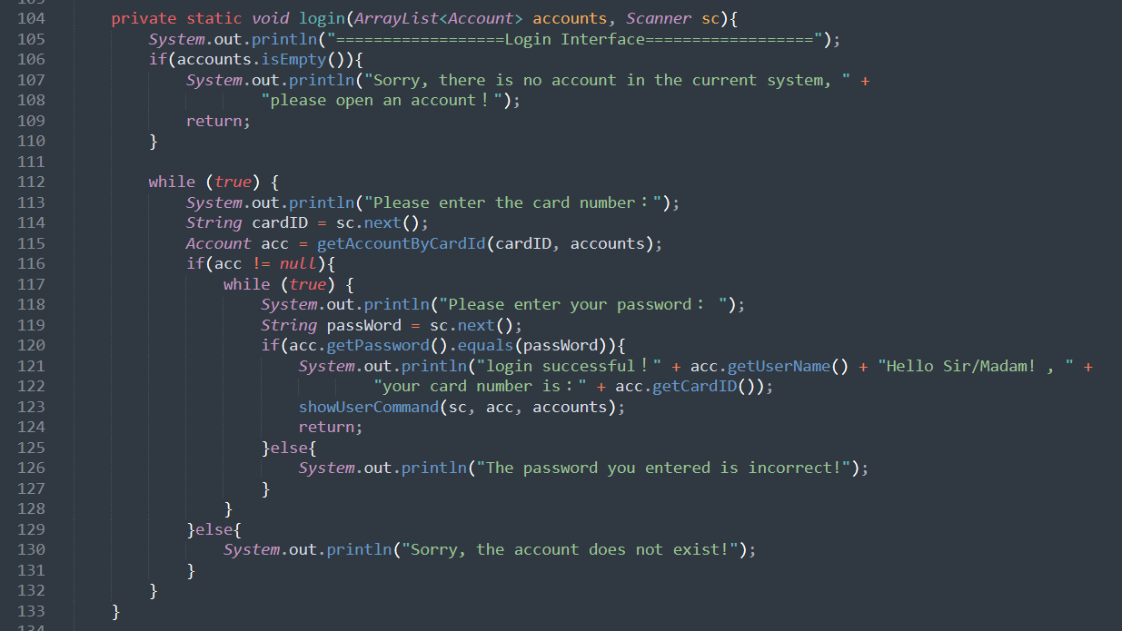
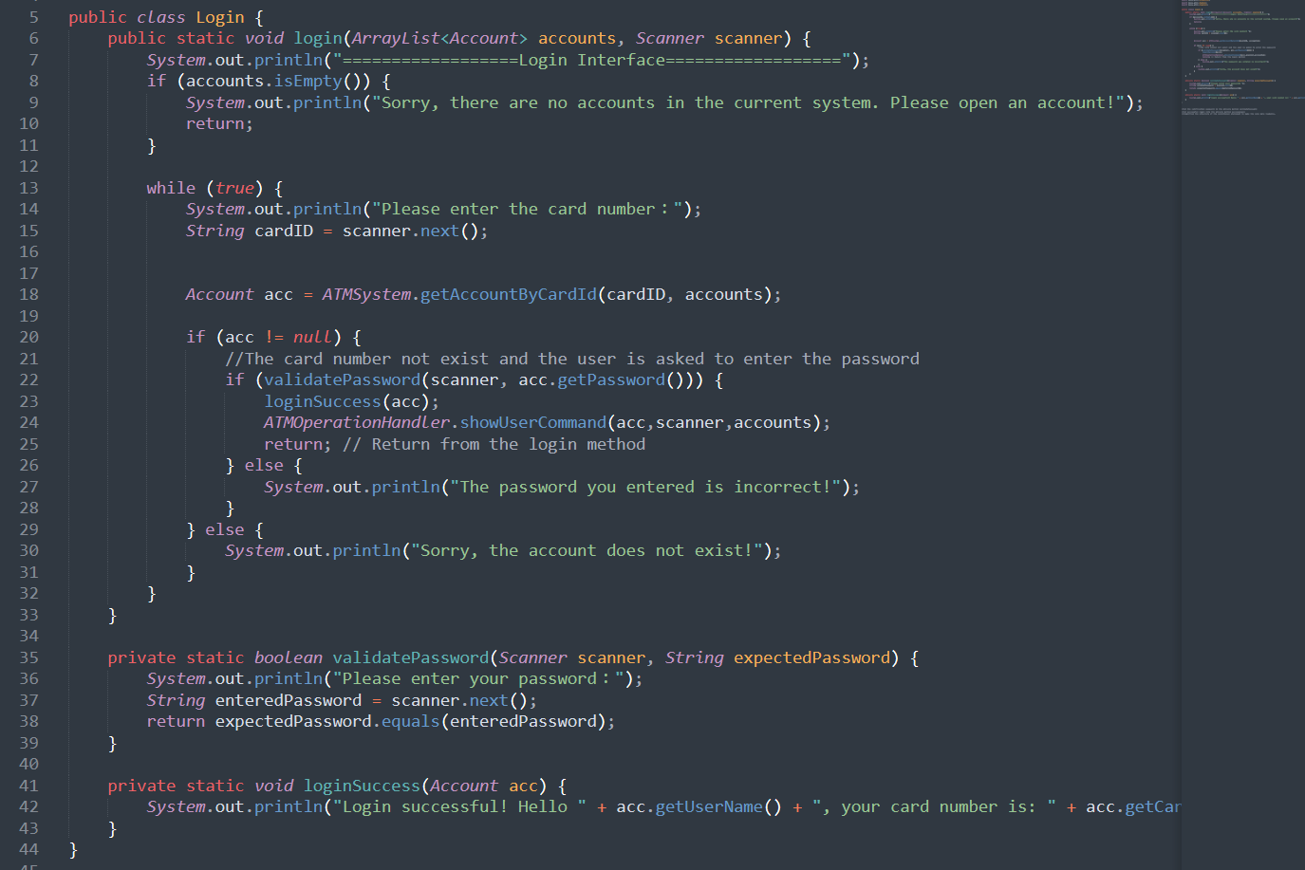
Login class: Put the verification password in the private method validatePassword Put successful login into the private method loginSuccess Simplified the structure of the conditional statement to make the code more readable.

Slide 7
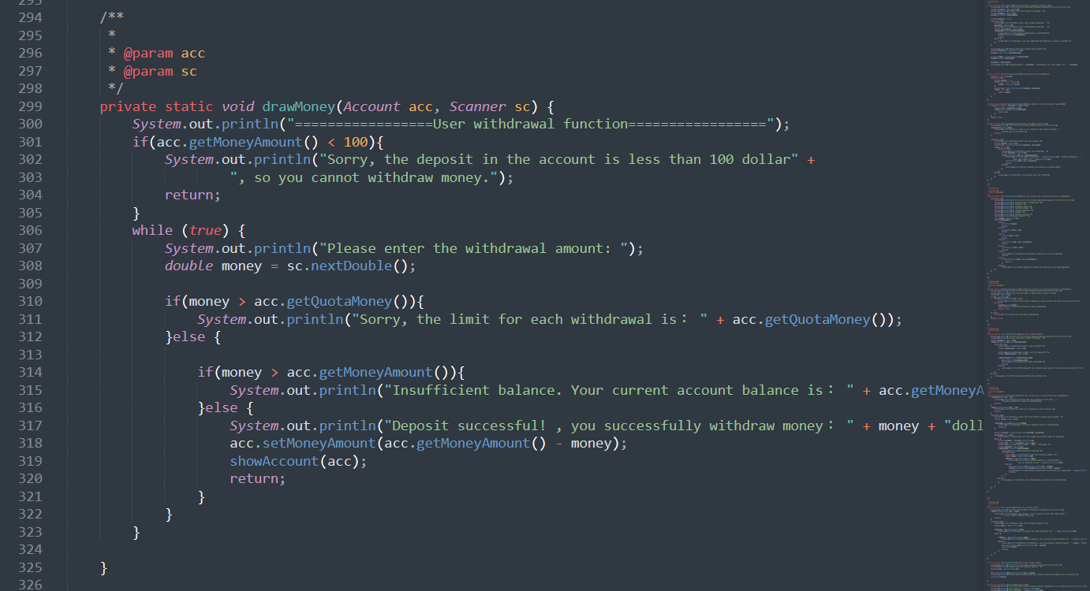
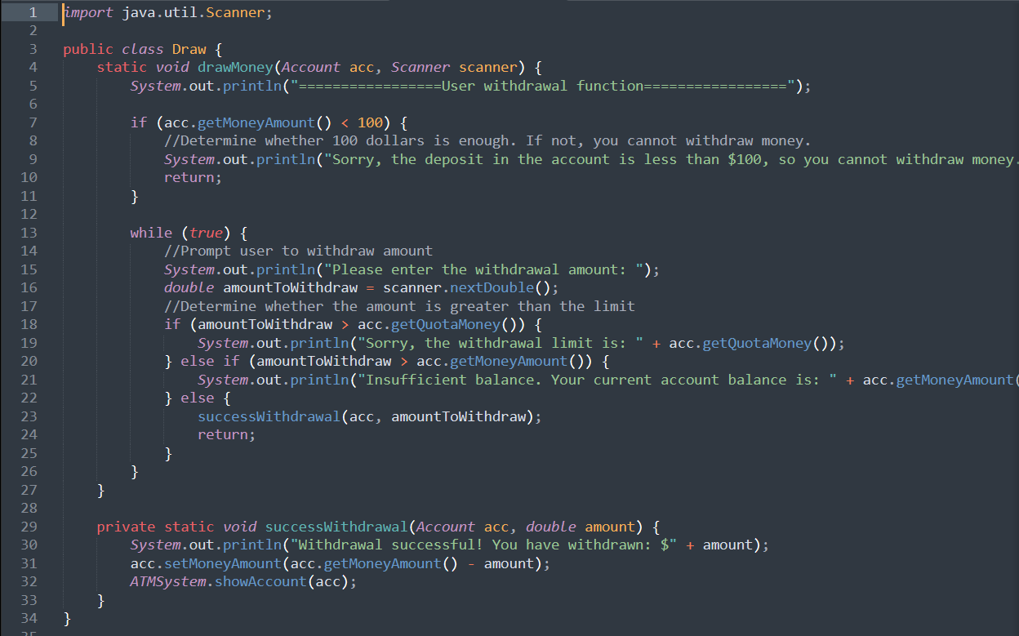
Draw class: Reorganize blocks of code into a more readable structure and use more descriptive variable names. Encapsulate the logic of executing withdrawals by extracting the successwithdrawal method to reduce code duplication. Combine else and if Use more descriptive prompt messages to improve user experience.

Slide 8
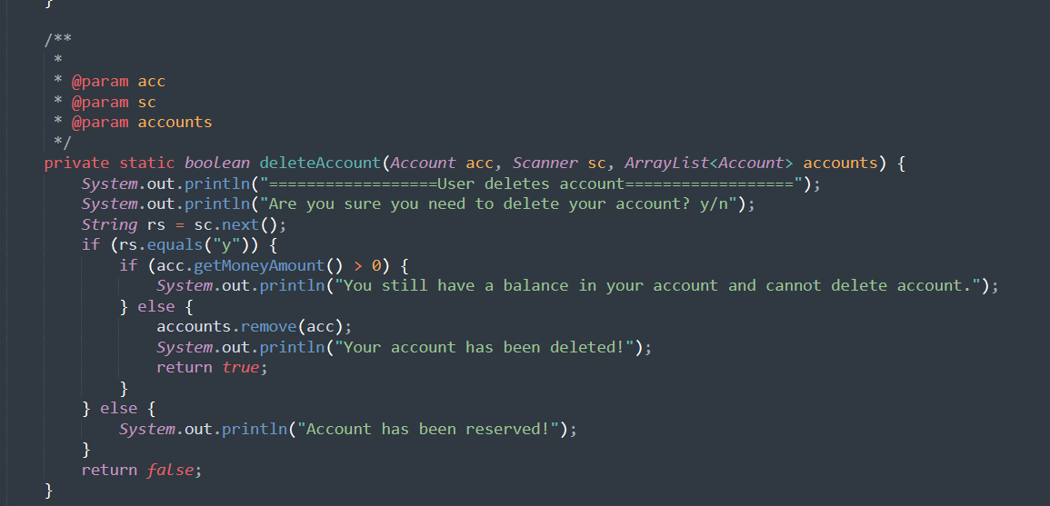
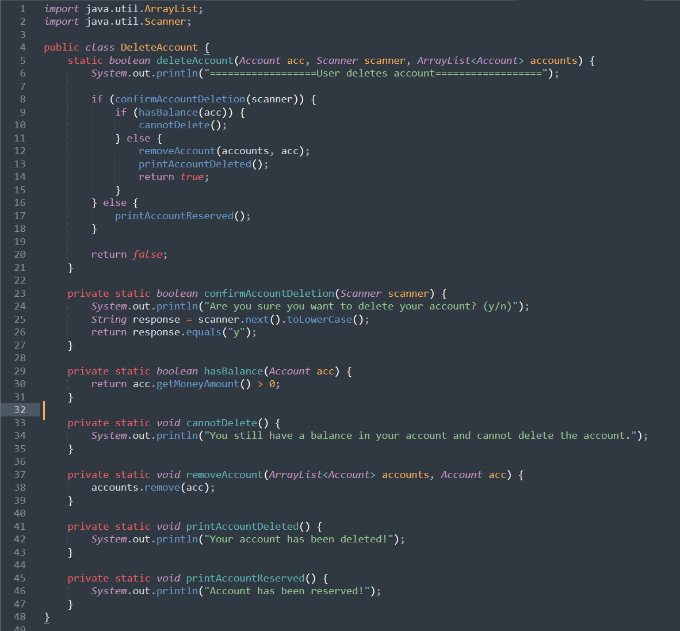
DeleteAccount class: Decompose the logic of deleteAccount into 6 private methods confirmAccountDeletion, hasBalance, cannotDelete, removeAccount, printAccountDeleted, printAccountReserved Improve code readability. Use more descriptive method and variable names to make your code easier to understand. Reduced nested conditional statements to make code clearer.

Slide 9
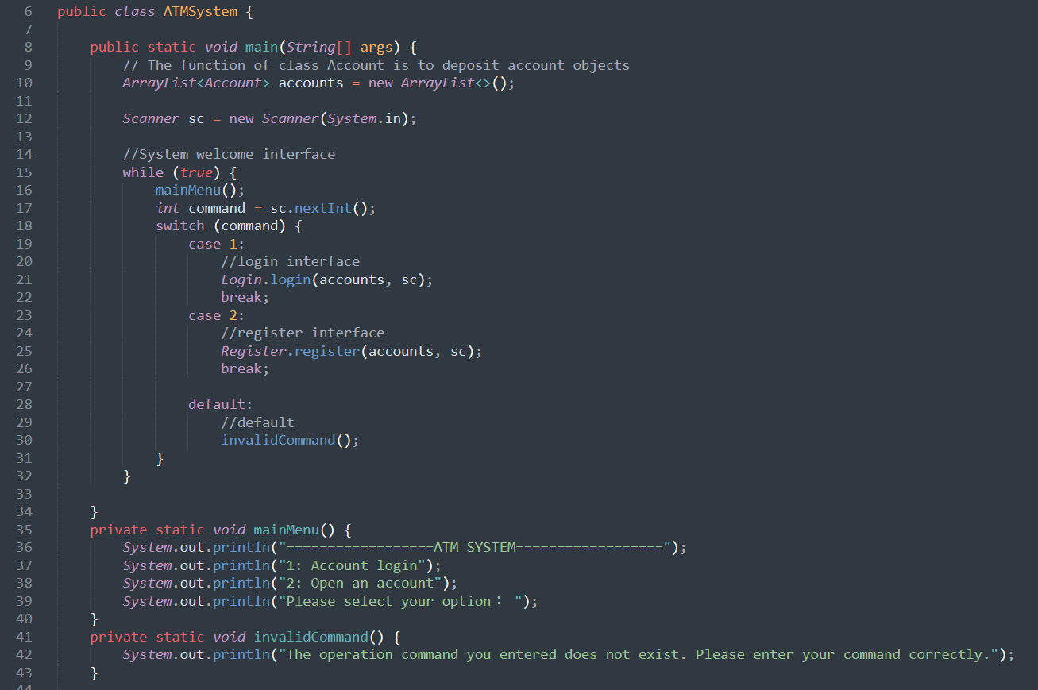
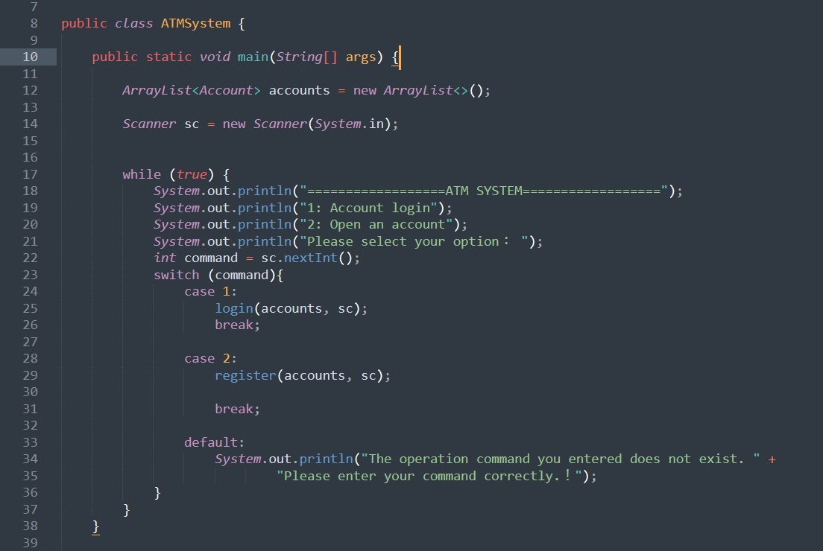
Main class: Change main to public. Encapsulate invalidCommandHandler and mainMenu,

Slide 10
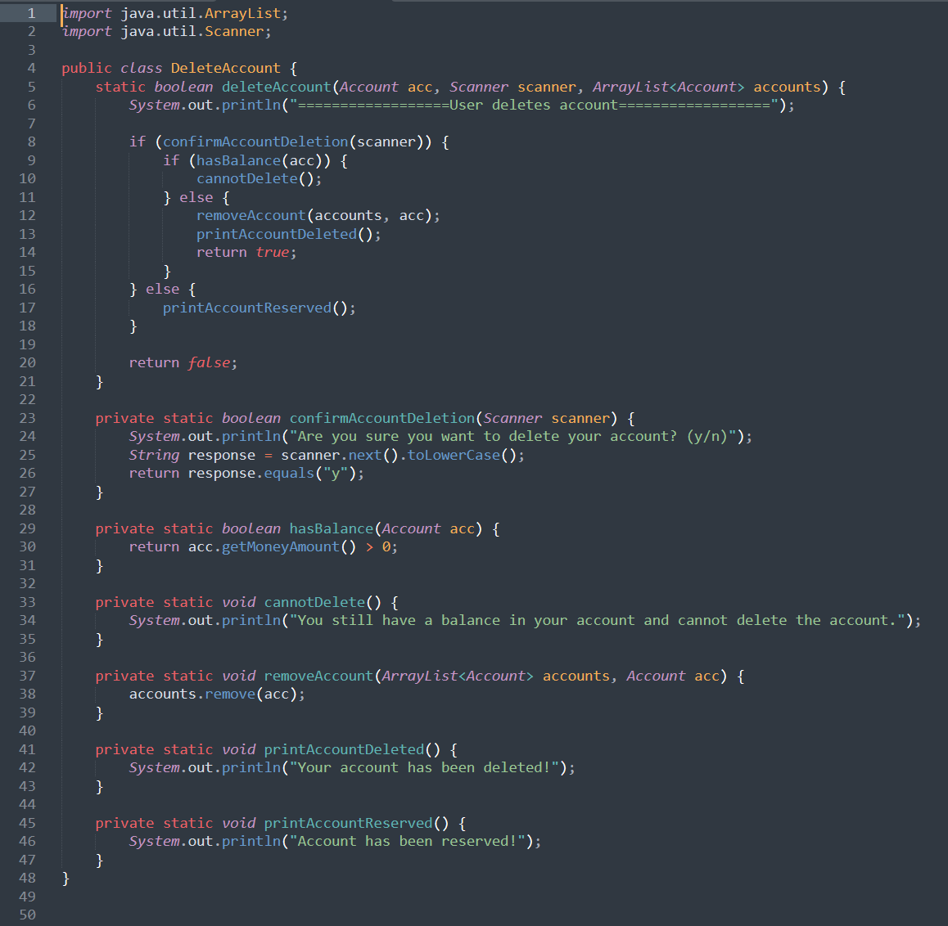
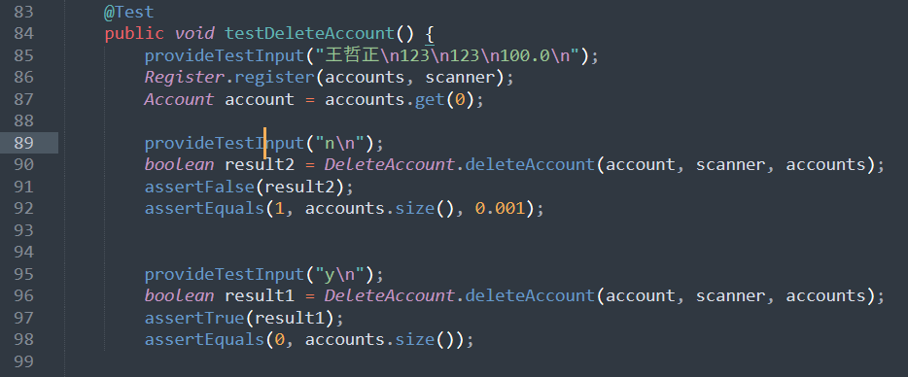
DeleteAccount Junit test

Slide 11
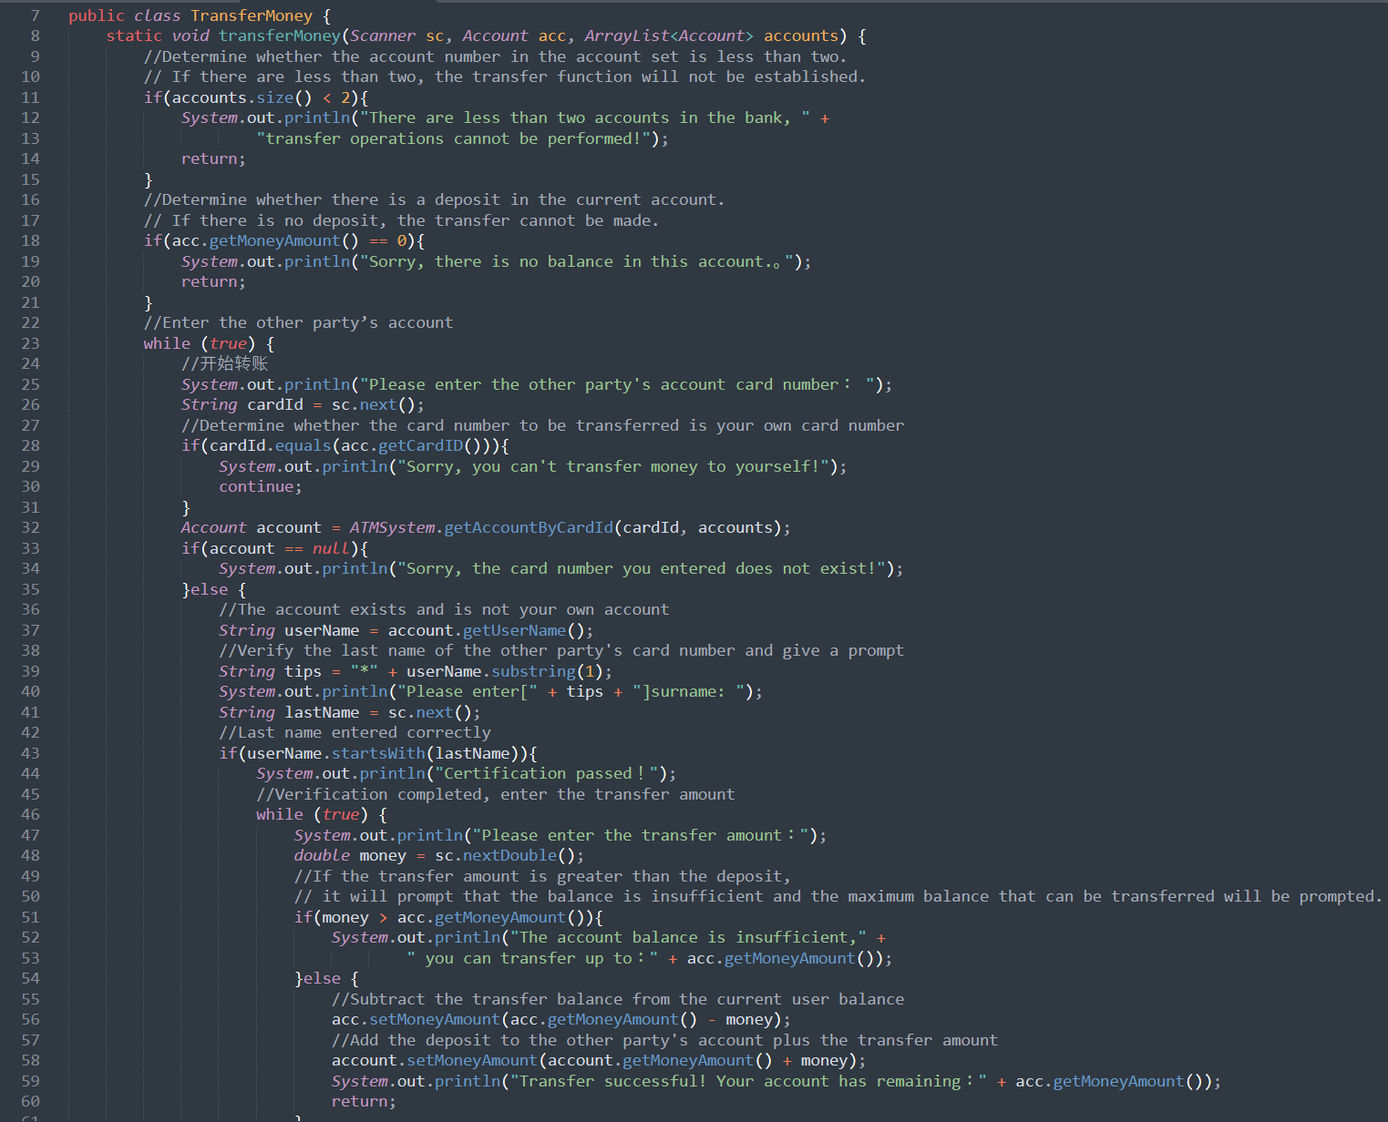
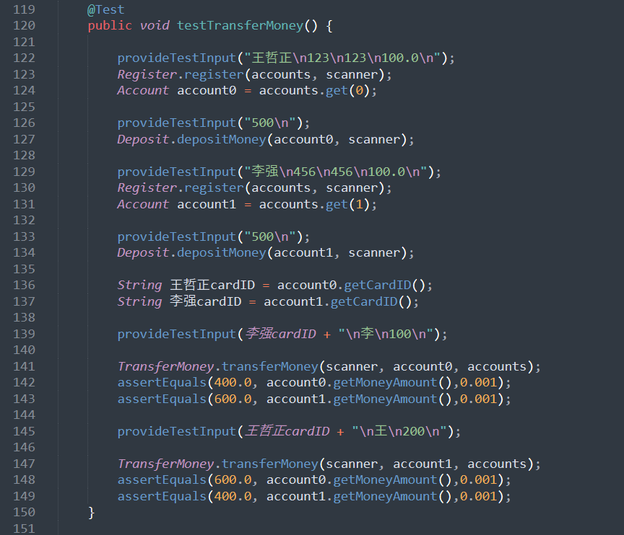
TransferMoney Junit test

Slide 12
Summary
Refactoring can improve code readability, maintainability, and scalability.
Structural optimization: After the code has been refactored, it is no longer one lengthy class or multiple lengthy functions, and the structure is clearer and more orderly.
Utilize Java encapsulation: Through encapsulation, I can hide the state of an object and restrict access to that state, thus ensuring that the object is not accidentally modified externally. At the same time, Java's encapsulation can make the code more concise and easier to read.
Improve the maintainability of code: When the code structure is clear and the functions are modularized, it will be much easier to maintain. When I encounter a problem, I can quickly locate the module where the problem lies instead of searching in a mess of code.
Lay the foundation for further refactoring: A good code structure can make future refactoring work smoother and make it easier to adjust and optimize each class in accordance with coding standards.
Supports increased testing: The refactored code makes it easier to write test cases, especially using testing tools such as JUnit. We can add some edge tests of the code to ensure the security of the system (because this is a banking system after all) and reduce potential loopholes and errors.

