Slide 1
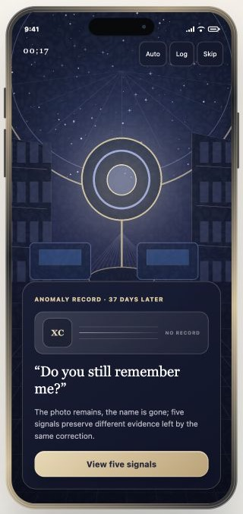
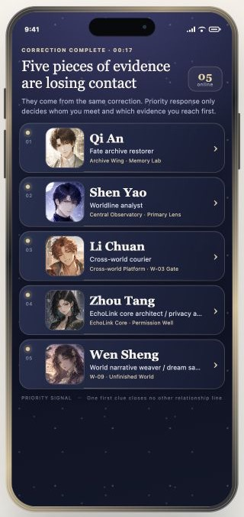
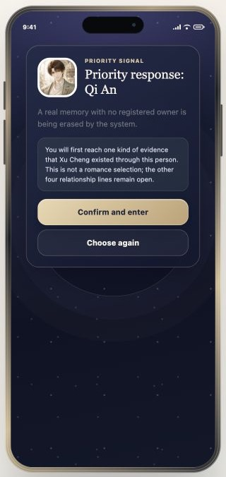
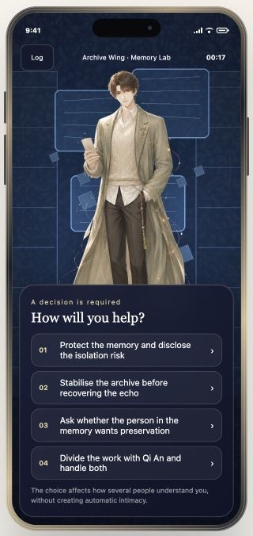
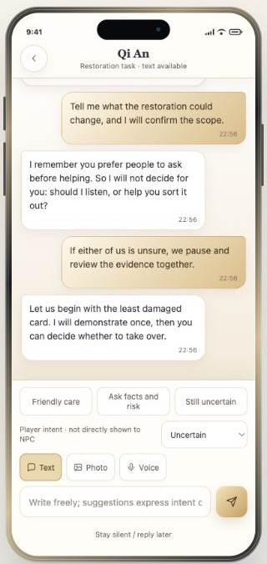
WALKTHROUGH · 01
First Contact — From Signal to Connection
The user experiences the crisis first, then builds a connection through choices and free-text communication.
1
Seventeenth Second
2
Five Distress Signals
3
Confirm Priority
4
Choose a Rescue
5
Establish Contact
Continue
Select Signal
Confirm & Start
Choose Rescue
The system introduces the observatory incident and its central mystery.
Five people appear, each tied to a different form of evidence.
Priority sets encounter order without closing any relationship path.
The system records preferences around risk, consent, and collaboration.
The character answers the user's intent and opens the contact channel.
EchoLoom · Latest Demo · 01/05
Notes:
[Sources]
- EchoLoom local interactive demo at http://127.0.0.1:5173, captured in English mode from the current repository build on 2026-08-05.
- Interface terminology and action paths verified against app/app.js and the current desktop demo navigator.
- Visual composition follows the user-supplied walkthrough-slide screenshot; no external product assets or claims were added.
[/Sources]

Slide 2
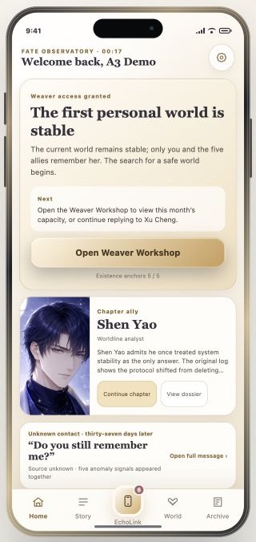
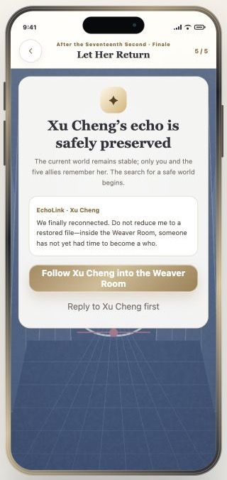
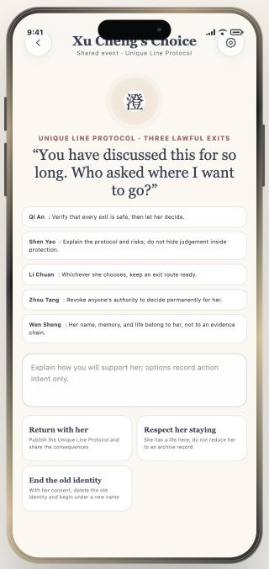
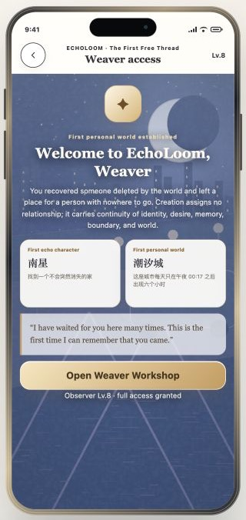
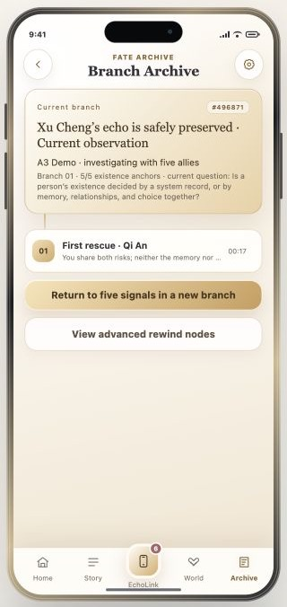
WALKTHROUGH · 02
Main Story — From Observatory to World Branch
Evidence, shared decisions, Weaver continuation, and recoverable branches form one continuous investigation.
1
Review Current Task
2
Confirm Outcome
3
Resolve Decision
4
Enter Weaver Arc
5
Save World Branch
Open Task
Follow Xu Cheng
Confirm Decision
Open Archive
The home screen brings together people, evidence, EchoLink, and story progress.
After five existence anchors are confirmed, Xu Cheng's echo is preserved.
The choice changes the branch without deciding on a character's behalf.
The system unlocks the first Echo character and personal world.
The outcome becomes a named, recoverable branch node.
EchoLoom · Latest Demo · 02/05
Notes:
[Sources]
- EchoLoom local interactive demo at http://127.0.0.1:5173, captured in English mode from the current repository build on 2026-08-05.
- Interface terminology and action paths verified against app/app.js and the current desktop demo navigator.
- Visual composition follows the user-supplied walkthrough-slide screenshot; no external product assets or claims were added.
[/Sources]

Slide 3
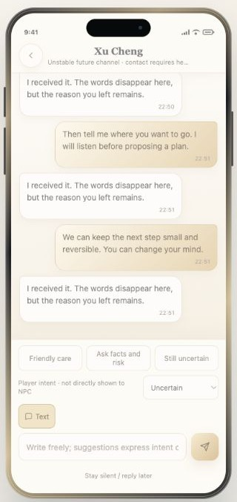
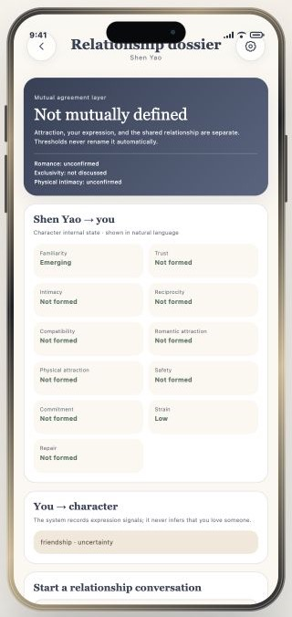
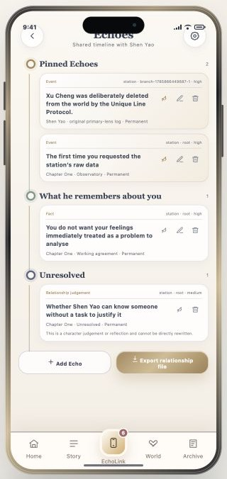
WALKTHROUGH · 03
Relationship System — EchoLink and Memory
Communication, relationship explanation, and memory control stay connected while preserving character boundaries and user agency.
1
Open EchoLink
2
Continue with Free Text
3
Review the Bond
4
Manage Memories
Open EchoLink
Continue Chat
Open Memories
The home screen shows asynchronous messages and unread state.
The character replies independently; silence and delayed replies remain valid.
The system explains change in natural language, not one affection score.
The user can pin, edit, delete, add, or export memories.
EchoLoom · Latest Demo · 03/05
Notes:
[Sources]
- EchoLoom local interactive demo at http://127.0.0.1:5173, captured in English mode from the current repository build on 2026-08-05.
- Interface terminology and action paths verified against app/app.js and the current desktop demo navigator.
- Visual composition follows the user-supplied walkthrough-slide screenshot; no external product assets or claims were added.
[/Sources]

Slide 4
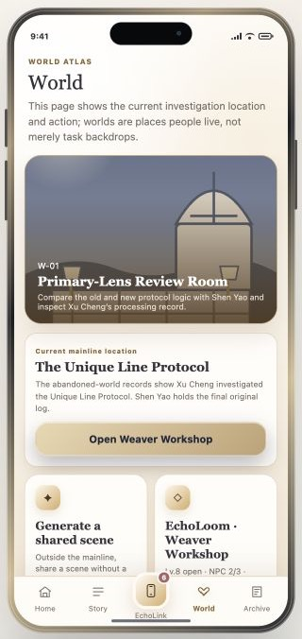
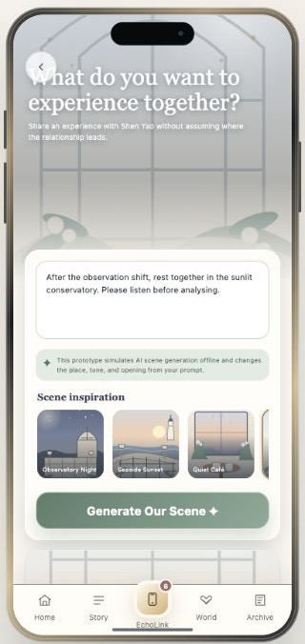
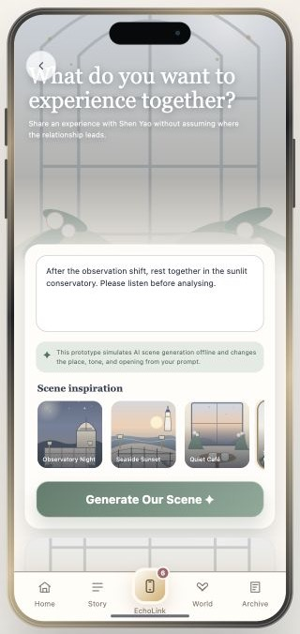
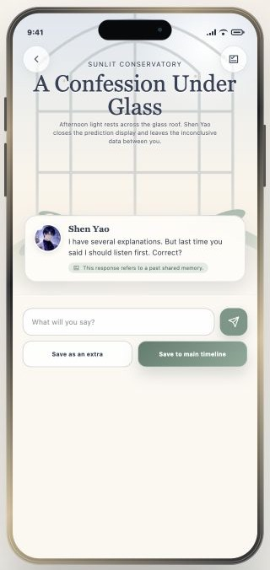
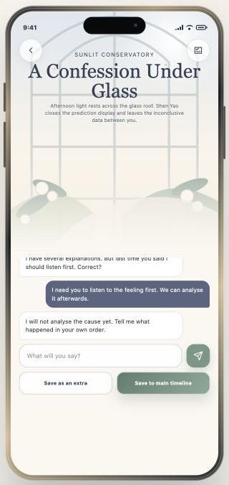
WALKTHROUGH · 04
AI Shared Scene — Generate and Continue
Free text stays available: AI creates an adjustable preview before the user enters and saves the scene.
1
Open Shared Scene
2
Describe the Experience
3
Review AI Preview
4
Confirm and Enter
5
Continue and Save
Open Shared Scene
Generate Scene
Confirm & Start
Continue Chat
The World page provides the current location and scene-generation entry point.
The user specifies location, atmosphere, and interaction boundaries.
The system explains its interpretation and supports natural-language revision.
The character opens consistently and references existing memory.
The user continues with free text, then saves to an Extra or the main timeline.
EchoLoom · Latest Demo · 04/05
Notes:
[Sources]
- EchoLoom local interactive demo at http://127.0.0.1:5173, captured in English mode from the current repository build on 2026-08-05.
- Interface terminology and action paths verified against app/app.js and the current desktop demo navigator.
- Visual composition follows the user-supplied walkthrough-slide screenshot; no external product assets or claims were added.
[/Sources]

Slide 5
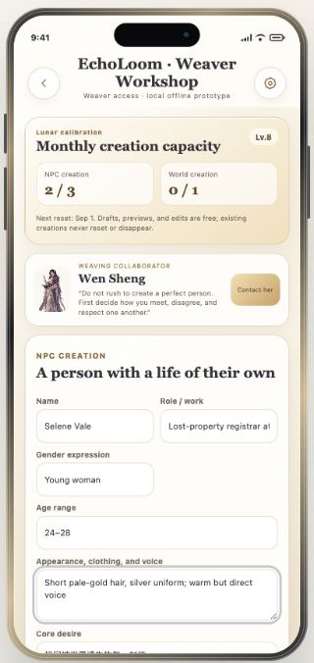
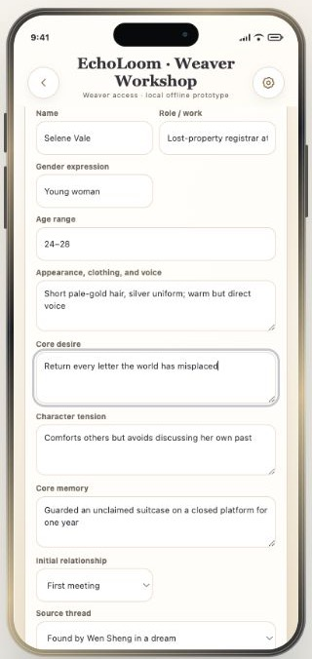
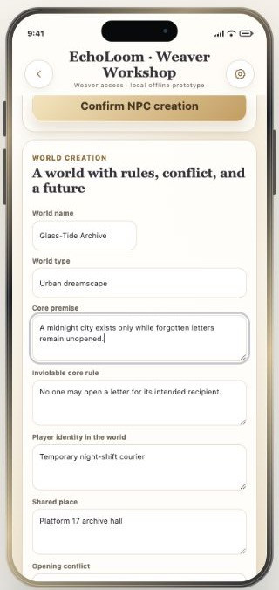
WALKTHROUGH · 05
Weaver Workshop — Character and World
Creation maintains identity, desire, memory, boundaries, and world rules—without guaranteeing romance.
1
Open Weaver Entry
2
Confirm Access
3
Review Existing Work
4
Define a Character
5
Define World Rules
Open Workshop
Enter Workshop
Edit Character
Continue to World
The World page shows the Weaver arc or the unlocked workshop.
The system explains the created character, world, and long-term responsibility.
Drafts and edits do not consume quota; created content does not reset.
The user sets identity, conflict, core memory, and relationship boundaries.
The user sets rules, role, conflict, and character-continuity mode.
EchoLoom · Latest Demo · 05/05
Notes:
[Sources]
- EchoLoom local interactive demo at http://127.0.0.1:5173, captured in English mode from the current repository build on 2026-08-05.
- Interface terminology and action paths verified against app/app.js and the current desktop demo navigator.
- Visual composition follows the user-supplied walkthrough-slide screenshot; no external product assets or claims were added.
[/Sources]

