Slide 1



Propose Title 1:
EGGPOINT: A LIGHTWEIGHT EDGE-AI SYSTEM FOR THE AUTOMATED CLASSIFICATION AND YIELD SUMMATION OF
MIXED SPECIES POULTRY
Group No.: 16 - BS CpE 4B
Group Members:
Shanice C. Omalsa
Arjole Jan B. Fostanes
Jhay Ann B. Remoreras
James Carl M. Osio

Slide 2

INTRODUCTION
The poultry industry is an important contributor to food production and rural livelihoods, with duck and quail farming serving as significant sectors of the egg industry. In the Philippines, duck eggs are widely produced for balut, where eggs incubated for 16 to 18 days are considered the optimal stage for harvesting, while quail production depends on accurate fertility assessment to improve hatchability and breeding efficiency. Both industries commonly employ manual candling, a non-destructive inspection method used to observe embryo development and determine fertility. However, this process is labor-intensive, time-consuming, and highly dependent on the experience of the inspector, often resulting in inconsistent and subjective classifications.
Recent advances in computer vision and deep learning have demonstrated the potential of automated candling systems for improving egg inspection. Cai et al. (2025) developed a deep learning-based machine vision system for distinguishing unfertilized, live embryonated, and abnormal eggs, demonstrating the potential of deep learning for accurate and automated duck egg inspection. Similarly, studies on quail eggs have shown that artificial intelligence can effectively analyze egg images for automated inspection. Nakaguchi et al. (2022) utilized deep learning with thermal imaging to perform non-destructive quail egg assessment, while Yildiz et al. (2025) demonstrated that machine learning algorithms can accurately classify quail egg characteristics, highlighting the applicability of artificial intelligence in quail egg production.
Despite these advancements, existing automated egg inspection systems primarily focus on a single poultry species or a single classification task. Studies involving duck eggs generally concentrate on embryo development or hatching status, whereas research on quail eggs has largely emphasized egg quality and freshness, with limited work on automated fertility detection using candling images.

Slide 3
DIFFERENTIATION/ GAPS
NEEDS
Reduce manual inspection: Minimize dependence on visual judgment during egg candling.
Improve classification: Accurately identify duck incubation stages and quail egg fertility.
Enable offline operation: Reduce reliance on internet connectivity and external computing resources.
Simplify monitoring: Automatically record and summarize egg classification results.
SOLUTIONS
Automated Candling: Uses a camera and controlled lighting to capture candled egg images.
Deep-Learning Classification: Classifies duck eggs by incubation stage and quail eggs by fertility.
Edge-AI Processing: Performs image processing and classification locally using a Raspberry Pi.
Yield Summation: Automatically records classification results and generates production summaries.
DIFFERENTIATION
Mixed-Species: Combines duck and quail egg inspection in one system.
Multi-Task Classification: Identifies duck incubation stages and quail egg fertility.
Offline-Capable: Performs processing locally without depending on cloud services.
Lightweight Platform: Uses a Raspberry Pi for affordable and portable deployment.
Integrated Monitoring: Combines egg classification with automated yield recording and summarization.
IMPACT
Reduced Workload: Minimizes repetitive manual inspection and counting.
Consistent Classification: Provides standardized image-based egg assessment.
Portable Inspection: Supports egg assessment using a compact embedded platform.
Improved Monitoring: Provides organized classification records and production summaries.
Practical Application: Supports poultry and balut producers in monitoring egg production.

Slide 4
DIFFERENTIATION TABLE
Features / Methods | Cai et al. (2025) | Nakaguchi & Ahamed (2022) | Nakaguchi et al. (2024) | Lubich et al. (2019) | Saha et al. (2023)
F1: Camera-Based Inspection | ✓ | ✓ | ✓ | ✓ | ✓
F2: Duck Egg Classification | ✓ |  |  | ✓
F3: Incubation-Stage Classification | ✓
F4: 16-, 17-, 18-Day Classification
F5: Quail Egg Assessment |  | ✓ | ✓
F6: Fertility Classification |  | ✓*
F7: Deep Learning | ✓ | ✓ | ✓ | ✓ | ✓
F8: Edge/Raspberry Pi Deployment |  |  |  |  | ✓
F9: Offline/Local Processing |  |  |  | ✓ | ✓
F10: Automated Yield Summation

Slide 5
SOP
How can the researchers design and develop a lightweight Edge-AI system capable of acquiring and processing candled images of duck and quail eggs for incubation-stage and fertility classification?
How can the researchers develop and implement a deep-learning pipeline for classifying duck eggs according to 16-, 17-, and 18-day incubation stages and determining the fertility of quail eggs from candled images?
How can the performance of the developed EggPoint system be evaluated in terms of classification accuracy and production-yield recording during actual poultry egg inspection?

Slide 6
OBJECTIVES
General Objective
The primary objective of this study is to design, develop, and evaluate EggPoint, a lightweight Edge-AI system that uses computer vision and deep learning to process candling images of duck and quail eggs, classify duck eggs according to their 16-, 17-, and 18-day incubation stages, determine quail egg fertility, and record and summarize egg inspection results.
Specific Objectives
1.To design and develop a portable Edge-AI system capable of capturing and processing candling images of duck and quail eggs for automated inspection.
2.To implement a deep-learning model for classifying duck eggs according to their 16-, 17-, and 18-day incubation stages and determining the fertility status of quail eggs using candling images.
3.To evaluate the developed EggPoint system in terms of classification accuracy and its ability to record and summarize egg inspection.

Slide 7
METHODOLOGY
Introduction
This chapter presents the methodology used to develop and evaluate EggPoint: A Lightweight Edge-AI System for the Automated Classification and Yield Summation of Mixed Species Poultry (Ducks and Quail). It describes the research design, system development, dataset collection, AI model training, system testing, and performance evaluation to ensure the proposed system achieves accurate and reliable egg classification.
Research Design
Dataset Collection
Quantitative developmental research approach covering hardware, software, image-processing, and deep-learning components.
Labeled candling image datasets for duck eggs (Days 16, 17, 18) and quail eggs (fertile and infertile).
AI Model Training
Performance Evaluation
Lightweight deep learning model trained and deployed for on-device classification via Edge-AI processing.
Classification accuracy and yield-recording performance measured through controlled experimental testing.

Slide 8
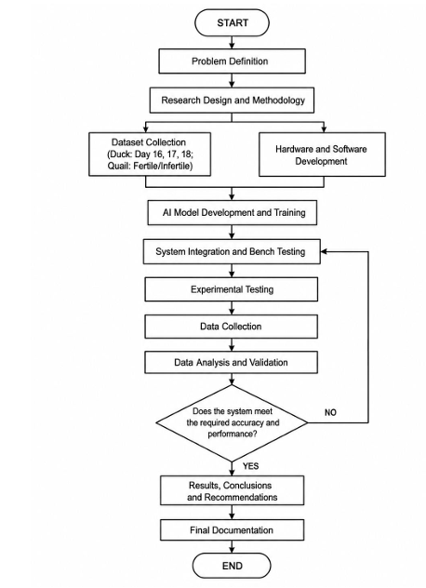
Research Process Flowchart
The research follows a structured process beginning with Problem Definition, followed by Research Design and Methodology. The project then proceeds into two parallel activities: Dataset Collection (duck eggs Days 16, 17, and 18; quail eggs fertile and infertile) and Hardware and Software Development. These phases converge in AI Model Development and Training, followed by System Integration and Bench Testing, Experimental Testing, Data Collection, and Data Analysis and Validation. Performance evaluation determines whether the system meets required accuracy criteria, with iterative refinement if needed, before proceeding to Results, Conclusions, and Recommendations.

Slide 9
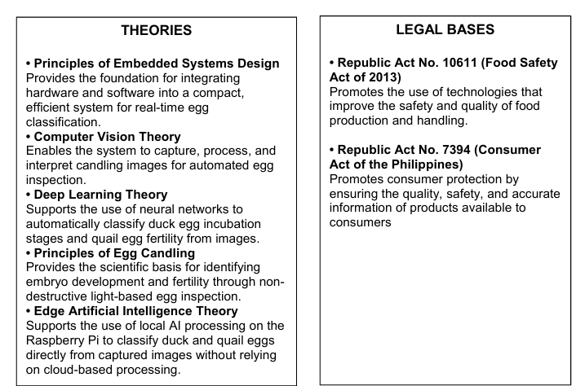
THEORETICAL FRAMEWORK
The theoretical foundation of this study combines the principles of embedded systems, computer vision, deep learning, Edge Artificial Intelligence, and poultry egg candling. Embedded systems provide the basis for integrating hardware and software into a dedicated and portable device, with the Raspberry Pi serving as the computing platform for image processing and Edge-AI classification

Slide 10
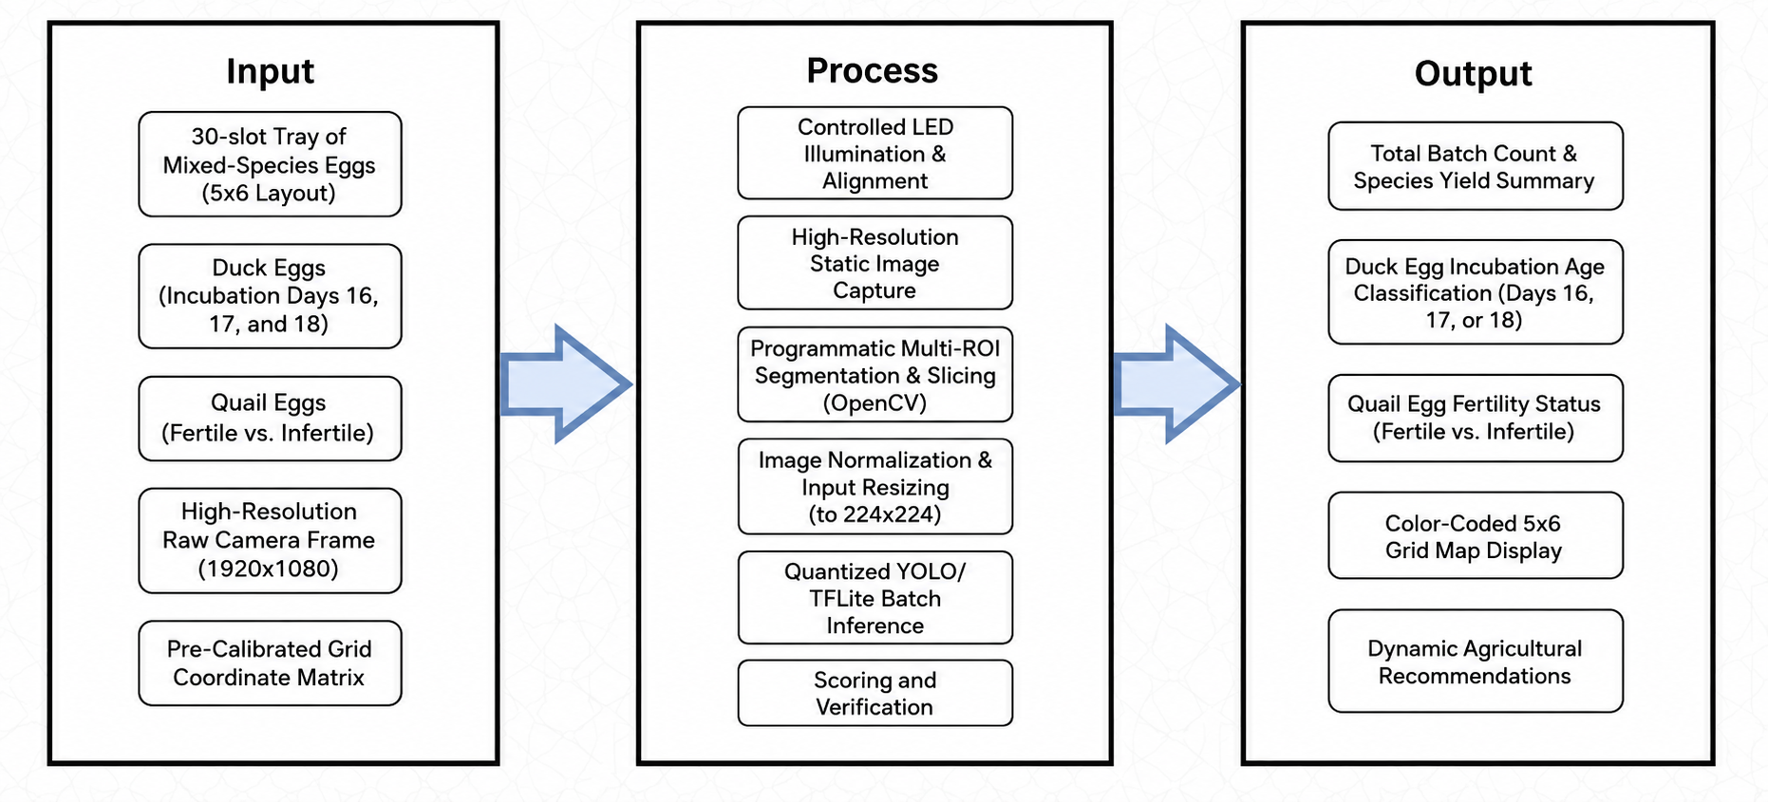
INPUT-PROCESS-OUTPUT
Input–Process–Output (IPO) model

Slide 11
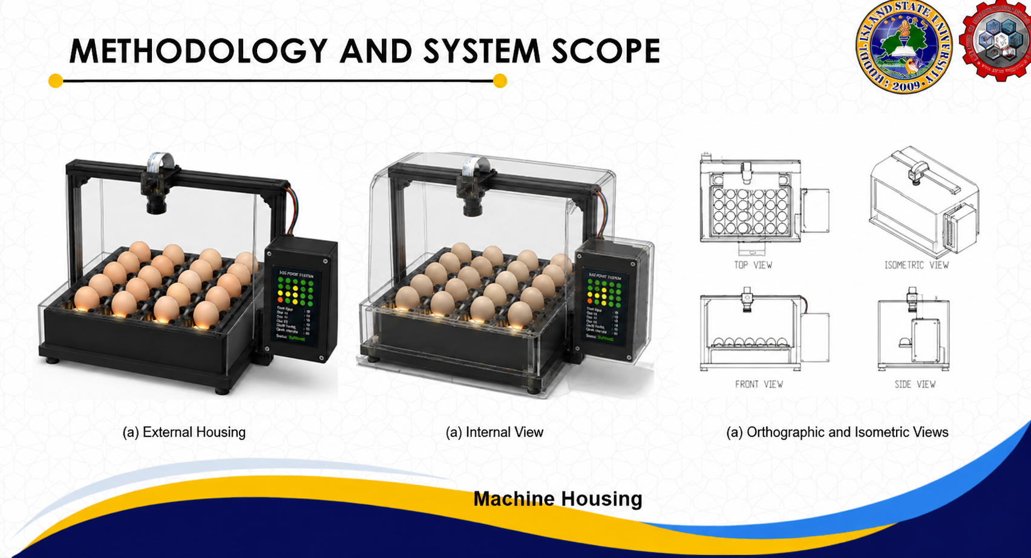
METHODOLOGY AND SYSTEM SCOPE
(a) External Housing
(a) Orthographic and Isometric Views

Slide 12
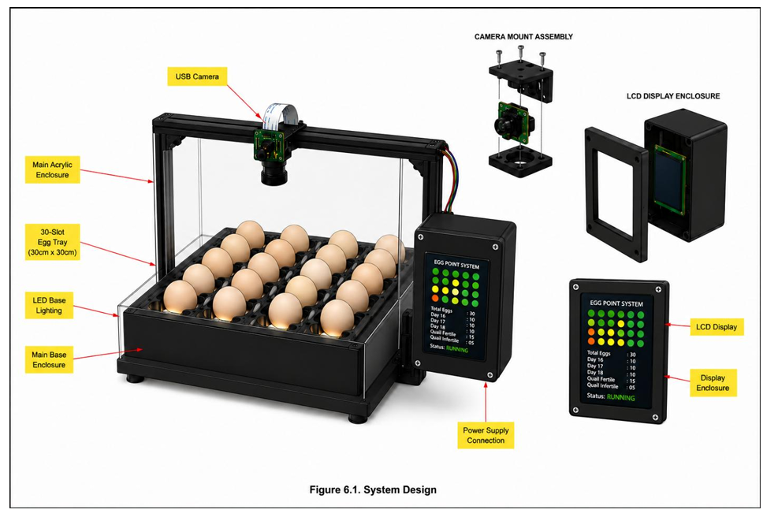
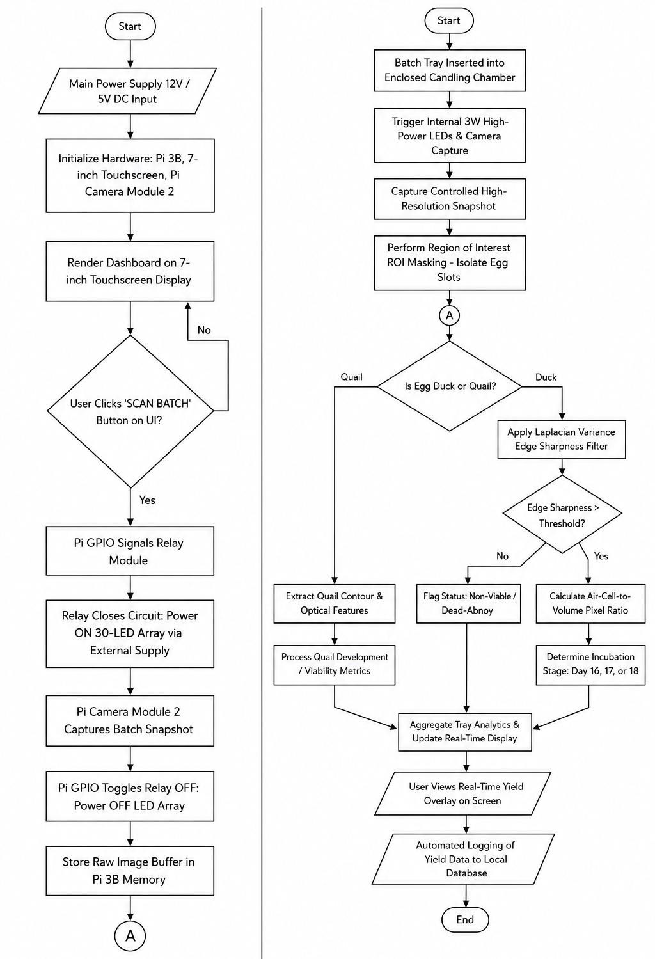
METHODOLOGY AND SYSTEM SCOPE
System Flowchart
System Design

Slide 13
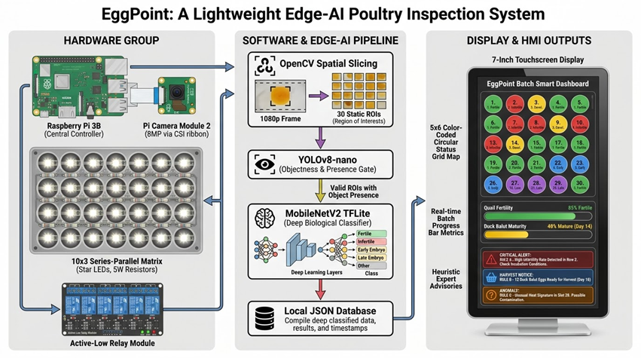
SYSTEM HARDWARE
System Architecture

Slide 14
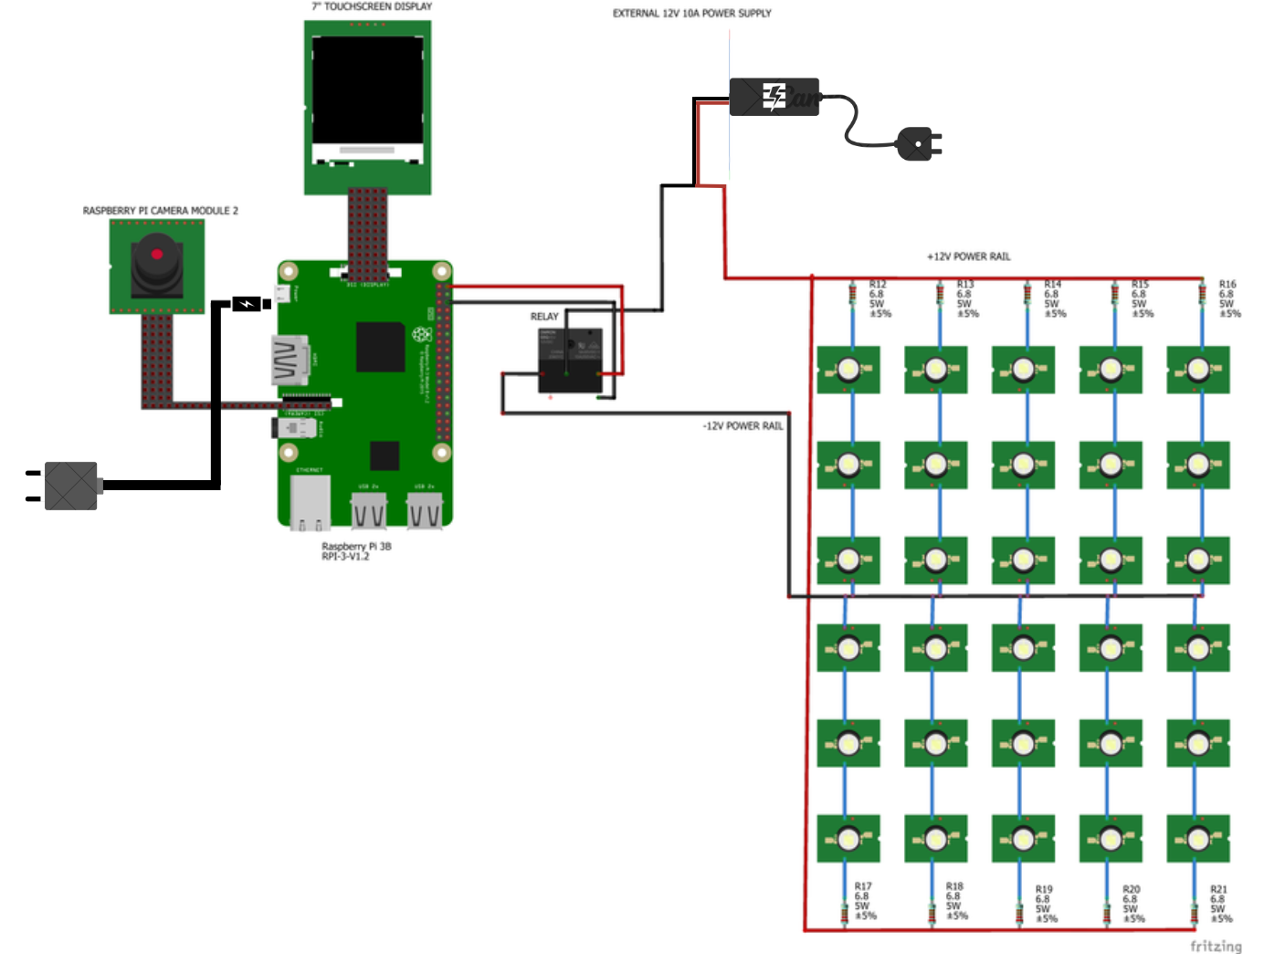
SYSTEM HARDWARE
Circuit Diagram

Slide 15
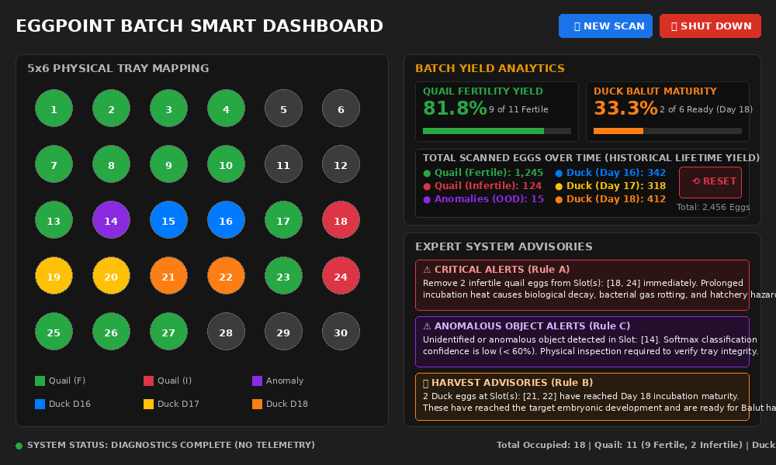
G raphical UI
a single-screen, localized, and high-contrast Human-Machine Interface (HMI) smart dashboard

Slide 16
THANK YOU
Group No.16 - BSCpE 4B
Shanice C. Omalsa
Arjole Jan B. Fostanes
Jhay Ann B. Remoreras
James Carl M. Osio

