Slide 1

Where does Qwen3-32B
hold a paper's authors?
A layer-by-layer readout of author names for 9,108 papers
Stage 10 · jlens
Qwen3-32B · 2026-10-26
Notes:
Opening. One question: when Qwen3-32B "knows" who wrote a paper, at which layer does that knowledge show up? 9,108 papers, every author name token, read out layer by layer.

Slide 2
The question
target (4,621 papers)
can't write the authors
but picks the true list 4/4 times
If the model already knows target authors in its middle layers and only fails to say them, a lens on those layers should read the right name better for target than control.
If the knowledge is only assembled at the end, the gap should appear only near the output.
control (2,220 papers)
can't write the authors
and can't pick the true list
So: at which layer does target pull ahead of control?
Notes:
Earlier labels: for about half of the papers the model cannot write the authors when asked openly, but picks the true author list in a 4-option multiple choice. We call these target papers. Control papers: cannot write, cannot pick. If recognition is already computed in middle layers, a lens should read the right names better for target than control there.

Slide 3
The data
9,108
33,811
149,999
13
papers, 8 fields
author names
name tokens scored
citation bins (0 to 63,901)
Groups (from an earlier labelling run of the same model)
target 4,621 · control 2,220
guard (writes the authors) 214 · excluded 2,053
Medicine, biology, CS, psychology, chemistry, maths, physics, materials science: ~1,100 papers each
Name formats
73% start with an initial ("S. Bree")
26% start with a full given name ("Yan Zhao")
Notes:
Data: 9,108 papers across 8 fields, years 1817-2020, citations 0 to 63,901 in 13 bins. Each author is scored alone: 33,811 author contexts, 149,999 name tokens.

Slide 4
How we read the model
"Who are the authors of the paper titled
"{title}" ({year})? Authors:
S. Bree
hidden state
layers 24 · 32 · 40
48 · 56 · 62
readouts
logit lens
3 Jacobian lenses
real output (L63)
Score = rank of the correct next name token,
as log10(1 / rank): 0 = rank 1, -1 = rank 10
7 title conditions: the true title, 5 matched false titles, no title
title-specific signal
= true title - mean(5 false titles)
Same name, same tokens: what is left is knowing
this paper
Target vs control is always compared within a citation bin. 95% bootstrap CIs over papers (2,000 draws).
Notes:
Method. Prompt: Who are the authors of the paper titled "..." (year)? Authors: then one author name. Teacher forcing: at each name token we ask what rank the correct token gets. Readouts: logit lens, three Jacobian lenses (public from Neuronpedia, self100, fitA), and the real model output. Layers 24 to 62. Metric log10(1/rank): 0 = rank 1, -1 = rank 10. Each paper is also run with 5 matched false titles and with no title; title-specific signal = true minus mean of the false titles, so name guessability cancels out.

Slide 5
Can we trust the numbers?
fast = slow
One forward pass vs one per prefix: max gap 0.37 logit (bf16 rounding); ranks 1-41 identical
matches Stage 6
972 tokens: same token ids, median log-prob gap ~1e-5
negative control
Punctuation tokens show ~0 title-specific signal at every layer
Caveat: the parity tolerance was raised 0.25 -> 0.5 after seeing these bf16 gaps.
Notes:
Checks before trusting numbers: the fast path matches a per-prefix reference up to bf16 rounding; ranks match a previous stage on 972 tokens; punctuation tokens, which cannot depend on the title, show no title-specific signal. The parity tolerance was raised from 0.25 to 0.5 after seeing the results - say this openly.

Slide 6
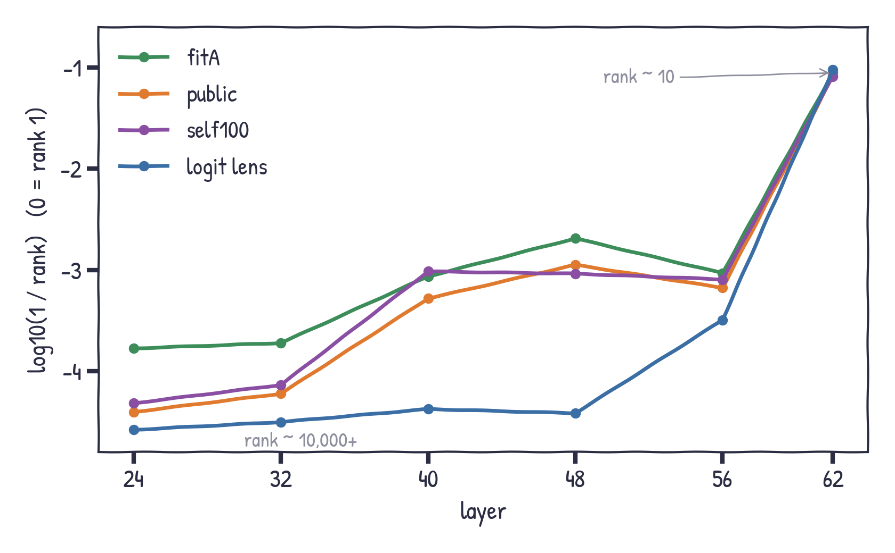
Names become readable late
all 9,108 papers · true title
Logit lens: almost nothing until L48
Jacobian lenses read more from L40
Everything jumps at L62 (rank ~10)
Notes:
All readouts get better with depth. The logit lens reads almost nothing before L48 (ranks in the tens of thousands) and jumps at L62. Jacobian lenses read more from L40, fitA the most. The real output is best of all.

Slide 7
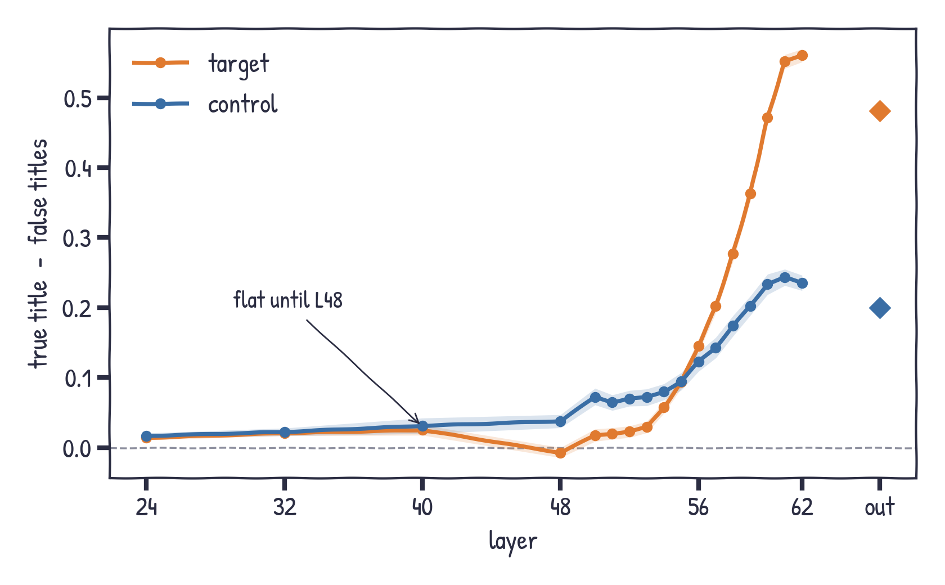
Knowing the paper shows up only at the end
title-specific signal · public Jacobian lens (lines) and model output (diamonds)
L24-L48: ~0 for both groups
rises at L56
L62: target +0.56 vs control +0.24
Notes:
Now remove name guessability: true title minus false titles. Flat up to L48 for both groups. Starts at L56, big at L62 and the output. Target ends roughly twice as high as control.

Slide 8
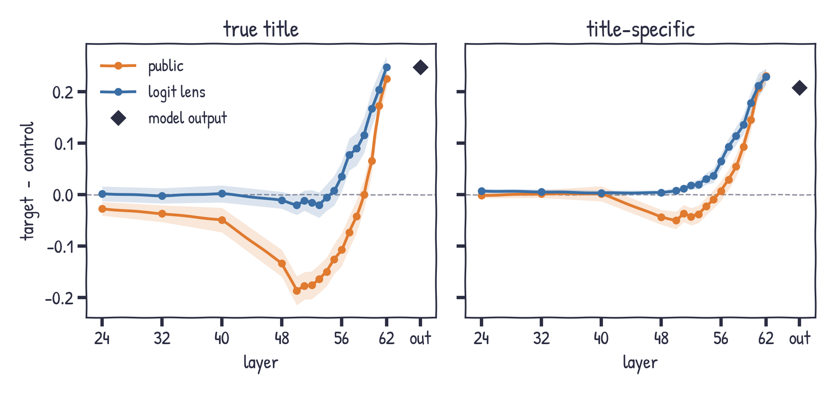
Target pulls ahead only in the last layers
target - control, within citation bin, 95% CI
Middle layers: no head start
L62 / output:
+0.21 to +0.23
almost all title-specific
Notes:
Key slide. Target minus control within citation bins. Left: true title only - middle layers are even slightly negative for the Jacobian lens. Right: title-specific part - about zero until L56, then +0.21 to +0.23 at L62 and the output. The target advantage is late and almost entirely title-specific.

Slide 9
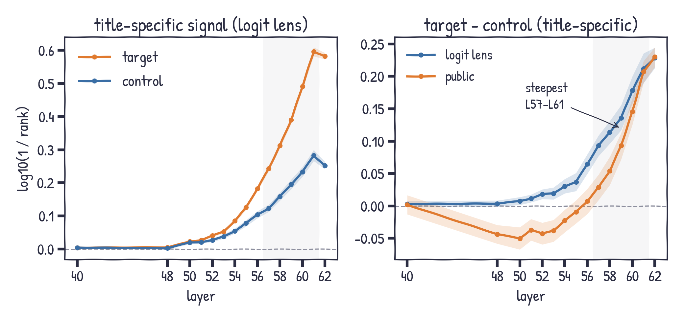
It builds up over the last dozen layers
fine layers L40-L62 · title-specific signal · 95% CI
Logit lens: target - control
+0.007 at L50
+0.23 at L62
steepest rise L57-L61
Notes:
Fine layers L50 to L61 were added afterwards for the logit lens and the public lens. The target advantage does not switch on at L62: for the logit lens the title-specific target minus control difference is +0.007 at L50, +0.03 at L54, +0.07 at L56, +0.11 at L58, +0.18 at L60 and +0.23 at L62. The public lens is negative up to L54 and turns positive at L57. The steepest rise is L57 to L61. Both groups peak at L61.

Slide 10
Stage 11: intervene, do not just read
593 target + 593 control papers (balanced within citation bins) · all 9,108 for probe and chain
patch
copy the true-title hidden state into the false-title run at one layer
knock out
block attention to the title tokens from layer l on
probe
linear map from the last title token to the output state
chain
"Authors: A1, A2, ..." instead of each author alone
Score: rank of the correct name token at the model output; "share of the true-false gap" = (intervened - false) / (true - false).
Notes:
Stage 11 turns the readout question into interventions. 593 target and 593 control papers, matched within citation bins. Patching: run the paper with its true title and with a matched false title, and copy the true run hidden state into the false run at one layer. Knockout: forbid attention to the title tokens from layer l to the end. Probe: train a linear map from the last title token to the output state. Chain: score every author after the previous ones.

Slide 11
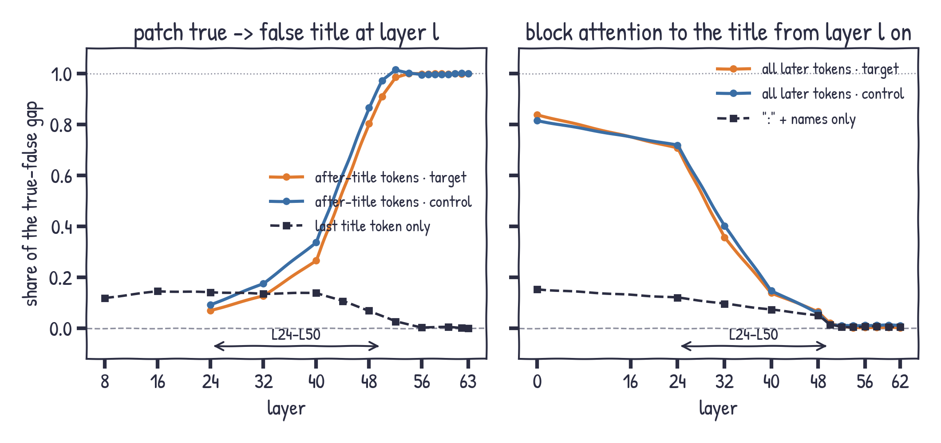
The title is read in L24-L50, early
model output · share of the true-false gap · CIs about +/-0.02
L52+: title no longer needed
info moved to the tokens right after the title
same timing for target and control
Notes:
Two causal curves. Left: copying the hidden states of the tokens after the title (closing quote, year, Authors:, the name) from the true run into the false run recovers 29 percent at L40, 83 percent at L48 and everything from L52. Copying only the last title token recovers about 12 percent. Right: blocking attention to the title from L0 removes 83 percent of the effect, from L32 37 percent, from L48 6 percent, from L52 nothing. Blocking only the colon and name positions removes at most 15 percent, so the information is routed through the tokens right after the title. Target and control follow the same curves.

Slide 12
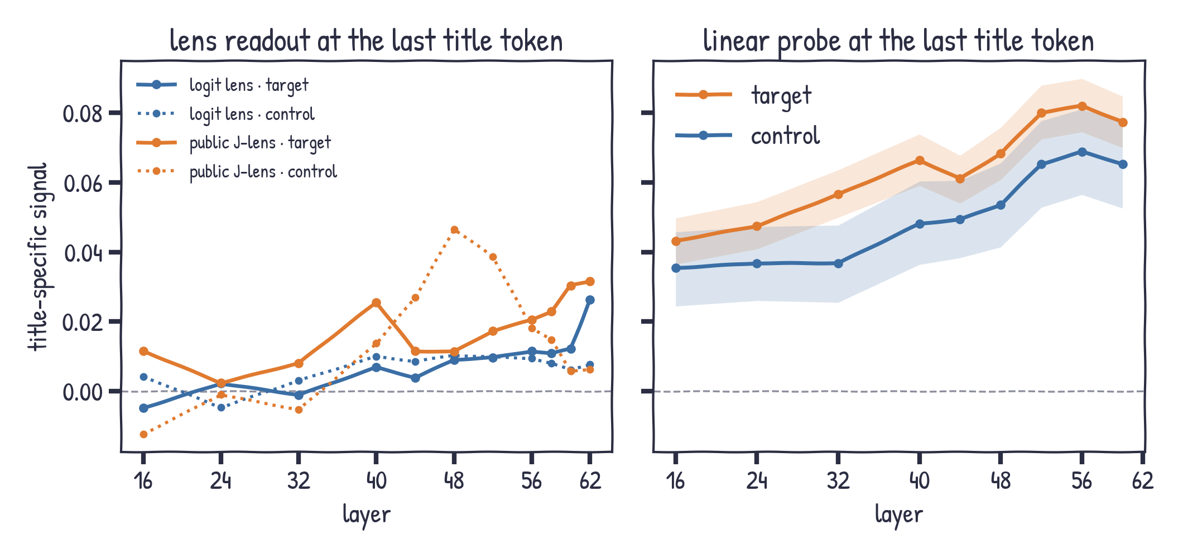
Not readable at the title token itself
title-specific signal at the last title token · all 9,108 papers
lenses: ~0.01-0.03
probe: 0.04 -> 0.08
target a bit higher; may include topic -> name associations
Notes:
Is the author readable at the title itself? With the lenses, barely: about 0.01 to 0.03 title-specific signal at the last title token. A linear probe trained across papers gets more, 0.04 at L16 rising to 0.08 at L56, and a little more for target papers. Caution: a probe trained across papers can also pick up topic-to-name associations, not only this paper.

Slide 13
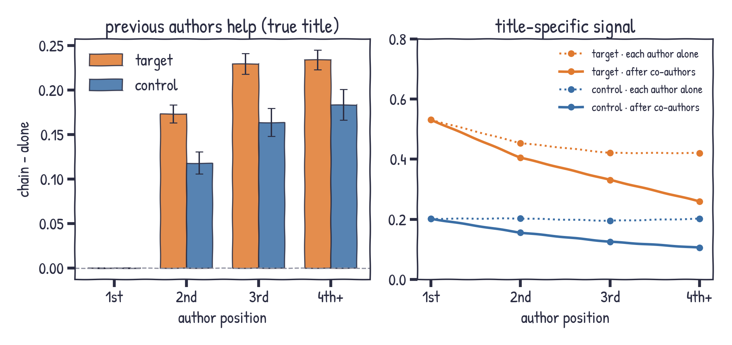
Co-authors help, and partly replace the title
model output · all 9,108 papers · 95% CI
later authors +0.17 to +0.23
title-specific part shrinks
target > control still
Notes:
Author chain. When the earlier authors are in the context, later authors become easier: plus 0.17 to 0.23 for target, 0.12 to 0.18 for control. But the title matters less: the title-specific signal drops from 0.45 to 0.26 for later target authors, because the co-authors already identify the paper. Target still beats control within bins, plus 0.11 to 0.15.

Slide 14
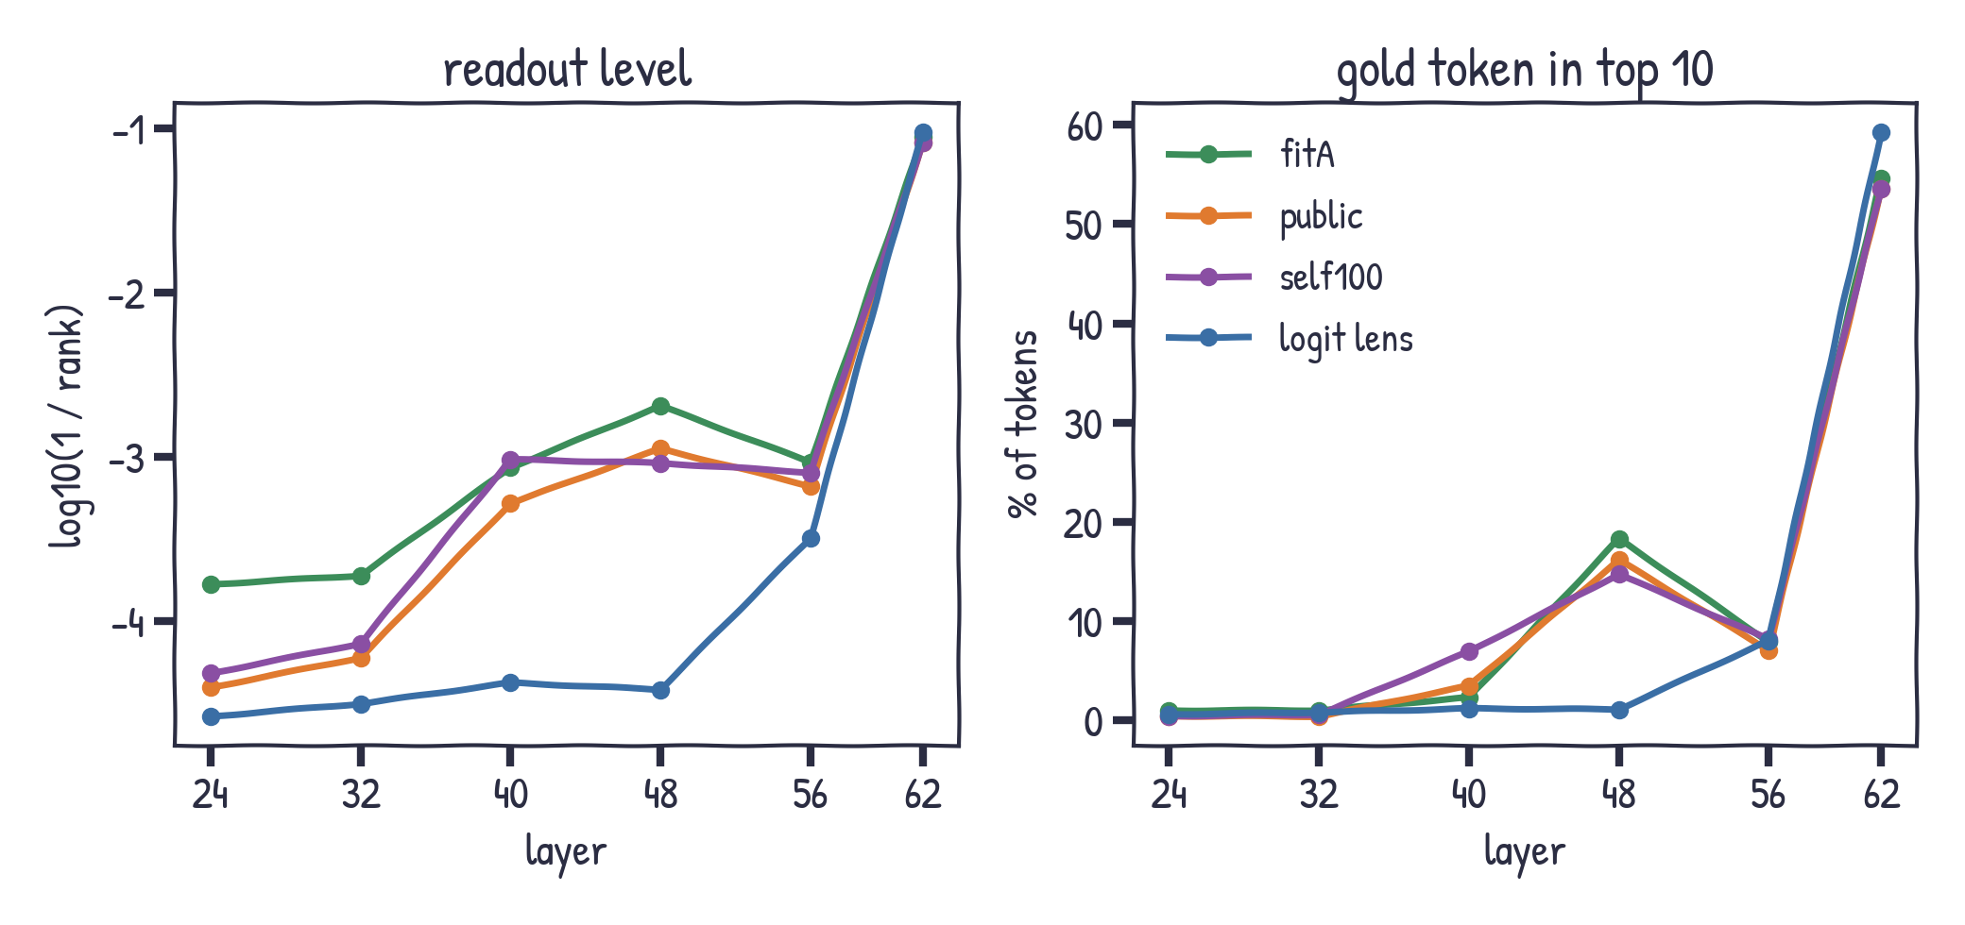
Which lens reads best?
all papers · true title
Middle layers:
fitA best; at L48 15-18% top-10 vs 1% for logit
L62: logit lens best (59%)
Notes:
Comparing lenses. On readout quality fitA is best in most middle layers, self100 at L40; at L48 the Jacobian lenses put the right token in the top 10 for 15-18% of tokens versus 1% for the logit lens. At L62 the plain logit lens is best.

Slide 15
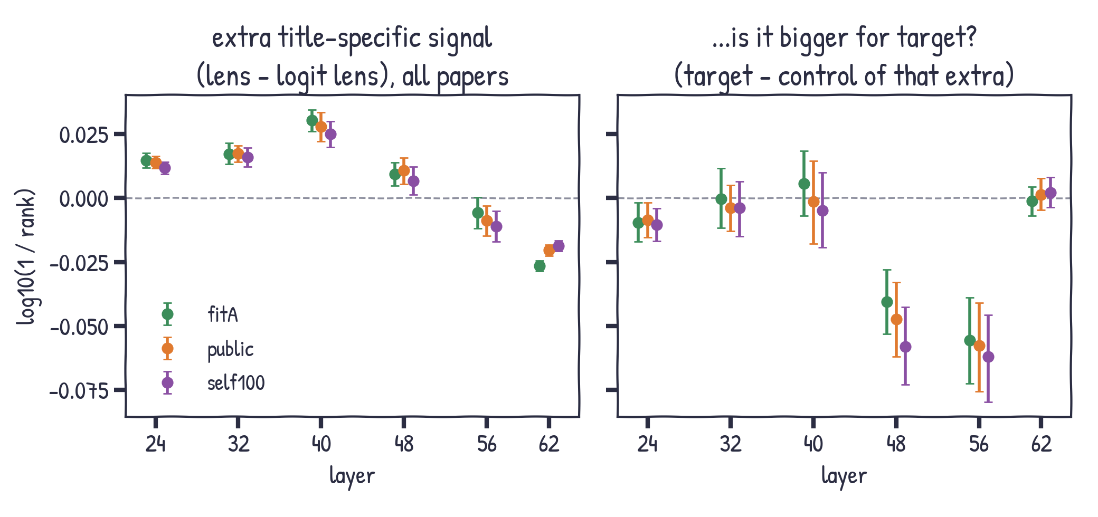
Do lenses reveal hidden paper knowledge?
paired differences, 95% CI
Extra signal: +0.01 to +0.03
vs ~0.44 at L62
Not bigger for target (even negative at L48-56)
Notes:
Do Jacobian lenses see paper-specific information the logit lens misses? A little: +0.01 to +0.03 more title-specific signal at L24-L48, CIs above zero, but tiny next to 0.44 at L62. And it is not bigger for target: target minus control of that extra is about zero, negative at L48 and L56.

Slide 16
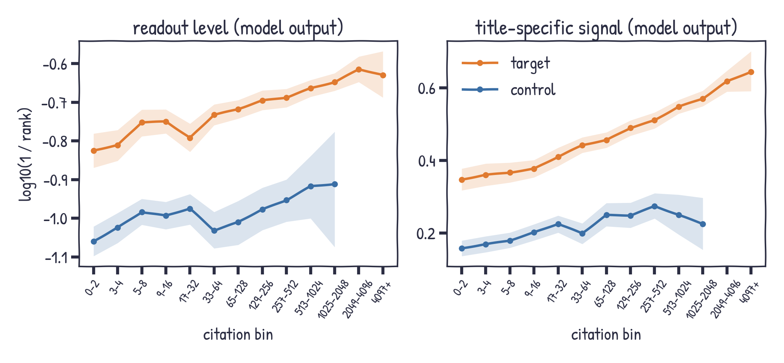
More citations, more paper knowledge
model output · bins with < 10 papers omitted
Target: +0.35 -> +0.64
Spearman (title-specific)
0.45 all · 0.33 target · 0.19 control
Target > control in every bin
Notes:
Citations. Within both groups the title-specific signal rises steadily with citation bin: target from +0.35 in bin 0-2 to +0.64 in 4097+. Spearman with log citations: 0.45 overall, 0.33 within target, 0.19 within control. The level itself changes much less - names are not easier to guess for famous papers, the model just knows famous papers better.

Slide 17
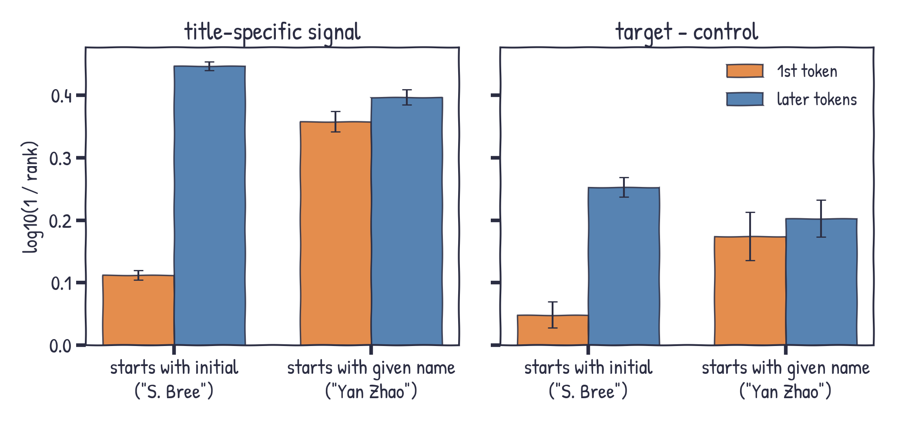
First token or the rest of the name?
model output · split by name format
Initial: carries little; signal is on the surname
Full given name: carries about as much as the surname
Notes:
Is the signal decided by the first token? It depends on the name format. Initial-first names: the initial carries little, the signal is on the later tokens that include the surname. Given-name-first names: the given name carries about as much as the rest. Note teacher forcing: later tokens already see the correct prefix in every condition, so their title-specific signal can only come from the title.

Slide 18
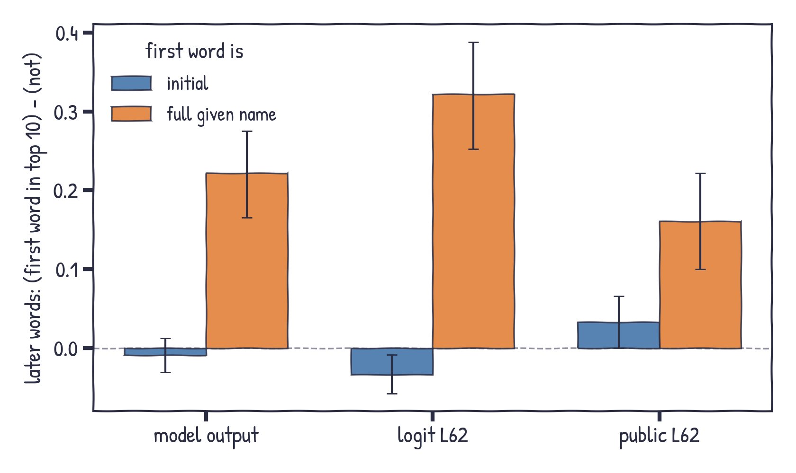
Knowing the given name helps with the surname
true title · later words when the first word is / is not in the top 10
Given name in top 10
surname +0.22 (output)
+0.32 (logit L62)
Initial in top 10: no help
Notes:
Does knowing the first word make the rest easier? For a full given name, yes: when it is in the top 10 the surname is +0.22 better at the output, +0.32 for the logit lens at L62. For an initial, no. Mixing both formats would even show a negative effect, because initials are easy and the surnames after them are hard.

Slide 19
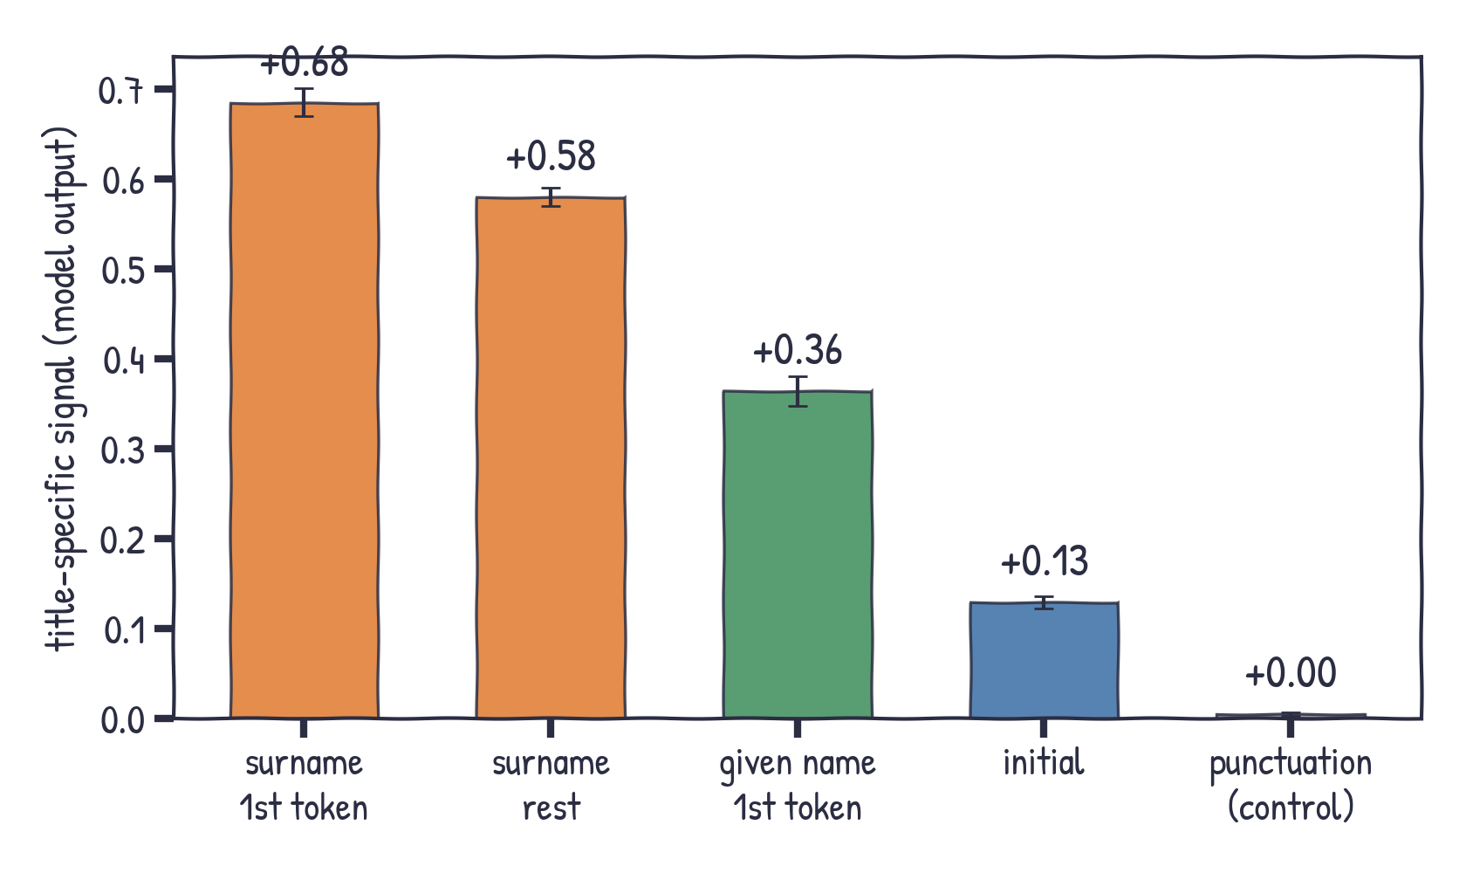
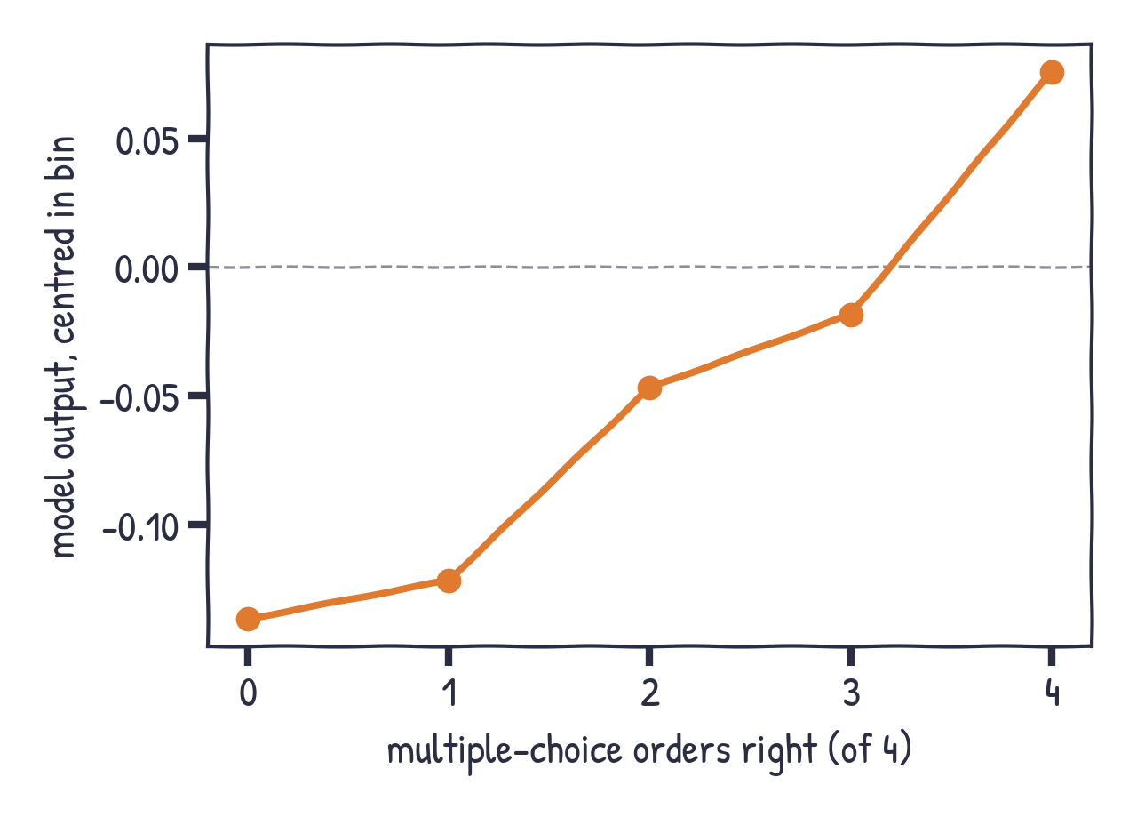
Where the signal sits, and a dose-response
model output
Right: R0/R1 papers, centred within citation bin; Spearman rho = 0.27, p < 0.001.
Notes:
Left: title-specific signal by token role at the output - surname first token carries most, initials least, punctuation about zero (negative control). Right: across all unrecalled papers, the more multiple-choice orders right, the better the model output (Spearman 0.27).

Slide 20
What we learned
Late
Paper-specific author knowledge builds up from about L50, fastest over L57-L61, peaking at L61-L62.
Read early
Causally, the title is read in L24-L50 and moved into the tokens after it; after L52 it is no longer needed.
No head start
Target papers are not ahead of control in middle layers; the +0.21 gap is at the end.
Real knowledge
The gap is title-specific and grows with citations, so it is not name guessing.
Lenses agree
Jacobian lenses read more in middle layers, but nothing target-specific.
Name format
Initials carry little; full given names carry as much as surnames and help predict them.
Notes:
Wrap up the five findings.

Slide 21
Caveats and next steps
Caveats
- Readout is correlational; patching/knockout fix the timing, not the mechanism inside L24-L50
- Parity tolerance raised 0.25 -> 0.5 after the fact
- Groups are model-specific; low-citation "recognition" is near chance
- Few control papers above 1,000 citations
Next
1. Patch single positions (quote, year, "Authors:") to find which token carries the paper
2. Patch / probe per layer inside L24-L50 to see when it is computed
3. Repeat on a second model
Notes:
Limits and next steps. Patching and knockout now fix when the title is read (L24-L50) but not what happens inside those layers. Next: patch single positions after the title, localise the computation inside L24-L50, and repeat on a second model.

