Slide 1

Where does Qwen3-32B
hold a paper's authors?
A layer-by-layer readout of author names for 9,108 papers
Stages 10-11 · jlens
Qwen3-32B · 2026-10-27
Notes:
Opening. One question: when Qwen3-32B "knows" who wrote a paper, at which layer does that knowledge show up? 9,108 papers, every author name token, read out layer by layer.

Slide 2
Stage 10
The question
target (4,621 papers)
can't write the list (R0/R1)
but picks the true list 4/4 times
If the model already knows target authors in its middle layers and only fails to say them, a lens on those layers should read the right name better for target than control.
If the knowledge is only assembled at the end, the gap should appear only near the output.
control (2,220 papers)
can't write the list (R0/R1)
and can't pick the true list
So: at which layer does target pull ahead of control?
Notes:
Earlier labels: for about half of the papers the model cannot write the author list when asked openly (R0: no true author, or R1: a few right but HR2 above 0.5), but picks the true author list in a 4-option multiple choice. We call these target papers. Control papers: cannot write, cannot pick. If recognition is already computed in middle layers, a lens should read the right names better for target than control there.

Slide 3
Stage 10
The data
9,108
33,811
149,999
13
papers, 8 fields
author names
name tokens scored
citation bins (0 to 63,901)
Source: the Dreaming Up Authors evaluation set. 9,999,863 random OAG v2 records + Semantic Scholar metadata (Sep 2025) -> quality filters -> 1.92 M papers -> up to 100 per field x citation bin
Groups (group lead's labelling run, same model)
target 4,621 · control 2,220
guard (writes the authors) 214 · excluded 2,053
Medicine, biology, CS, psychology, chemistry, maths, physics, materials science: ~1,100 papers each
Name formats
73% start with an initial ("S. Bree")
26% start with a full given name ("Yan Zhao")
Notes:
Data: the evaluation set of the Dreaming Up Authors study, reused as is. It started from 9,999,863 random OAG v2 records, enriched with Semantic Scholar (citations, canonical names, fields, September 2025) and filtered: journal and conference papers, 1 to 19 authors, English (FastText at least 0.8), clean person names, title and first-author surname agreeing between OAG and Semantic Scholar. 1.92 million papers remained. 8 fields chosen by frequency (77 percent of the data), 13 exponential citation bins, up to 100 papers per field and bin: 9,108 papers. Each author is scored alone: 33,811 author contexts, 149,999 name tokens.

Slide 4
Stage 10
How groups and contrasts are built
labels: group lead's pipeline on the same Qwen3-32B · we use them unchanged
open answer -> R0 / R1 / R2
greedy, chat template
fuzzy name match: M, H, U
HR2 = (H+U) / (M+H+U)
R2: HR2 <= 0.5 · R0: M = 0 · R1: M > 0
a fixed rule, no human or model judge
multiple choice -> target / control
true list + 3 real teams of other papers
(same field, team size, citation bin, ~year)
4 orders · p(letter) from next token
target: 4/4 and mean p(true) >= 0.5
control: <= 1/4
5 false titles per paper
same field, own year kept
min-cost on |dyear|/5 + |dauthors|
+ |dtitle tokens| + 1.5 |dcitation bin|
no shared surname, Jaccard <= 0.6
79% strict tier
statistics
target vs control only within citation bin
10 bins with >= 30 per group
weight n_t n_c / (n_t + n_c)
95% bootstrap over papers, 2,000
sensitivity: drop bins 0-4
Notes:
The rules behind every number. Open answer: greedy decoding inside the chat template; a deterministic fuzzy name match counts matched, hallucinated and unretrieved authors; HR2 = (H+U)/(M+H+U); R2 if HR2 is at most 0.5, otherwise R0 if nothing matched and R1 if something did. No human or model judge. Multiple choice: the true list against the real teams of 3 other papers from the same field, with similar team size, the same citation bin and a similar year; 4 orders; the letter probabilities come from the next-token distribution, A and space-A summed, not renormalised (mass is 1.00 on average). Target: 4 of 4 orders right and mean true-letter probability at least 0.5; control: at most 1 of 4. False titles: 5 per paper from the same field, year kept, minimum-cost matching on year, author count, title length and citation bin, no shared surname, word Jaccard at most 0.6; 79 percent strict tier. Statistics: target versus control only within citation bins with at least 30 papers per group, weighted n_t n_c over n_t plus n_c; bootstrap over papers 2,000 times; sensitivity without bins 0-4.

Slide 5
Stage 10
How we read the model
"Who are the authors of the paper titled
"{title}" ({year})? Authors:
S. Bree
hidden state
layers 24 · 32 · 40
48 · 56 · 62
readouts
logit lens
3 Jacobian lenses
real output (L63)
Score = rank of the correct next name token,
as log10(1 / rank): 0 = rank 1, -1 = rank 10
7 title conditions: the true title, 5 matched false titles, no title
title-specific signal
= true title - mean(5 false titles)
Same name, same tokens: what is left is knowing
this paper
Lenses (model weights never change; Jacobians to L63 averaged over prompts): public = 557 WikiText-103 prompts (Neuronpedia) · self100 = 100 frozen WikiText-103 prompts · fitA = 100 other WikiText-103 prompts (Stage 9: one skipped prompt replaced -> 100 valid)
Notes:
Method. Prompt: Who are the authors of the paper titled "..." (year)? Authors: then one author name. Teacher forcing: at each name token we ask what rank the correct token gets. Readouts: logit lens, three Jacobian lenses (public from Neuronpedia, self100, fitA), and the real model output. Layers 24 to 62. Metric log10(1/rank): 0 = rank 1, -1 = rank 10. Each paper is also run with 5 matched false titles and with no title; title-specific signal = true minus mean of the false titles, so name guessability cancels out.

Slide 6
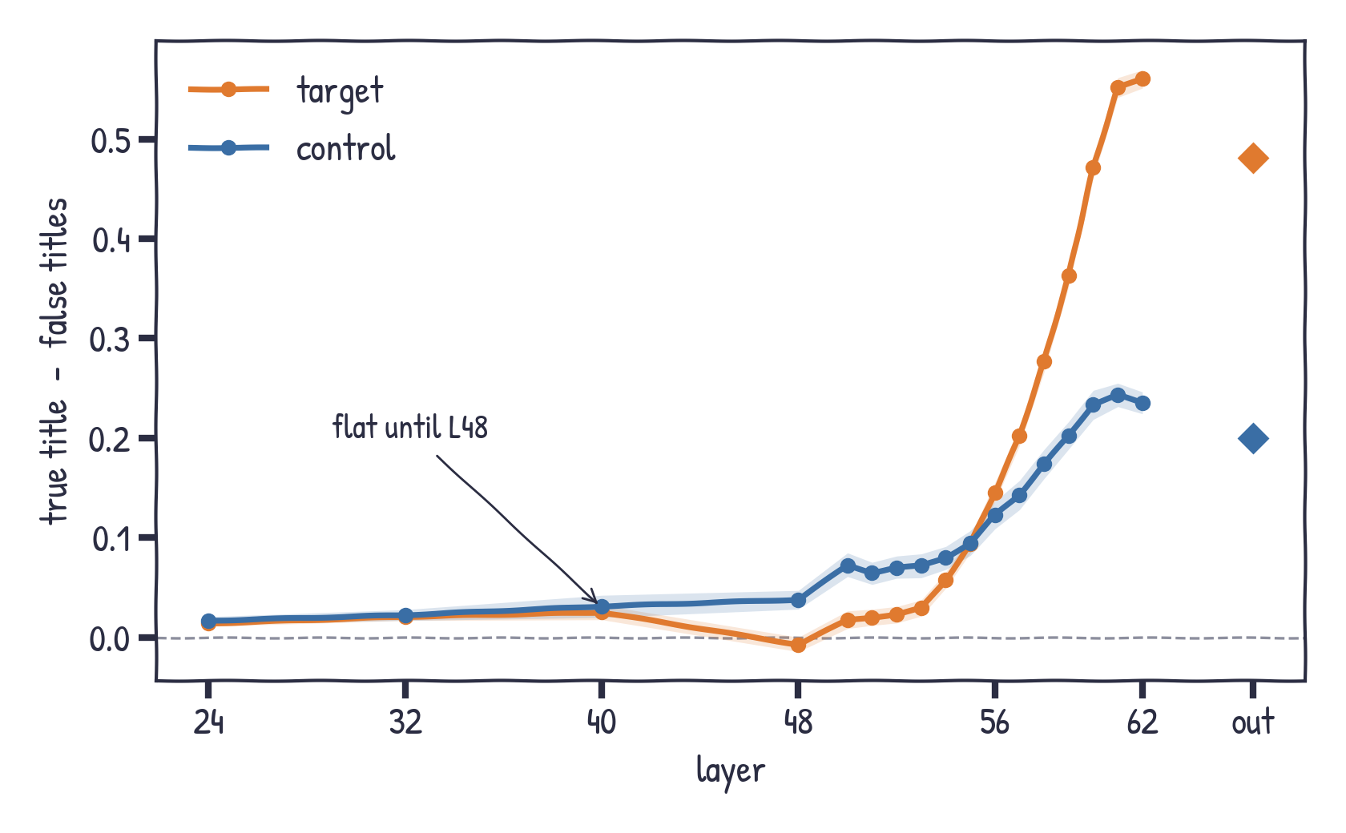
Stage 10
Knowing the paper shows up only at the end
title-specific signal · public Jacobian lens (lines) and model output (diamonds)
L24-L48: ~0 for both groups
rises at L56
L62: target +0.56 vs control +0.24
Notes:
Now remove name guessability: true title minus false titles. Flat up to L48 for both groups. Starts at L56, big at L62 and the output. Target ends roughly twice as high as control.

Slide 7
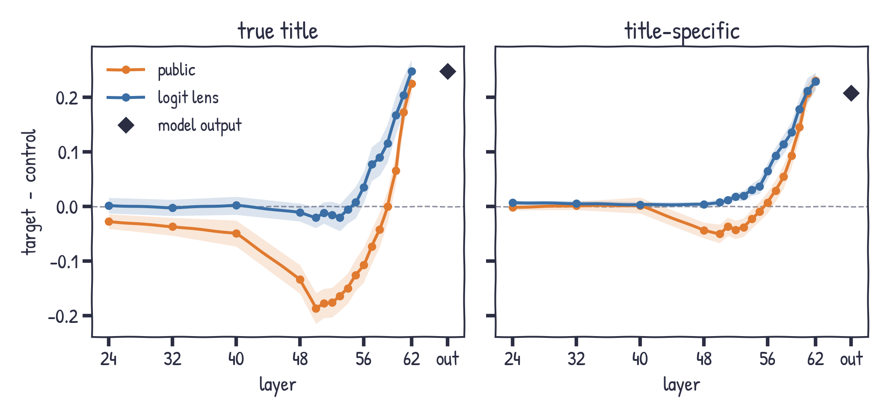
Stage 10
Target pulls ahead only in the last layers
target - control, within citation bin, 95% CI
Middle layers: no head start
L62 / output:
+0.21 to +0.23
almost all title-specific
R0 only (no author written): output +0.199 vs +0.207
Notes:
Key slide. Target minus control within citation bins. Left: true title only - middle layers are even slightly negative for the Jacobian lens. Right: title-specific part - about zero until L56, then +0.21 to +0.23 at L62 and the output. Robustness: 11 percent of target papers are R1 (a few authors right) against 1.5 percent of controls; keeping R0 papers only in both groups, the output difference is +0.199 instead of +0.207 and every layer looks the same, and the Stage 11 curves do not change either. The target advantage is late and almost entirely title-specific.

Slide 8
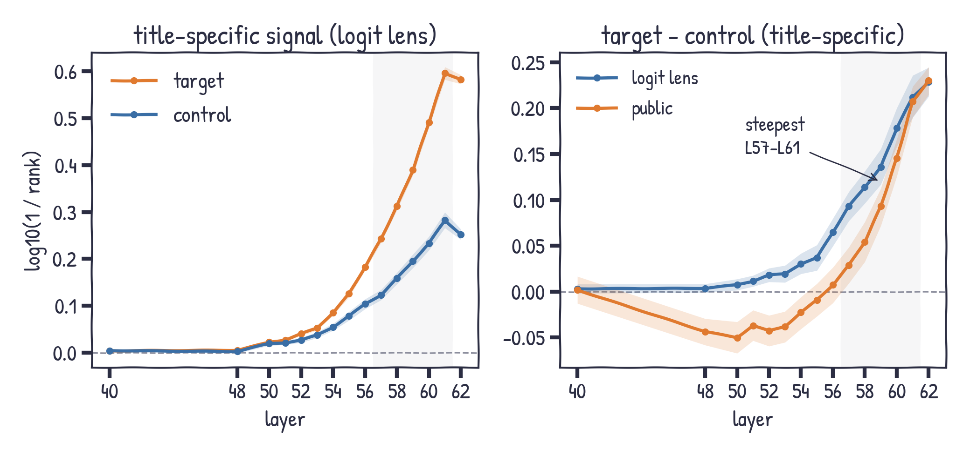
Stage 10
It builds up over the last dozen layers
fine layers L40-L62 · title-specific signal · 95% CI
Logit lens: target - control
+0.007 at L50
+0.23 at L62
steepest rise L57-L61
Notes:
Fine layers L50 to L61 were added afterwards for the logit lens and the public lens. The target advantage does not switch on at L62: for the logit lens the title-specific target minus control difference is +0.007 at L50, +0.03 at L54, +0.07 at L56, +0.11 at L58, +0.18 at L60 and +0.23 at L62. The public lens is negative up to L54 and turns positive at L57. The steepest rise is L57 to L61. Both groups peak at L61.

Slide 9
Stage 11
Stage 11: intervene, do not just read
593 + 593 papers: min(60, n_t, n_c) per citation bin, seed 11 · patch uses false_0 · knockout masks all heads · all 9,108 for probe and chain
patch
copy the true-title hidden state into the false-title run at one layer
knock out
block attention to the title tokens (all heads) from layer l to the last layer
probe
linear map from the last title token to the output state
chain
"Authors: A1, A2, ..." instead of each author alone
Score: rank of the correct name token at the model output; "share of the true-false gap" = (intervened - false) / (true - false).
Notes:
Stage 11 turns the readout question into interventions. 593 target and 593 control papers, matched within citation bins. Patching: run the paper with its true title and with a matched false title, and copy the true run hidden state into the false run at one layer. Knockout: forbid attention to the title tokens from layer l to the end. Probe: train a linear map from the last title token to the output state. Chain: score every author after the previous ones.

Slide 10
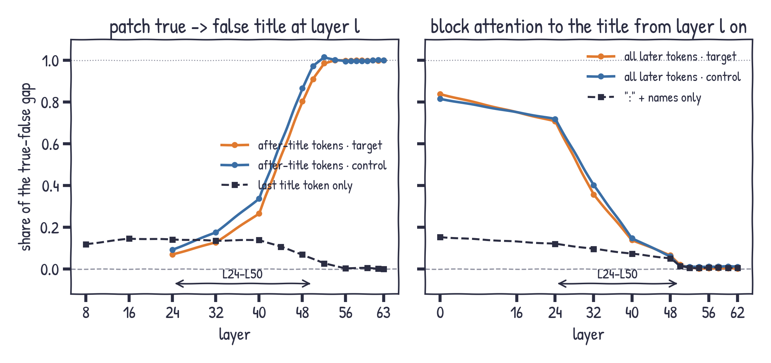
Stage 11
The title is read in L24-L50, early
model output · share of the true-false gap · CIs about +/-0.02
L52+: title no longer needed
info moved to the tokens right after the title
same timing for target and control
Notes:
Two causal curves. Left: copying the hidden states of the tokens after the title (closing quote, year, Authors:, the name) from the true run into the false run recovers 29 percent at L40, 83 percent at L48 and everything from L52. Copying only the last title token recovers about 12 percent. Right: blocking attention to the title from L0 removes 83 percent of the effect, from L32 37 percent, from L48 6 percent, from L52 nothing. Blocking only the colon and name positions removes at most 15 percent, so the information is routed through the tokens right after the title. Target and control follow the same curves.

Slide 11
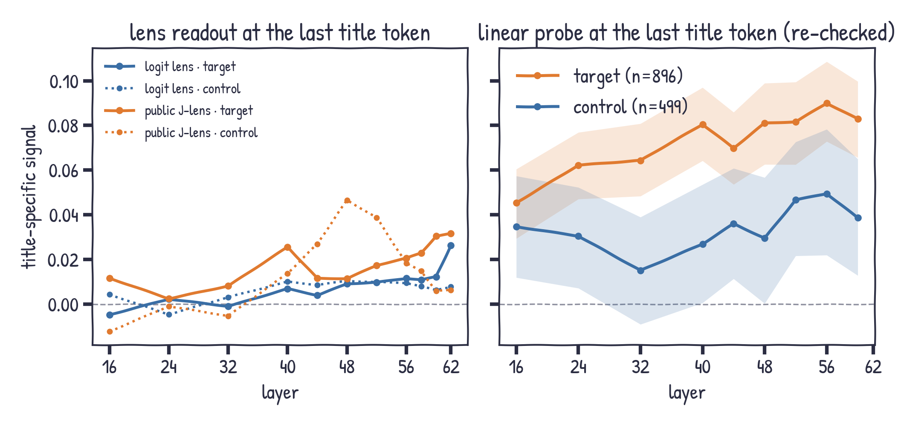
Stage 11
Read early: a probe finds it at the title
title-specific signal at the last title token · lenses: all 9,108 papers · probe: re-checked, title reuse removed: 1,863 papers (896 target, 499 control)
lenses: ~0.01-0.03
probe: 0.05 -> 0.08
target > control by +0.04-0.08
re-checked: team folds, title reuse removed
scores the first name token only (mostly an initial); subtracts false_0 only
read early (title, from L24), spoken late (names, L57-61)
Notes:
Is the author readable at the title itself? With the lenses, barely: about 0.01 to 0.03 title-specific signal at the last title token. A linear probe trained across papers gets more: re-checked with author-team folds and with papers whose prompt title the probe saw in training removed, about 0.05 at L24 rising to 0.08 at L56, and 0.04 to 0.08 more for target papers. The controls (appendix) show this probe signal is specific to the paper, not a topic-to-name association. This is not in conflict with the lens result: the title is read early, at the title token, but names only become readable at the name positions in L57 to L61. Read early, spoken late.

Slide 12
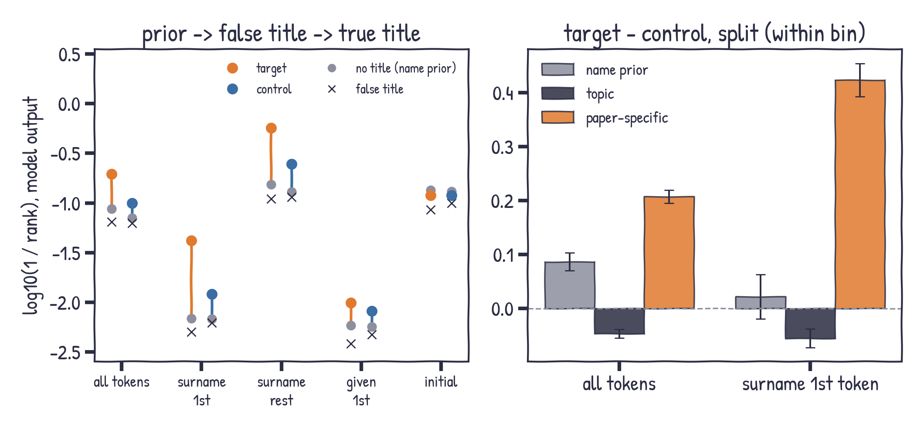
Stage 11
How much is just the name prior?
model output · no title vs false title vs true title · all 9,108 papers
no title: rank ~12
target - control: +0.09 prior, +0.21 paper
surname 1st: prior ~0, paper +0.42
prior vs recognition rho 0.09
Notes:
How much is just the name prior? We score the same names with no title at all. Without a title the correct name already sits around rank 12 on average: punctuation and the rest of a surname are easy once the prefix is given. The true title improves the surname first token the most: for target papers from about rank 146 to rank 24. Split the target minus control gap within citation bins: about 0.09 is already there without a title (target names are a bit easier to guess), false titles take back 0.05, and 0.21 is paper-specific. On the surname first token the prior part is about zero and 0.42 is paper-specific. The prior barely tracks multiple-choice recognition (Spearman 0.09 vs 0.33 for the paper-specific part).

Slide 13
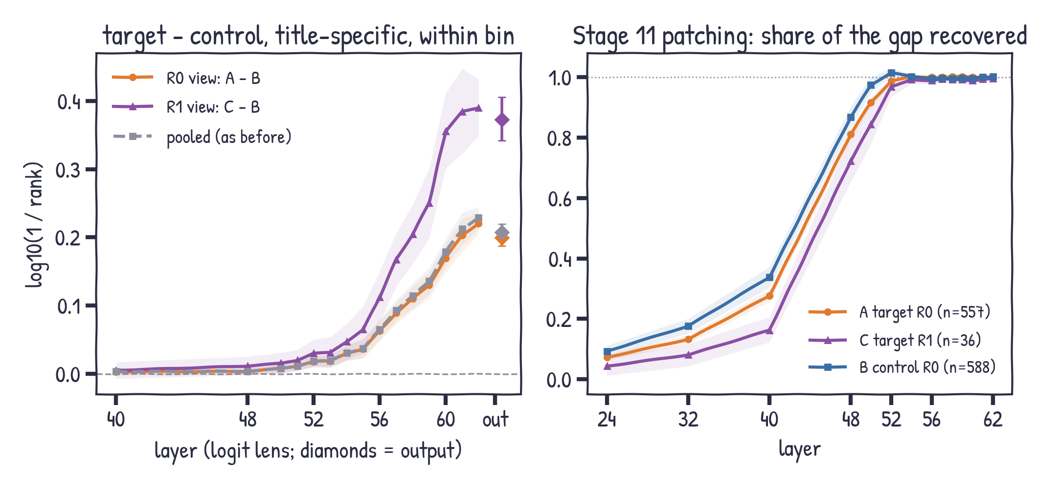
Stage 10-11
Is it just the R1 papers? No.
R0 = no true author written · R1 = a few written · A/B/C/D = target/control x R0/R1
R0 only (A - B):
output +0.199 vs +0.207, same shape
R1 (C - B): +0.37, also late
C - A within target: +0.11, from L56
patching: R1 a bit later, done by L52
Notes:
Is the target advantage just the R1 papers? Target pools R0 papers, where the open answer named no true author, and R1 papers, where it named a few; 11 percent of target papers are R1 but only 1.5 percent of controls. Left: three views of target minus control within citation bins. R0 only (groups A versus B, the Stage 1 to 9 comparison) gives +0.199 at the output against +0.207 pooled, and the curve has the same shape. R1 target papers against R0 controls give +0.37: they know their papers better, but they also only pull ahead after L52. Control R1 has only 34 papers, so it is described, not tested. Right: Stage 11 patching by recall level; R1 targets (36 papers) recover a little later but are complete by L52. The title-position probe gives the same picture: R0 view +0.02 to +0.04. Conclusion unchanged.

Slide 14
What we learned: read early, spoken late
Read early
Causally the title is read in L24-L50 and gathered at the name positions by L52, then no longer needed. A probe at the title token reads a little of it from L24 (re-checked).
Spoken late
At the name positions, paper-specific author knowledge becomes lens-readable only from ~L50, fastest over L57-L61.
No lens lead
Read with a lens at the names, target is not ahead of control in middle layers; the +0.21 gap is at the end (probe at the title: target − control +0.04–0.08, re-checked).
Real knowledge
Name prior is ~1/3 of the gap overall but ~0 on surnames; the rest is paper-specific and grows with citations.
Lenses agree
Jacobian lenses read more in middle layers, but nothing target-specific.
Name format
Initials carry little; full given names carry as much as surnames and help predict them.
Notes:
Wrap up. One line: read early, spoken late. The title is taken in during L24 to L50 (patching, knockout, probe at the title token), but the author names only become readable at the name positions in L57 to L61. The lens result (no middle-layer lead for target) and the probe result (a small target lead at the title token) are about different positions and do not conflict.

Slide 15
Stage 12 plan
Caveats and next steps
Caveats
- Readout is correlational; patching/knockout fix the timing, not the mechanism inside L24-L50
- Parity tolerance raised 0.25 -> 0.5 after the fact
- Groups are model-specific; low-citation "recognition" is near chance
- Few control papers above 1,000 citations
- Label run settings (max length, thinking mode) not in the package
Stage 12 (running)
1. Patch single positions (quote, year, "Authors:") - done, analysing
2. Attention vs MLP patching in L8-L56
3. A lens fitted on author prompts, read at L24-L62
4. Name-prior baselines: distractor lists without a title; a prompt with no paper
Notes:
Limits and next steps. Patching and knockout fix when the title is read (L24-L50) but not what happens inside those layers. Stage 12 is running: single-position patching, attention versus MLP patching, a lens fitted on author prompts, and two name-prior baselines. A second model is out of scope: the groups come from the group lead labelling run of Qwen3-32B.

Slide 16
Appendix
checks · readout levels · author chain · probe controls · lenses · citations · name formats
Notes:
Appendix: backup slides for questions - checks, readout levels, the author chain, probe controls, lens comparisons, citations and name formats.

Slide 17
Stage 10
Can we trust the numbers?
fast = slow
One forward pass vs one per prefix: max gap 0.37 logit (bf16 rounding); ranks 1-41 identical
matches Stage 6
972 tokens: same token ids, median log-prob gap ~1e-5
negative control
Punctuation tokens show ~0 title-specific signal at every layer
Caveat: the parity tolerance was raised 0.25 -> 0.5 after seeing these bf16 gaps.
Notes:
Checks before trusting numbers: the fast path matches a per-prefix reference up to bf16 rounding; ranks match a previous stage on 972 tokens; punctuation tokens, which cannot depend on the title, show no title-specific signal. The parity tolerance was raised from 0.25 to 0.5 after seeing the results - say this openly.

Slide 18
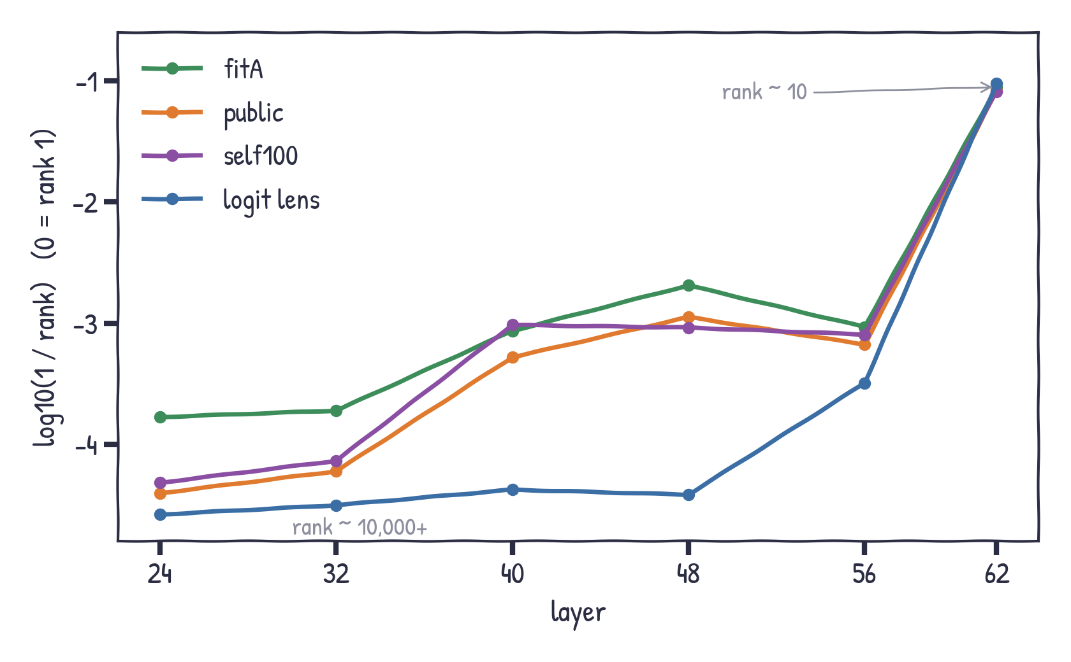
Stage 10
Names become readable late
all 9,108 papers · true title
Logit lens: almost nothing until L48
Jacobian lenses read more from L40
Everything jumps at L62 (rank ~10)
Notes:
All readouts get better with depth. The logit lens reads almost nothing before L48 (ranks in the tens of thousands) and jumps at L62. Jacobian lenses read more from L40, fitA the most. The real output is best of all.

Slide 19
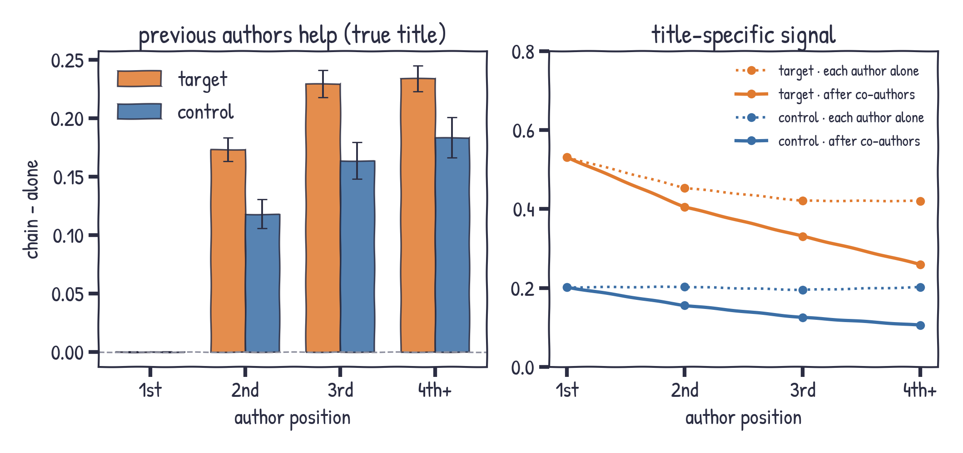
Stage 11
Co-authors help, and partly replace the title
model output · all 9,108 papers · 95% CI
later authors +0.17 to +0.23
title-specific part shrinks
target > control still
Notes:
Author chain. When the earlier authors are in the context, later authors become easier: plus 0.17 to 0.23 for target, 0.12 to 0.18 for control. But the title matters less: the title-specific signal drops from 0.45 to 0.26 for later target authors, because the co-authors already identify the paper. Target still beats control within bins, plus 0.11 to 0.15.

Slide 20
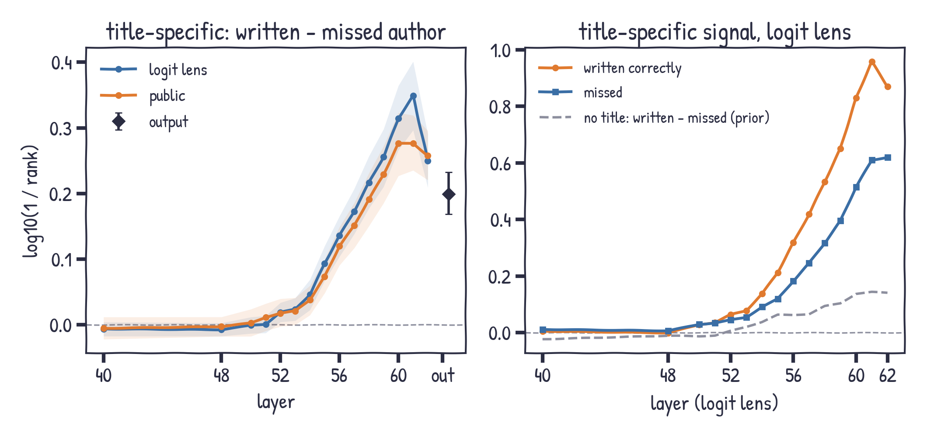
Stage 10-11
Authors it wrote vs authors it missed
inside 495 R1 papers · paired within paper · 95% CI
written - missed, output: +0.20
~0 up to L52, grows from L54
no title (prior): +0.10
same without first authors
Notes:
Inside R1 papers the open answer got some authors right and missed others. The label package only counts matches, so we rebuilt which authors matched; the rebuilt count equals the package count for 99.3 percent of R1 papers. In 495 papers with both kinds, the authors the model wrote correctly carry more title-specific signal at the output, +0.20, and the same holds without first authors. But the difference is zero up to L52 and grows from L54: even for authors the model actually produces, the paper-specific signal appears only in the last layers. They are also somewhat easier to guess without a title, +0.10.

Slide 21
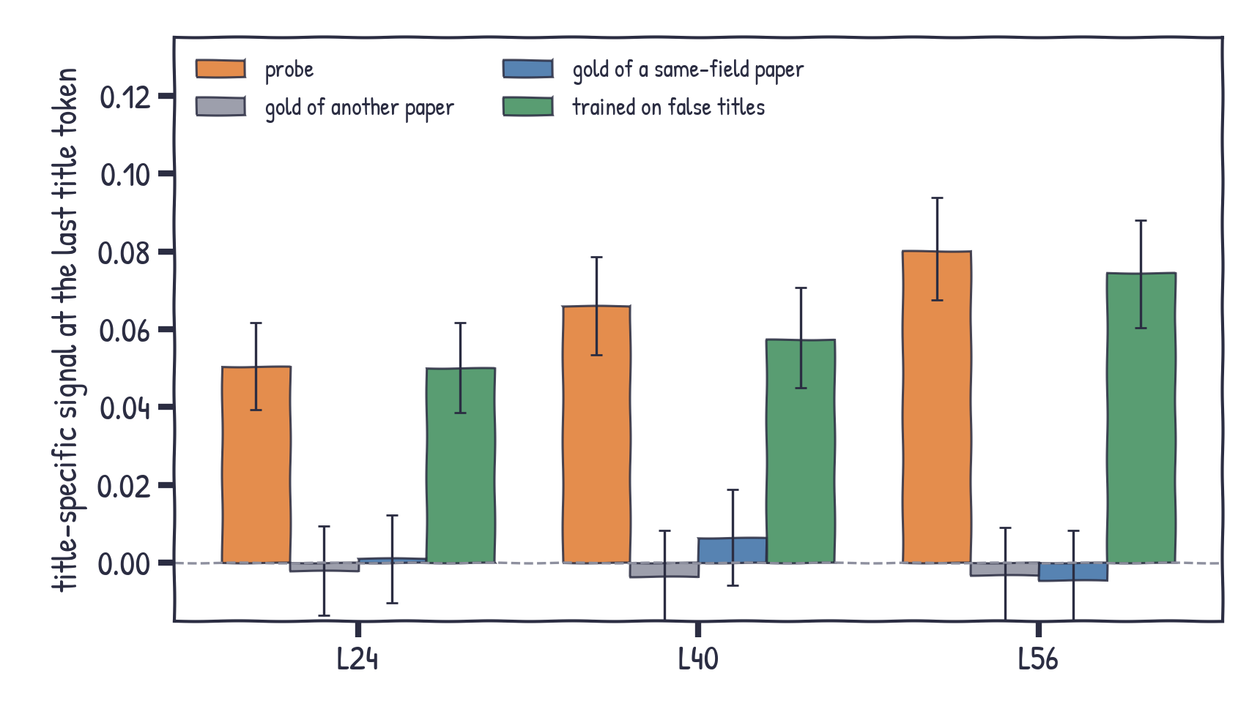
Stage 12
The probe signal is paper-specific
last title token · 5-fold ridge probe · re-checked: author-team folds, title reuse removed
another paper's authors: 0
same-field paper: 0
so it is this paper, already at L24
lenses cannot read it
Notes:
Is the probe at the title token reading real paper knowledge, or just topic to name associations? If we score its output against the authors of another paper, or of another paper in the same field, the signal drops to zero. If we train it only on false-title pairs it gives a similar signal (the earlier even-stronger result came from a leak: the same donor title in training and test). So the last title token carries linearly decodable, paper-specific author information already at L24, more for target papers, even though the lenses cannot read it.

Slide 22
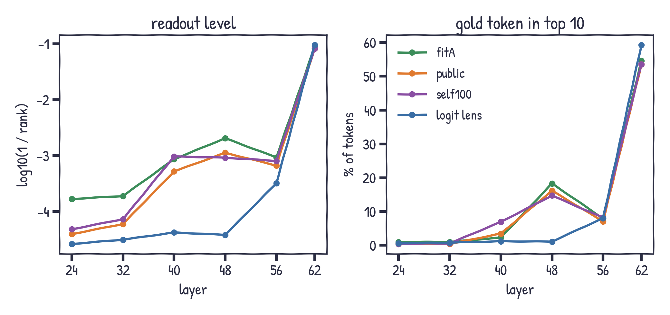
Stage 10
Which lens reads best?
all papers · true title
Middle layers:
fitA best; at L48 15-18% top-10 vs 1% for logit
L62: logit lens best (59%)
Notes:
Comparing lenses. On readout quality fitA is best in most middle layers, self100 at L40; at L48 the Jacobian lenses put the right token in the top 10 for 15-18% of tokens versus 1% for the logit lens. At L62 the plain logit lens is best.

Slide 23
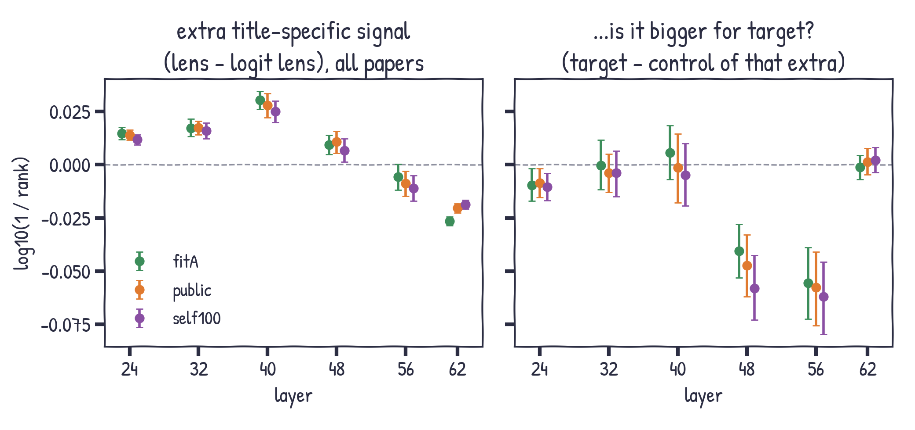
Stage 10
Do lenses reveal hidden paper knowledge?
paired differences, 95% CI
Extra signal: +0.01 to +0.03
vs ~0.44 at L62
Not bigger for target (even negative at L48-56)
Notes:
Do Jacobian lenses see paper-specific information the logit lens misses? A little: +0.01 to +0.03 more title-specific signal at L24-L48, CIs above zero, but tiny next to 0.44 at L62. And it is not bigger for target: target minus control of that extra is about zero, negative at L48 and L56.

Slide 24
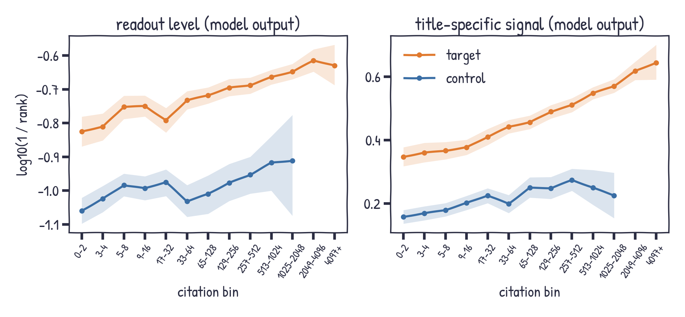
Stage 10
More citations, more paper knowledge
model output · bins with < 10 papers omitted
Target: +0.35 -> +0.64
Spearman (title-specific)
0.45 all · 0.33 target · 0.19 control
Target > control in every bin
Notes:
Citations. Within both groups the title-specific signal rises steadily with citation bin: target from +0.35 in bin 0-2 to +0.64 in 4097+. Spearman with log citations: 0.45 overall, 0.33 within target, 0.19 within control. The level itself changes much less - names are not easier to guess for famous papers, the model just knows famous papers better.

Slide 25
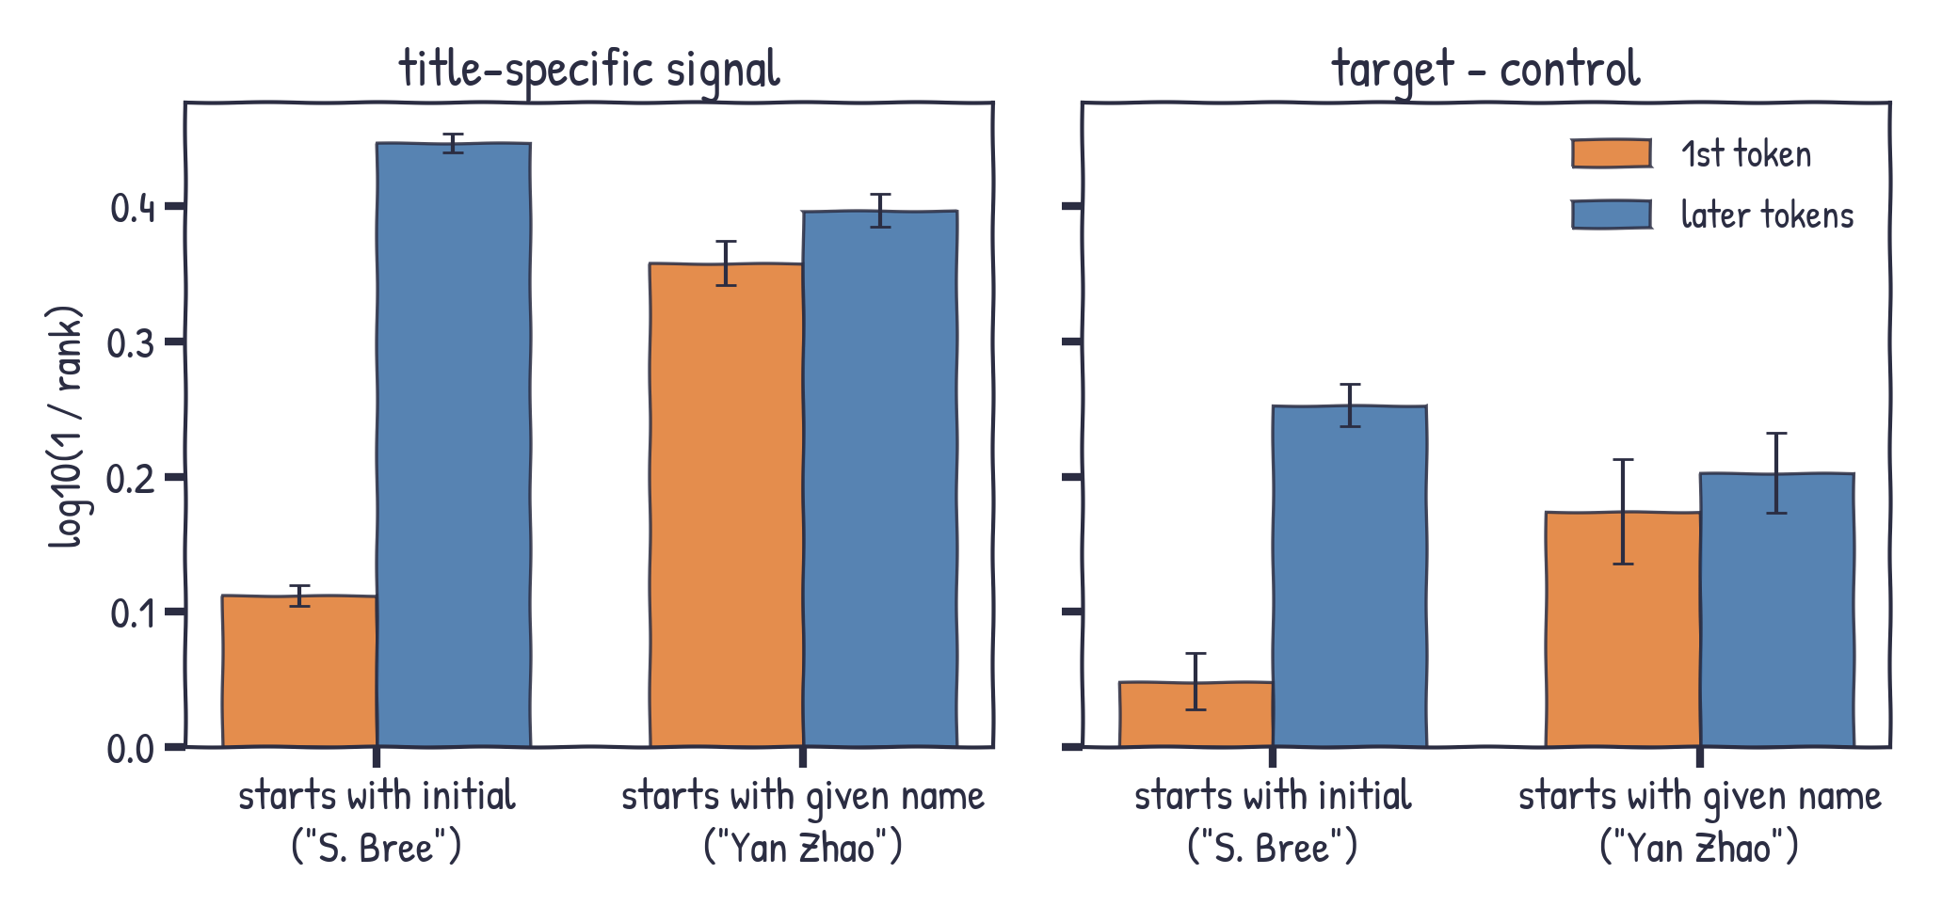
Stage 10
First token or the rest of the name?
model output · split by name format
Initial: carries little; signal is on the surname
Full given name: carries about as much as the surname
Notes:
Is the signal decided by the first token? It depends on the name format. Initial-first names: the initial carries little, the signal is on the later tokens that include the surname. Given-name-first names: the given name carries about as much as the rest. Note teacher forcing: later tokens already see the correct prefix in every condition, so their title-specific signal can only come from the title.

Slide 26
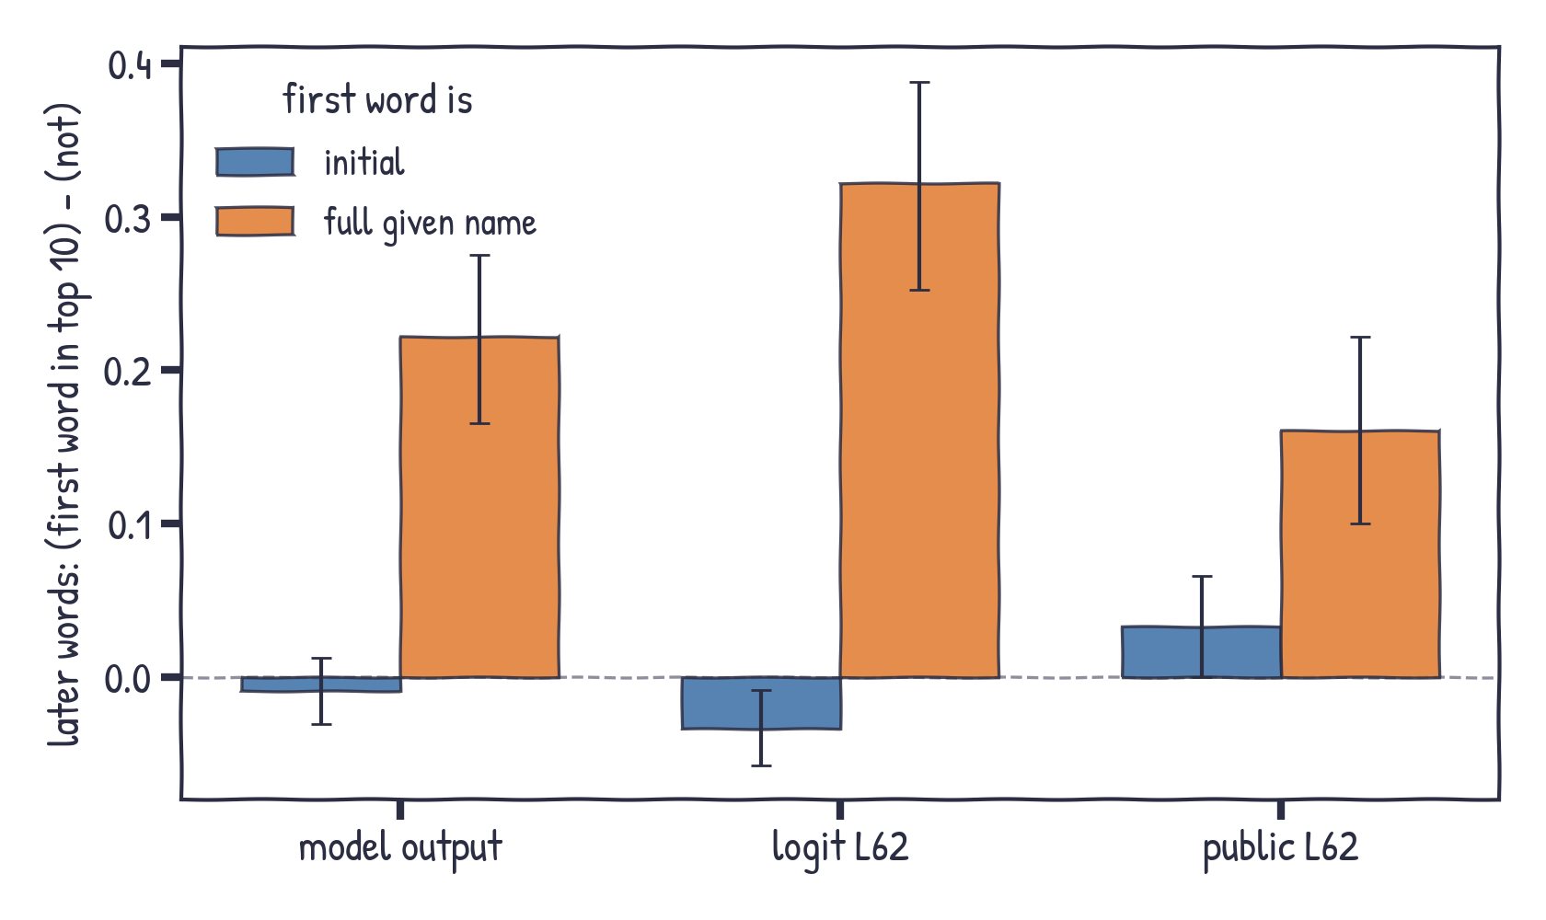
Stage 10
Knowing the given name helps with the surname
true title · later words when the first word is / is not in the top 10
Given name in top 10
surname +0.22 (output)
+0.32 (logit L62)
Initial in top 10: no help
Notes:
Does knowing the first word make the rest easier? For a full given name, yes: when it is in the top 10 the surname is +0.22 better at the output, +0.32 for the logit lens at L62. For an initial, no. Mixing both formats would even show a negative effect, because initials are easy and the surnames after them are hard.

Slide 27
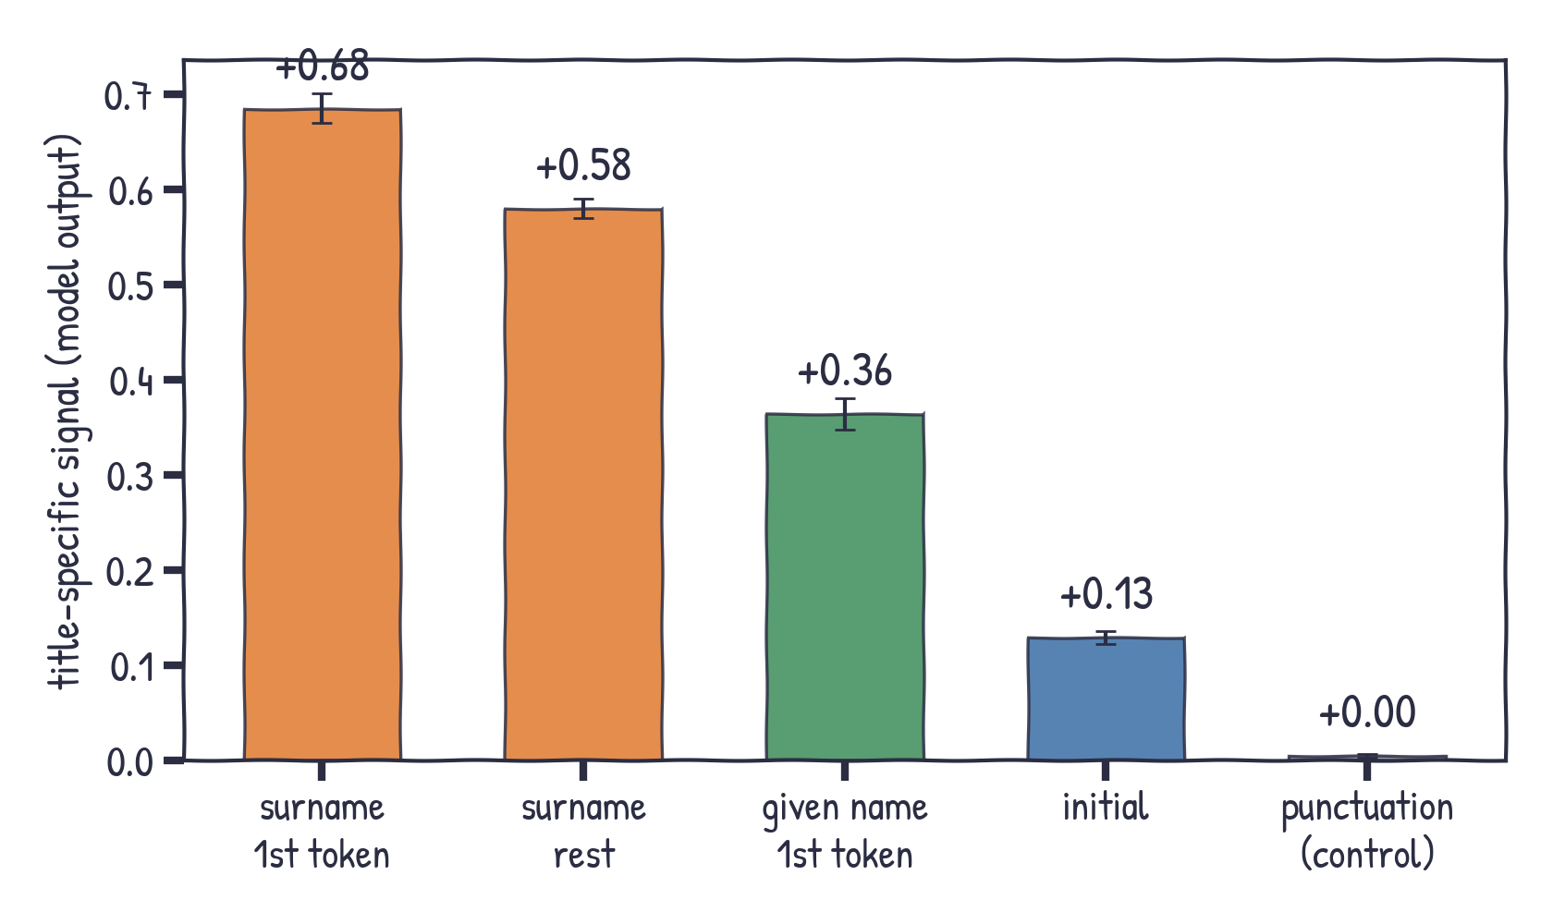
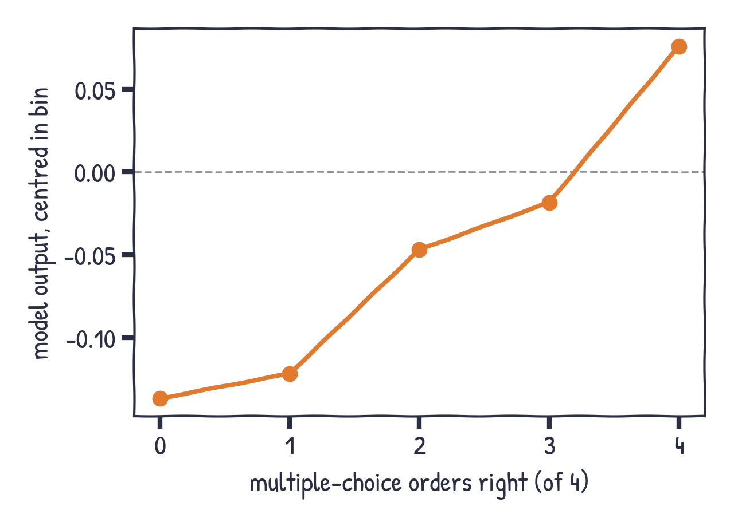
Stage 10
Where the signal sits, and a dose-response
model output
Right: R0/R1 papers, centred within citation bin; Spearman rho = 0.27, p < 0.001.
Notes:
Left: title-specific signal by token role at the output - surname first token carries most, initials least, punctuation about zero (negative control). Right: across all unrecalled papers, the more multiple-choice orders right, the better the model output (Spearman 0.27).

