Slide 1
Introduction to Data Mining

Slide 2
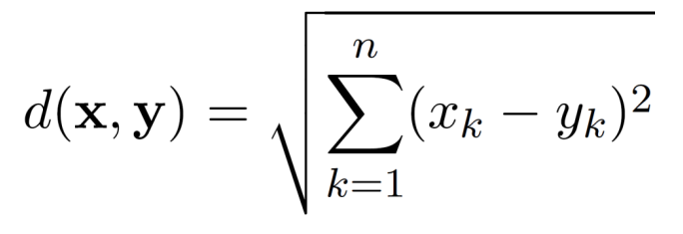
Euclidean Distance
Euclidean Distance
where n is the number of dimensions (attributes) and x_{k} and y_{k} are, respectively, the k^{th} attributes (components) or data objects x and y.
If scales differ, Standardization is necessary.

Slide 3
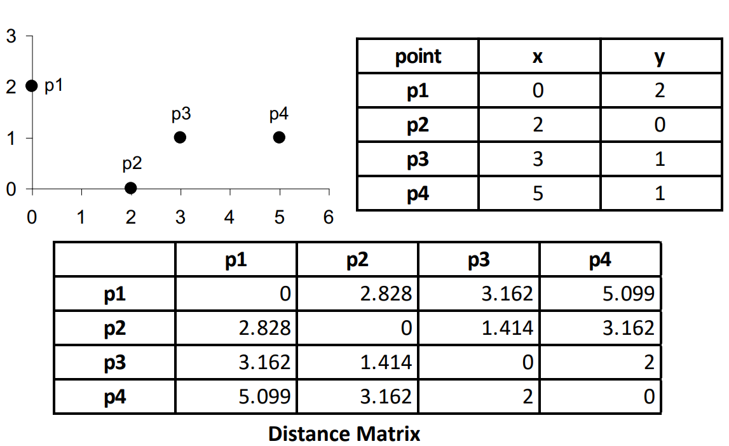
Euclidean Distance

Slide 4
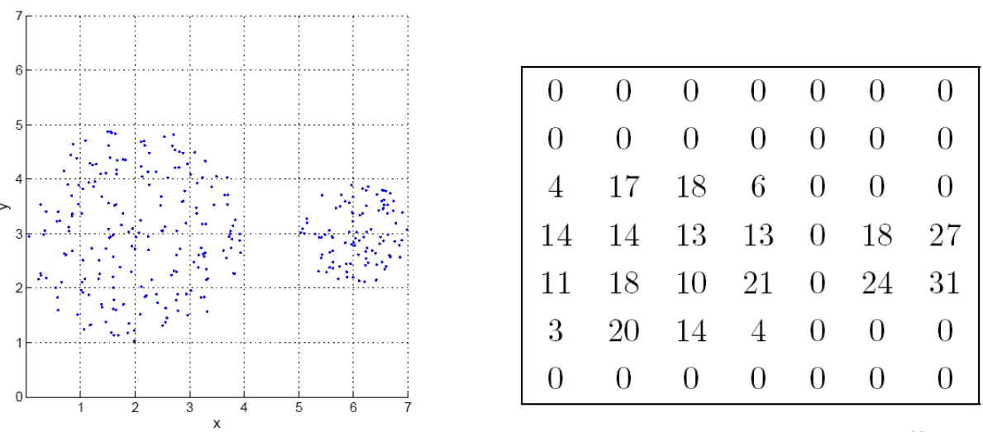
Euclidean Density: Grid-based Approach
Simplest approach is to divide region into a number of rectangular cells of equal volume and define density as # of points the cell contains

Slide 5
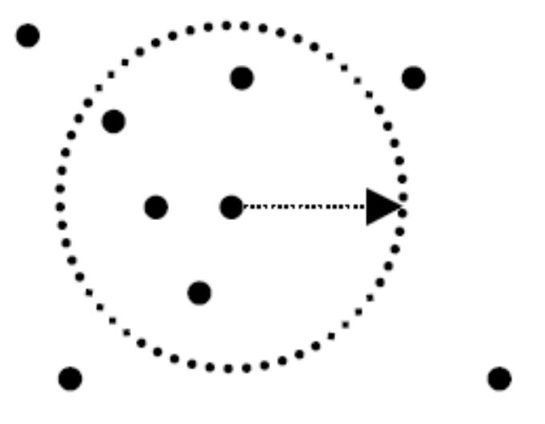
Euclidean Density: Center-Based
Euclidean density is the number of points within a specified radius of the point
Illustration of center-based density

Slide 6
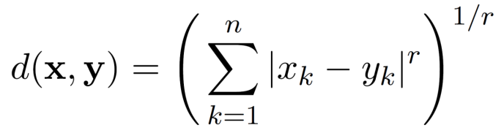
Minkowski Distance
Minkowski Distance is a generalization of Euclidean Distance
Where r is a parameter, n is the number of dimensions (attributes) and x_{k} and y_{k} are, respectively, the k^{th} attributes (components) or data objects x and y.

Slide 7
Minkowski Distance: Examples
r = 1. City block (Manhattan, taxicab, L₁ norm) distance.
A common example of this for binary vectors is the Hamming distance, which is just the number of bits that are different between two binary vectors
r = 2. Euclidean distance
r → ∞. “supremum” (L_{max} norm, L∞ norm) distance.
This is the maximum difference between any component of the vectors
Do not confuse r with n, i.e., all these distances are defined for all numbers of dimensions.

Slide 8
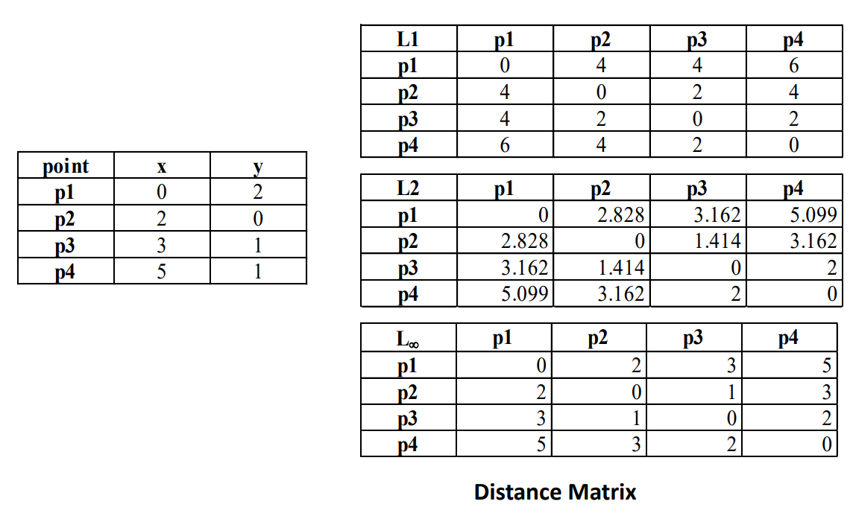
Minkowski Distance: Examples

Slide 9

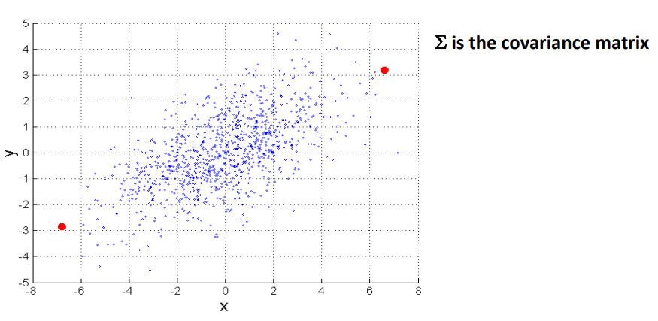
Mahalanobis Distance
For red points, the Euclidean distance is 14.7, Mahalanobis distance is 6.

Slide 10
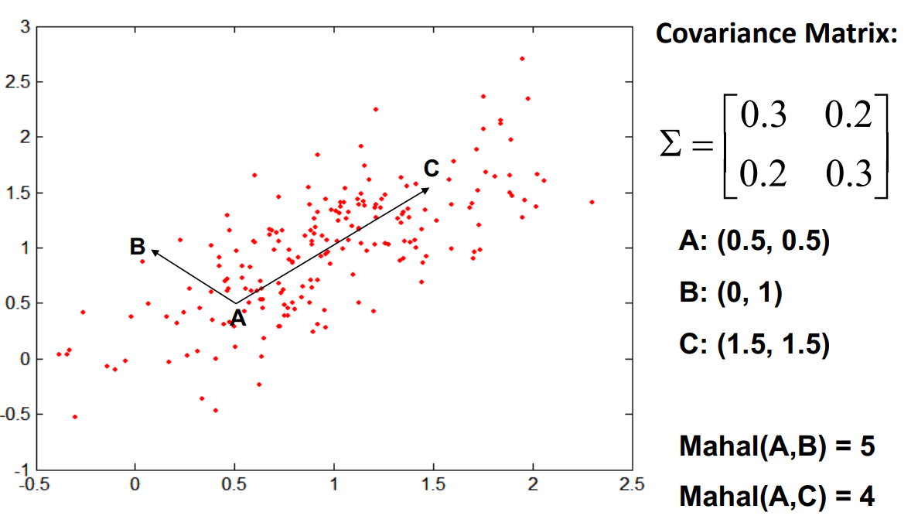
Mahalanobis Distance

Slide 11
Common Properties of a Distance
Distances, such as the Euclidean distance, have some well known properties.
d(x, y) ≥ 0 for all x and y and d(x, y) = 0 if and only if x = y.
d(x, y) = d(y, x) for all x and y. (Symmetry)
d(x, z) ≤ d(x, y) + d(y, z) for all points x, y, and z. (Triangle Inequality)
where d(x, y) is the distance (dissimilarity) between points (data objects), x and y.
A distance that satisfies these properties is a metric

Slide 12
Common Properties of a Similarity
Similarities, also have some well known properties.
s(x, y) = 1 (or maximum similarity) only if x = y. (does not always hold, e.g., cosine)
s(x, y) = s(y, x) for all x and y. (Symmetry)
where s(x, y) is the similarity between points (data objects), x and y.

Slide 13
Similarity Between Binary Vectors
Common situation is that objects, x and y, have only binary attributes
Compute similarities using the following quantities
f₀₁ = the number of attributes where x was 0 and y was 1
f₁₀ = the number of attributes where x was 1 and y was 0
f₀₀ = the number of attributes where x was 0 and y was 0
f₁₁ = the number of attributes where x was 1 and y was 1
Simple Matching and Jaccard Coefficients
SMC = number of matches / number of attributes
= (f₁₁ + f₀₀) / (f₀₁ + f₁₀ + f₁₁ + f₀₀)
J = number of 11 matches / number of non-zero attributes
= (f₁₁) / (f₀₁ + f₁₀ + f₁₁)

Slide 14
SMC versus Jaccard: Example
x = 1 0 0 0 0 0 0 0 0 0
y = 0 0 0 0 0 0 1 0 0 1
f₀₁ = 2 (the number of attributes where x was 0 and y was 1)
f₁₀ = 1 (the number of attributes where x was 1 and y was 0)
f₀₀ = 7 (the number of attributes where x was 0 and y was 0)
f₁₁ = 0 (the number of attributes where x was 1 and y was 1)
SMC = (f₁₁ + f₀₀) / (f₀₁ + f₁₀ + f₁₁ + f₀₀)
= (0+7) / (2+1+0+7) = 0.7
J = (f₁₁) / (f₀₁ + f₁₀ + f₁₁) = 0 / (2 + 1 + 0) = 0

Slide 15
Cosine Similarity
If d₁ and d₂ are two document vectors, then
cos( d₁, d₂ ) = <d₁,d₂> / ||d₁|| ||d₂|| ,
where <d₁,d₂> indicates inner product or vector dot product of vectors, d₁ and d_{2,} and || d || is the length of vector d.
Example:
d₁ = 3 2 0 5 0 0 0 2 0 0
d₂ = 1 0 0 0 0 0 0 1 0 2
<d₁, d2> = 3*1 + 2*0 + 0*0 + 5*0 + 0*0 + 0*0 + 0*0 + 2*1 + 0*0 + 0*2 = 5
| d₁ || = (3*3+2*2+0*0+5*5+0*0+0*0+0*0+2*2+0*0+0*0)^{0.5} = (42) ^{0.5} = 6.481
|| d₂ || = (1*1+0*0+0*0+0*0+0*0+0*0+0*0+1*1+0*0+2*2) ^{0.5} = (6) ^{0.5} = 2.449
cos(d₁, d₂ ) = 0.3150

Slide 16
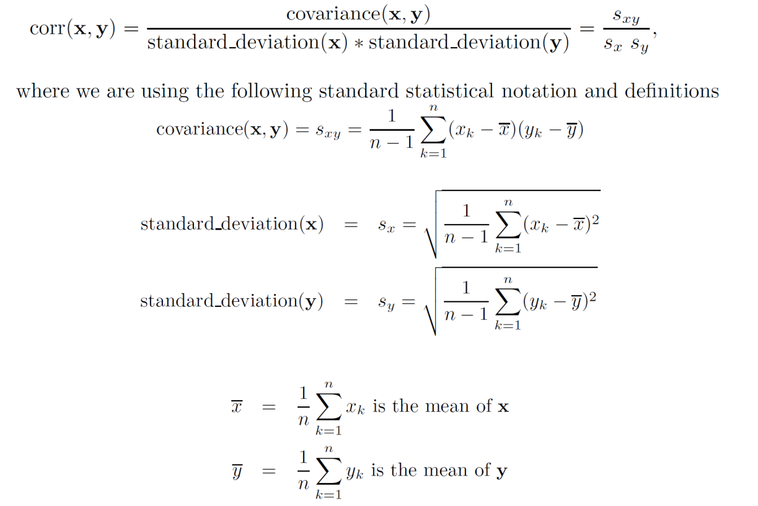
Correlation measures linear relationship between objects

Slide 17
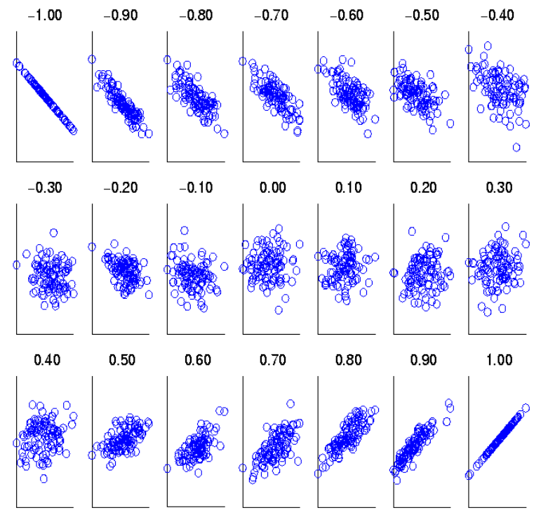
Visually Evaluating Correlation
Scatter plots showing the similarity from –1 to 1.

Slide 18
Drawback of Correlation
x = (-3, -2, -1, 0, 1, 2, 3)
y = (9, 4, 1, 0, 1, 4, 9)
y_{i} = x_{i}²
mean(x) = 0, mean(y) = 4
std(x) = 2.16, std(y) = 3.74
corr = (-3)(5)+(-2)(0)+(-1)(-3)+(0)(-4)+(1)(-3)+(2)(0)+3(5) / ( 6 * 2.16 * 3.74 )
= 0

Slide 19
Density
Measures the degree to which data objects are close to each other in a specified area
The notion of density is closely related to that of proximity
Concept of density is typically used for clustering and anomaly detection
Examples:
– Euclidean density
Euclidean density = number of points per unit volume
– Probability density
Estimate what the distribution of the data looks like
– Graph-based density
Connectivity

Slide 20
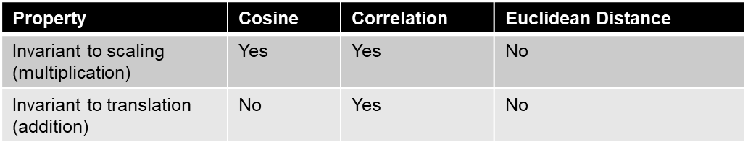
Correlation vs Cosine vs Euclidean Distance
Compare the three proximity measures according to their behavior under variable transformation
scaling: multiplication by a value
translation: adding a constant
Consider the example
x = (1, 2, 4, 3, 0, 0, 0), y = (1, 2, 3, 4, 0, 0, 0)
y_{s} = y * 2 (scaled version of y), y_{t} = y + 5 (translated version)
Measure | (x , y) | (x , y_{s}) | (x , y_{t})
Cosine | 0.9667 | 0.9667 | 0.7940
Correlation | 0.9429 | 0.9429 | 0.9429
Euclidean Distance | 1.4142 | 5.8310 | 14.2127

Slide 21
Correlation vs cosine vs Euclidean distance
Choice of the right proximity measure depends on the domain
What is the correct choice of proximity measure for the following situations?
Comparing documents using the frequencies of words
Documents are considered similar if the word frequencies are similar
Comparing the temperature in Celsius of two locations
Two locations are considered similar if the temperatures are similar in magnitude
Comparing two time series of temperature measured in Celsius
Two time series are considered similar if their “shape” is similar, i.e., they vary in the same way over time, achieving minimums and maximums at similar times, etc.

Slide 22
Comparison of Proximity Measures
Domain of application
Similarity measures tend to be specific to the type of attribute and data
Record data, images, graphs, sequences, 3D-protein structure, etc. tend to have different measures
However, one can talk about various properties that you would like a proximity measure to have
Symmetry is a common one
Tolerance to noise and outliers is another
Ability to find more types of patterns?
Many others possible
The measure must be applicable to the data and produce results that agree with domain knowledge

Slide 23
Information Based Measures
Information theory is a well-developed and fundamental disciple with broad applications
Some similarity measures are based on information theory
Mutual information in various versions
Maximal Information Coefficient (MIC) and related measures
General and can handle non-linear relationships
Can be complicated and time intensive to compute

Slide 24
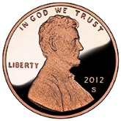


Information and Probability
Information relates to possible outcomes of an event
transmission of a message, flip of a coin, or measurement of a piece of data
The more certain an outcome, the less information that it contains and vice-versa
For example, if a coin has two heads, then an outcome of heads provides no information
More quantitatively, the information is related the probability of an outcome
The smaller the probability of an outcome, the more information it provides and vice-versa
Entropy is the commonly used measure

Slide 25
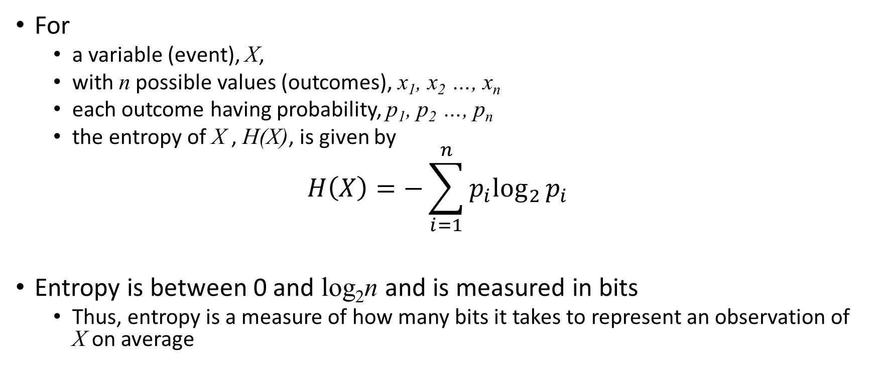
Entropy
For
a variable (event), X,
with n possible values (outcomes), x₁, x₂ …, x_{n}
each outcome having probability, p₁, p₂ …, p_{n}
the entropy of X , H(X), is given by
$$H\left(X\right)=−\sum_{i=1}^{n}{{p_{i}log}_{2}{p_{i}}}$$
Entropy is between 0 and log₂n and is measured in bits
Thus, entropy is a measure of how many bits it takes to represent an observation of X on average

Slide 26

Entropy Examples
For a coin with probability p of heads and probability q = 1 – p of tails
$$H=−p\log_{2}{p−}q\log_{2}{q}$$
For p= 0.5, q = 0.5 (fair coin) H = 1
For p = 1 or q = 1, H = 0

Slide 27
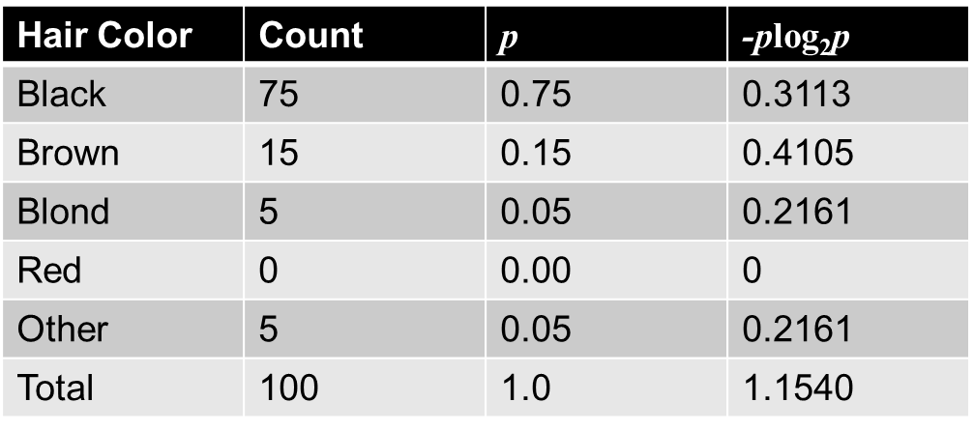
Entropy for Sample Data: Example
Maximum entropy is log₂5 = 2.3219

Slide 28
What is Data Exploration?
A preliminary exploration of the data to better understand its characteristics
Key motivations of data exploration include
Helping to select the right tool for preprocessing or analysis
Making use of humans’ abilities to recognize patterns
People can recognize patterns not captured by data analysis tools
Related to the area of Exploratory Data Analysis (EDA)
Created by statistician John Tukey
Seminal book is Exploratory Data Analysis by Tukey
A nice online introduction can be found in Chapter 1 of the NIST/SEMATECH e-Handbook of Statistical Methods http://www.itl.nist.gov/div898/handbook/index.htm

Slide 29
Techniques Used in Data Exploration
In EDA, as originally defined by Tukey
The focus was on visualization
Clustering and anomaly detection were viewed as exploratory techniques
In data mining, clustering and anomaly detection are major areas of interest, and not thought of as just exploratory
Now
Clustering and anomaly detection are major areas of interest, not just exploratory
Our focus
Summary statistics
Visualization

Slide 30
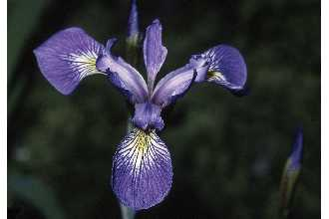
Iris Sample Data Set
Many of the exploratory data techniques are illustrated with the Iris Plant data set.
Can be obtained from the UCI Machine Learning Repository http://www.ics.uci.edu/~mlearn/MLRepository.html
From the statistician Douglas Fisher
Three flower types (classes):
Setosa
Virginica
Versicolour
Four (non-class) attributes
Sepal width and length
Petal width and length
Virginica. Robert H. Mohlenbrock. USDA NRCS. 1995. Northeast wetland flora: Field office guide to plant species. Northeast National Technical Center, Chester, PA. Courtesy of USDA NRCS Wetland Science Institute.

Slide 31
Iris Flower
Virginica. Robert H. Mohlenbrock. USDA NRCS. 1995. Northeast wetland flora: Field office guide to plant species. Northeast National Technical Center, Chester, PA. Courtesy of USDA NRCS Wetland Science Institute.

Slide 32
Summary Statistics
Numbers that summarize properties of the data
Examples:
Frequency – counts
Location – mean
Spread – standard deviation
Most summary statistics can be calculated in a single pass through the data

Slide 33
Frequency and Mode
The frequency of an attribute value is a percentage measuring how often the value occurs in the data set
Example: ‘gender’
In a representative population of people, ‘female’ occurs about 50% of the time
The mode of an attribute is the most frequent attribute value
Typically used with categorical data

Slide 34
Percentiles
For continuous data, the notion of a percentile is more useful.
Given an ordinal or continuous attribute x and a number p between 0 and 100, the pth percentile is a value x_{p} of x such that p% of the observed values of x are less than x_{p}.
For instance, the 50th percentile is the value x_{50%} such that 50% of all values of x are less than x_{50%.}

Slide 35
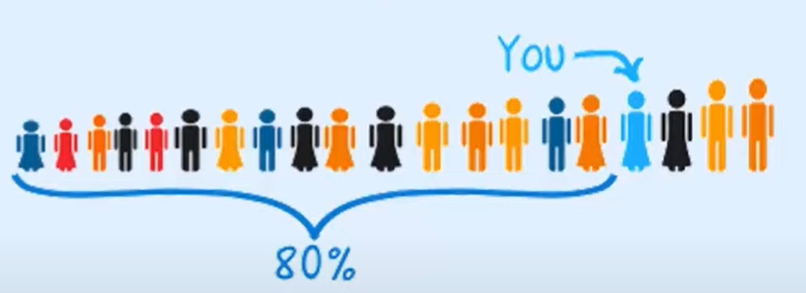
Percentiles
Ex: You are the fourth tallest person in a group of 20
80% of people are shorter than you:
That means you are at the 80th percentile.
If your height is 1.85m then “1.85m” is the 80th percentile height in that group.

Slide 36
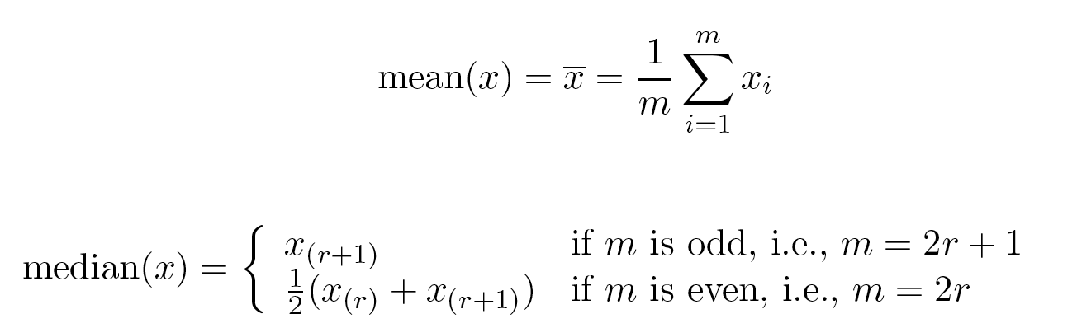
Measures of Location: Mean and Median
Mean: The most common measure of the center of a set of points
Very sensitive to outliers

Slide 37
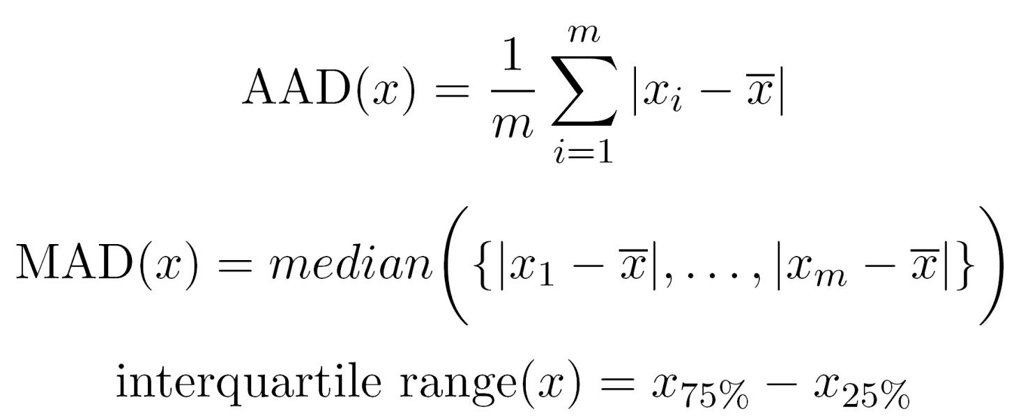
Measures of Spread: Range and Variance
Range: The difference between the max and min
Variance and standard deviation are the most common measure of the spread of a set of points
These are sensitive to outliers, other measures used include

Slide 38
Visualization
Visualization is the conversion of data into a visual or tabular format so that the characteristics of the data and the relationships among data items or attributes can be analyzed or reported.
Visualization of data is one of the most powerful and appealing techniques for data exploration.
Humans have a well developed ability to analyze large amounts of information that is presented visually
Can detect general patterns and trends
Can detect outliers and unusual patterns

Slide 39
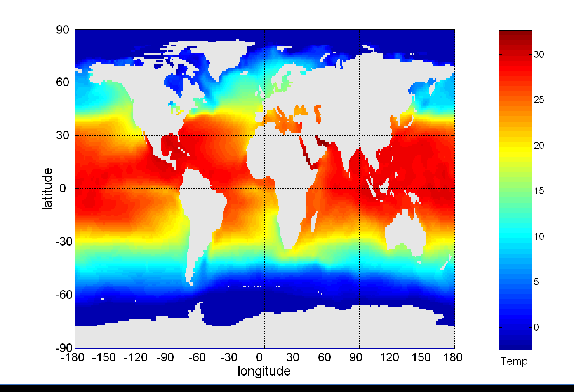
Example: Sea Surface Temperature
The following shows the Sea Surface Temperature (SST) for July 1982
Thousands of data points are summarized in a single figure

Slide 40
Representation
Is the mapping of information to a visual format
Data objects, their attributes, and the relationships among data objects are translated into graphical elements such as points, lines, shapes, and colors.
Example:
Objects are often represented as points
Their attribute values can be represented as the position of the points or the characteristics of the points, e.g., color, size, and shape
If position is used, then the relationships of points, i.e., whether they form groups or a point is an outlier, is easily perceived.

Slide 41
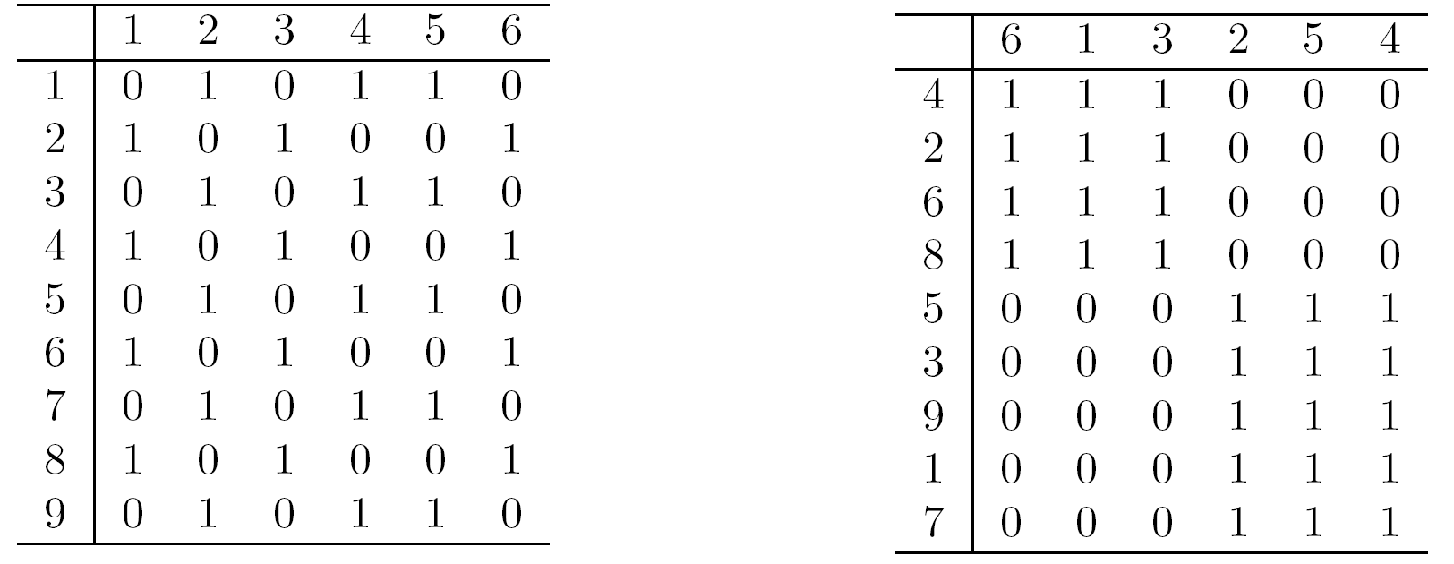
Arrangement
Is the placement of visual elements within a display
Can make a large difference in how easy it is to understand the data
Example:

Slide 42
Selection
Is the elimination or the de-emphasis of certain objects and attributes
Selection may involve the choosing a subset of attributes
Dimensionality reduction is often used to reduce the number of dimensions to two or three
Alternatively, pairs of attributes can be considered
Selection may also involve choosing a subset of objects
A region of the screen can only show so many points
Can sample, but want to preserve points in sparse areas

Slide 43
Visualization techniques-Histograms
Histograms
Shows the distribution of values of a single variable
Divide the values into bins and show a bar plot of the number of objects in each bin
The height of each bar indicates the number of objects
Shape of histogram depends on the number of bins- experiment

Slide 44
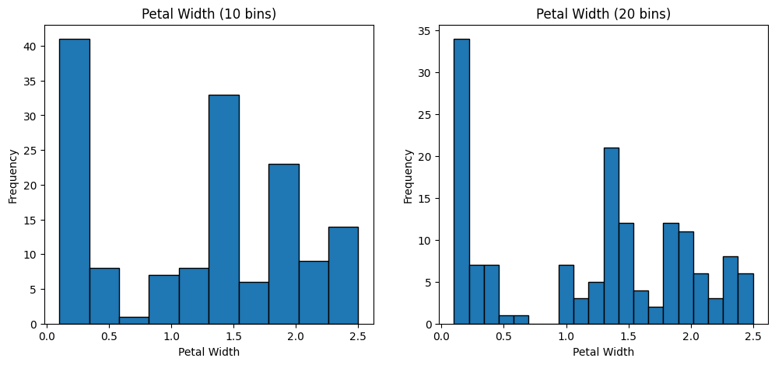
Petal width (10 and 20 bins)

Slide 45
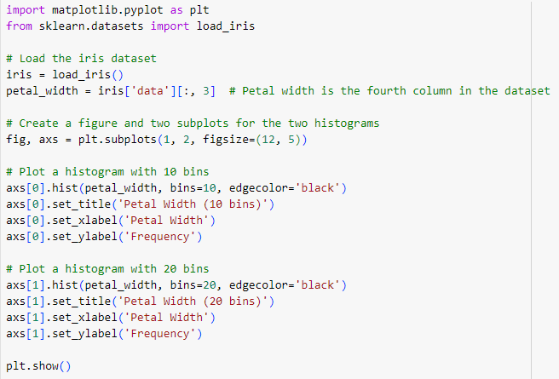
Petal width (10 and 20 bins)

Slide 46
Two-dimensional Histograms
Show the joint distribution of the values of two attributes
Ex: Petal width and petal length

Slide 47
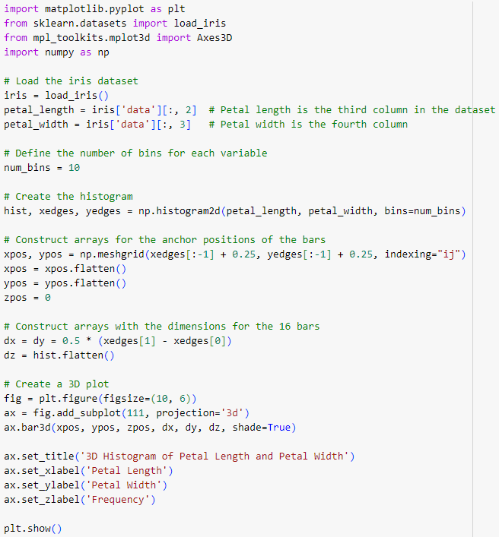
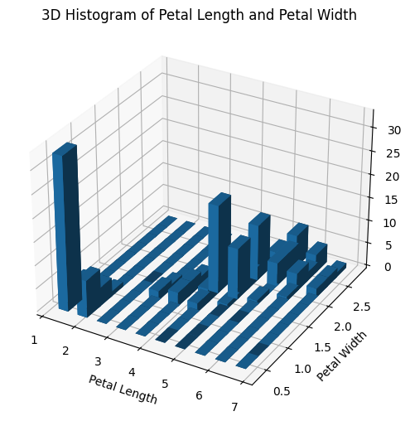
Petal width and petal length

Slide 48
Visualization techniques-Box Plots
outlier
90th percentile
Box Plots:
Invented by J. Tukey
Displays distribution of data
Format:
75th percentile
50th percentile
25th percentile
10th percentile

Slide 49
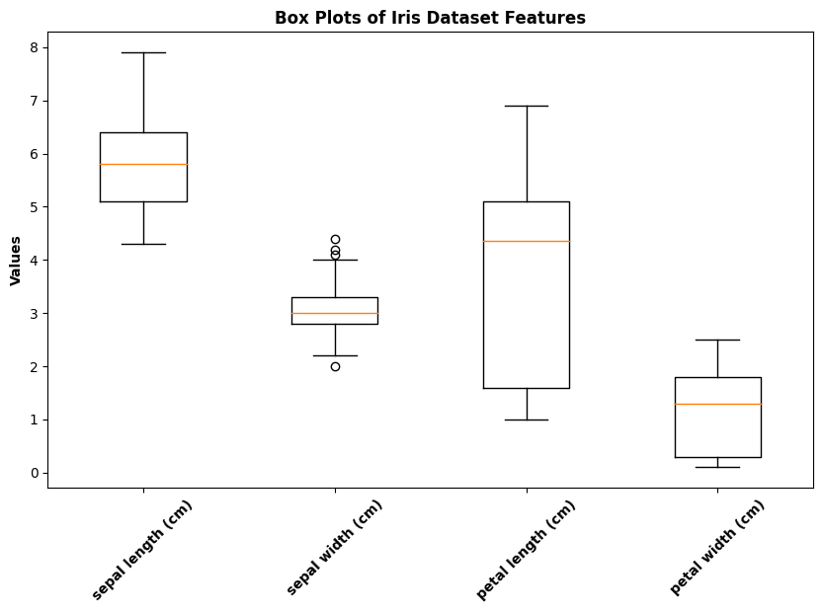
Examples of Box Plots
Box plots can be used to compare attributes

Slide 50
Visualization techniques-Scatter Plots
Scatter Plots:
Attribute values determine the position
Two-dimensional scatter plots most common
Three-dimensional scatter plots also used
Often additional attributes can be displayed by using the size, shape, and color of the markers that represent the objects
It is useful to have arrays of scatter plots can compactly summarize the relationships of several pairs of attributes
See example on the next slide

Slide 51
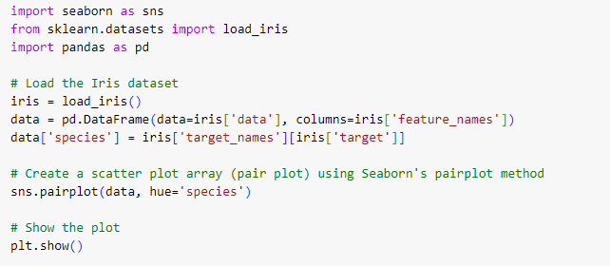
Ex: Scatter Plot

Slide 52
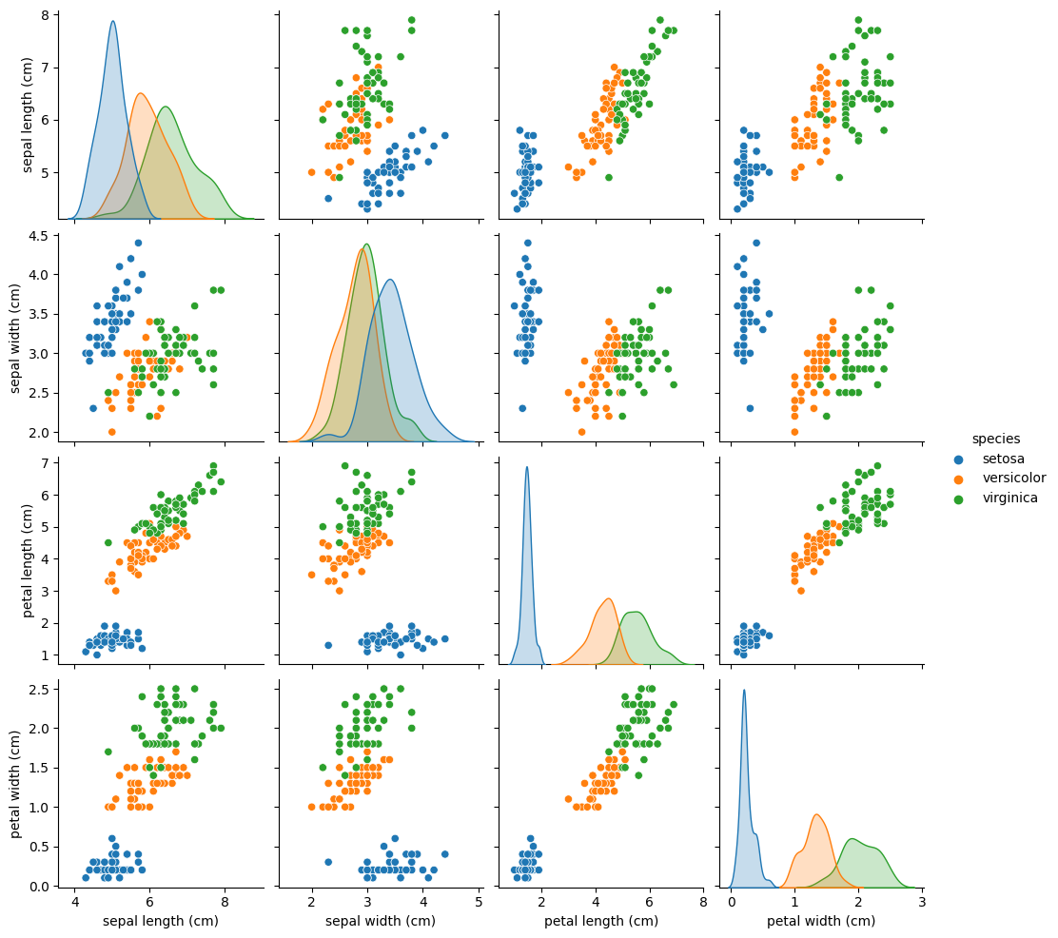
Scatter Plot Array of iris Attributes

Slide 53
Visualization techniques-Contour Plots
Contour plots
Useful when a continuous attribute is measured on a spatial grid
They partition the plane into regions of similar values
The contour lines that form the boundaries of these regions connect points with equal values
The most common example is contour maps of elevation
Can also display temperature, rainfall, air pressure, etc.
An example for Sea Surface Temperature (SST) is provided on the next slide

Slide 54
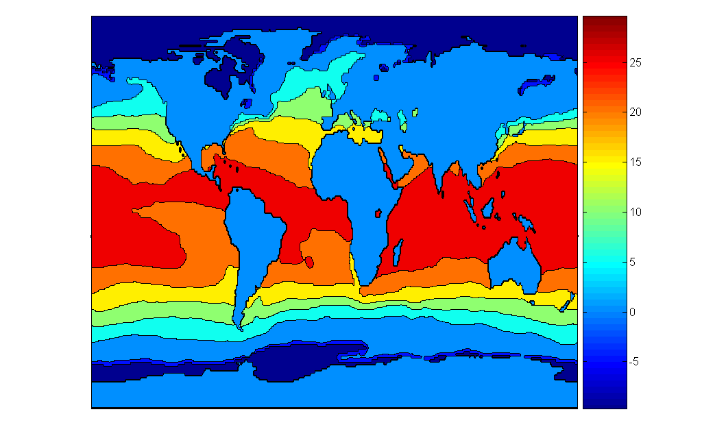
Contour Plot Example: SST Dec, 1998
Celsius

