Slide 1
PCA Example
Python Code

Slide 2
Example of PCA_Python
Generate some data that we can apply PCA to
Use PCA function from sklearn package
Determine how much variation each PC accounts for
Create figure of PCA using matplotlip package
Examine the loading scores to determine what variables have the largest effect on the graph

Slide 3
Import Libraries
import pandas as pd
Pandas: short for “panel data”, easy to manipulate data in Python
import numpy as np
Numpy lets us generate random numbers and do math
import random as rd
Random is useful for generating an example dataset

Slide 4
Import Libraries
from sklearn.decomposition import PCA
PCA function from sklearn package
5. from sklearn import preprocessing
The preprocessing package has functions for scaling data
6. import matplotlib.pyplot as plt
Matplotlib helps us draw figures

Slide 5
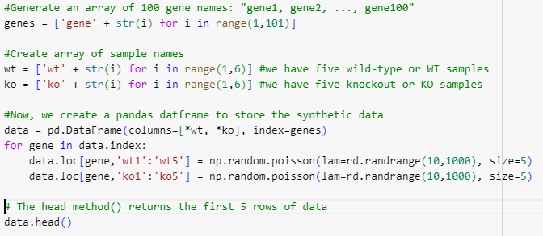
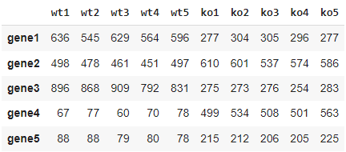
Generate data set

Slide 6

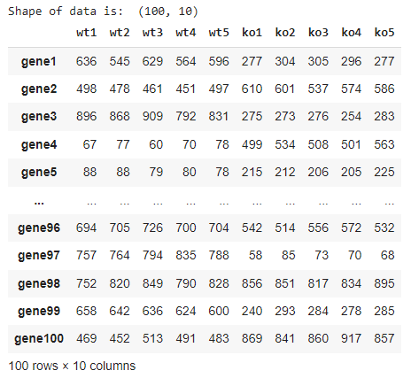
Transpose data

Slide 7

Preprocess data
Center and scale data
Centering: the average value for each gene will be 0.
Scaling: std of values for each gene will be 1.
Alternatively, we could use
StandardScaler().fit_transform(data)

Slide 8

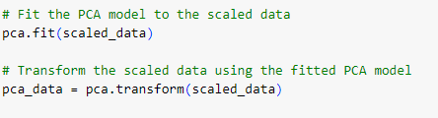
Create a PCA object
Instead of having a function that does PCA and returns results, sklearn uses objects that can be trained using a dataset.
Let’s do PCA math:

Slide 9
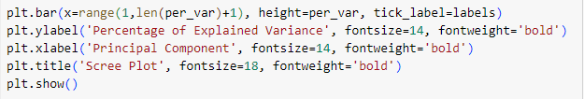
Create scree plot
Create labels for the scree plot.

Slide 10
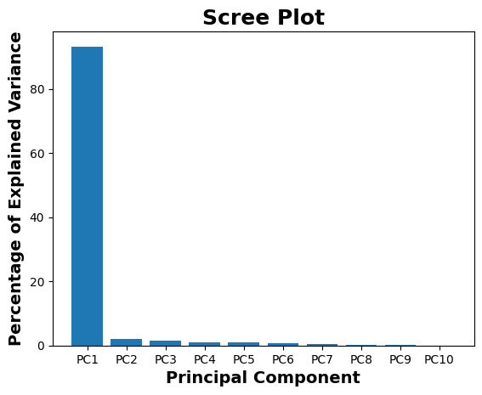
Almost all of the variation is along the first principal component !

Slide 11
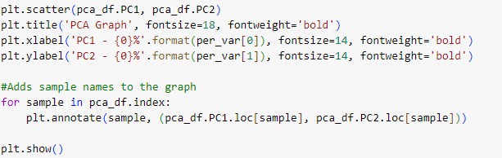
PCA Plot
To draw a PCA plot, we’ll first put the new coordinates, created by pca.transform(scaled_data), into a matrix where the rows have sample labels, and the columns have PC labels.

Slide 12
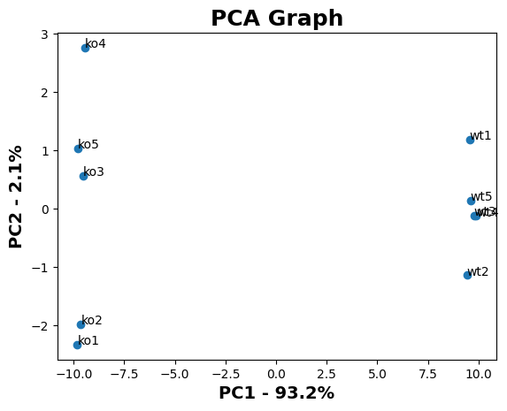
PCA Plot

Slide 13

Loading Scores
Create a Pandas “series” object with the loading scores in PC1.
Sort the loading scores based on their magnitude (absolute value).
Print out the top 10 gene names

Slide 14
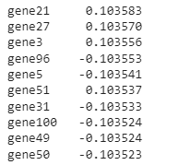
Loading Scores
Create a Pandas “series” object with the loading scores in PC1.
Sort the loading scores based on their magnitude (absolute value).
Print out the top 10 gene names

Slide 15
PCA Example data set diabetes of sklearn
Python Code

Slide 16
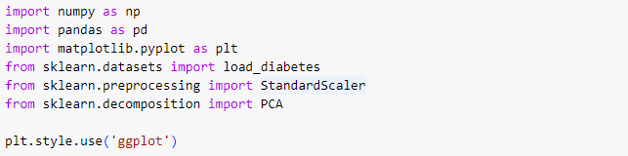
Import Libraries

Slide 17
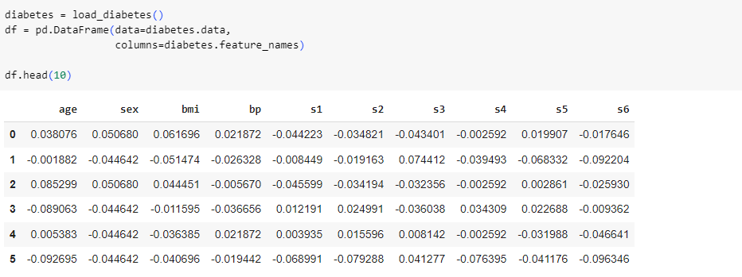
Data Preparation

Slide 18
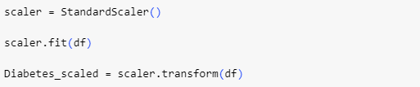
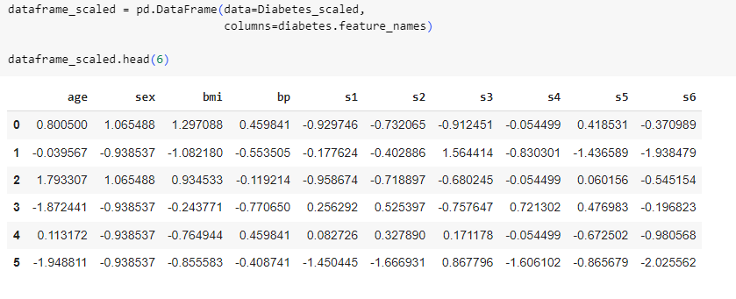
Data Standardization

Slide 19
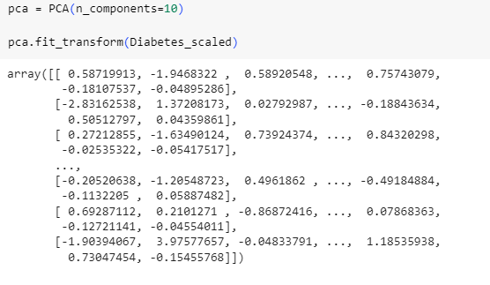
Ideal Number of Components

Slide 20

Ideal Number of Components
Once we have our PCA done, we can extract the proportion of variance explained and the eigenvalues.

Slide 21
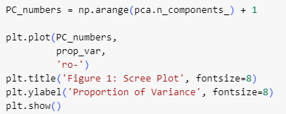
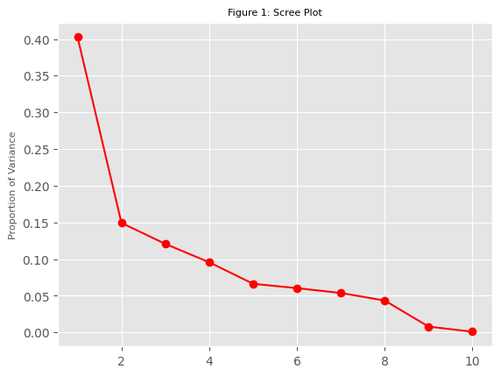
Scree plot

Slide 22


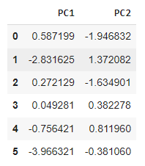
Principal Component Calculation

Slide 23
PCA is just one way of reducing the dimensionality and visualizing a dataset. There are many other dimensionality reduction methods.
Let’s explore LDA and t-SNE

Slide 24
Linear Discriminant Analysis(LDA)
LDA projects data from a p dimensional feature space down to a l (p > l) dimensional space in a way to maximize the variability between the classes and reducing the variability within the classes.
LDA doesn’t work on finding the principal component, it basically looks at what type of point/features/subspace gives more discrimination to separate the data.

Slide 25
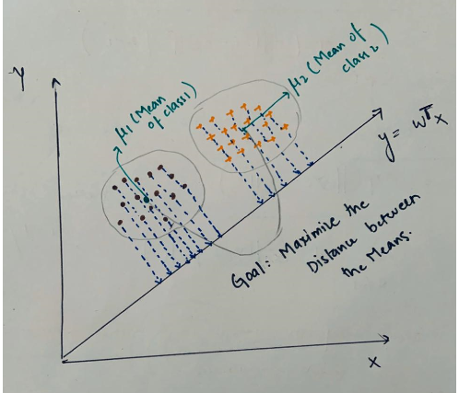
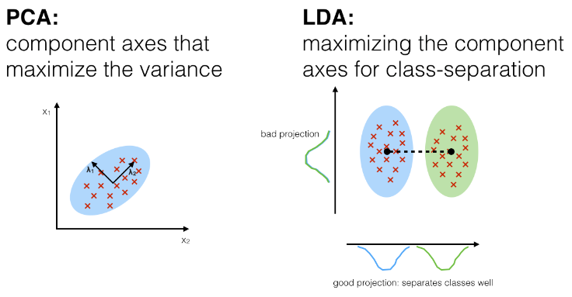
Linear Discriminant Analysis(LDA)
The objective of LDA is to find a line that maximizes the class separation. Therefore, to do this we need to define a good separation measure.
https://medium.com/analytics-vidhya/pca-vs-lda-vs-t-sne-lets-understand-the-difference-between-them-22fa6b9be9d0

Slide 26
LDA
LDA makes some assumptions about the data:
Assumes the data to be distributed normally or Gaussian distribution of data points i.e., each feature must make a bell-shaped curve when plotted.
Each of the classes has identical covariance matrices.
However, it is worth mentioning that LDA performs quite well even if the assumptions are violated.

Slide 27
Steps of LDA
Compute the p-dimensional mean vectors for the different classes from the dataset.
Compute the scatter matrices (in-between-class and within-class scatter matrix).
Compute the eigenvectors (e1,e2,...,ep) and corresponding eigenvalues (λ1,λ2,...,λp) for the scatter matrices.
Sort the eigenvectors by decreasing eigenvalues and choose k eigenvectors with the largest eigenvalues to form a d×l dimensional matrix W (where every column represents an eigenvector).
Use this p×l eigenvector matrix to transform the samples onto the new subspace. This can be summarized by the matrix multiplication: Y=X×W (where X is a n×p -dimensional matrix representing the n samples, and y are the transformed n×l-dimensional samples in the new subspace).

Slide 28
Similarities between PCA and LDA
Both are linear transformation techniques that are commonly used for dimensionality reduction.
Both rank the new axes in order of importance.
PC1 (the first new axis that PCA creates) accounts for the most variation in the data.
PC2 (the second new axis) does the second best job.
LD1 (the first new axis that LDA creates) accounts for the most variation between the categories.
Both can let you dig in and see which features are driving the new axes.

Slide 29
In summary
PCA looks at the features with the most variation.
In contrast, LDA tries to maximize the separation of known categories.
PCA can be described as an “unsupervised” algorithm, since it “ignores” class labels and its goal is to find the directions (the so-called principal components) that maximize the variance in a dataset.
In contrast to PCA, LDA is “supervised” and computes the directions (“linear discriminants”) that will represent the axes that that maximize the separation between multiple classes.
https://sebastianraschka.com/Articles/2014_python_lda.html

Slide 30
In summary
LDA is like PCA-both try to reduce dimensions.
https://sebastianraschka.com/Articles/2014_python_lda.html

Slide 31
References
Principal Component Analysis Written by Zakaria Jaadi
https://statisticsglobe.com/
StatQuest: Principal Component Analysis (PCA), Step-by-Step
https://sebastianraschka.com/Articles/2014_python_lda.html

