Slide 1
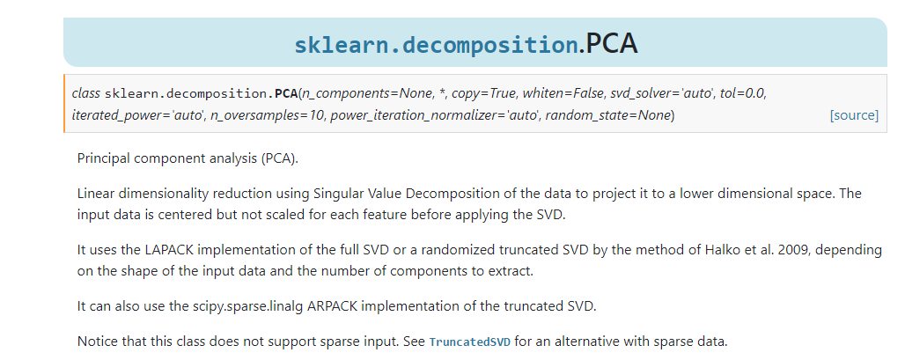
https://scikit-learn.org/stable/modules/generated/sklearn.decomposition.PCA.html

Slide 2
Extensions of PCA
Kernel PCA (kPCA): This extension of PCA is used for nonlinear dimensionality reduction. It maps the original data into a higher-dimensional feature space using a kernel function (e.g., polynomial, radial basis function) and then applies PCA in the transformed space.

Slide 3
Extensions of PCA
Sparse PCA: Sparse PCA modifies the PCA algorithm to produce sparse principal components. This means that most of the loadings (coefficients) in the principal components are set to zero, resulting in a more interpretable representation.
Sparse PCA is particularly useful when dealing with high-dimensional datasets where many variables may be irrelevant, redundant, or noisy.

Slide 4
Extensions of PCA
Incremental PCA (IPCA): IPCA is designed for large datasets that don't fit into memory. It processes data in smaller batches, updating the principal components incrementally, rather than requiring the entire dataset to be stored in memory.

Slide 5
PCA is just one way of reducing the dimensionality and visualizing a dataset. There are many other dimensionality reduction methods.
Let’s explore LDA and t-SNE

Slide 6
Linear Discriminant Analysis(LDA)
LDA projects data from a p dimensional feature space down to a l (p > l) dimensional space in a way to maximize the variability between the classes and reducing the variability within the classes.
LDA doesn’t work on finding the principal component, it basically looks at what type of point/features/subspace gives more discrimination to separate the data.

Slide 7
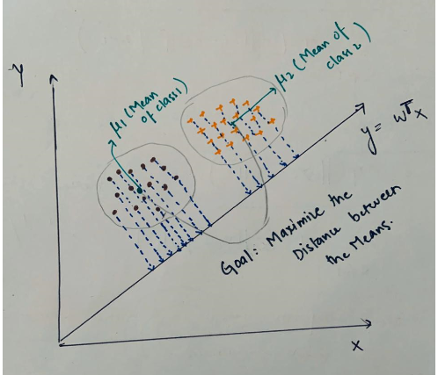
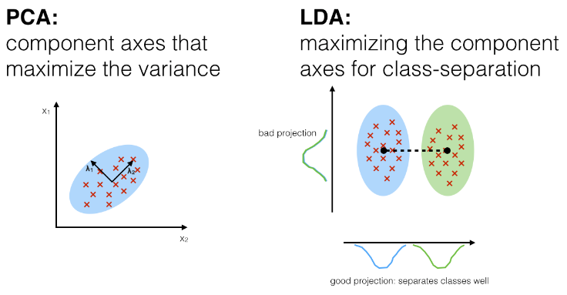
Linear Discriminant Analysis(LDA)
The objective of LDA is to find a line that maximizes the class separation. Therefore, to do this we need to define a good separation measure.
https://medium.com/analytics-vidhya/pca-vs-lda-vs-t-sne-lets-understand-the-difference-between-them-22fa6b9be9d0

Slide 8
LDA
LDA makes some assumptions about the data:
Assumes the data to be distributed normally or Gaussian distribution of data points i.e. each feature must make a bell-shaped curve when plotted.
Each of the classes has identical covariance matrices.
However, it is worth mentioning that LDA performs quite well even if the assumptions are violated.

Slide 9
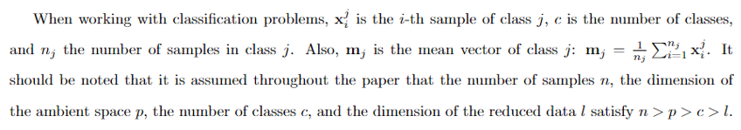
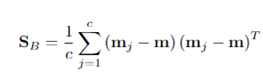
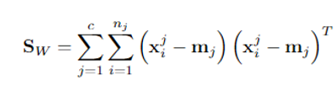
Steps of LDA
Compute the p-dimensional mean vectors for the different classes from the dataset.
Compute the scatter matrices (in-between-class and within-class scatter matrix).

Slide 10

Steps of LDA
3. Compute the eigenvectors (e1,e2,...,ep) and corresponding eigenvalues (λ1,λ2,...,λp) for the scatter matrices .
4. Sort the eigenvectors by decreasing eigenvalues and choose k eigenvectors with the largest eigenvalues to form a p×k dimensional matrix W (where every column represents an eigenvector).
5. Use this p×k eigenvector matrix to transform the samples onto the new subspace. This can be summarized by the matrix multiplication: Y=X×W (where X is a n×p -dimensional matrix representing the n samples, and y are the transformed n×l-dimensional samples in the new subspace).

Slide 11
Similarities between PCA and LDA
Both are linear transformation techniques that are commonly used for dimensionality reduction.
Both rank the new axes in order of importance.
PC1 (the first new axis that PCA creates) accounts for the most variation in the data.
PC2 (the second new axis) does the second best job.
LD1 (the first new axis that LDA creates) accounts for the most variation between the categories/classes.
Both can let you dig in and see which features are driving the new axes.

Slide 12
In summary
PCA looks at the features with the most variation.
In contrast, LDA tries to maximize the separation of known categories.
PCA can be described as an “unsupervised” algorithm, since it “ignores” class labels and its goal is to find the directions (the so-called principal components) that maximize the variance in a dataset.
In contrast to PCA, LDA is “supervised” and computes the directions (“linear discriminants”) that will represent the axes that that maximize the separation between multiple classes.
https://sebastianraschka.com/Articles/2014_python_lda.html

Slide 13
In summary
LDA is like PCA-both try to reduce dimensions.
https://sebastianraschka.com/Articles/2014_python_lda.html

Slide 14
Extensions of LDA
Quadratic Discriminant Analysis (QDA): This extension is used when there are multiple input variables. Unlike LDA, QDA allows each class to have its own estimate of variance and covariance. This flexibility can be beneficial when the assumption of equal covariance matrices among classes doesn't hold.

Slide 15
Extensions of LDA
Flexible Discriminant Analysis (FDA): In cases where a non-linear combination of inputs is required, FDA, often involving the use of splines, offers a solution. It allows for more complex relationships between variables, making it suitable for non-linear classification problems.

Slide 16
Extensions of LDA
Regularized Discriminant Analysis (RDA): RDA moderates the influence of various variables in LDA by applying regularization techniques to the estimate of covariance. This helps prevent overfitting and can be useful when dealing with high-dimensional data.

Slide 17
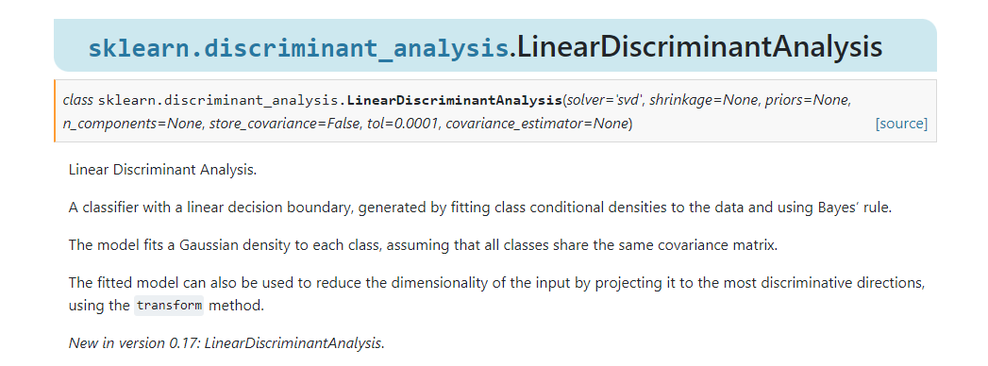
https://scikit-learn.org/stable/modules/generated/sklearn.discriminant_analysis.LinearDiscriminantAnalysis.html

Slide 18
t-Distributed Stochastic Neighbor Embedding (t-SNE)
a nonlinear dimensionality reduction technique for embedding high-dimensional data for visualization in a low-dimensional space of two or three dimensions.
Specifically, it models each high-dimensional object by a two- or three-dimensional point in such a way that similar objects are modeled by nearby points and dissimilar objects are modeled by distant points with high probability.

Slide 19
t-SNE: Capturing Local and Global Structure in High-Dimensional Data
t-SNE is a powerful technique for visualizing high-dimensional data.
Unlike linear techniques like PCA, t-SNE excels in preserving both local and global structures within the data.
Linear techniques might not effectively capture complex, nonlinear relationships in the data.
t-SNE focuses on preserving local structures by keeping similar data points close together.
It also reveals global structures, such as clusters at multiple scales.

Slide 20
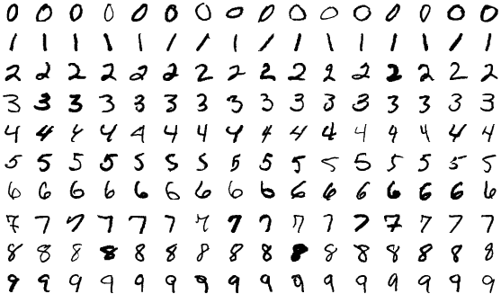
Illustrative Example: MNIST Dataset
The MNIST dataset contains images of handwritten digits.
Let's see how t-SNE can help us visualize this complex high-dimensional data.
https://en.wikipedia.org/wiki/MNIST_database#/media/File:MnistExamplesModified.png

Slide 21
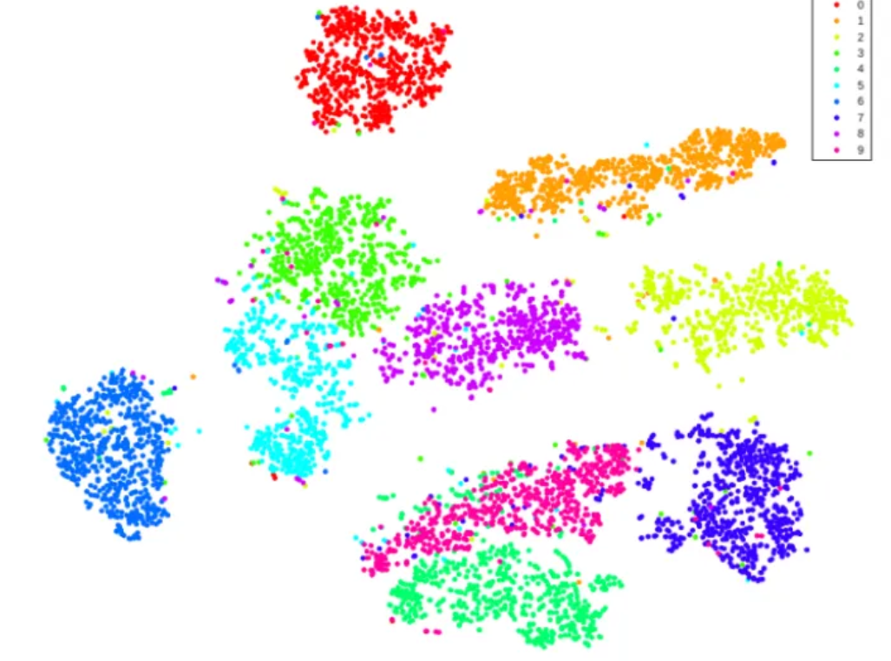
Illustration of t-SNE on MNIST dataset
Source: Visualizing Data using t-SNE, research paper by Laurens van der Maaten and Geoffrey Hinton

Slide 22

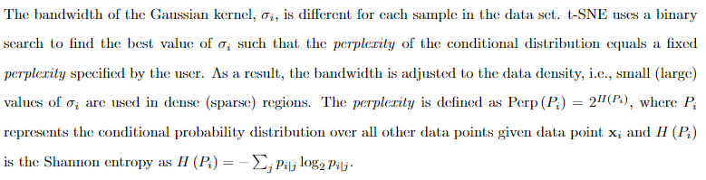
t-SNE
The idea is that if two points are close in the input space, their corresponding map points should be close as well. We define a conditional similarity between pairs of samples xi and xj:

Slide 23
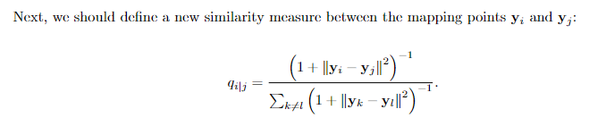
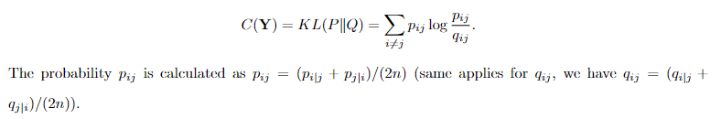
t-SNE
The final component of t-SNE is to ensure that these two metrics are close to each other based on the KL divergence (a way to measure how two probability distributions are different from each other. ) between the two joint probability distributions P (in the original input space) and Q (in the embedding space):

Slide 24
Understanding Similarity in t-SNE
begins by converting high-dimensional Euclidean distances into joint probabilities that represent similarities.
In t-SNE, the similarity of a high-dimensional data point ‘xj’ to that of ‘xi’ is represented by the joint probability ‘pij’.
Think of ‘pij’ as the probability that ‘xi’ would pick ‘xj’ as its neighbor if neighbors were chosen proportionally to their probability density under a Normal (Gaussian) distribution.

Slide 25
Interpreting ‘pij’
When data points are nearby in the high-dimensional space, ‘pij’ will be high.
For widely separated data points, ‘pij’ becomes negligible.
Significance of Probability Distributions
This transformation of distances into probabilities helps t-SNE effectively capture both local and global structures in the data.
It forms the foundation for the t-SNE algorithm's ability to reveal complex patterns and relationships within high-dimensional datasets.

Slide 26
t-SNE
T-SNE is an unsupervised machine learning method that is used to visualize the higher dimensional data in low dimensions. T-SNE can bring down any number of feature space into 2-D feature space.
Both PCA and LDA are used for visualization and dimensionality reduction but T-SNE is specifically used for visualization purposes only. It is well suited for the visualization of high-dimensional datasets.
Unlike PCA and LDA, T-SNE is a non-linear data visualizer. It means it doesn’t form a linear line to separate the classes or to calculate the variance and it doesn’t use any norm or distance metric to calculate the distance between points.

Slide 27
Perplexity in t-SNE
The performance of t-SNE is fairly robust under different settings of the perplexity. The most appropriate value depends on the density of your data. Loosely speaking, one could say that a larger / denser dataset requires a larger perplexity. Typical values for the perplexity range between 5 and 50.
Perplexity is a measure for information that is defined as 2 to the power of the Shannon entropy. The perplexity of a fair die with k sides is equal to k. In t-SNE, the perplexity may be viewed as a knob that sets the number of effective nearest neighbors. It is comparable with the number of nearest neighbors k that is employed in many manifold learners.

Slide 28
Non-Deterministic Nature of t-SNE
In contrast to, e.g., PCA, t-SNE has a non-convex objective function. The objective function is minimized using a gradient descent optimization that is initiated randomly. As a result, it is possible that different runs give you different solutions.
It’s not deterministic and iterative so each time it runs, it could produce a different result.

Slide 29
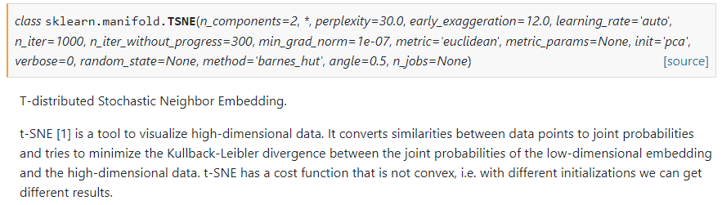
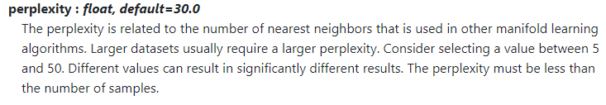
sklearn.manifold.TSNE
https://scikit-learn.org/stable/modules/generated/sklearn.manifold.TSNE.html

Slide 30
Paper
Dimensionality reduction techniques in structural and earthquake engineering
https://www.sciencedirect.com/science/article/abs/pii/S0141029622015619

Slide 31
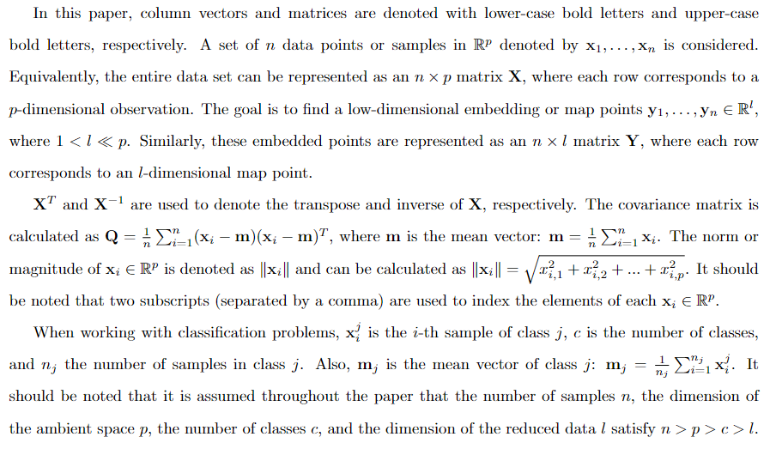
Notation

Slide 32
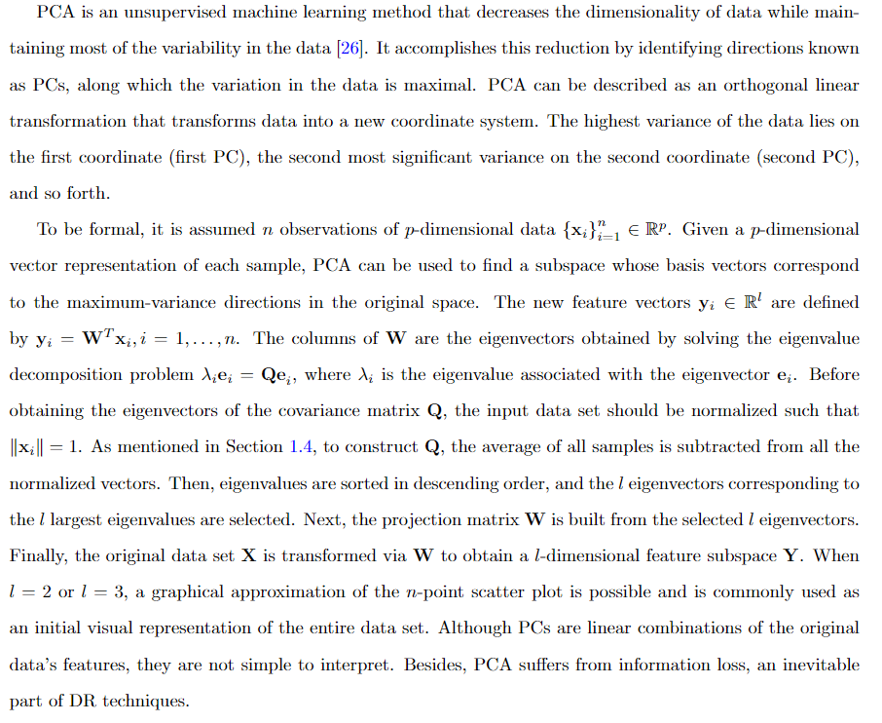
PCA

Slide 33
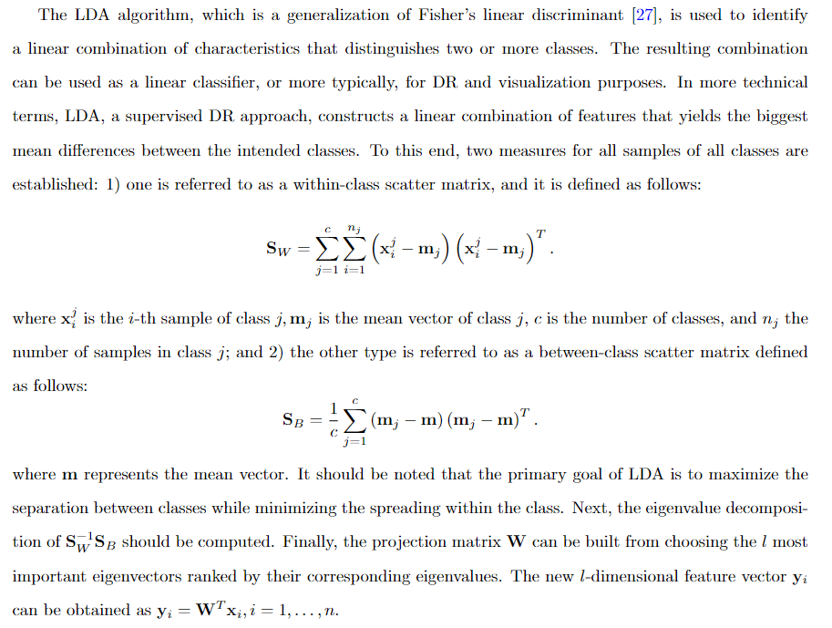
LDA

Slide 34
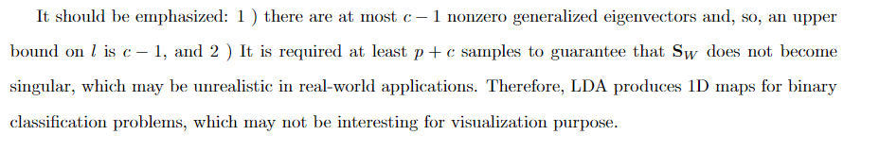
LDA

Slide 35
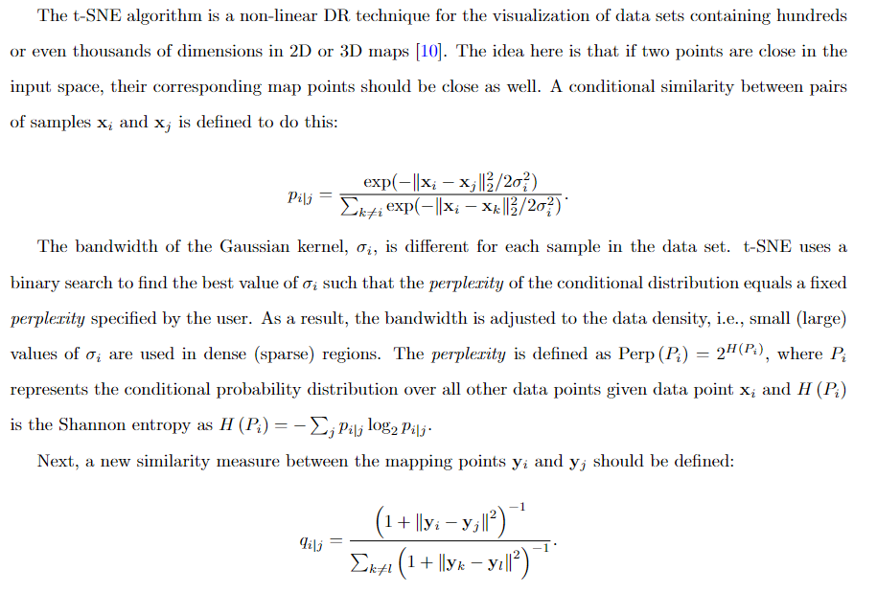
t-SNE

Slide 36
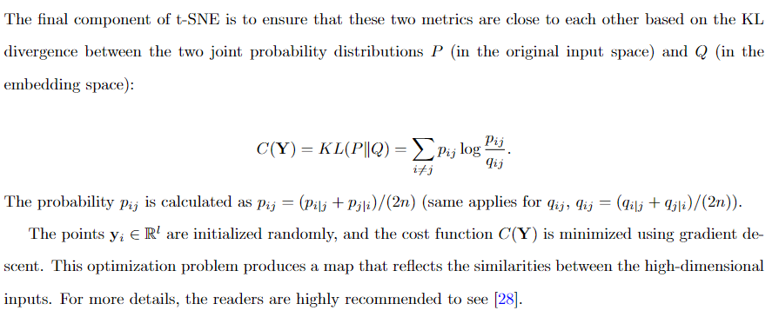
t-SNE
Notes:
KL divergence is a non-symmetric metric that measures the relative entropy or difference in information represented by two distributions. It can be thought of as measuring the distance between two data distributions showing how different the two distributions are from each other.

Slide 37
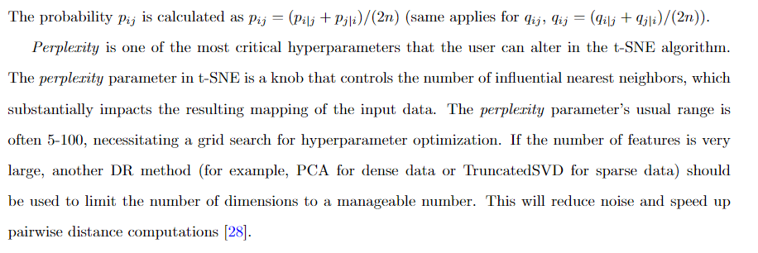
t-SNE

Slide 38
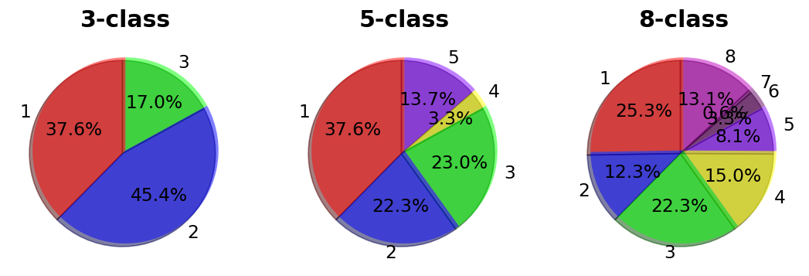
Data Sets
Let’s see the figures of a data set with 3 classes!

Slide 39
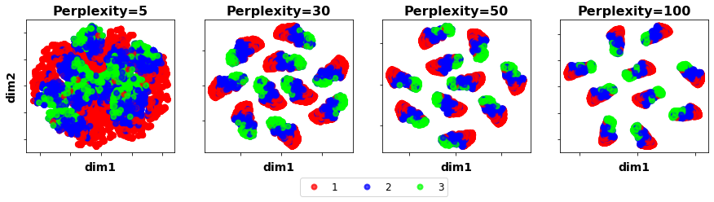
T-SNE with different perplexity

Slide 40
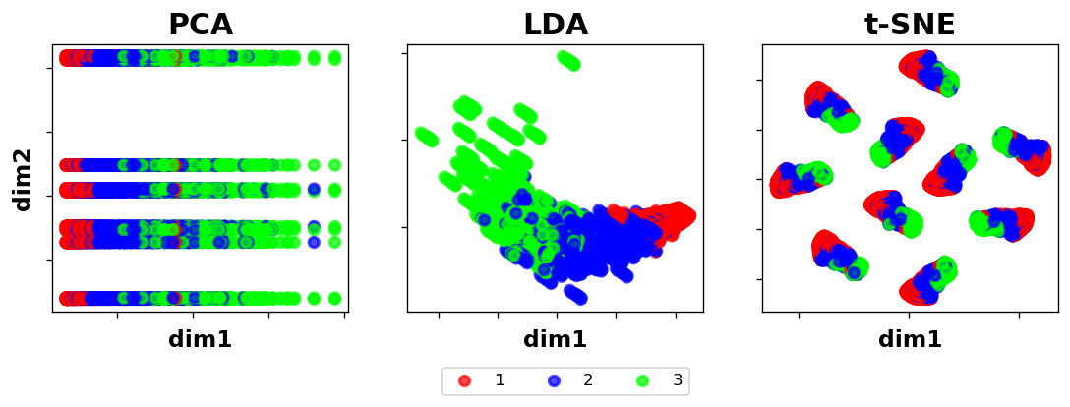
Comparison of Three Methods

Slide 41
Future research ideas related to these topics
Anomaly Detection with PCA: Explore how PCA can be used for anomaly detection in various domains, such as finance, healthcare, or cybersecurity. Investigate novel methods for identifying anomalies by analyzing the principal components and their variances.
Classification Enhancement with LDA: Focus on improving classification accuracy by incorporating LDA into machine learning models. Investigate how LDA can help reduce class overlap and enhance the separability of different classes in classification tasks.
Text Data Visualization with t-SNE: Apply t-SNE to text data, such as document embeddings or word embeddings. Visualize high-dimensional text data in 2D or 3D space to uncover patterns, clusters, or similarities between documents or words.

Slide 42
Useful Resources
StatQuest avoids the complex linear algebra and use illustrations to show you what each method does so you will know when to use it and how to interpret the results.
Principal Component Analysis (PCA) clearly explained
StatQuest: Linear Discriminant Analysis (LDA) clearly explained
StatQuest: t-SNE, Clearly Explained

Slide 43
References
Principal Component Analysis Written by Zakaria Jaadi
https://statisticsglobe.com/
StatQuest: Principal Component Analysis (PCA), Step-by-Step
https://sebastianraschka.com/Articles/2014_python_lda.html

