Slide 1
Introduction to Data Mining

Slide 2
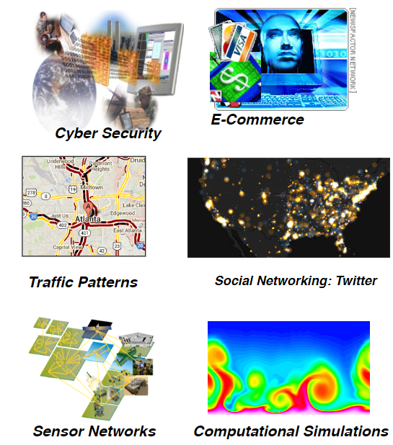
Large-scale Data is Everywhere!
There has been enormous data growth in both commercial and scientific databases due to advances in data generation and collection technologies
New mantra
Gather whatever data you can whenever and wherever possible.
Expectations
Gathered data will have value either for the purpose collected or for a purpose not envisioned.

Slide 3

Why Data Mining? Commercial Viewpoint
Lots of data is being collected and warehoused
Web data
Yahoo has Peta Bytes of web data
Facebook has billions of active users
purchases at department/ grocery stores, e-commerce
Amazon handles millions of visits/day
Bank/Credit Card transactions
Computers have become cheaper and more powerful
Competitive Pressure is Strong
Provide better, customized services for an edge (e.g. in Customer Relationship Management)

Slide 4
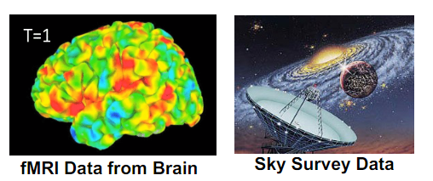
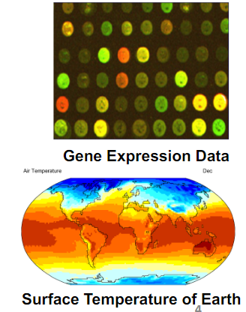
Why Data Mining? Scientific Viewpoint
Data collected and stored at enormous speeds
remote sensors on a satellite
NASA EOSDIS archives over petabytes of earth science data / year
telescopes scanning the skies
Sky survey data
High-throughput biological data
Scientific simulations
terabytes of data generated in a few hours
Data mining helps scientists
in automated analysis of massive datasets
in hypothesis formation

Slide 5
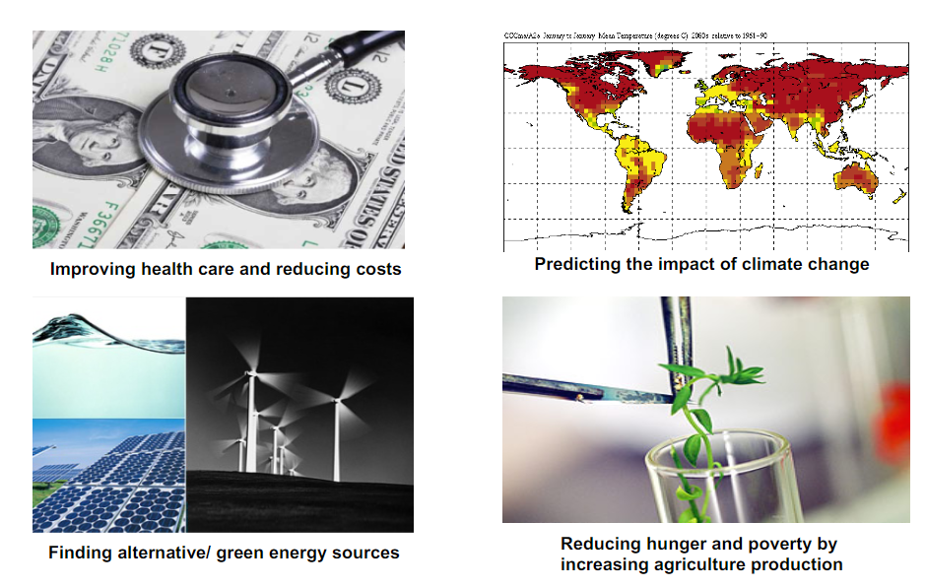
Great Opportunities to Solve Society’s Major Problems

Slide 6
What is Data Mining?
Many Definitions
Non-trivial extraction of implicit, previously unknown and potentially useful information from data
Exploration & analysis, by automatic or semi-automatic means, of large quantities of data in order to discover meaningful patterns

Slide 7
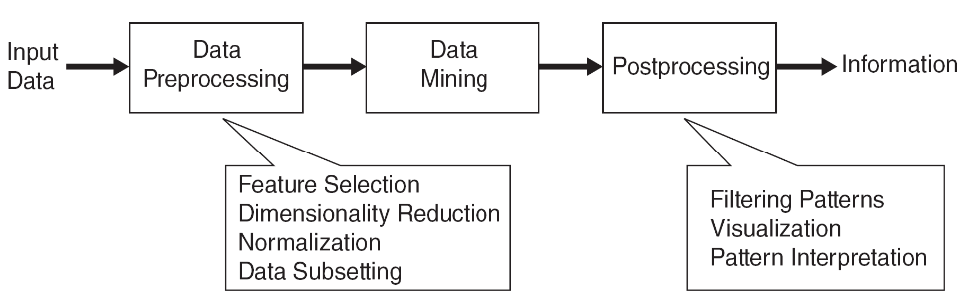
What is Data Mining?

Slide 8
Data Mining Tasks
Prediction Methods
Use some variables to predict unknown or future values of other variables.
Description Methods
Find human-interpretable patterns that describe the data.

Slide 9
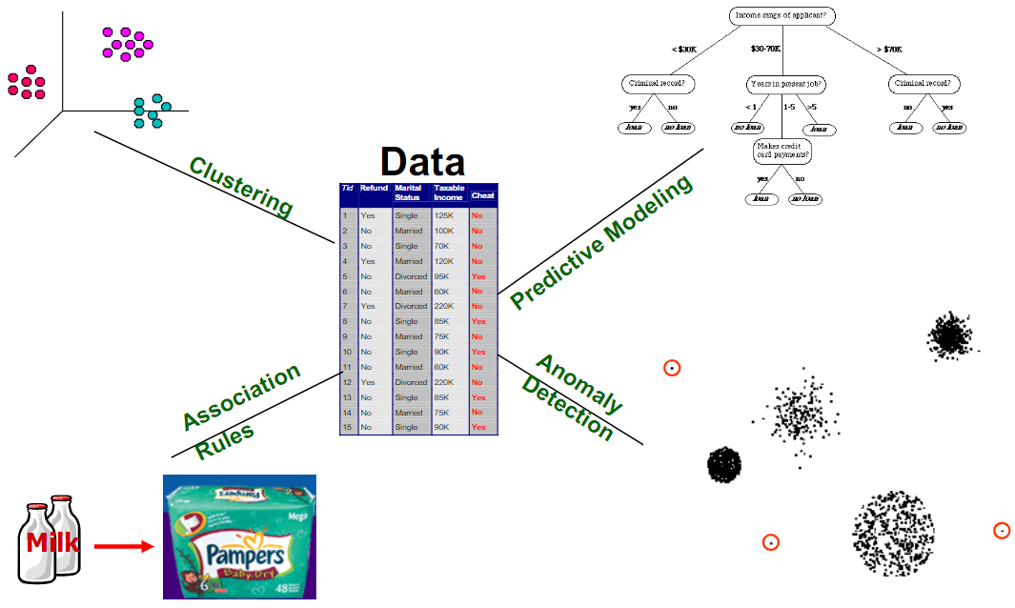
Data Mining Tasks ...

Slide 10
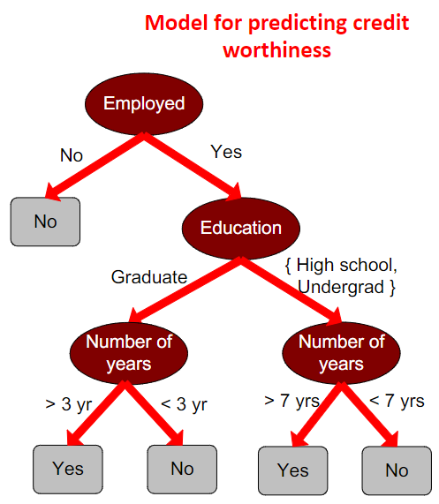
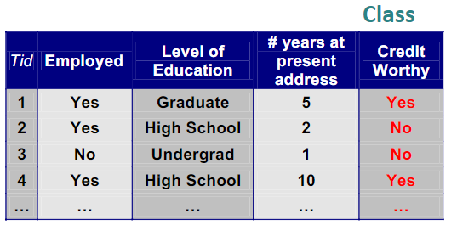
Predictive Modeling: Classification
Find a model for class attribute as a function of the values of other attributes

Slide 11
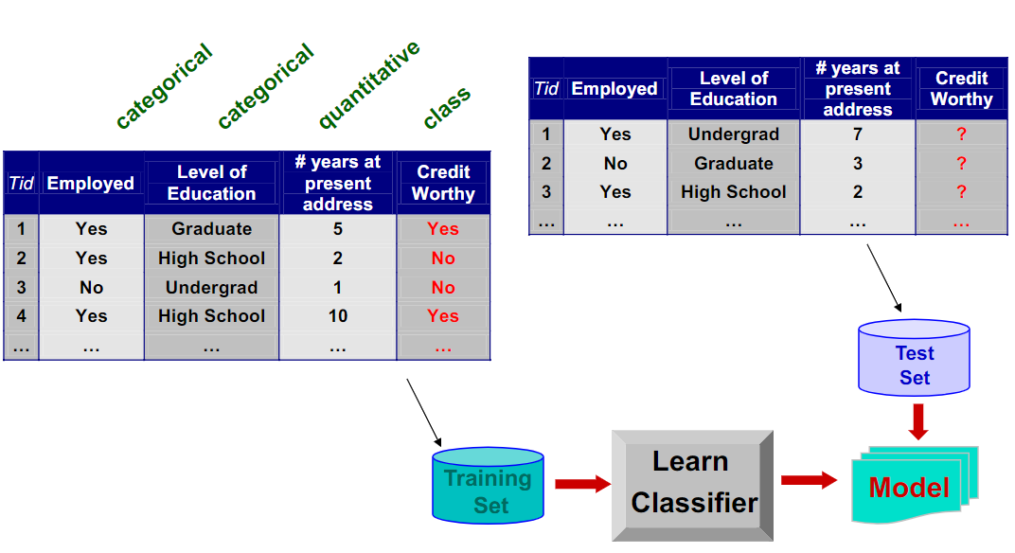
Classification Example

Slide 12

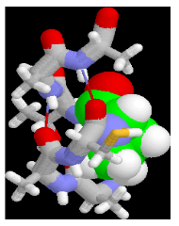
Examples of Classification Task
Classifying credit card transactions as legitimate or fraudulent
Classifying land covers (water bodies, urban areas, forests, etc.) using satellite data
Categorizing news stories as finance, weather, entertainment, sports, etc
Identifying intruders in the cyberspace
Predicting tumor cells as benign or malignant
Classifying secondary structures of protein as alpha-helix, beta-sheet, or random coi

Slide 13
Regression
Predict a value of a given continuous valued variable based on the values of other variables, assuming a linear or nonlinear model of dependency.
Extensively studied in statistics, neural network fields.
Ex:
Predicting sales amounts of new product based on advertising expenditure.
Predicting wind velocities as a function of temperature, humidity, air pressure, etc.
Time series prediction of stock market indices.

Slide 14
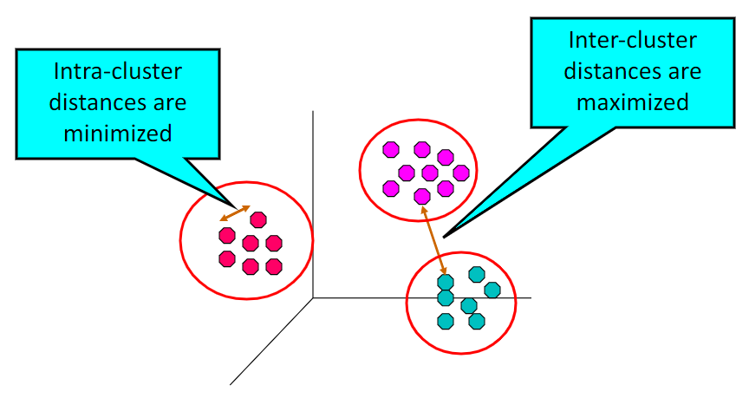
Clustering
Finding groups of objects such that the objects in a group will be similar (or related) to one another and different from (or unrelated to) the objects in other groups

Slide 15
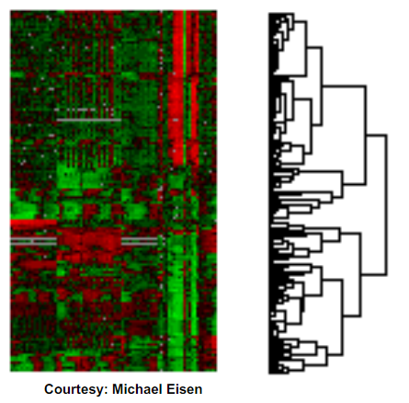
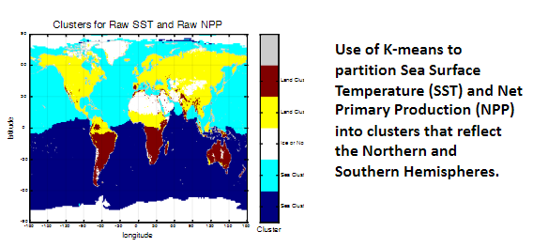
Applications of Cluster Analysis
Understanding
Custom profiling for targeted marketing
Group related documents for browsing
Group genes and proteins that have similar functionality
Group stocks with similar price fluctuations
Summarization
Reduce the size of large data sets

Slide 16
Clustering: Application 1
Market Segmentation:
Goal: subdivide a market into distinct subsets of customers where any subset may conceivably be selected as a market target to be reached with a distinct marketing mix.
Approach:
Collect different attributes of customers based on their geographical and lifestyle related information.
Find clusters of similar customers.
Measure the clustering quality by observing buying patterns of customers in same cluster vs. those from different clusters.

Slide 17
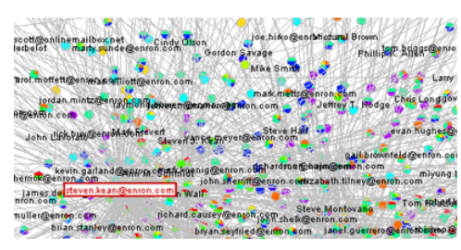
Clustering: Application 2
Document Clustering:
Goal: To find groups of documents that are similar to each other based on the important terms appearing in them.
Approach: To identify frequently occurring terms in each document. Form a similarity measure based on the frequencies of different terms. Use it to cluster

Slide 18
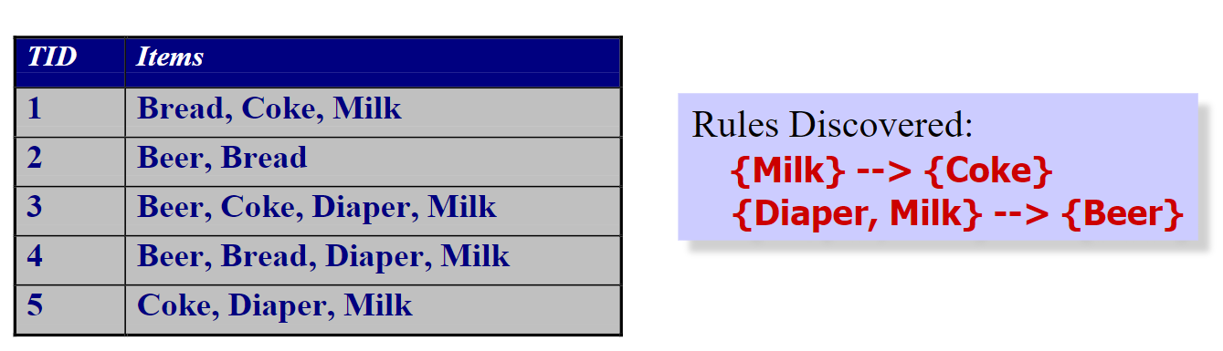
Association Rule Discovery: Definition
Given a set of records each of which contain some number of items from a given collection
Produce dependency rules which will predict occurrence of an item based on occurrences of other items.

Slide 19
Association Analysis: Applications
Market-basket analysis
Rules are used for sales promotion, shelf management, and inventory management
Telecommunication alarm diagnosis
Rules are used to find combination of alarms that occur together frequently in the same time period
Medical Informatics
Rules are used to find combination of patient symptoms and test results associated with certain diseases

Slide 20
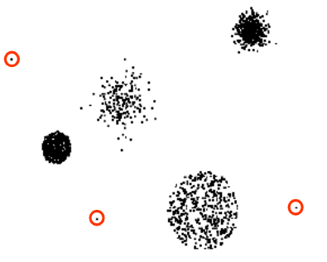
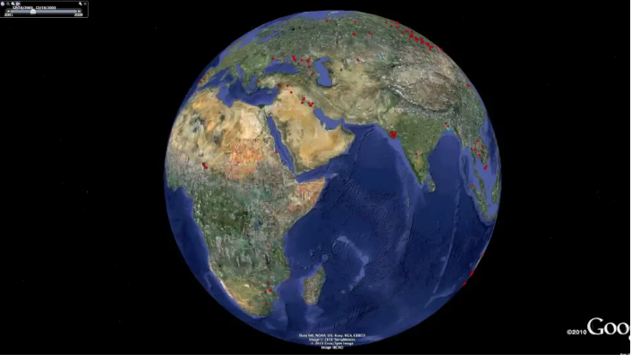
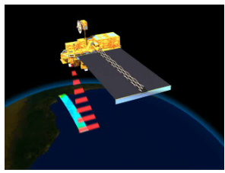
Deviation/Anomaly/Change Detection
Detect significant deviations from normal behavior
Applications:
Credit Card Fraud Detection
Network Intrusion Detection
Identify anomalous behavior from sensor networks for monitoring and surveillance.
Detecting changes in the global forest cover.

Slide 21
Motivating Challenges
Scalability
High Dimensionality
Heterogeneous and Complex Data
Data Ownership and Distribution
Non-traditional Analysis

