Slide 1
Introduction to Data Mining

Slide 2
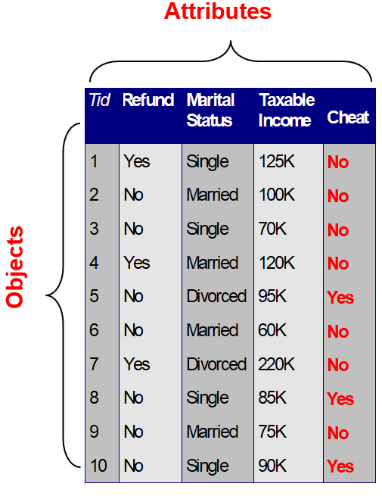
What is Data?
Collection of data objects (observations) defined by attributes (features)
An attribute is a property or characteristic of an object
Ex: eye color, temperature, …
Also known as feature, variable, field, characteristic.
A collection of attributes described an object
Also known as observation, record, point, case, sample, or instance.

Slide 3
Attribute Values
Attribute values are numbers or symbols assigned to an attribute for a particular object.
The same attribute can be mapped to different attribute values.
Ex: Temperature can be measured in Celsius or Fahrenheit
Different attributes can be mapped to the same set of values.
Ex: Attribute values for ID and age are integers.
But the properties of attribute values can be different.

Slide 4
Attributes Classification
Discrete Attribute
Has a finite or countably infinite set of values
Ex: Zip codes, click counts, set of words in a collection of documents
Often represented as integer variables
Binary attributes are a special case of discrete attributes
Continuous Attribute
Has real numbers as attribute values
Ex: temperature, height, or weight
Continuous attributes are typically represented as floating-point variables

Slide 5
Attributes Classification
Important attribute classes
Categorical
Nomial
Ex: Eye color, ID numbers, Zip codes (without any inherent order)
Ordinal
Ex: Rankings(e.g., place in competition), grades, clothing sizes ({XS, S,.., XL}) (with a meaningful order)

Slide 6
Attributes Classification
Categorical
Interval
type of numerical attribute that has a meaningful order and a consistent interval between values.
This means that ratios of values are not meaningful, but differences between values are.
Ratio
Ex: length, elapsed time (e.g., time to run a race), counts
A weight of 20 kg is twice as heavy as a weight of 10 kg.
A weight of 0 kg represents the absence of weight (no weight).

Slide 7
Attributes Classification
Interval attributes have a meaningful order and consistent intervals but an arbitrary zero point. (the zero point on the scale does not indicate a complete absence of the attribute.)
Ratio attributes have a meaningful order, consistent intervals, and a true zero point.

Slide 8
Types of Data Sets
Record
Data matrix
Document Data
Transaction Data
Graph
World Wide Web
Molecular Structures
Ordered
Spatial Data
Temporal Data
Sequential Data
Genetic Sequence Data

Slide 9
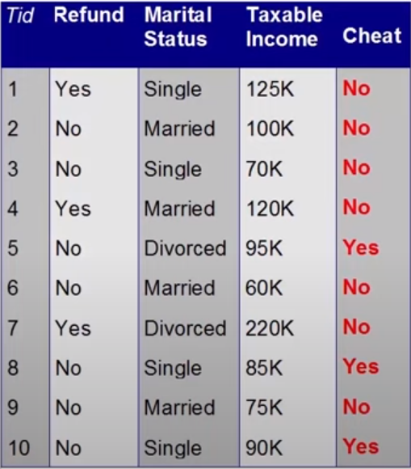
Recorded Data
Data that consists of a collection of records, each of which consists of a fixed set of attributes

Slide 10
Data Matrix
Data objects with only numeric attributes can be represented by m by n matrix, where there are m rows, one for each object, and n columns, one for each attribute.
The data objects can be thought of as points in a multi-dimensional space, where each dimension represents a distinct attribute.
Projection of x Load | Projection of y Load | Distance | Load | Thickness
10.23 | 5.27 | 15.22 | 2.7 | 1.2
12.65 | 6.25 | 16.22 | 2.2 | 1.1

Slide 11
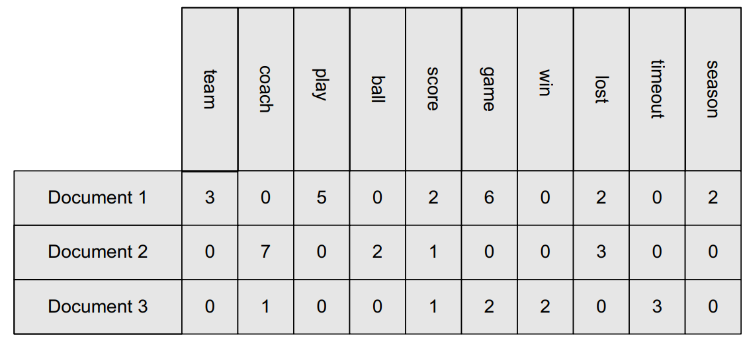
Document Data
Special type of data arrangement that's commonly used for text analysis.
Each document becomes a “term” vector
Each item is a component (attribute) of the vector
The value of each component is the number of times the corresponding term occurs in the document

Slide 12
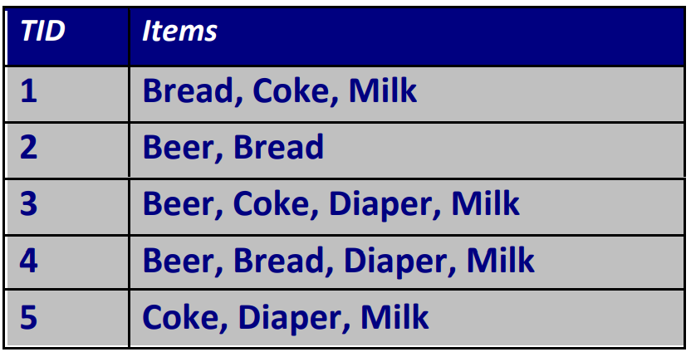
Transaction Data
A special type of record data, where
– Each record (transaction) involves a set of items.
– Consider a grocery store. The set of products purchased by a customer during one shopping trip constitute a transaction, while the individual products that were purchased are the items.

Slide 13
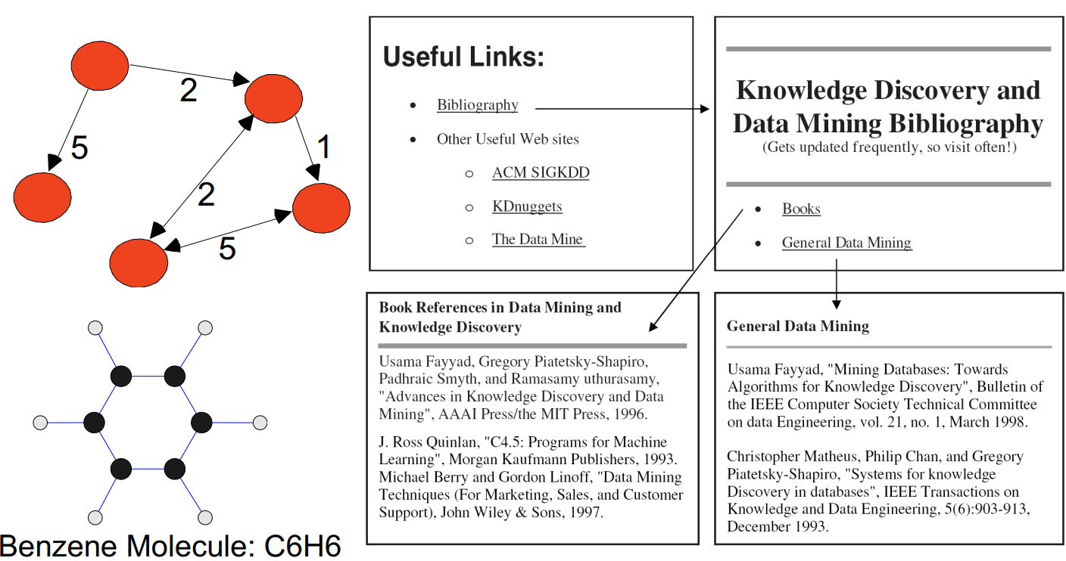
Graph Data
Ex: Generic graph, a molecule, and webpages

Slide 14
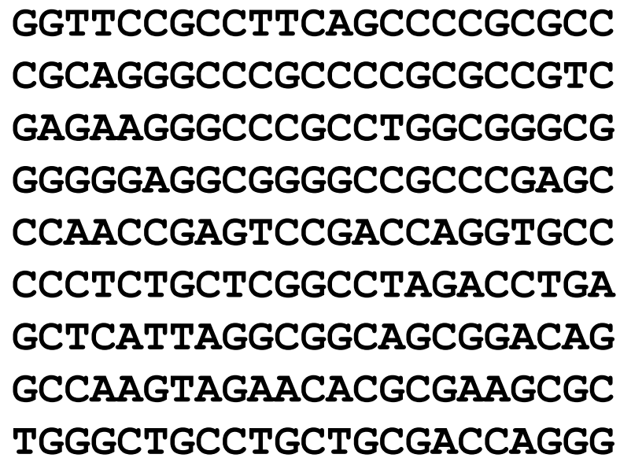
Ordered Data
Genomic Sequence Data
Notes:
Ordered data reveals patterns in sequence, and it's especially fascinating when it comes to genetic information.
Ordered data is data that follows a specific sequence or order, where the arrangement of elements is essential for understanding the data's meaning. This sequence holds vital information and patterns that might not be evident in other formats.
Look at the slide. Genomic Sequence Data is a prime example. This type of data involves the specific arrangement of nucleotides (A, T, C, and G) in a DNA molecule. The sequence of these nucleotides contains the genetic instructions for building and maintaining living organisms.
Ordered data, such as genomic sequences, helps us understand how genes and genetic information are structured. It allows scientists to study genetic variations, identify specific genes responsible for traits or diseases, and explore evolutionary relationships between species.
Can you explain how this sequence is used in genomics?
The order of nucleotides in a DNA sequence holds the genetic code. This code provides instructions for building proteins, which are essential for various biological functions. By analyzing these sequences, scientists can identify mutations, genetic markers, and even predict potential health risks.
Is ordered data limited to genomics?
Not at all! While genomics is a significant application, ordered data appears in various fields. Think about temporal data, which involves time-based sequences, or even sequential patterns in data mining, where events follow a particular order. Order provides context and can unveil valuable insights.

Slide 15
Question
Is ordered data limited to genomics?
Answer: Not at all! While genomics is a significant application, ordered data appears in various fields.
Think about temporal data, which involves time-based sequences, or even sequential patterns in data mining, where events follow a particular order.
Order provides context and can unveil valuable insights.

Slide 16
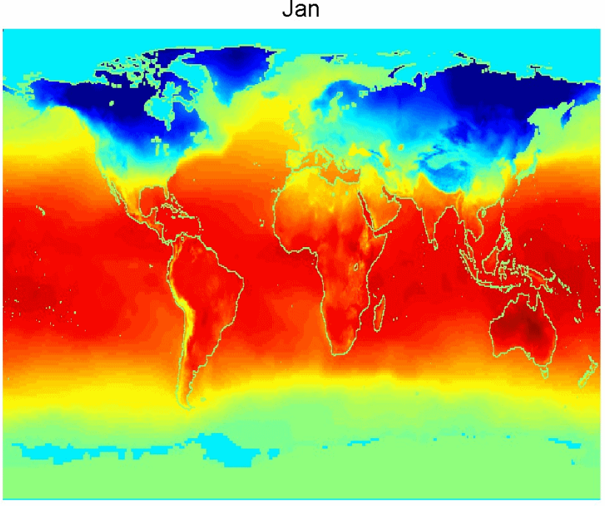
Ordered Data
Spatial – Temporal Data
gives us the ability to track changes across both space and time,
it's particularly interesting in climate and environmental analysis.
Average Monthly Temperature of land and ocean

Slide 17
Data Quality
Poor data quality negatively affects many data processing efforts.
Data quality refers to the overall reliability, accuracy, and consistency of the data we work with.
Data mining example: A classification model is built to detect loan risks using poor data
Some credit-worthy candidates are denied loans
More loans are given to individuals who are likely to fail in repaying those loans.

Slide 18
Data Quality
What problems should we worry about?
How can we detect problems with the data?
What can we do about these problems?
Examples of data quality problems:
Noise and outliers
Missing values
Duplicate data
Wrong data

Slide 19
Noise
For objects, noise is an extraneous object
Ex: In a dataset of students' exam scores, if there's an entry with an abnormally high score that doesn't align with the overall pattern of scores, it could be considered as noise.
For attributes, noise refers to modification of original values
This could be due to errors during data entry, measurement, or other sources.
Ex: In a dataset of temperature measurements, if some temperature values are recorded with incorrect decimal places (e.g., 100 instead of 10.0), it introduces attribute noise.

Slide 20
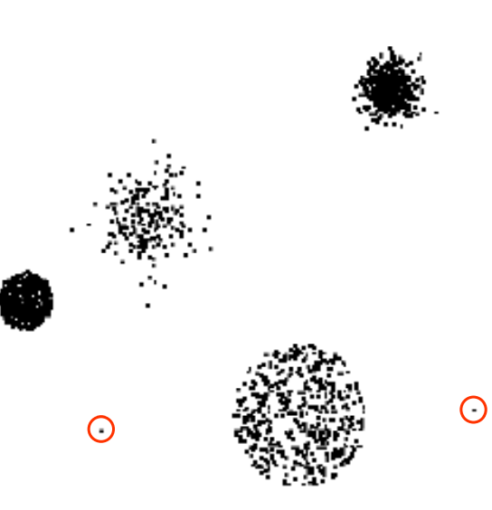
Outliers
Data objects with characteristics that are considerably different than most of the other data objects in the data set.
Outliers can be either noise or meaningful anomalies depending on the context.
Case 1: Outliers are noise that interferes with data analysis
Case 2: Outliers are the goal of our analysis
Credit card fraud
Intrusion detection

Slide 21
Discussion
How do we identify outliers?
One common approach is using the z-score, which measures how many standard deviations a data point is away from the mean. Data points with z-scores beyond a certain threshold could be considered outliers.
Can outliers have a positive impact too?
In some cases, outliers can provide valuable insights. They might indicate unusual trends, opportunities, or exceptional cases. For example, in marketing, identifying outliers in customer behavior could help develop targeted strategies.

Slide 22
Missing Values
Reasons for missing values
– Information is not collected
(e.g., people decline to give their age and weight)
– Attributes may not be applicable to all cases
(e.g., annual income is not applicable to children) !
Handling missing values
– Eliminate data objects or variables
– Estimate missing values
Example: time series of temperature
Example: census results (due to non-responses or incomplete surveys)
– Ignore the missing value during analysis
– Replace with all possible values (weighted by their probabilities)

Slide 23
Duplicate Data
Data set may include data objects that are duplicates, or almost duplicates of one another
Major issue when merging data from heterogeneous sources !
Ex: – Same person with multiple email addresses !
Data cleaning – Process of dealing with duplicate data issues

Slide 24
Data Preprocessing
Aggregation
Sampling
Dimensionality Reduction
Feature Subset Selection
Feature Creation
Discretization and Binarization
converting continuous data into discrete or binary data. This can be useful for making the data more manageable and for improving the performance of machine learning algorithms.
Attribute Transformation
transforming the data into a different format. This can be useful for making the data more compatible with machine learning algorithms.

Slide 25
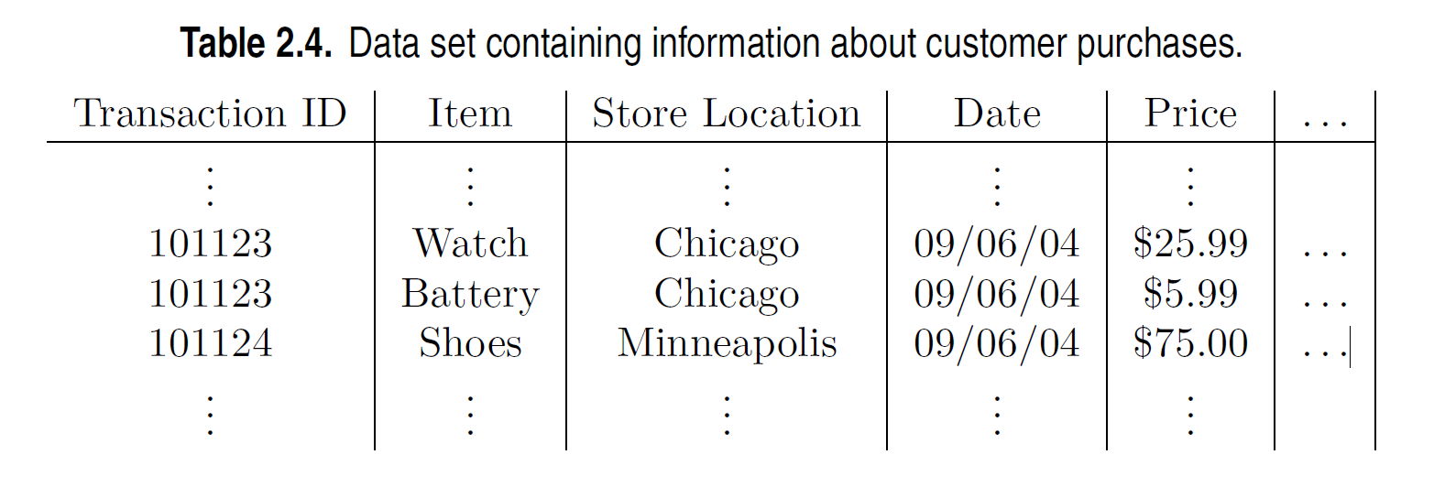
Aggregation
Combining two or more attributes (or objects) into a single attribute (or object)
Purpose
Data Reduction
Reduce the number of attributes or objects
Change of scale
Cities aggregated into regions, states, countries, etc.
Days aggregated into weeks, months, or years
More ‘stable’ data
Aggregated data tends to have less variability

Slide 26
Sampling
A way to grasp the essence of the whole from a smaller representation.
The main technique employed for data selection
Often used for both the preliminary investigation of the data and the final data analysis
Statisticians sample because obtaining the entire set of data of interest is too expensive or time consuming

Slide 27
Sampling
Data miners sample because processing the entire set of data of interest is too expensive or time consuming
The key principle for effective sampling is:
A sample will work almost as well as using the entire data set if the sample is representative.

Slide 28
Types of Sampling
Simple Random Sampling
There is an equal probability of selecting any particular item
Stratified sampling
Split the data into several partitions; draw random samples from each partition
Sampling without replacement
As each item is selected; it is removed from the population
Sampling with replacement
Objects are not removed from the population as they are selected for the sample
The same object can be picked up more than once.

Slide 29
Curse of Dimensionality
A challenge that arises when we deal with data in higher dimensions.
When dimensionality increases, data becomes increasingly sparse in the space that is occupies.
Definition of density and distance between points, which is critical for clustering and outlier detection, become less meaningful.

Slide 30
Dimensionality Reduction
Purpose:
Avoid curse of dimensionality
Reduce time and memory required
Allow data to be more easily visualized
May help to eliminate irrelevant features or reduce noise
Techniques:
Principal Component Analysis
Linear Discriminant Analysis
t-distributed Stochastic Neighbor Embedding
Others: various supervised/unsupervised and linear/non linear techniques

Slide 31
Feature Subset Selection
Another way to reduce dimensionality of data
Redundant features
Duplicate much or all of the information contained in one or more other attributes
Ex: purchase price of a product and the amount of sales tax paid
Irrelevant features
Contain no information that is useful for the data mining task at hand
Ex: Students’ ID is often irrelevant to the task of predicting students’ GPA

Slide 32
Feature Subset Selection
Techniques:
Brute-force approach:
Try all possible feature subsets as input to data mining algorithm
Embedded approach:
incorporates feature selection within the model training process.
Filter approach:
ranks or scores features based on predefined criteria before model training.
Wrapper approach:
treats feature selection as a search problem and uses a separate algorithm to evaluate feature subsets' performance.

Slide 33
Feature Creation
Original attributes not always best representation of information
Create new features which are more efficient/focused.
Three general methodologies:
Feature Extraction-domain specific
Feature construction- combing features
Mapping data to new space

Slide 34
Attribute Transformation
A function that maps the entire set of values of a given attribute to a new set of replacement values such that each old value can be identified with one of the new values
Simple functions: x^k, log (x), e^x, |x|
Standardization
a mean of 0 and a standard deviation of 1
Normalization
scales your data to a range between 0 and 1

Slide 35
Similarity and Dissimilarity
Similarity
Numerical measures of how alike two data objects are
Higher when objects are more alike
Often falls in the range [0, 1]
Dissimilarity
Numerical measures of how different two data objects are
Lower when objects are more alike
Minimum dissimilarity is often 0
Upper limit varies
Proximity refers to a similarity or dissimilarity

Slide 36
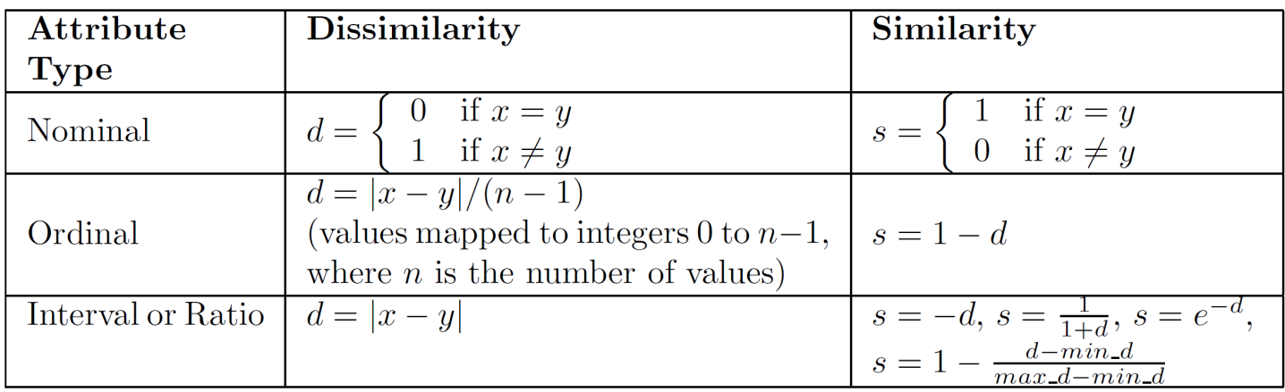
Similarity/Dissimilarity for Simple Attributes
The following table shows the similarity and dissimilarity between two objects, x and y, with respect to a single, simple attribute.

