Slide 1
Neural networks
Zhichen Gong
2017/6/1

Slide 2
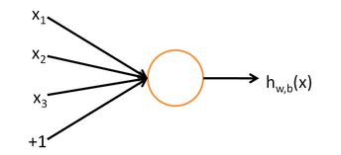





Neural Network
A neuron(a logistic regression function)
activation function or

Slide 3
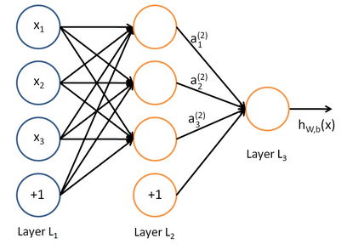
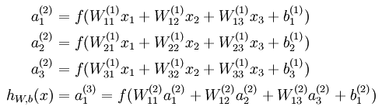
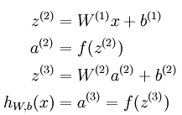
Neural Network
A network
forward propagation

Slide 4
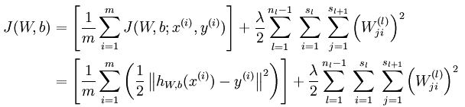
Neural Network
Mean square error and weight decay

Slide 5
Neural Network
Initialization
Normal distribution
Symmetry breaking

Slide 6
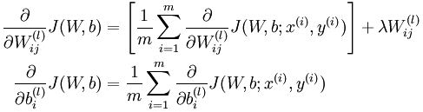
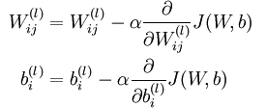
Neural Network
Back propagation

Slide 7
Neural Network
Back propagation
Step 1: forward propagation, get activations
Step 2: residual error of the last layer
Step 3: residual error of the proceeding layers
Step 4: partial gradient

Slide 8
Neural Network
Back propagation
Step 1: forward propagation, get activations

Slide 9

Neural Network
Back propagation
Step 2: residual error of the last layer

Slide 10

Neural Network
Back propagation
Step 3: residual error of the proceeding layers

Slide 11
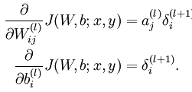
Neural Network
Back propagation
Step 4: partial gradient

Slide 12

Neural Network
Back propagation
Gradient check

Slide 13
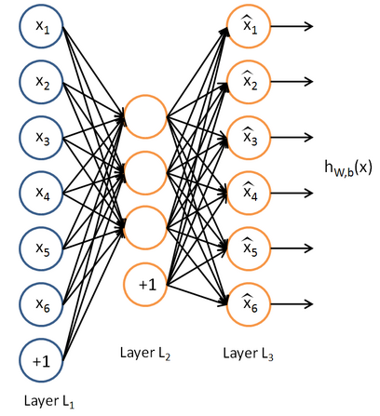
AutoEncoder
Data compression

Slide 14




AutoEncoder
Sparsity constraint

Slide 15
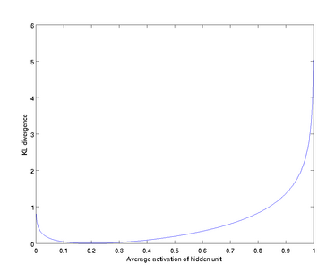

AutoEncoder
Sparsity constraint

Slide 16
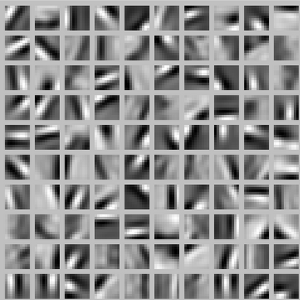
AutoEncoder
Sparsity constraint

Slide 17

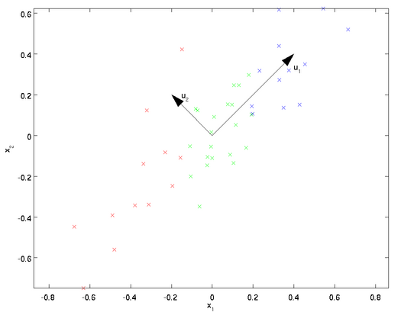
Principle component analysis

Slide 18

Principle component analysis

Slide 19

Principle component analysis
Rotation and dimensional reduction

Slide 20
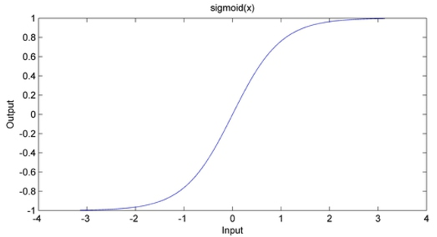
Principle component analysis
Preprocessing:
sphering
(1) reduce the correlation among features
(2) same variance
Centralize
Zero mean and unit deviation

Slide 21

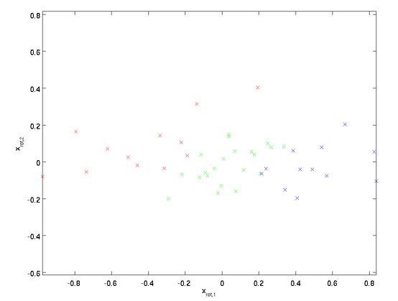
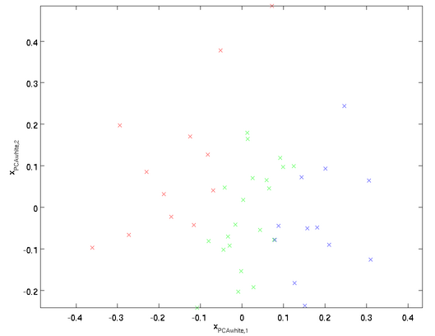
Principle component analysis
PCAwhitening

Slide 22

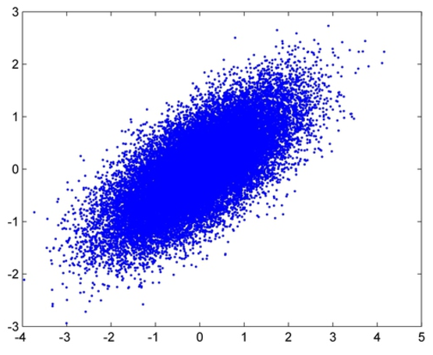
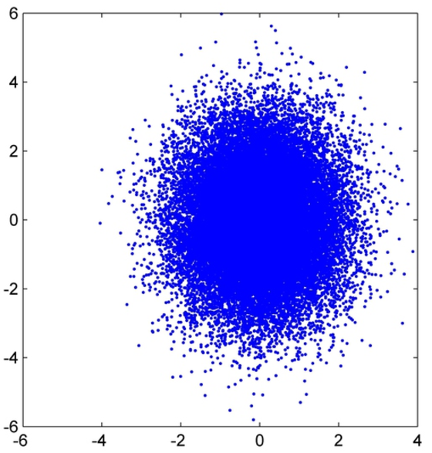
Principle component analysis
ZCAwhitening

Slide 23


Principle component analysis
Implementation tips for whitening
Normalization
Code
avg = mean(x, 1); x = x - repmat(avg, size(x, 1), 1);
sigma = x * x' / size(x, 2);
[U,S,V] = svd(sigma);
xRot = U' * x;
xTilde = U(:,1:k)' * x;
xPCAwhite = diag(1./sqrt(diag(S) + epsilon)) * U' * x;
xZCAwhite = U * diag(1./sqrt(diag(S) + epsilon)) * U' * x;

