Slide 1
Individual project
SW Architecture and Design
Zhicong Zeng
Notes:
We designed this template so that each member of the project team has a set of slides with its own theme. Members, here’s how you add a new slide to just your set:
Mark where you want to add the slide: Select an existing one in the Thumbnails pane, click the New Slide button, then choose a layout. The new slide gets the same theme as the other slides in your set.
Careful! Don’t annoy your fellow presenters by accidentally changing their themes. That can happen if you choose a different theme from the Design tab, which changes all of the slides in the presentation to that look.

Slide 2
Github address:
https://github.com/Zhicong-Zeng/Photo_Manipulation
Feel free to clone and try in your environment.
May need to install some toolkits.

Slide 3
Some thoughts

Slide 4
Conclusions
Just a demo. FastAPI is suitable for class project but not suitable for commercial business.
The project contains UI but doesn’t contain front-end codes.
FastAPI + Opencv + Aiofiles
Looks like factory pattern
It is a good project enough to know how api works.

Slide 5
High Level Overview

Slide 6
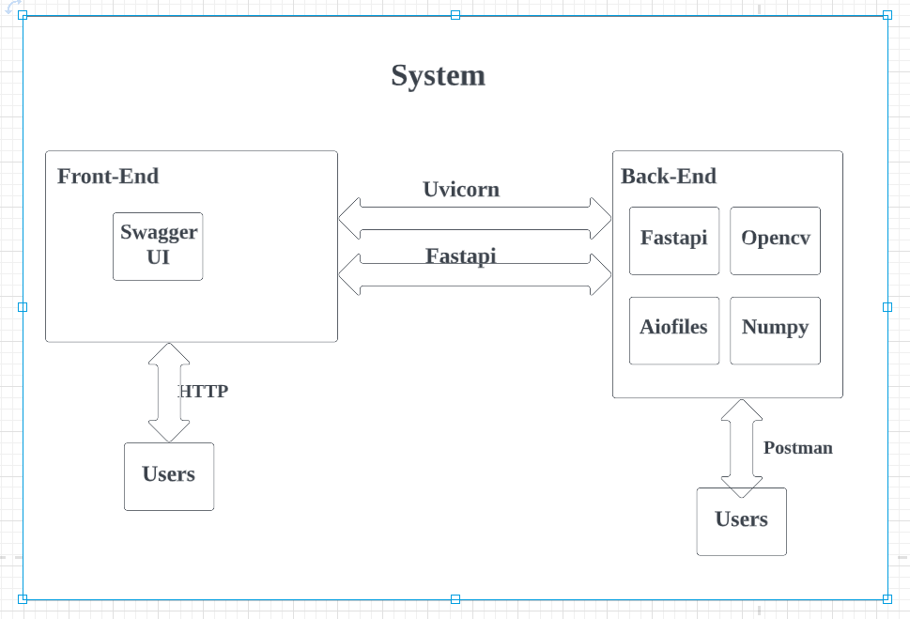
Overall architecture

Slide 7
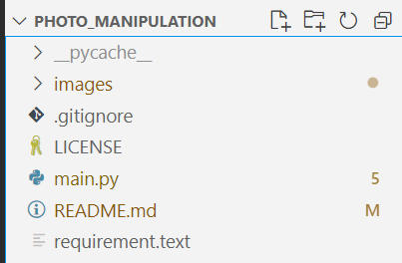
File Organization
FastAPI is a modern, fast (high-performance), web framework for building APIs with Python 3.6+ based on standard Python type hints.

Slide 8
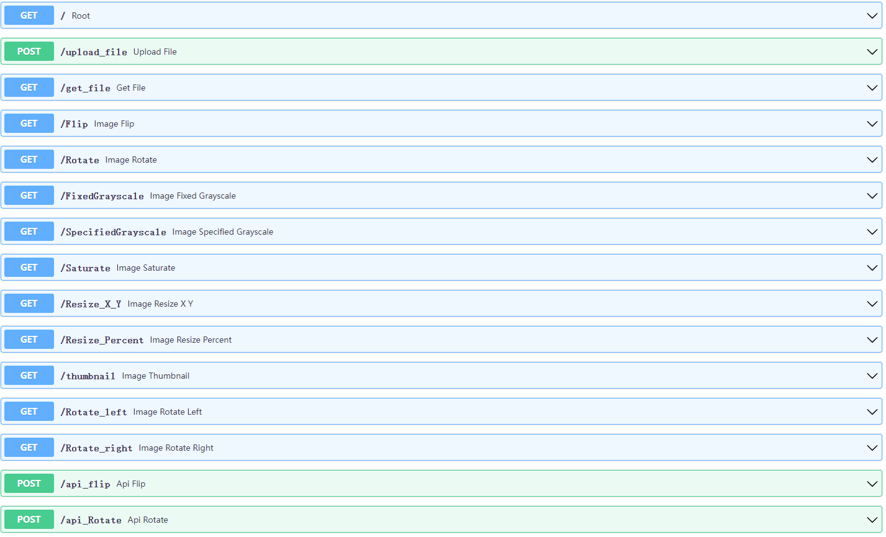
Users upload their image first. Then choose the way they want

Slide 9
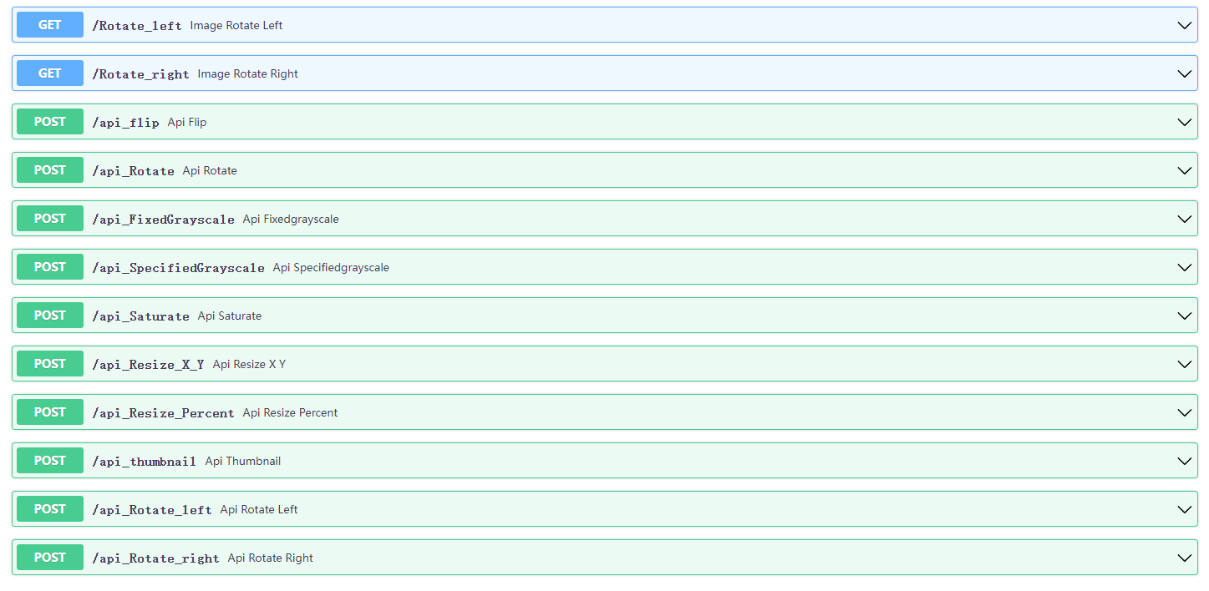
Users upload their image and get the result

Slide 10
Code example

Slide 11
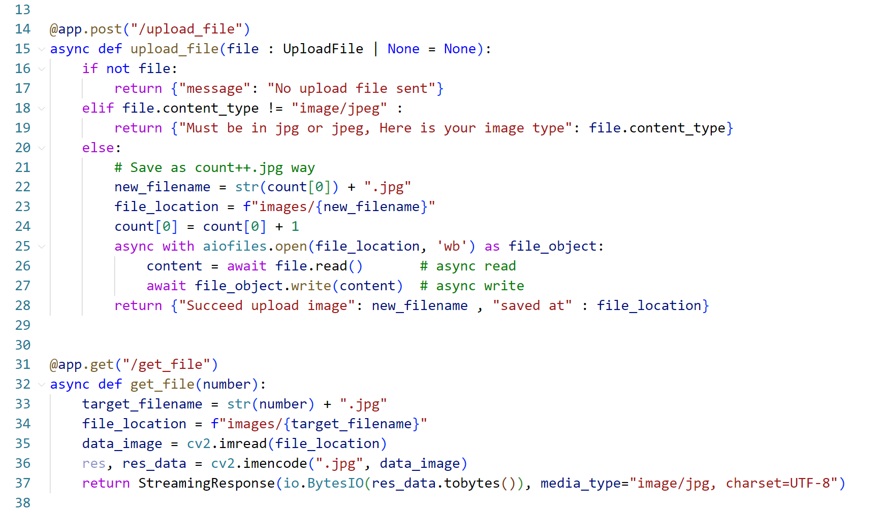
Upload file and Get file

Slide 12
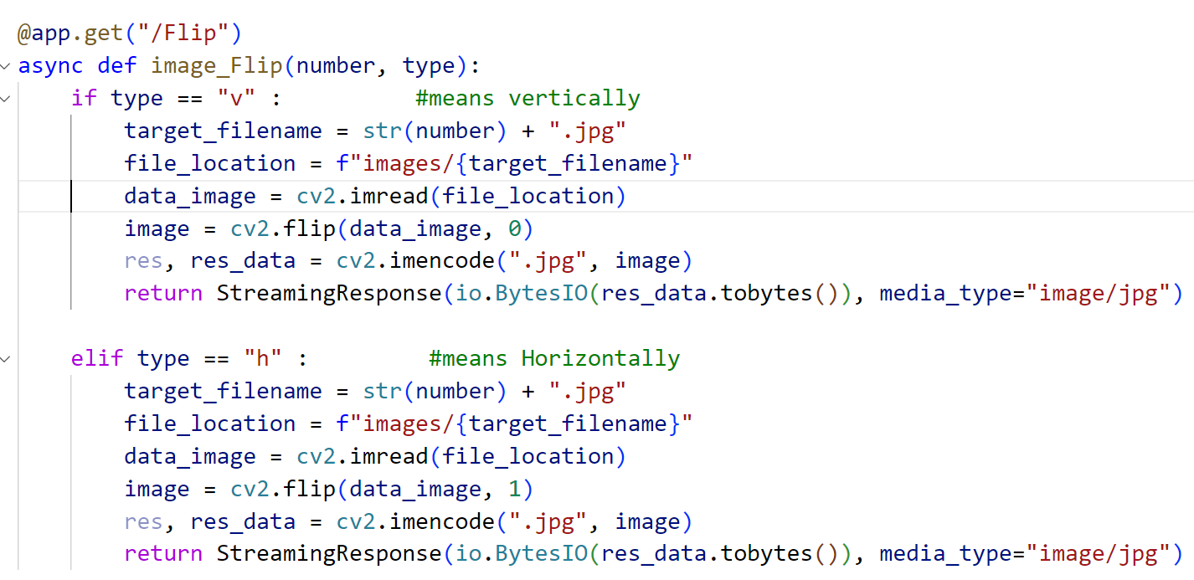
Image Flip by Get

Slide 13
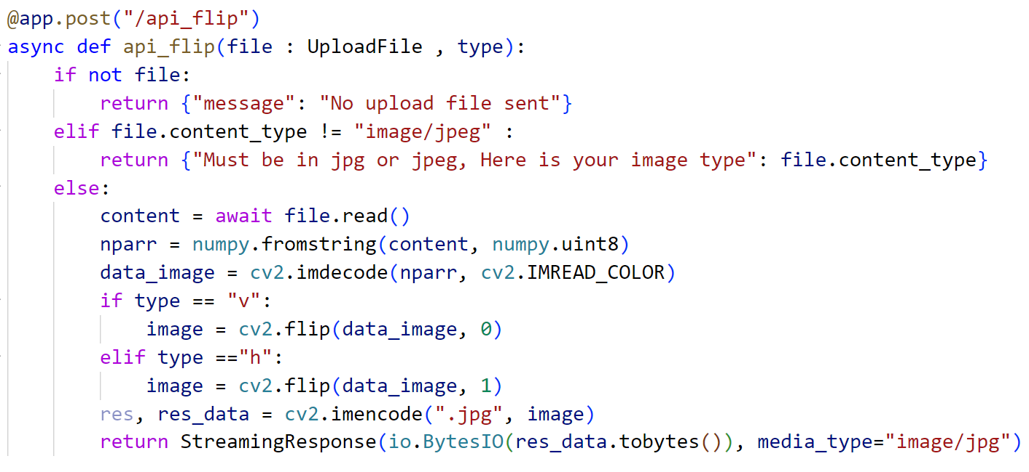
Image Flip by Post

Slide 14
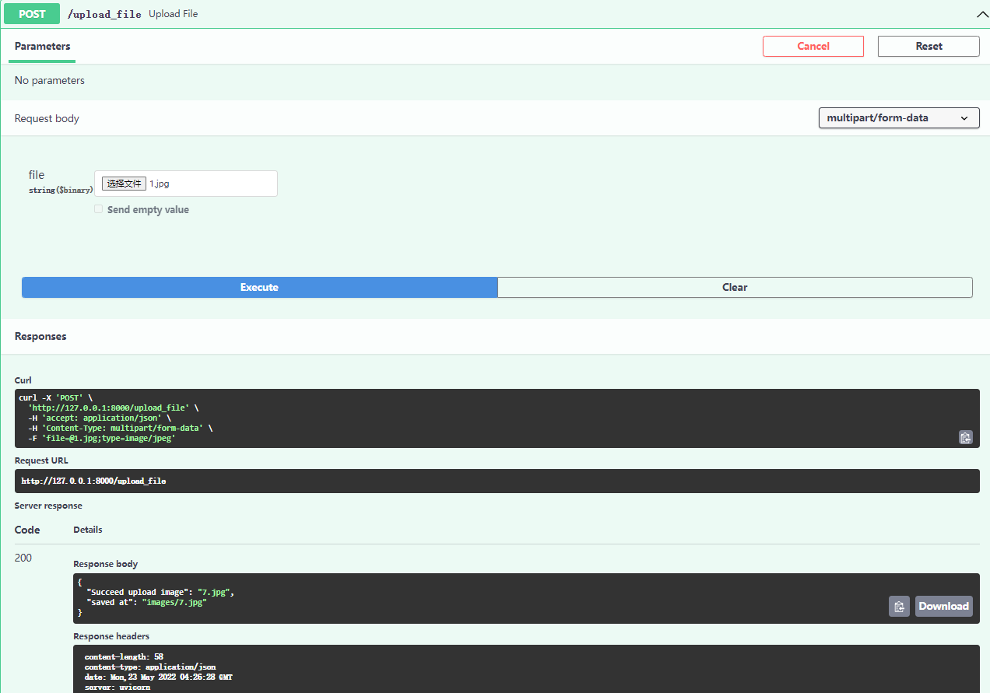
Web Page

Slide 15
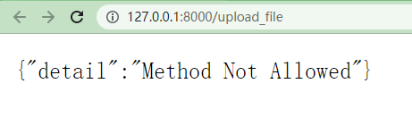
We can’t access the data within Post method
Web Page

Slide 16
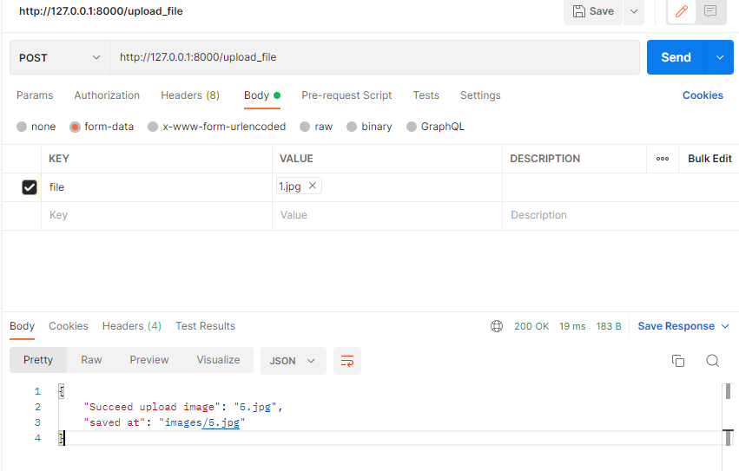
We can get the response message the data within Post method
Postman

Slide 17
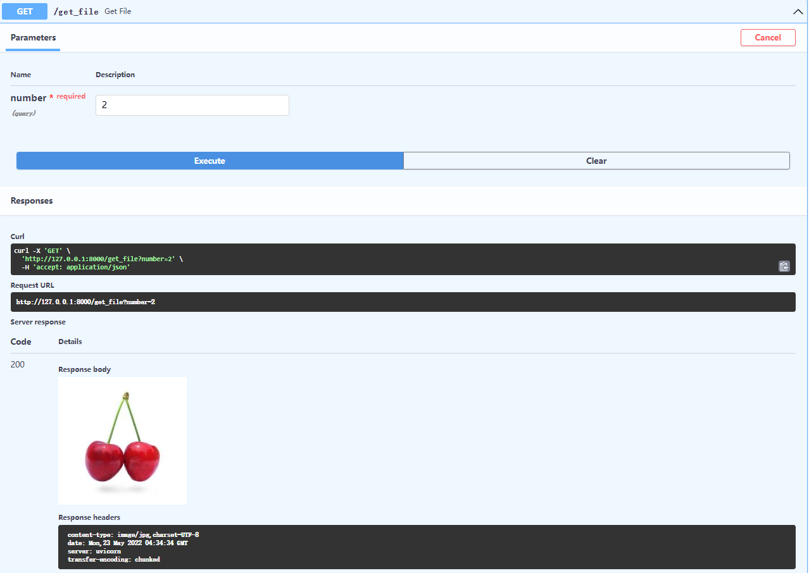
Web Page

Slide 18
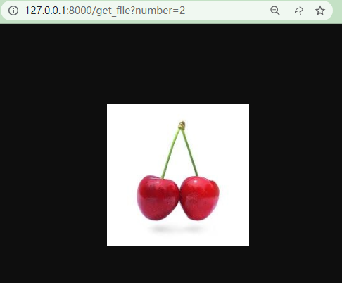
We can access the data within Get method
Web Page

Slide 19
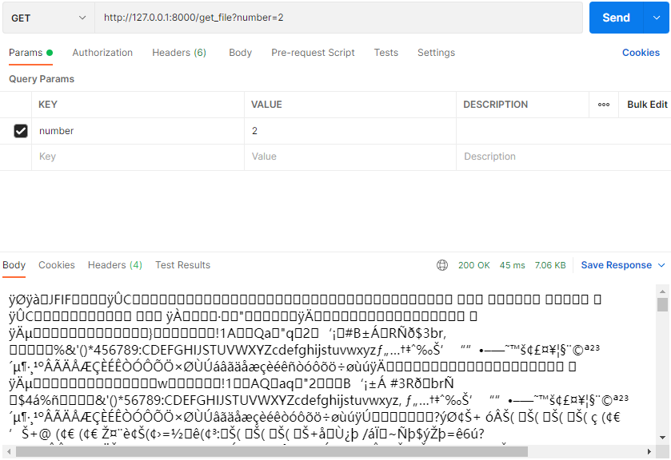
We can get the response message the data within Get method
Postman

Slide 20
Share Screen

Slide 21
Thank you

