Slide 1
Ethernet interface for CTPS using ESP32-WROOM-32
Hexing yang
09.10.2019

Slide 2
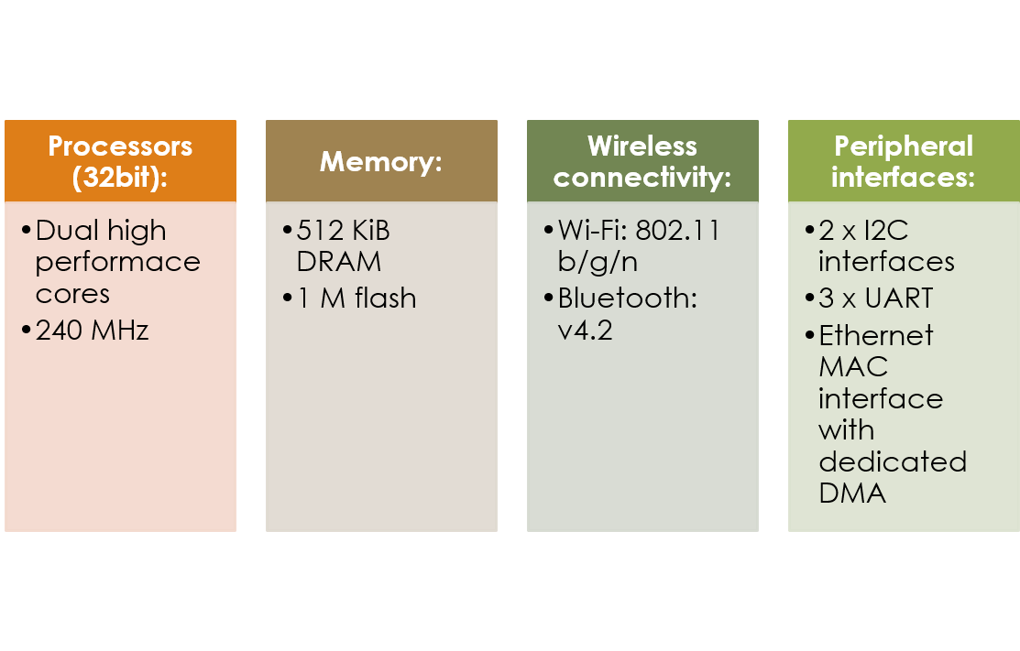
ESP32 –EROOM-32
Ethernet interface for CTPS

Slide 3



Development FrameWork
ESP-32-WROOM-32
ESP-IDF
IoT Integrated Development Framework, provides toolchain, API, and workflows to develop applications for ESP32.
ESP32 for Arduino

Slide 4
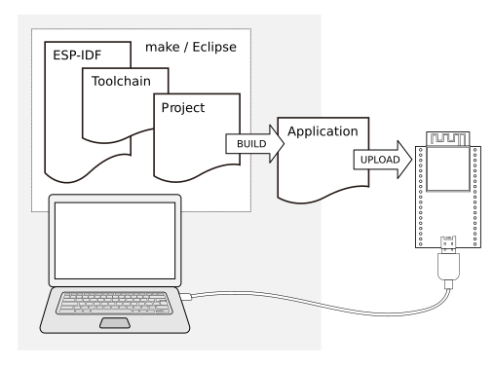





ESP-IDF
ESP-32 Development Framework
Framework based on Free RTOS
Toolchain to compile code for ESP32
Build tools to build a full Application for ESP32
ESP-IDF that essentially contains API (software libraries and source code) for ESP32 and scripts to operate the Toolchain

Slide 5
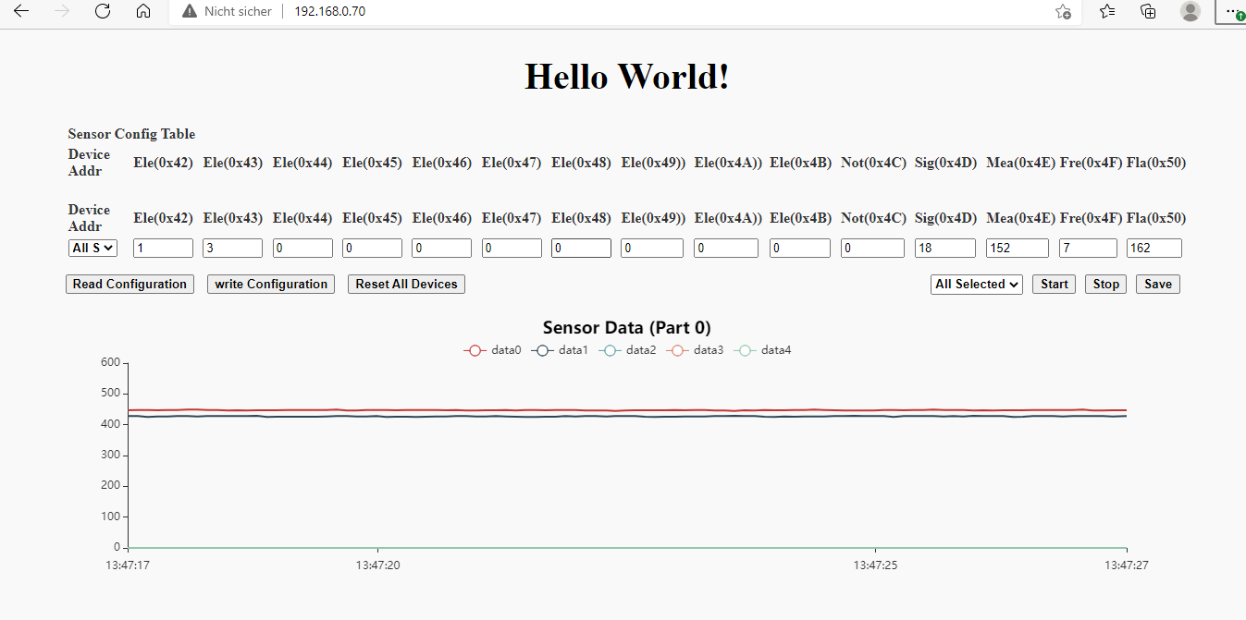
HTTP Server
192.168.0.70

Slide 6
File directory
Ethernet interface for CTPS
│ CMakeLists.txt
│ Makefile
│ sdkconfig
│ readme.md
│ Python script
├─components
│
│ ├─sensor
│ ├─server
│ └─websocket
│
└─main
Create TCP oder UDP server
initialize the i2c module
configure sensors
data processing
webpage source
http server
persistent connection
create working threads ,connection way and TCP oder UDP client

Slide 7
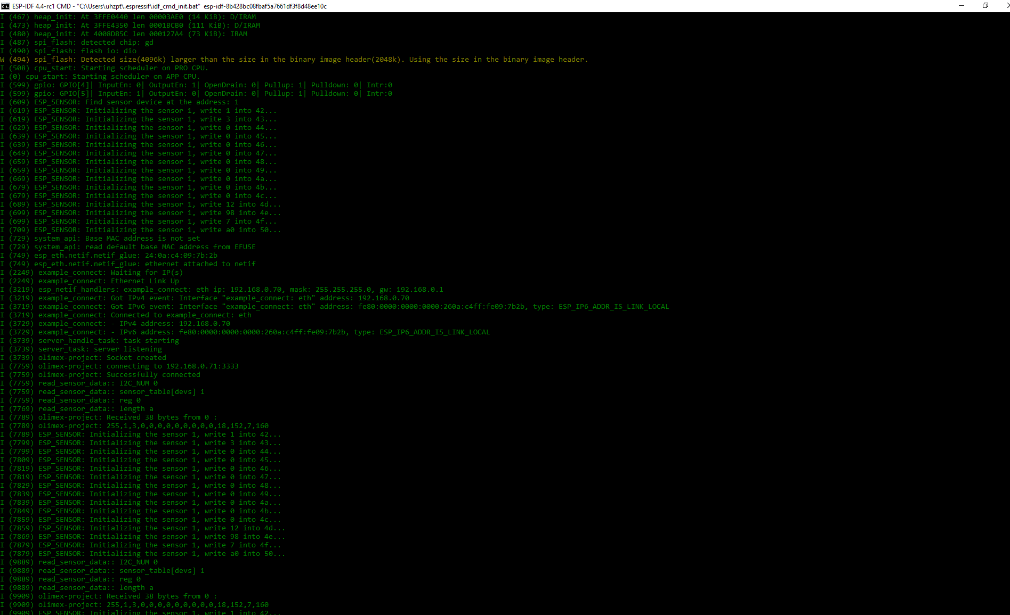
monitor

Slide 8
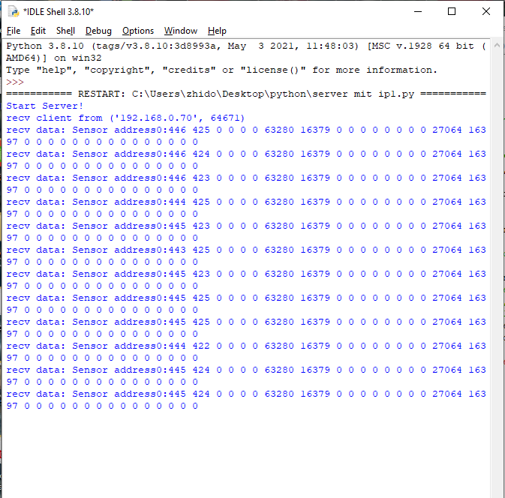
Python server

Slide 9
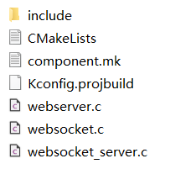
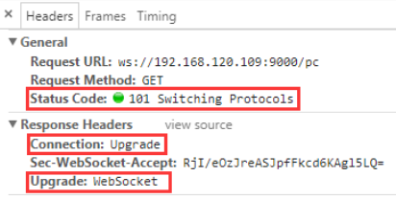
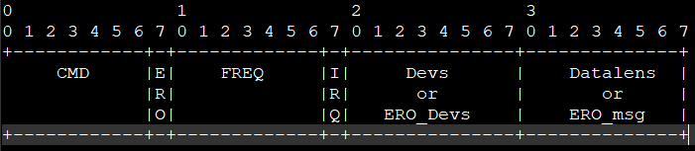
./components/websocket
Why websocket?
Full-duplex, unlike HTTP
Light communications protocol
Supported by most browsers
Application layer
…
Transport layer
Data frame header:
Network layer
Data link layer
Physical layer
Open Systems Interconnection model (OSI model)

Slide 10
Why TCP oder UDP
Only need Devs and msg
Application layer
…
Transport layer
Data frame header:
Network layer
Data link layer
Physical layer
Open Systems Interconnection model (OSI model)

Slide 11
Ethernet interface for CTPS
using ESP32-WROOM-32
Thanks for attention!

