Slide 1
Ethernet and Wifi interface for CTPS using ESP32-WROOM-32
Zhidong yang
14.04.2022

Slide 2
Motivation
The websocket is a good way for data-communication, but for high real-time
Requirements it is not a good choice.
TCP and UDP protocol can be used for real-time Requirements.
Analyses the data Throughput of TCP and UDP.
https://www.ti.com/lit/an/slva704/slva704.pdf
Zhidong Yang
Mechatronik und informationstechnik(Master)

Slide 3
Sketch of the project
Capacitive Tactile and Proximity Sensor (CTPS) provide in-phase&quadrature and root-mean-square information for each measurement channel > 66 Bytes
CTPS
Server
ESP32 board
Register Address:
Sensor 0~65
Config 66~80
I2C Master
Connection:
1.Wifi
2.Ethernet
1.Websocket
Protocol:
2.TCP
3.UDP
Sensor data
Device:
1.Webpage
2.3.Python
sensor data
I2C
connection
sensor configuration
Sensor configuration
Zhidong Yang
Mechatronik und informationstechnik(Master)

Slide 4
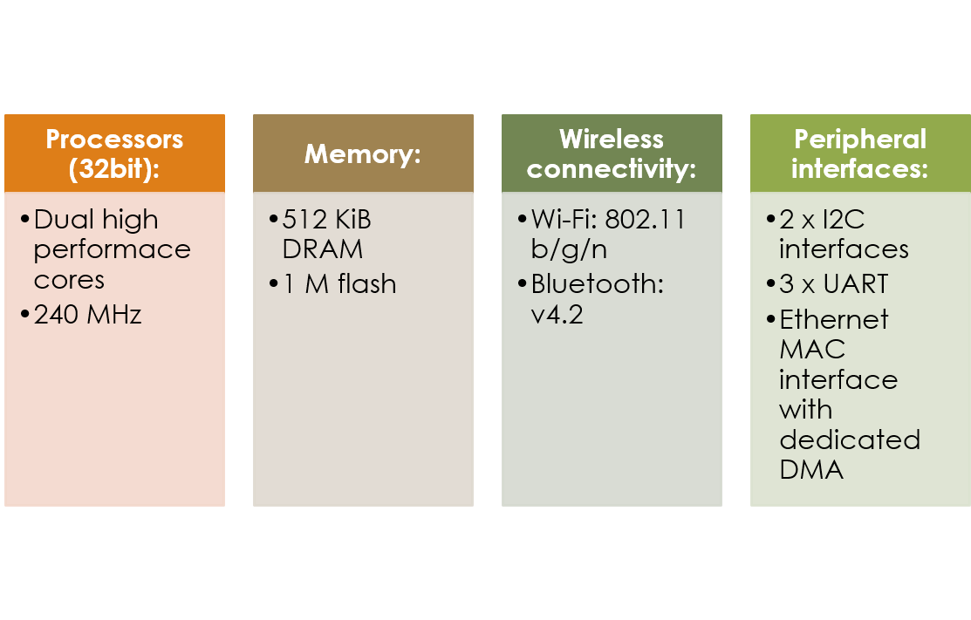
ESP32 –EROOM-32
Ethernet interface for CTPS
Zhidong Yang
Mechatronik und informationstechnik(Master)

Slide 5
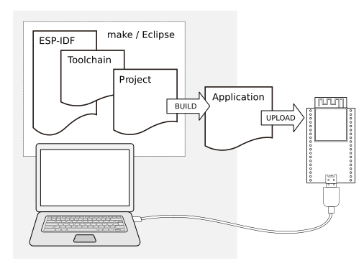





ESP-IDF
ESP-32 Development Framework
Framework based on Free RTOS
Toolchain to compile code for ESP32
Build tools to build a full Application for ESP32
ESP-IDF that essentially contains API (software libraries and source code) for ESP32 and scripts to operate the Toolchain
Zhidong Yang
Mechatronik und informationstechnik(Master)

Slide 6
File directory
Ethernet and Wifi interface for CTPS
│ CMakeLists.txt
│ Makefile
│ sdkconfig
│ readme.md
├─components
│ ├─connect
│ ├─sensor
│ ├─server
│ └─websocket
└─main
│ Python script
Connect via wifi or ethernet
initialize the i2c module
configure sensors
data processing
webpage source
http server
persistent connection
create working threads, protocol TCP oder UDP
Device:Create TCP or UDP server
Zhidong Yang
Mechatronik und informationstechnik(Master)

Slide 7
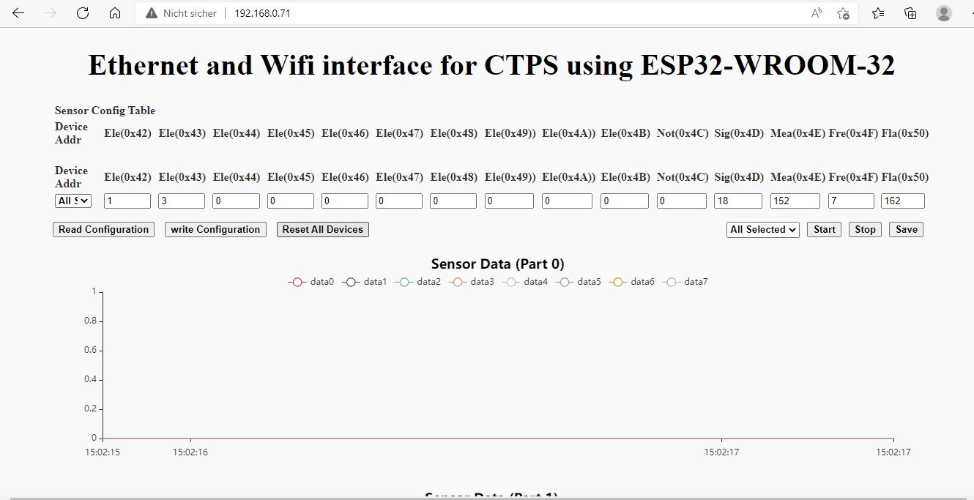
Webpage:HTTP Server
192.168.0.71
Zhidong Yang
Mechatronik und informationstechnik(Master)

Slide 8
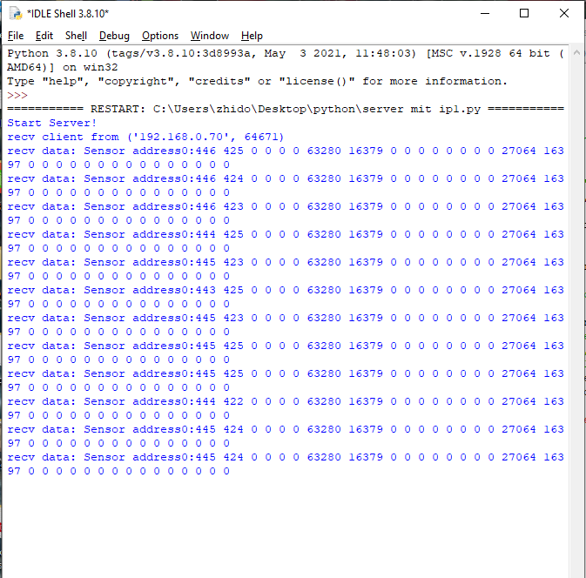
Python Server
Zhidong Yang
Mechatronik und informationstechnik(Master)

Slide 9
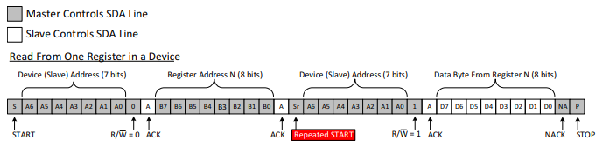
Data Throughput of I2C read sensor data
I2C read data process: read 1 byte data
https://www.ti.com/lit/an/slva704/slva704.pdf
Ideal situation Read 66 bytes data: 66* 39= 2574 bit (total data size)
Given Master frequence 100KHZ:
Netto data speed : 100000/2574 * 66 =2564 bytes/s
Zhidong Yang
Mechatronik und informationstechnik(Master)

Slide 10
Data Throughput of TCP and UDP
Ethernet Frame Formate
7 bytes | 1 byte | 6 bytes | 6 bytes | 2 bytes | 42 to 1500 bytes | 4 bytes
Preamble | Start of frame Delimiter | Destination MAC Address | Source MAC Address | Type | Data(payload) | CRC
IPv4 header(20 bytes) | Tcp header (20) Udp header (8) | Nettodata:address+sensor data
Throughput(air in lab) : UDP 30 Mbit/s , TCP 20 Mbit/s
TCP: Data length 26+40 + 122 (nettodata)= 188 bytes
nettodata speed 122/188 *20*10^6/8= 1.62 *10^6 bytes/s
ideal situation simultaneously the number of sensor:
1.62 *10^6 / 2564 = 631
UDP: 2.60 *10^6 / 2564 = 1014
Zhidong Yang
Mechatronik und informationstechnik(Master)

Slide 11
Conclusion
Done:
Exented the webserver
Implement communication with tcp udp
Calcualte the data throughput
Future:
Use CAN, UART instead of I2C
Use different board, e.g Arduino

Slide 12
Ethernet and Wifi interface for CTPS
using ESP32-WROOM-32
Thanks for your attention!
Zhidong Yang
Mechatronik und informationstechnik(Master)

