Slide 1
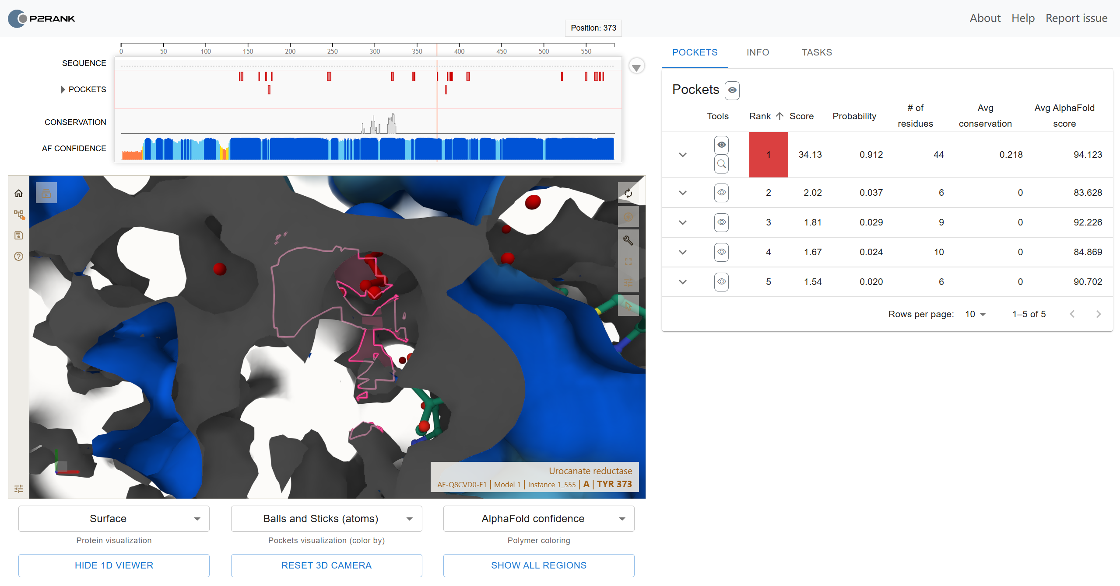
根据Alphafold结果PrankWeb可以预测活性位点
A_139 A_141 A_142 A_143 A_162 A_170 A_171 A_173 A_174 A_175 A_177 A_243 A_244 A_245 A_246 A_247 A_319 A_320 A_321 A_344 A_346 A_373 A_383 A_385 A_388 A_390 A_391 A_408 A_409 A_410 A_411 A_520 A_521 A_548 A_549 A_550 A_559 A_560 A_561 A_562 A_563 A_565 A_566 A_569
Pfam结果，FAD结构域与预测位点基本重合
seq_id | aln_start | aln_end | env_start | env_end | hmm_acc | hmm_name | type | hmm_start | hmm_end | hmm_length | score | evalue | significance | clan
sp|Q8CVD0|URDA_SHEON | 36 | 107 | 36 | 108 | PF04205.18 | FMN_bind | Domain | 1 | 76 | 77 | 47.5 | 2.50E-12 | 1 | No_Clan
sp|Q8CVD0|URDA_SHEON | 134 | 564 | 134 | 566 | PF00890.28 | FAD_binding_2 | Family | 1 | 412 | 414 | 253 | 6.90E-75 | 1 | CL0063

