Slide 1
Bubble~~~
Explore you interests on this website
Bubble+
Mark Wang
Peter Xv
Tigo Jiang
Tom Zhao

Slide 2
01
INSPIRATION
02
OUR PRODUCT
CONTENT
03
TECHNIQUE
04
FUTURE

Slide 3

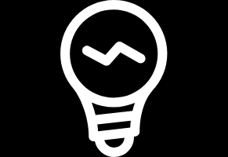
Part 01
INSPIRATION

Slide 4
INSPIRATION
Instead of giving you the most broadly popular result, Internet now tries to predict what you are most likely to click on.
Burst Your Bubble…

Slide 5
Part 02
PRODUCT

Slide 6
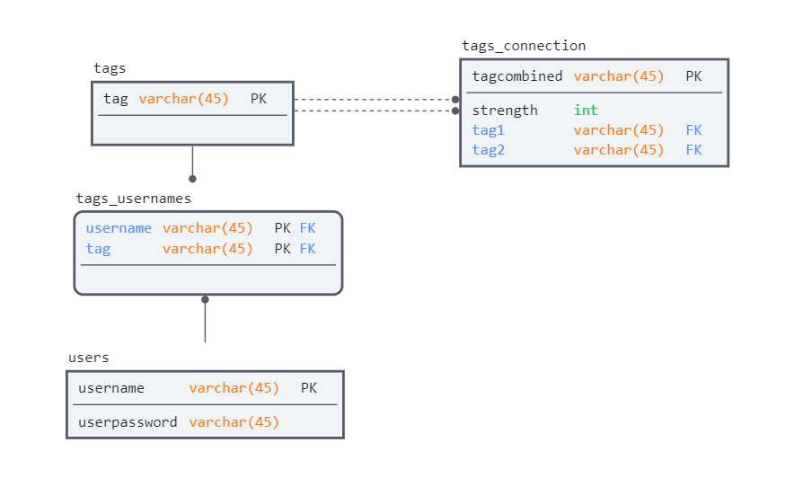
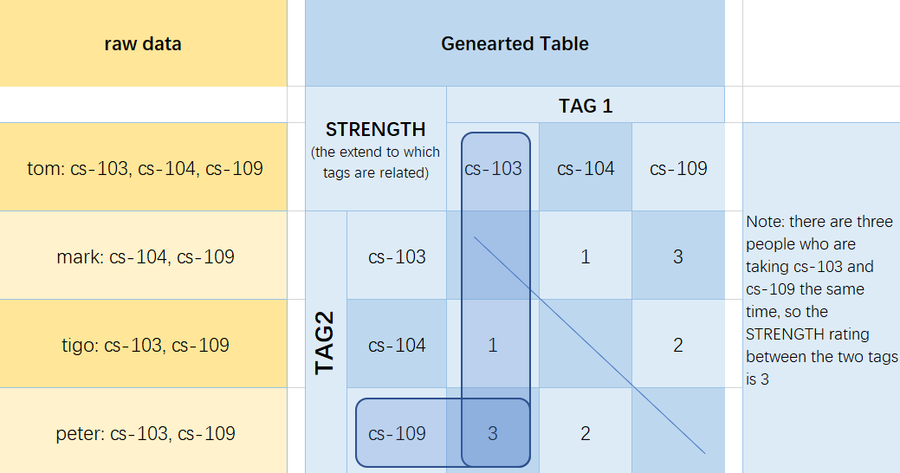
PRODUCT

Slide 7
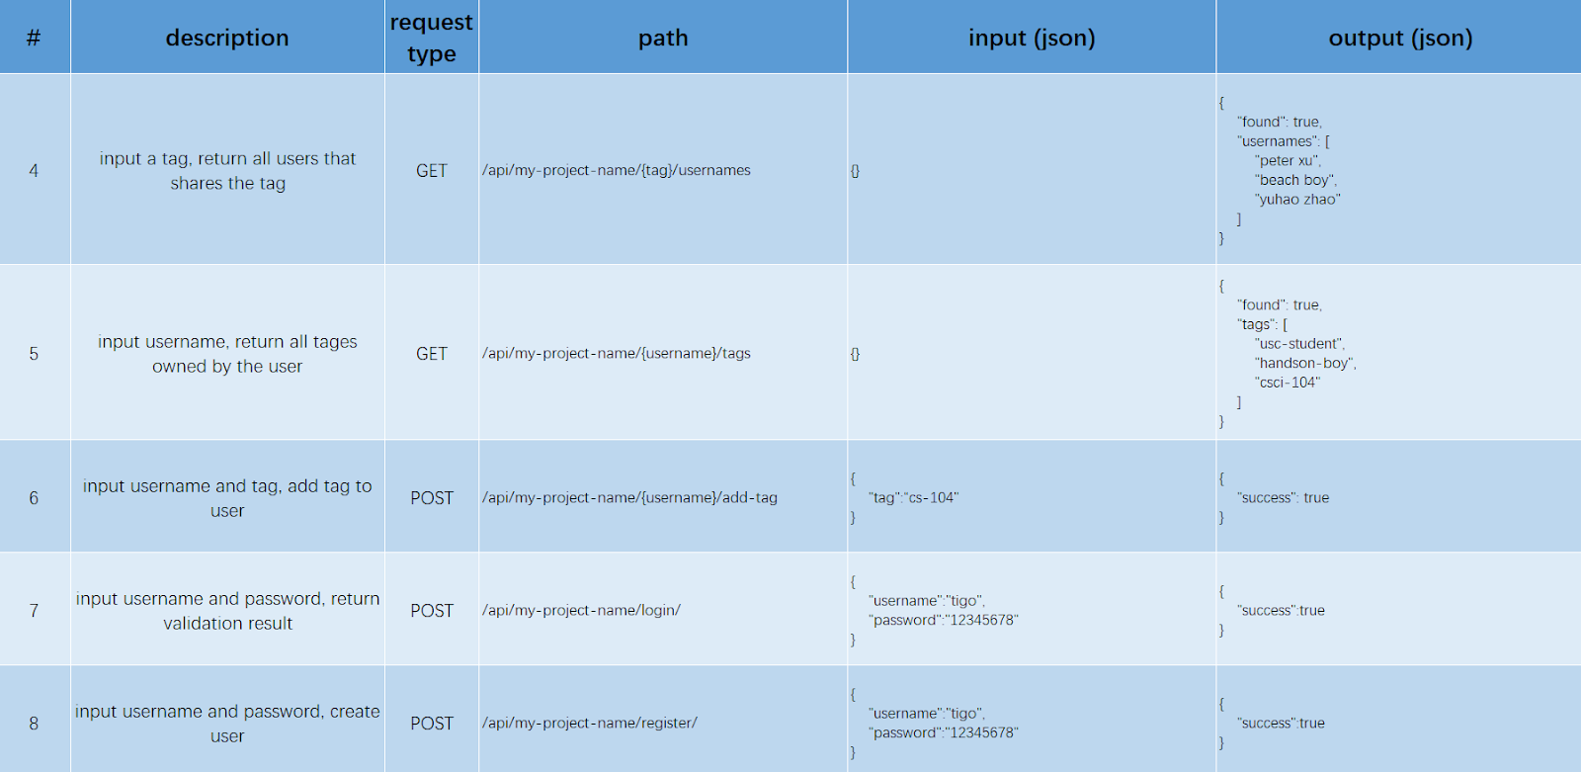
PRODUCT

Slide 8
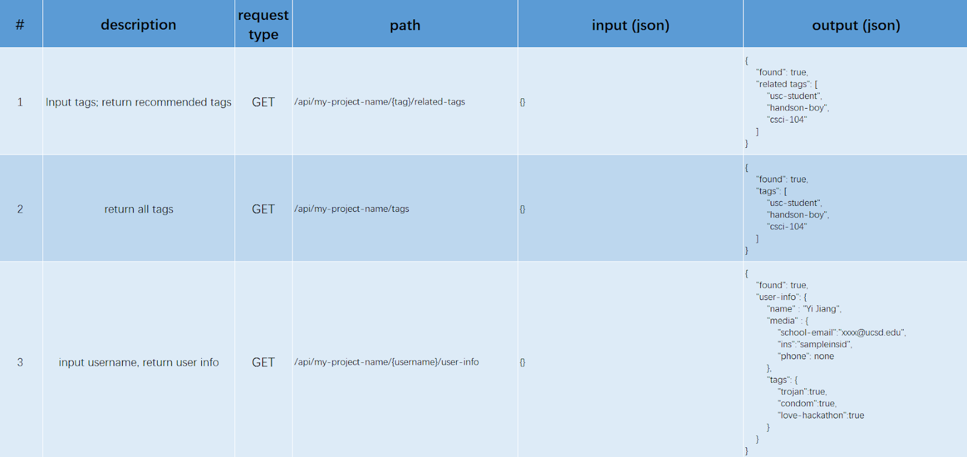
PRODUCT

Slide 9
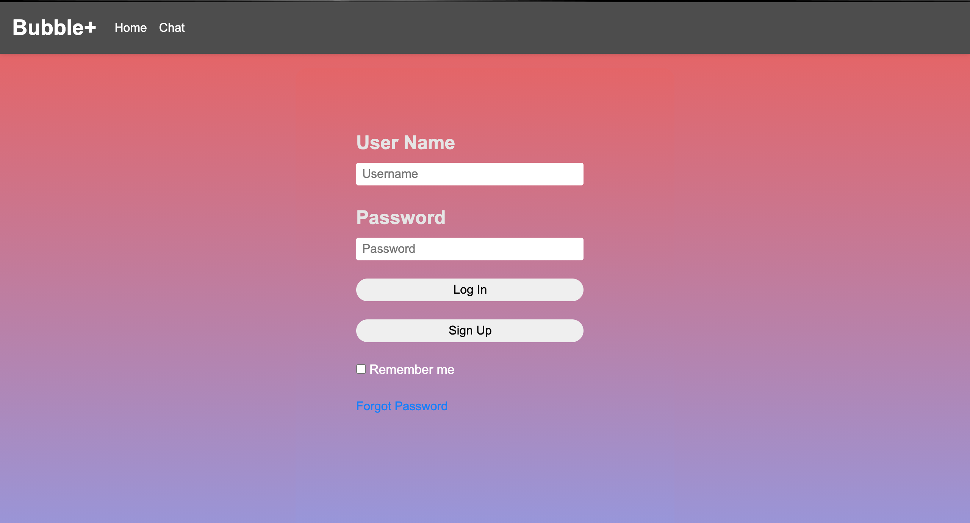

Slide 10
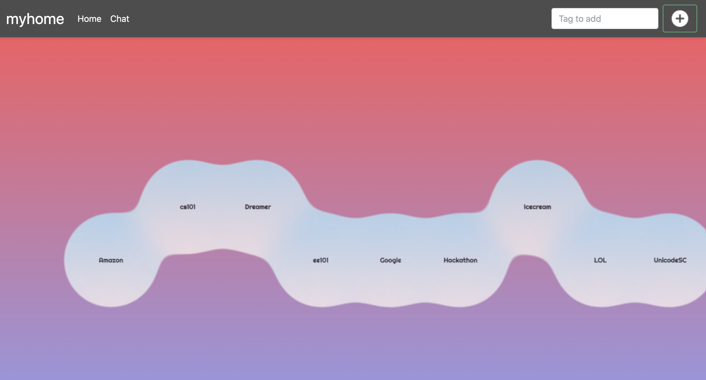
PRODUCT

Slide 11
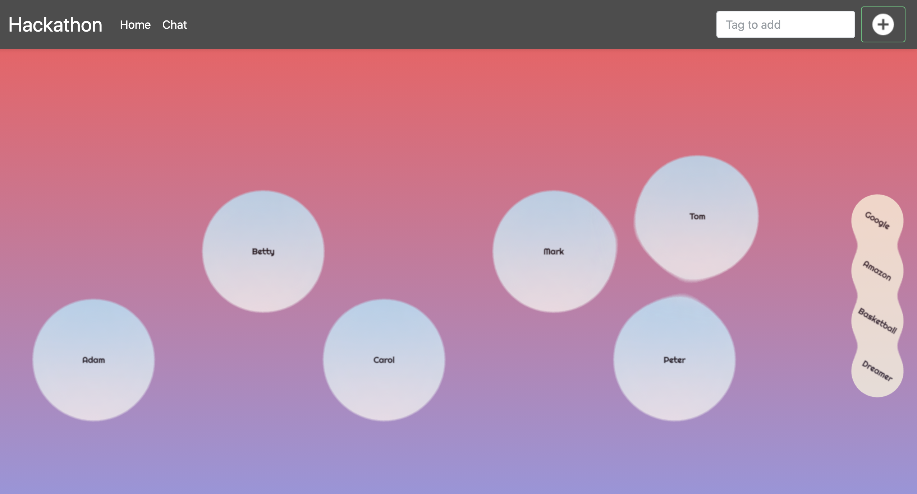
PRODUCT

Slide 12
PRODUCT
05
04
03
02
01

Slide 13
Part 03
TECHNIQUE

Slide 14
TECHNIQUE
recommendation mechanism
Database Design
asynchronous function and server

Slide 15
Part 04
FUTURE

Slide 16

FUTURE
APP on Phone
Add Friend
Message
Group Chat
DEVELOPMENT SPACE

Slide 17
THANK YOU

