Slide 1

Guan Wang

Slide 2

Debugging
Grace Hopper

Slide 3
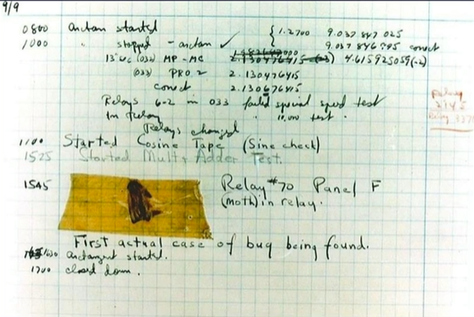
Notes:
word_per_page

Slide 4
Everyone gets bugs
Don’t feel down.
Everyone gets bugs.

Slide 5
Tips
Describe the problem
Reproduce the bug
Play as a computer
Fix the errors
Print is your friend
User a debugging tool

Slide 6
Tips
Take a break
Ask a friend
Run often
Ask StackOverflow

