Slide 1
Topic: On-Device MoE Inference Workflow Figures
Figure type: architecture_flowchart
9 reference figure(s) · ClawPhD 🐈

Slide 2
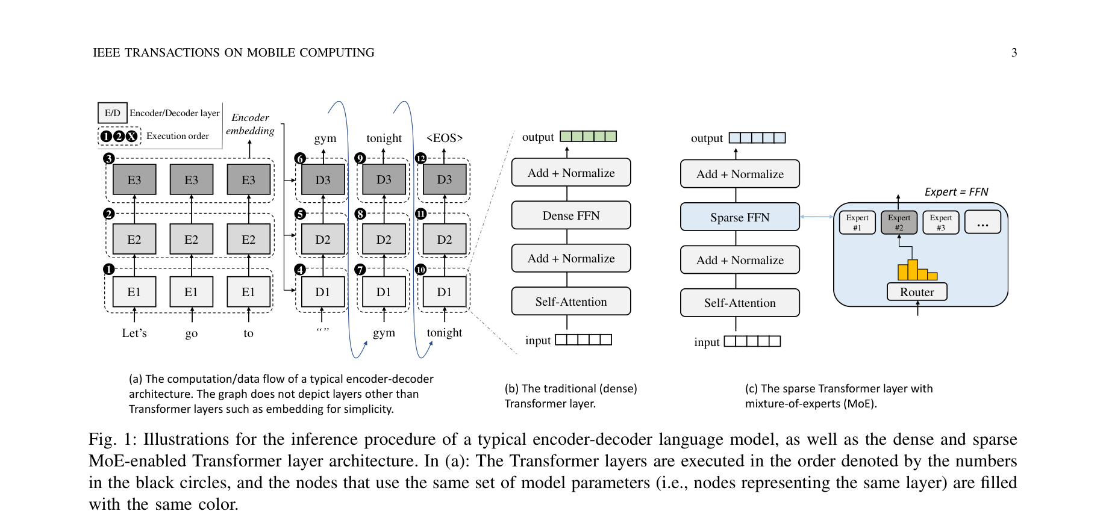
[architecture_flowchart] Fig. 1: Illustrations for the inference procedure of a typical encoder-decoder language model, as well as the dense and sparseMoE-enabled Transformer layer architecture.
EdgeMoE: Fast On-Device Inference of MoE-based Large Language Models (2023)

Slide 3
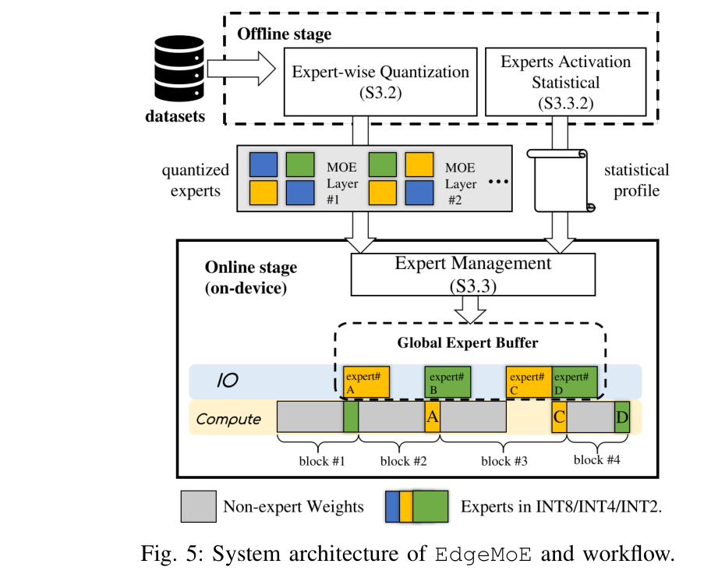
[architecture_flowchart] Fig. 5: System architecture of EdgeMoE and workflow.
EdgeMoE: Fast On-Device Inference of MoE-based Large Language Models (2023)

Slide 4
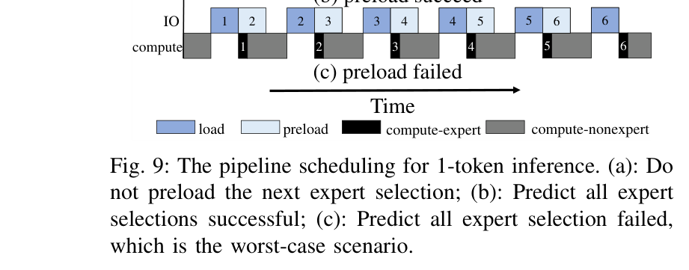
[architecture_flowchart] Fig. 9: The pipeline scheduling for 1-token inference.
EdgeMoE: Fast On-Device Inference of MoE-based Large Language Models (2023)

Slide 5
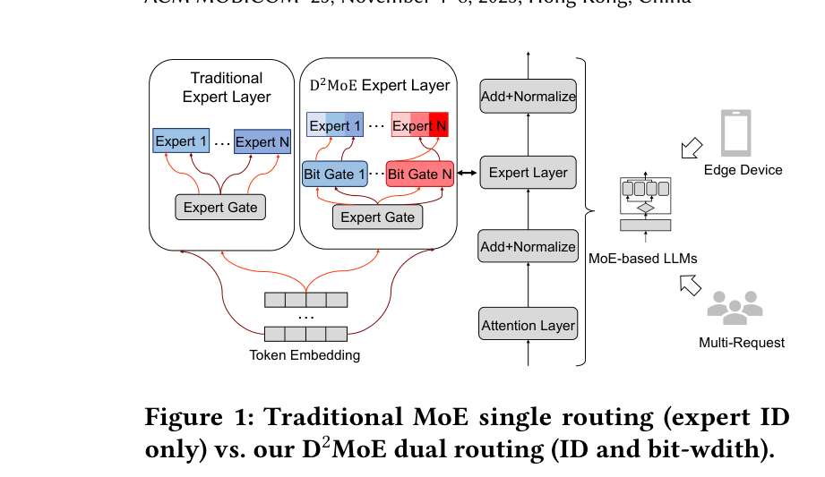
[architecture_flowchart] Figure 1: Traditional MoE single routing (expert IDonly) vs. our D2MoE dual routing (ID and bit-wdith).
D2MoE: Dual Routing and Dynamic Scheduling for Efficient On-Device MoE-based LLM Serving (2025)

Slide 6
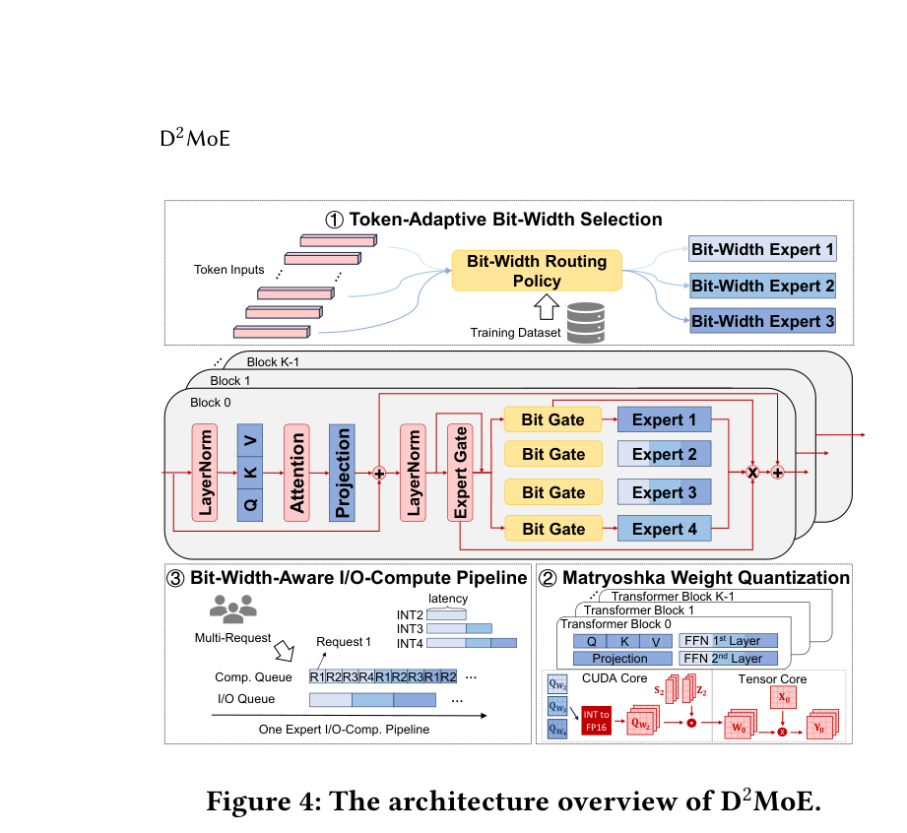
[architecture_flowchart] Figure 4: The architecture overview of D2MoE.
D2MoE: Dual Routing and Dynamic Scheduling for Efficient On-Device MoE-based LLM Serving (2025)

Slide 7
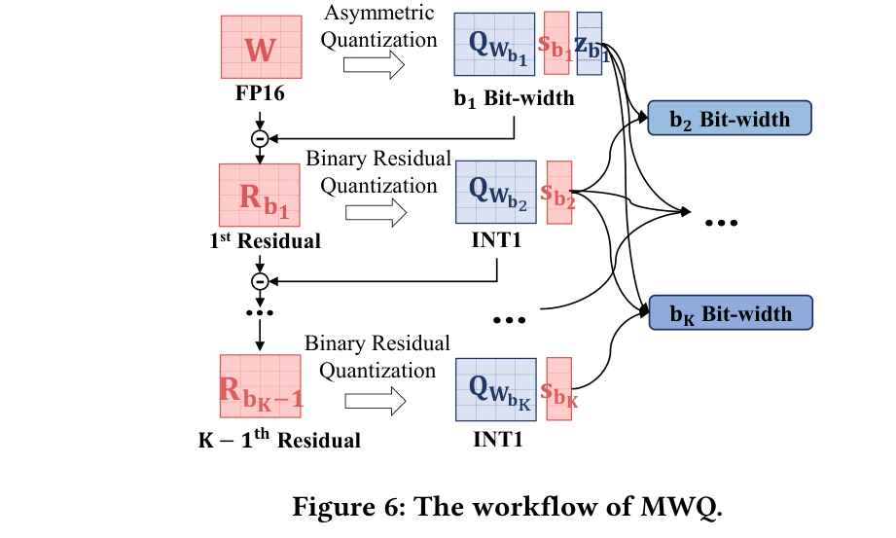
[architecture_flowchart] Figure 6: The workflow of MWQ.
D2MoE: Dual Routing and Dynamic Scheduling for Efficient On-Device MoE-based LLM Serving (2025)

Slide 8
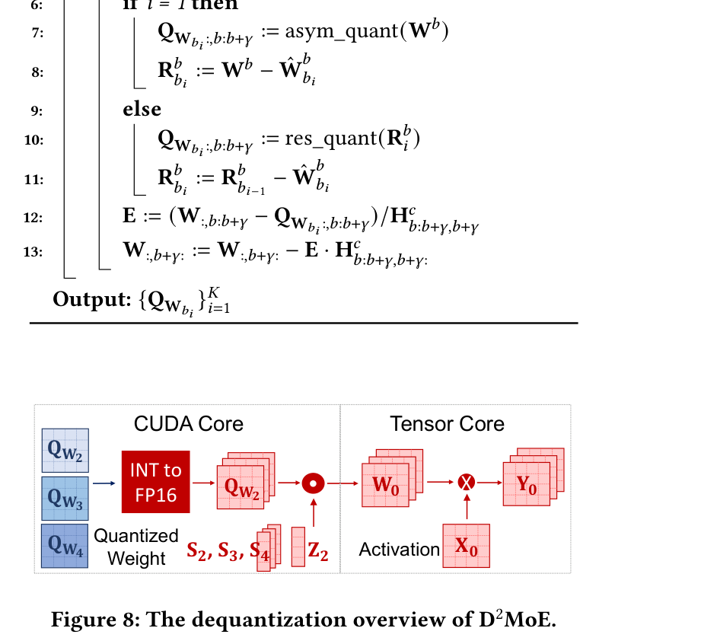
[architecture_flowchart] Figure 8: The dequantization overview of D2MoE.
D2MoE: Dual Routing and Dynamic Scheduling for Efficient On-Device MoE-based LLM Serving (2025)

Slide 9
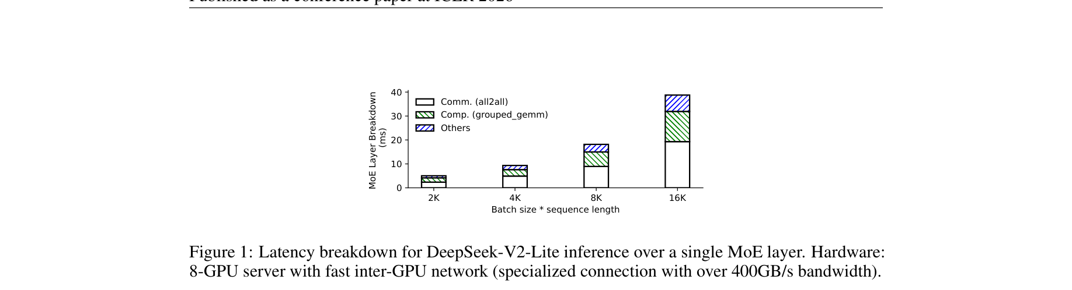
[architecture_flowchart] Figure 1: Latency breakdown for DeepSeek-V2-Lite inference over a single MoE layer.
Semantic Parallelism: Redefining Efficient MoE Inference via Model-Data Co-Scheduling (2025)

Slide 10
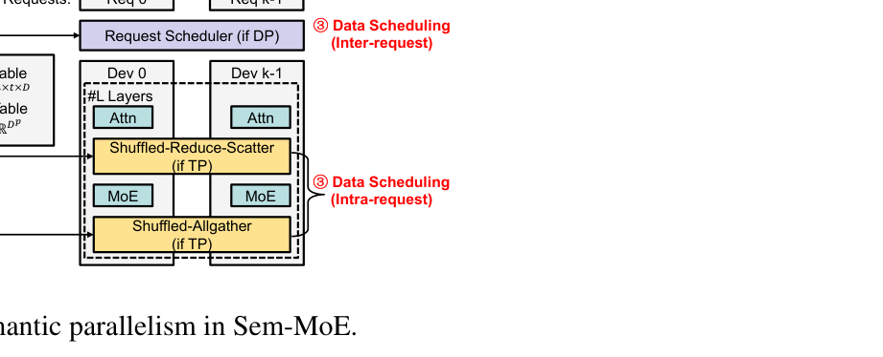
[architecture_flowchart] Figure 2: The workflow of semantic parallelism in Sem-MoE.
Semantic Parallelism: Redefining Efficient MoE Inference via Model-Data Co-Scheduling (2025)

