Slide 1

Photography Studio Management System
Wenjing CAI 116010004
Yifan LAN 116010103
Chengwei YE 116010265
Haolin YE 116010266

Slide 2

1 Introduction
Integrated data management system
Role-oriented operation support
Background
Elegant & user-friendly interface
Small scale photography studio
Solution
Traditional managing methods
Inefficient & not user-friendly

Slide 3

2 Functions
1
Register & Log in
2
View all orders & Create new order & Check order details
3
Update user profile
5
Track vehicles & devices
4
View statistical analysis
6
Support quick messaging

Slide 4
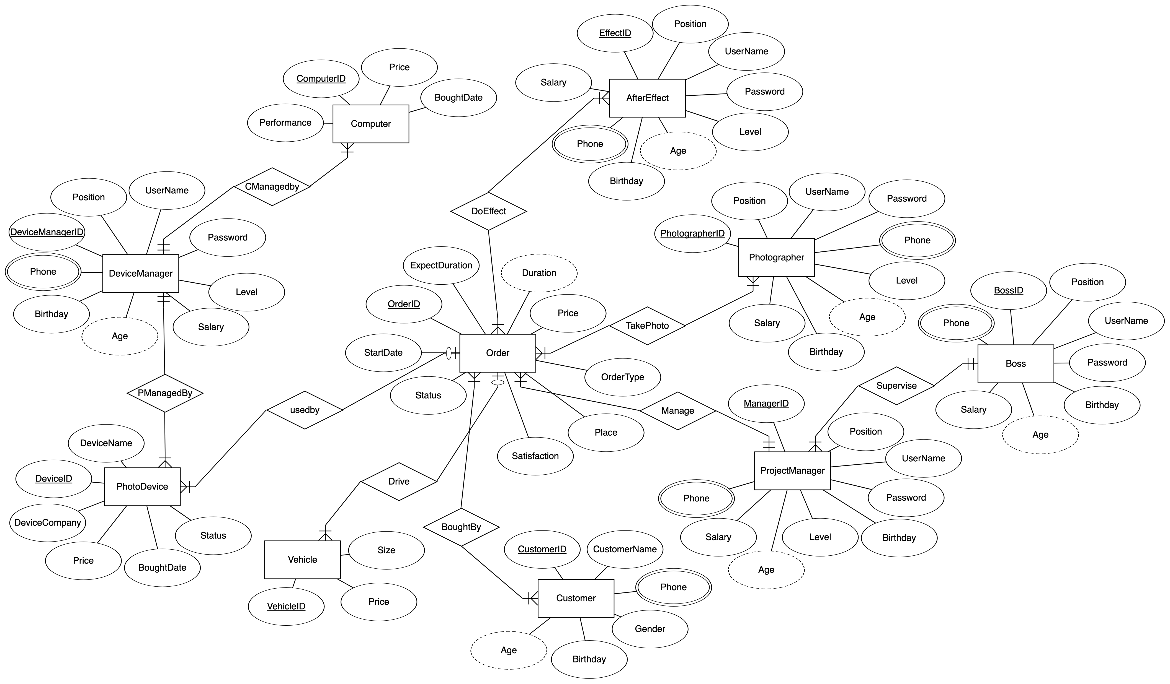
3 ER Diagram

Slide 5
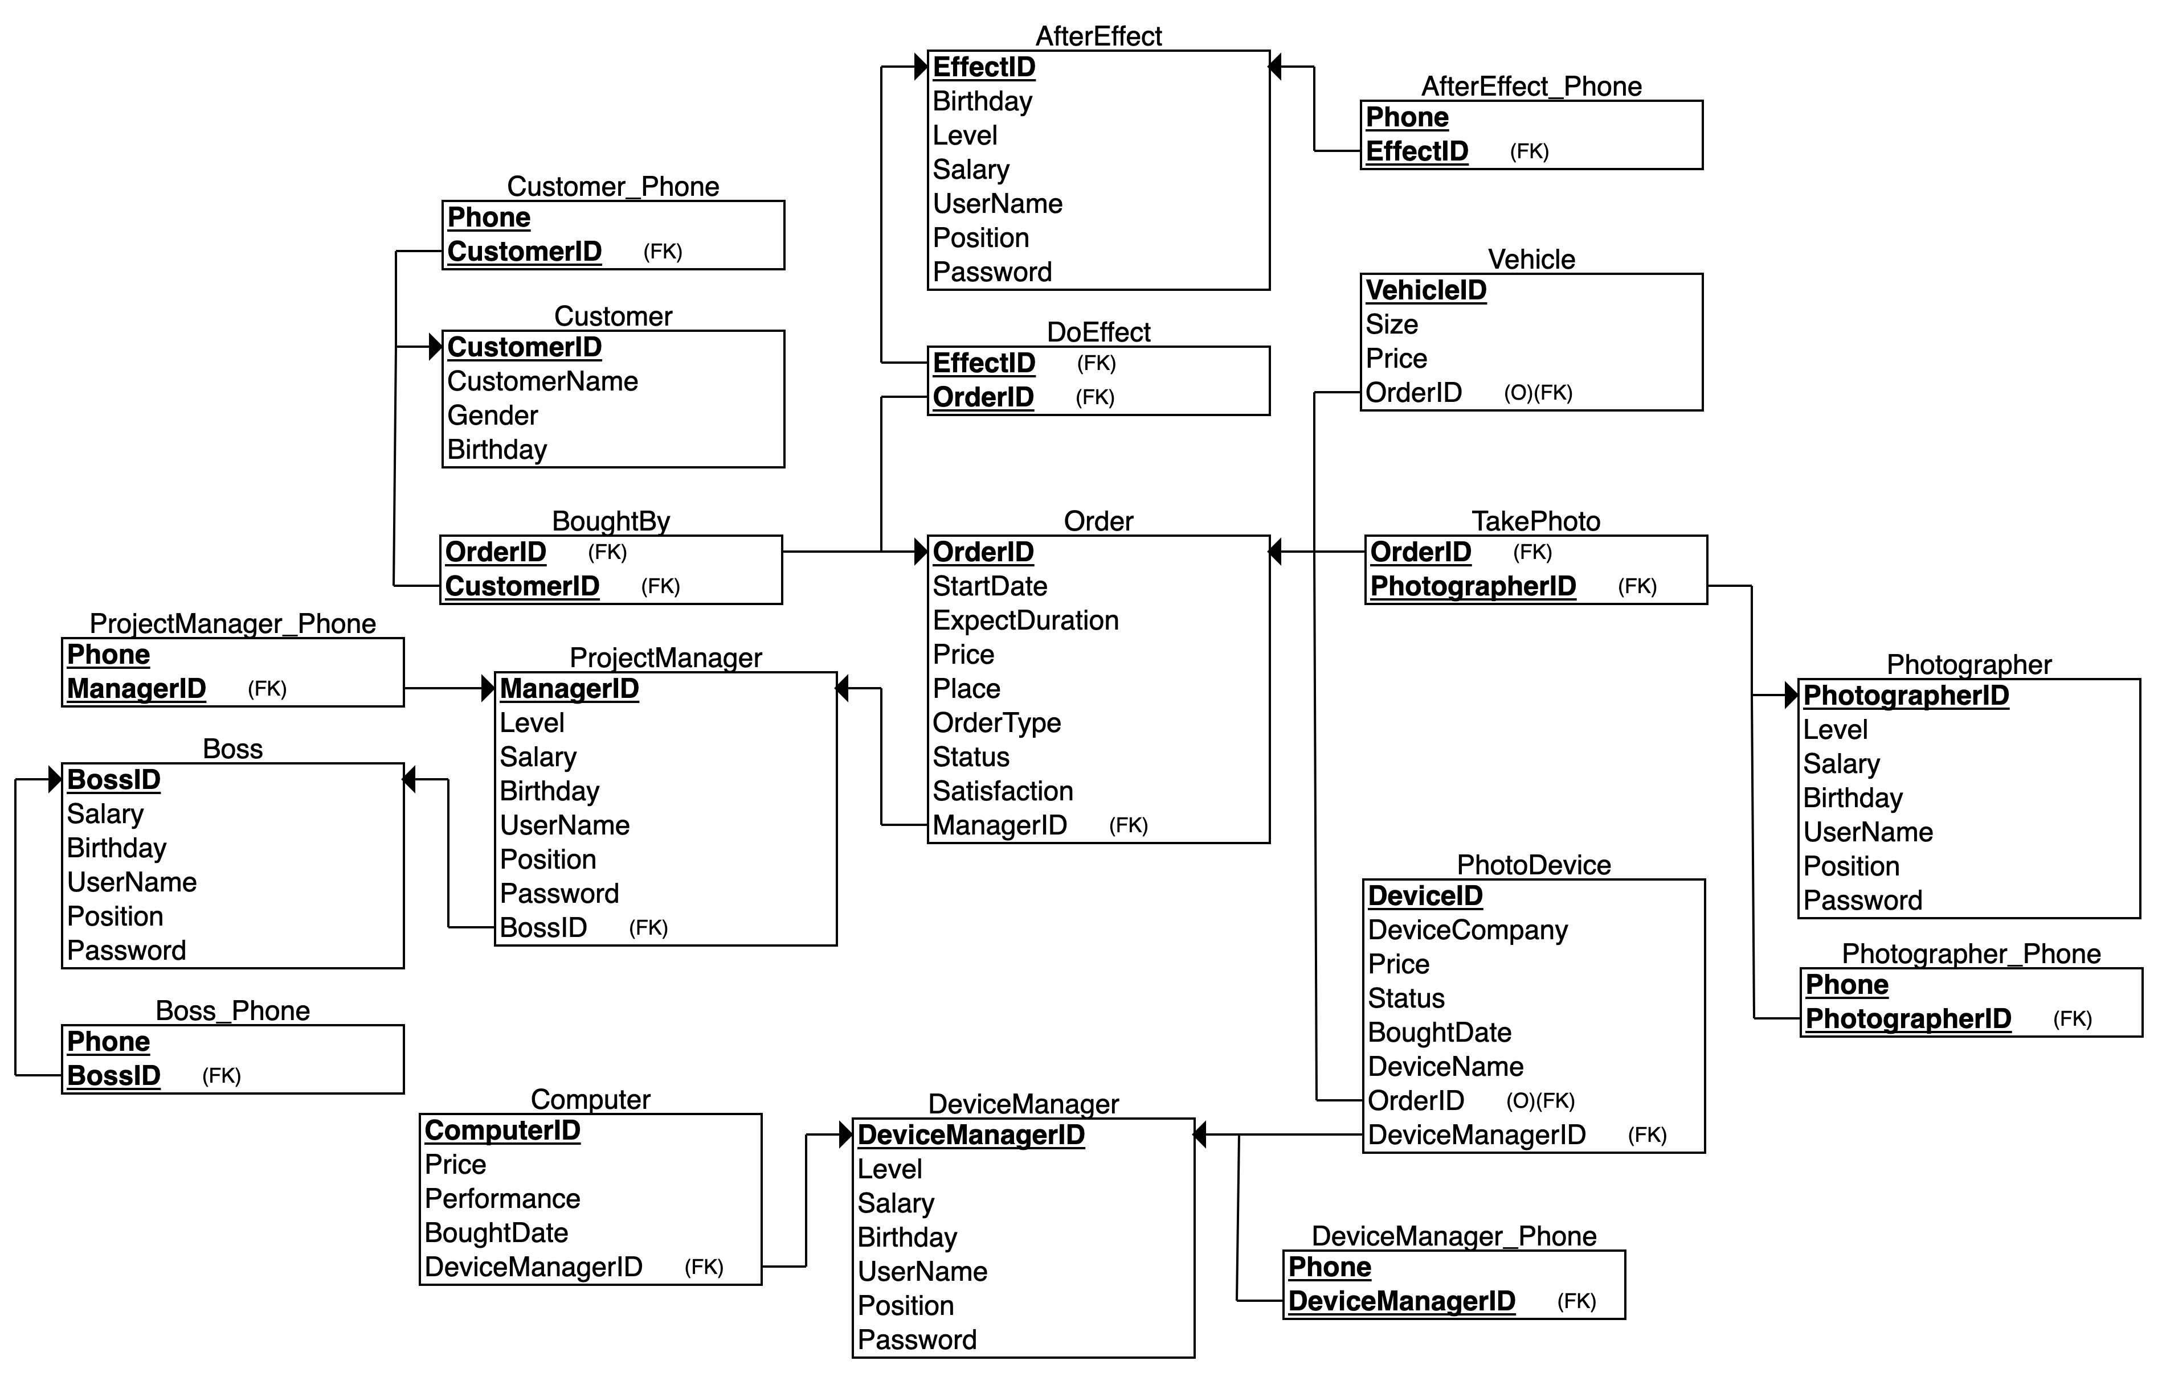
4 Relational Schema

Slide 6






5 Implementation
Front End
Back End

Slide 7
DEMO

