Slide 1
Suggestions for Businesses
Module 3

Slide 2
Summary of Analytics
Data pre-processing
First convert to standard .csv files.
Find ‘open’ ‘Hotel’ category tag.
Focus on specific words in reviews.
Analysis of relationship between appearance frequency and star ratings.

Slide 3
Summary of Analytics
For rating is greater than 4, here are some key words: Great, nice, clean, friendly, etc.
For rating is no more than 2, the key words are: Just, location, old, bathroom, shower, etc.
Some factors that may affect hotel ratings.

Slide 4
Hotel Advice
A quiet room is associated with a higher rating.
Parking lots have little impact on rating. (p = 0.414)
Providing WiFi does not help to get more stars. (p = 0.414)
No Significant difference in accepting credit card or not. (p = 0.134)
Not providing TV is useful to increase rating. (p = 0.0009)
Allowing pets is not factor that people consider. (p = 0.865)
There is no difference whether hotels are good for kids. (p = 0.633)
Make the customers feel the hotel is newly designed or furnished. Since word “old” will deduct 0.679 from rating.
Keep the hotel as clean as possible is also critical.

Slide 5
Action Plan
Hotel owners would better provide quiet atmosphere for customers.
Not to provide TV. TV-free gains 1.34 more in ratings.
Free WiFi and big parking lot have little impact on ratings. Owners can focus on other things.
Offering delicious meals will have a higher feedback.
Employee trainings are essential. Polite behavior and friendly altitude make guests feel comfortable.

Slide 6
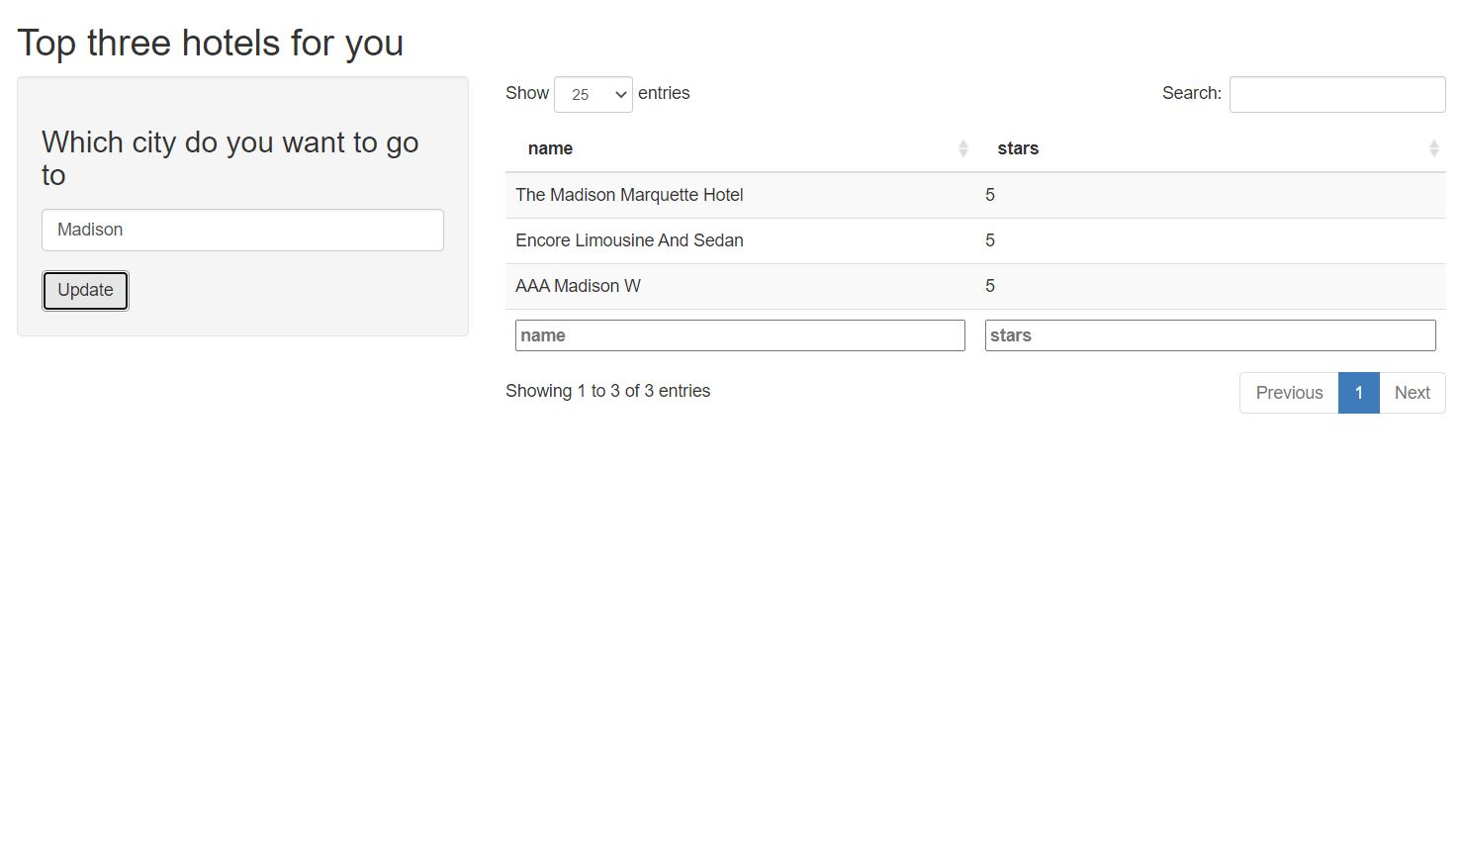
Top 3 Hotel App

