Slide 1
Suggestions for Businesses
Module 3

Slide 2
Summary of Analytics
Data pre-process
First convert to standard .csv files.
Find ‘open’ ‘Hotel’ category tag.
Focus on specific words in reviews.
Analysis of relationship between appearance frequency and star ratings.

Slide 3
Summary of Analytics
For rating is greater than 4, here are some key words: Great, nice, clean, friendly, etc.
For rating is no more than 2, the key words are: Just, location, old, bathroom, shower, etc.
Some factors that may affect hotel ratings.
Find out how key words influent star ratings.

Slide 4
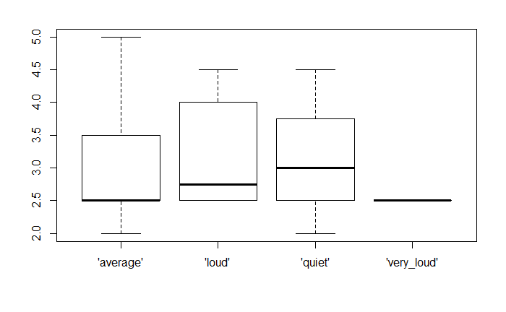
Noise Level
What the graph demonstrates accords
to our experience: louder room, lower
ratings.
But “loud” is lowest why?
Six feedbacks: 2.5, 2.5, 2.5, 3, 4.5, 4.0.
Extreme values have huge impact on
statistical analysis.

Slide 5
Hotel Advice
A quiet room is associated with a higher rating.
Parking lots have little impact on rating. (p = 0.414)
Providing Wi-Fi does not help to get more stars. (p = 0.414)
No Significant difference in accepting credit card or not. (p = 0.134)
Not providing TV is useful to increase rating. (p = 0.0009)
Allowing pets is not factor that people consider. (p = 0.865)
There is no difference whether hotels are good for kids. (p = 0.633)

Slide 6
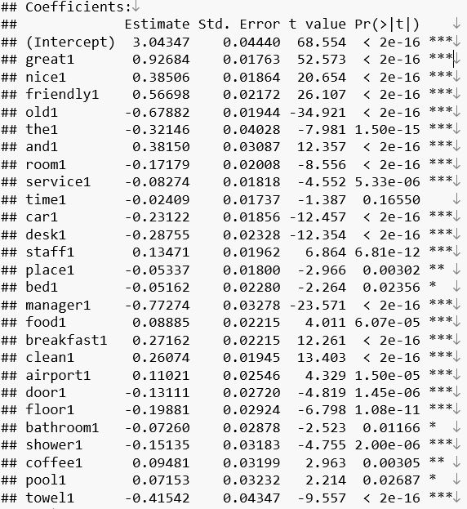
Key Words Regression
Fit a MLR with key words in slide 3.
For example, the word “great” will
increase 0.93 in ratings.
The intercept means that none of
the words is mentioned, customers
will rate 3.04.

Slide 7
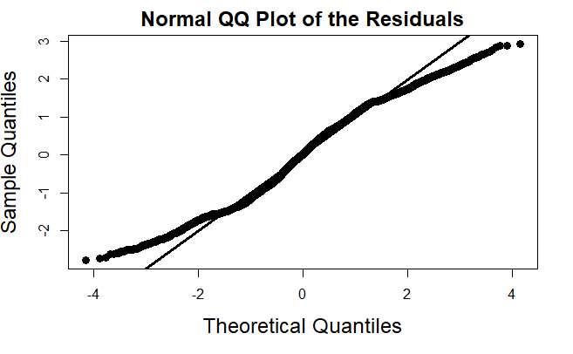
Model Diagnosis
Check for normality by QQ plot.
The trend is not severe, we can accept that the model is valid.

Slide 8
Action Plan
Hotel owners would better provide quiet atmosphere for customers.
Not to provide TV. TV-free gains 1.34 more in ratings.
Free Wi-Fi and big parking lot have little impact on ratings. Owners can focus on other things.
Offering delicious meals will have a higher feedback.
Employee trainings are essential. Polite behavior and friendly altitude make guests feel comfortable.

Slide 9
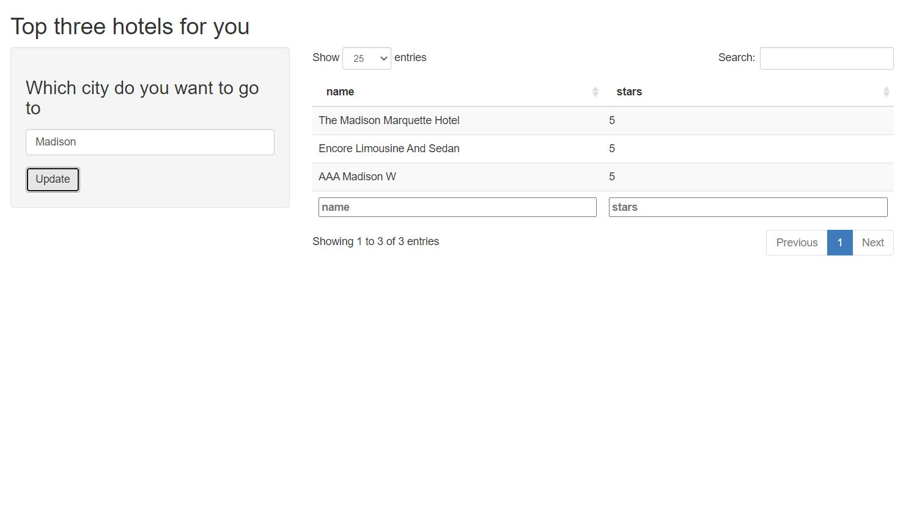
Top 3 Hotel App

