Slide 1

How Could Hotel Owners improve their business
Module 3 Group 14

Slide 2
What we concerned:
How to improve hotels’ star ratings? For example, should hotel provides free WiFi?
How to improve the performance of hotel to better serve their customers according to customers’ reviews. For example, is it important to update old facilities?

Slide 3

Background Information
Our analysis is based on user data provided by Yelp.
Yelp is an Internet company found in 2004 which aims to “ help people find great local business” via establishing a platform for users to write reviews and rating their experiences.

Slide 4
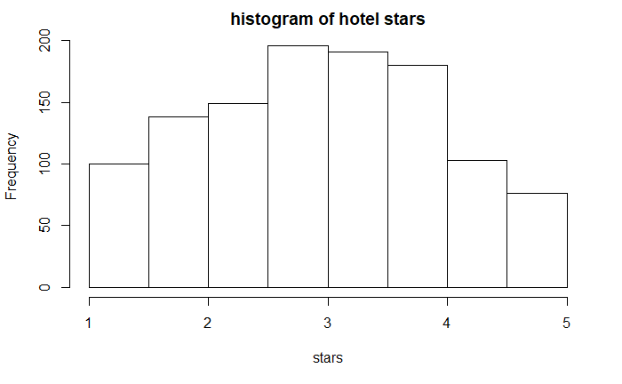
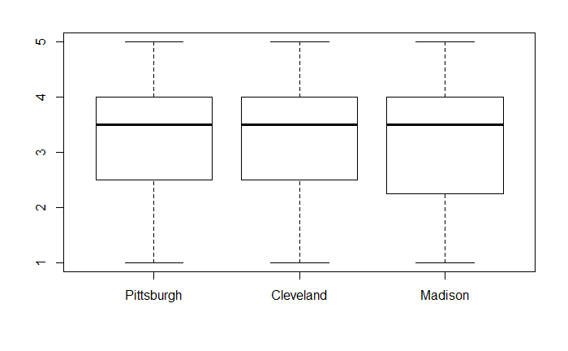
General Introduction
The average star rating for hotels is 3.18 and the standard deviation is 1.02 and the associated histogram is shown in the right hand side.
The average ratings of hotel in Pittsburgh, Cleveland and Madison are 3.30,3.30 and 3.19. Although ratings in Madison seems to be a little bit lower than the others, there is no significant difference among hotel ratings in three cities (anova F-test p-val= 0.602).

Slide 5
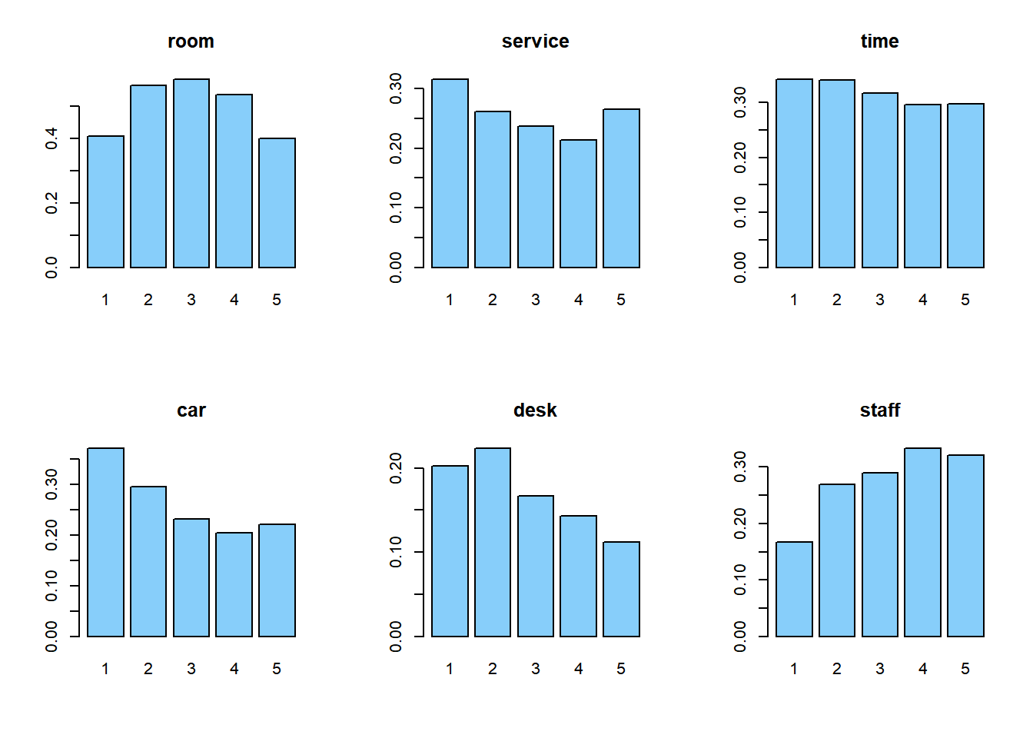
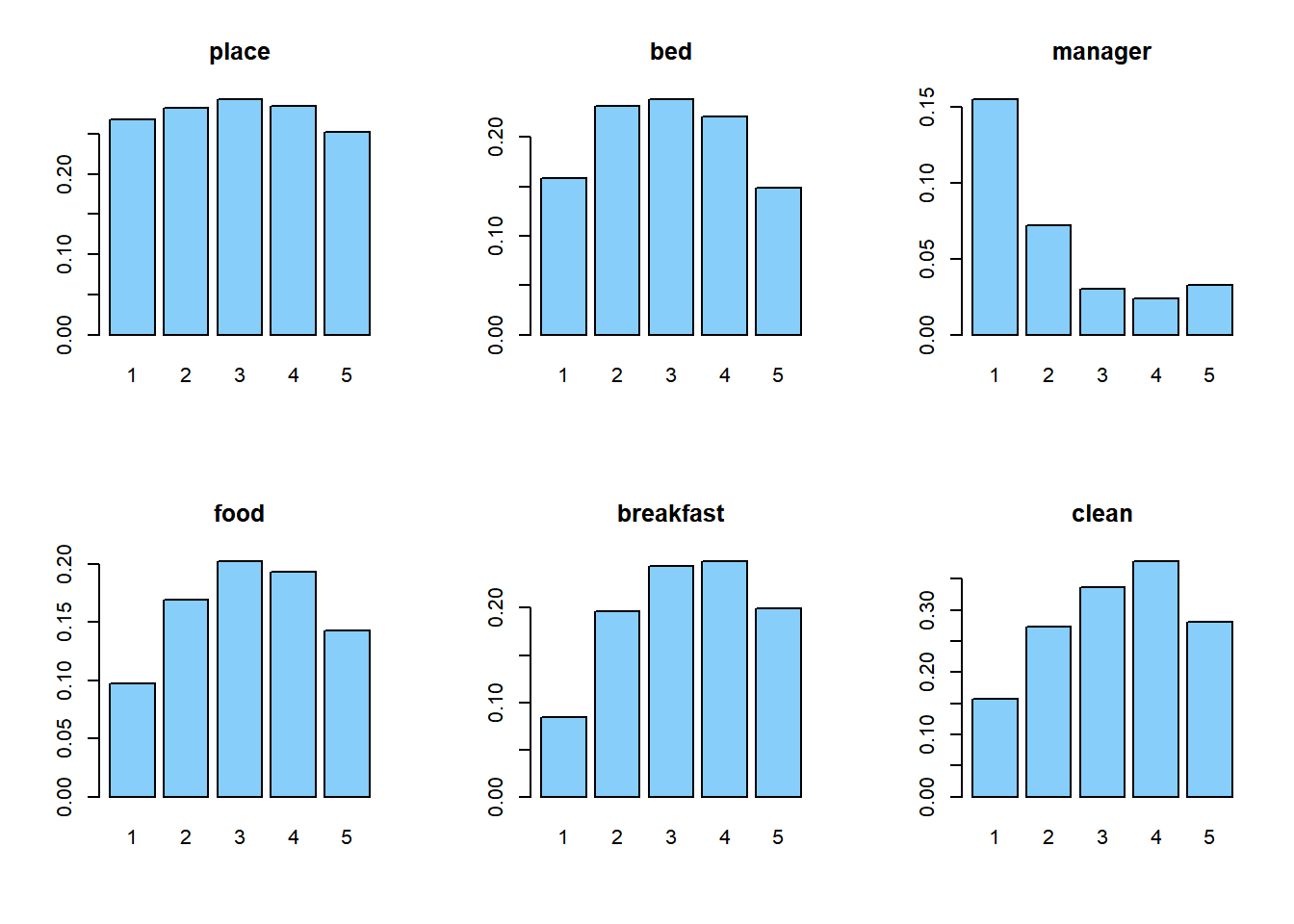
Words Frequency and Stars
We draw freq vs. stars plot. And we can see that frequency of some words is relative to stars.
We fit a multiple linear regression model with outcomes as star ratings and predictors as all words frequency we’re interested in.

Slide 6
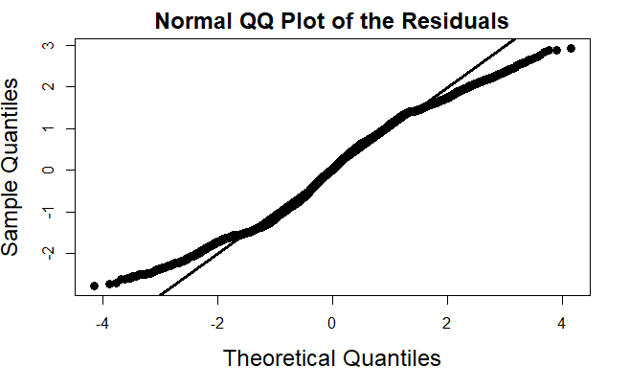
Model Diagnosis
we use linear regression, so we draw QQ-plot as shown. The plot shows a trend of light-tail distribution, but not severe.
residual plot has an obvious linear pattern, which indicates lack of fit. Since the purpose of this model is just to detect the relationship between star ratings and certain words, not to explain the variation in star ratings, we can still draw some useful conclusion from model.

Slide 7
Action Plans
Room Service:
It might be better for hotel owners not to provide TV: on average, a hotel doesn’t provide TV outperform others with TV by 1.34 in rating. (two sample t-test p-val: 0.0009)
Quiet room is important: average star ratings for hotel with quiet room is 3.0, while other noise level “average”, “loud”, and “very loud” get rating 2.5, 2.75, 2.5
Keep room clean: the appearance of word “clean” would help to gain 0.26 in star rating. (p-val < 2e-16)
It’s not worth investing WiFi: the difference between average rating for free WiFi and paid WiFi is 0.15; while the difference between average for free WiFi and no WiFi is -0.18. (anova F-test p-val: 0.299)

Slide 8
Action Plans
Other Service:
We suggest hotel owners to provide delicious breakfast for customers: the appearance of word “breakfast” would increase the star rating by 0.272. (p-val < 2e-16)
Hire staffs with friendly and polite behavior to make customers feel better: the appearance of word “friendly” would increase the star rating by 0.567. (p-val < 2e-16)
Update old facilities, especially in bathroom: the appearance of word “old” would reduce the star rating by 0.679. (p-val < 2e-16)
It’s not worth having parking lot or having special place for kids to play in: neither has significant influence on star ratings (both t-test p-val > 0.05)

Slide 9
Conclusion
We utilize different types of analysis to help hotel owners better serve their customers and get higher star ratings on Yelp.
Some results are pretty surprising like people don’t care much on whether hotel would provide free WiFi.
We deeply understand that our results rely on some assumptions which are not perfectly matched.
Every result is associated with 5% type I error. They bring some uncertainty to our conclusion.
We hope the analysis above could help hotel owners to make reliable decision and get better and better.

Slide 10
Limitations
Our Recommendations rely on some assumptions we have made about the data and the analysis like normality and homoscedasticity. But model diagnosis shows neither is perfectly matched, which brings some uncertainty to our conclusions.
Our conclusions based on variables in ”attribute” part are not very reliable since most people didn’t offer any information about these variables so most of them are just ”NA”. The conclusions are drawn only from very small sample size, which may leads to wrong results or even opposite results, and we happen to have such example when analyzing variable ”Noise Level”.

Slide 11
THANK YOU
Module 3 Group 14

