Slide 1
NxM Templates for SuperCDMS SNOLAB Run 4 — Ge Activation Data
K-line event selection · free-pretrigger two-exponential fits · 1x1 and NxM (PCA) templates
Zhiheng Li — July 2026
Notes:
Today I will present the phonon pulse-template work for SNOLAB Run 4: how we selected events on the Ge-activation K-line, the fit-and-align pipeline, the quality cuts and how each was derived, and the two template families we delivered for all 13 detectors.

Slide 2
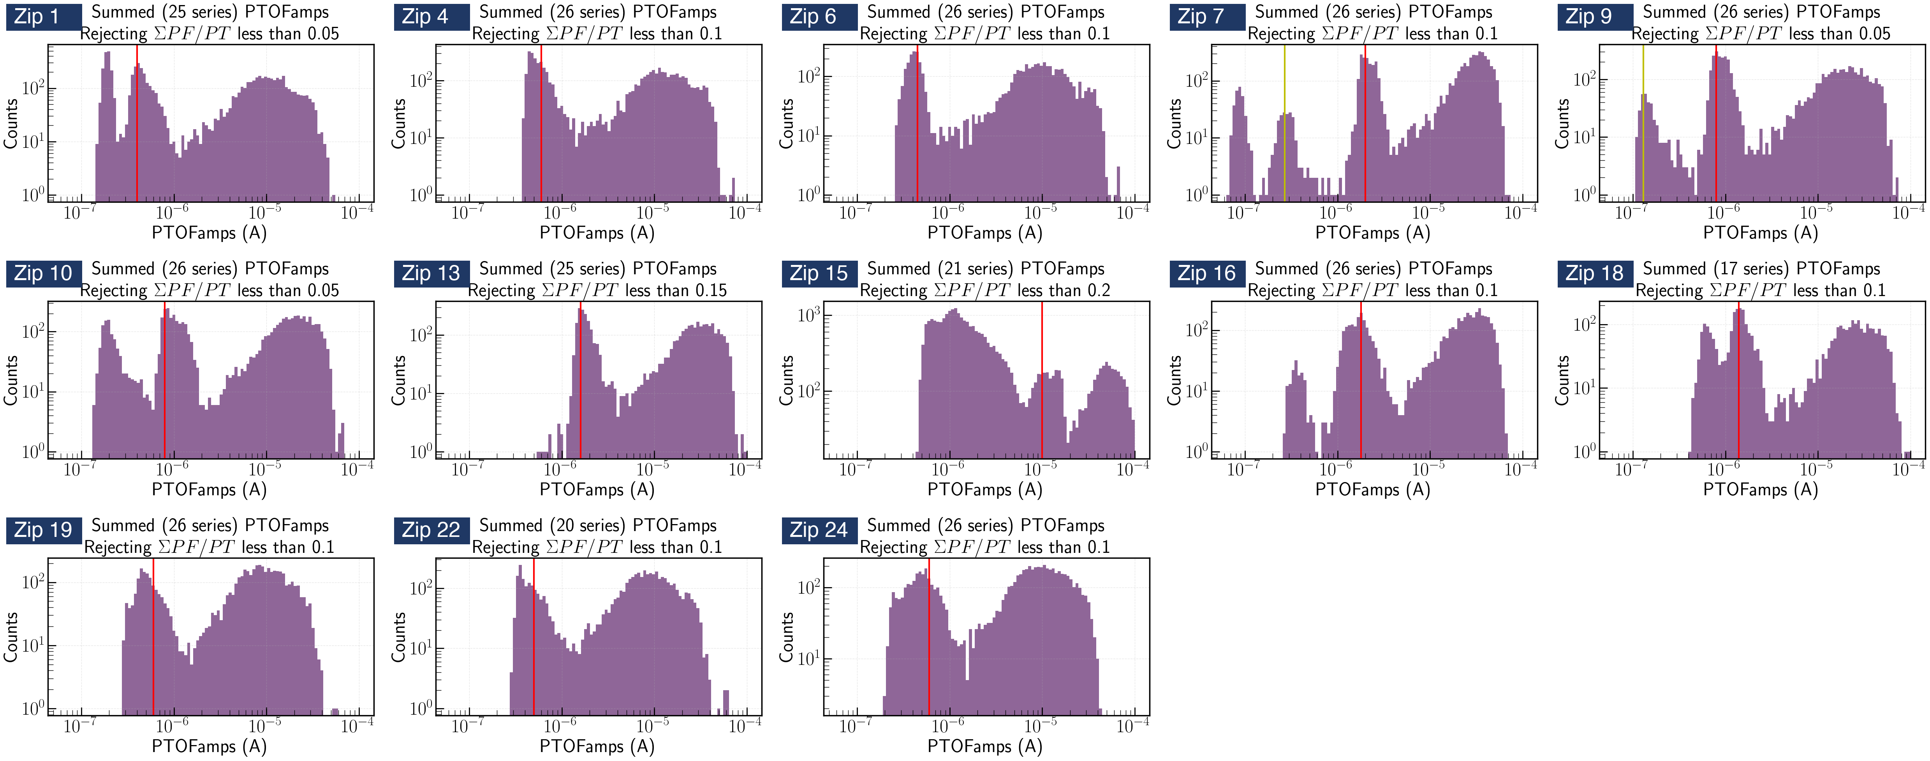
From the Ge-activation K-line to an event sample
Goal: one clean, minimally-biased pulse population per detector × channel
Data: Ge Activation Data — Ops Shift 260612
Credit: Prof. Tarek Saab · SuperCDMS Confluence
• Per detector, Prof. Saab's study marked the 10.37 keV K-line position in PTOFamps — the red line in each panel below
• Our event selection: a PTOFamps window bracketing the red line — position ×/÷ 1.35, a rough, somewhat arbitrary eyeballed choice; deliberately minimal, no other cuts
• For every selected event: cache the fully unprocessed raw MIDAS traces of all channels + event metadata
• 13 detectors (zips) × 27–30 series — full raw traces cached
2 / 15
All 13 detectors, PTOFamps spectra (Prof. Saab's study)
Notes:
Everything starts from the Ge activation data. After Cf activation every detector shows the 10.37 keV K-line. Professor Saab's study located the K-line position in the PTOFamps spectrum of each detector - that is the red line in every panel here. Our event selection is exactly one condition: a window around the red line, a factor 1.35 both ways - a rough, eyeballed choice - and nothing else. For each selected event we cache the fully unprocessed raw MIDAS traces of all channels. You can already see on the weak detectors that the window will admit part of the noise-trigger population next to the K-line - that is intentional: the cache is raw, so every later cut stays explicit and reversible.

Slide 3
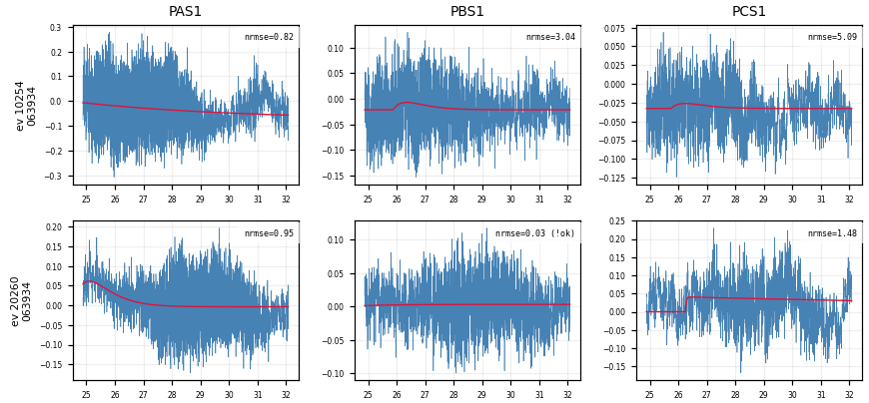
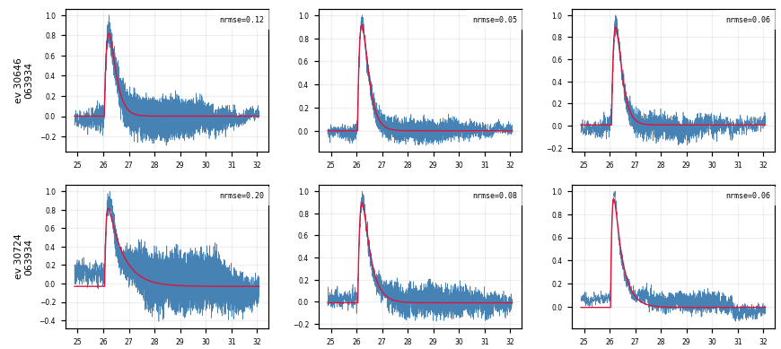
Fit quality at a glance — event × channel grids
• One row per event, one column per channel: the low-passed trace (blue) with the fitted pulse model (red) overlaid
• A real event fits well in every channel at once; a noise trigger fails in every channel — a clean handle on which events are real
Noise triggers (Z7): the fit fails in every channel at once
K-line events (Z7): consistent good fits across channels
3 / 15
Notes:
Before the algorithm, a quick look at the data itself. We use event-by-channel grids: each row is one event, each column one channel, with the low-passed trace in blue and a fitted pulse model in red on top. The pattern is already clear: a real K-line event fits well in every channel at once, while a noise trigger fails in every channel at once. So the events split cleanly into two kinds. How we actually fit and align each trace is the next slide, and how we turn that split into a quantitative cut comes shortly after.

Slide 4
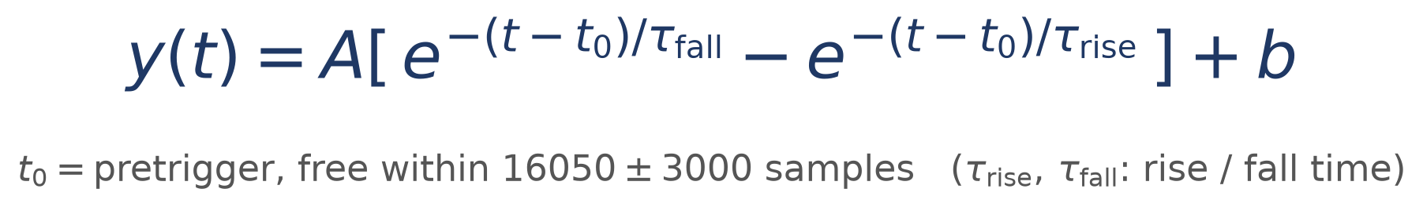
Per-trace algorithm: low-pass → fit → align
1. Low-pass — 100 kHz Butterworth
2. Normalize — subtract the baseline, scale the trace to unit peak
3. Fit — two-exponential model, all 5 parameters free (including the pretrigger t₀):
4. Two quality checks per trace (recorded here, not cut yet):
• fit_ok — amplitude is positive, and the pulse rises faster than it falls
• NRMSE — RMS of the fit residual ÷ pulse peak (smaller = better fit)
4 / 15
Notes:
The per-trace algorithm. First a low-pass filter to smooth away the high-frequency noise, then the baseline is subtracted and the trace is scaled to unit peak - without that normalization the traces could not be overlaid or compared. The core is the fit: a two-exponential function, one exponential for the rise and one for the fall, with all five parameters free, including the pretrigger - the pulse start time. The pretrigger is never pinned: real trigger times vary, and the fitted pretriggers cluster about 230 samples after the nominal value - pinning it would bias the time constants. Each fit records two quality numbers: fit_ok, a physicality check - positive amplitude, rise faster than fall - and the NRMSE, the normalized root-mean-square error, the fit residual divided by the pulse height. At this stage we only record them. Step five, alignment, and its output get their own slide next.

Slide 5
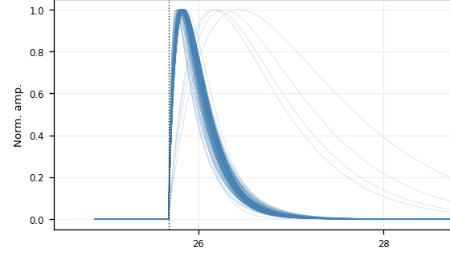

5. Align — shift each trace to a common pretrigger
• Shift the measured trace by (fitted pretrigger − 16050) — a pure translation. Drawn at the common pretrigger, the fitted curves stack into one shape family:
All fit_ok fitted curves (Z7 PBS1) — no cut
After NRMSE ≤ 0.4 (Z7 PBS1) — one tight shape family
5 / 15
Notes:
Step five: alignment. Each measured trace is shifted by its fitted pretrigger minus the nominal 16050 - a pure translation, nothing about the waveform is regenerated. Once everything is at the common pretrigger, the fitted curves stack up. On the left, all physical fits: you can see the slow stragglers spreading off the main bundle. On the right, after the NRMSE cut, a single tight, consistent shape family remains. That tight family is what makes a well-defined template possible - and where the cut comes from is what I show next.

Slide 6
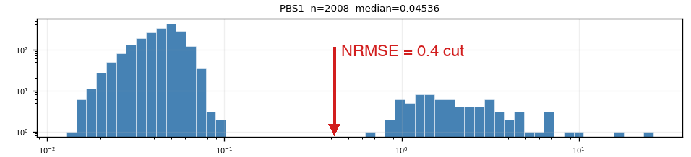
Quality cut 1: NRMSE ≤ 0.4 — where the number comes from
• NRMSE of fit_ok events is bimodal: good fits (median ≈ 0.05–0.1) vs noise triggers (≈ 1–2), valley at ≈ 0.4–0.5
• The cut sits in the valley — it is read off the distribution, not tuned on the templates
• Weak detectors (Z1, Z4, Z6, Z18, Z19, Z22, Z24): same bimodal picture, noise peak dominates
Z7 PBS1: two clean populations, log-log axes
6 / 15
Notes:
First quality cut. The NRMSE distribution of physical fits is bimodal on every detector: a good-fit population around 0.05 to 0.1, and a noise-trigger population around 1 to 2, separated by a valley at about 0.4. We place the cut in the valley - it is read off the distribution itself. This is Z7 PBS1, the channel used throughout the talk. The weak detectors - Z22, for example - show the same bimodal picture with the noise peak dominating, and there this same cut is what digs the real pulses out of the mixture. (If someone asks what a weak detector looks like, show the backup slide.)

Slide 7
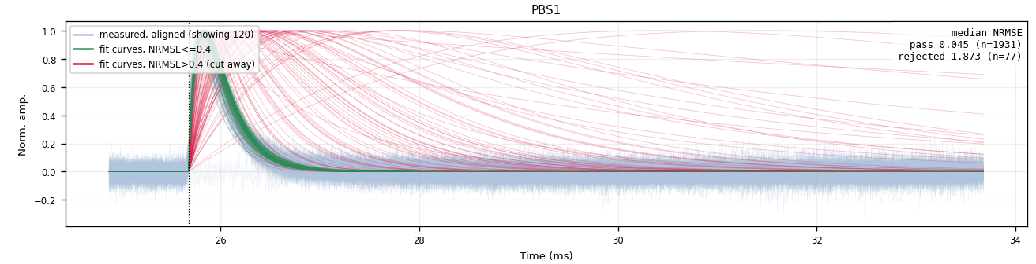
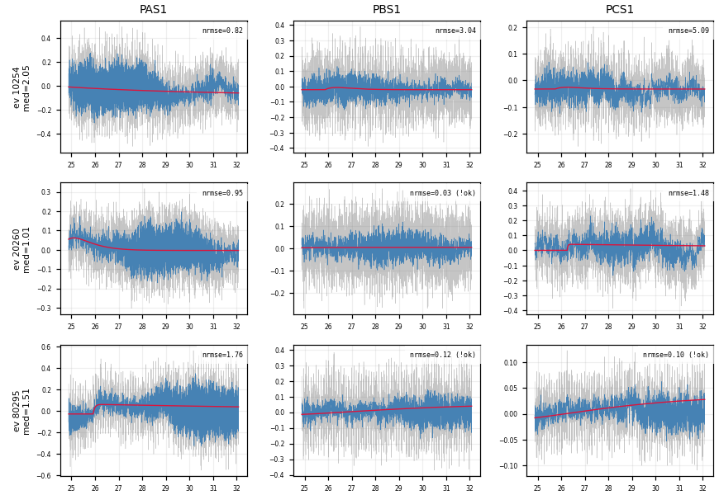
The rejected population is noise — verified in the raw traces
• Event grids of NRMSE-rejected events (median NRMSE > 0.4 across channels): the raw traces show no pulse — the cut removes noise triggers, not physics
Z7 PBS1 ── passes the cut (kept) ── cut away = rejected
faint blue = measured traces 1931 kept / 77 cut (~3.8%)
Z7: NRMSE-rejected events — raw traces are noise
7 / 15
Notes:
Before trusting the cut we looked at what it throws away. These are event grids of the rejected population on Z7: the raw traces show no pulse at all - they are noise triggers whose slow two-exp fit happened to converge. The fan-cut view on the right overlays the passing fitted curves in green and the rejected ones in red on the aligned data: the green population is the fast physical pulse shape, the red one is spread out with a median NRMSE forty times higher - 1.87 against 0.045 - and on this channel only three point eight percent of the events get cut. So the cut removes noise triggers, and no real pulses are lost.

Slide 8
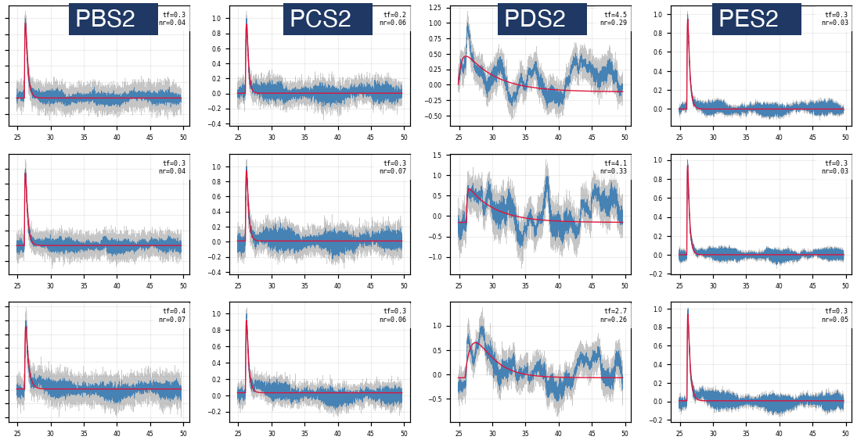
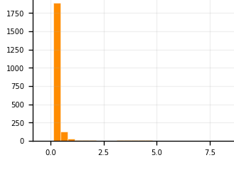
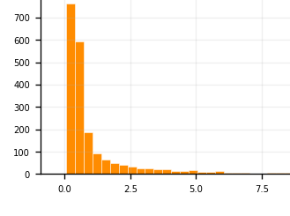
Follow-up 1 — the slow-fall tail is a one-channel artifact
• The post-cut fan still shows slow-fall tails → sample them: NRMSE ≤ 0.4 AND τ_fall > 1.5 ms, 10 random events, raw vs fit drawn in all 12 channels
• The sampled events are real pulses → kept. Their extreme fall times trace to one channel: only PDS2 swings (τ_fall median 0.51 ms vs ≈ 0.25 ms elsewhere) — a low-frequency disturbance
• Conclusion: no τ_fall cut — slow-fall events passing NRMSE stay in; the extreme tail is a one-channel artifact, not a slow pulse
Fitted τ_fall distribution, same 0–7 ms axis:
Z7 PAS1 — normal channel: narrow (median 0.25 ms)
Z7 PDS2 — bad channel: broad tail (median 0.51 ms)
Z7, 3 sampled slow-fall events: normal in PBS2/PCS2/PES2, swings only in PDS2
8 / 15
Notes:
The first lead comes from the fan plot after the cut: some curves still fall very slowly. We chased it by sampling: among events passing the cut, take fall times above one point five milliseconds, randomly sample ten, and draw raw versus fit in every channel. Two findings. First, the sampled events are real pulses - so they stay in, and we apply no fall cut. Second, their extreme fall times all trace back to one channel: only PDS2 is swinging wildly, while the same events are normal fast pulses in the other eleven channels - so the extreme tail is a one-channel low-frequency artifact, not a genuinely slow pulse.

Slide 9
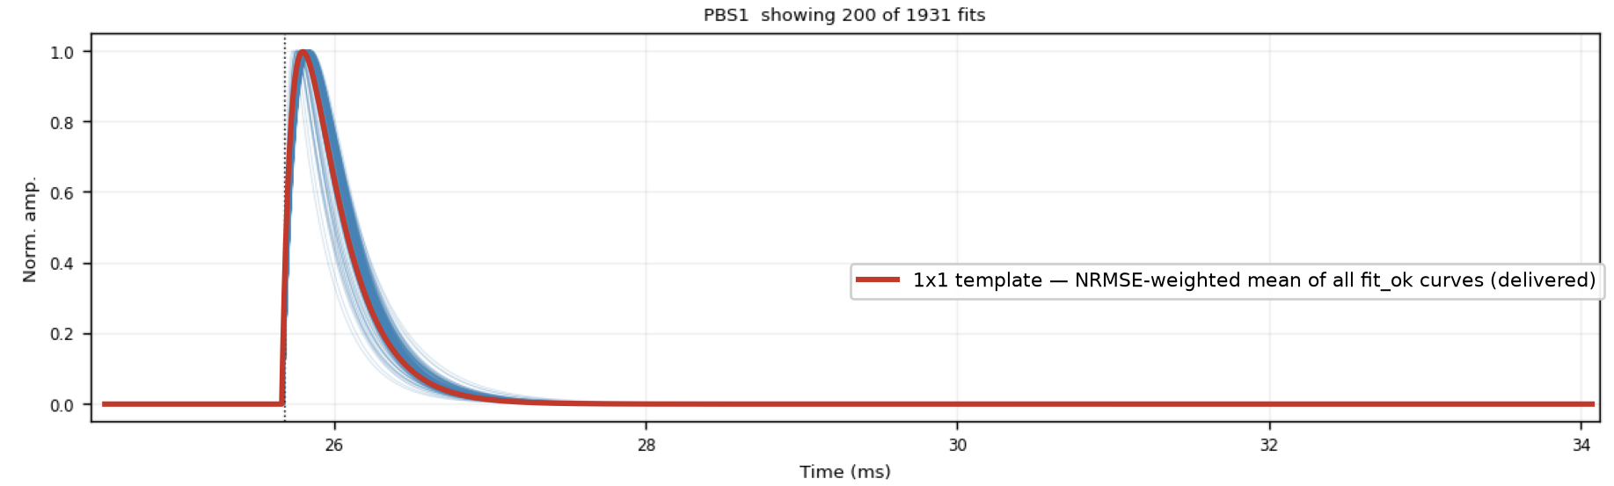
Template family 1 — analytic 2-exp, NRMSE-weighted (1x1)
• NRMSE-weighted mean of the fit_ok 2-exp curves
• Smooth & noise-free by construction
• ROOT histograms, peak-normalized (+ summed PT / PS1 / PS2)
Z7 PBS1 — blue: the fitted curves (200 of 1931 drawn); red: the delivered 1x1 template, the NRMSE-weighted mean of all fit_ok curves, read back from the ROOT file
9 / 15
Notes:
First template family: the analytic one. For each channel we take every physical fitted curve at the common pretrigger and average them with a weight of one over NRMSE squared - badly fit events count less but nothing is excluded by hand. After the cuts, shown here, a single tight shape family remains, and its weighted mean is the 1x1 template - smooth and noise-free by construction because it is built from analytic curves, delivered as peak-normalized ROOT histograms.

Slide 10
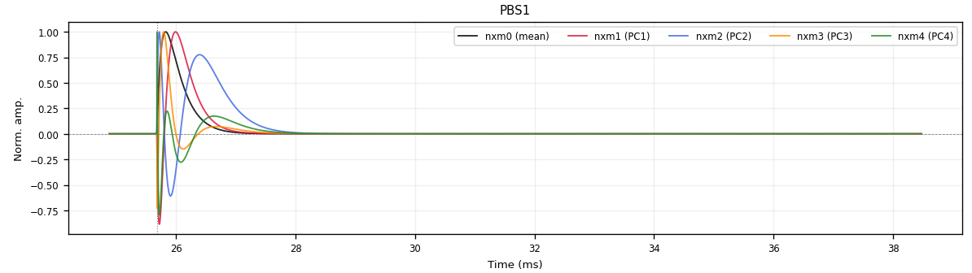
Template family 2 — NxM PCA templates
• Per-channel PCA over the clean fitted curves (fit_ok + NRMSE ≤ 0.4 + τ_rise ≤ 0.3 ms)
• nxm0 = mean shape; nxm1–4 = principal components; real pulse = Σᵢ ampᵢ · nxmᵢ
• PC1 + PC2 ≈ 96–98% of the shape variance; delivered peak-normalized
Z7 PBS1: nxm0 (mean) + nxm1–4 (PCs) — the oscillating components encode rise/fall-time variation
10 / 15
Notes:
Second family: the NxM PCA templates, built to capture the pulse-shape variation across events. We run a PCA over the fitted curves that pass all cuts, in a window around the pulse. The mean shape becomes template zero, and the first four principal components become templates one to four - they oscillate and can be negative, and the optimal filter fits a real pulse as a linear combination of them. The first two components already capture 96 to 98 percent of the shape variance on every detector.

Slide 11
Delivered — and what remains
• Two template families built for all 13 detectors: 1x1 (2-exp weighted) + NxM PCA
• Delivered in the official cdmsbats PulseTemplates format
• Cuts read off the data, verified in raw traces: NRMSE ≤ 0.4, τ_rise ≤ 0.3 ms
11 / 15
Notes:
To summarize: both template families are delivered for all 13 detectors in the official PulseTemplates format - the analytic 1x1 templates and the PCA NxM set. The whole chain is traceable from raw traces to every figure, and both quality cuts were read off the data and verified in the raw traces. Two things remain: the final call on the rise-time ceiling versus the genuine slow pulses, and running the group's template-validation method on the new templates. Thank you - happy to take questions.

Slide 12
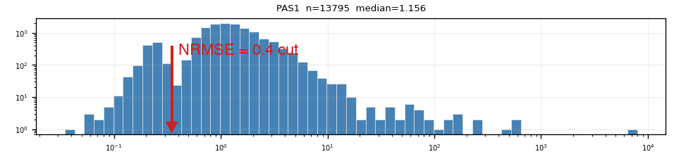
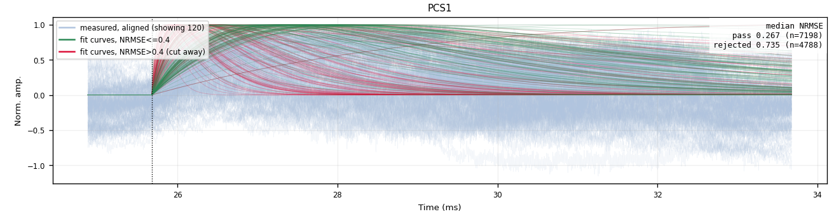
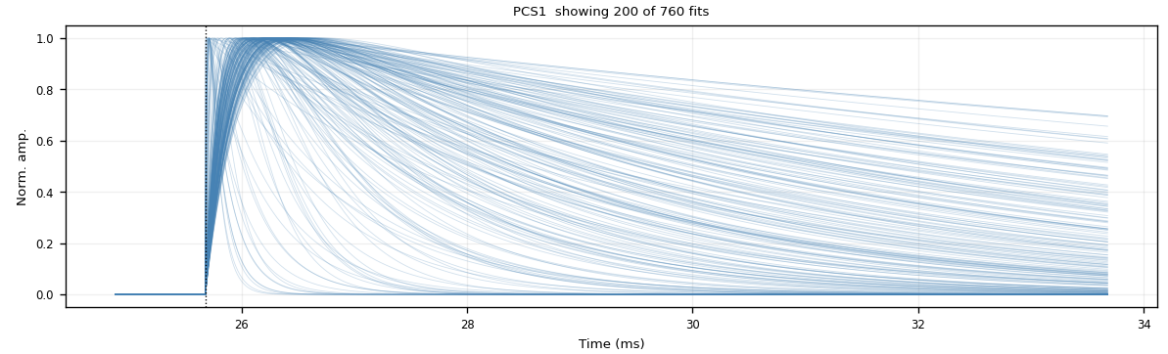
Backup — weak detectors (example: Z22)
• Z1 / Z4 / Z6 / Z18 / Z19 / Z22 / Z24: K-line sits inside the noise population — the PTOF window admits a noise-dominated mixture
• Same bimodal NRMSE picture, noise peak dominates; the same 0.4 cut digs the real pulses out — Z22 PCS1: 7198 kept / 4788 cut (~40%)
• Kept bundle broader than on quiet detectors; steep red curves = fits latching onto sharp noise spikes, not fast pulses being cut
• τ_rise ≤ 0.3 ms (after NRMSE): removes 55–74% on weak zips (Z22: 71%) vs 1.6% on Z7 — residual slow drift
Z22 PAS1: NRMSE histogram — noise dominates
Z22 PCS1: kept (green) vs cut (red)
Z22 PCS1 after NRMSE ≤ 0.4 + τ_rise ≤ 0.3 ms — final shape family (760 fits)
12 / 15
Notes:
Backup. On the weak detectors the K-line overlaps the noise population, so the PTOF window admits a noise-dominated mixture. The NRMSE distribution is still bimodal but the noise peak dominates, and the same 0.4 cut is what extracts the real pulses - on Z22 PCS1 about forty percent of the physical fits are removed. The kept bundle is broader than on a quiet detector, and the steep red curves are fits latching onto sharp noise spikes, not fast pulses being thrown away. The rise-time ceiling then removes fifty-five to seventy-four percent of what survived the NRMSE cut on the weak zips - residual slow drift - versus one point six percent on Z7. The surviving shape family is at the bottom.

Slide 13
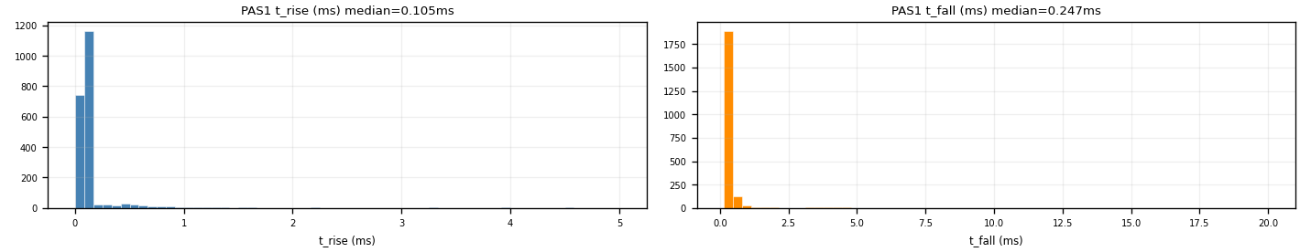
Backup — the τ_rise ≤ 0.3 ms ceiling (PCA input)
• Slow baseline drift survives NRMSE (a slow 2-exp hugs it) → mimics a slow rise
• Fast pulses at τ_rise ≈ 0.1 ms (p90 ≈ 0.15 ms) → ceiling at 0.3 ms blocks the drift tail
• Removed after the NRMSE cut: Z7 1.6% (quiet 2–6%) — weak 55–74% (Z22 71%) — all zips 54%
• Trade-off: trims the very slowest genuine pulses → decision pending
Z7 PAS1: fitted τ_rise (median 0.105 ms) and τ_fall distributions
13 / 15
Notes:
Backup for the rise-time cut. On weak-window detectors a slow baseline drift also fits as a slow rise, with a tiny residual, so NRMSE cannot catch it. Real fast pulses cluster near 0.1 ms while the drift tail stretches much further, so the PCA input gets a ceiling at 0.3 ms. Relative to the NRMSE step it removes almost nothing on quiet detectors - 1.6% on Z7, mostly the bad channel PDS2 - but 55 to 74% on the weak ones, 71% on Z22, pooled 54% over all zips. The price is that the very slowest genuine pulses get trimmed too; that trade-off is documented and not final.

Slide 14
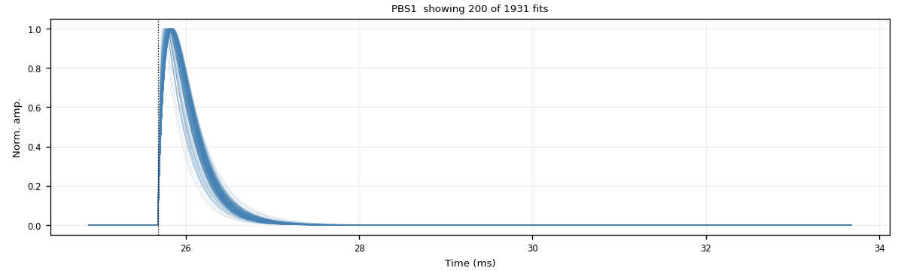
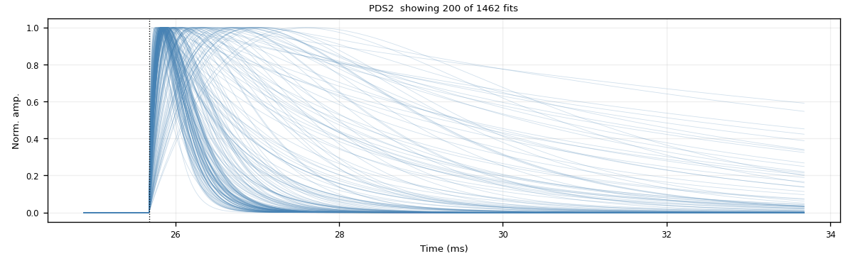
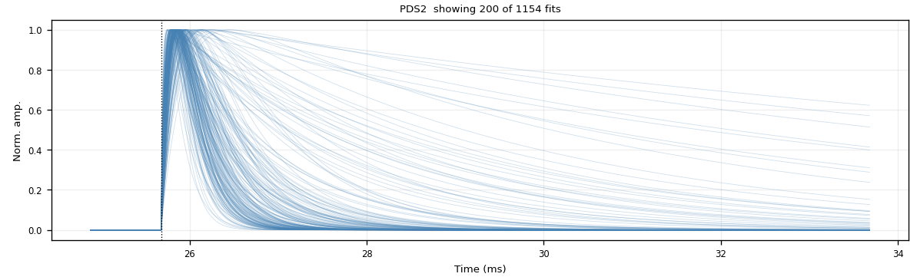
Backup — τ_rise cut: a good vs a bad channel (Z7)
• Good channel PBS1: tight clean bundle — the τ_rise ≤ 0.3 ms cut removes ~0% (nearly free on quiet channels)
• Bad channel PDS2: broad, messy fan — the channel itself is bad; the cut trims the slow-rise curves, 1462 → 1154 (21%)
PBS1 (good) — NRMSE ≤ 0.4
PBS1 (good) — + τ_rise ≤ 0.3 ms (unchanged)
PDS2 (bad) — NRMSE ≤ 0.4
PDS2 (bad) — + τ_rise ≤ 0.3 ms (slow risers trimmed)
14 / 15
Notes:
Backup showing the cut channel-by-channel on Z7. On the good channel PBS1 the fitted curves are already a tight, clean bundle, and adding the rise-time ceiling changes essentially nothing - it removes about zero percent. On the bad channel PDS2 the fan is broad and messy, which by itself shows the channel is misbehaving; there the ceiling trims the slow-rising curves, 1462 down to 1154, about twenty-one percent. So the cut is nearly free where the data is clean and does real work only where a channel is bad.

Slide 15
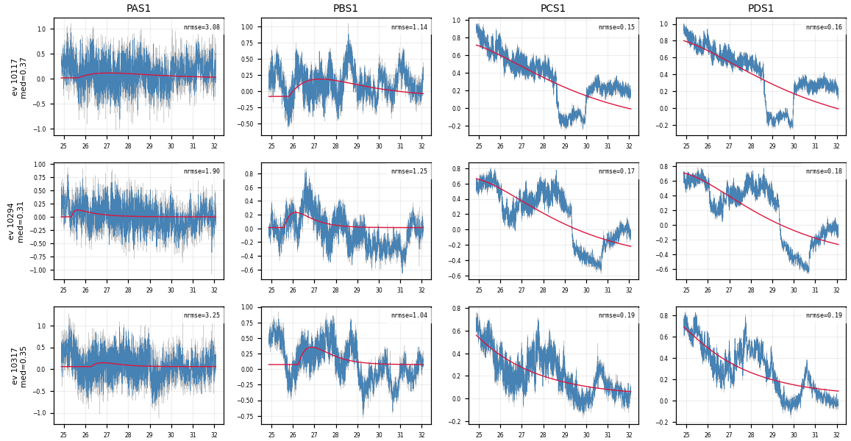
Backup — what the τ_rise cut removes: noise NRMSE missed (Z22)
• Exactly the events that PASS NRMSE ≤ 0.4 but are REMOVED by τ_rise ≤ 0.3 ms — the noise 0.4 let through, 0.3 catches
• PCS1 / PDS1 pass at NRMSE ≈ 0.15 (a slow 2-exp hugs a slow baseline drift) — but the raw trace has no clean fast pulse
• Trade-off: the same cut also trims genuine slow-rise pulses — documented, decision pending
Z22: 3 events × PAS1/PBS1/PCS1/PDS1 — pass NRMSE ≤ 0.4, removed by τ_rise ≤ 0.3 ms; PCS1/PDS1 are pure slow drift
15 / 15
Notes:
Backup: what the rise-time cut actually removes. These are exactly the Z22 events that pass the NRMSE cut - median NRMSE below 0.4 - but are removed by the rise-time ceiling, median t_rise above 0.3 ms. In other words, the noise that 0.4 let through and 0.3 catches. Look at PCS1 and PDS1: their NRMSE is low, around 0.15, because a slow two-exp hugs the trace with a tiny residual - but the raw trace is just a slow baseline drift, there is no clean fast pulse. The honest caveat is that the same cut also trims a small number of genuine slow-rise pulses, which is the documented, still-open trade-off.

