Slide 1
Phonon collection efficiency of Z7
Zhiheng Li · University of Minnesota · SuperCDMS SNOLAB Run 4 · September 2026
github.com/ZhihengLi0/urop → snolab/collection_efficiency/
1
Notes:
Title.

Slide 2
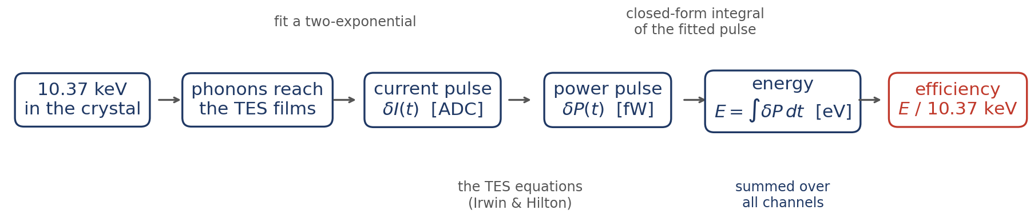
The Main Idea
For detectors operated at 0 V (no NTL effect):
Collection efficiency = energy absorbed by the TESs, summed over all channels ÷ the 10.37 keV of the event
Sample: Z7, the K-line events of the Ge activation run, from SNOLAB R4 (2207 events, 30 series, all 11 channels).
2
Notes:
Efficiency = energy absorbed by the TESs, summed over all channels, / 10.37 keV, for a detector operated at 0 V (no NTL amplification). Z7, K-line events of the Ge activation, SNOLAB R4, 2207 events over 30 series.

Slide 3
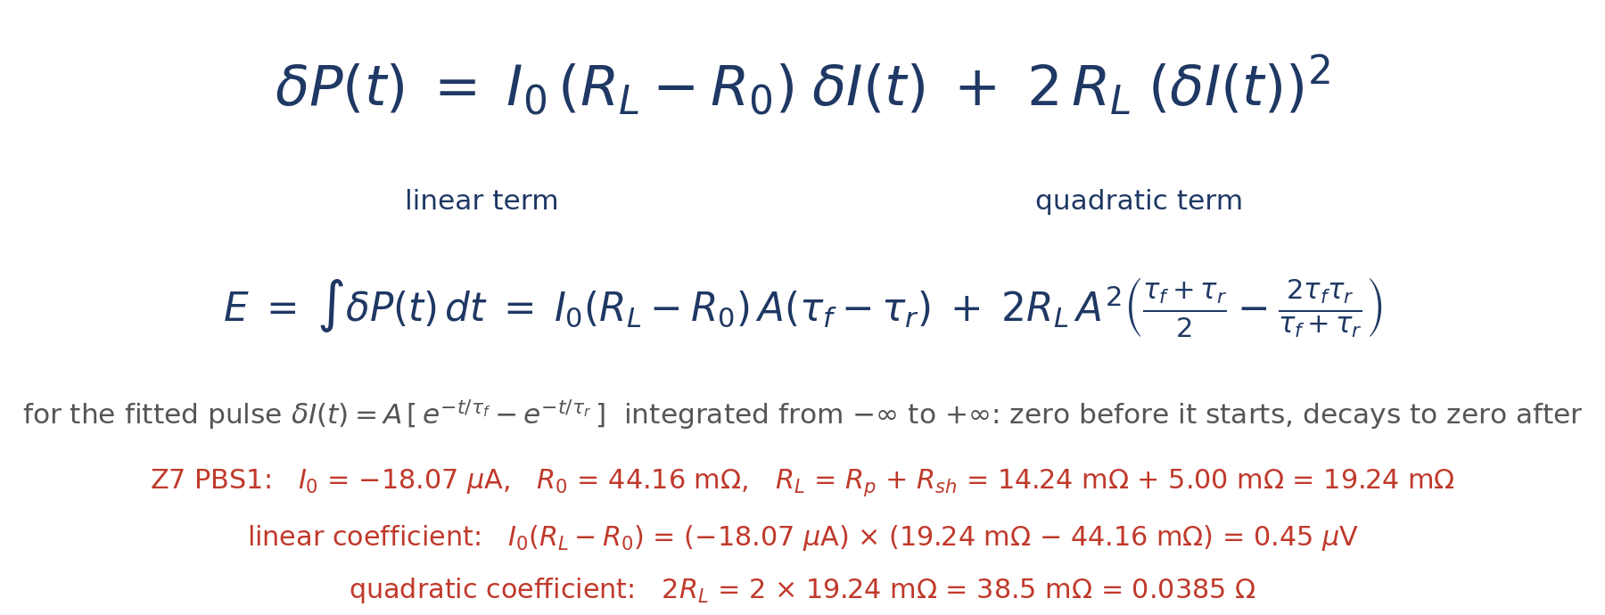
The formula, and the two numbers it needs
Method 1 of the CDMS collection-efficiency note
δP = the change of Joule heating when the current moves by δI: a linear term and a small quadratic term.
I₀: TES current at the bias point · R₀: TES resistance at the bias point · R_L = R_p + R_sh: load resistance (R_p parasitic, R_sh shunt) · δI: change in current, from the trace
The note also gives Method 2: δP = I₀(R_L − R₀)·δI − R_L·(δI)² in our sign convention — same linear term, only the quadratic term differs, 1.7 % less energy (PBS1, median of 15 events).
Sources — CDMS wiki, "Collection Efficiency Analysis" (both Methods and the procedure); Method 1 derived in N. Kurinsky, PhD thesis, appendix D (slac.stanford.edu/exp/cdms/ScienceResults/Theses/kurinsky.pdf); Method 2 in S. Watkins, "energy_absorbed_deriv_v3.pdf" on the SLAC confluence page "Internal Documentation: PD2 DM Search v2"; the difference between the two is discussed in "Power_derivation.pdf" on confluence; the TES equations: Irwin & Hilton, Transition-Edge Sensors, Topics in Applied Physics 99 (2005), pp. 74-75 and 87-88.
3
Notes:
TES small-signal result (Irwin & Hilton), Method 1 of the CDMS note. Coefficients from the measured bias point of each channel: I0(R_L-R0) = 0.45 uV, 2R_L = 0.0385 Ohm for PBS1. For a two-exponential pulse the integral is a formula in A, tau_f, tau_r.

Slide 4
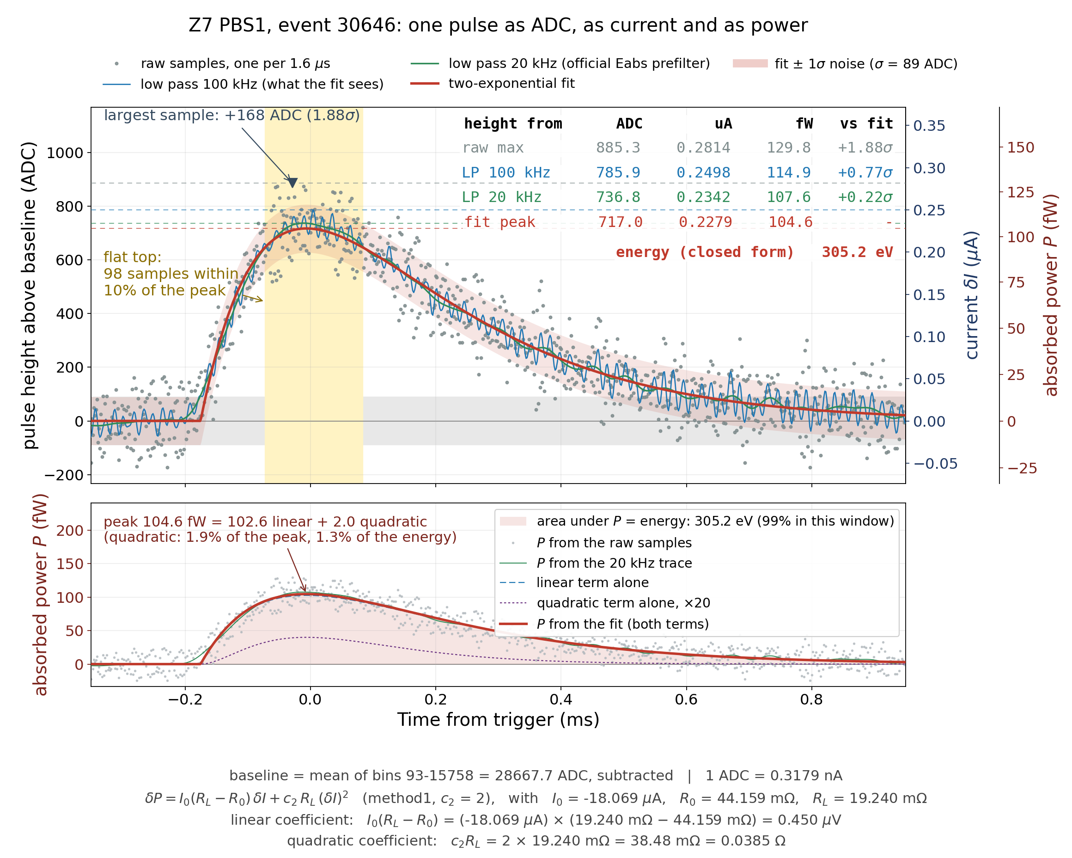
Example: one pulse
Z7 PBS1, event 30646: the same trace as ADC counts, as current, as power
The two-exponential is fitted to the 100 kHz low-passed trace (blue), not to the raw samples; the raw samples are only drawn.
4
Notes:
Top: the pulse zoomed on its peak, three axes. Bottom: the power and its area. 1 ADC = 0.318 nA. The next two slides walk through the two panels.

Slide 5
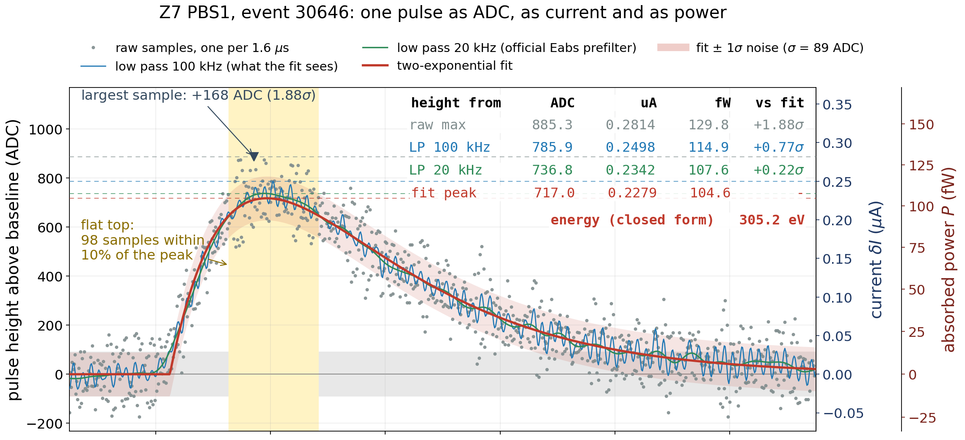
The height: take it from the fit, not from the largest sample
5
Notes:
Grey raw samples, blue 100 kHz low pass (what the fit sees), green 20 kHz (official prefilter), red the two-exponential fit, pink band fit ± 1 sigma (89 ADC). Yellow: 98 samples within 10% of the peak. Raw max 885 ADC vs fit 717: +23%. The maximum of 98 equal samples is the biggest upward noise. The fit averages every sample.

Slide 6
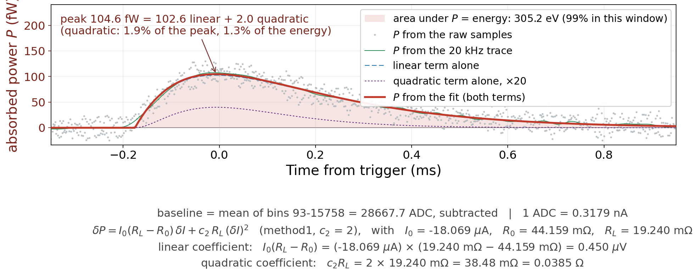
The power pulse, and its area is the energy
Red: the fitted current put through the formula. Blue dashed: the linear term alone. Purple: the quadratic term, ×20.
The quadratic term is 1.9 % of the peak — the power pulse has the shape of the current pulse.
The shaded area is the energy this channel absorbed: 305 eV.
6
Notes:
Red: power from the fitted current, two terms added. Blue dashed: linear term alone. Purple dotted: quadratic term x20. Peak 104.6 fW = 102.6 + 2.0: quadratic 1.9% of peak, 1.3% of energy. Shaded area 305.2 eV, 99% inside this window. Bottom line: the bias point that fixes the coefficients.

Slide 7
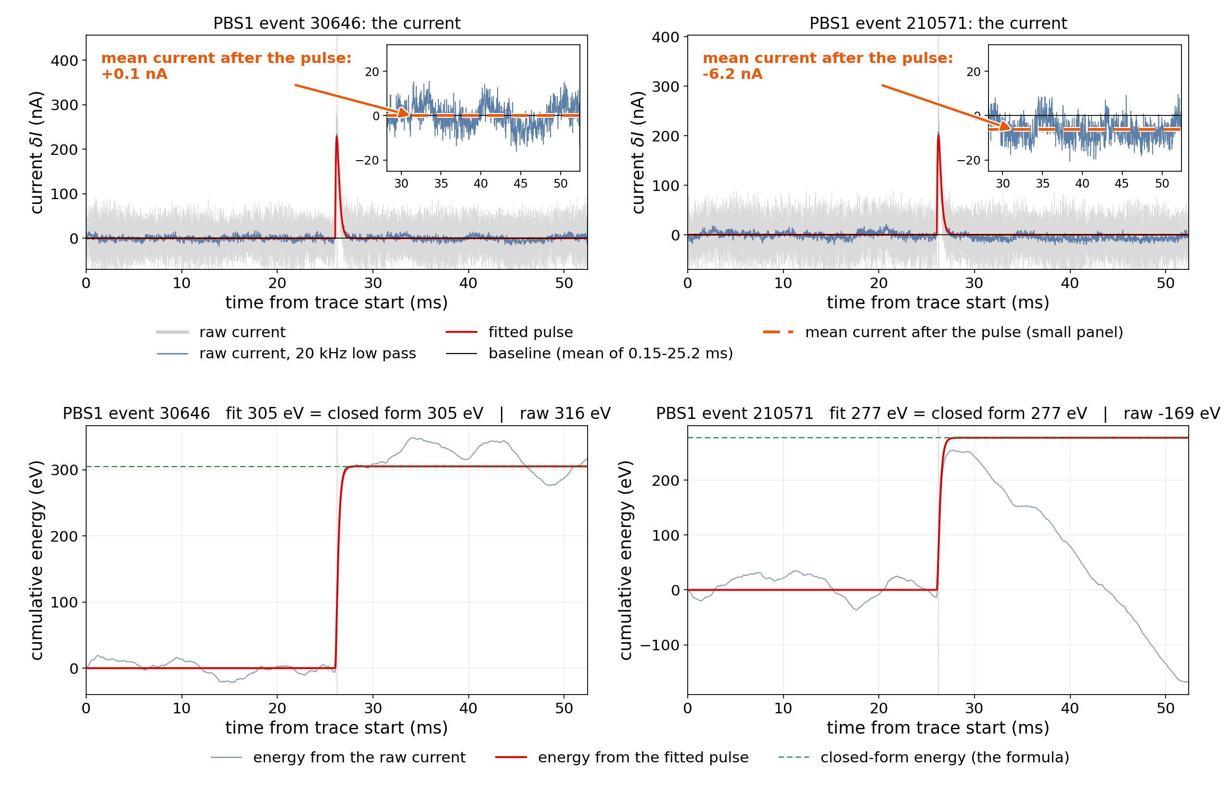
Why we integrate the fit, not the raw data
Top: the raw current of the two events; the small panel zooms in on the baseline after the pulse. Bottom: the energy accumulated from the raw current (grey) and from the fit (red).
Right: after the pulse the current sits 6 nA below its baseline — hidden in 28 nA of noise, yet over 24 ms it is −420 eV: raw −169 eV, fit 277 eV.
7
Notes:
Top: raw current of events 30646 and 210571, y zoomed to +-60 nA; dashed green is the mean after the pulse. Bottom: accumulated energy. Left: after-pulse mean +0.1 nA, raw 316 vs fit 305 eV. Right: -6.2 nA, i.e. -2.8 fW over 24 ms = -420 eV, raw -169 vs fit 277.

Slide 8
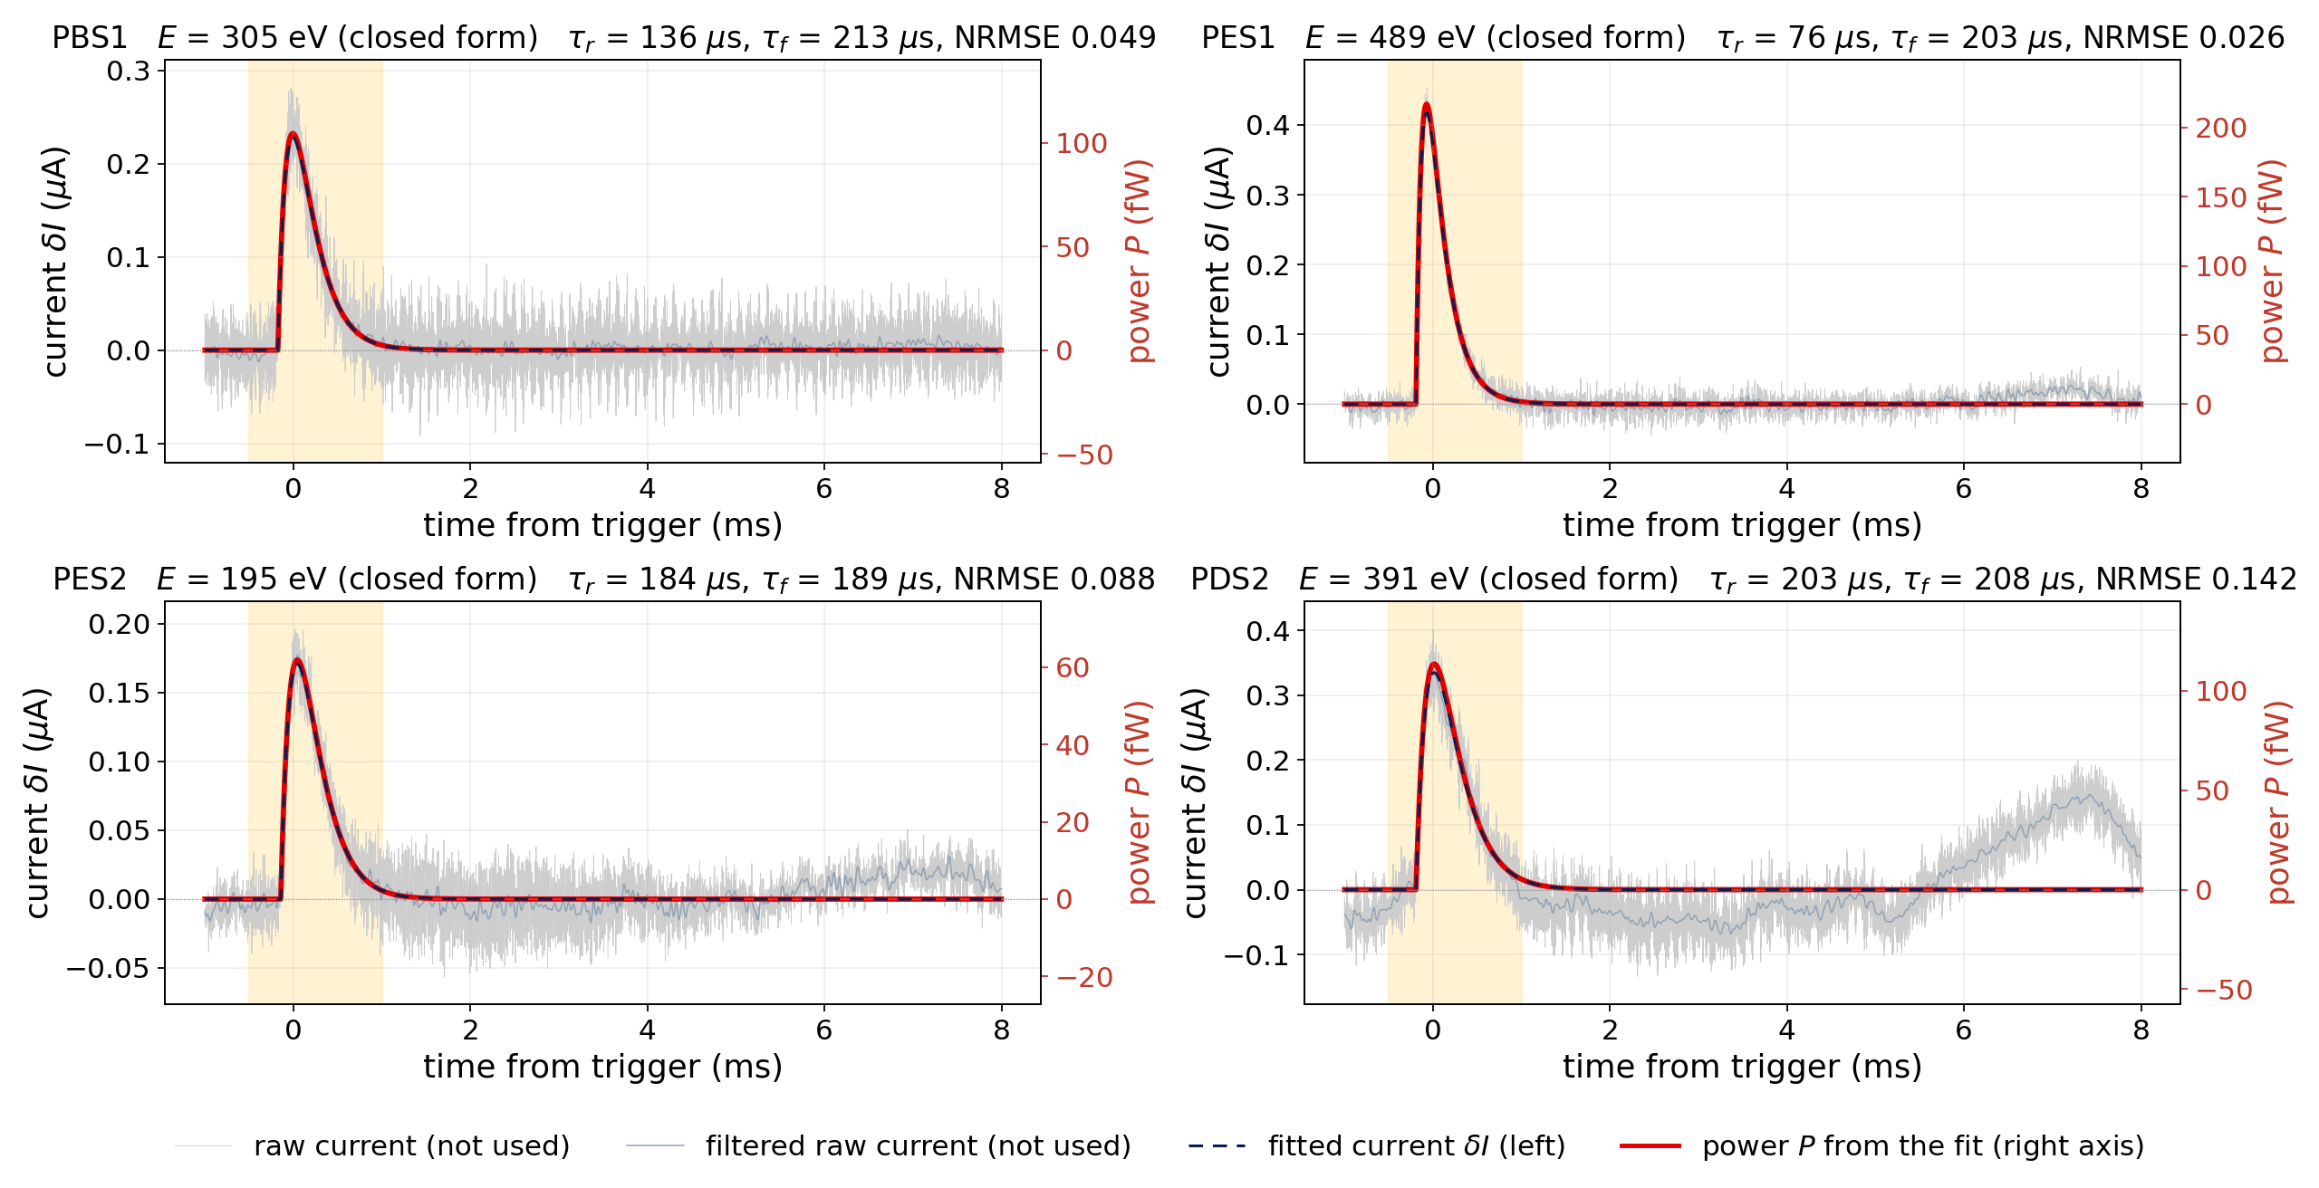
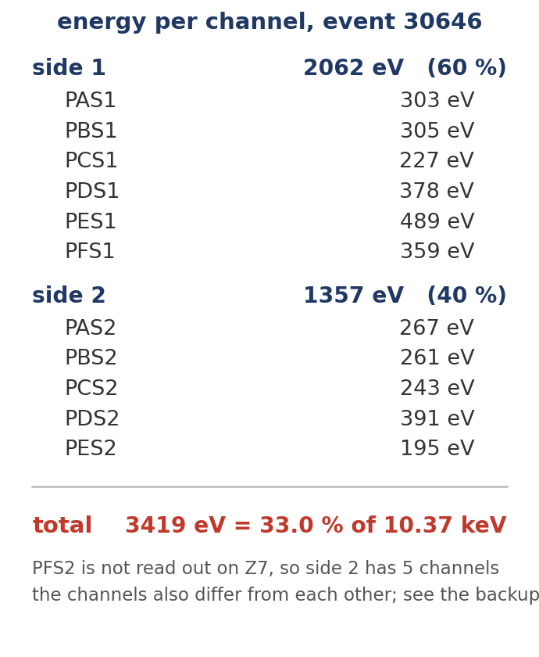
The same event in its other channels: they add up to 33 %
Z7 event 30646; four of the eleven channels
The channels do not share the energy equally: 60 % of it lands on side 1, and PES1 alone has 489 eV against 195 eV in PES2.
Summed over the eleven channels: 3419 eV = 33.0 % of 10.37 keV. PDS2 (bottom right) carries a slow swing.
8
Notes:
PES1 489 eV, PES2 195 eV: position. Sum over 11 channels 3419 eV = 33.0%. Official window on the raw traces: 3397 eV = 32.8%. PDS2: slow swing after 5 ms, a low-frequency artefact; residual 0.14, three times the others.

Slide 9
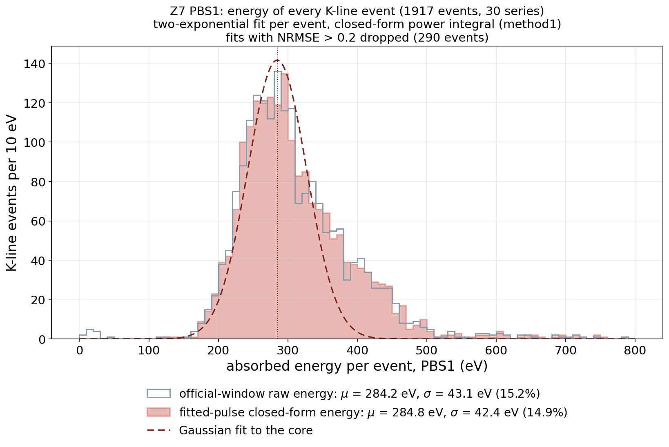
Now every event: one channel gives a wide, lopsided distribution
PBS1, 1917 K-line events, one fit and one integral each
Red: from the fit. Grey: the official window on the raw trace. Same peak to 0.2 %.
Peak 285 eV, width 15 % — for a line whose energy is fixed.
The tail to the right is the events that happened near this channel.
One channel's width is event position, not noise.
9
Notes:
Red: fit. Grey outline: official window on the raw trace; same peak to 0.2%. Peak 285 eV, width 42 eV = 15%, for a fixed-energy line. Right tail to 600 eV: events near PBS1. The width is position, not noise.

Slide 10
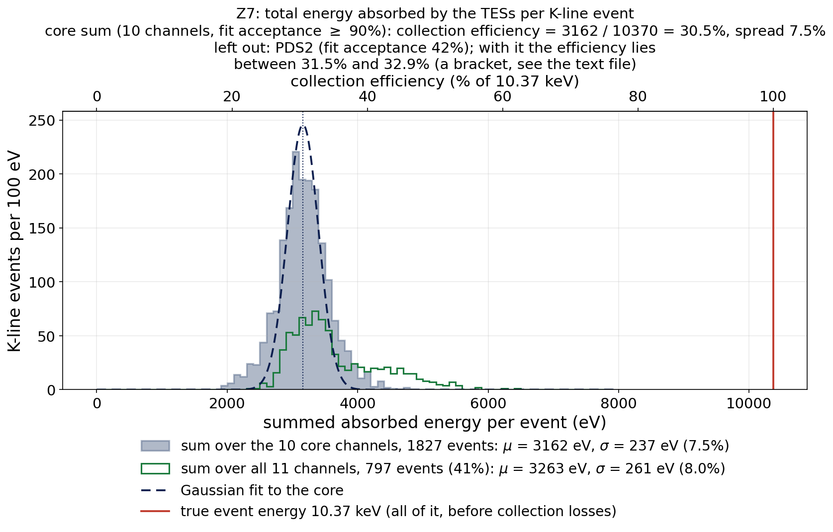
Summed over the channels: 32 ± 1 %
the total energy the TESs absorbed per K-line event
Ten channels summed, 1827 events: 3162 eV = 30.5 %, and the width drops to 7.5 % — the position effect cancels.
PDS2 fits only 42 % of the events (that slow swing), and those events are not typical; its share can only be bracketed.
Full efficiency 31.5–32.9 %: 32 ± 1 %.
Red line: 10.37 keV — two thirds of the energy never reaches the TESs.
10
Notes:
Grey: ten channels that fit ≥ 95% of events, 1827 events, 3162 eV = 30.5%, width 7.5% — the position dependence cancels in the sum. PDS2 fits only 42% (the swing) and on those events the other ten channels are 4.8% low, so its share is a bracket: 31.5 to 32.9%. Red line 10.37 keV.

Slide 11
Summary, and what is still open
A current pulse becomes a power pulse through the TES equations; the area under the power is the energy. The quadratic term is 2 %.
The energy comes from the fitted pulse, integrated from −∞ to +∞: no bias from the noisy maximum, no drift.
One channel: 15 % wide and lopsided (position). Ten channels summed: 7.5 % and symmetric.
Z7 absorbs 32 ± 1 % of a 10.37 keV event in its TESs. The CDMS note on the R37 CUTE tower reports 26–41 %.
Open: Z7 only · the HV bias of Z7 is not established (0 V assumed) · no dI/dV, so the inductor term is dropped · PDS2 is the ± 1 % · 12.5 % of events fit in no channel and are not in the histograms.
11
Notes:
Chain: current -> power -> energy -> sum -> 32 ± 1%. R37 CUTE note: 26-41%. Open: Z7 only; HV bias unknown (0 V assumed); no dIdV, inductor term dropped; PDS2; 12.5% of events fit nowhere.

Slide 12
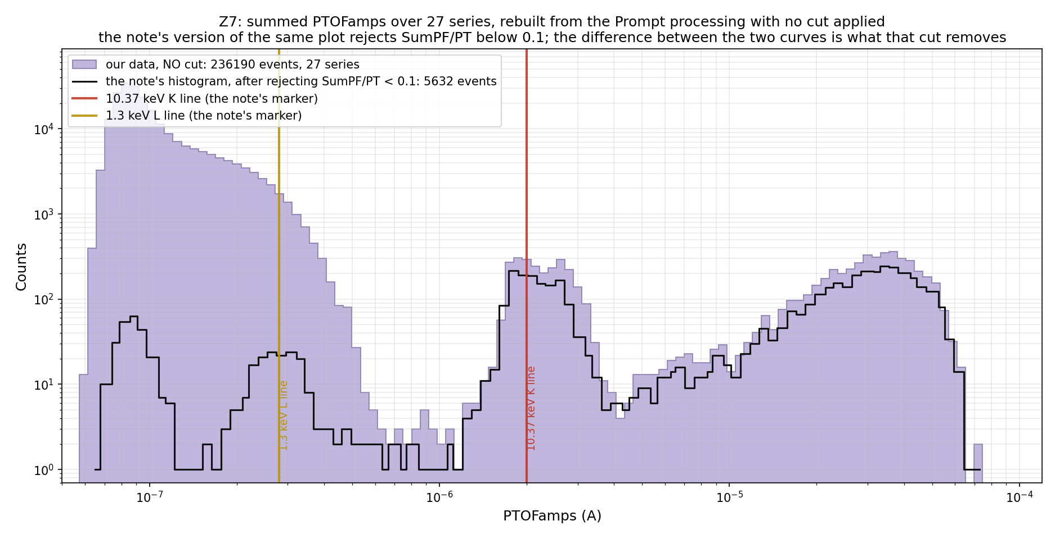
Backup — the events
12
Notes:
Z7 summed PTOFamps, our rebuild with no cut; K line at 2e-6 A.

Slide 13
Backup — the two Methods of the CDMS note
δP = I₀(R_L − R₀)·δI + c₂·R_L·(δI)² with c₂ = 2 (Method 1, used here) and c₂ = −1 (Method 2)
The two differ only in the quadratic term: 1.7 % in energy (PBS1, median of 15 events) — far below the 15 % single-channel width and the PDS2 bracket.
The inductor term of the full equations needs L and the loop gain from dI/dV, which do not exist for these series on MSI; it is neglected.
The official Eabs (trigger bin 16383, baseline bins 93..15758, 5-pole 20 kHz prefilter, window −0.5/+1 ms, same formula) is reproduced to 0.2 %; the grey outlines on the histogram slides are it.
13
Notes:
c2 = 2 is Method 1 (used here), c2 = -1 is Method 2; 1.7% apart in energy.

Slide 14
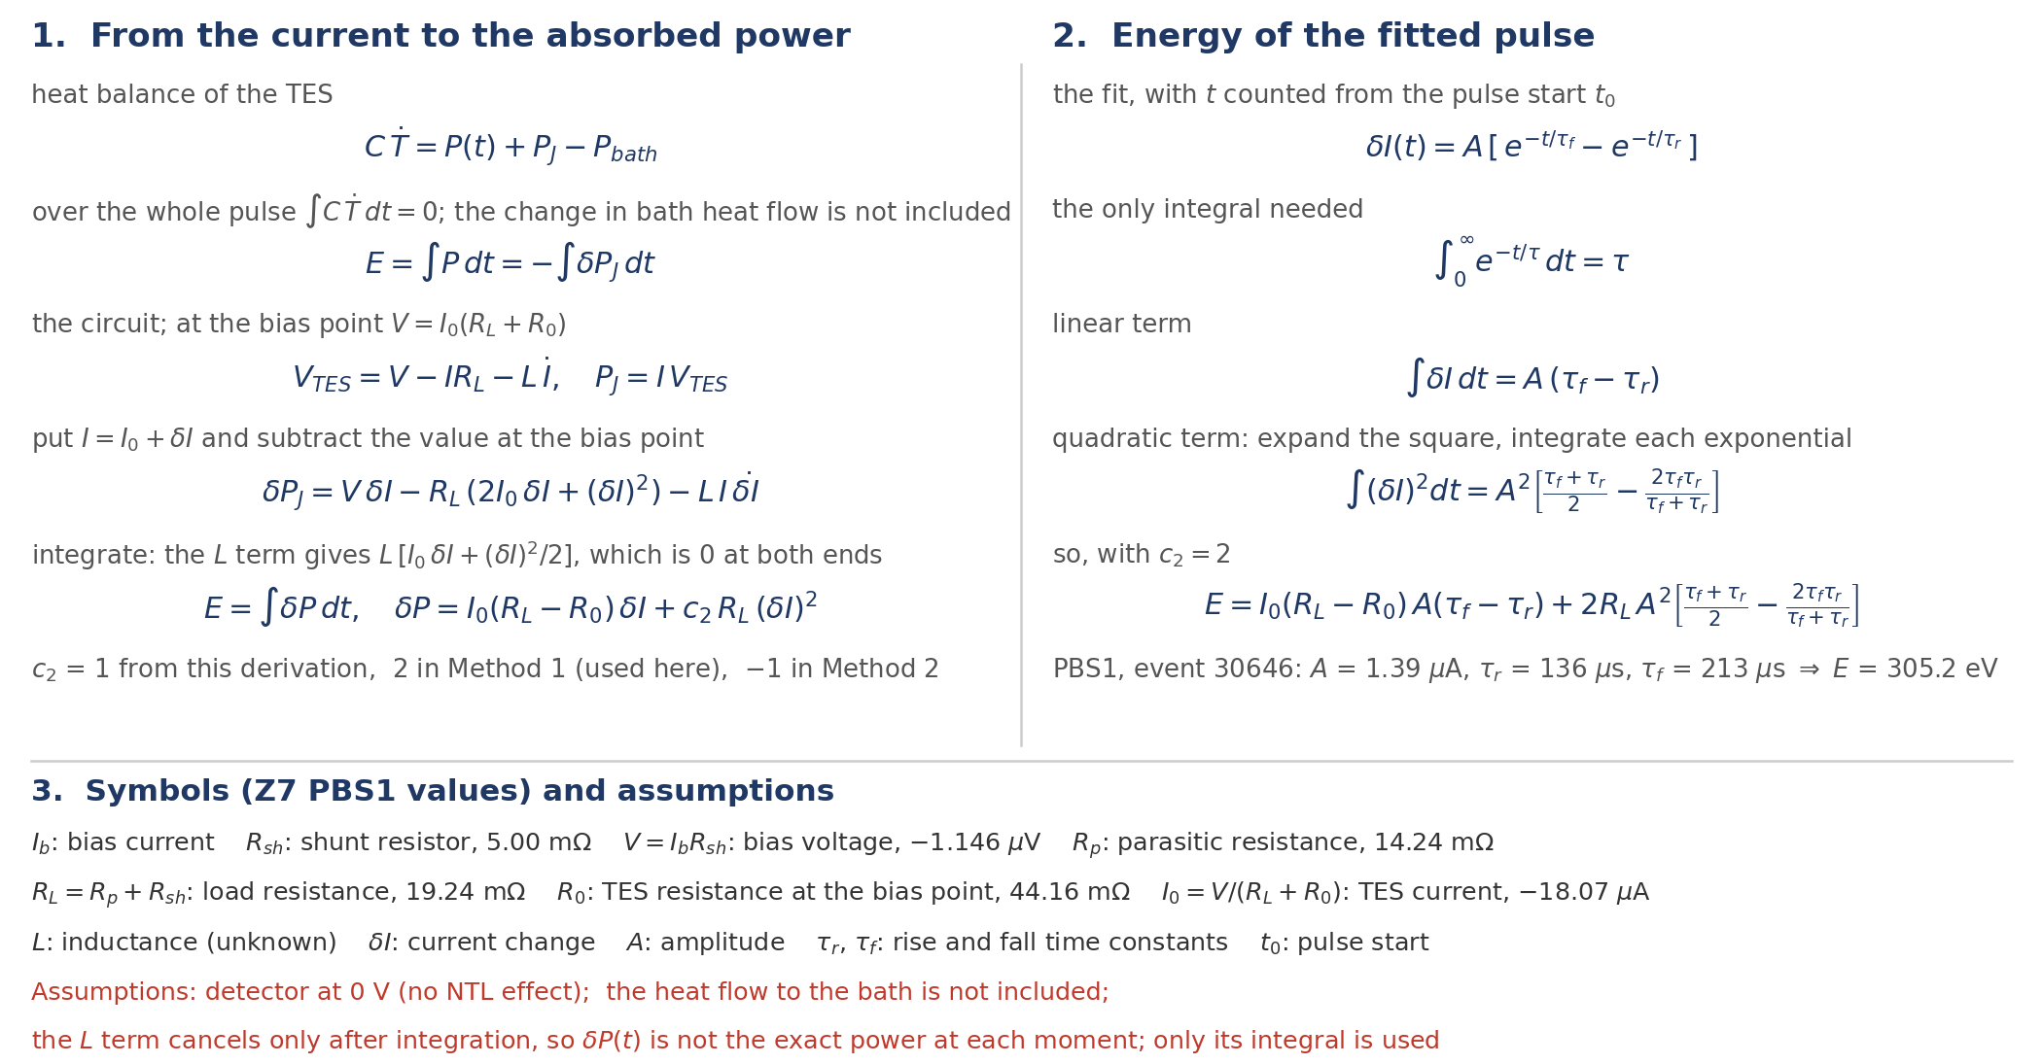
Backup — how the formulas are derived
14

Slide 15
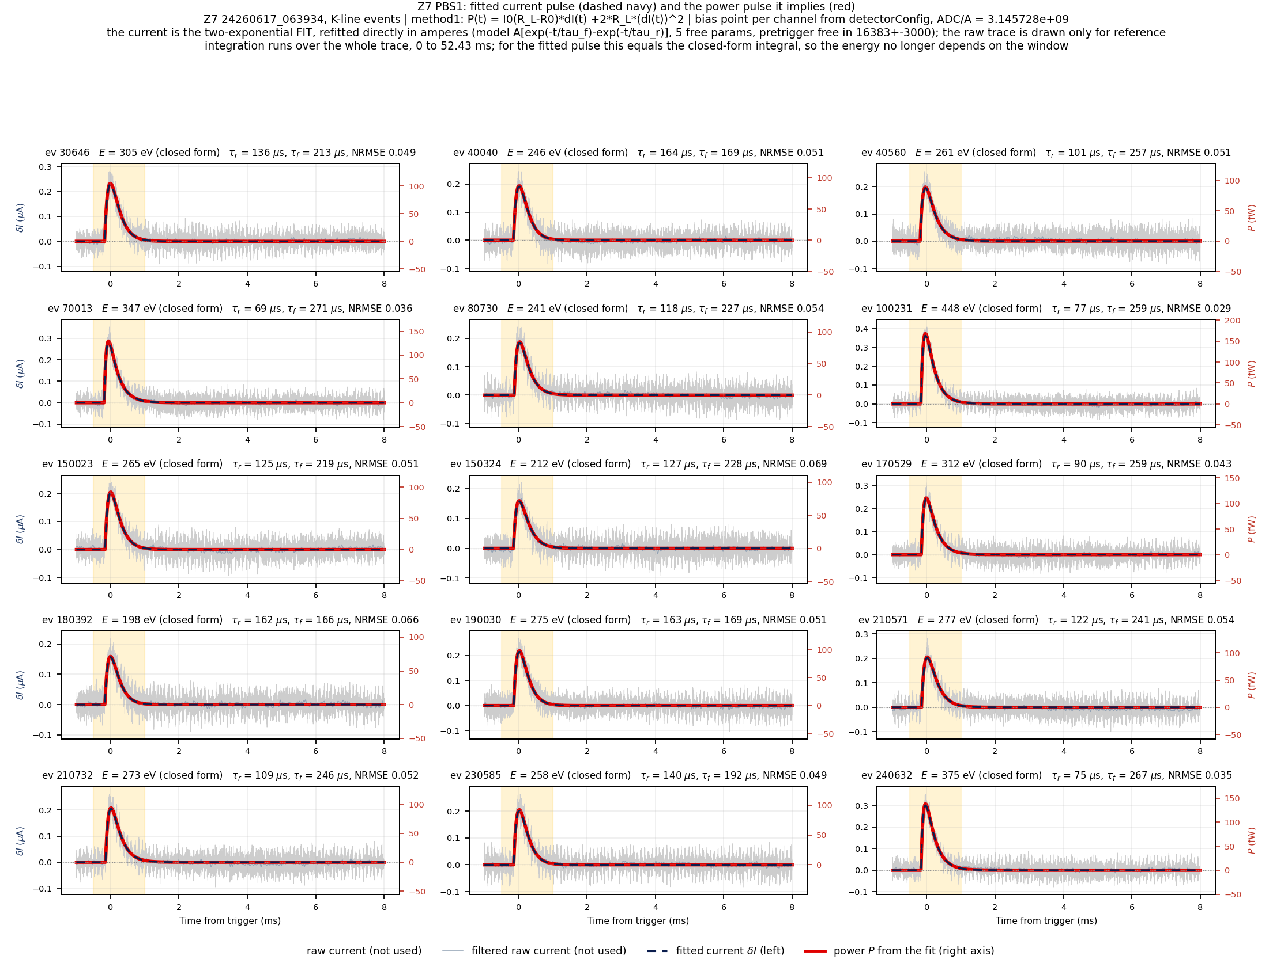
Backup — 15 events, fitted current and power (PBS1)
15
Notes:
All 15 example events.

Slide 16
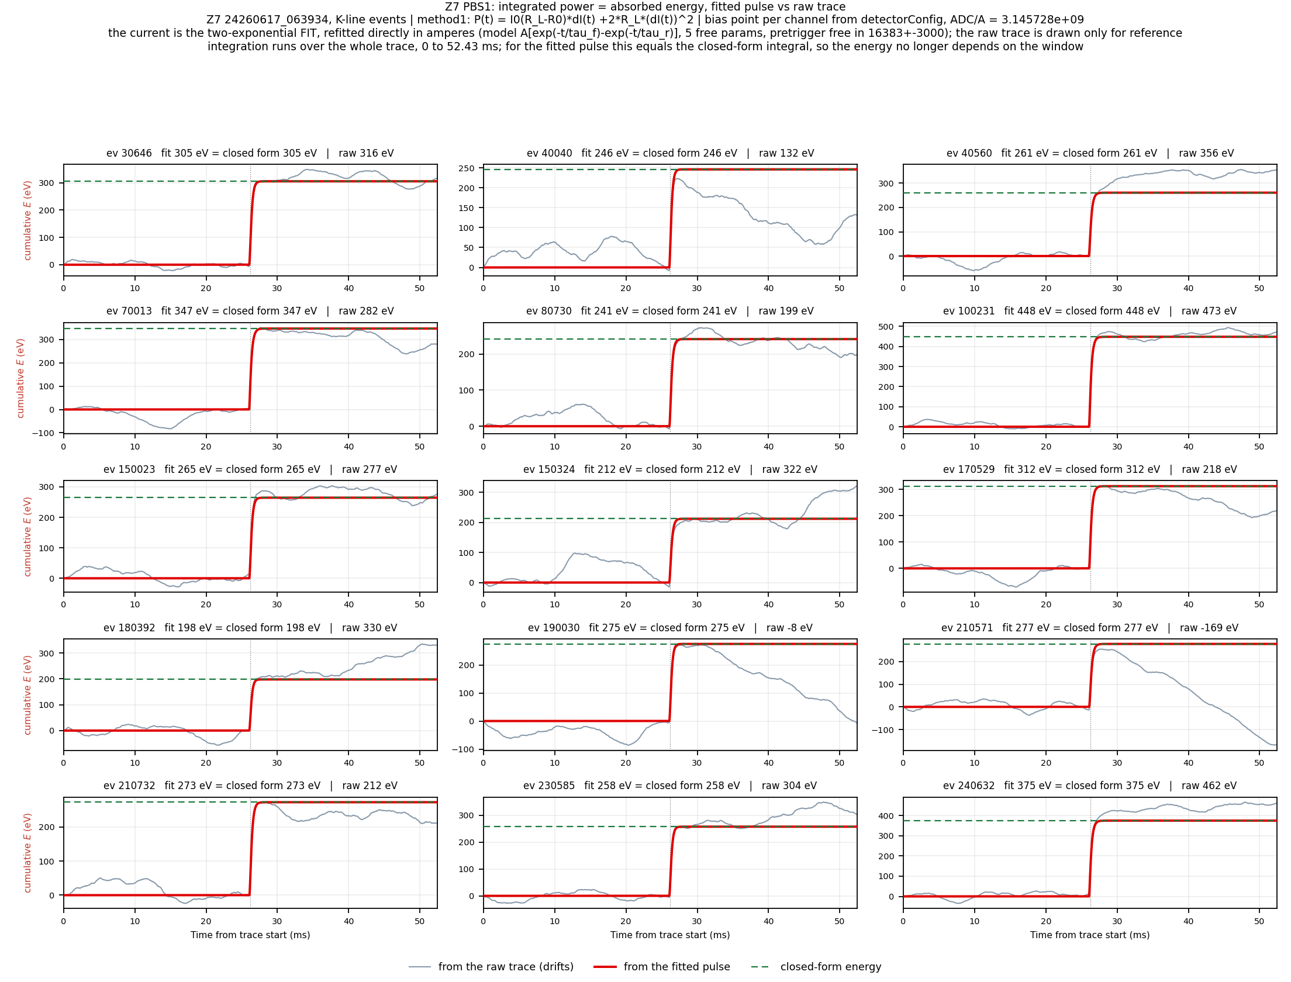
Backup — 15 events, cumulative energy (PBS1)
16
Notes:
Fit vs raw, 15 events.

Slide 17
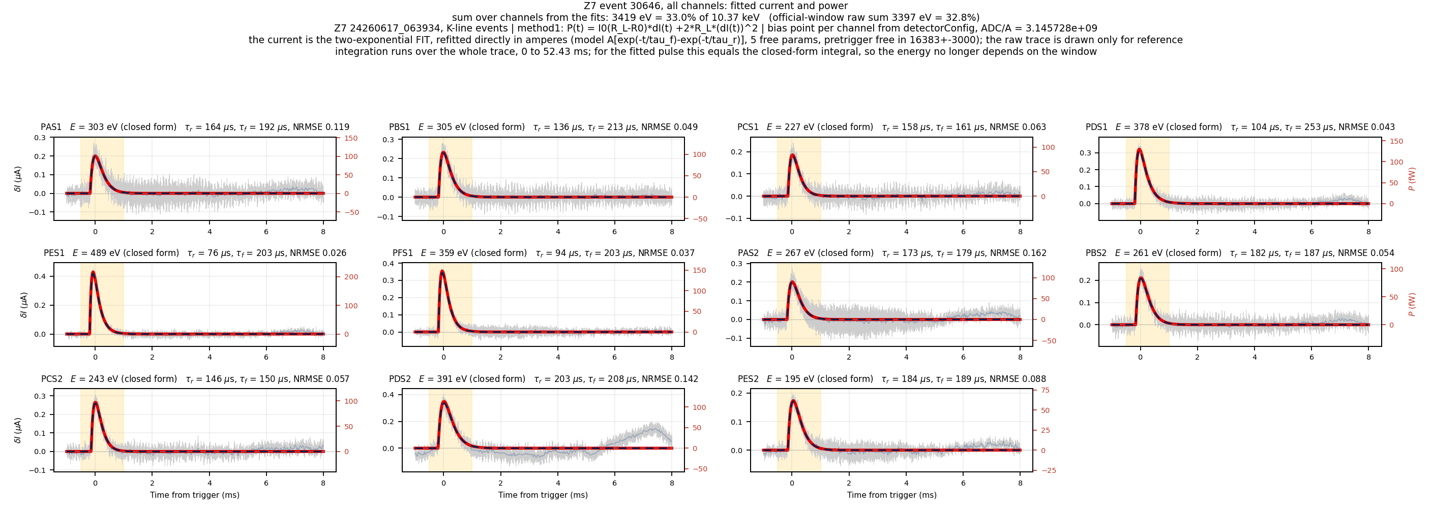
Backup — event 30646, all channels
17
Notes:
Sum 3419 eV = 33.0%.

Slide 18
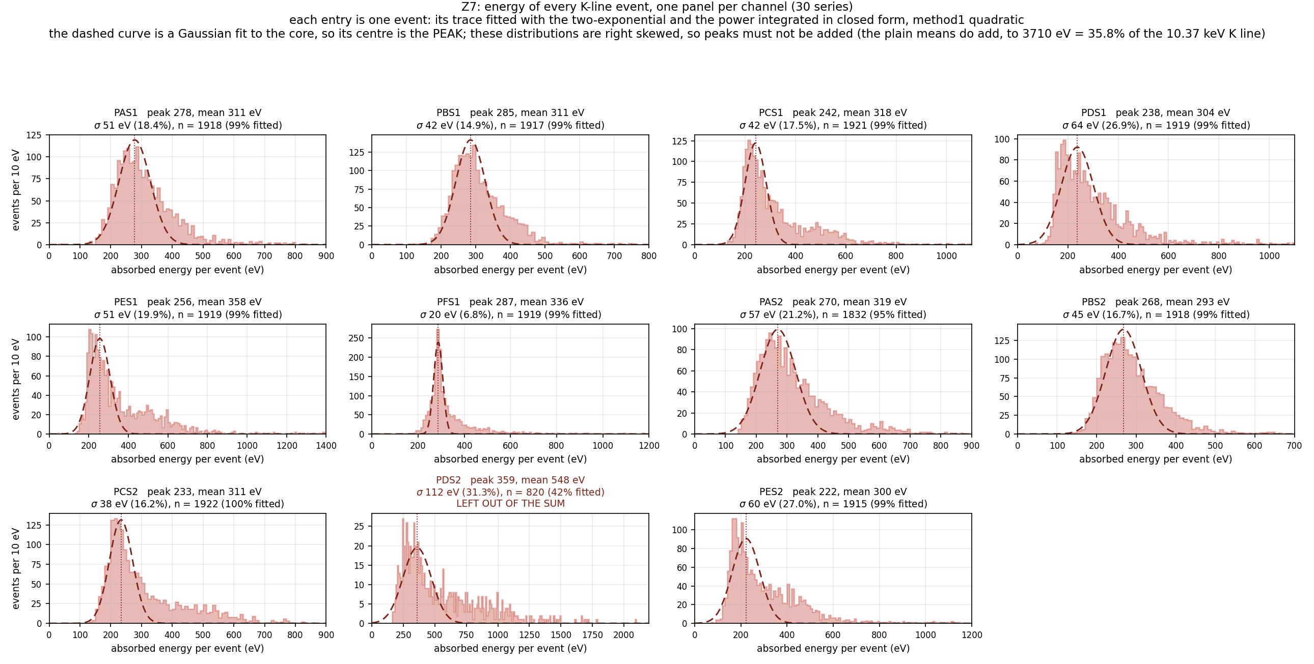
Backup — energy distribution of every channel
18
Notes:
Every channel is right-skewed; the peaks must not be added (21% low), the means add. PDS2 left out.

