Slide 1
Phonon collection efficiency of Z7
Zhiheng Li · University of Minnesota · SuperCDMS SNOLAB Run 4 · September 2026
github.com/ZhihengLi0/urop → snolab_run4_phonon_pulse_analysis/collection_efficiency/
1
Notes:
Title.

Slide 2
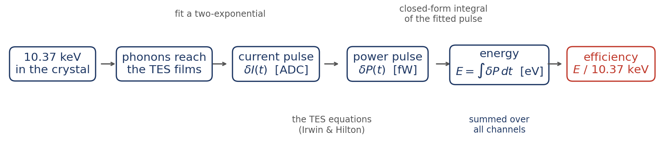
The Main Idea
For detectors operated at 0 V (no NTL effect):
Collection efficiency = energy absorbed by the TESs, summed over all channels ÷ the 10.37 keV of the event
Sample: Z7, the K-line events of the Ge activation run, from SNOLAB R4 (2207 events, 30 series, all 11 channels).
2
Notes:
Efficiency = energy absorbed by the TESs, summed over all channels, / 10.37 keV, for a detector operated at 0 V (no NTL amplification). Z7, K-line events of the Ge activation, SNOLAB R4, 2207 events over 30 series.

Slide 3
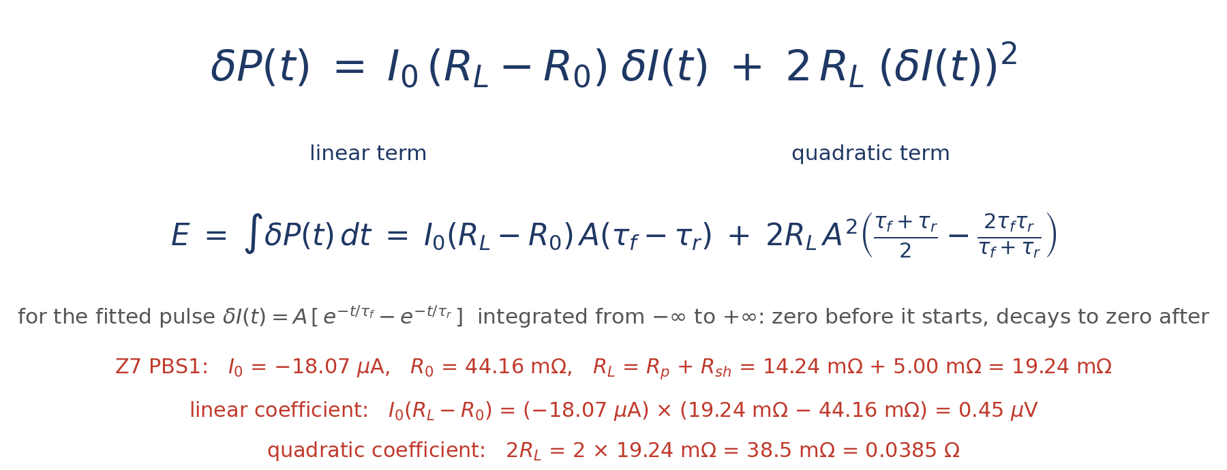
The formula, and the two numbers it needs
Method 1 of the CDMS collection-efficiency note
δP = the change of Joule heating when the current moves by δI: a linear term and a small quadratic term.
I₀: TES current at the bias point · R₀: TES resistance at the bias point · R_L = R_p + R_sh: load resistance (R_p parasitic, R_sh shunt) · δI: change in current, from the trace
The note also gives Method 2: δP = I₀(R_L − R₀)·δI − R_L·(δI)² in our sign convention — same linear term, only the quadratic term differs, 1.7 % less energy (PBS1, median of 15 events).
Source: Antoine Rehberg, CDMS wiki, Collection Efficiency Analysis — confluence.slac.stanford.edu/spaces/CDMS/pages/542577254
3
Notes:
TES small-signal result (Irwin & Hilton), Method 1 of the CDMS note. Coefficients from the measured bias point of each channel: I0(R_L-R0) = 0.45 uV, 2R_L = 0.0385 Ohm for PBS1. For a two-exponential pulse the integral is a formula in A, tau_f, tau_r.

Slide 4
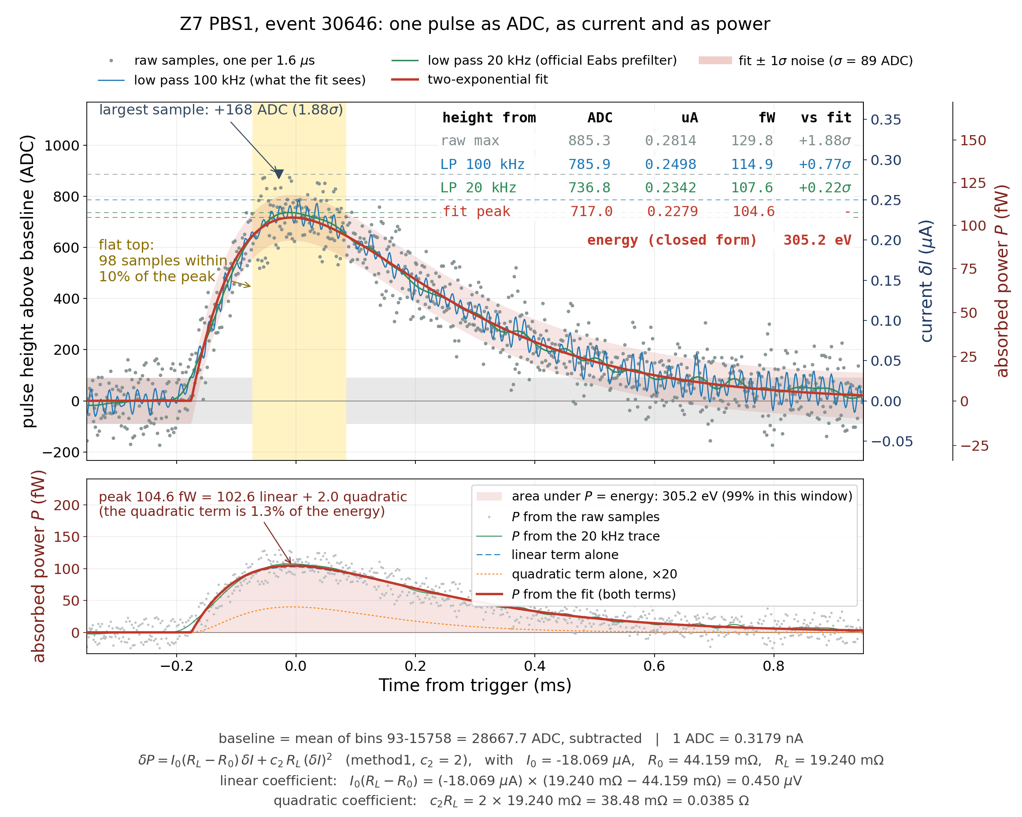
Example: one pulse
Z7 PBS1, event 30646: the same trace as ADC counts, as current, as power
The two-exponential is fitted to the 100 kHz low-passed trace (blue), not to the raw samples; the raw samples are only drawn.
4
Notes:
Top: the pulse zoomed on its peak, three axes. Bottom: the power and its area. 1 ADC = 0.318 nA. The next two slides walk through the two panels.

Slide 5
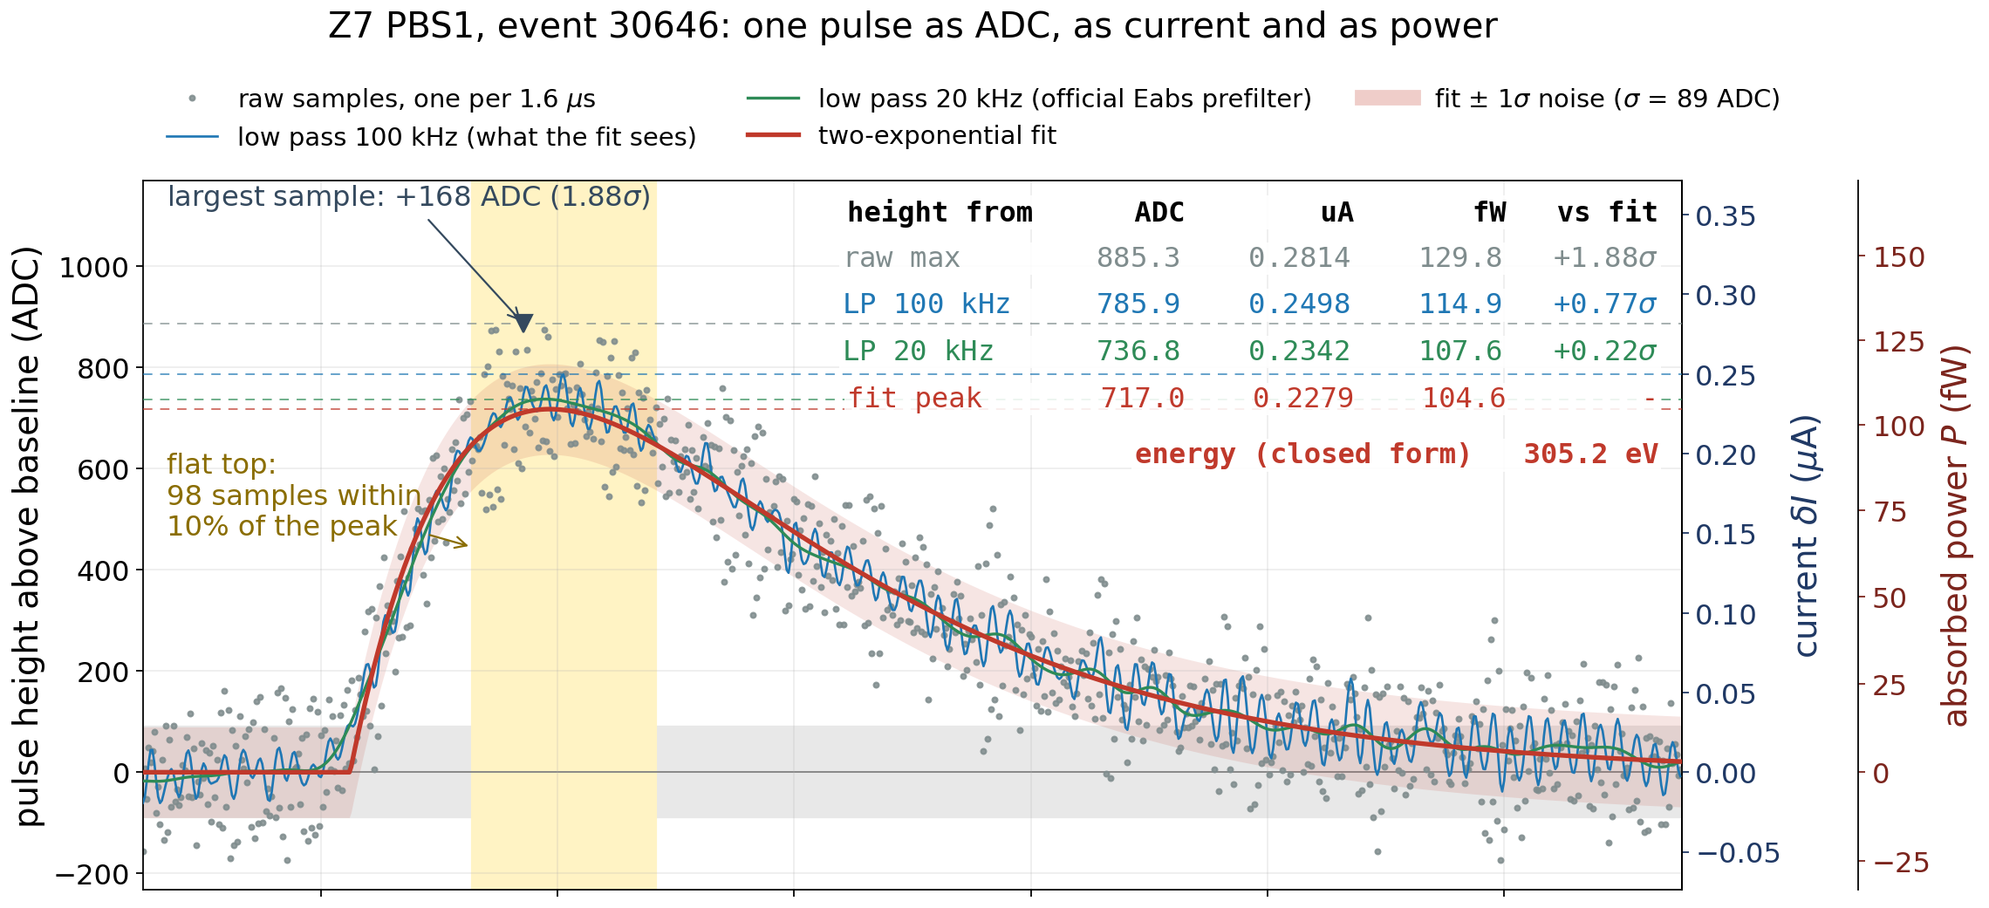
The height: take it from the fit, not from the largest sample
5
Notes:
Grey raw samples, blue 100 kHz low pass (what the fit sees), green 20 kHz (official prefilter), red the two-exponential fit, pink band fit ± 1 sigma (89 ADC). Yellow: 98 samples within 10% of the peak. Raw max 885 ADC vs fit 717: +23%. The maximum of 98 equal samples is the biggest upward noise. The fit averages every sample.

Slide 6
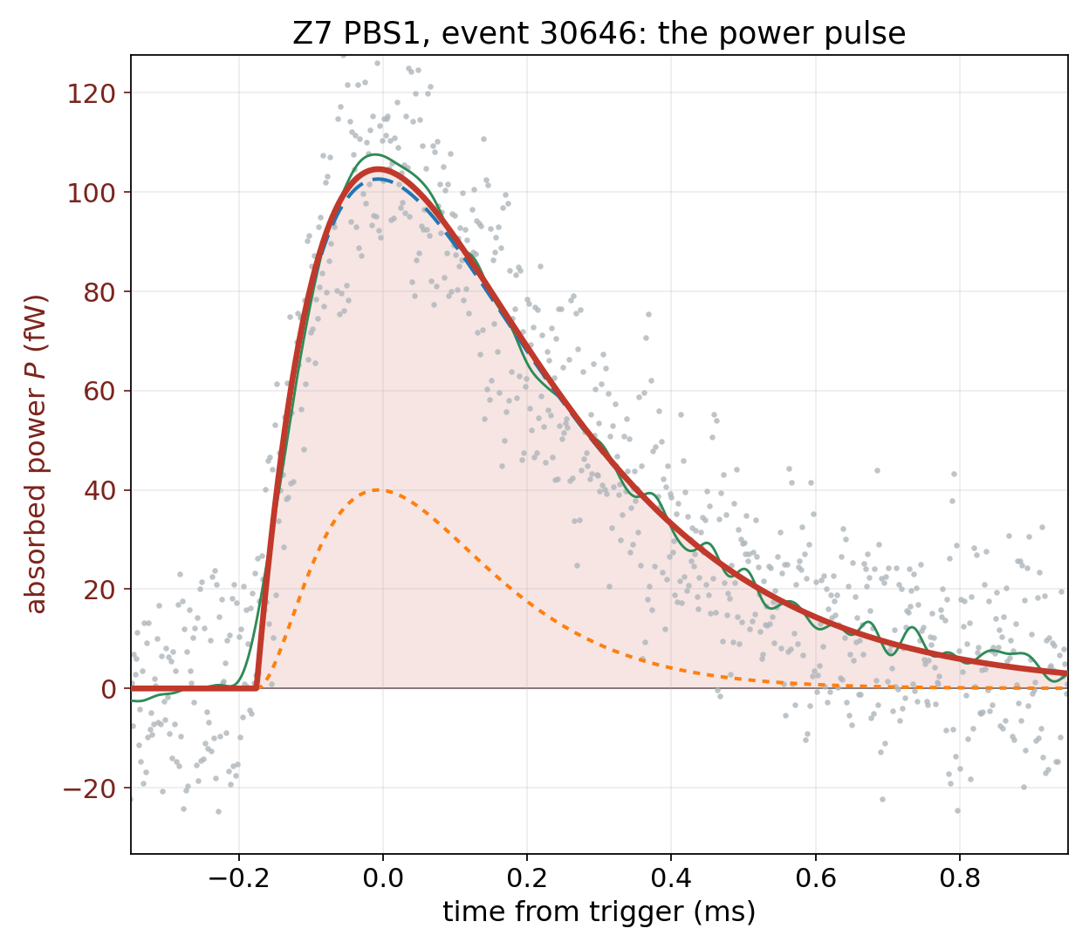
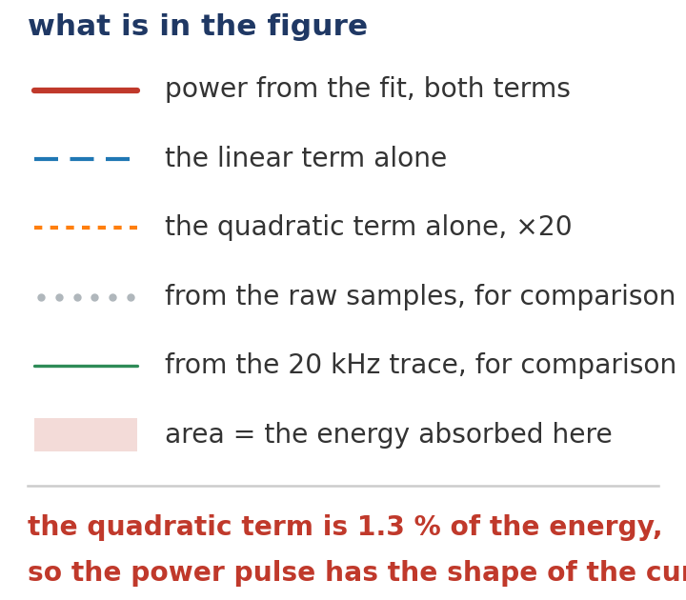
The power pulse, and its area is the energy
6
Notes:
Red: power from the fitted current, two terms added. Blue dashed: linear term alone. Orange dotted: quadratic term x20. Peak 104.6 fW = 102.6 + 2.0: the quadratic term is 1.3% of the energy. Shaded area 305.2 eV, 99% inside this window. Bottom line: the bias point that fixes the coefficients.

Slide 7
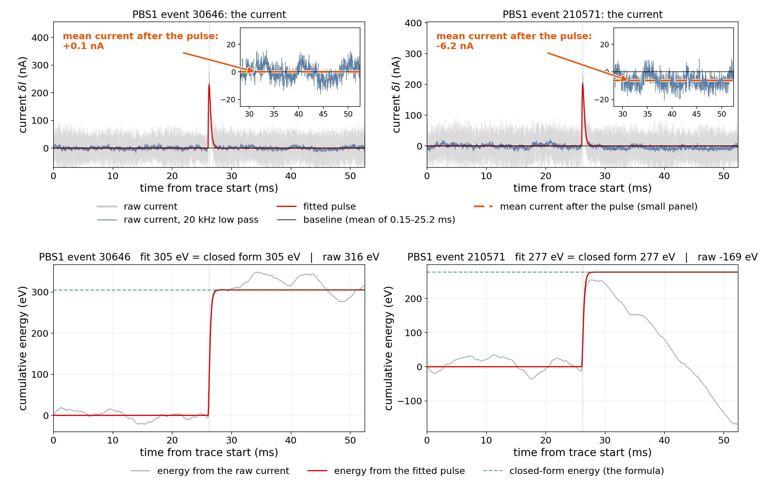
Why we integrate the fit, not the raw data
Top: the raw current of the two events; the small panel zooms in on the baseline after the pulse. Bottom: the energy accumulated from the raw current (grey) and from the fit (red).
Right: after the pulse the current sits 6 nA below its baseline — hidden in 28 nA of noise, yet over 24 ms it is −420 eV: raw −169 eV, fit 277 eV.
7
Notes:
Top: raw current of events 30646 and 210571, y zoomed to +-60 nA; dashed green is the mean after the pulse. Bottom: accumulated energy. Left: after-pulse mean +0.1 nA, raw 316 vs fit 305 eV. Right: -6.2 nA, i.e. -2.8 fW over 24 ms = -420 eV, raw -169 vs fit 277.

Slide 8
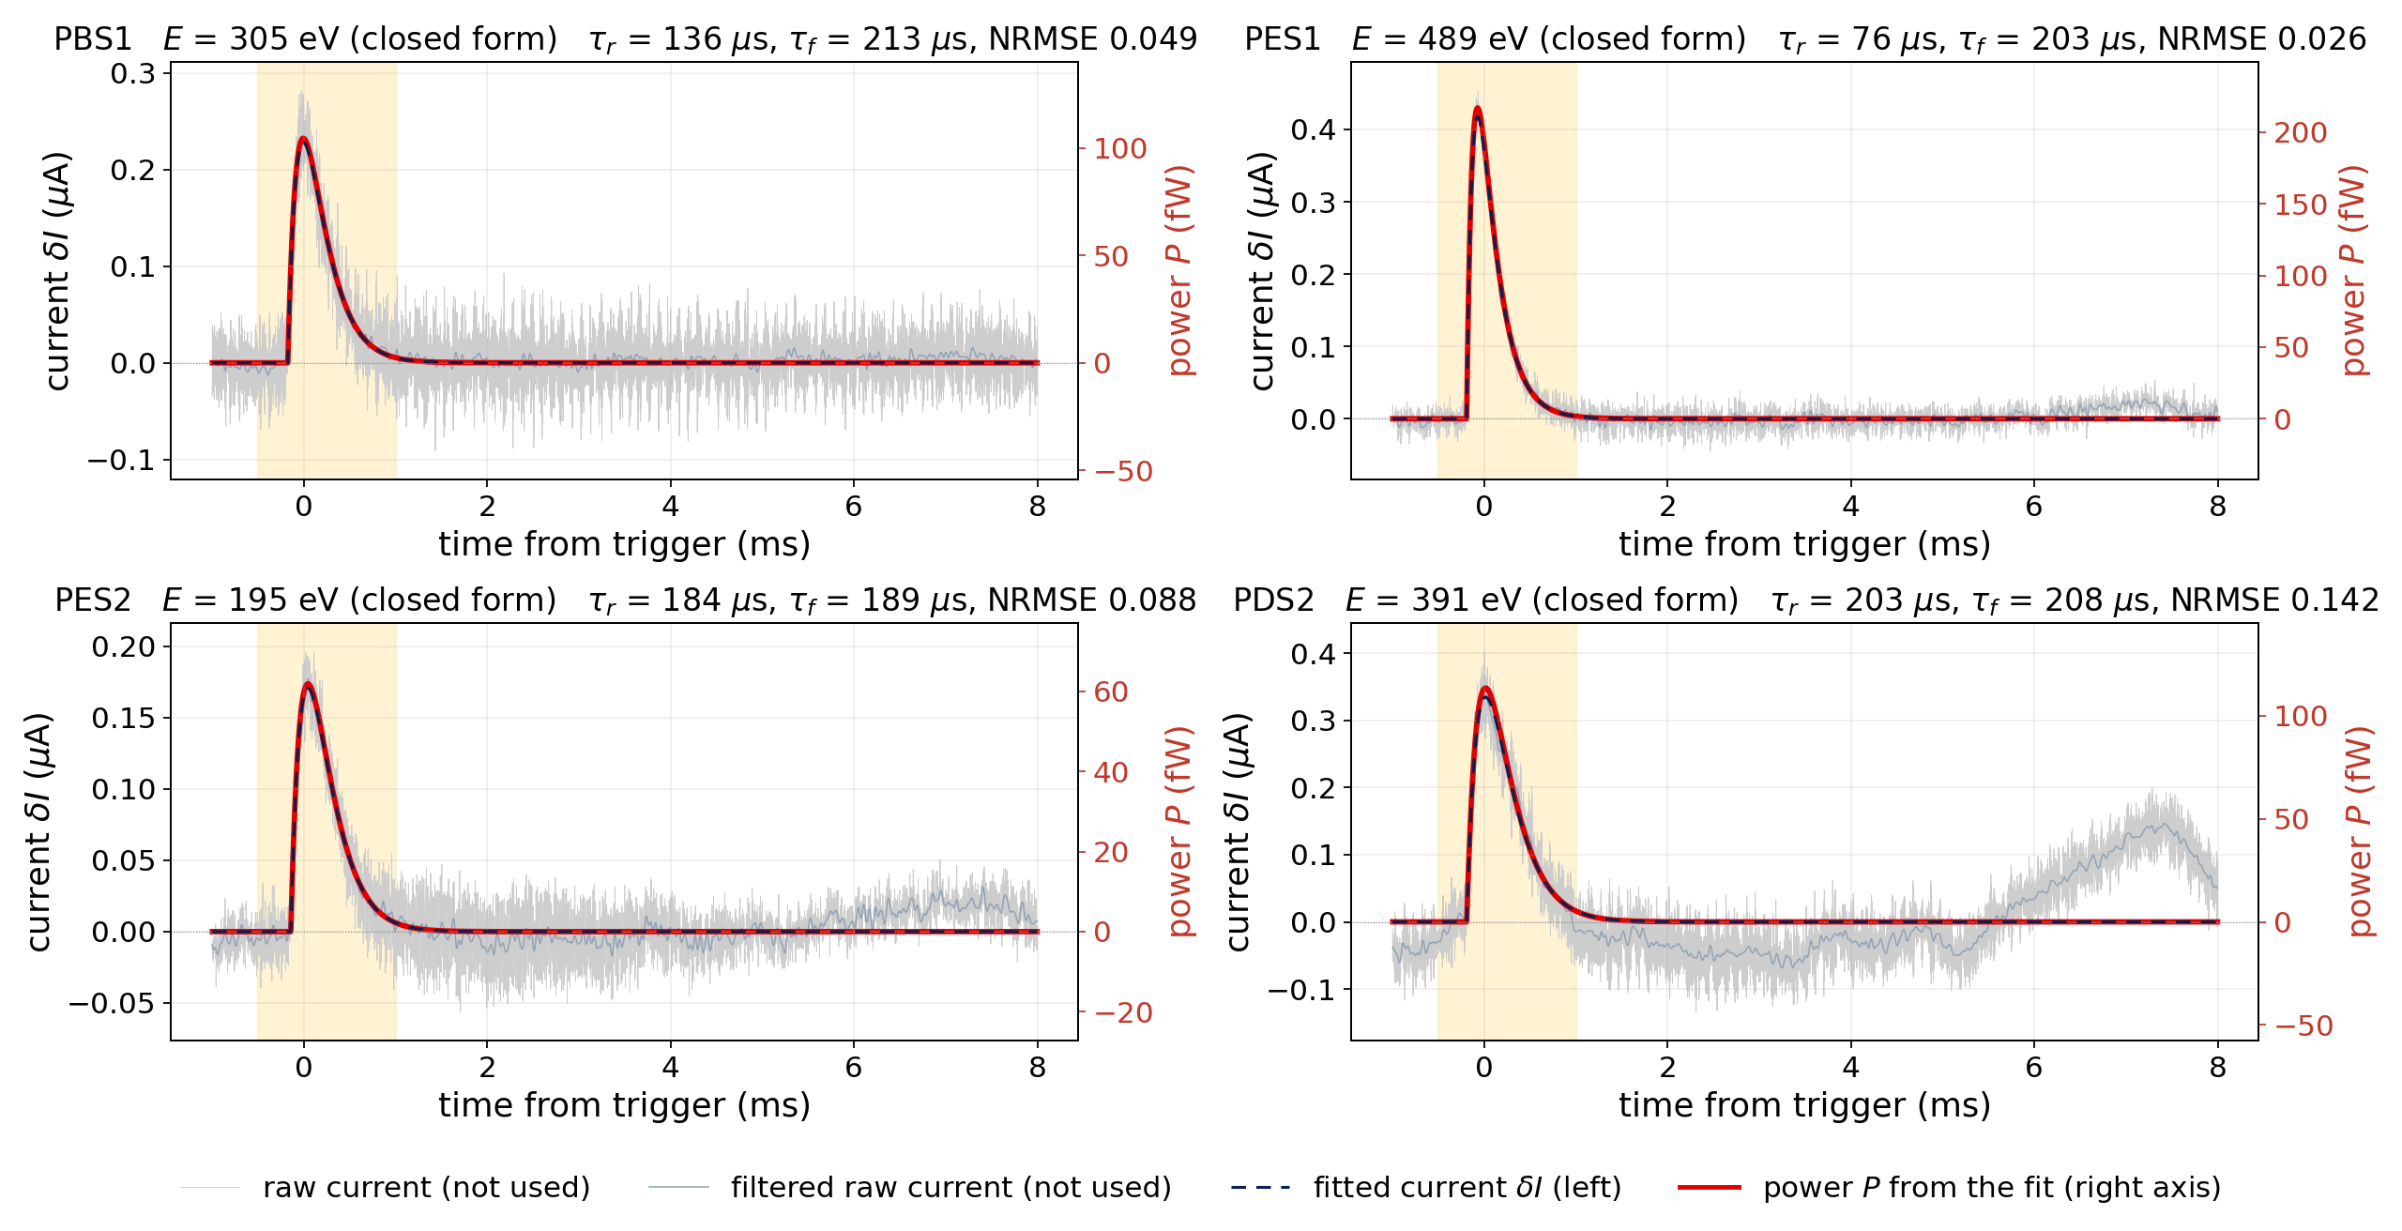
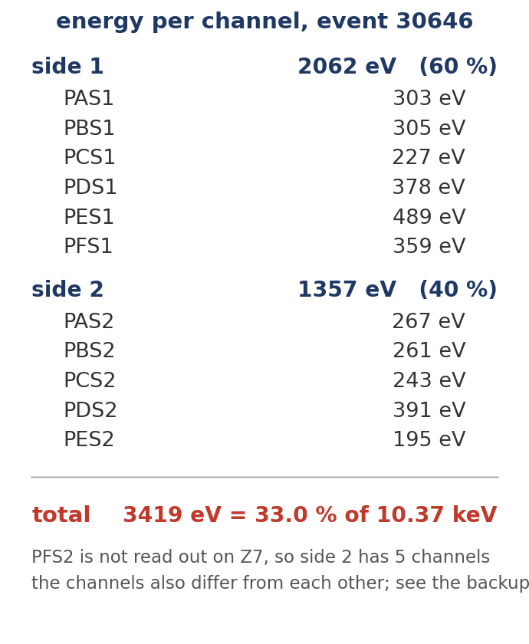
The same event in its other channels: they add up to 33 %
Z7 event 30646; four of the eleven channels
The channels do not share the energy equally: 60 % of it lands on side 1, and PES1 alone has 489 eV against 195 eV in PES2.
Summed over the eleven channels: 3419 eV = 33.0 % of 10.37 keV. PDS2 (bottom right) carries a slow swing.
8
Notes:
PES1 489 eV, PES2 195 eV: position. Sum over 11 channels 3419 eV = 33.0%. Official window on the raw traces: 3397 eV = 32.8%. PDS2: slow swing after 5 ms, a low-frequency artefact; residual 0.14, three times the others.

Slide 9
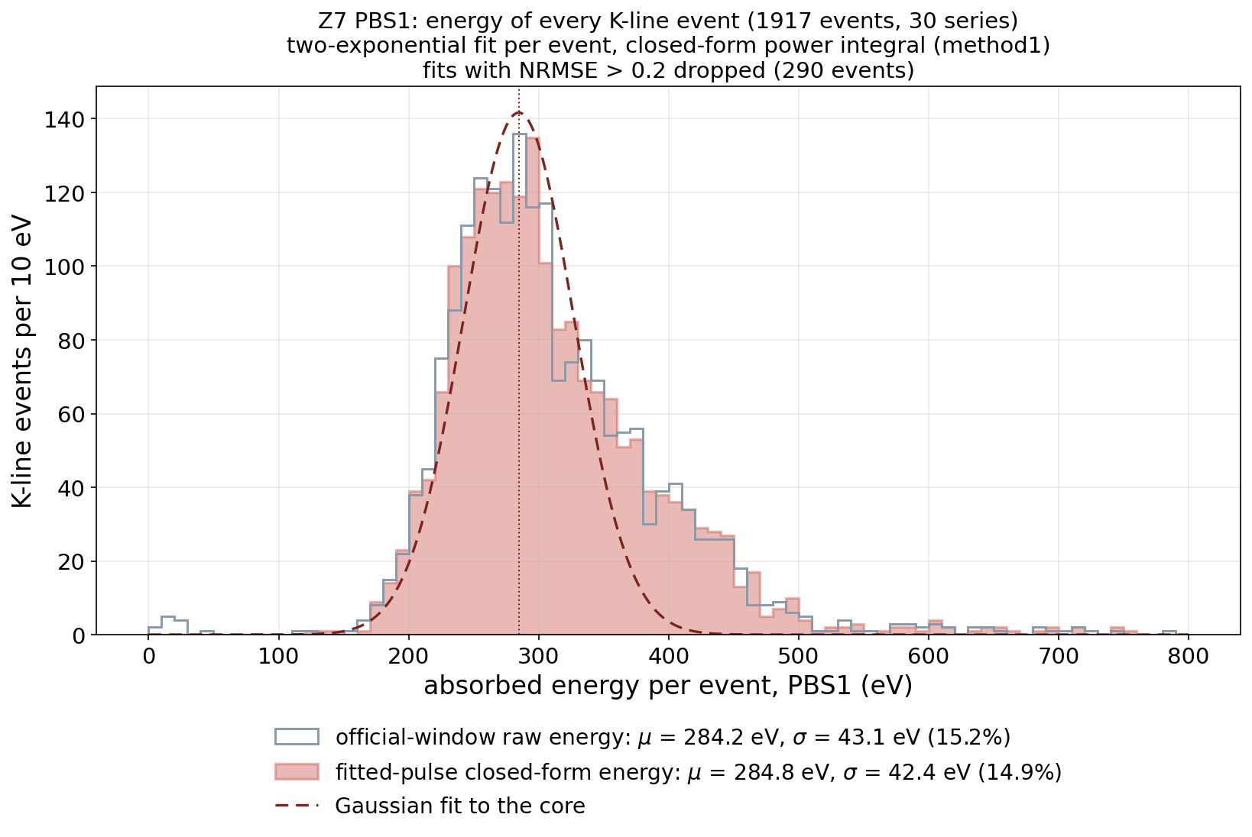
Now every event: one channel gives a wide, lopsided distribution
PBS1, 1917 K-line events, one fit and one integral each
Red: from the fit. Grey: the official window on the raw trace. Same peak to 0.2 %.
Peak 285 eV, width 15 % — for a line whose energy is fixed.
The tail to the right is the events that happened near this channel.
One channel's width is event position, not noise.
9
Notes:
Red: fit. Grey outline: official window on the raw trace; same peak to 0.2%. Peak 285 eV, width 42 eV = 15%, for a fixed-energy line. Right tail to 600 eV: events near PBS1. The width is position, not noise.

Slide 10
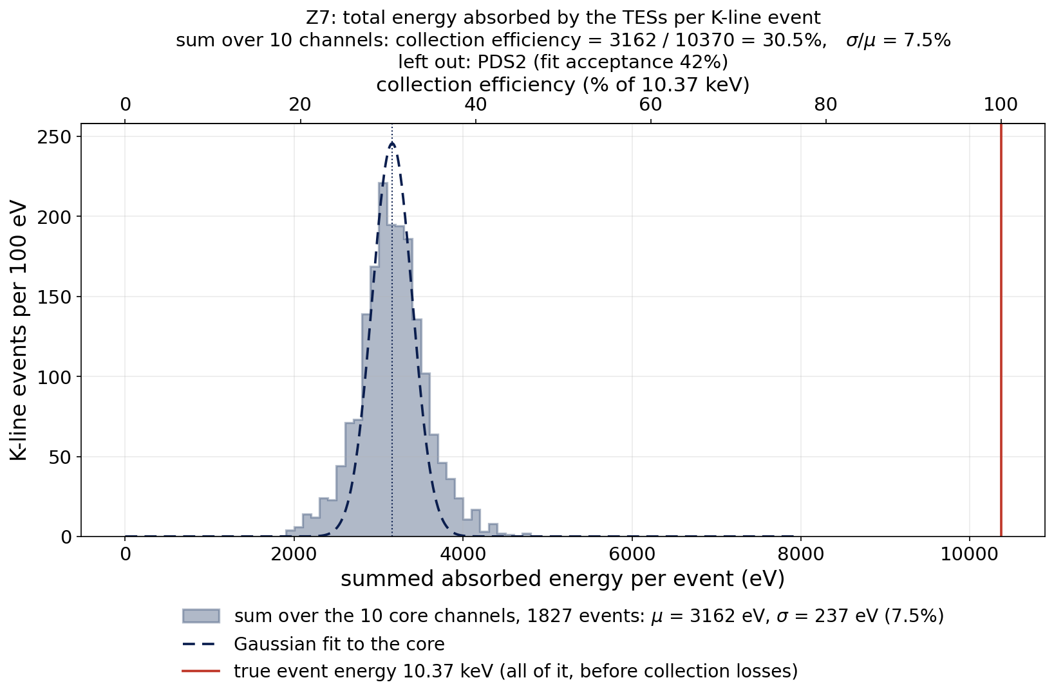
Summed over the channels: 30.5 %
the total energy the TESs absorbed per K-line event
Ten channels summed, 1827 events: 3162 eV = 30.5 %, and the width drops to 7.5 % — the position effect cancels.
PDS2 is left out: only 42 % of its events can be fitted, and those are the events that happened near it.
Collection efficiency:
30.5 % ± 2.3 % (σ/μ = 7.5 %).
Red line: 10.37 keV — two thirds of the energy never reaches the TESs.
10
Notes:
Grey: ten channels that fit ≥ 95% of events, 1827 events, 3162 eV = 30.5%, width 7.5% — the position dependence cancels in the sum. Uncertainty = sigma/mu of the Gaussian fit, 7.5% (Prof. Liu). PDS2 fits only 42%, and those are events near it, so it is left out. Red line 10.37 keV.

Slide 11
Summary, and what is still open
The current pulse becomes a power pulse through the TES equations; the area under the power is the energy.
The energy is taken from the fitted pulse, so the noise at the peak and the baseline drift do not enter.
Z7 absorbs 30.5 % ± 2.3 % (σ/μ = 7.5 %) of a 10.37 keV event in its TESs, summed over 10 channels. The CDMS note reports 26–41 % on the R37 CUTE tower.
Open: Z7 only · the bias of Z7 is not established (0 V assumed) · no dI/dV · PDS2 not included · 12.5 % of events fit in no channel.
11
Notes:
Chain: current -> power -> energy -> sum over 10 channels -> 30.5% (sigma/mu 7.5%). R37 CUTE note: 26-41%. Open: Z7 only; HV bias unknown (0 V assumed); no dIdV, inductor term dropped; PDS2; 12.5% of events fit nowhere.

Slide 12
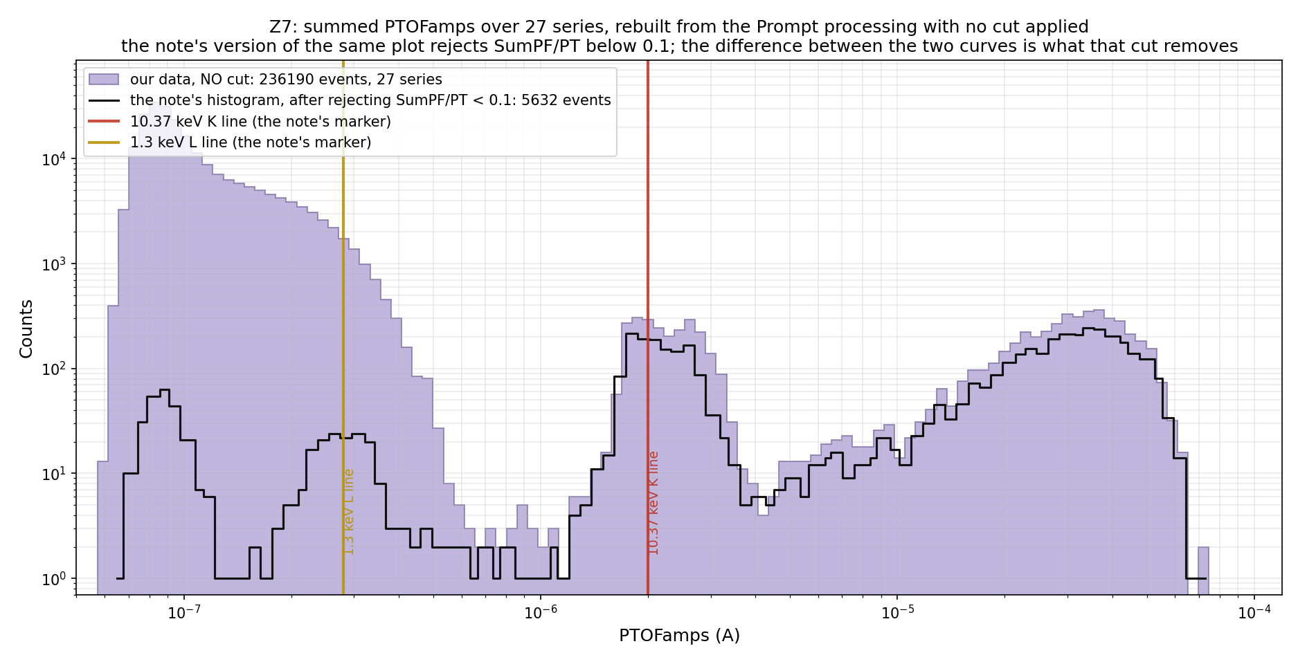
Backup — the events
12
Notes:
Z7 summed PTOFamps, our rebuild with no cut; K line at 2e-6 A.

Slide 13
Backup — the two Methods of the CDMS note
δP = I₀(R_L − R₀)·δI + c₂·R_L·(δI)² with c₂ = 2 (Method 1, used here) and c₂ = −1 (Method 2)
The two differ only in the quadratic term: 1.7 % in energy (PBS1, median of 15 events) — far below the 15 % single-channel width and the 7.5 % width of the sum.
The inductor term of the full equations needs L and the loop gain from dI/dV, which do not exist for these series on MSI; it is neglected.
The official Eabs (trigger bin 16383, baseline bins 93..15758, 5-pole 20 kHz prefilter, window −0.5/+1 ms, same formula) is reproduced to 0.2 %; the grey outlines on the histogram slides are it.
13
Notes:
c2 = 2 is Method 1 (used here), c2 = -1 is Method 2; 1.7% apart in energy.

Slide 14
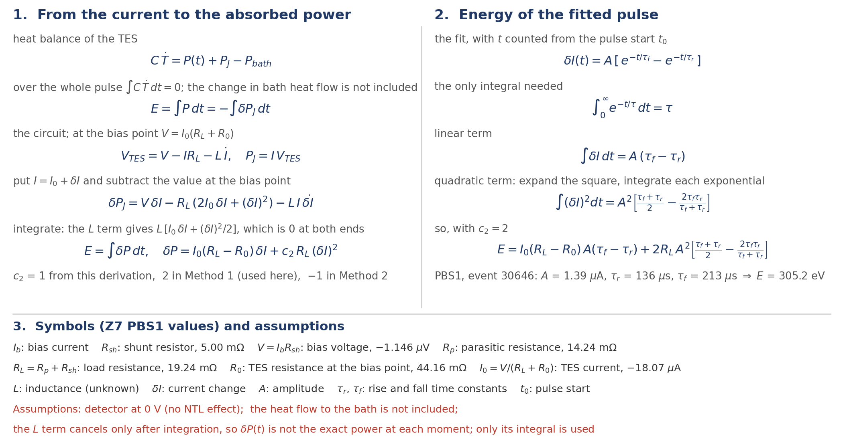
Backup — how the formulas are derived
14

Slide 15
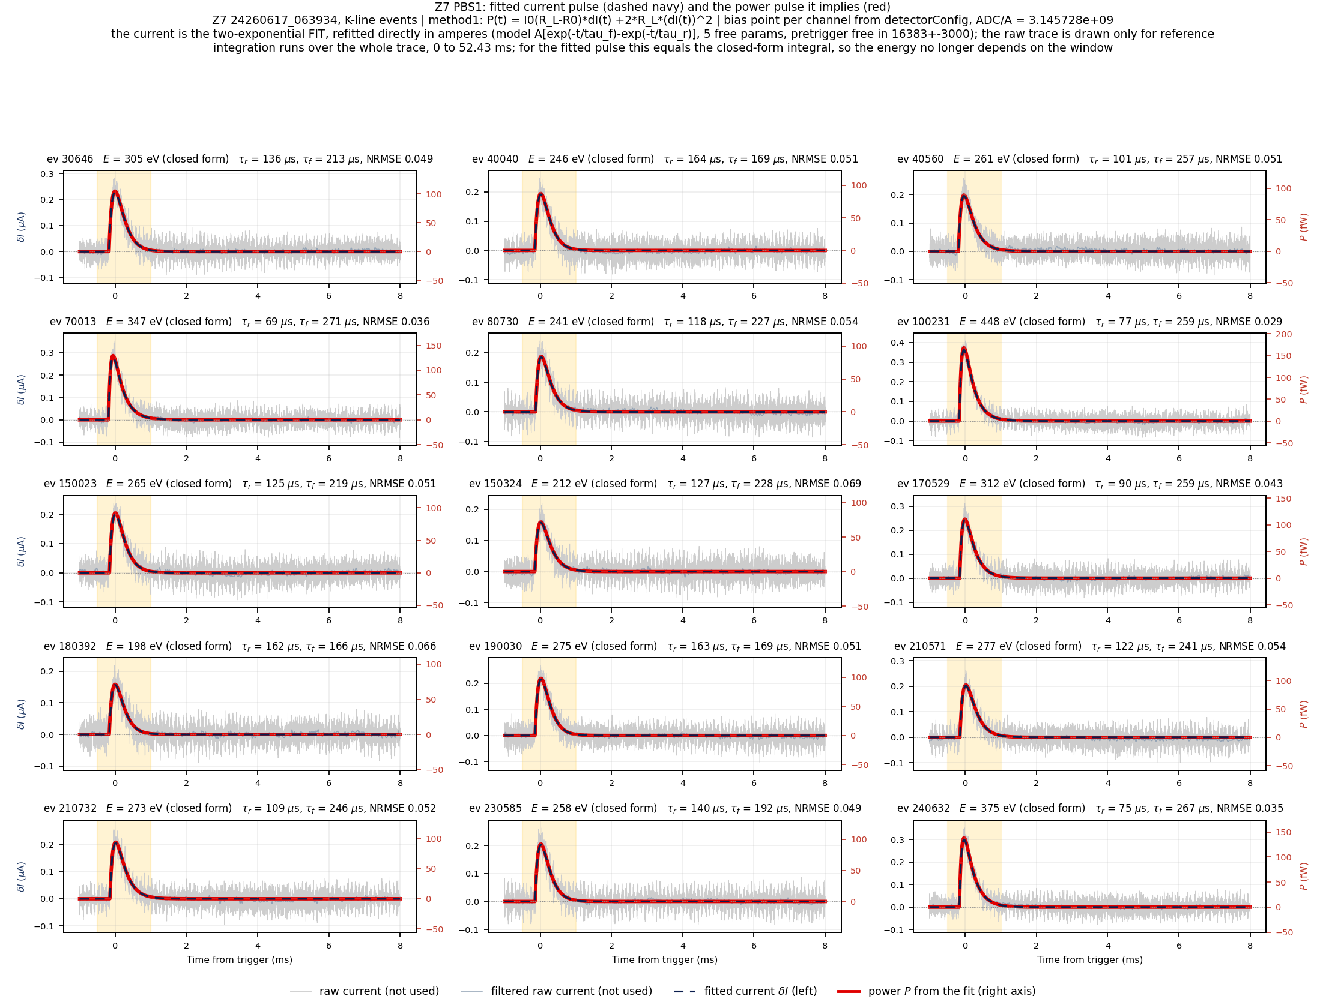
Backup — 15 events, fitted current and power (PBS1)
15
Notes:
All 15 example events.

Slide 16
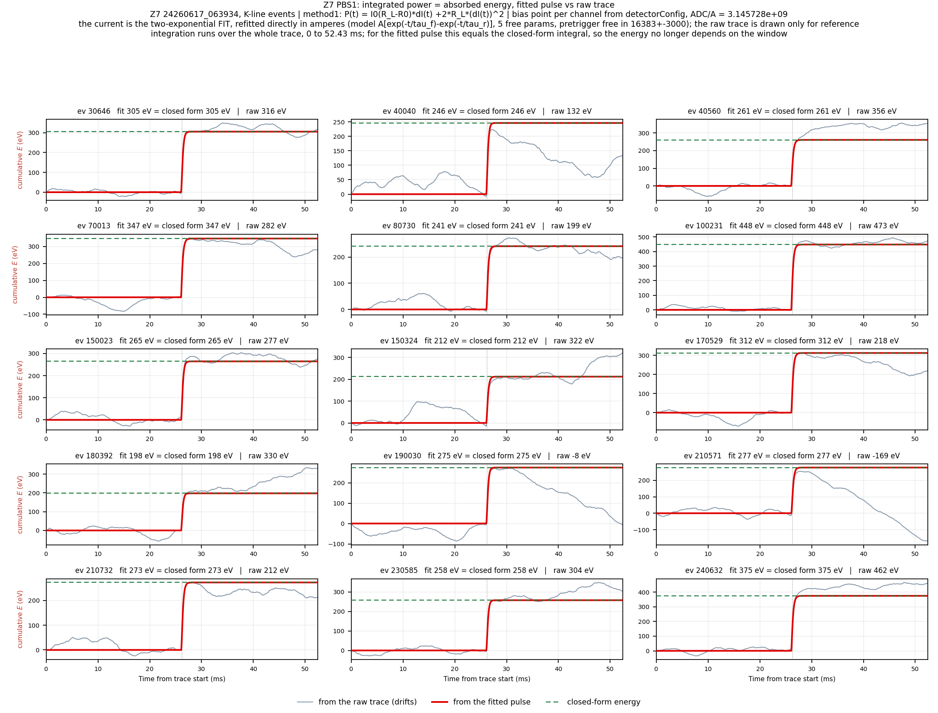
Backup — 15 events, cumulative energy (PBS1)
16
Notes:
Fit vs raw, 15 events.

Slide 17
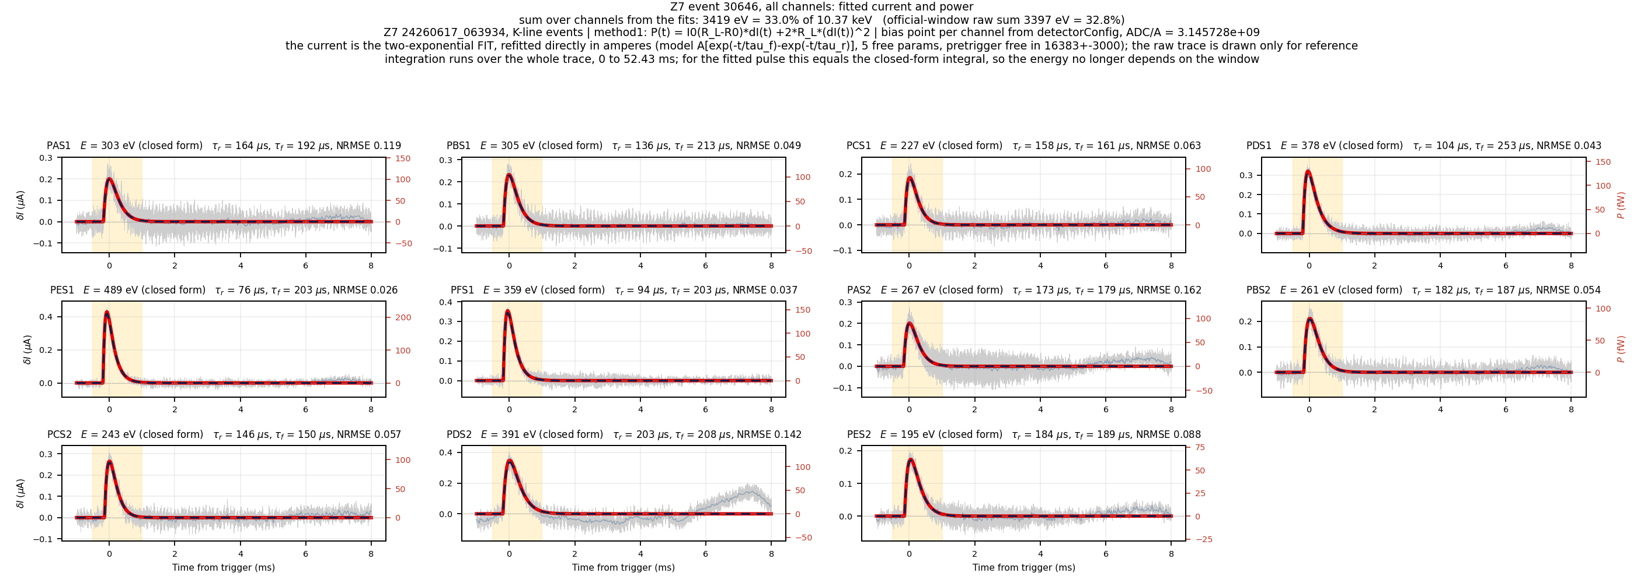
Backup — event 30646, all channels
17
Notes:
Sum 3419 eV = 33.0%.

Slide 18
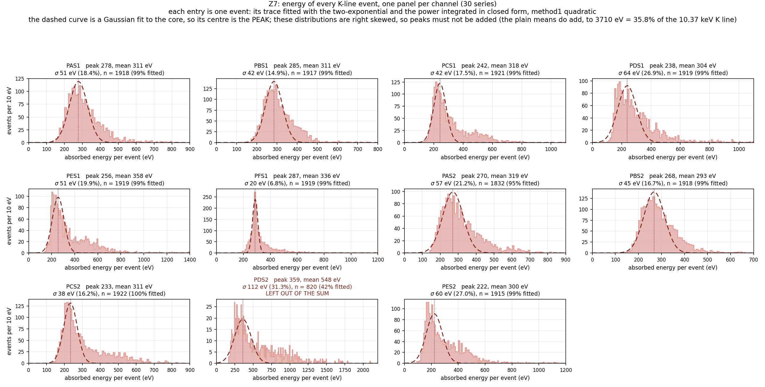
Backup — energy distribution of every channel
18
Notes:
Every channel is right-skewed; the peaks must not be added (21% low), the means add. PDS2 left out.

