Slide 1
Cache Simulation Using SimpleScalar
Zhijia Chen & HONGHAO GAN
Dec 3rd, 2018

Slide 2
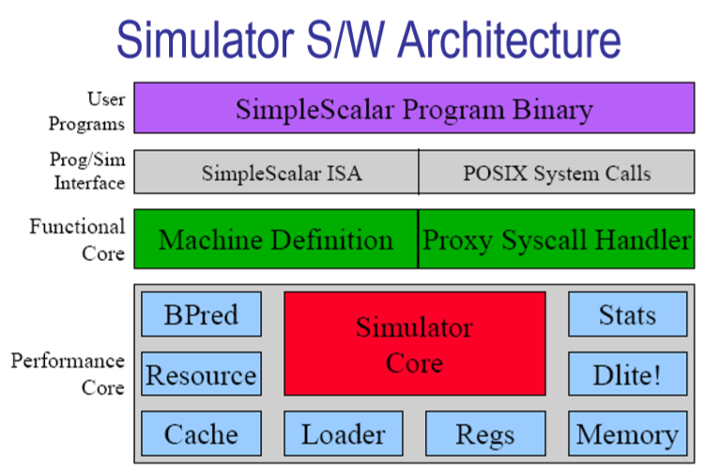
What we going to do with SimpleScalar?

Slide 3
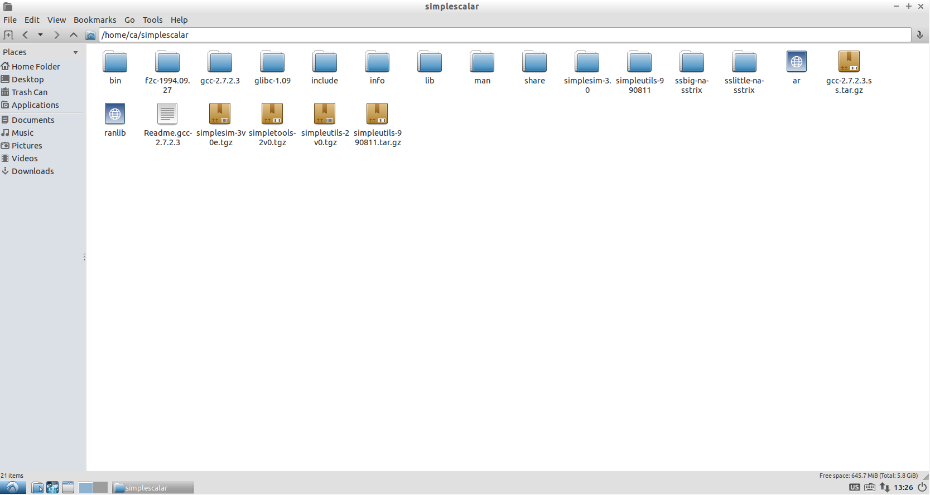
What we going to do with SimpleScalar?

Slide 4
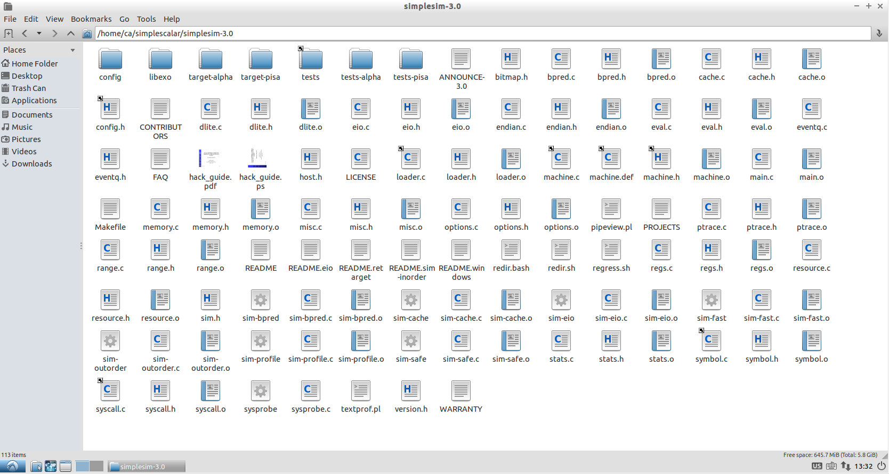
What we going to do with SimpleScalar?

Slide 5
Implementing L3 Cache
Implementing LFU Replacement Policy
Implementing Multi-Core
Test & Collect Data

Slide 6
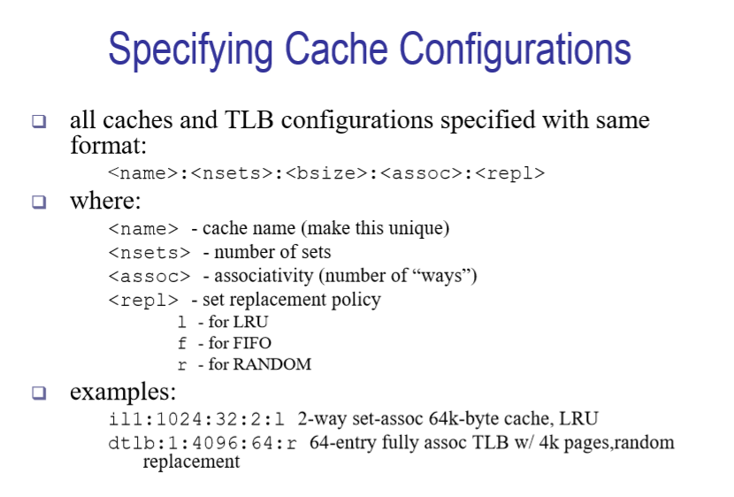
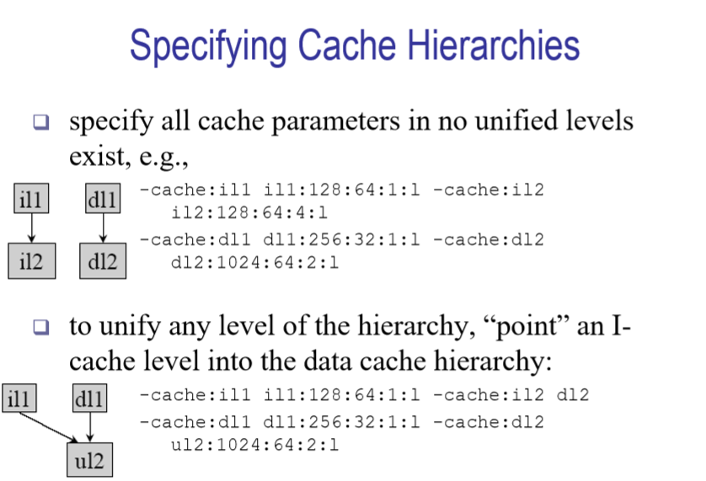
Implementing L3 Cache

Slide 7
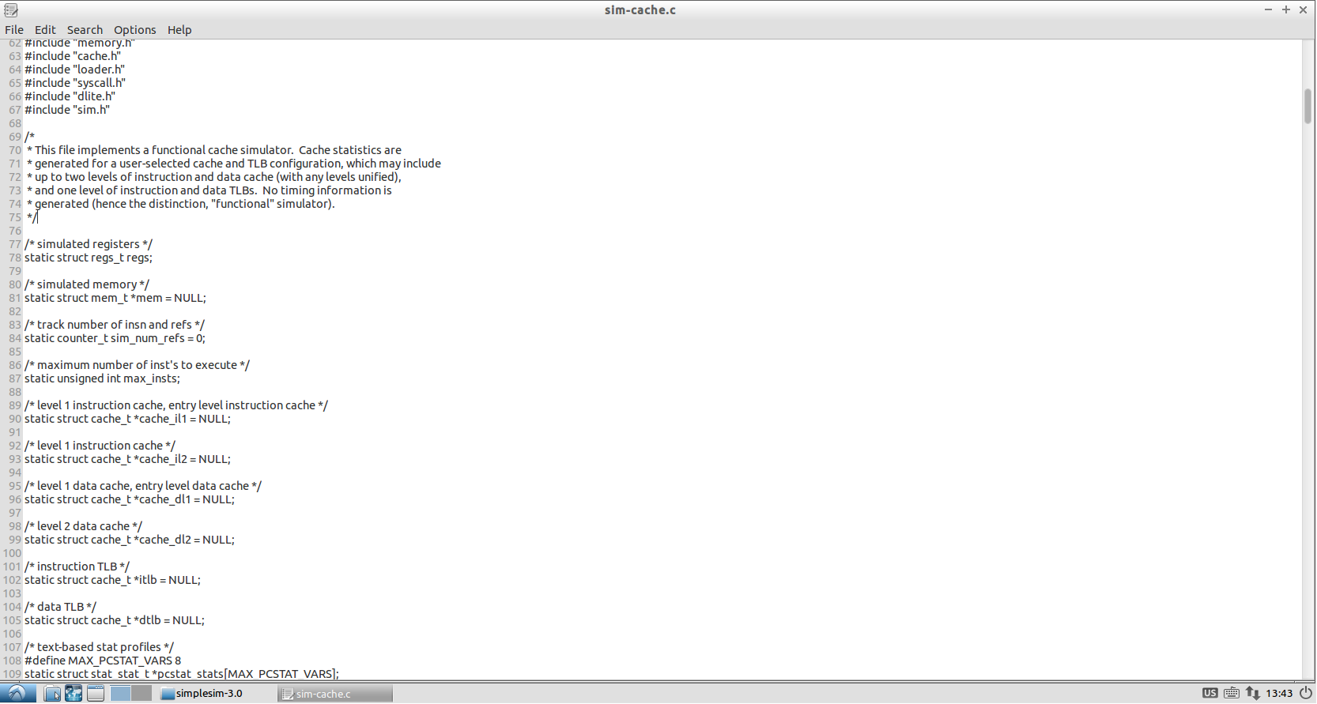
Implementing L3 Cache

Slide 8
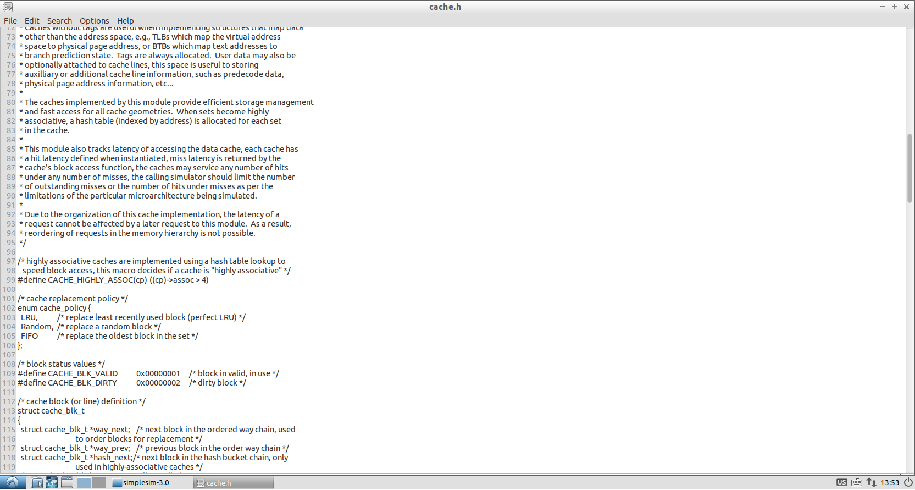
Implementing LFU Replacement Policy

Slide 9
Implementing Multi-Core

Slide 10
Test & Collect Data
Two test programs
Sequential Access to Memory
Random Access to Memory

Slide 11
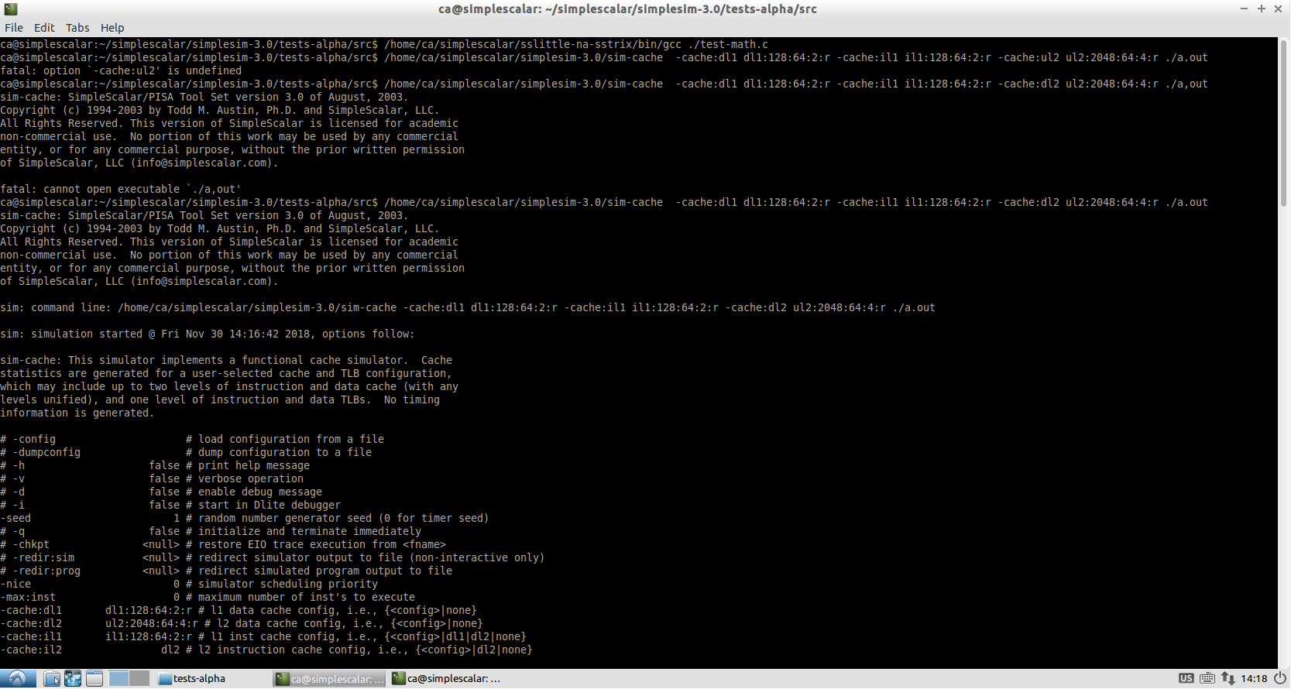
Test & Collect Data

Slide 12
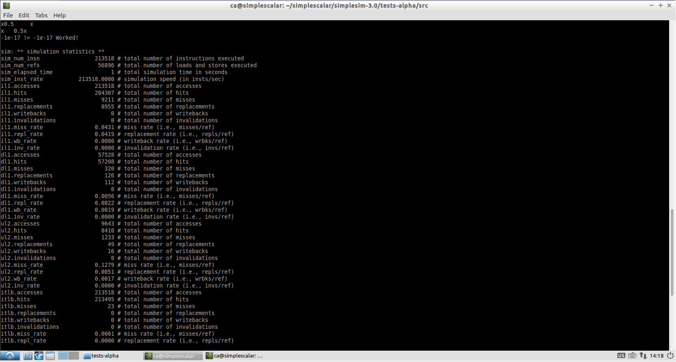
Test & Collect Data

