Slide 1
Cache Simulation Using SimpleScalar
Zhijia Chen & HONGHAO GAN
Dec 3rd, 2018

Slide 2
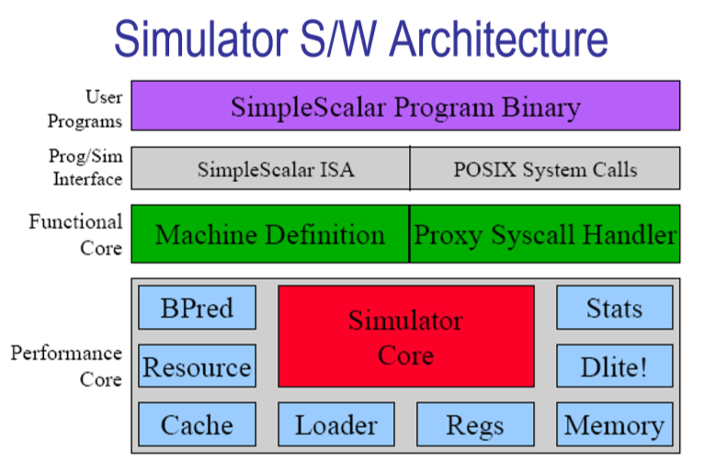
What we going to do with SimpleScalar?

Slide 3
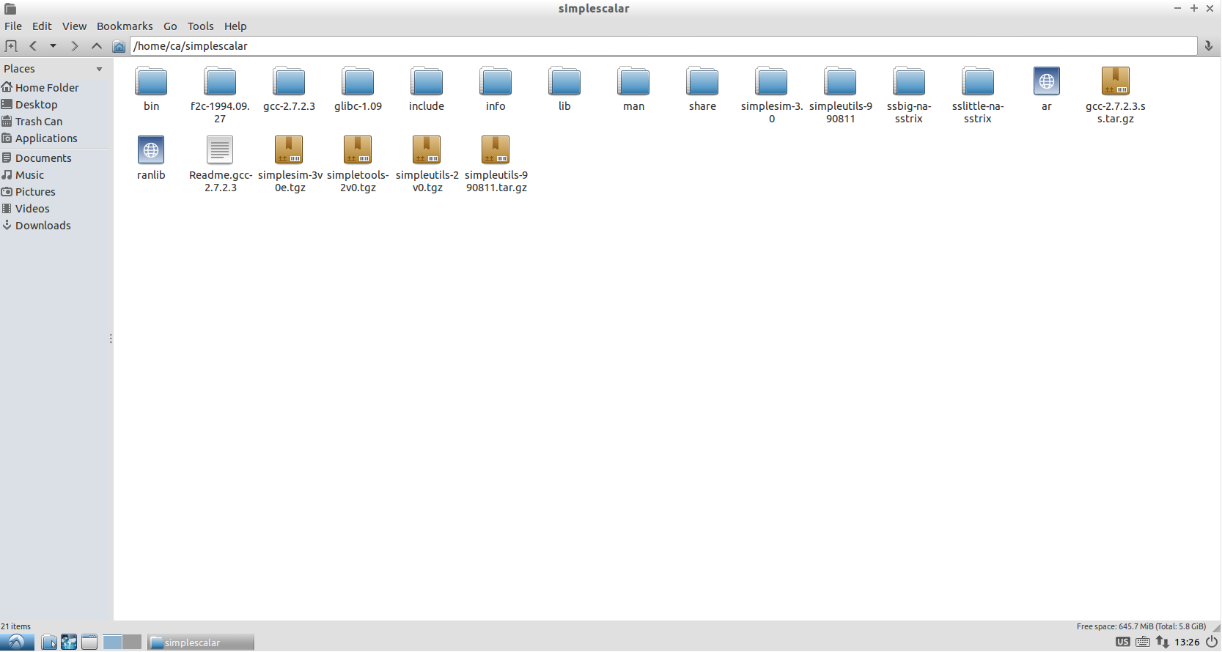
What we going to do with SimpleScalar?

Slide 4
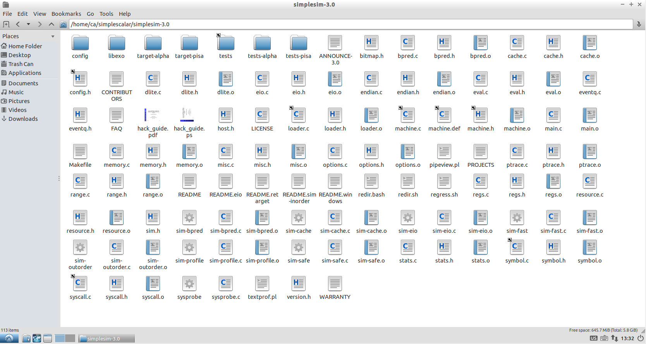
What we going to do with SimpleScalar?

Slide 5
Implementing L3 Cache
Implementing LFU Replacement Policy
Implementing Multi-Core
Test & Collect Data

Slide 6
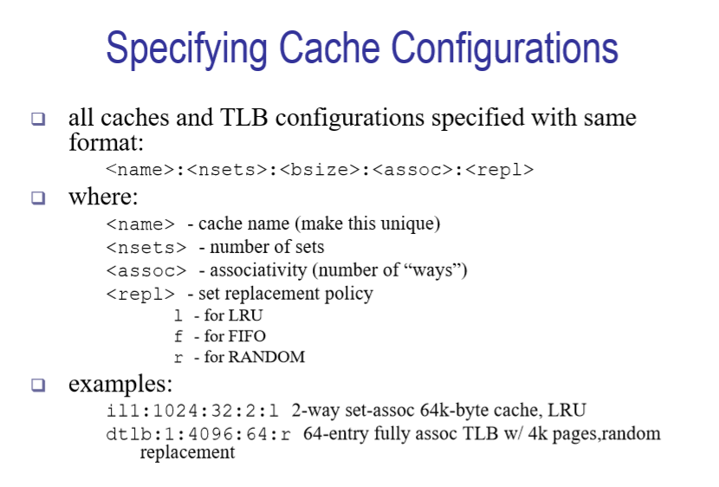
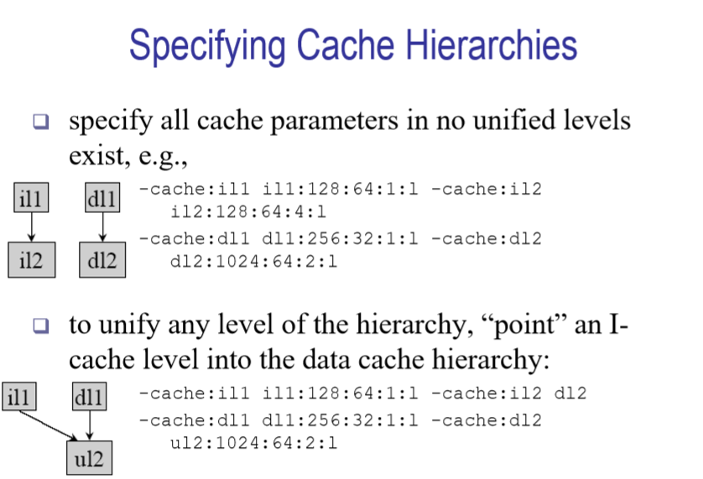
Implementing L3 Cache

Slide 7
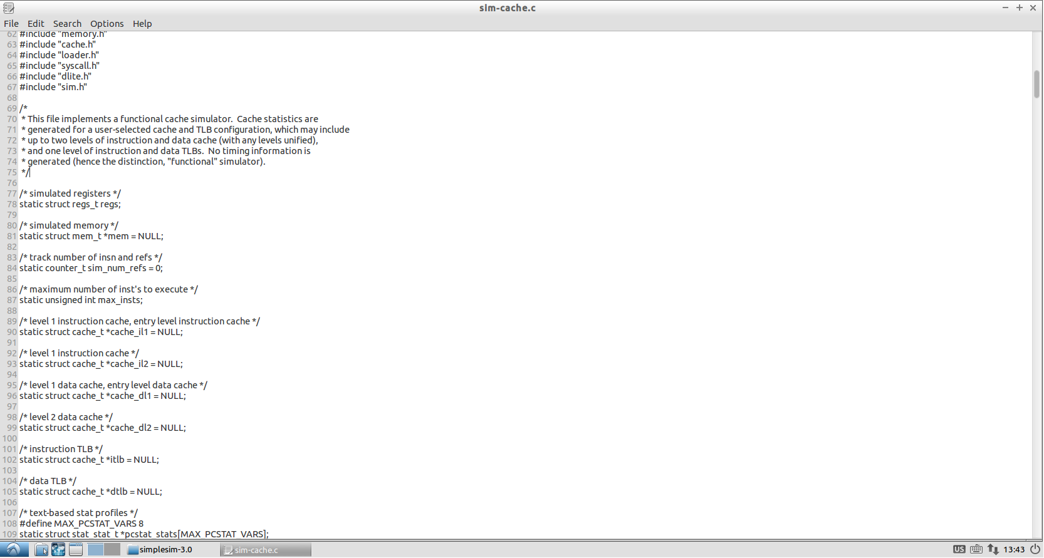
Implementing L3 Cache

Slide 8
Implementing L3 Cache Declare L3 cache
/* level 1 instruction cache, entry level instruction cache */
static struct cache_t *cache_il1 = NULL;
/* level 2 instruction cache */
static struct cache_t *cache_il2 = NULL;
/* level 3 instruction cache */
static struct cache_t *cache_il3 = NULL;
/* level 1 data cache, entry level data cache */
static struct cache_t *cache_dl1 = NULL;
/* level 2 data cache */
static struct cache_t *cache_dl2 = NULL;
/* level 3 data cache */
static struct cache_t *cache_dl3 = NULL;

Slide 9
Implementing L3 Cache Cache miss handler function
struct cache_t
{
… unsigned int /* latency of block access */
(*blk_access_fn)(enum mem_cmd cmd, /* block access command */
md_addr_t baddr, /* program address to access */
int bsize, /* size of the cache block */
struct cache_blk_t *blk, /* ptr to cache block struct */
tick_t now); /* when fetch was initiated */
…
}

Slide 10
Implementing L3 Cache Link L3 cache to L2 cache
static unsigned int
il2_access_fn(enum mem_cmd cmd, md_addr_t baddr, int bsize,
struct cache_blk_t *blk,
tick_t now)
{
/* this is a miss to the lowest level, so access main memory, which is
always done in the main simulator loop */
return 1;
}
static unsigned int
il2_access_fn(…)
{
if (cache_il3)
{
return cache_access(cache_il3, cmd, baddr, NULL, bsize, now, NULL, NULL);
}
else
{
return 1;
}
}
static unsigned int
il3_access_fn(…)
{
return 1;
}

Slide 11
Implementing L3 Cache Inclusion property
struct cache_blk_t
{
struct cache_blk_t *way_next;
struct cache_blk_t *way_prev;
struct cache_blk_t *hash_next;
md_addr_t tag; /* data block tag value */
unsigned int status; /* block status */
…
unsigned int presentCnt;
};
presentCnt++ When a block is read.
presentCnt-- When an upper level cache block that read from current block is evicted.
In replacement policy, only blocks with presentCnt = 0 can be replaced.

Slide 12
Core 1
Core 2
L1 I-Cache
Access #: 40905687
L1 D-Cache
Access #: 12494388
L1 I-Cache
Access #: 1823262177
L1 D-Cache
Access #: 517354205
miss # : 236
writeback # : 0
miss # : 579211
writeback # : 568299
miss # : 247
writeback # : 0
miss # : 32502204
writeback # : 2260610
L2 Unified Cache
Access #: 1147746
L2 Unified Cache
Access #: 34763061
miss # : 378457
writeback # : 376080
miss # : 2496411
writeback # : 21993
L3 Unified Cache
Access #: 3272939

Slide 13
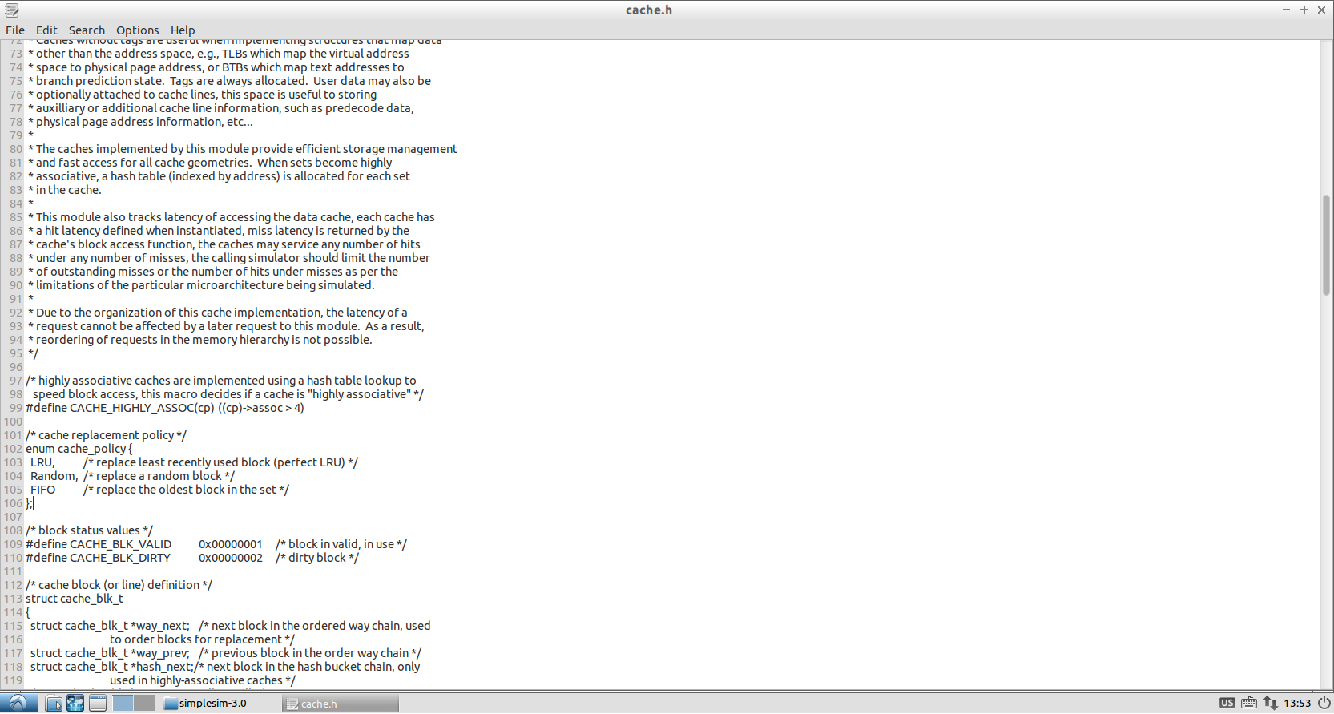
Implementing LFU Replacement Policy

Slide 14
Implementing LFU Replacement Policy
struct cache_blk_t
{
struct cache_blk_t *way_next;
struct cache_blk_t *way_prev;
struct cache_blk_t *hash_next;
md_addr_t tag; /* data block tag value */
unsigned int status; /* block status */
…
unsigned int presentCnt;
unsigned int useCnt;
};
LFU replacement policy: useCnt++ when a block is accessed. Evict the cache block that has the minimun useCnt. Randomly pick one if there are multiple blocks with minimum useCnt.
Need to take care of useCnt overflow. Stop adding up useCnt for a block whose useCnt is going to overflow.

Slide 15
Implementing Multi-Core
Preliminary idea:
Start multiple threads for sim_main function, each thread simulates a core.
Feed different test program for each thread.
Synchronize clock among simulation threads.
Each thread keeps its private caches.
For shared caches, each clock only satisfy one read/write, other threads have to wait for next cycle.

Slide 16
Test & Collect Data
Two test programs
Sequential Access to Memory
Random Access to Memory

Slide 17
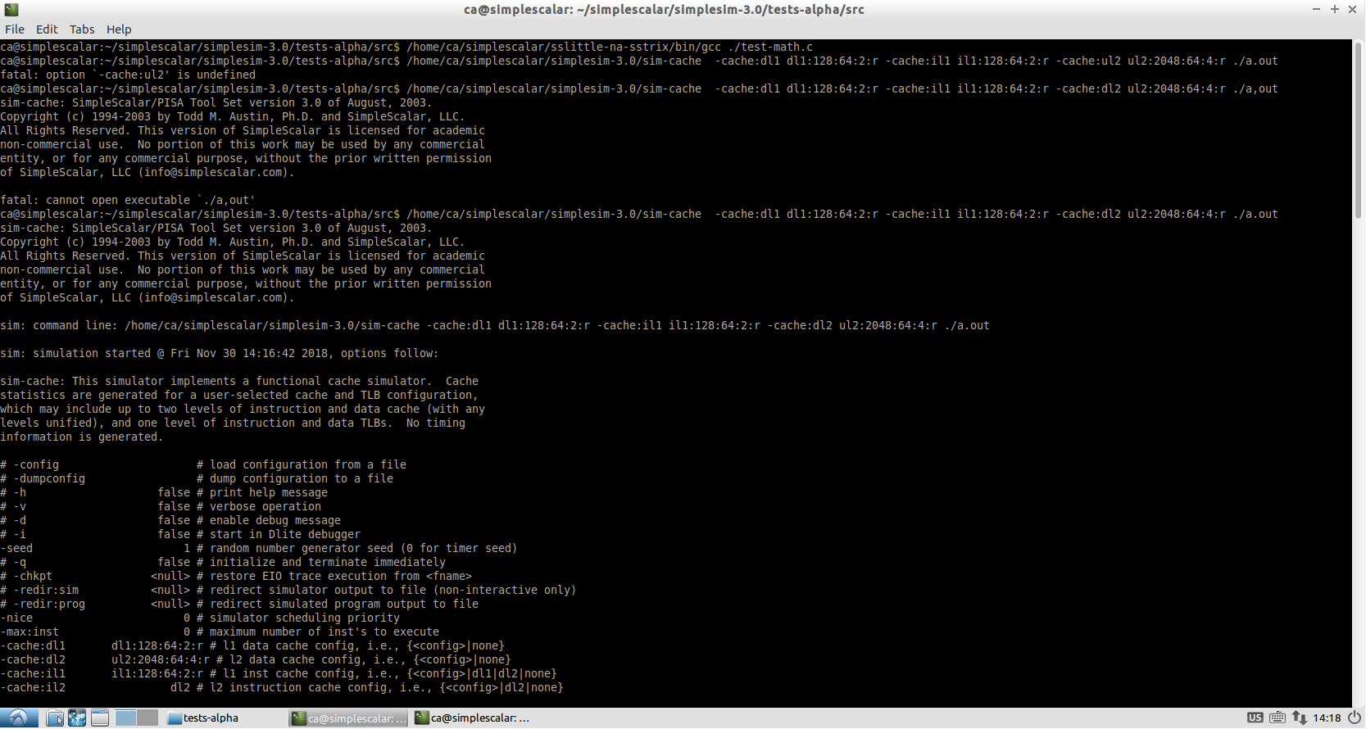
Test & Collect Data

Slide 18
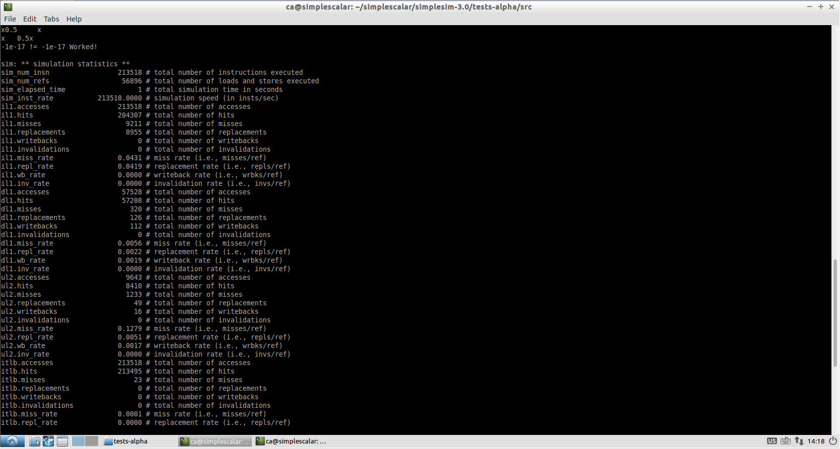
Test & Collect Data

