Slide 1


Get To Know Your [Text]
Aaron McKenny
Academy of Management | August 10, 2024

Slide 2
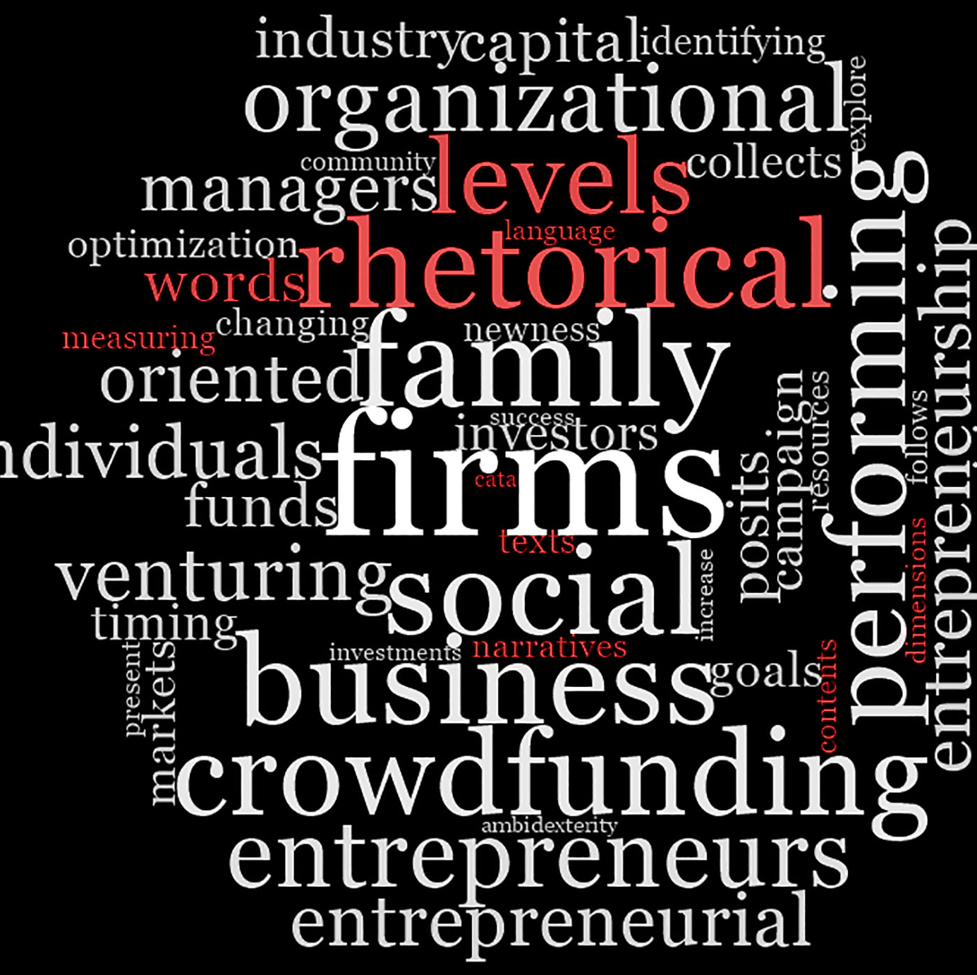
About me
Text Analysis Methodologist
Entrepreneurship
Fascinated by language
Influential and reflective
Mediates many (most?) management phenomena

Slide 3
My goal – two tools
Provide you with:
High-level demonstration
Ideas for how they may apply in your research
Texts that you can use to test them out
Code so you can try them today
QR code to my GitHub at end of presentation
(Just about) everything you need to do what I did today
Slides are uploaded as well

Slide 4
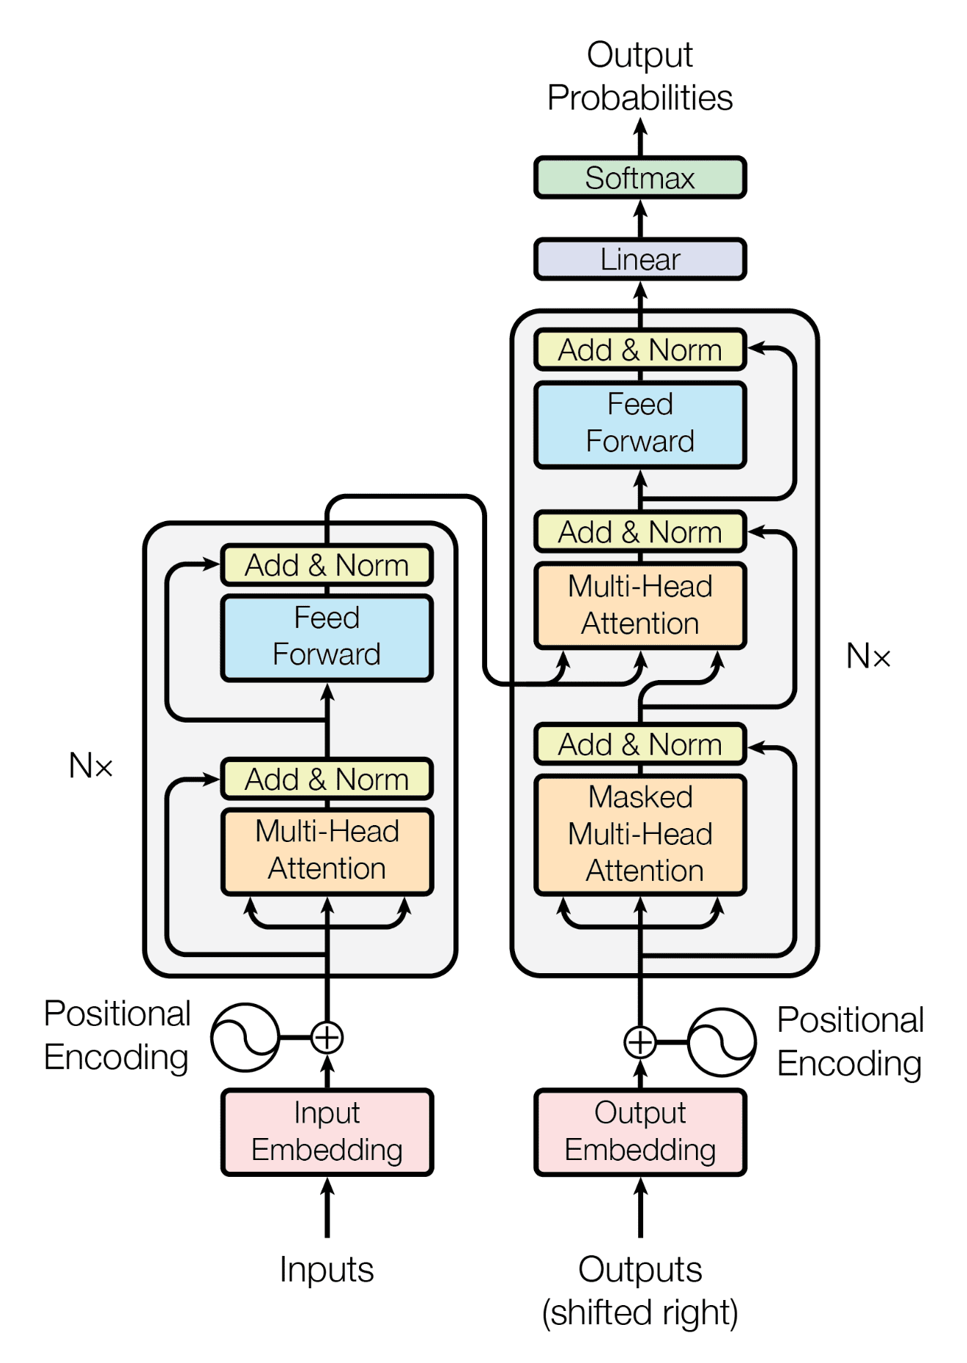
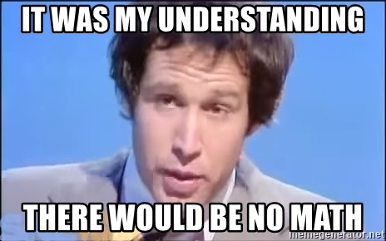
My… other goal

Slide 5

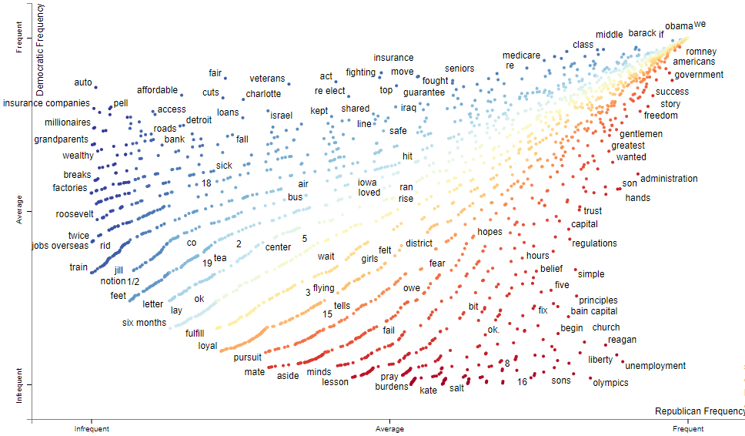
Two Tools
Scattertext
https://github.com/JasonKessler/scattertext

Slide 6
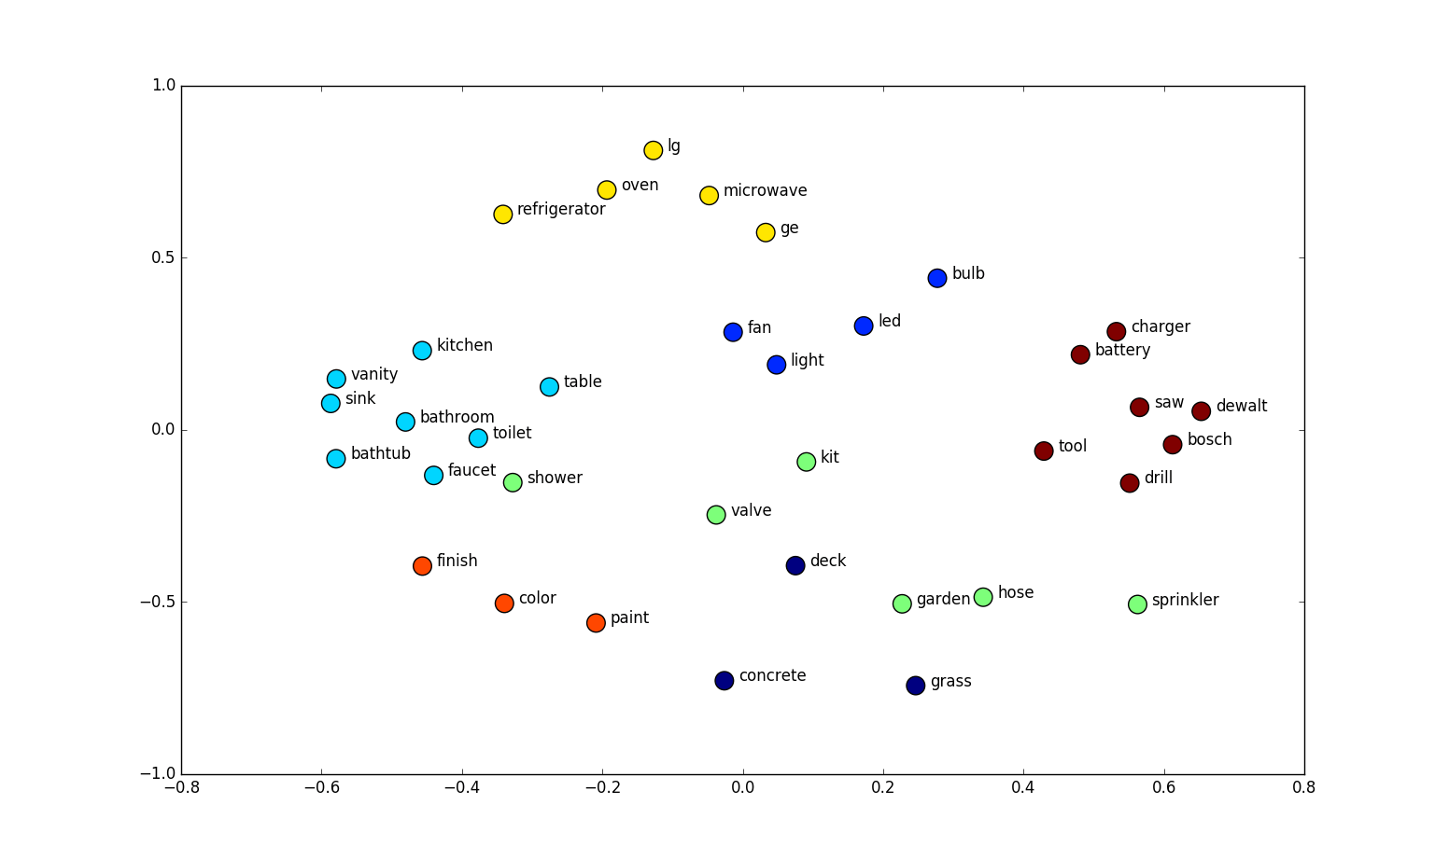
Two Tools
Text Embeddings
Scattertext
Visualize the distinctive usage of words/n-grams
https://github.com/JasonKessler/scattertext
https://www.ollama.ai

Slide 7
Two Tools
Text Embeddings
Scattertext
Numeric vector representations of text
https://www.ollama.ai
https://github.com/JasonKessler/scattertext

Slide 8
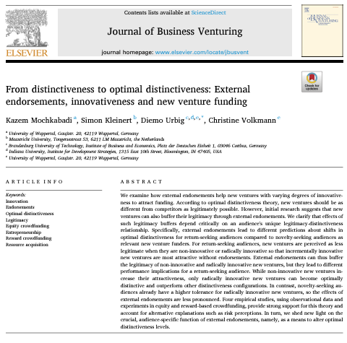
Texts: Article Abstracts
Why?
Relevant to everyone in the room
Easily obtainable
I provide you with the code to do so
Science of science is interesting!
Consistent perspective across tools
My projects use a variety of texts, none use both tools
Corpora
Current and recent editors of JBV/SEJ/ETP
All JBV/SEJ/ETP articles since 2000

Slide 9
Tool #1
Scattertext
Visualize the distinctive usage of words/n-grams
https://github.com/JasonKessler/scattertext

Slide 10
What does Scattertext do? (simplified)
Scatterplot where each dot is a word or n-gram
Compares word frequency in a corpus for two groups
One vs other (social vs commercial ventures)
One vs rest (serial entrepreneurs vs everyone else)
Considers relative frequency:
Total utterances
Total documents in which the utterances occur

Slide 11
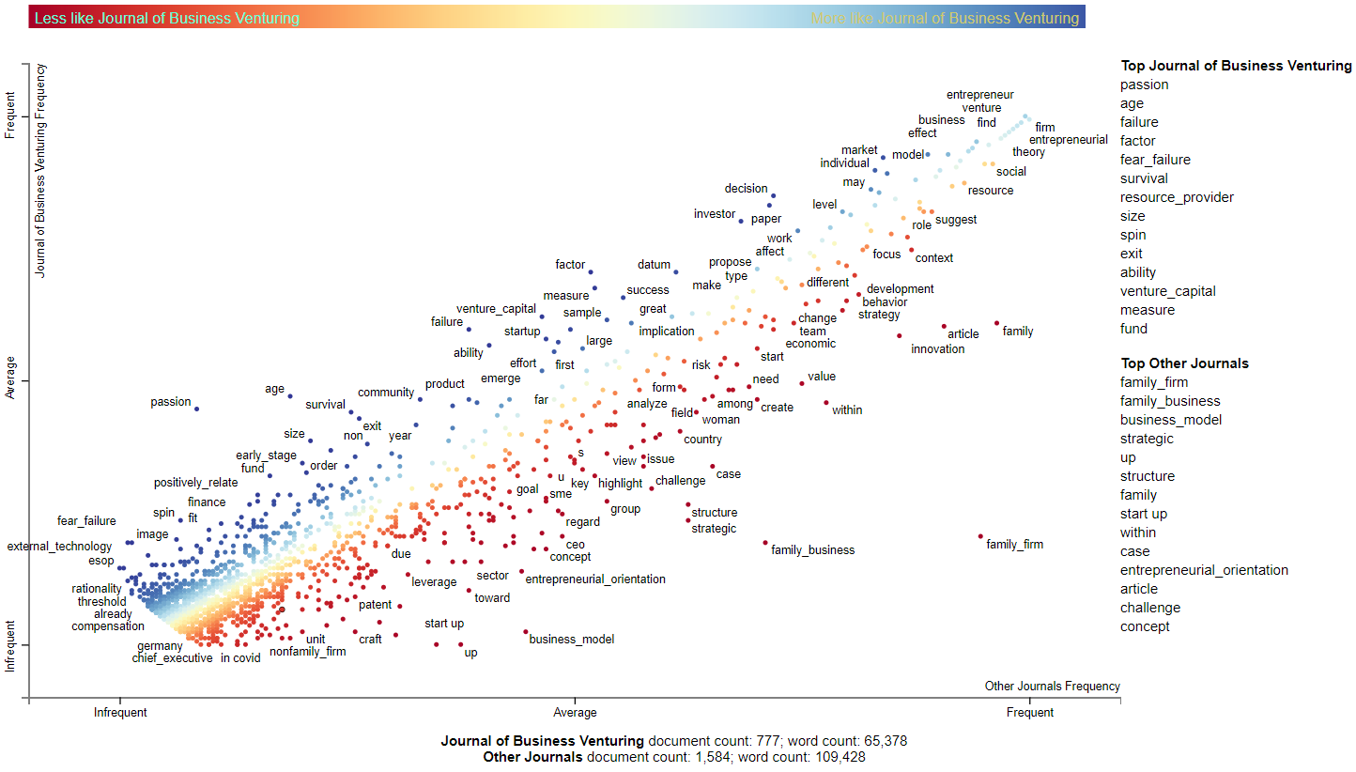
Deconstructing a Scattertext: JBV
Compare word usage between two groups.
Here: JBV vs non-JBV

Slide 12
Deconstructing a Scattertext: JBV
More Distinctive of JBV
JBV: Frequent
Other Journals: Infrequent
Characteristic and Frequent
JBV: Frequent
Other Journals: Frequent
Characteristic but infrequent
JBV: Infrequent
Other Journals: Infrequent
More Distinctive of Others
JBV: Infrequent
Other Journals: Frequent

Slide 13
Deconstructing a Scattertext: JBV
Top words characteristic of JBV
Top words characteristic of other journals

Slide 14
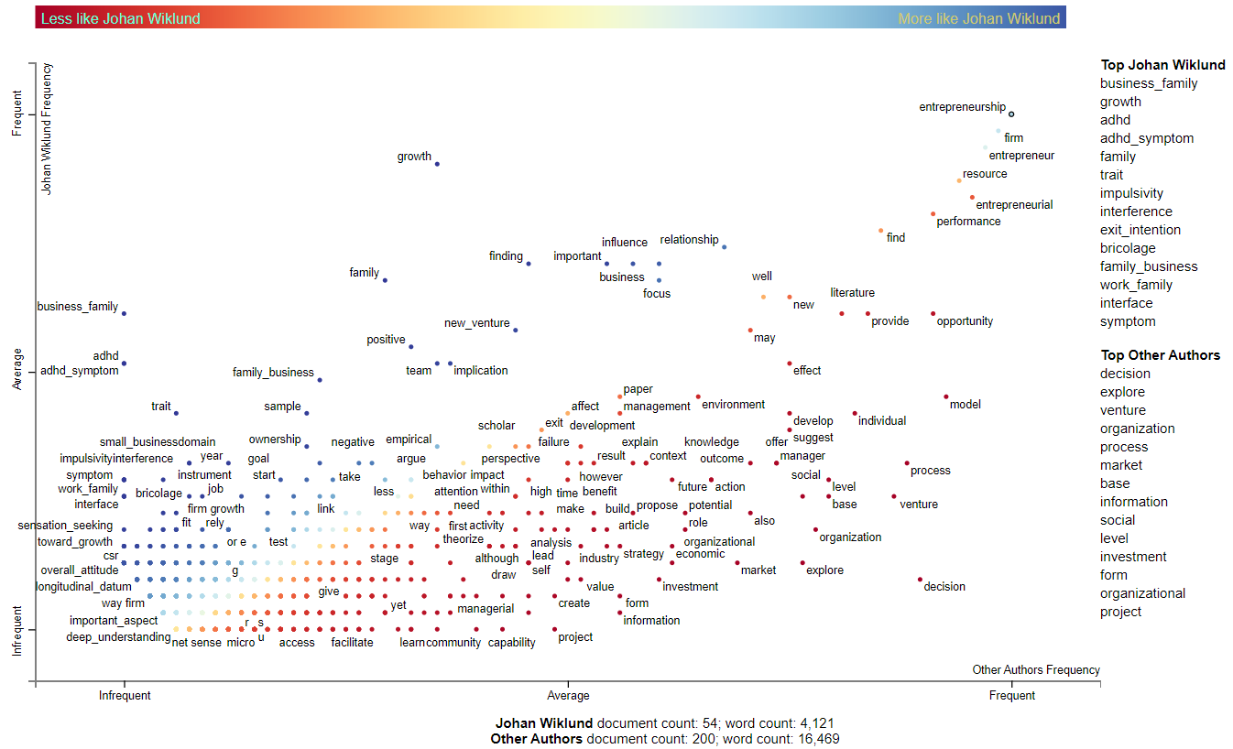
Johan Wiklund vs other ENT Journal editors

Slide 15
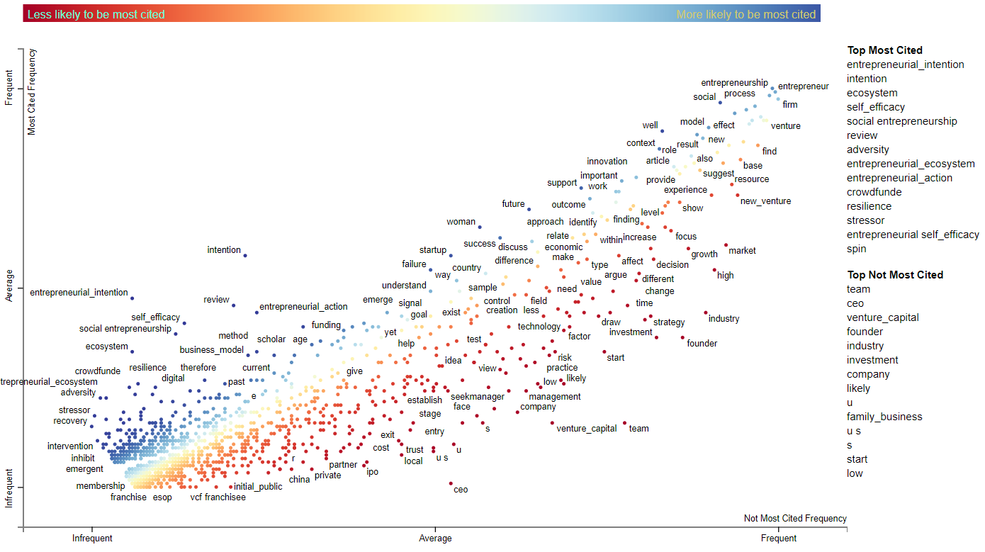
Top 20% most cited ENT articles in each year

Slide 16
Opportunities
Demographics (gender, age, immigrant)
How do women/men/non-binary entrepreneurs frame decisions differently?
Time (crisis, trauma, failure)
How do entrepreneurs speak differently about their ventures before/after a traumatic event?
Venture type (franchise, high-growth, social/sustainable)
How do social entrepreneurs attempt to attract potential employees differently than traditional commercial entrepreneurs?

Slide 17
Tool #2
Text Embeddings
Numeric vector representations of text
https://www.ollama.ai

Slide 18
What are word embeddings?
Whiskey
Beer
Wine
United States
Germany
France
Entrepreneur
Capitalist
CEO

Slide 19
Interesting tendencies of embeddings
Wine
Vector Algebra: Beer – Germany + France = ????
Beer
Wine
Germany
France
Embeddings capture elements of ‘meaning’ of the text
as reflected in the corpus in which the embeddings were trained

Slide 20
What can we learn from embedding vectors?
Baker & Nelson (2005) - ASQ
Title: Resource Construction through Entrepreneurial Bricolage
Abstract Embedding Vector:
[0.2, 1.74, -3.56, -0.45, 0.54,
0.39, 0.19, 0.0, -0.02, 0.21,
0.29, -0.51, 1.69, 0.17, 0.87,
-0.21, -0.17, -0.53, 0.25, 0.08,
-0.51, -0.1, 1.0, 0.43, 0.17,
0.15, -0.25, -0.25, 0.86, …]
Five most similar articles in corpus
Social Bricolage: Theorizing Social Value Creation in Social Enterprises - 0.8546
Resource Mobilization in International Social Entrepreneurship: Bricolage as a Mechanism of Institutional Transformation - 0.8534
Optimization or Bricolage? Overcoming Resource Constraints in Global Social Entrepreneurship - 0.8450
Bridging Behavioral Models and Theoretical Concepts: Effectuation and Bricolage in the Opportunity Creation Framework - 0.8342
Learning from Levi–Strauss’ Legacy: Art, Craft, Engineering, Bricolage, and Brokerage in Entrepreneurship - 0.7975

Slide 21
Abstract similarity to ENT journal pubs…
Hill et al (2024) – Applied Psychology
Third-party perceptions of mistreatment: A meta-analysis and integrative model of reactions to perpetrators and victims
Federman et al (2024) – Astrophysics
Investigating Protostellar Accretion-driven Outflows across the Mass Spectrum: JWST NIRSpec Integral Field Unit 3–5 μm Spectral Mapping of Five Young Protostars
Entrepreneurship Baker & Nelson (2005) | Applied Psychology Hill et al. (2024) | Astrophysics Federman et al. (2024)
ET&P: 0.8168 JBV: 0.8192 SEJ: 0.8257 | ET&P: 0.6423 JBV: 0.6299 SEJ: 0.6068 | ET&P: 0.5293 JBV: 0.5373 SEJ: 0.5377

Slide 22
Alternative text comparisons
A question
What is the role of institutions in entrepreneurship?
Question Embedding Vector:
[-1.26, 2.24, -3.54, 1.04, 1.73,
-0.43, 0.3, 1.1, 1.29, -0.34,
-0.14, -0.19, 1.81, -1.0, 0.54,
-0.46, 0.26, -0.02, -0.99, 0.71,
-0.33, 0.07, -0.5, 0.83, 1.83,
1.1, 0.47, -0.63, -0.21, … ]
Five most similar articles in corpus
Institutional Determinants of Macro–Level Entrepreneurship - 0.7946
Opportunities and institutions: A co-creation story of the king crab industry - 0.7947
Institutions and Entrepreneurship Quality - 0.7832
A theory of entrepreneurship and institutional uncertainty - 0.7847
Micro-Foundations of Corporate Entrepreneurship in Family Firms: An Institution-Based Perspective - 0.7765

Slide 23
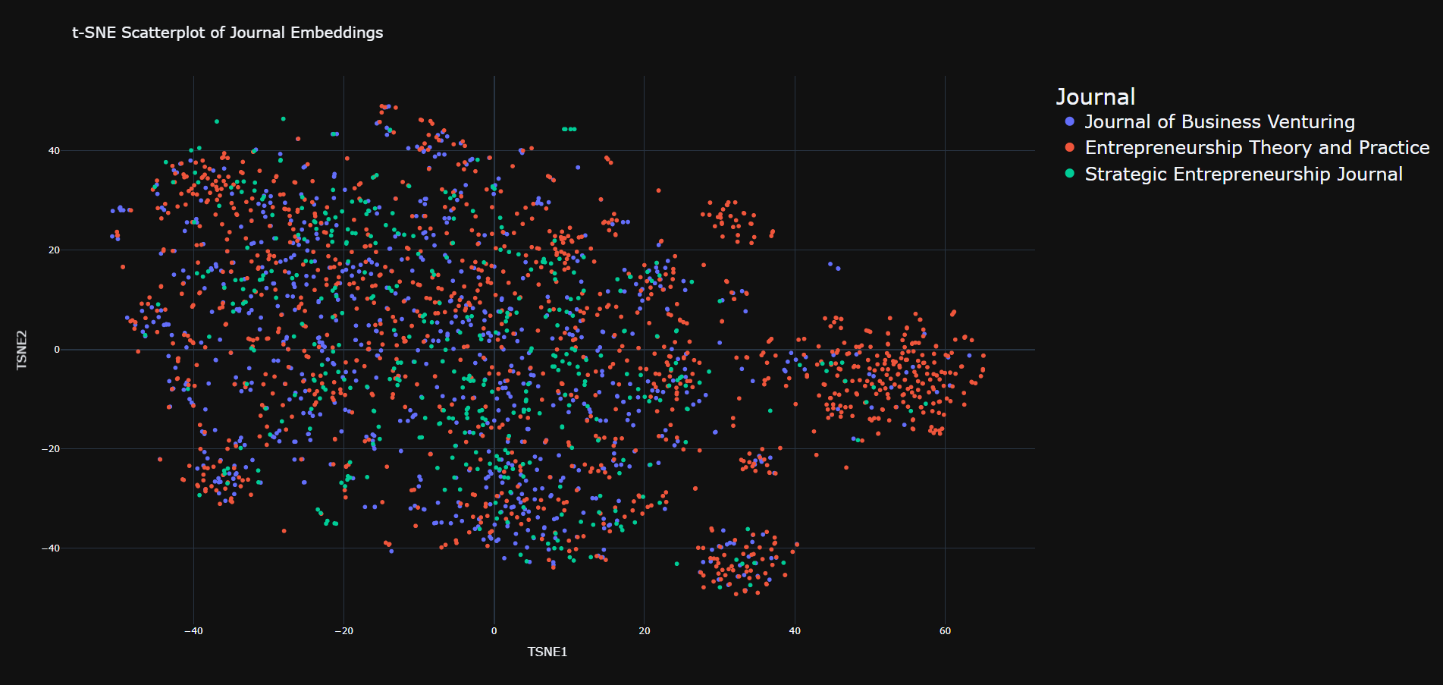

Slide 24
The Family Business Cluster
ETP Four Bases of Family Business Successor Commitment: Antecedents and Consequences
SEJ Resource orchestration in family firms: Investigating how EO, generational involvement and participative strategy affect performance
JBV Toward a theory of agency and altruism in family firms
JBV EO and innovation in family SMEs: Unveiling the (actual) impact of the board of directors
SEJ Are family female directors catalysts of innovation in family small and medium enterprises?
ETP When do women make a better table? Examining the influence of women directors on family firms’ CSP

Slide 26
The Science of Science/Review Cluster
SEJ Effects of theoretical contribution, methodological rigor, and journal quality, on the impact of scale development articles in the field of entrepreneurship
ETP Knowledge accumulation in entrepreneurship
JBV Trends and patterns in sustainable entrepreneurship research: A bibliometric review and research agenda
SEJ Portrait of a Research Pioneer: Andrew Van de Ven
Science of Science/Review: Enrepreneur Cognition
Expanding entrepreneurial cognition’s toolbox
What lies beneath? The experiential essence of entrepreneurial thinking
The central question in entrepreneurial cognition research
The distinctive and inclusive domain of entrepreneurial cognition research
Toward a theory of entrepreneurial cognition: Rethinking the people side of entrepreneurship research
ETP Look who is talking … And who is listening: Finding an integrative “we” voice in entrepreneurial scholarship
JBV From homo economicus to homo agens: Toward a subjective rationality for entrepreneurship

Slide 27
Entrepreneur Psychology/Well-being
ET&P Teaching Cases
Failure
Franchising
Gender
Crowdfunding
Social Entrepreneurship
New Venture Finance

Slide 28
Opportunities
ML Inputs
Text Meaning
Custom Corpora
Embeddings can be used as inputs for:
Text Classification
Regression
Cluster Analysis
Retrieval Augmented Generation
…and more!
Compare embeddings with other word/text embeddings:
Categorization
Association
Stigma
Bias
Train custom embeddings to capture idiosyncrasies in meaning
How does meaning change over time?
Institutionalization
Requires a lot of text!

Slide 29
Opportunities
ML Inputs
Text Meaning
Custom Corpora
Embeddings can be used as inputs for:
Text Classification
Regression
Cluster Analysis
Retrieval Augmented Generation
…and more!
Compare embeddings with other word/text embeddings:
Categorization
Association
Stigma
Bias
Train custom embeddings to capture idiosyncrasies in meaning
How does meaning change over time?
Institutionalization
Requires a lot of text!

Slide 30
Opportunities
ML Inputs
Text Meaning
Custom Corpora
Embeddings can be used as inputs for:
Text Classification
Regression
Cluster Analysis
Retrieval Augmented Generation
…and more!
Compare embeddings with other word/text embeddings:
Categorization
Association
Stigma
Bias
Train custom embeddings to capture idiosyncrasies in meaning
How does meaning change over time?
Institutionalization
Requires a lot of text!

Slide 31
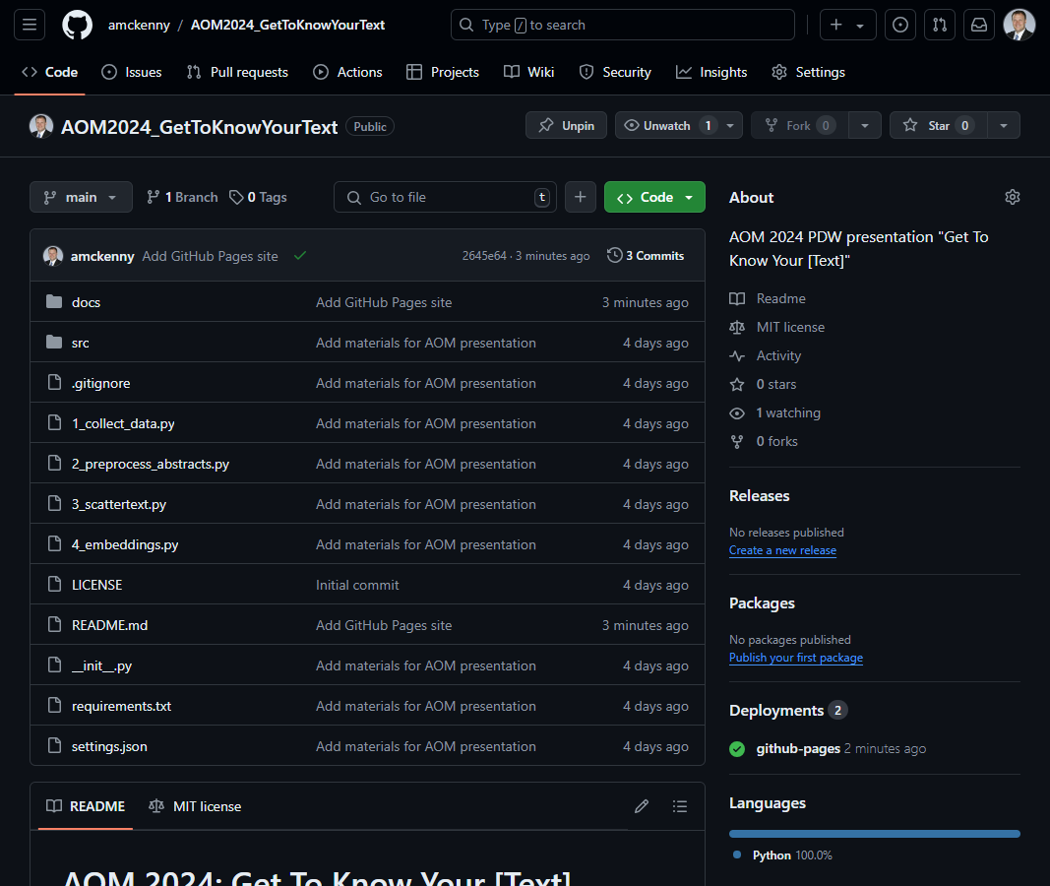
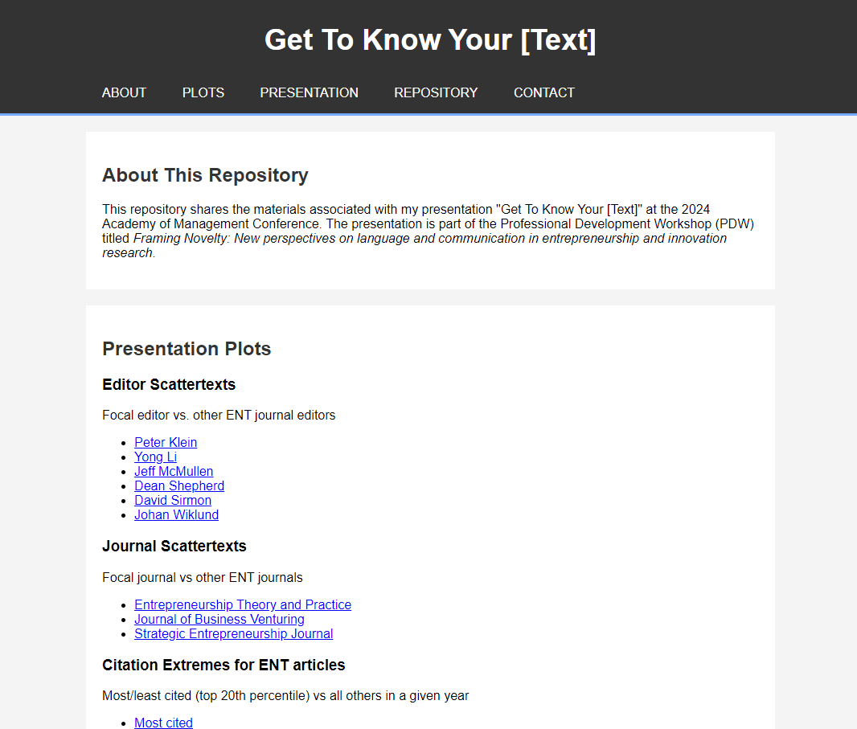
Resources
Main Repository
https://github.com/amckenny/AOM2024_GetToKnowYourText
GitHub Pages
https://amckenny.github.io/
AOM2024_GetToKnowYourText

Slide 32
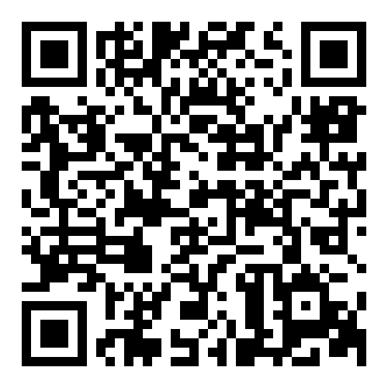
Thank You!
https://github.com/amckenny/AOM2024_GetToKnowYourText

Slide 33

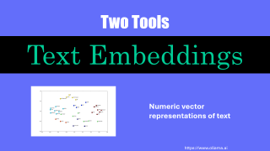
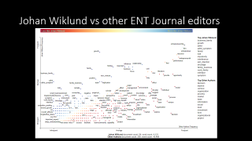
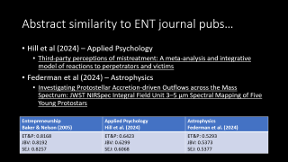
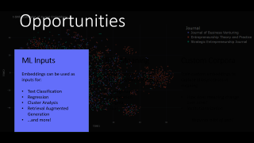
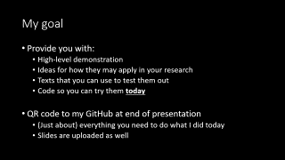
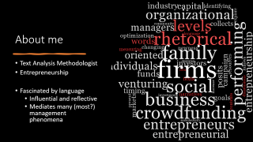
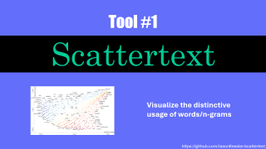
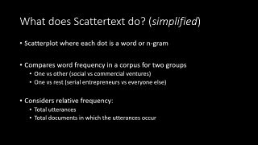
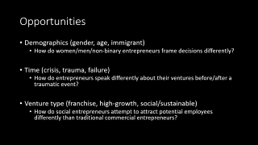
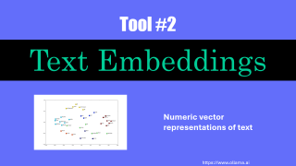
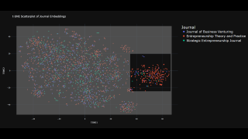
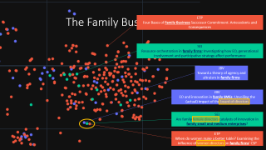
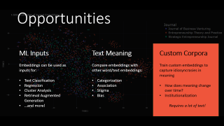
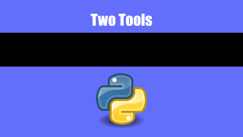
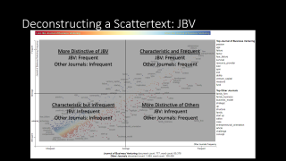
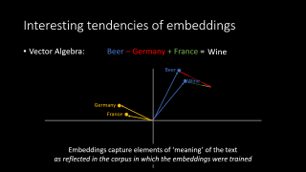
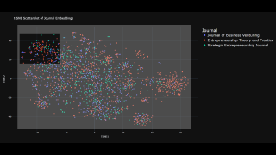
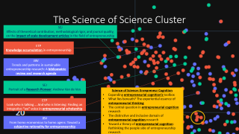
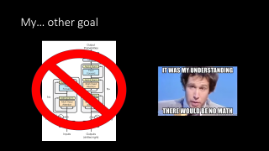
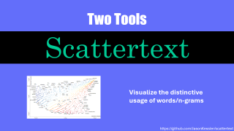
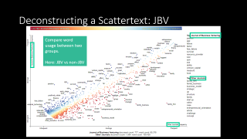
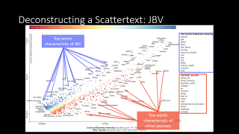
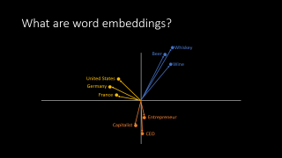
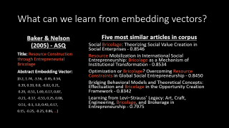
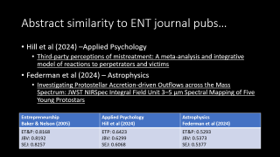
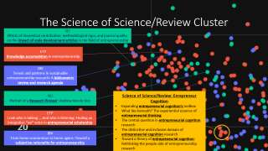
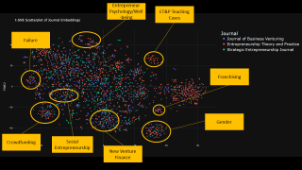
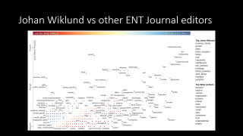

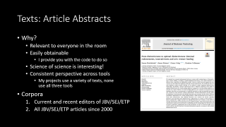
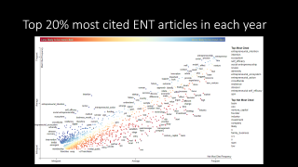
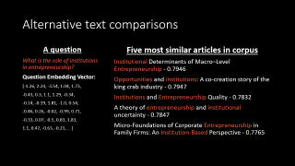
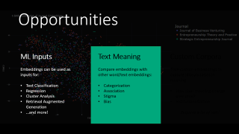
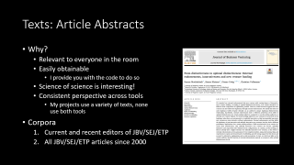
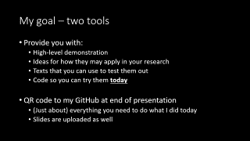
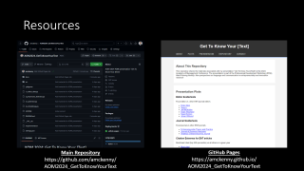

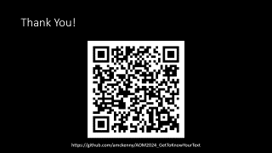
Thank You!
https://github.com/amckenny/AOM2024_GetToKnowYourText

Slide 34
Thank You!
https://github.com/amckenny/AOM2024_GetToKnowYourText

Slide 35
Thank You!
https://github.com/amckenny/AOM2024_GetToKnowYourText

Slide 36
Thank You!
https://github.com/amckenny/AOM2024_GetToKnowYourText

Slide 37
Thank You!
https://github.com/amckenny/AOM2024_GetToKnowYourText

Slide 38
Thank You!
https://github.com/amckenny/AOM2024_GetToKnowYourText

Slide 39
Thank You!
https://github.com/amckenny/AOM2024_GetToKnowYourText

Slide 40
Thank You!
https://github.com/amckenny/AOM2024_GetToKnowYourText

Slide 41
Thank You!
https://github.com/amckenny/AOM2024_GetToKnowYourText

Slide 42
Thank You!
https://github.com/amckenny/AOM2024_GetToKnowYourText

Slide 43
Thank You!
https://github.com/amckenny/AOM2024_GetToKnowYourText

