Slide 1
DTU SCIQIS COURSE PROJECT
QAOA Routing
From a weighted graph to QUBO, Ising, QAOA, and decoded routes
Ideal statevector simulation · teaching-scale instance · no quantum-advantage claim
Notes:
We show the complete scientific chain for one transparent routing instance. The aim is to understand the encoding and probability dynamics, not to outperform classical shortest-path algorithms.

Slide 2
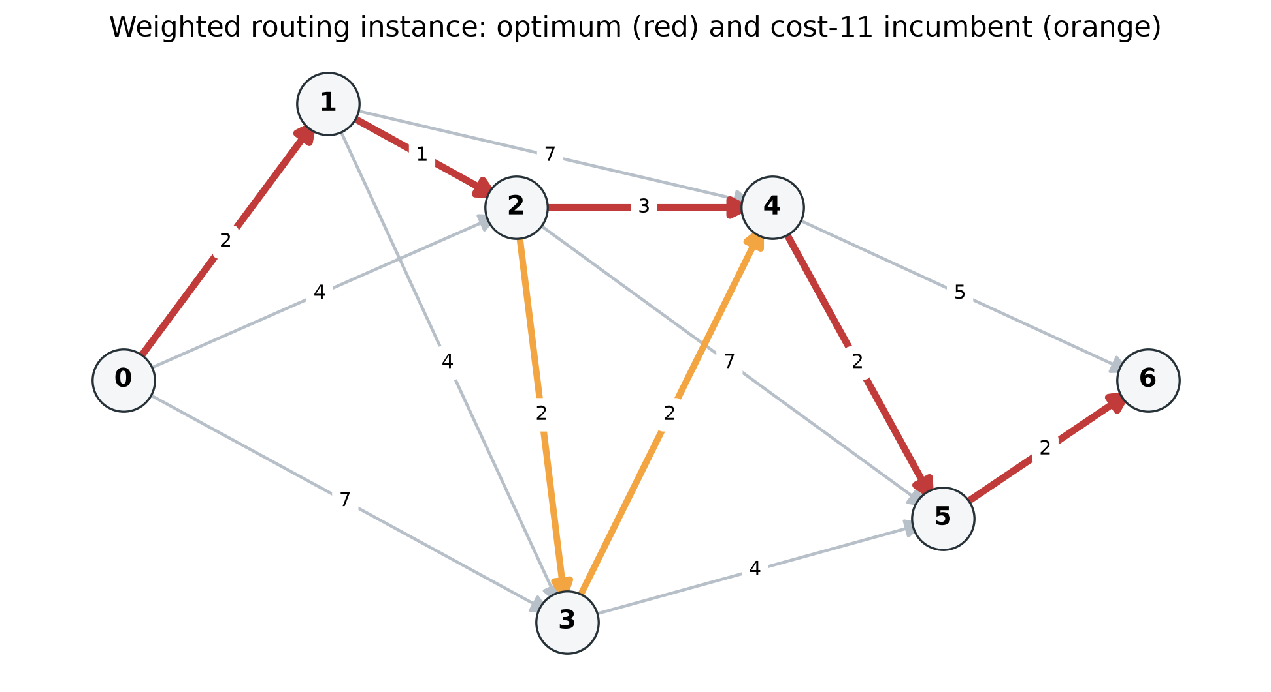
GRAPH AND EXACT REFERENCE
The routing problem
• 7 nodes and 14 directed weighted edges
• Source 0, target 6; one binary variable per edge
• Unique optimum: 0 → 1 → 2 → 4 → 5 → 6
• Exact route cost: 10
2
Notes:
The graph is fixed in data/graph.json. NetworkX shortest path and exhaustive simple-route enumeration agree on the same unique cost-10 route.

Slide 3
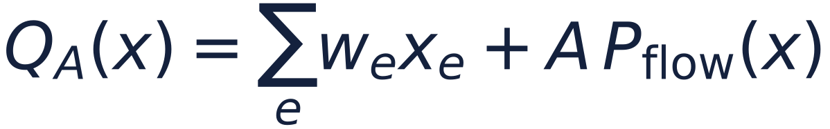
CONSTRAINED BINARY OPTIMIZATION
Edge variables become a routing QUBO
• x_e = 1 means that directed edge e is selected
• Routing cost is the weighted sum of selected edges
• Squared flow residuals enforce source, conservation, and target constraints
• The frozen penalty coefficient is A = 6
3
Notes:
The objective says which route is cheap, while the flow penalty says whether the selected edges form a valid source-to-target route.

Slide 4
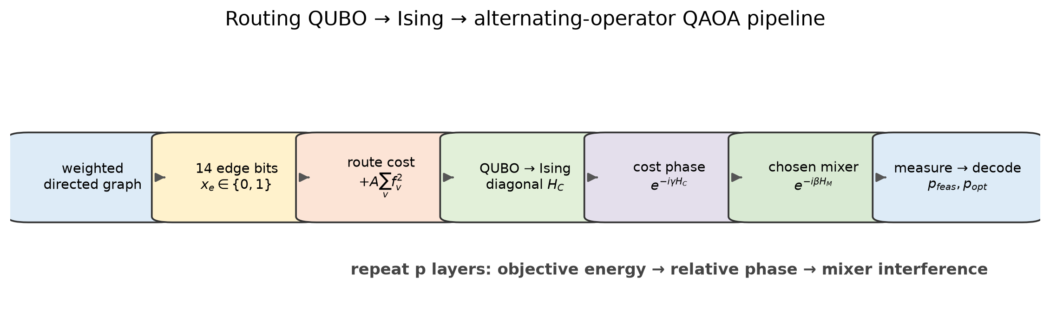
QUANTUM MODEL
QUBO → Ising → QAOA
• Substitute x_j = (I − Z_j) / 2
• The diagonal cost Hamiltonian contains I, Z, and ZZ terms
• A cost phase changes phases; the mixer converts phase differences into probability changes
• All 16,384 QUBO and Ising basis energies agree exactly
4
Notes:
The cost layer alone does not change measurement probabilities. Interference appears after the mixer, so the mixer geometry is scientifically important.

Slide 5
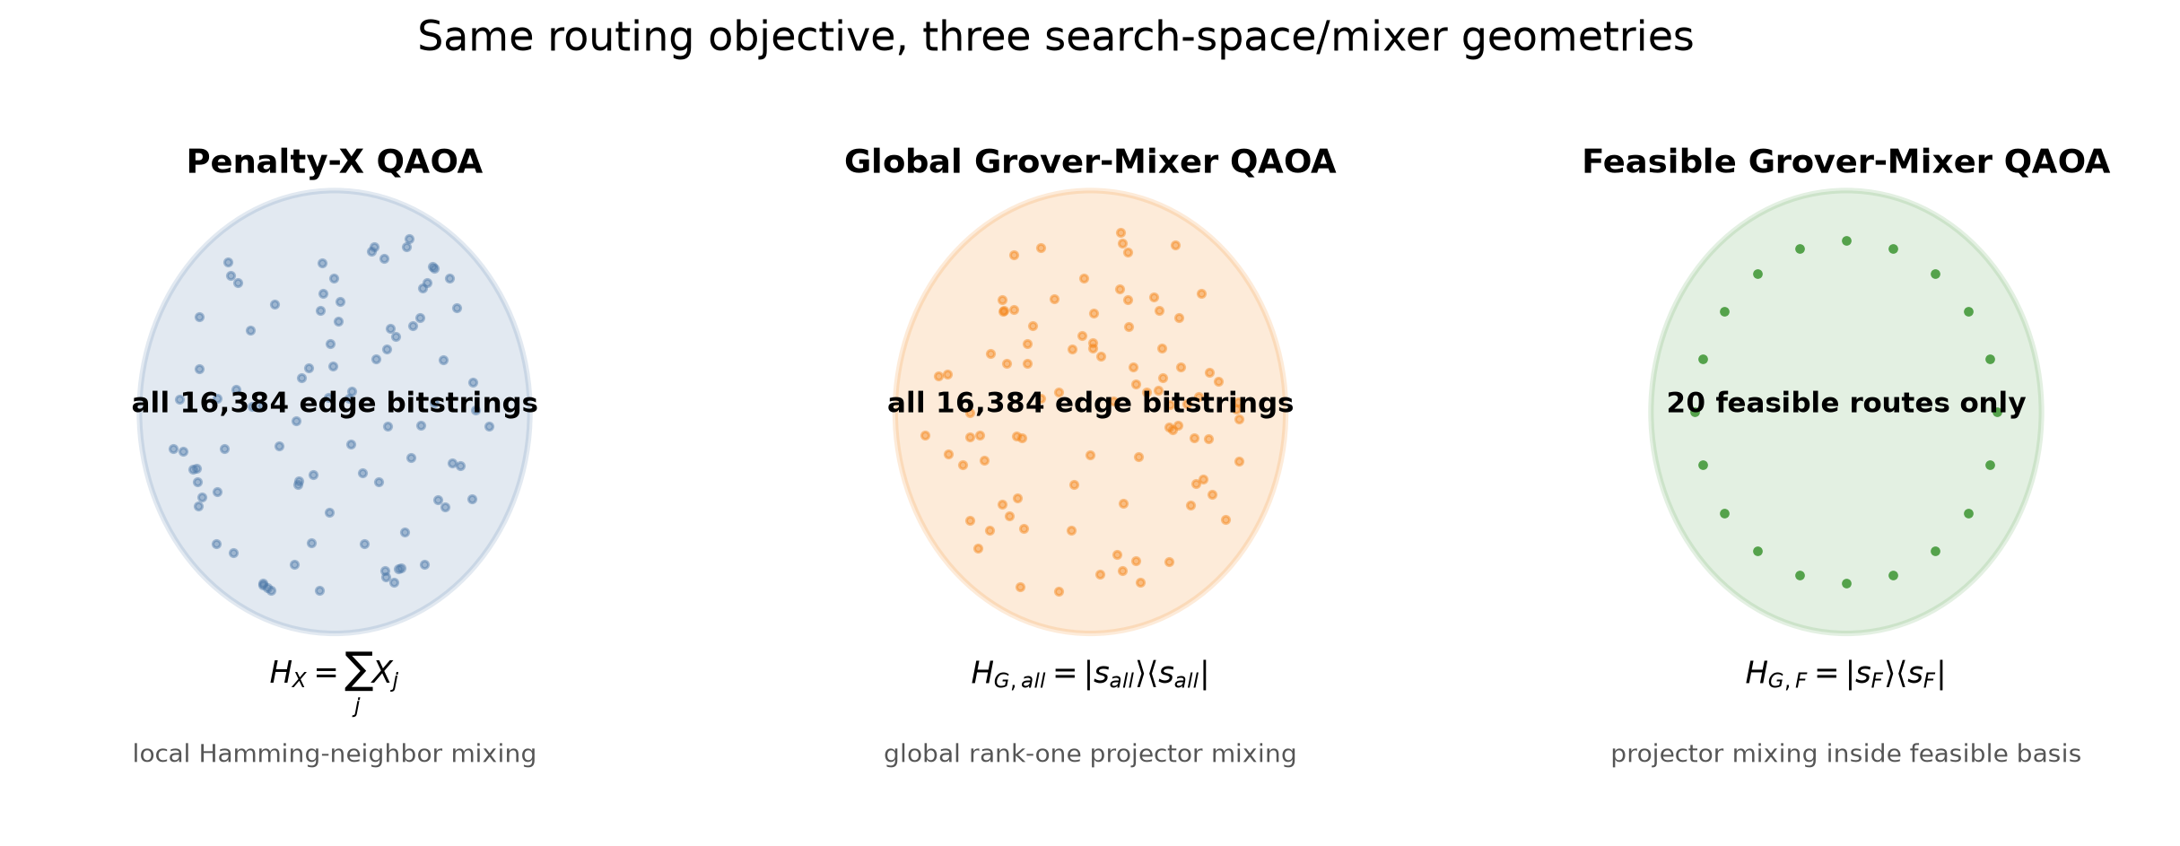
REPRESENTATION MATTERS
Two search spaces, three mixers
• Penalty-X: 2^14 = 16,384 edge bitstrings
• Global-Grover: the same full bitstring space
• Feasible-Grover: only 20 enumerated valid routes
• Global-Grover and Feasible-Grover are QAOA mixers, not standard Grover search
5
Notes:
Restricting the logical basis to valid routes structurally removes infeasible probability mass, but it does not by itself guarantee concentration on the optimum.

Slide 6
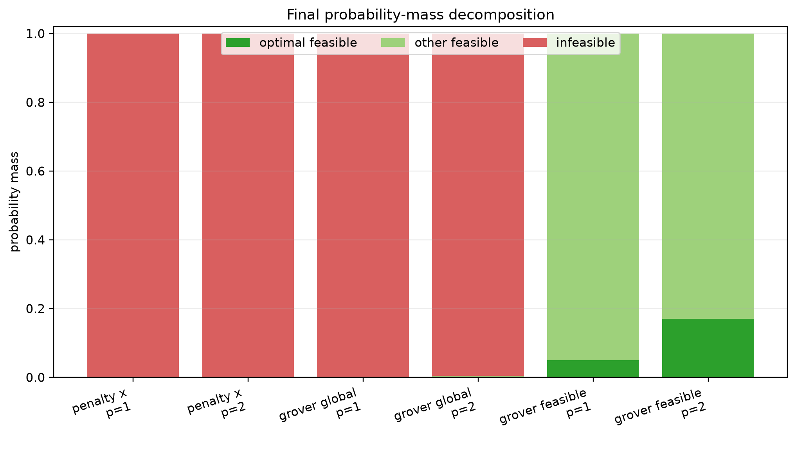
SHALLOW QAOA DYNAMICS
What happens to probability mass?
• Full-space initial p_feas = 20 / 16,384 ≈ 0.00122
• At p=2, Global-Grover reaches p_opt ≈ 0.000213
• At p=2, Feasible-Grover keeps p_feas = 1 and reaches p_opt ≈ 0.170927
• Feasible restriction solves validity; phase and mixer still determine optimality
6
Notes:
The full-space methods leave most probability on infeasible bitstrings. The feasible basis removes that mass by construction and lets us study concentration among valid routes.

Slide 7
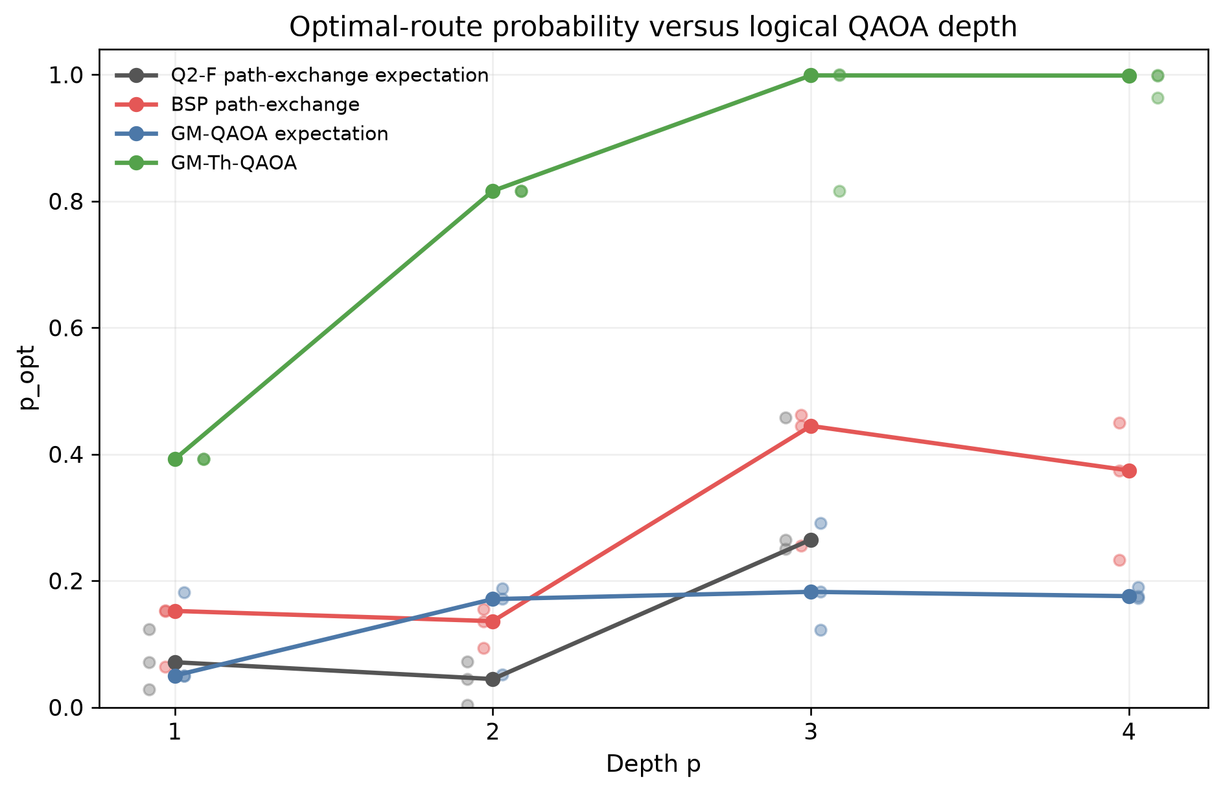
THREE SEEDS · MEDIAN p_opt
Final course method comparison
• Q2-F Expectation, p=3: 0.264901
• BSP / path exchange, p=3: 0.444656
• GM-QAOA Expectation, p=3: 0.182410
• GM-Th-QAOA, p=3: 0.998712
• All four methods use the 20-route feasible basis, so p_feas ≈ 1
7
Notes:
The table uses the saved three-seed median. Evaluation caps differ between the historical Q2-F baseline and the final matrix, so this is a course-result summary rather than a strict equal-budget leaderboard.

Slide 8
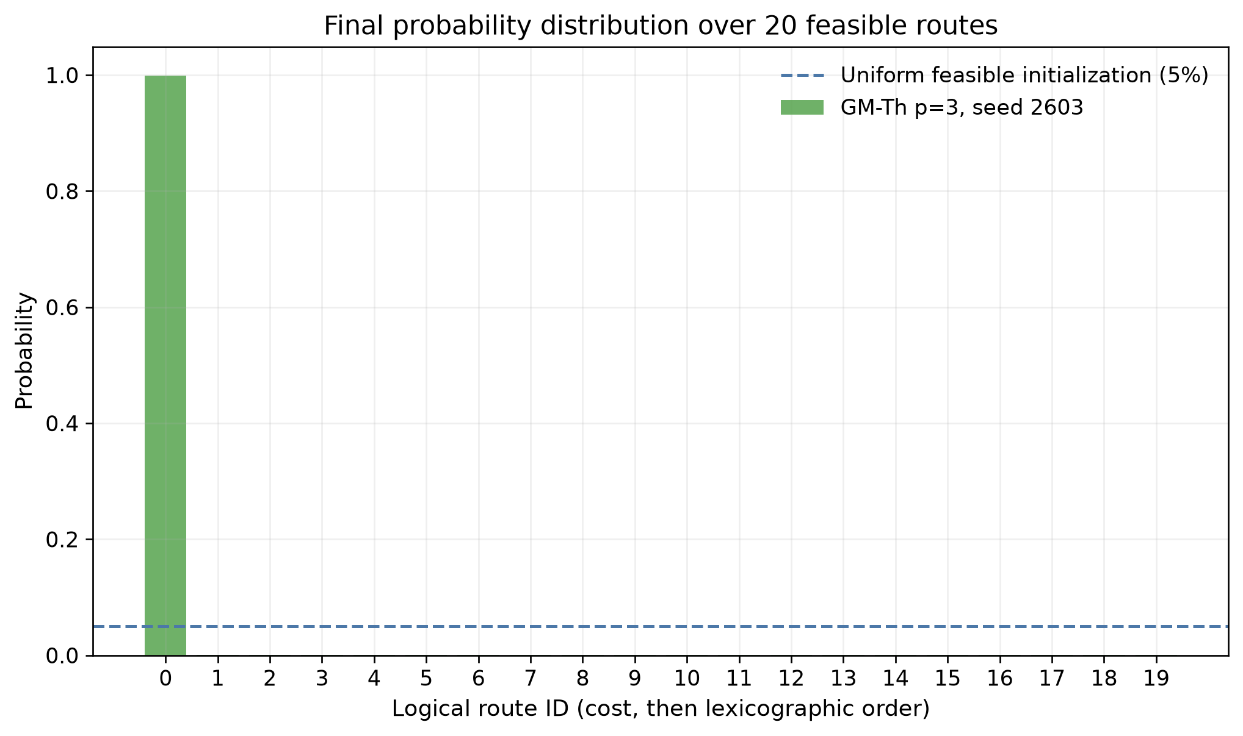
GM-Th-QAOA · DEPTH 3
The final distribution is concentrated on the optimum
• Median p_opt = 0.998712
• Seed range: 0.816034–0.999804
• Median expected route cost = 10.002983
• The highlighted state is the unique cost-10 route
8
Notes:
This is an ideal statevector probability distribution, not finite-shot frequency. The optimum label is used for evaluation and presentation, not supplied directly to COBYLA.

Slide 9
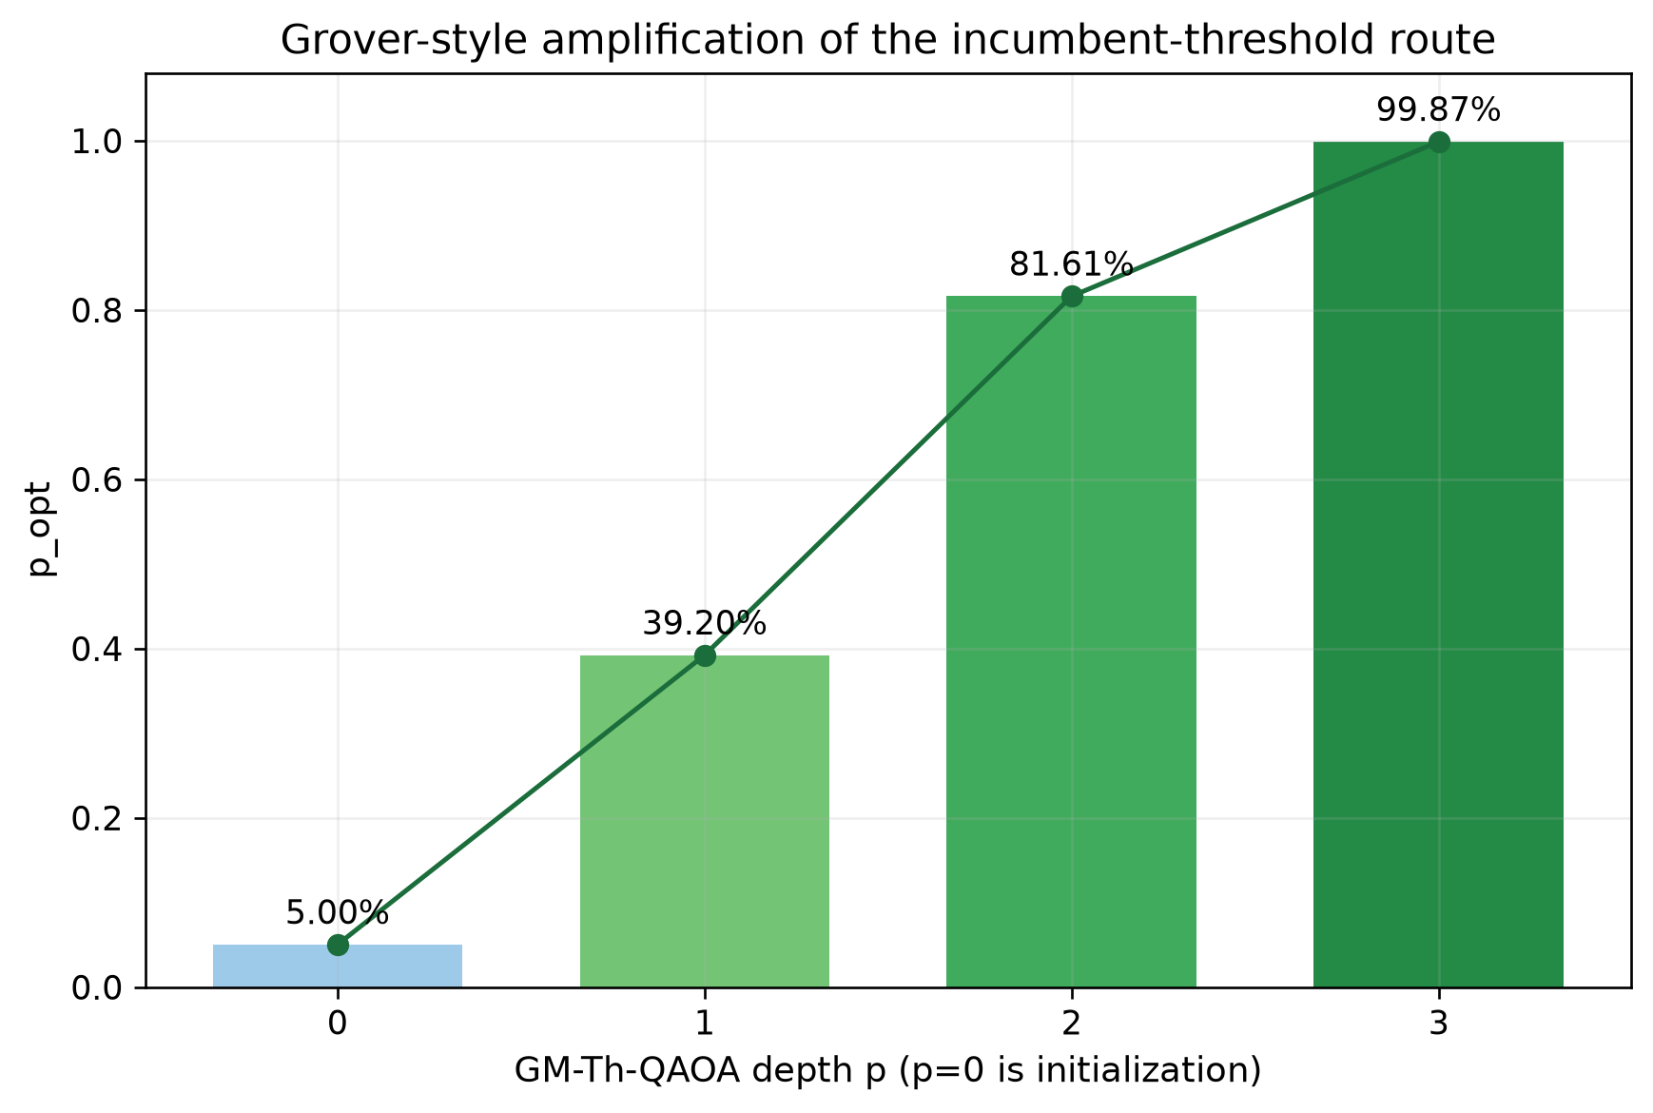
FEASIBLE BASIS + THRESHOLD PHASE + MIXER
Why GM-Th works on this instance
• The logical basis contains only valid routes: p_feas = 1
• A deterministic greedy incumbent has cost 11
• The threshold marks routes with cost < 11
• On this graph, that marked set contains exactly the unique optimum
• The feasible Grover mixer amplifies the marked probability
9
Notes:
The near-unit success probability depends on instance-specific threshold information. This is a clear mechanism demonstration, not a scalable quantum-routing or quantum-advantage result.

Slide 10
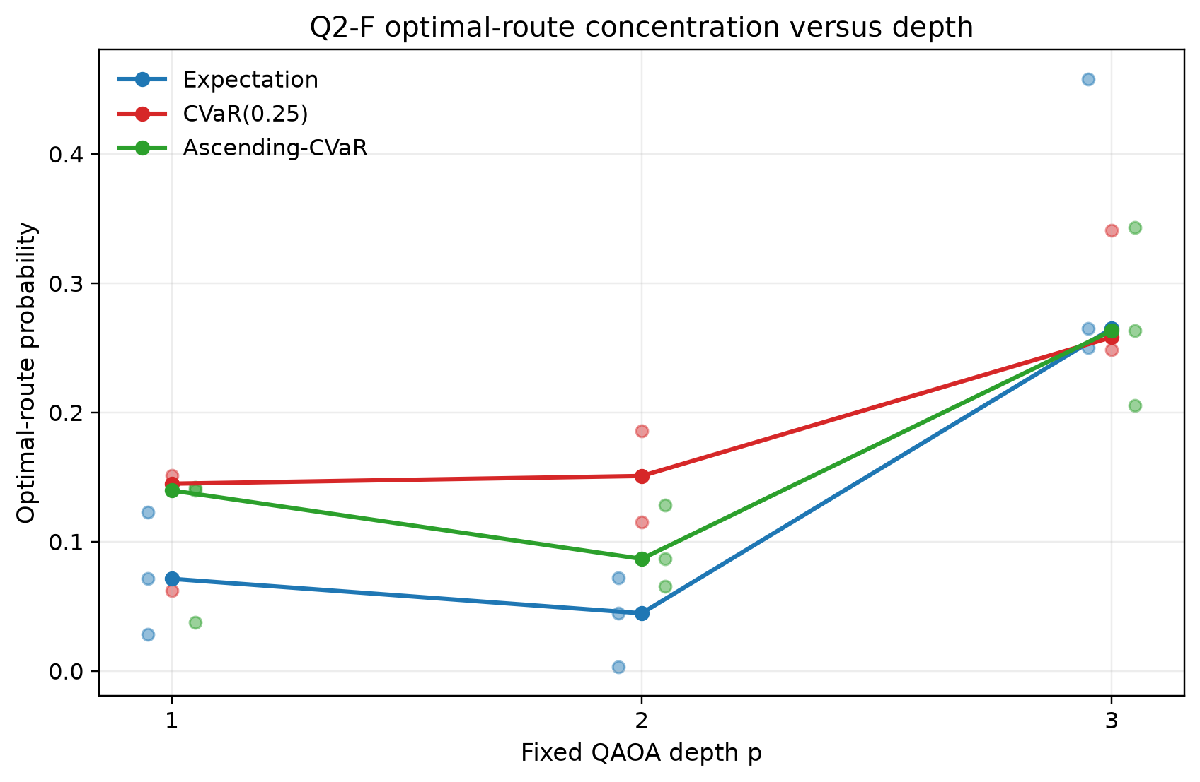
EXPECTATION · CVaR · ASCENDING CVaR
CVaR course extension: a useful negative result
• CVaR changes the classical objective, not the mixer
• At depth 3: Expectation 0.264901, CVaR 0.258176, Ascending CVaR 0.263190
• CVaR did not provide a clear improvement in this course experiment
• The fractional cutoff implementation remains tested and available
10
Notes:
Some shallow cells improve, but the saved three-seed depth-three comparison does not show stable superiority over expectation. We report this as a legitimate negative result.

Slide 11
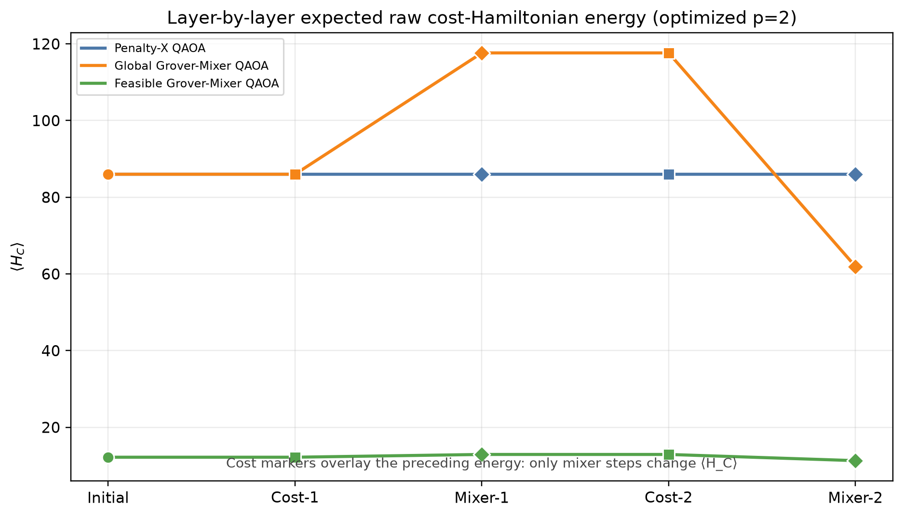
REPRODUCIBLE COURSE DEMO
Run it and watch it
• python -m src.main
• python scripts/run_course_final.py --seed 2601 --depth 1
• python scripts/run_qaoa_visualizer.py
• python scripts/run_qaoa_dynamics_visualizer.py
• Both browser demos replay saved data and do not rerun historical experiments
11
Notes:
The circuit replay focuses on the final feasible methods. The dynamics dashboard compares Penalty-X, Global-Grover, and Feasible-Grover layer by layer.

Slide 12
COURSE TAKEAWAYS AND LIMITATIONS
What we learned
• Graph → QUBO → Ising → QAOA → decoded routes works end to end
• Full-space QAOA can waste most probability on infeasible bitstrings
• Feasibility preservation does not automatically imply optimal-state concentration
• Mixer and phase/objective design strongly change the final distribution
• One fixed graph, ideal simulation, enumerated feasible basis, finite optimizer budgets
• No hardware, scalability, or quantum-advantage claim
12
Notes:
The main scientific message is the separation of validity from optimality. Representation controls where amplitude is allowed; the phase and mixer control where probability concentrates inside that representation.

Slide 13
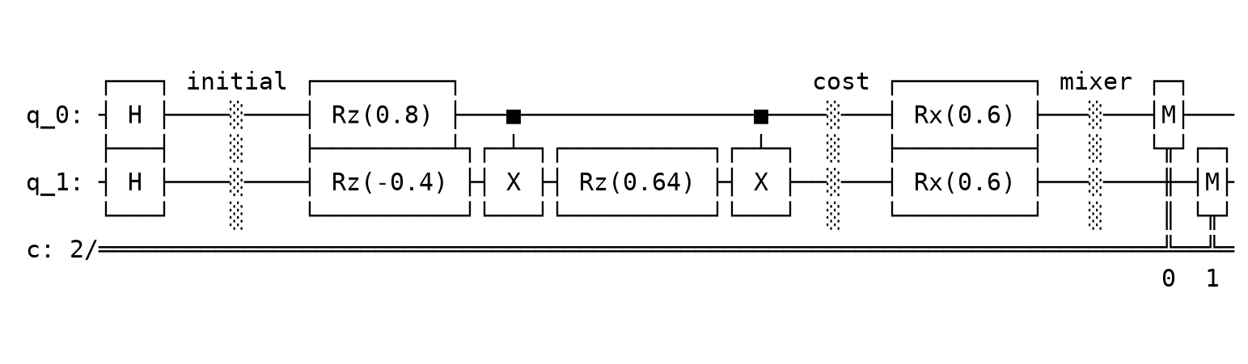
COURSE IMPLEMENTATION DETAIL
Backup: a two-qubit Ising gate example
• Local Z terms become RZ rotations
• A ZZ coupling becomes CX–RZ–CX
• The X mixer becomes RX rotations
• This is a small teaching decomposition, not the full 14-qubit compiled circuit
13
Notes:
This optional Qiskit example connects the Ising formula to familiar gates without claiming that the logical feasible-space operators have a shallow hardware decomposition.

