Slide 1
LIME Local interpretable model-agnostic explanations The Neighbourhood
Summer term 2019
Department of Statistics
Ludwig Maximilian University Munich
Speaker: Philipp Kopper
Supervisor: Christoph Molnar
Seminar:
Interpretable Machine Learning

Slide 2

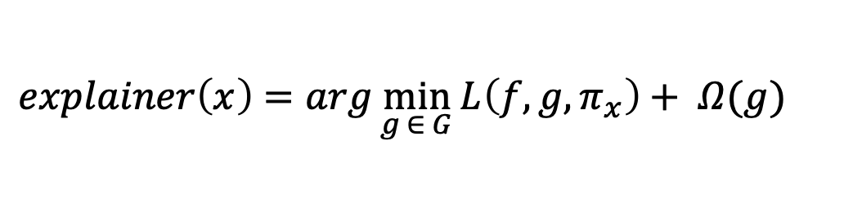

Model Math [RECAP]: The proximity is arbitrary.
x: data point desired to interpret
G: set of interpretable models
$L$: loss function
f: predictive model
$π_{x}$: proximity measure
$Ω$: complexity measure
$$explainer\left(x\right)={arg\min_{g ∈ G}{L\left(f, g, π_{x}\right)+ Ω(g)} }_{}$$
Which kernel?
Which width?
$$π_{x}\left(z\right)=kern(D\left(x, z\right), σ)$$
Which distance?

Slide 3
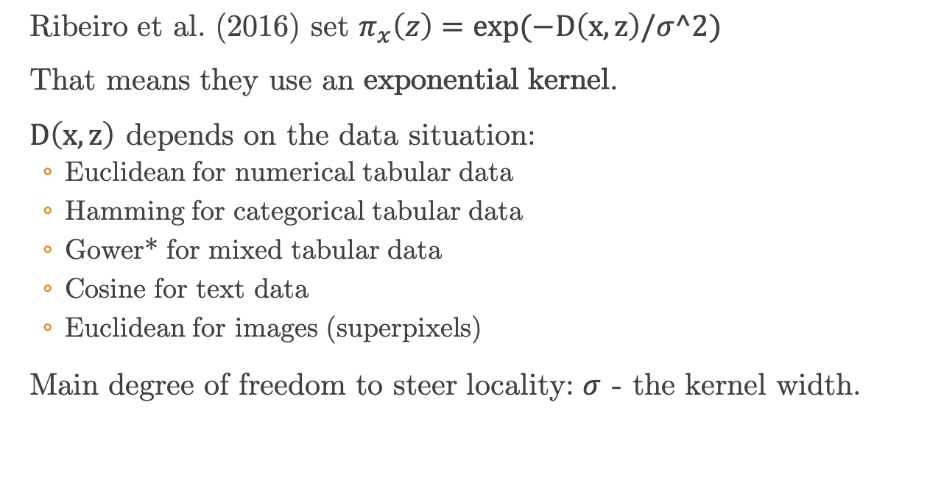
The Proximity measure: The kernel width as main hyperparameter
Ribeiro et al. (2016) set $π_{x}\left(z\right)=exp(−D\left(x, z\right)/σ^2)$
That means they use an exponential kernel.
$D\left(x, z\right)$ depends on the data situation:
Euclidean for numerical tabular data
Hamming for categorical tabular data
Gower* for mixed tabular data
Cosine for text data
Euclidean for images (superpixels)
Main degree of freedom to steer locality: $σ$ - the kernel width.

Slide 4
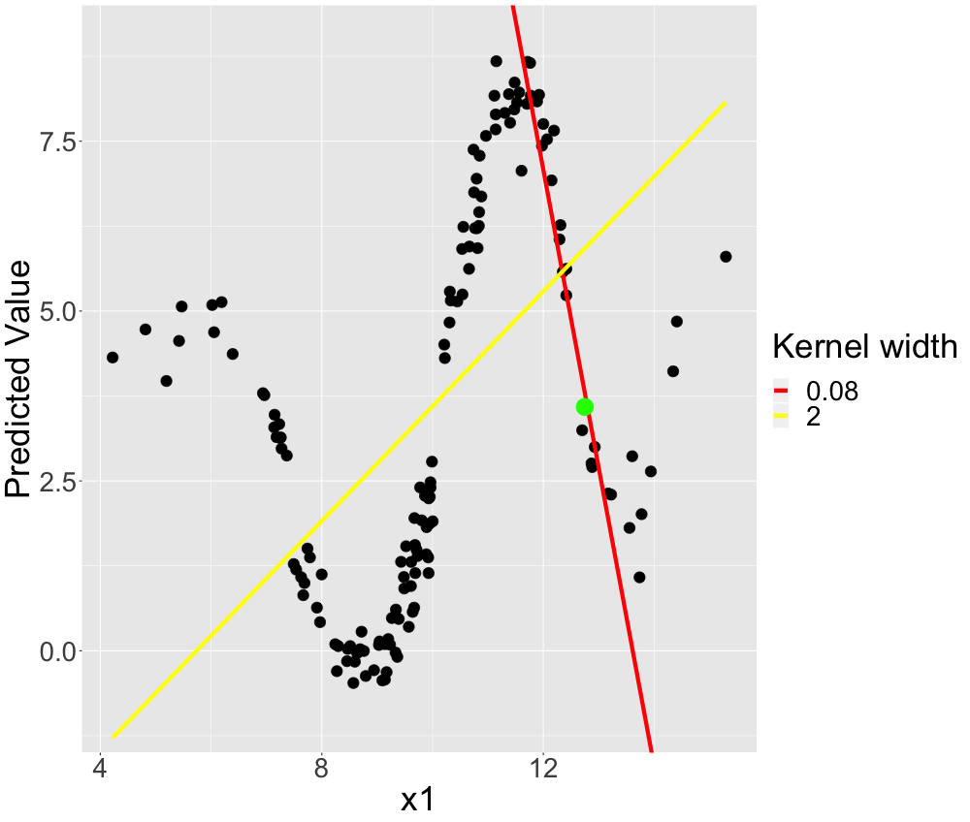
Size really matters.

Slide 5
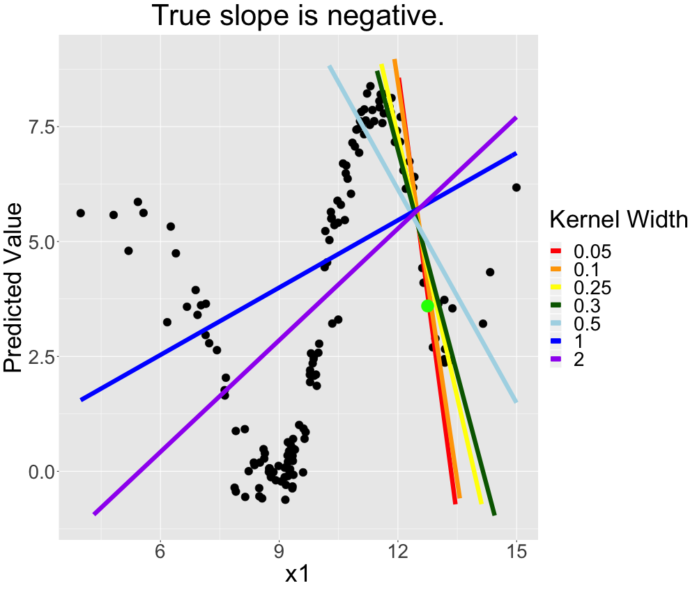
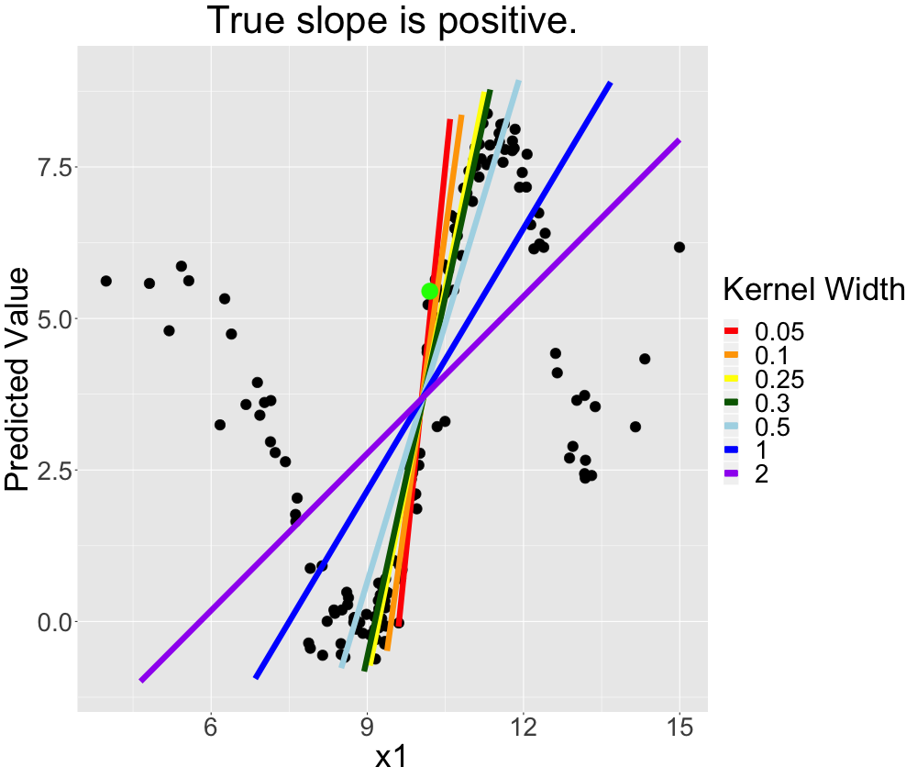
Size really matters.

Slide 6
Simulations

Slide 7
LIME explanations revised: Either unstable or too global
Alvarez-Melis and Jaakkola (2018):
Instable explanations
Explaining the same observations over and over again may yield very different interpretations.
Kernel width too small?
Laugel et al. (2018):
Global explanations
Explanations tend to be biased towards global surrogate models.
Kernel width too large?

Slide 8
Experimental Strategy
We are interested in LIME explanations for different kernel width.
Hence, we compute them over a grid of kernel widths.
To reduce the explanations variance we always use an aggregation of the explanations (e.g. average slope of coefficients plus variance).
Kernel width = 0.5
Iteration | x1 | x2
1 | 2 | 0
2 | 3 | 5
3 | 4 | 1
4 | 2 | 5
5 | 3 | 5
… | … | …
Kernel width | x1 | x2
0.01 | 10.1 | 0.4
0.05 | 4.5 | 5.4
0.1 | 4.4 | 1.9
0.25 | 3.3 | 5.5
0.5 | 2.8 | 3.2
… | … | …

Slide 9
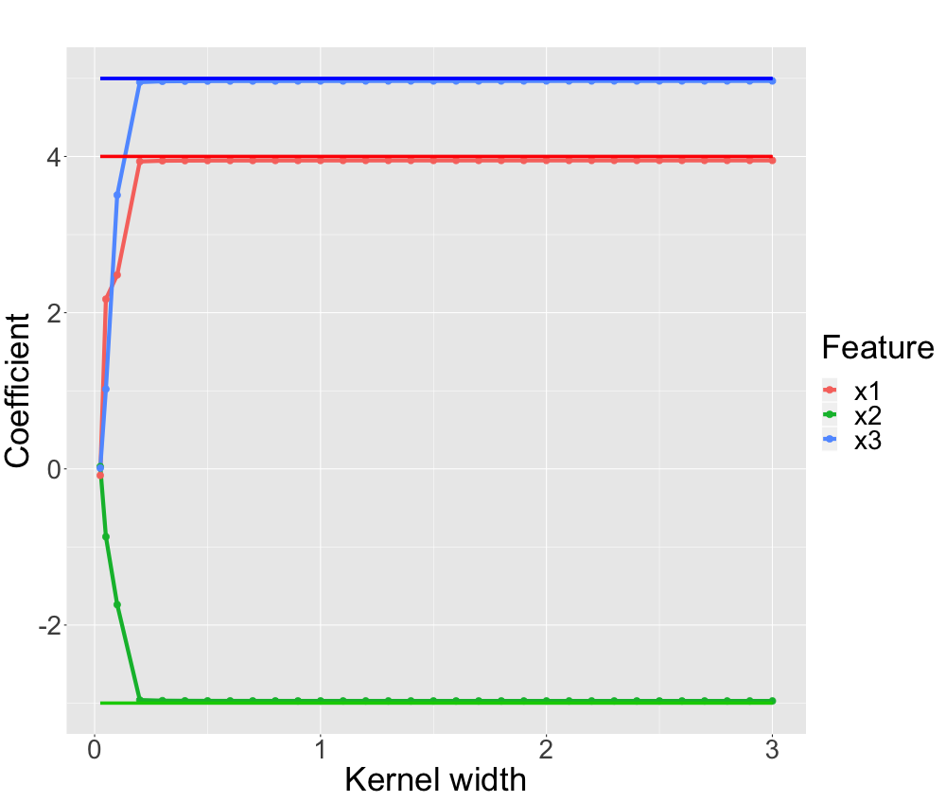
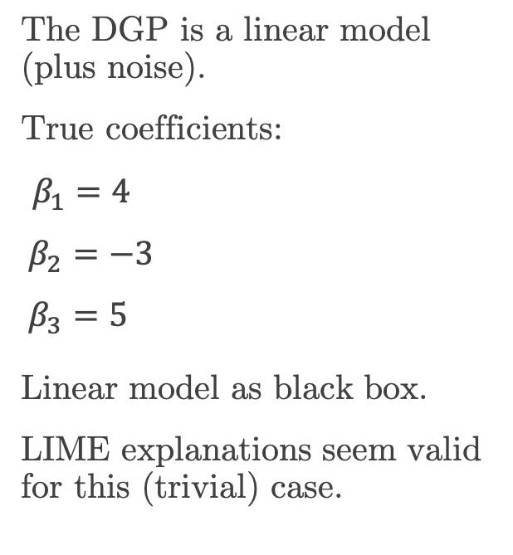
Simulation: LIME manages to recover linear model.
The DGP is a linear model (plus noise).
True coefficients:
$β_{1}=4$
$β_{2}=−3$
$β_{3}=5$ Linear model as black box.
LIME explanations seem valid for this (trivial) case.

Slide 10
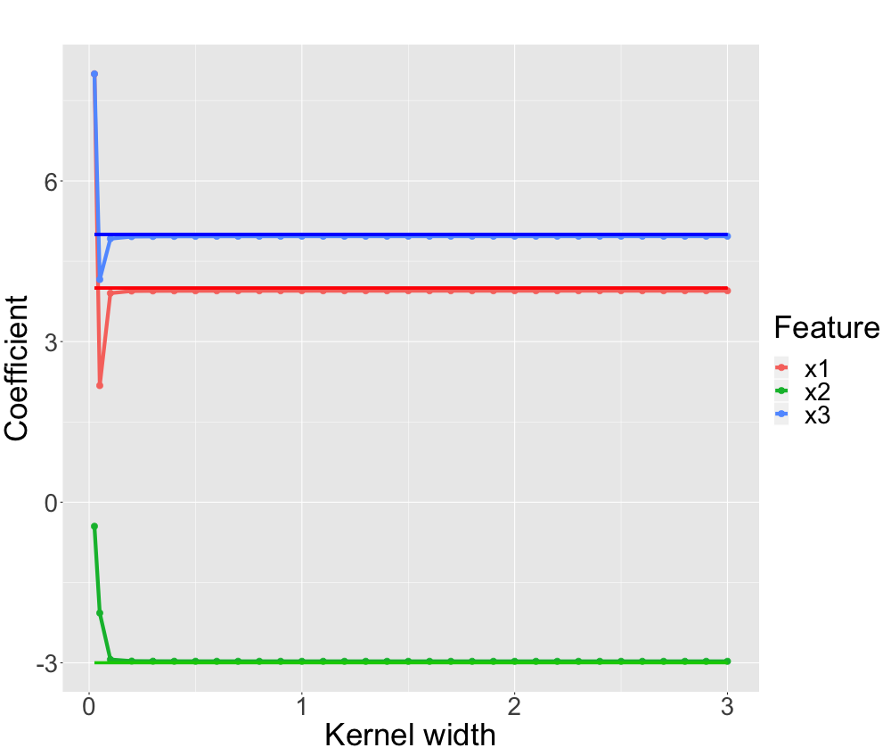
Simulation: LIME manages to recover linear model.
Explanation not good for very small kernels.
This seems to be what Alvarez-Melis and Jaakkola (2018) observe.
For too small kernels, it is likely that solely noise is fit.

Slide 11
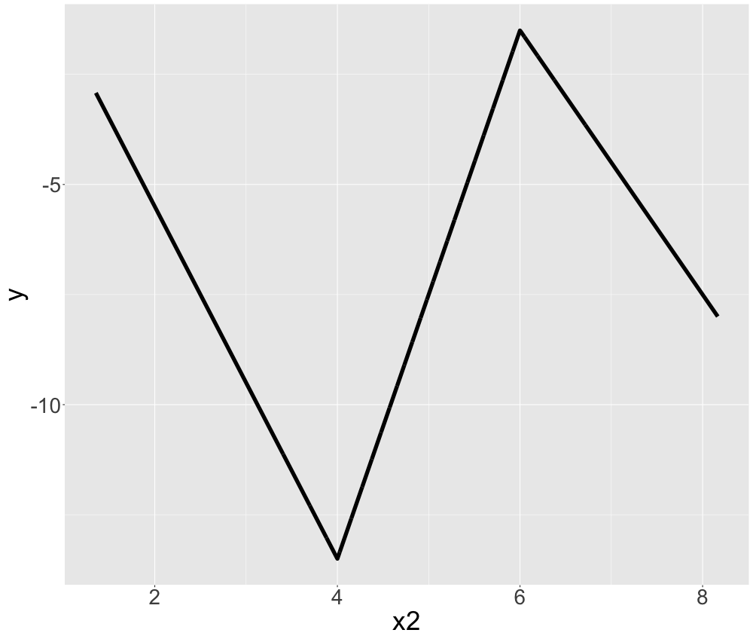
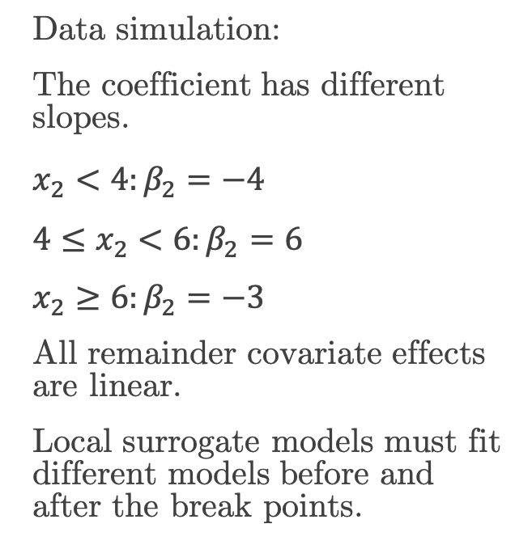
Simulation: LIME manages to recover global non-linear model.
Data simulation:
The coefficient has different slopes.
$x_{2}<4:β_{2}=−4$
$4≤x_{2}<6:β_{2}=6$
$x_{2}≥6:β_{2}=−3$
All remainder covariate effects are linear.
Local surrogate models must fit different models before and after the break points.

Slide 12
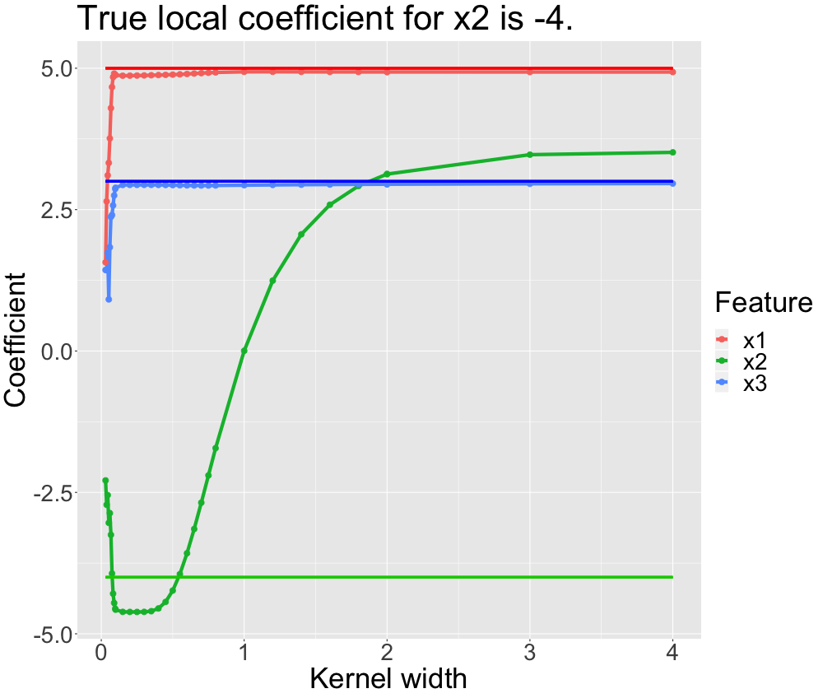
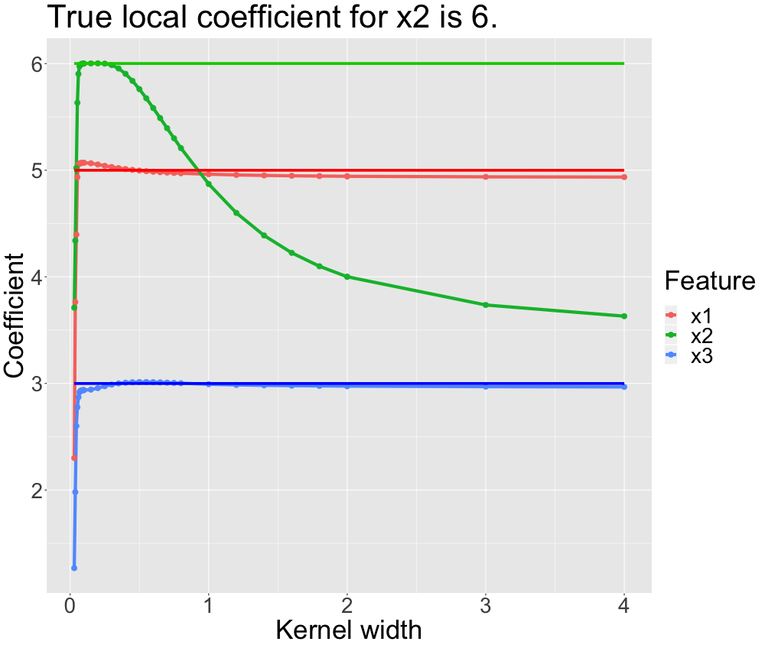
Simulation: LIME manages to recover global non-linear model.

Slide 13
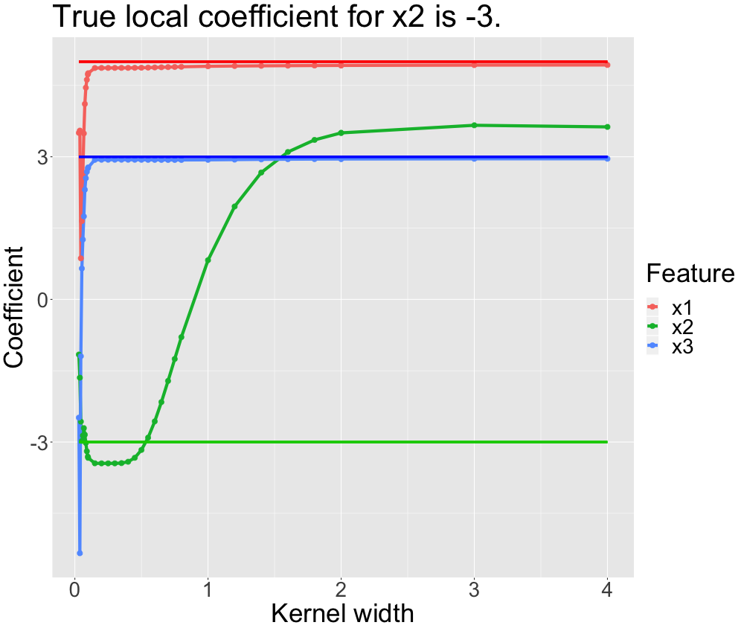
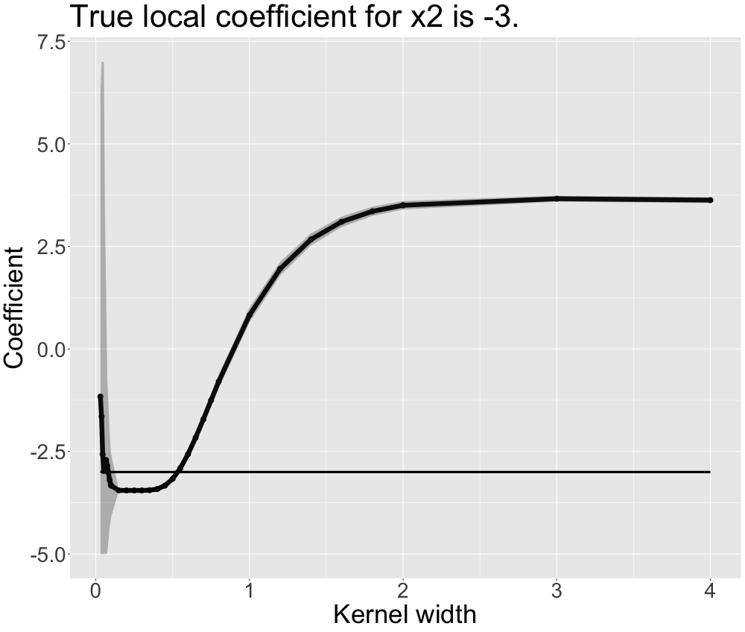
Simulation: LIME manages to recover global non-linear model.

Slide 14
Simulation: LIME manages to recover global non-linear model.
Kernel too small
Good kernel
Kernel too large

Slide 15
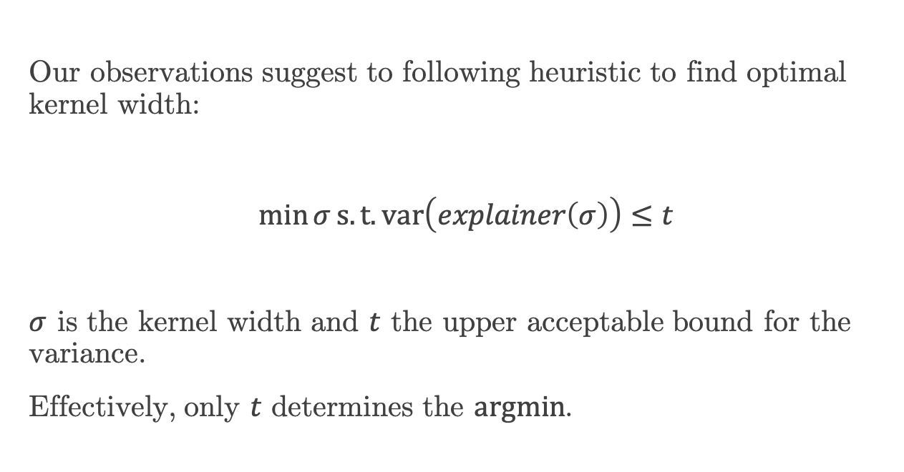
Optimal kernel width via constrained minimisation?
Our observations suggest to following heuristic to find optimal kernel width:
$\min{σ}s.t. var\left(explainer\left(σ\right)\right)≤t$
$σ$ is the kernel width and $t$ the upper acceptable bound for the variance.
Effectively, only $t$ determines the $argmin$.

Slide 16
Real data

Slide 17
The bicycle data set.
Feature | Levels | Mean
holiday | No, Yes
hum |  | 62.79
season | Winter, Spring, Summer, Autumn
temp |  | 20.35
weathersit | Clear, Cloudy, Rainy / Stormy
windspeed |  | 12.76
workingday | No, Yes
count |  | 4054

Slide 18
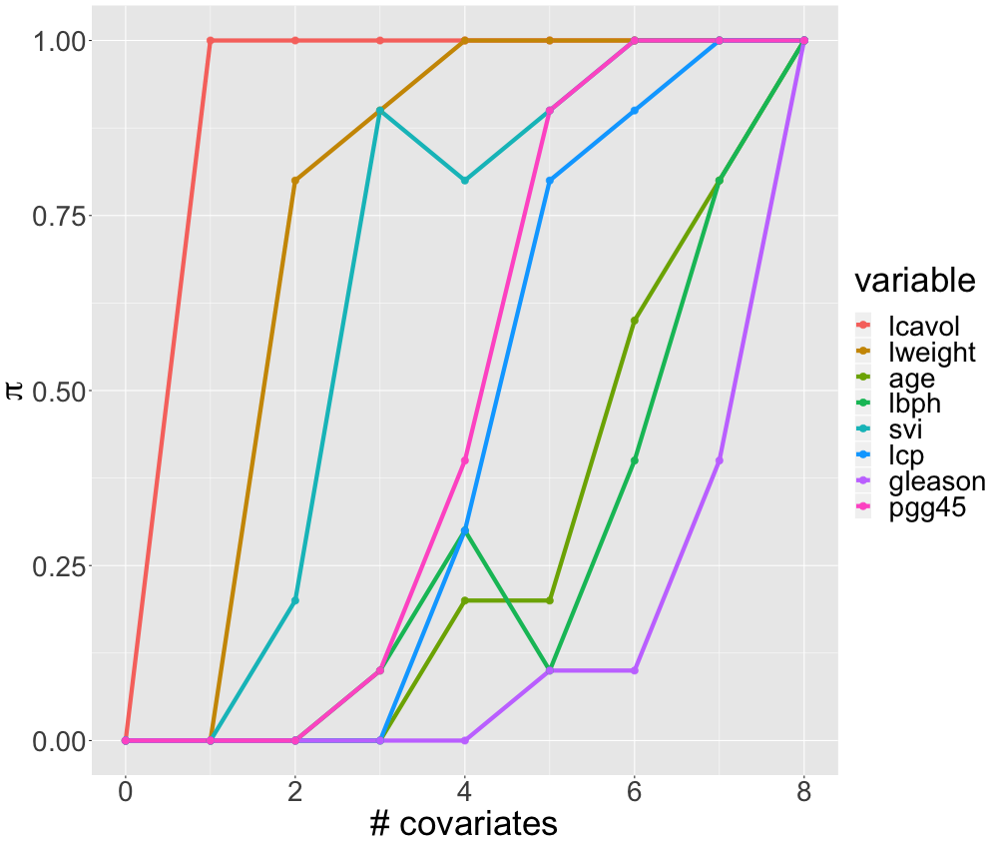
Stability selection and stability paths
Stability selection (Meinshausen and Bühlmann 2010) for analysing explanation stability.
Stability selection assesses the probability of a covariate being included into a sparse model for a given level of regularisation.
Probabilistic because of resampling.
Applicable to LIME when regularisation is replaced by kernel width.
Example for stability paths using prostate data (MASS).

Slide 19
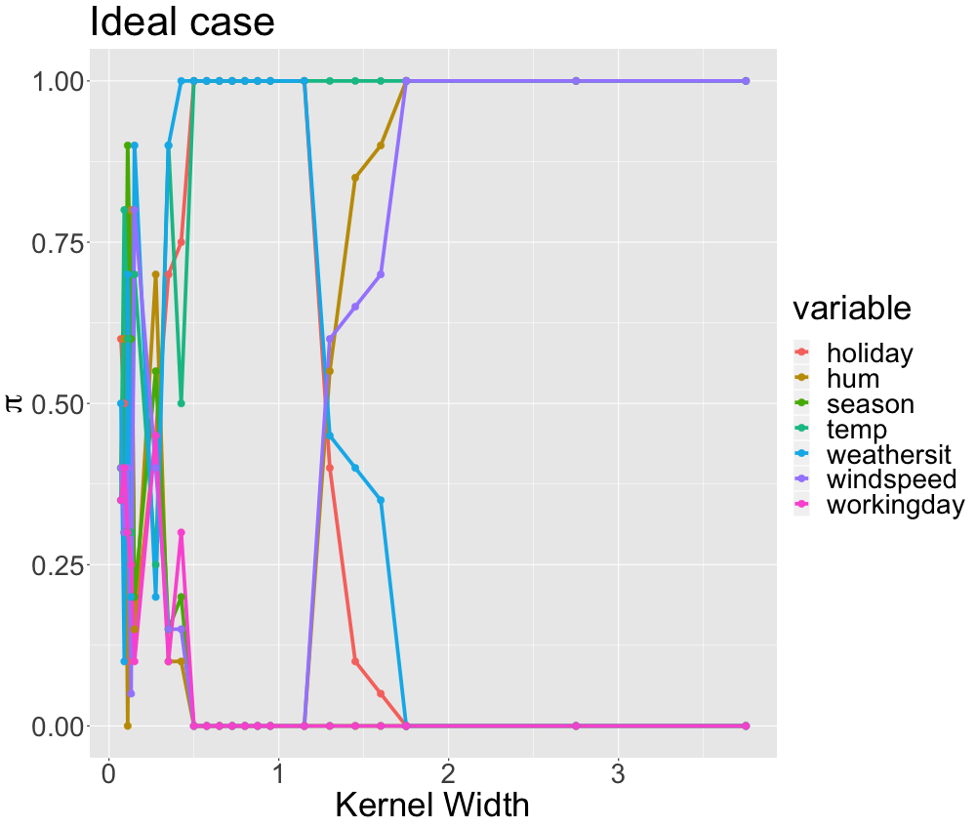
Ideally, we find clear local models.
Local features:
Temperature, weather situation and holiday
Global features:
Temperature, humidity and wind speed
Kernel too small
Good kernel
Kernel too large

Slide 20
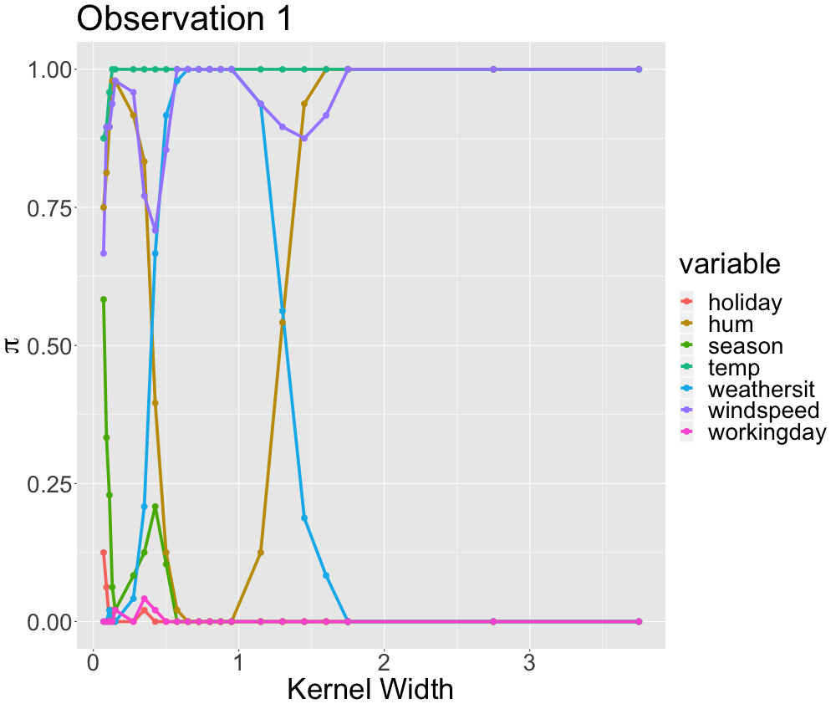
For real data it is hard to find a good kernel width.
Feature | Attribute
holiday | No
hum | 43.7
season | Spring
temp | 28.96
weathersit | Clear
windspeed | 12.5
workingday | Yes
count | 6460
Kernel too small
Good kernel??
Kernel too large

Slide 21
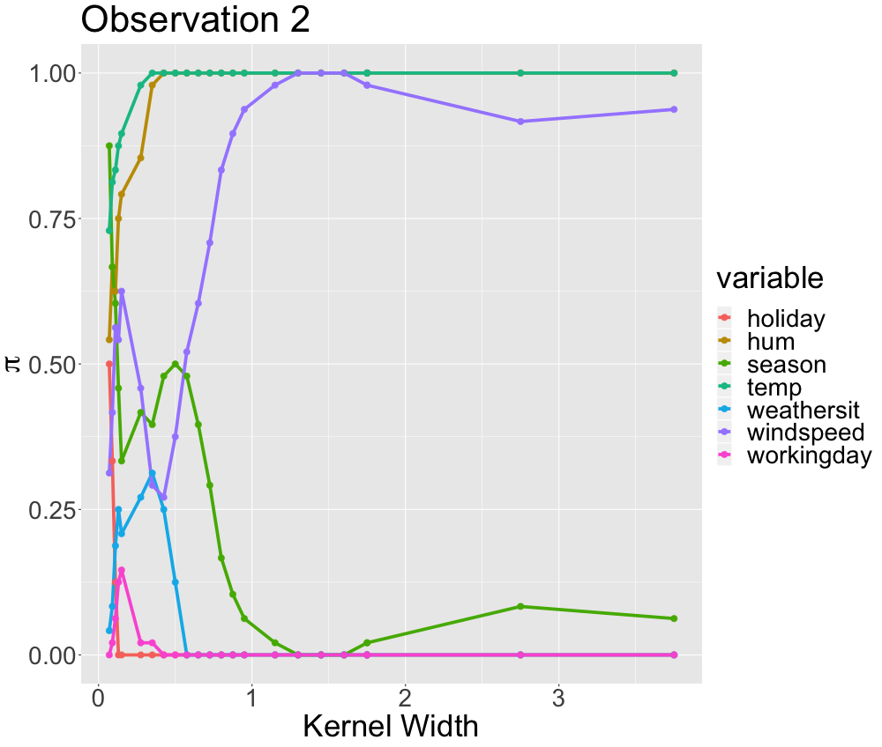
For real data it is hard to find a good kernel width.
Feature | Attribute
holiday | No
hum | 91.1
season | Autumn
temp | 15.6
weathersit | Cloudy
windspeed | 6.8
workingday | No
count | 5582
Kernel too small
Kernel too large

Slide 22
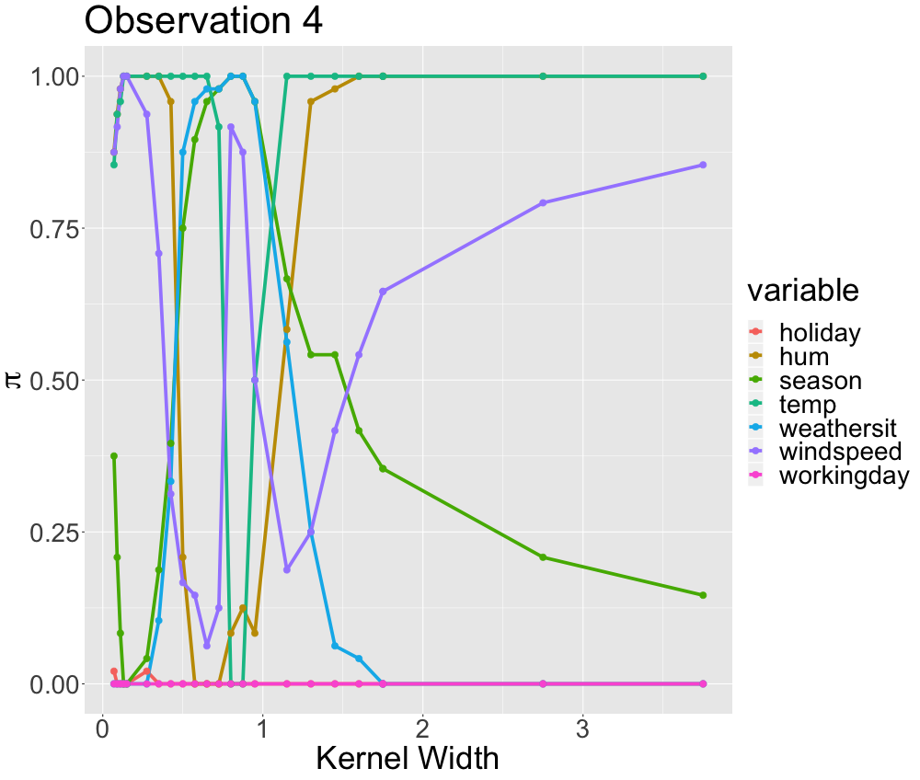
For real data it is hard to find a good kernel width.
Feature | Attribute
holiday | No
hum | 42.3
season | Summer
temp | 30.72
weathersit | Clear
windspeed | 11.5
workingday | Yes
count | 6879
Kernel too small
Good kernel???
Kernel too large

Slide 23
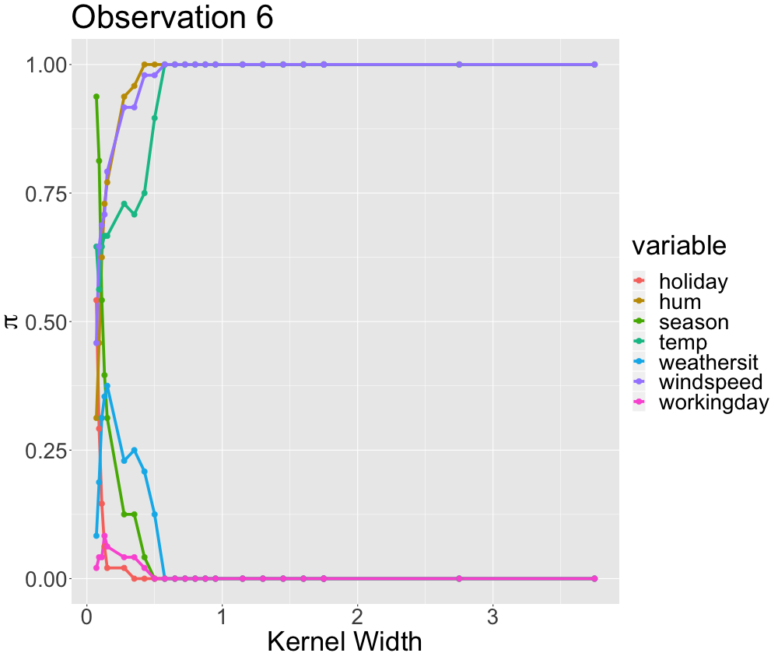
For real data it is hard to find a good kernel width.
Feature | Attribute
holiday | No
hum | 97.25
season | Autumn
temp | 24.98
weathersit | Cloudy
windspeed | 5.25
workingday | Yes
count | 2395
Kernel too small
Kernel too large

Slide 24
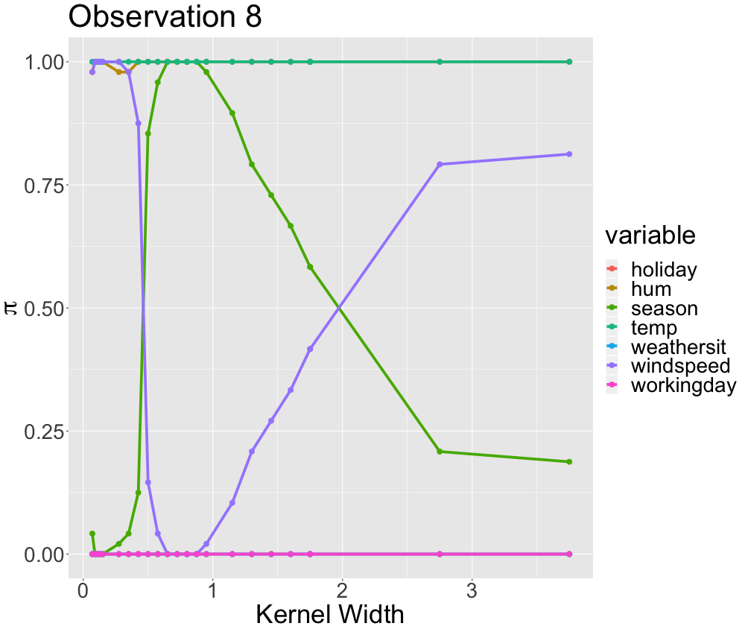
For real data it is hard to find a good kernel width.
Feature | Attribute
holiday | No
hum | 61.83
season | Summer
temp | 22.41
weathersit | Clear
windspeed | 7.92
workingday | Yes
count | 7720
Kernel too small
Good kernel??
Kernel too large

Slide 25
For real (tabular) data LIME struggles.
Observations:
Instability (Alvarez-Melis and Jaakkola 2018) and bias towards a global surrogate (Laugel et al. 2018) are also observed for real data.
Sometimes it is impossible to determine a local model. (Grid not granular enough?)
In cases where we find local models, there is still some doubt.
Many stable & local models look very similar for different observations.
In rare cases there is divergence in the global surrogate for different observations.
LIME does not provide the intended level of interpretability.
Do local explanations necessarily exist?
LIME should be applied with great care!

Slide 26
References
Alvarez-Melis, David, and Tommi S Jaakkola. 2018. “On the Robustness of Interpretability Methods.” arXiv Preprint arXiv:1806.08049.
Craven, Mark, and Jude W Shavlik. 1996. “Extracting Tree-Structured Representations of Trained Networks.” In Advances in Neural Information Processing Systems, 24–30.
Fanaee-T, Hadi, and Joao Gama. 2014. “Event Labeling Combining Ensemble Detectors and Background Knowledge.” Progress in Artificial Intelligence 2 (2-3). Springer: 113–27.
Laugel, Thibault, Xavier Renard, Marie-Jeanne Lesot, Christophe Marsala, and Marcin Detyniecki. 2018. “Defining Locality for Surrogates in Post-Hoc Interpretablity.” arXiv Preprint arXiv:1806.07498.
Meinshausen, Nicolai, and Peter Bühlmann. 2010. “Stability Selection.” Journal of the Royal Statistical Society: Series B (Statistical Methodology) 72 (4). Wiley Online Library: 417–73.
Molnar, Christoph. 2019. Interpretable Machine Learning: A Guide for Making Black Box Models Explainable.
Pedersen, T. & Benetsy, M. (2018). “Package ‘lime’“. Cran R.
Ribeiro, M. T., Singh, S., & Guestrin, C. (2016) “Why should I trust you?: Explaining the predictions of any classifier.“. Proceedings of the 22nd ACM SIGKDD international conference on knowledge discovery and data mining, 1135-1144.

Slide 27
Backup

Slide 28
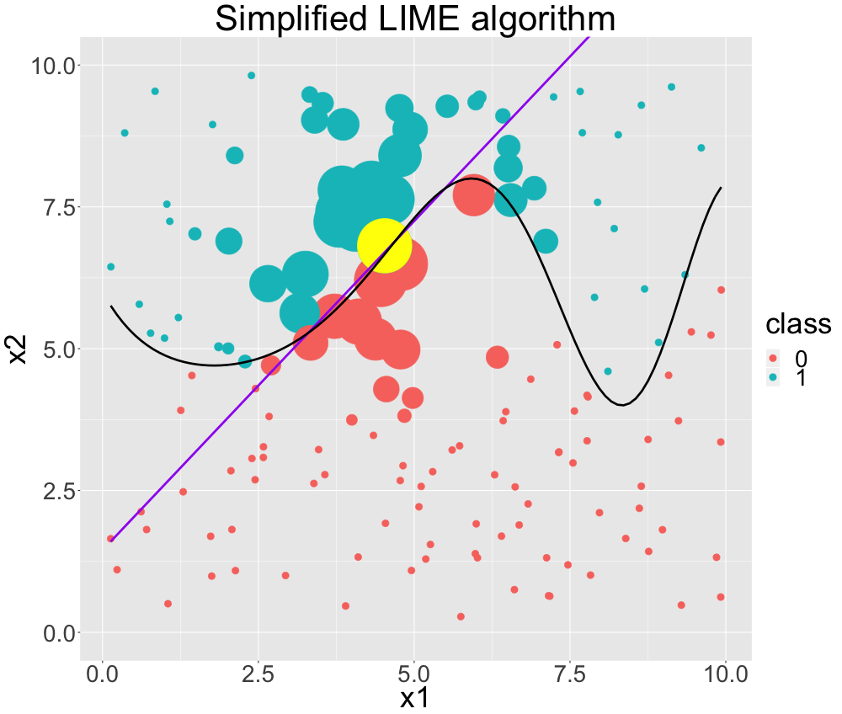
Algorithm for a single LIME explanation
Notes:
Wie funktioniert LIME nochmal?
Wir sehen hier ein Klassifikationsproblem. Die schwarze Linie ist unser Black Box Modell, das in Klassen unterteilt.
LIME nimmt das Black Box Model und predictet pertubierte Daten entspechend der Black Box Funktion.
Wir möchten nun einen Punkt erklären (gelb) mit einem einfacheren Modell, zb einer logistischen Regression.
LIME gewichtet nun die pertubierten Daten, so dass „nahe“ Beobachtungen zum gelben Punkt hohe Gewichte bekommen.
Dementsprechend wird ein gewichtestes lokales Modell (lila Linie) gefittet, das in der Tat wirklich gut lokal die decision boundary beschreibt.
Global macht sie allerdings schmarn.

Slide 29
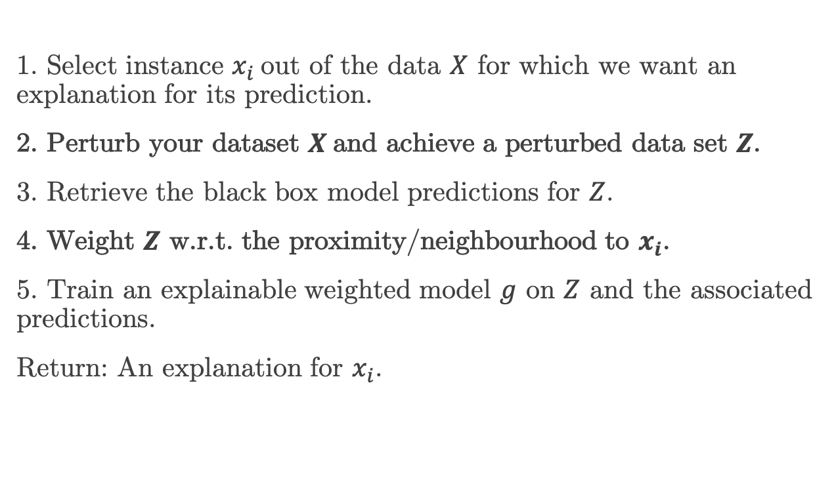
Algorithm for a single LIME explanation
1. Select instance $x_{i}$out of the data $X$ for which we want an explanation for its prediction.
2. Perturb your dataset $X$and achieve a perturbed data set $Z$.
3. Retrieve the black box model predictions for $Z$.
4. Weight $Z$ w.r.t. the proximity/neighbourhood to $x_{i}$.
5. Train an explainable weighted model $g$ on $Z$ and the associated predictions.
Return: An explanation for $x_{i}$.

Slide 30
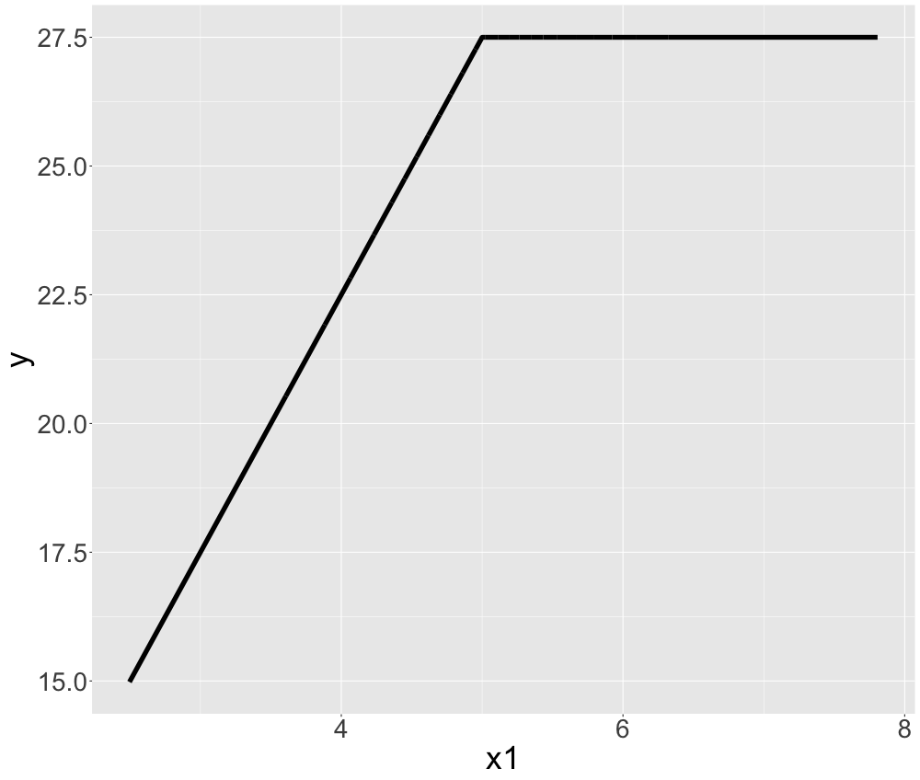
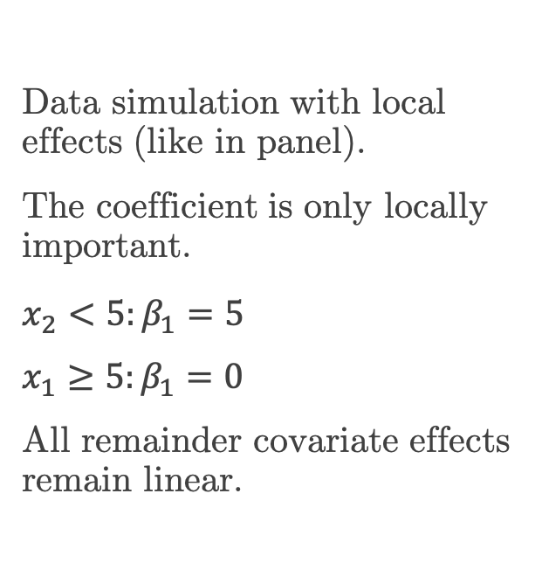
Simulation: LIME manages to recover local linear model.
Data simulation with local effects (like in panel).
The coefficient is only locally important.
$x_{2}<5:β_{1}=5$
$x_{1}≥5:β_{1}=0$
All remainder covariate effects remain linear.

Slide 31
What would a global surrogate do?
Weighted avg. slope (here appr. 2.5)

Slide 32
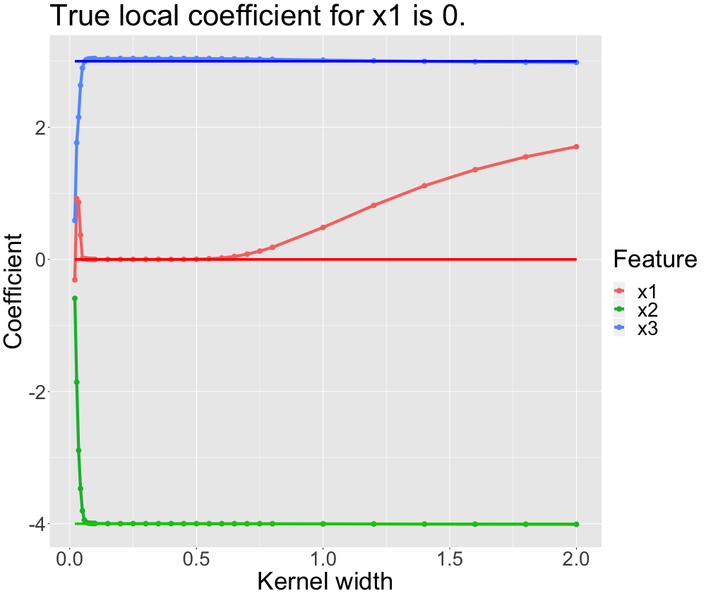
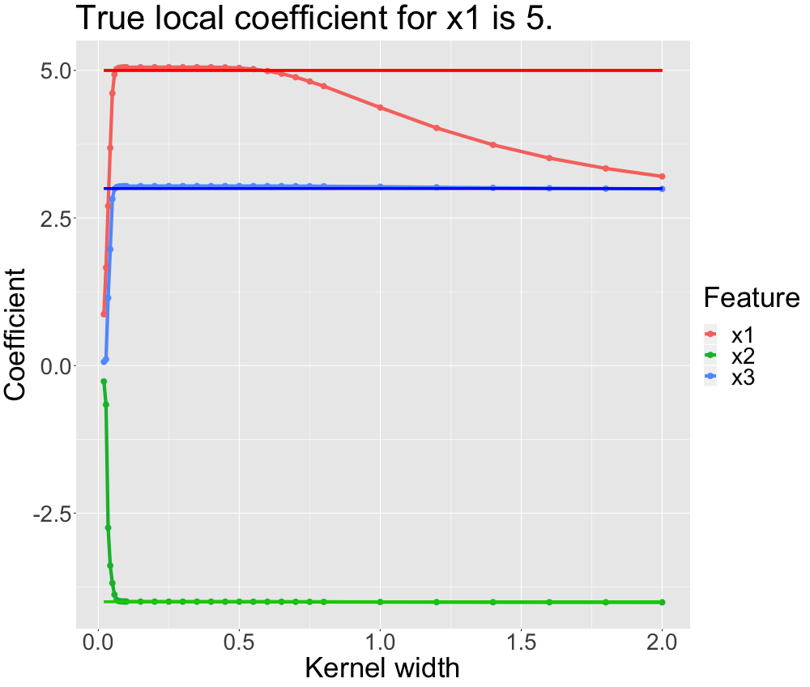
Simulation: LIME manages to recover local linear model.

Slide 33
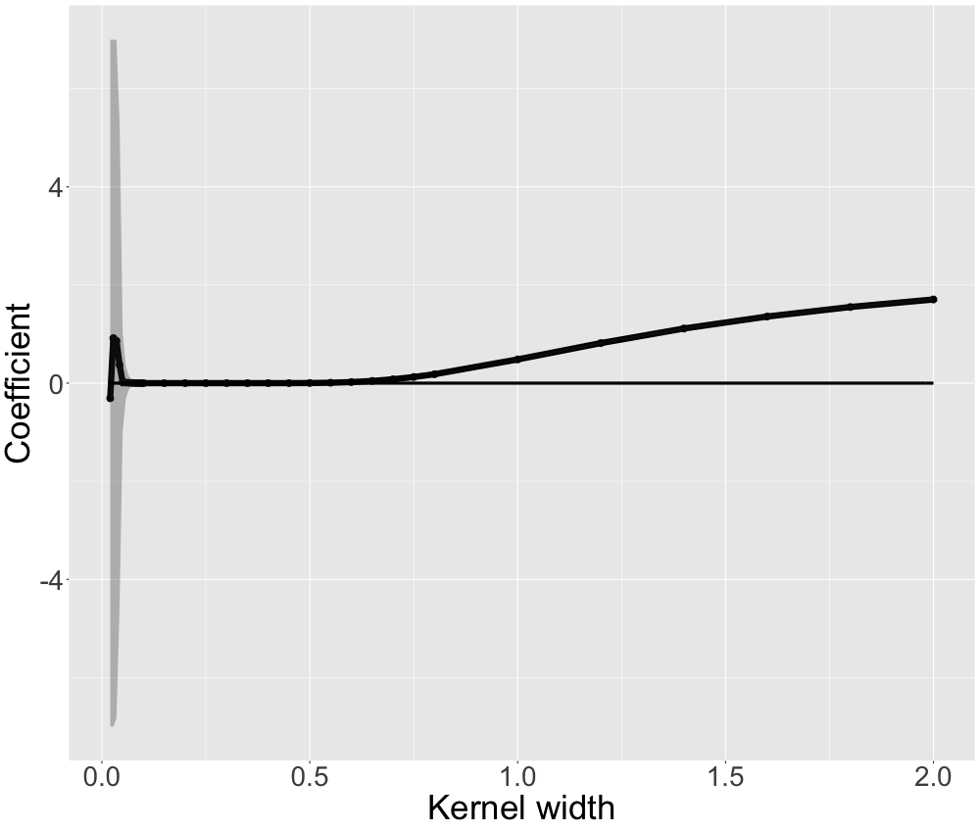
Simulation: LIME manages to recover local linear model.
LIME capable of recovering local coefficients (given the right kernel size).
Instability for small kernel widths and a bias towards a global surrogate for large kernel widths.
Results in line with Alvarez-Melis and Jaakkola (2018) and Laugel et al. (2018).

Slide 34
Things not mentioned / open to discussion
What about other parameters: e.g. distance measure and kernel type?
What about interaction effects?
What about increasing number of permutations massively (instead of local sampling)?
What about binning?
Use other methods of interpretable machine learning for evaluation of local model?

Slide 35
The problem may lie in the sampling.
For complex decision boundaries / predictive surfaces global sampling is unsatisfactory.
The sampling may result in only few observations that are actually in proximity to the instance to be explained.
Craven and Shavlik (1996) argue (in a very different context) that local fidelity is achieved by increasing the density of observations around the instance of interest.
Local sampling should be preferred over global sampling (Laugel et al. 2018).
Local sampling is actually also performed for LIME for non-tabular data (next slide).

Slide 36
LIME for text data applies local sampling.
Example taken from Molnar (2019):
Content | Class
PSY is a good guy | 0
For Christmas Song visit my channel! ;) | 1
 | For | Christmas | Song | visit | my | channel! | ;)
2 | 1 | 0 | 1 | 1 | 0 | 0 | 1
3 | 0 | 1 | 1 | 1 | 1 | 0 | 1
4 | 1 | 0 | 0 | 1 | 1 | 1 | 1
5 | 1 | 0 | 1 | 1 | 1 | 1 | 1
6 | 0 | 1 | 1 | 1 | 0 | 0 | 1

Slide 37
The problem lies in the sampling.
For complex decision boundaries / predictive surfaces global sampling is unsatisfactory.
The sampling may result in only few observations that are actually in proximity to the instance to be explained.
Craven and Shavlik (1996) argue (in a very different context) that local fidelity is achieved by increasing the density of observations around the instance of interest.
Local sampling should be preferred over global sampling (Laugel et al. 2018).
More on this topic in the next talk.

Slide 38
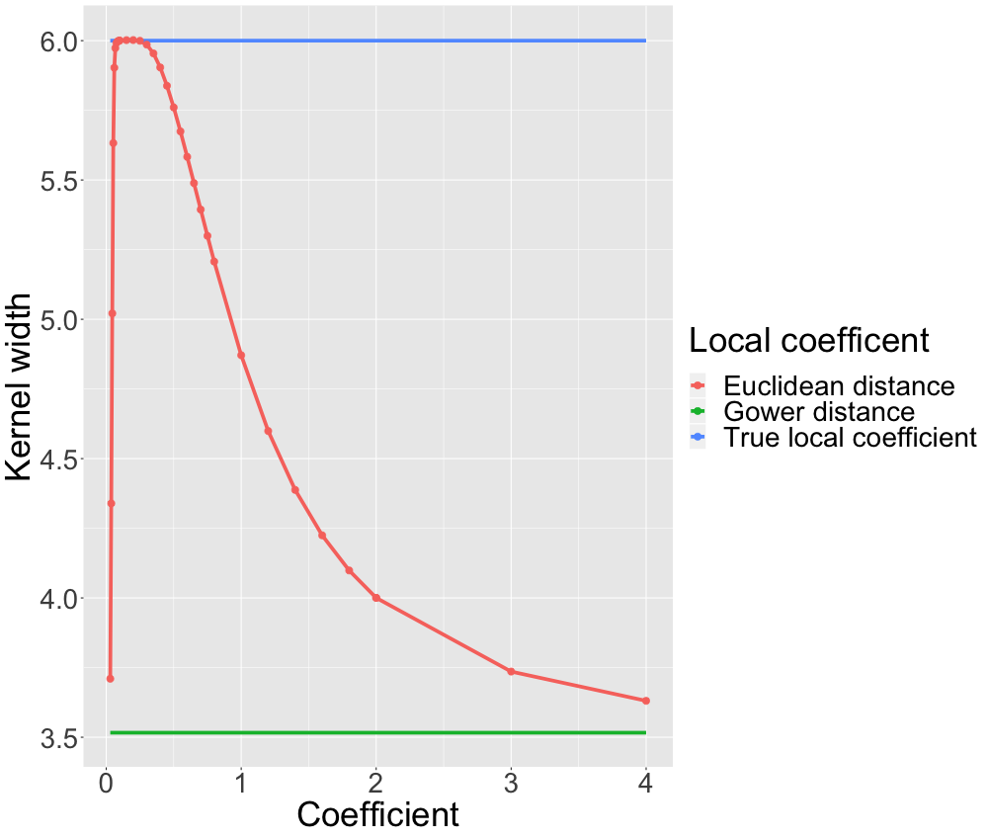
Why we do not use Gower’s distance.

