Slide 1
Deep Learning Exp3
Peng Xue

Slide 2
Outline
● Task Description
● Dataset
● Data segmentation
● Guidelines

Slide 3
Task Introduction
● Self-attention
○ Proposed in GOOGLE's work, Attention is all you need . It combines the strengths of RNN (consider whole sequence) and CNN (processing parallelly).
● Main goal: Learn how to use transformer.

Slide 4


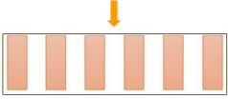


Exp3: Speaker classiﬁcation
Task: Multiclass Classiﬁcation
Predict speaker class from given speech.
Speaker 1
Speaker 2

Slide 5
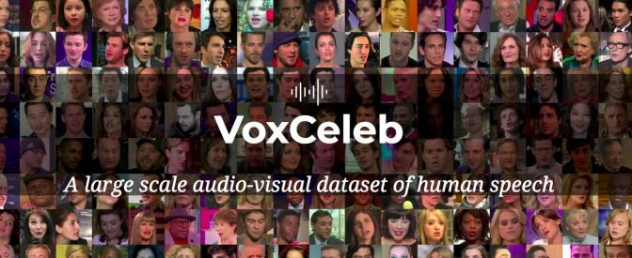
Dataset
● Training: 63438 processed audio features with labels.
● Testing: 6000 processed audio features without labels.
● Label: 600 classes in total, each class represents a speaker.

Slide 6
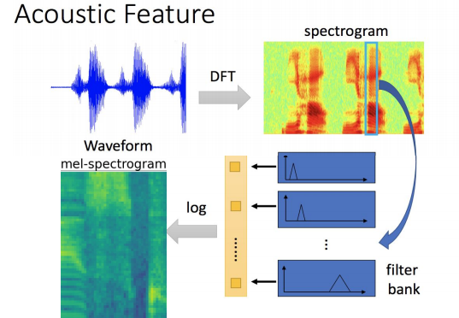
Data Preprocessing

Slide 7
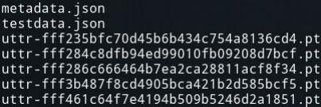
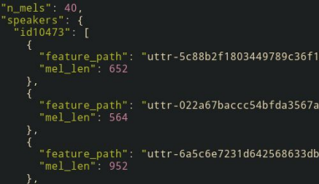
Data formats
● Data Directory
○ metadata.json
○ testdata.json
○ mapping.json
○ uttr-{random string}.pt
● The information in metadata
○ "n_mels": The dimention of mel-spectrogram.
○ "speakers": Adictionary.
■ Key: speaker ids.
■ value: "feature_path" and "mel_len"

Slide 8
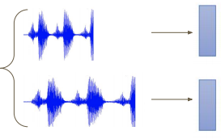

Data segmentation during training
Diﬀerent length

Slide 9
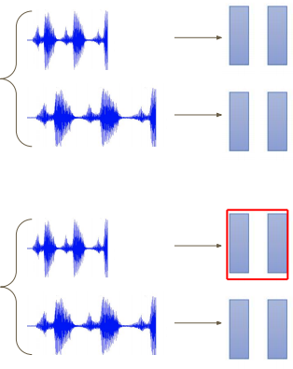

Data segmentation during training
Diﬀerent length
Segment
during training
Segment = 2

Slide 10
Sample Code
● Baselines:
○ Simple: Run sample code and knowhow to use transformer.
○ Medium: Know how to adjust parameters of transformer.
○ Hard: Construct conformer which is a variety of transformer.

Slide 11
Requirements- Simple
● Build a self-attention network to classify the speaker with the sample code.
● Simple public baseline: 0.80455

Slide 12
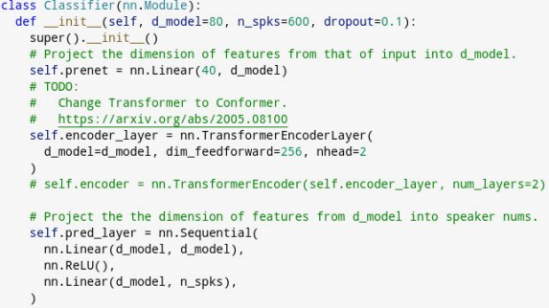
Requirements- Medium
● Modify the parameters of the transformer modules in the sample code.

Slide 13
Requirements- Hard
● Improve the performance by constructing the conformer layer.

Slide 14
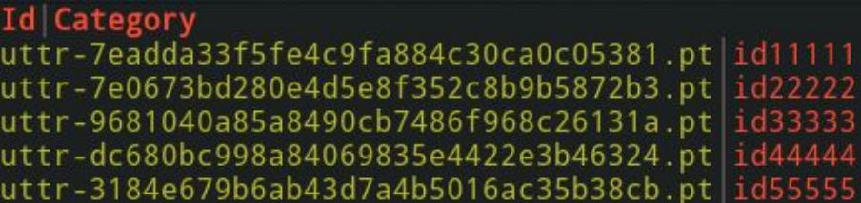
Submission Format
● "Id, Category" split by','in the ﬁrst row。
● Followed by 6000 lines of "ﬁlename, speaker name" split by ','.

