Slide 1
Deep Learning Experiment1
COVID-19 Cases Prediction
Xue Peng

Slide 2
Outline
Objectives
Task Description
Data
Evaluation Metric
Kaggle
Grading
Code Submission
Deadlines
Hints
Regulations again

Slide 3
Objectives
● Solve a regression problem with deep neural networks (DNN).
● Understand basic DNN training tips
e.g. hyper-parameter tuning, featureselection, regularization, ...
● Get familiar with PyTorch.

Slide 4
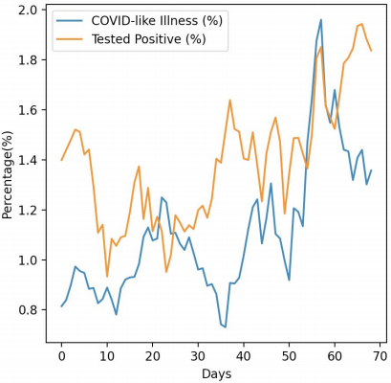
Task Description
● COVID-19 Cases Prediction
● Source: Delphi group @ CMU
○ A daily survey since April 2020 via facebook.
Do not attempt to ﬁnd any related data! Using additional data is prohibited and your ﬁnal grade x 0.9 !

Slide 5



Task Description
● Given survey results in the past 3 days in a speciﬁc state in U.S., then predict the percentage of new tested positive cases in the 3rd day.
survey
positive
cases
survey
positive
cases
survey
positive
cases
Day 1
Day 2
Day 3

Slide 6


Data -- Delphi's COVID-19 Surveys
Conducted surveys via facebook (every day & every state)
Survey: symptoms, COVID-19 testing, social distancing, mental health, demographics, economic eﬀects, ...

Slide 7



Data -- Delphi's COVID-19 Surveys
estimation for all
population in that
state
(data we are using)
All population in a
certain state of the U.S.
some samples survey

Slide 8
Data -- Delphi's COVID-19 Surveys
● States (40, encoded to one-hot vectors)
○ e.g. AL, AK, AZ, ...
● COVID-like illness (4)
○ e.g. cli,ili (inﬂuenza-like illness), ...
● Behavior Indicators (8)
○ e.g. wearing_mask, travel_outside_state, ...
● Mental Health Indicators (5)
○ e.g. anxious, depressed, ...
● Tested Positive Cases (1)
。 tested_positive (this is what we want to predict)
Percentage

Slide 9

Data -- One-hot Vector
● One-hot vectors:
Vectors with only one element equals to one while others are zero.
Usually used to encode discrete values.
_{If} _{state} _{code} ₌ _{AZ} ^{one-hot} ^{encoding}
(Arizona)
AL (Alabama) AK (Alaska)
AZ (Arizona)
AR (Arkansas)
WI (Wisconsin)

Slide 10
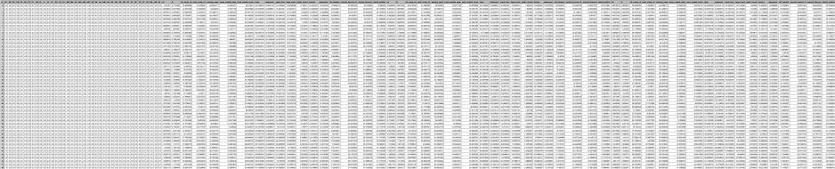
Data -- Training
Covid_Autum_train.csv (2000 samples)
state one-hot encoding (40)
Day 1 features
(18)
Day 2 features
(18)
Day 3 features
(18)
tested
1 row = 1 sample
positive

Slide 11
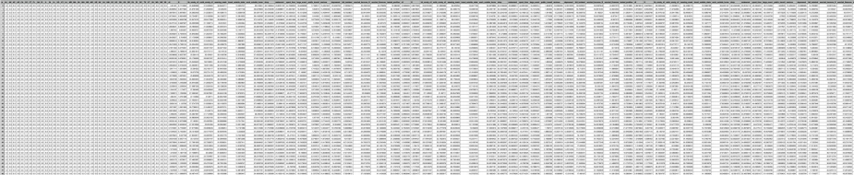
Data -- Testing
Covid_Autum_test.csv (700 samples)
state one-hot encoding (40)
Day 1 features
(18)
Day 2 features
(18)
Day 3 features
(17)
1 row = 1 sample

Slide 12

Evaluation Metric
● Root Mean Squared Error (RMSE)
your model
ground truth label (correct answer)
input features (testing data)

Slide 13
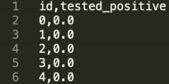
Kaggle
● Link: https://www.kaggle.com/competitions/dl2023autum
● Displayed name: <student ID>_<anything>
○ e.g. b06901020_puipui
○ For auditing, don’t put student ID in your displayed name.
● Submission format: .csv ﬁle
○ See sample code

Slide 14
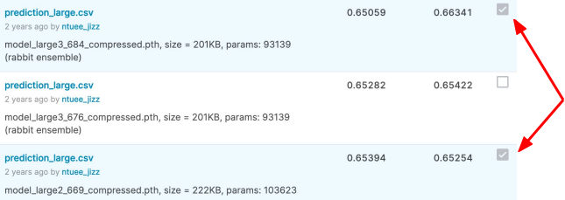
Kaggle -- Submission
● You may submit up to 5 results each day (UTC).
● Up to 2 submissions will be considered for the private leaderboard.
remember to select 2 results for your ﬁnal scores before the
competition ends!

Slide 15
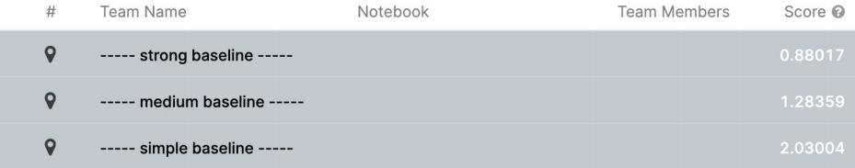
Grading -- Kaggle
● We might change the strong baseline if it’s too hard.

Slide 16

Code Submission
● Your .zip ﬁle should includeonly
Code: either .py or .ipynb
Report: .pdf
● Example:

Slide 17
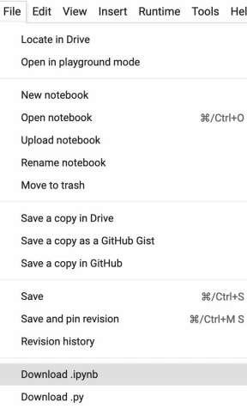
Code Submission
● How to download your code from Google Colab?

Slide 18
Hints
● Simple Baseline ○ Sample code
● Medium Baseline
○ Feature selection: 40 states + 2 tested_positive (will be demonstrated in class)
● Strong Baseline
Feature selection (what other features are useful?)
DNN architecture (layers? dimension? activation function?)
Training (mini-batch? optimizer? learning rate?)
L2 regularization

Slide 19
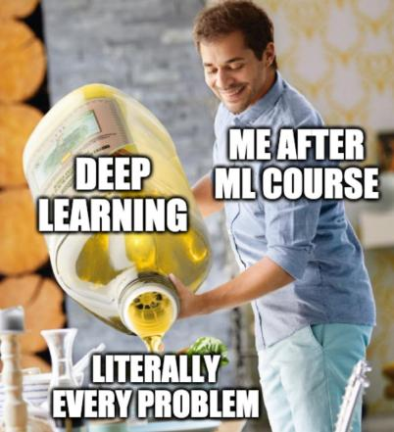
Have fun and wish you goodluck!

