Slide 1
Deep Learning Exp2 – Image Classiﬁcation
Xue Peng

Slide 2
Objective
1. Solve imageclassiﬁcation with convolutional neural networks.
2. Improve the performance with data augmentations.
3. Understand how to utilize unlabeled data and how it beneﬁts.

Slide 3
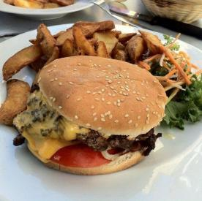
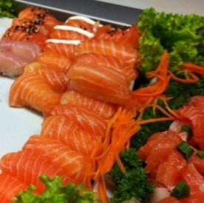
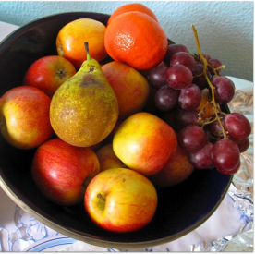
Task - Food Classiﬁcation

Slide 4
Task - Food Classiﬁcation
● The images are collected from the food-11 dataset classiﬁed into 11 classes.
● The dataset here is slightly modiﬁed:
● Training set: 224 * 11 labeled images + 6786 unlabeled images
● Validation set: 51 * 11 labeled images
● Testing set: 696 images
● DO NOT utilize the original dataset or labels.
○ This is cheating.

Slide 5
Task - Food Classiﬁcation
logits
(not normalized)
probability (normalized)
-0.25 +3.02 +0.56 -3.90 -0.01 +0.25 -0.47 +5.00 -1.32 +1.14 -0.28
0.004 0.114 0.009 0.001 0.005 0.007 0.003
0.831
0.001 0.017 0.004
softmax
CNN model

Slide 6
Requirements
● You can easily ﬁnish the easy level by running the example code.
● For the rest, we recommend you start with the same code.
○ We already prepared some TODO blocks for you.
● DO NOT pre-train your model on other datasets.
● If you use some well-known model architecture (e.g., ResNet), make sure NOT to load pre-trained weights as initialization.

Slide 7
Requirements - Easy
● Build a convolutional neural network using labeled images with provided codes.
● Public simple baseline: 43.027 (accuracy, %)

Slide 8
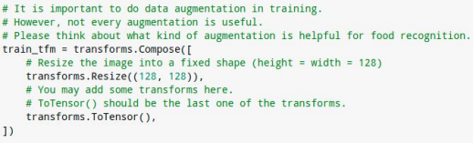
Requirements - Medium
● Improve the performance using labeled images with diﬀerent model architectures or data augmentations.
● Public medium baseline: ~50 (accuracy, %)
● You can achieve the baseline by adding a few lines to the example code.

Slide 9
Requirements - Hard
● Improve the performance with additional unlabeled images.
● Public strong baseline: ~80 (accuracy, %)
● Do it on your own (by ﬁnishing TODO blocks in the example code).
● Using unlabeled testing data here is allowed.
● Hint: semi-supervised learning, self-supervised learning

Slide 10
Semi-supervised Learning
● There are many ways to do semi-supervised learning.
● E.g., generate pseudo-labels for unlabeled data and train with them.
training
unlabeled data
labeling
ﬁltering
labeled data
CNN model
subset of data
combining

Slide 11
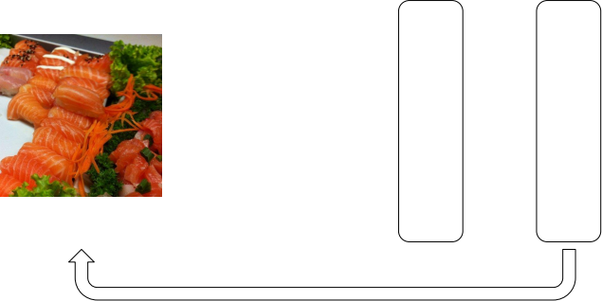
training
labeling
ﬁltering
labeled
data
CNN
model
subset
of data
Pseudo-labels
unlabeled data
combining
logits
(not normalized)
probability (normalized)
-0.25
+3.02
+0.56
-3.90
-0.01
+0.25
-0.47
+5.00
-1.32
+1.14
-0.28
pseudo-label = 7
yes
0.004 0.114 0.009 0.001 0.005 0.007 0.003
0.831
0.001 0.017 0.004
softmax
CNN model
conﬁdent enough?

Slide 12
Kaggle Submission Format
● The submitted predictions should be in CSV format.
● The ﬁrst row is “Id, Category”
● The rest of rows are “{id}, {prediction}” (e.g., 5, 8)
● There should be (696 + 1) rows in total.

