Slide 1
Happiness report and Covid data in the world
By Zhipeng Chen

Slide 2
Discussion about datasets
Happiness report 2020 and 2021
Ratings on happiness around the world relies on the Gallup World Poll, an annual survey conducted in more than 160 countries covering 99 per cent of the world's population.
The happiness score is valued based on the happiness score of an imaginary country that has the world's least-happy people as the benchmark of it.
each of six factors (levels of GDP, life expectancy, generosity, social support, freedom, and corruption) is estimated to contribute to making life evaluations higher in each country

Slide 3
Discussion about datasets
2. covid datasets
Data collected on dates from Mar 2020 to May 2022 by web scraping by a programmer on the Internet.
Variables: cases/ deaths/ tests/ populations/ countries

Slide 4
What I want to examine?
Happiness report Itself:
The correlations between scores and six factors and covid factor as well
(levels of GDP, life expectancy, generosity, social support, freedom, and corruption)
The region differences in scores
Happiness report comparison for 2020 and 2021

Slide 5
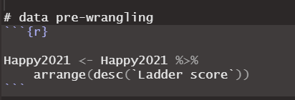
Data wrangling
1. data order

Slide 6
Data wrangling
2. aesethic and format
horizontal adjustment/ vertical adjustment
Number on the right of the column
Coordinate flip

Slide 7
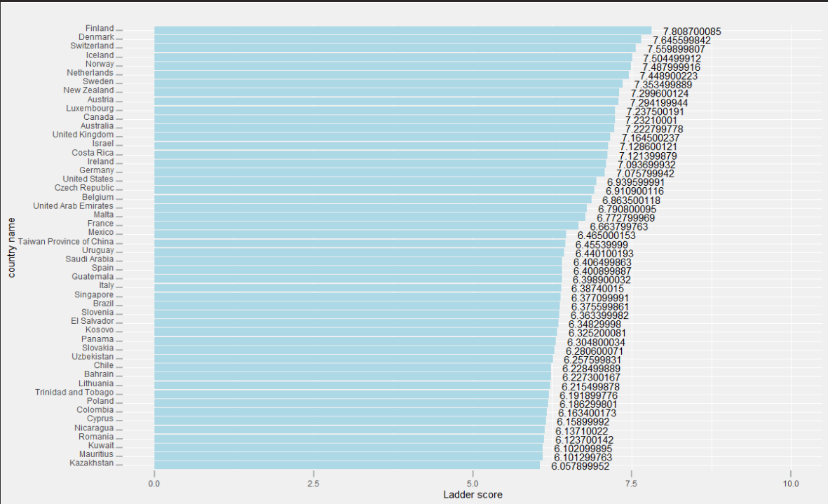
Top 50 happiness countries

Slide 8
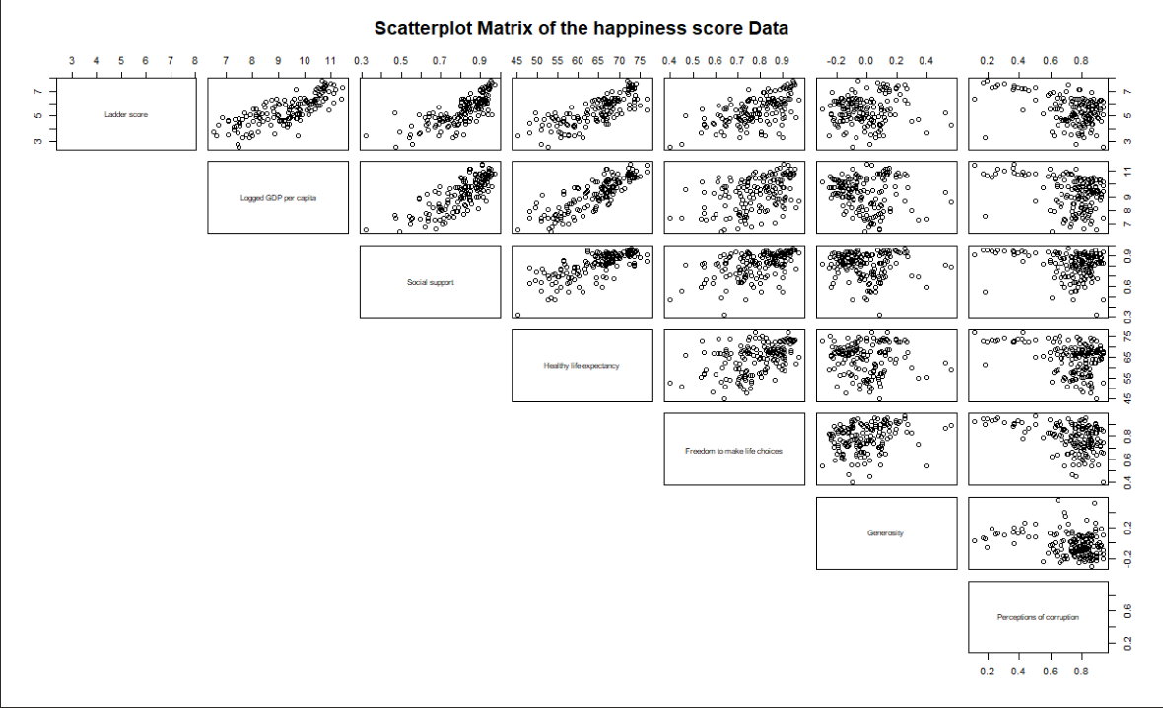
The relationships

Slide 9
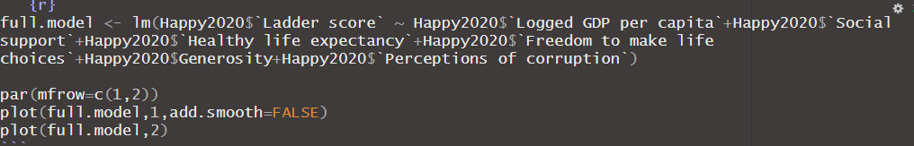
Building linear model to show residual plot
If this model is fitting well…

Slide 10
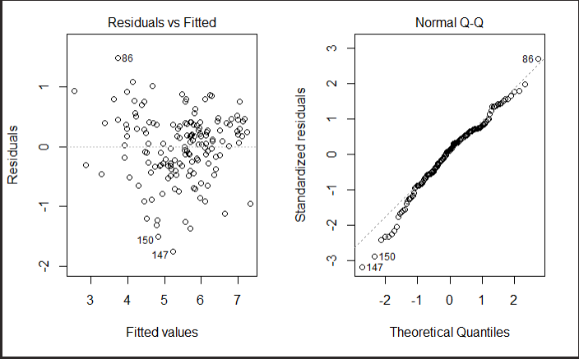
Constant variance?
Dots away in the end of the line?

Slide 11
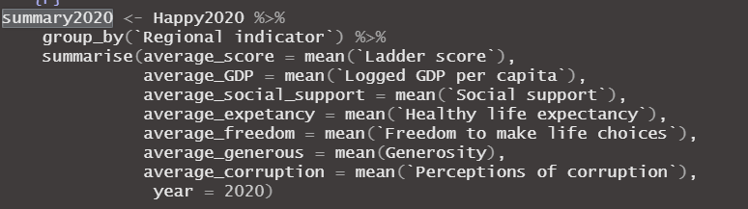
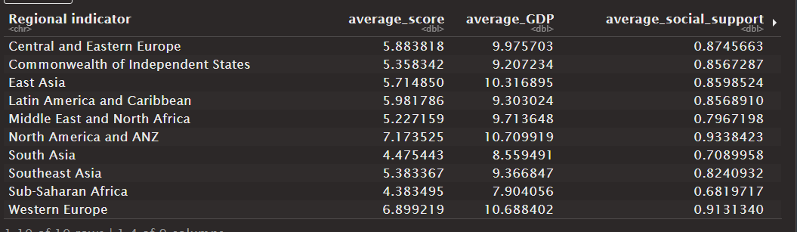
Regional difference on scores

Slide 12
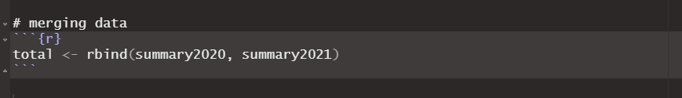
Data processing
Just merging the data…

Slide 13
Data wrangling
1. data order

Slide 14
Data wrangling
1. data order

Slide 15
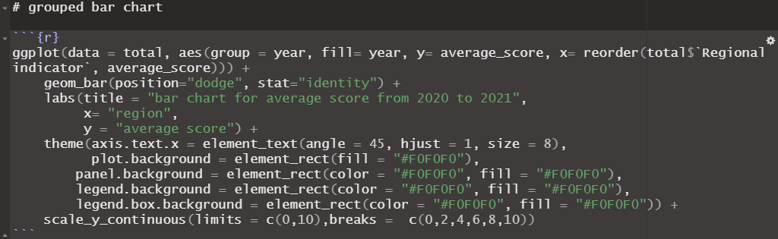
Grouped bar chart

Slide 16
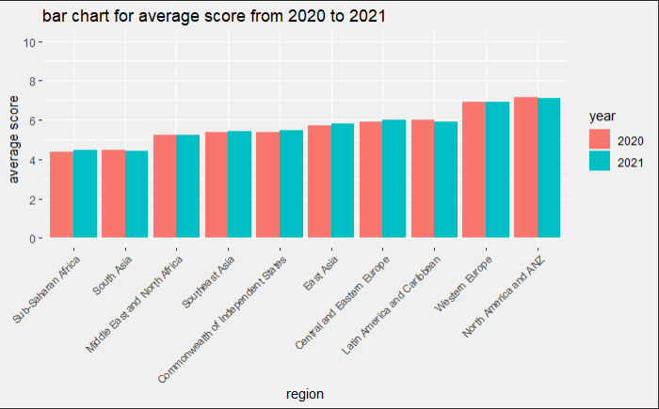

Slide 17
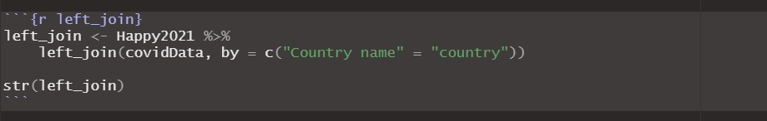
covid and happiness score

Slide 18
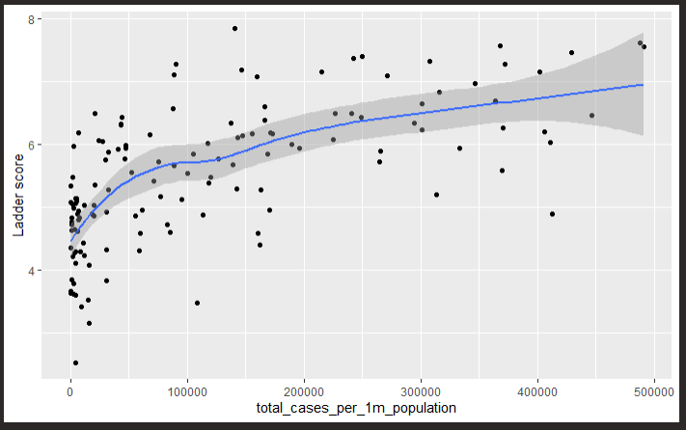
Total cases per 1M people

Slide 19
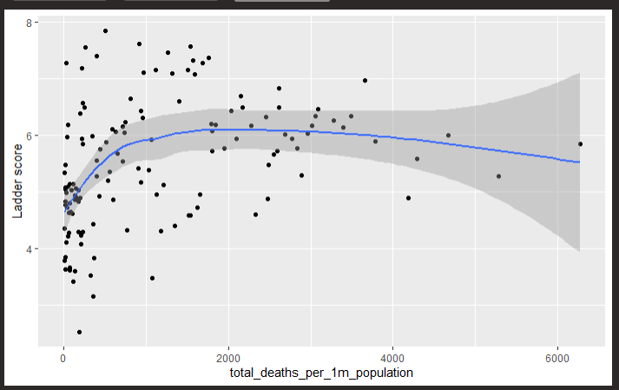
Total death per 1M people

Slide 20
Ethical concerns and shortcomings
1. survey/ benmark (fake country)/ missing some factors(hard to collect)/ big pictures/
2. data is not specific/ hard to find data yearly like this one
……….

