Slide 1
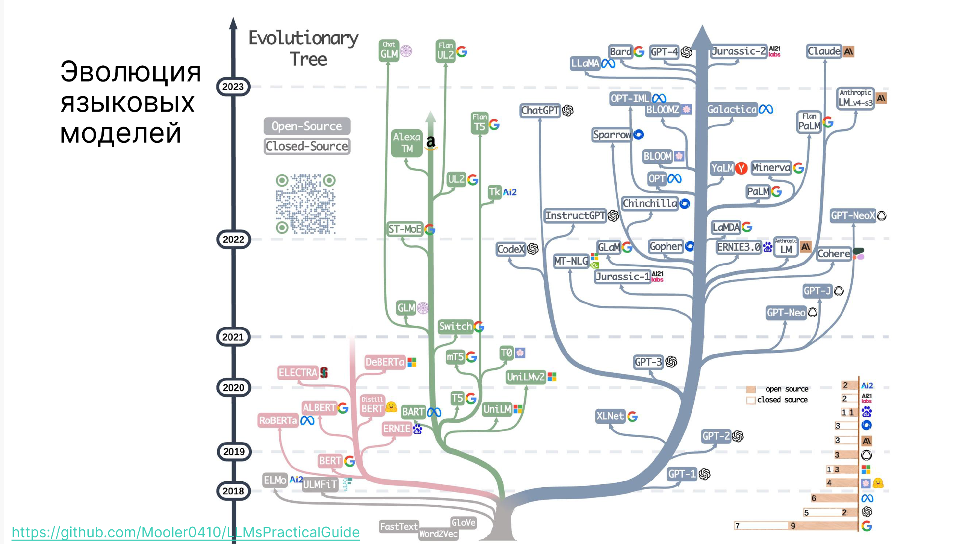

Slide 2
BERT и его друзья

Slide 3
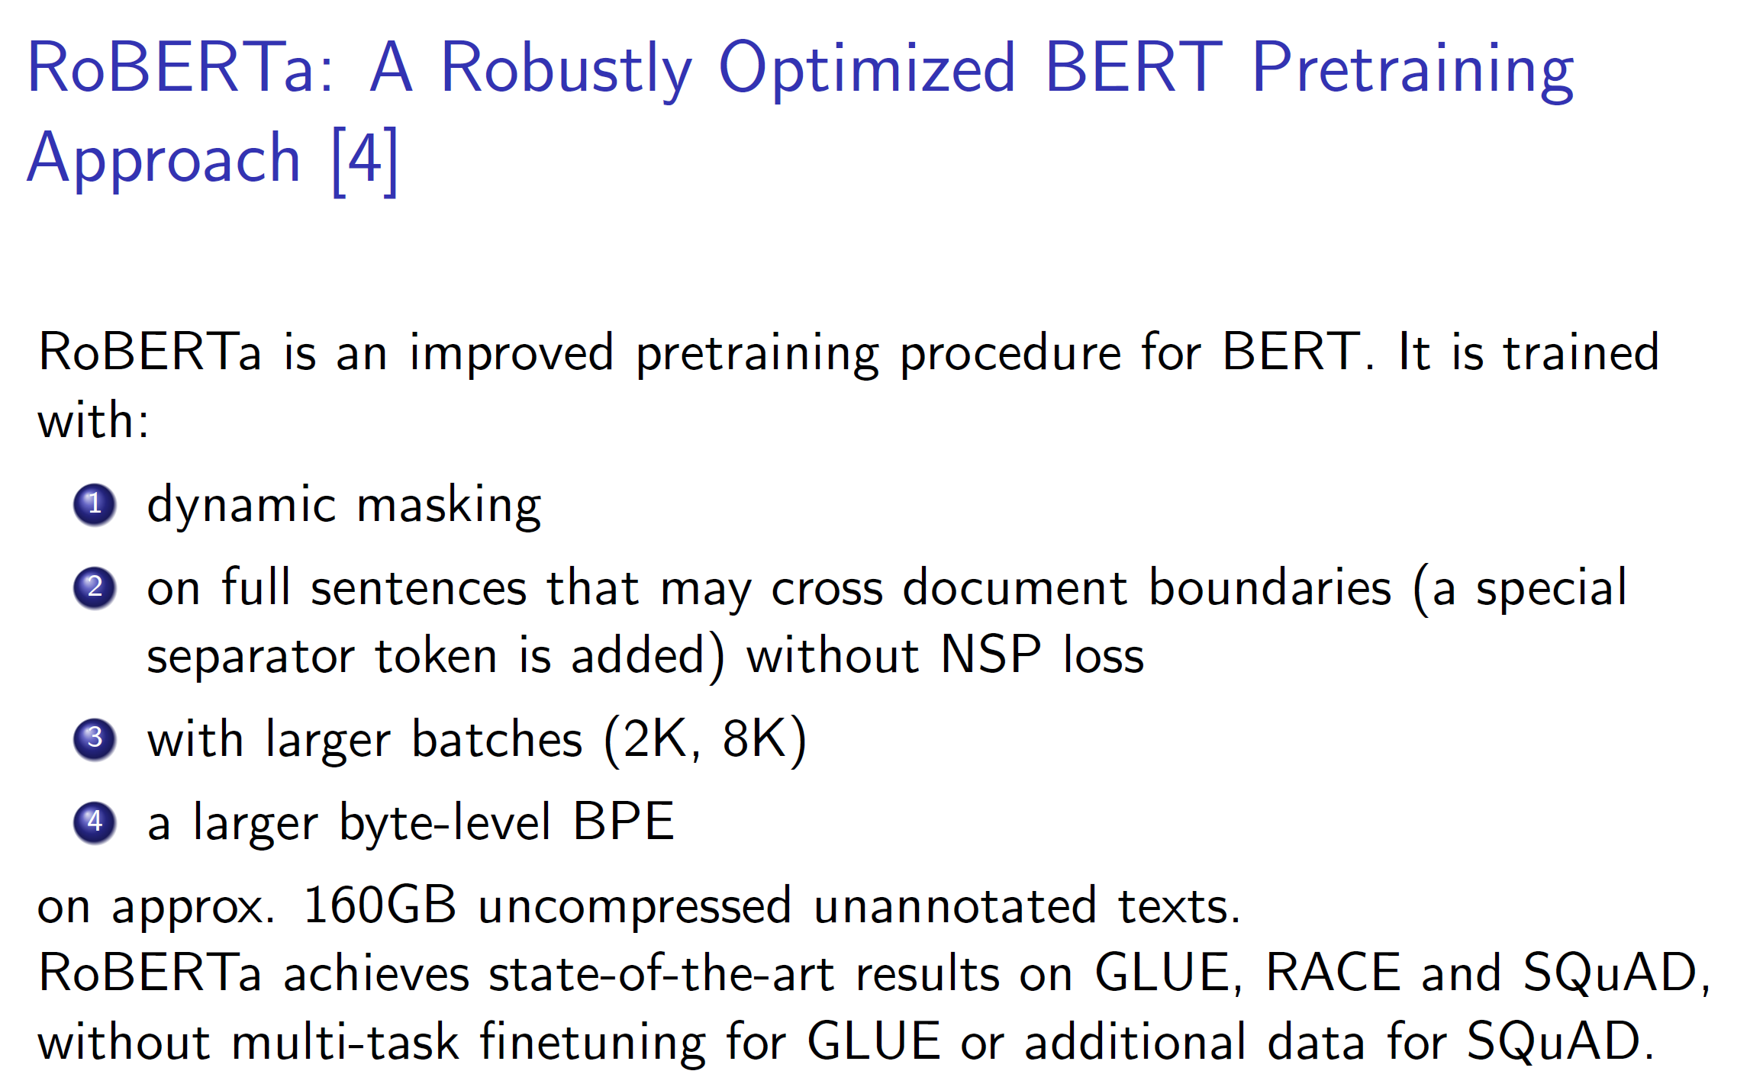

Slide 4
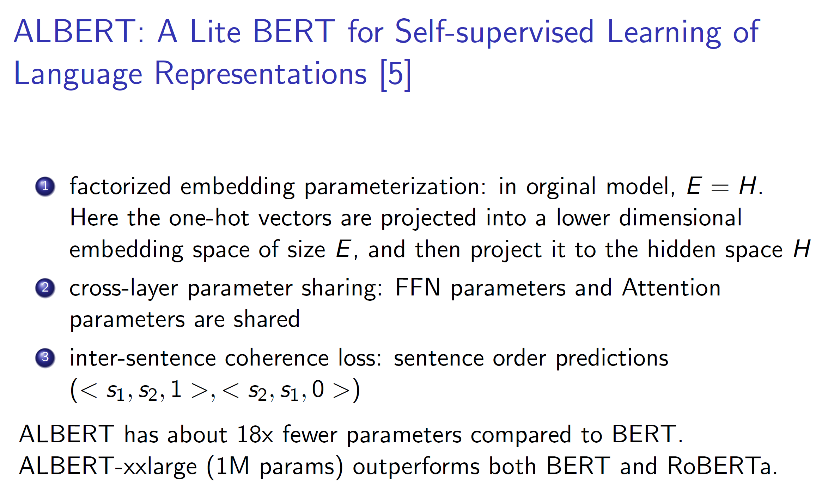

Slide 5
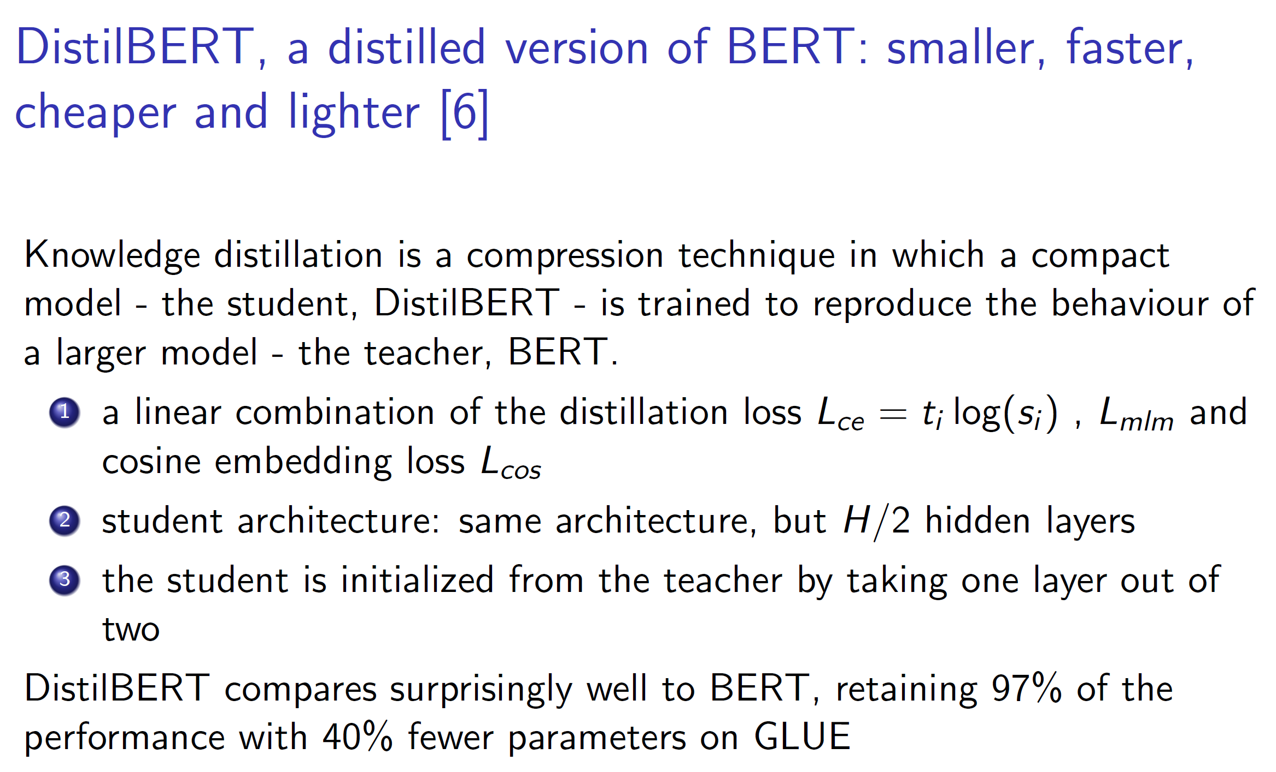

Slide 6
Deberta: Decoding-enhanced BERT with Disentangled Attention
Improved Transformer — builds on BERT/RoBERTa with new attention and position encoding.
Disentangled Representations — each token has separate content and position embeddings.
Disentangled Attention — combines content–content, content–position, and position–content interactions for richer syntax understanding.
Enhanced Mask Decoder — better prediction of masked tokens by using position information.
Superior Performance — outperforms BERT and RoBERTa on GLUE, SuperGLUE, and other NLP benchmarks.

Slide 7
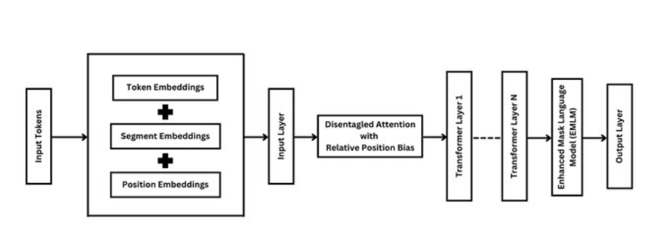
Deberta: Decoding-enhanced BERT with Disentangled Attention

Slide 8
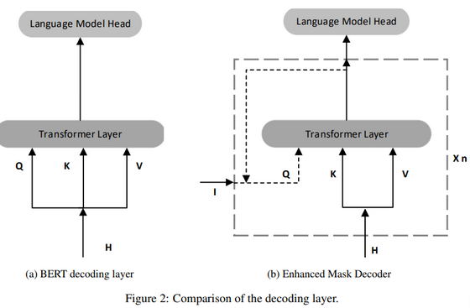
Deberta: Decoding-enhanced BERT with Disentangled Attention

Slide 9
ModernBERT: Efficient Transformer for Modern Hardware
BERT Re-engineered — redesigned architecture for higher speed and lower memory use.
Rotary Position Embeddings (RoPE) — replaces absolute positions, enabling better long-context handling.
Parallelized Attention & MLP — optimized computation to fully utilize GPUs/TPUs.
Lightweight & Scalable — smaller parameter count with performance comparable or superior to RoBERTa.

Slide 10
ROPe: Rotary Position Embeddings
Relative Position Encoding — encodes positions through rotations in embedding space instead of absolute indices.
Applies a rotation matrix to token embeddings based on their position, preserving distance information naturally.
Enables Extrapolation — supports longer sequences beyond training length better than absolute embeddings.
No additional learned parameters, easy to implement in attention layers.
Improves Context Handling — widely used in modern LLMs (e.g., GPT-NeoX, LLaMA, ModernBERT) for better long-range reasoning.

Slide 11
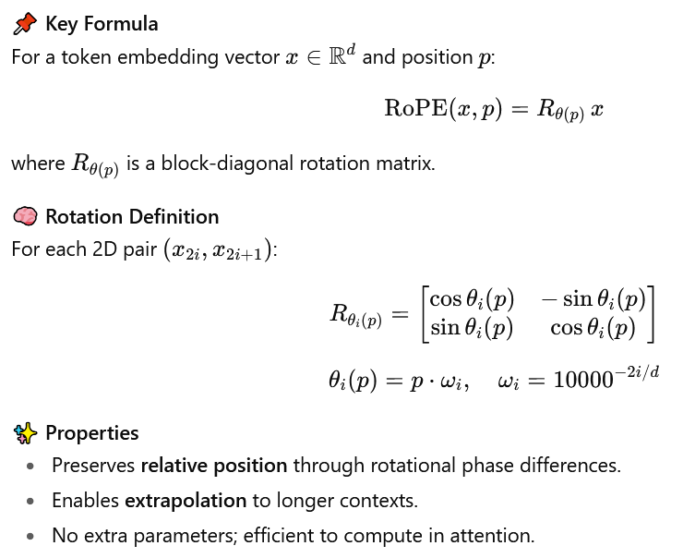
ROPe: Rotary Position Embeddings

Slide 12
FlashAttention: Fast and Memory-Efficient Exact Attention
Goal — speed up Transformer attention while preserving exact results (no approximation) and restructure computation to reduce memory traffic, not FLOPs.
Performs attention in blocks (tiles) that fit into fast GPU SRAM.
Avoids storing large intermediate attention matrices.
FlashAttention сomputes softmax and weighted sum on the fly, block by block:
Time: O(n² d) (same as standard)
Memory: O(n*d) instead of O(n²)
Much lower memory — enables longer sequences and larger batches
2–4× faster than standard attention in practice.

Slide 13
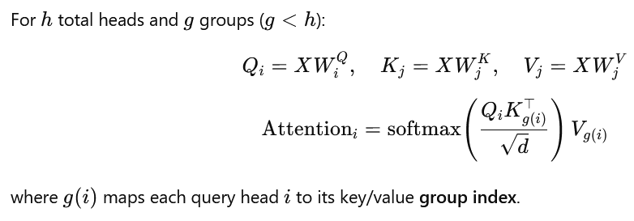
GQA: Group Query Attention
Standard Multi-Head Attention (MHA) has independent query–key–value projections per head.
GQA groups multiple query heads to share one set of key/value projections. Each group still has its own query matrix but shared K/V matrices.
2–4 times memory reduction in inference and training.

Slide 14
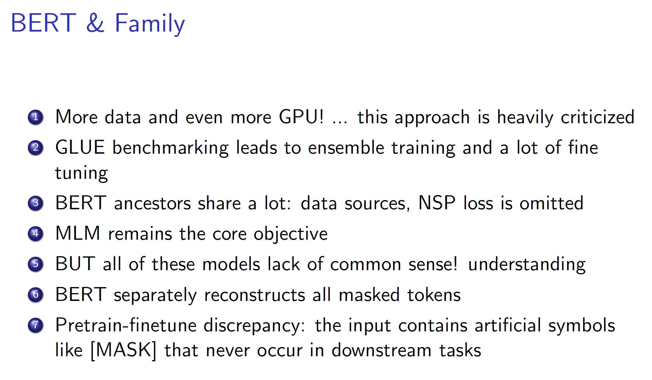

Slide 15
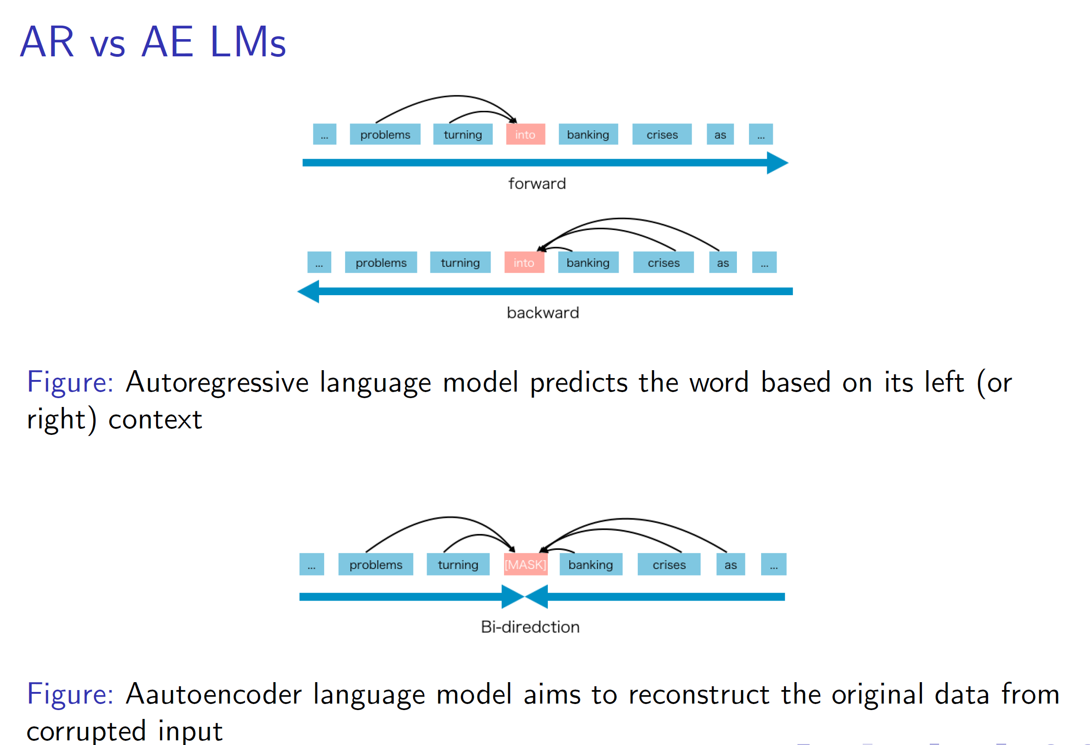

Slide 16
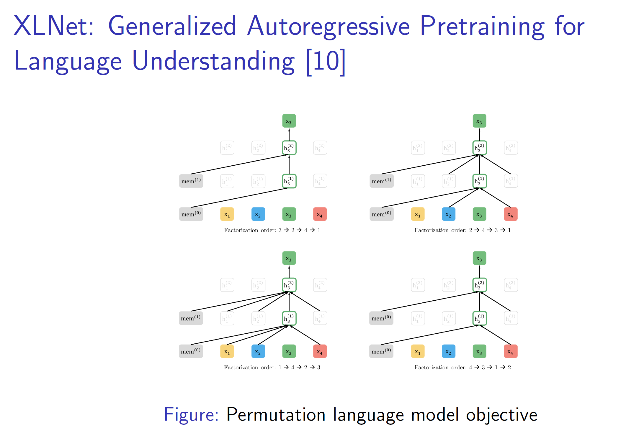

Slide 17
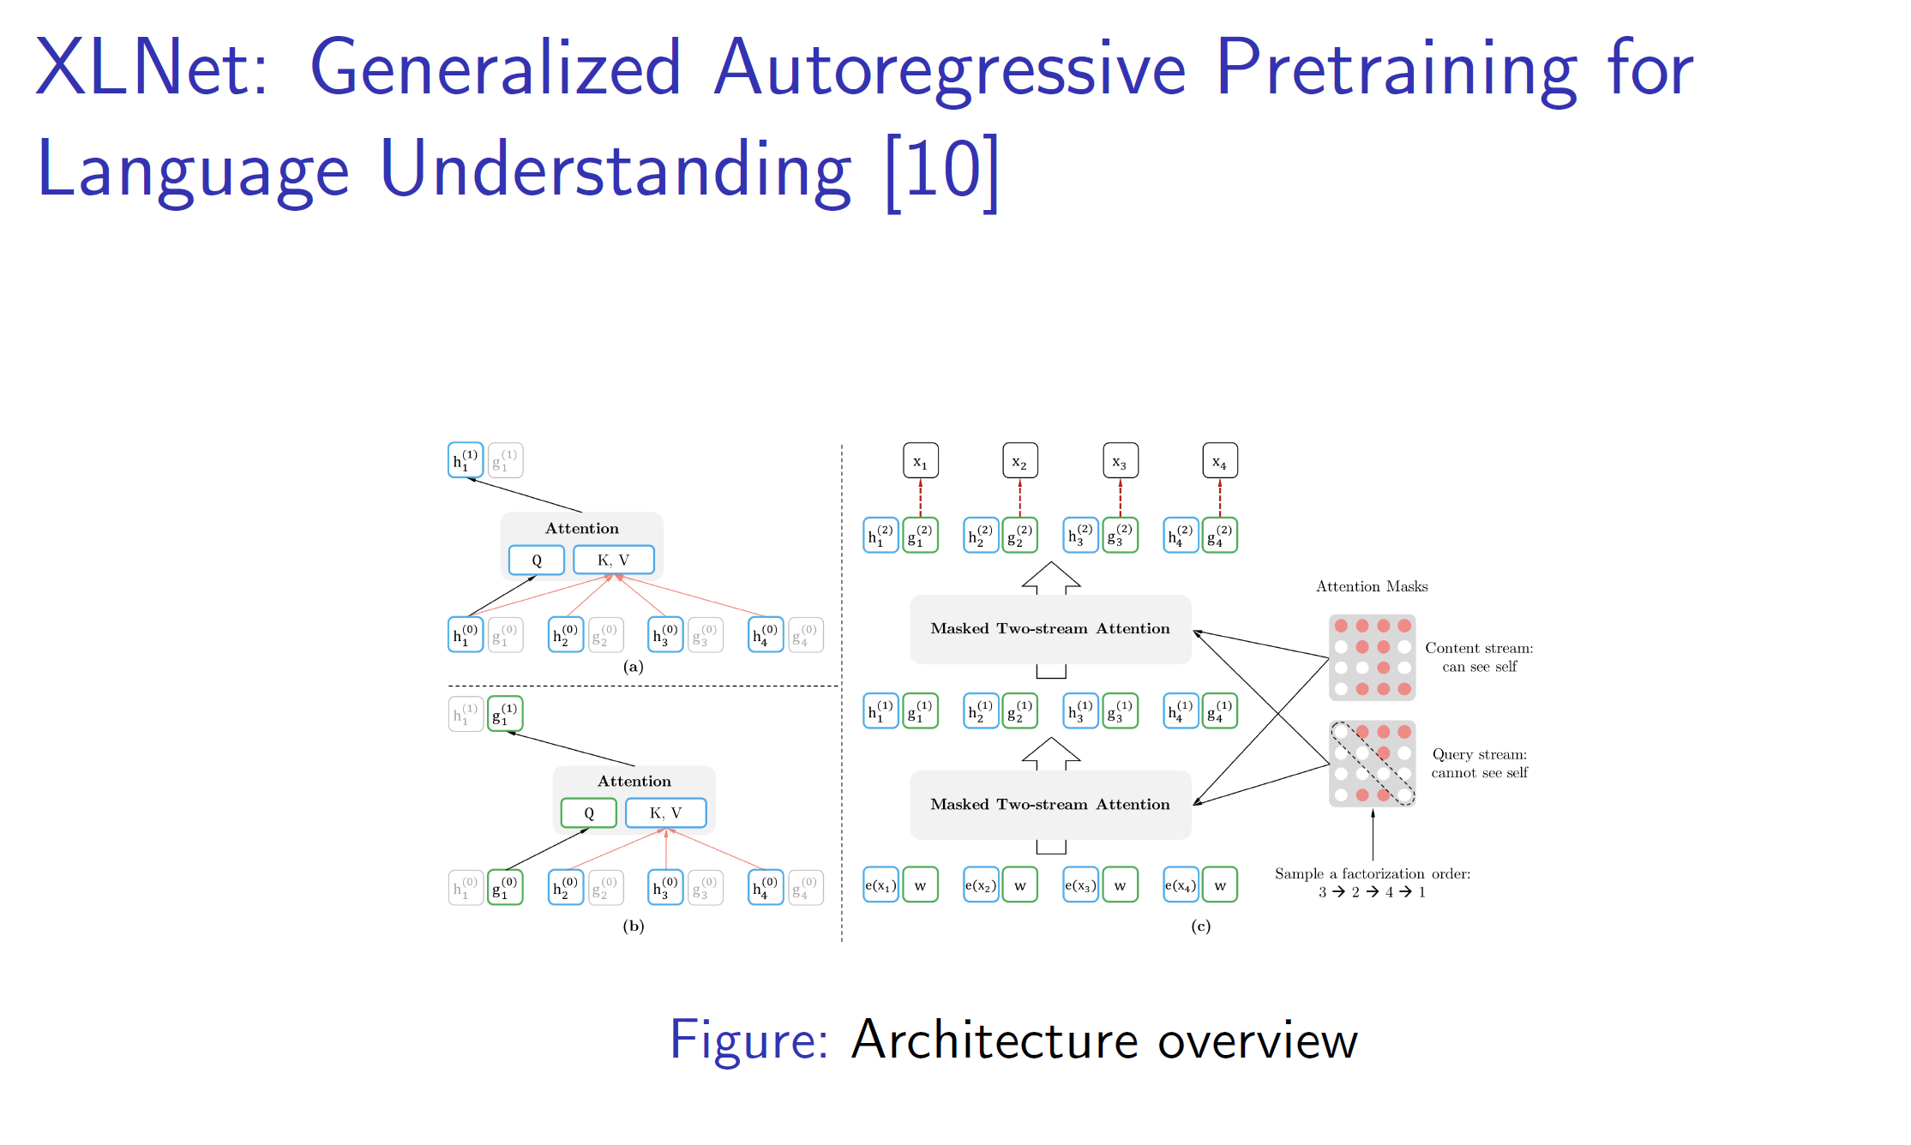

Slide 18
Beyond XLNet
ELECTRA
Replaces token masking with replaced-token detection.
Much more sample-efficient than XLNet/BERT
UniLM / UniLMv2
Unified framework: autoregressive, autoencoding, and seq2seq pretraining.
Basis for later generative LMs (e.g., mT5, GLM).
ERNIE (Baidu)
Extends permutation + masking with knowledge-enhanced pretraining
GLM (General Language Model)
Integrates XLNet-style autoregression with longer context handling
Inspired by XLNet’s unified autoregressive pretraining but optimized for scalability

Slide 19
Генеративные LLM сегодня

Slide 21
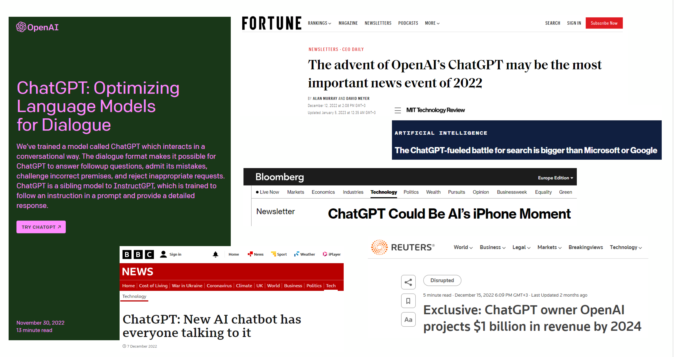

Slide 22
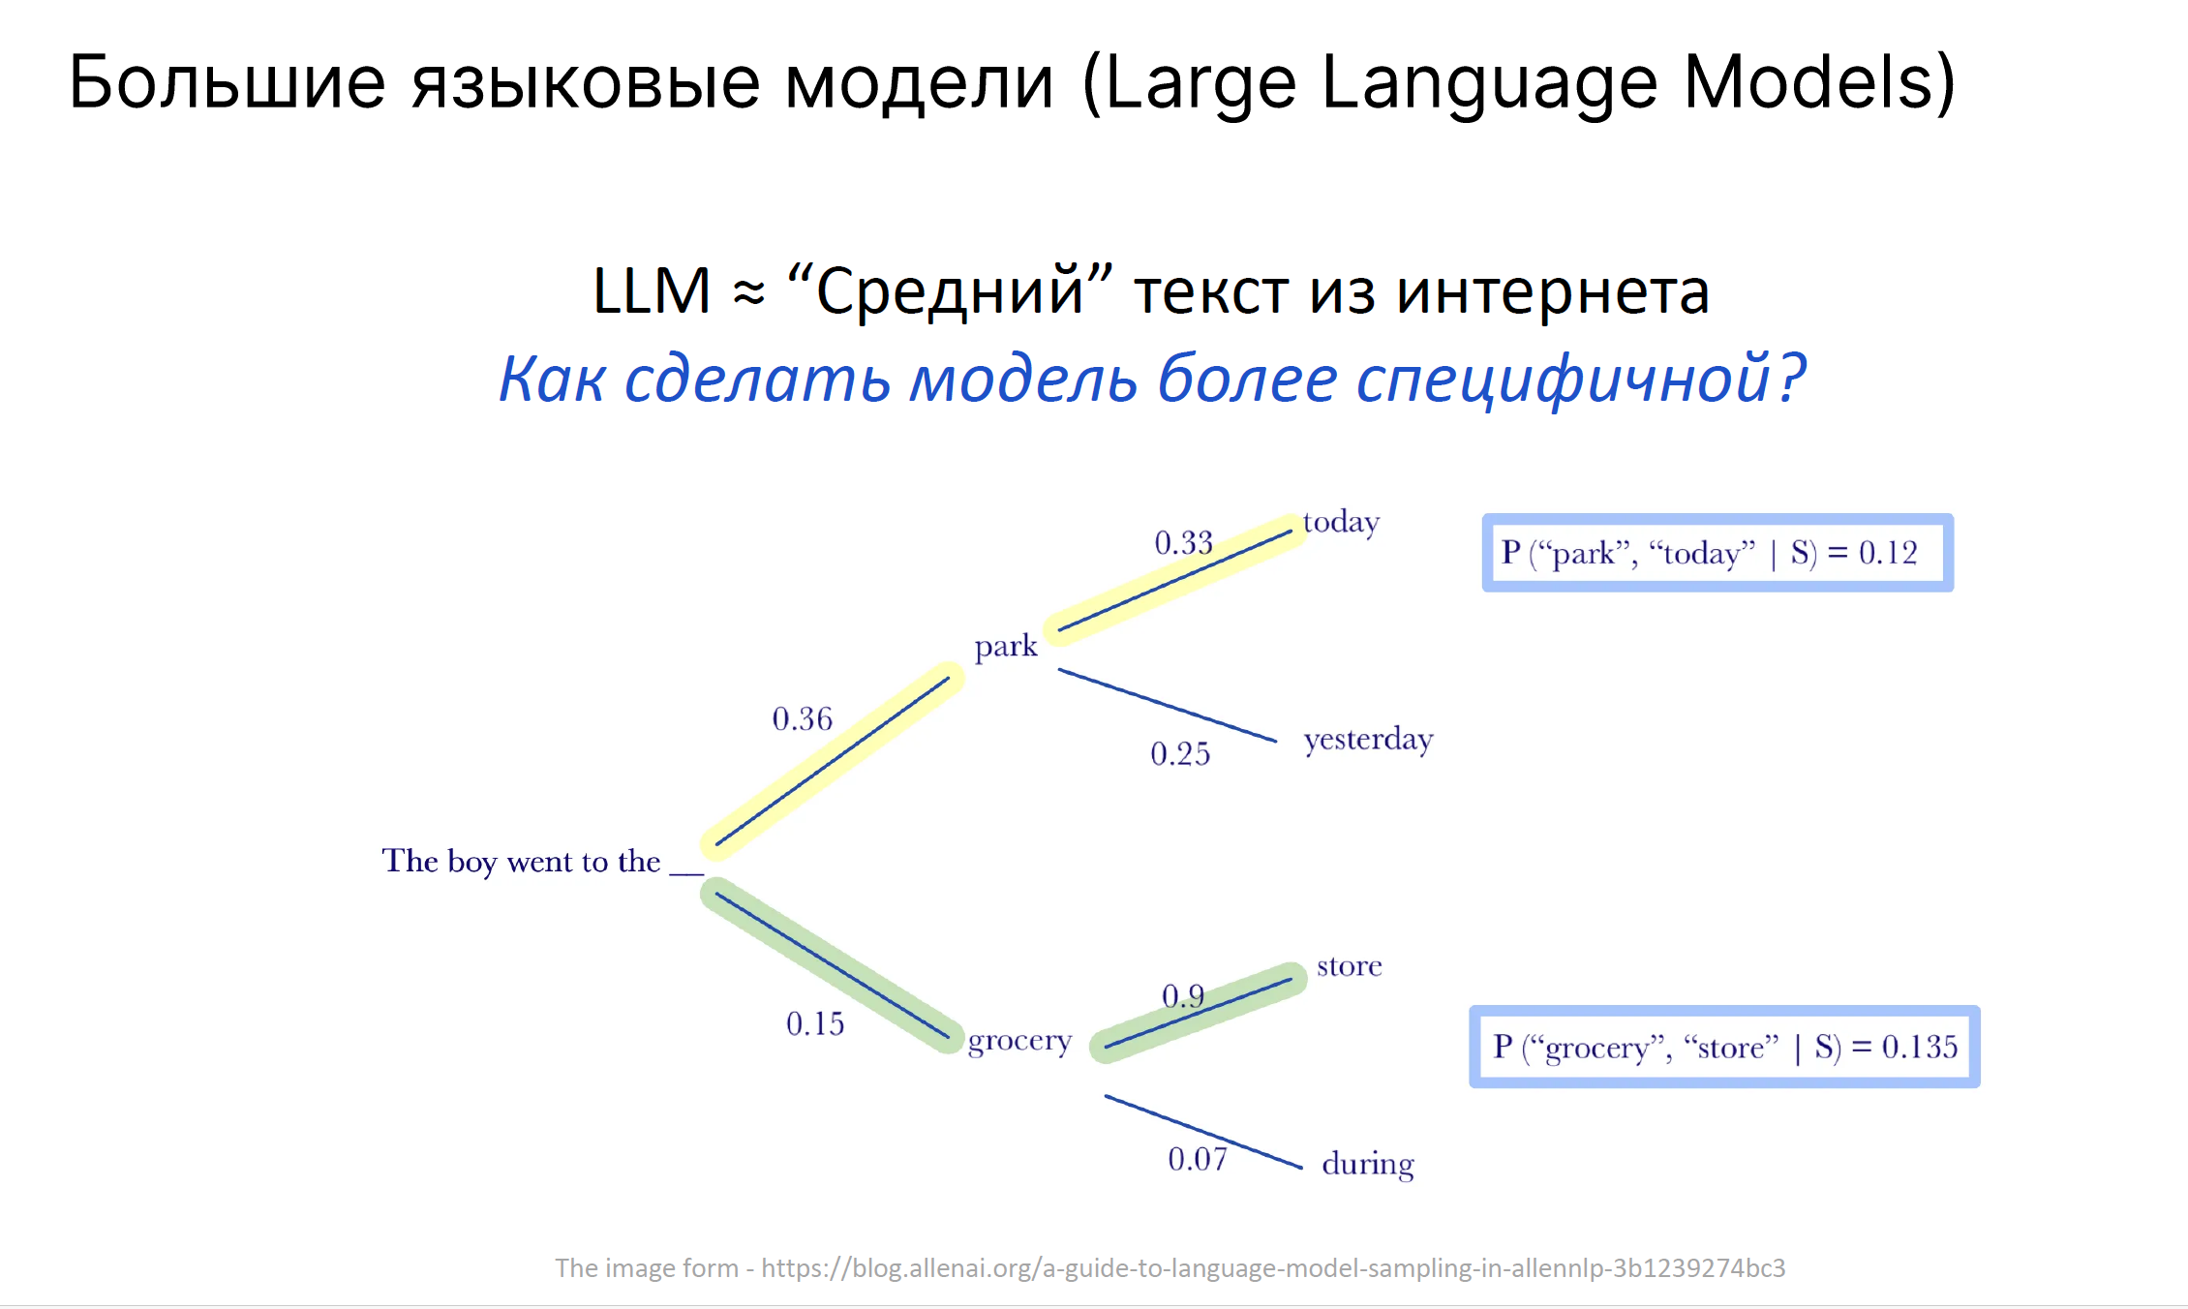

Slide 23
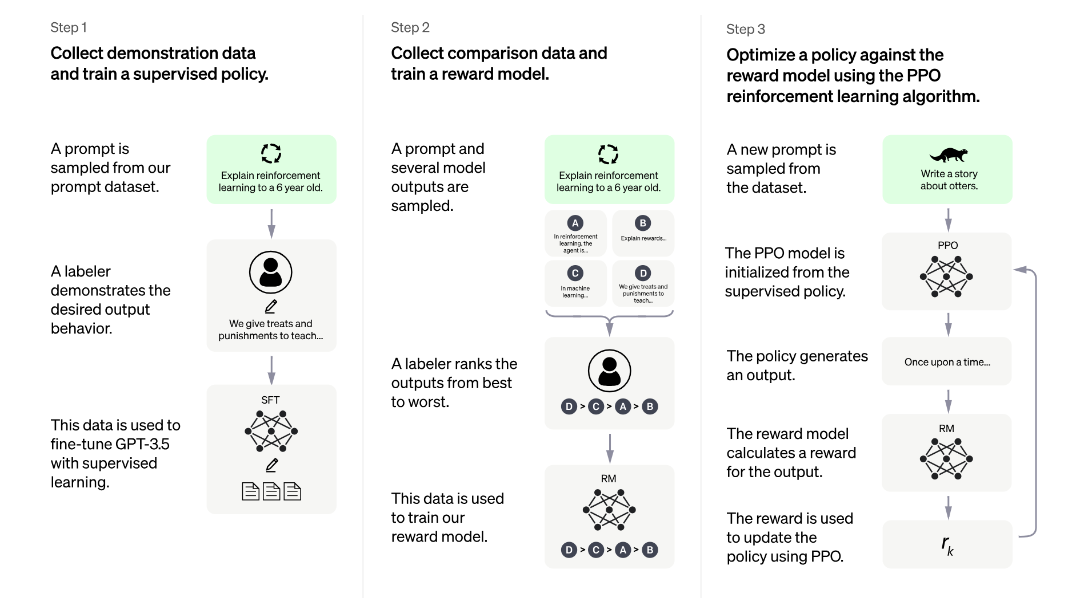

Slide 24
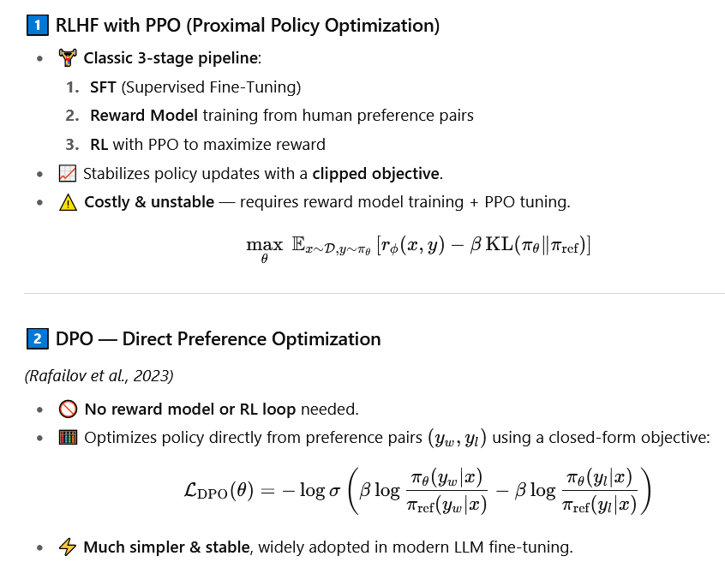

Slide 25
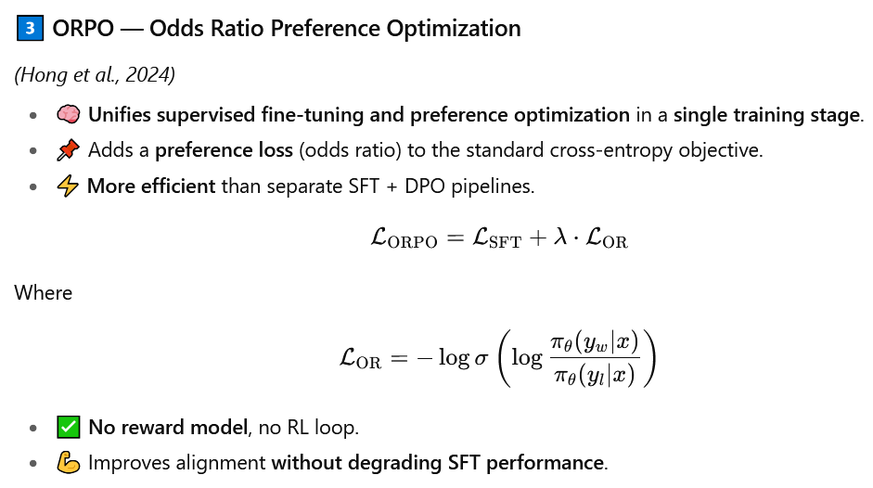
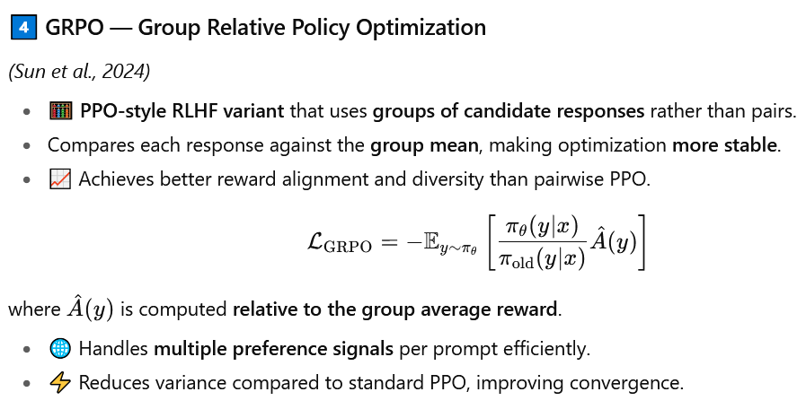

Slide 26
General LLM training pipeline
Pretraining -> base model
Goal: Learn general language representations from massive unlabeled corpora.
Objective: next-token prediction (causal LM) or masked-token prediction (BERT-style).
Data: tons of language data
Mid-Training -> base model
Goal: Refine the pretrained model on specialized domains or curated data
Objective: same as for step 1
Supervised Fine-Tuning (SFT) -> instruction-tuned model
Goal: Teach the model to follow instructions in a controlled way
Objective: standard cross-entropy loss on target responses
Data: high-quality prompt–response pairs written or filtered by humans
Preference Optimization / RLHF / RLAIF -> instruction-tuned model
Goal: Align the model with human preferences (helpfulness, honesty, harmlessness)
Post-Training / Safety Tuning
Goal: Ensure safe, robust, and policy-compliant behavior.
Methods: Adversarial training / red teaming, Constitutional AI (rule-based feedback), Guardrail fine-tuning (safety classifiers)

Slide 27
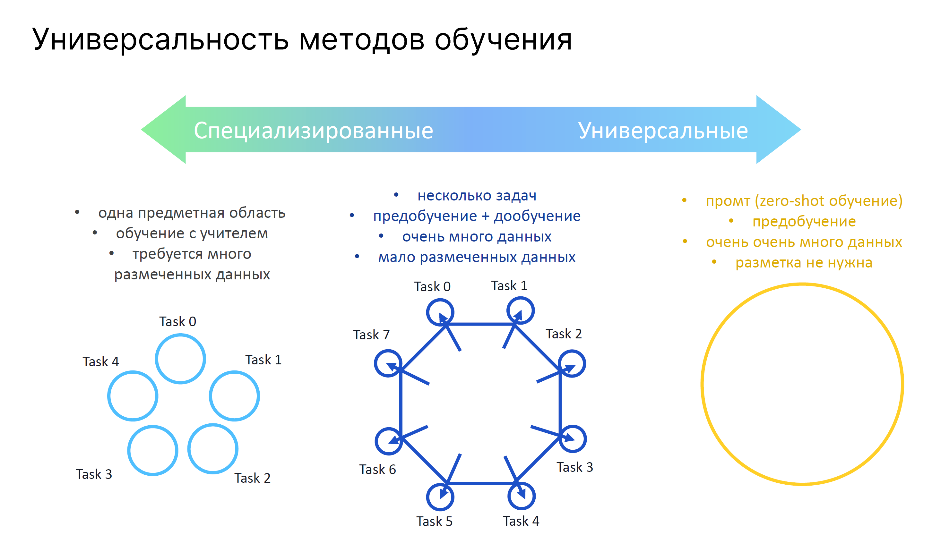

Slide 28
PEFT for LLMs: Parameter-Efficient Fine-Tuning
Adapt large pretrained LLMs to new tasks without updating all parameters.
Freeze most of the model and train only a small subset (e.g., adapters or low-rank layers).
Techniques:
LoRA (Low-Rank Adaptation) — injects trainable rank-decomposition matrices.
Prefix / Prompt Tuning — adds small learned tokens or embeddings to the input.
Adapters — insert lightweight modules between transformer layers.
Benefits: 10–100× fewer trainable parameters, faster training, lower memory, easier multi-task adaptation.

Slide 29
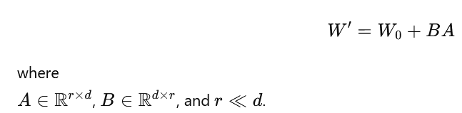
LORA: Low-rank adaptation
Freeze the pretrained model weights​ W₀ and learn small low-rank update matrices instead of full weight updates.
Only A and B are trained — all other parameters stay frozen.
Reduces trainable parameters by 10–100×.
Integrates seamlessly with existing Transformer layers (often in attention or feedforward blocks)
Multiple LoRA adapters can be swapped or merged post-training

Slide 30
Генеративные LLM сегодня: DeepSeek

Slide 31
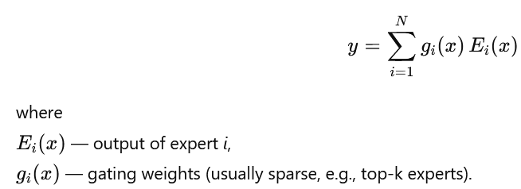
MoE: Mixture of Experts
Instead of one large dense network, use multiple specialized “experts” (sub-networks).A gating network dynamically selects which experts to activate for each input.
Only a small subset (k) of experts is active per token (e.g., 2 of 64). Greatly reduces compute per token, while maintaining total model capacity. Gating network learns which expert suits which input.
Specialization: experts learn domain- or pattern-specific behaviors.
Efficient inference: only partial model activated per step.

Slide 32
