Slide 1
Intro to NLP
Dmitry Ilvovsky
September 02, 2026

Slide 2
Natural language processing ...
along with computer vision a crucial part of modern artificial intelligence
deals with all human (and machine) interactions in language
requires understanding of linear algebra, statistics, mathematics in general, linguistics and coding skills

Slide 3
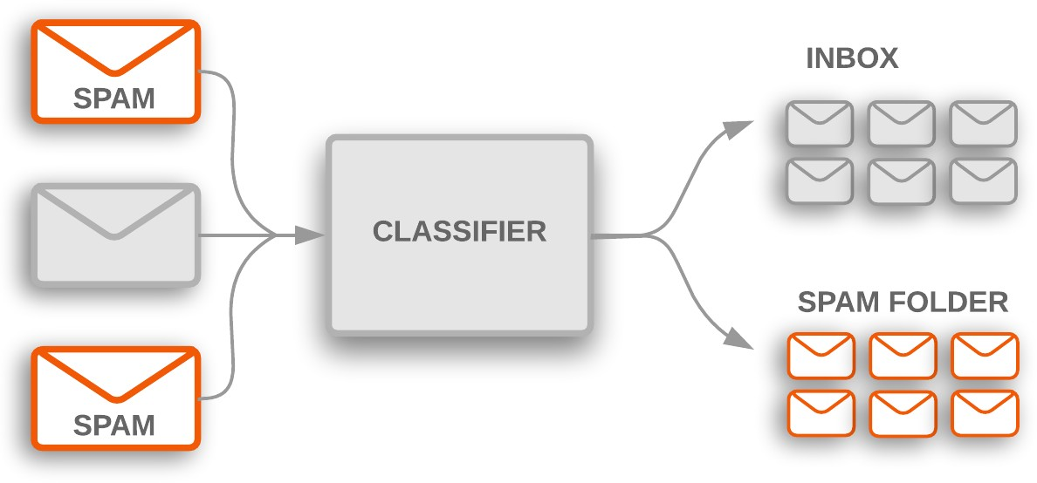
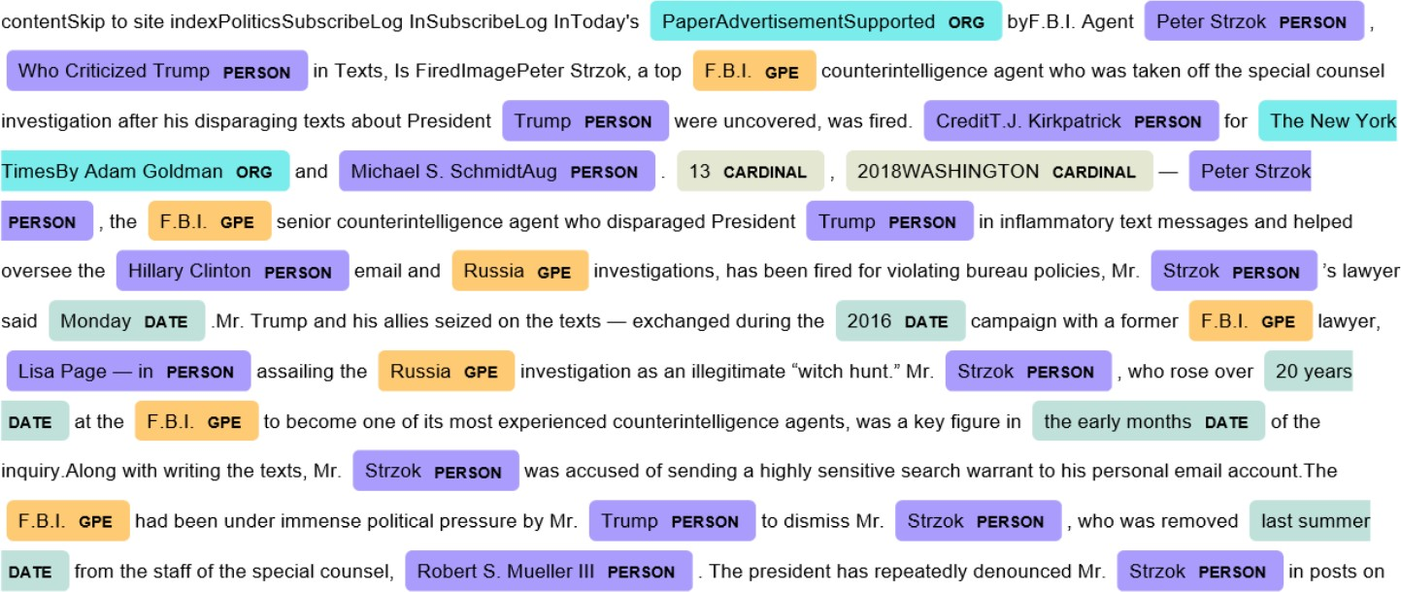
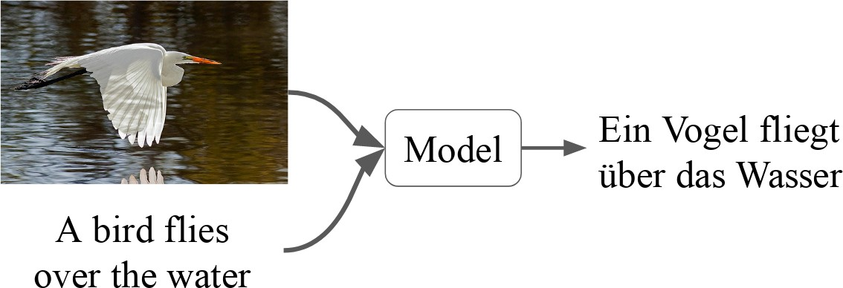
Example tasks
Text classification
Sentiment analysis
Intent detection
Spam filtering
Topic classification
Sequence labelling
Named entity recognition
Coreference resolution
Sequence transformation (seq2seq)
Machine translation
Question answering
Image sources: developers.google.com, towardsdatascience.com, statmt.org

Slide 4
Phenomena to handle
Tokenization and sentence boundary detection
Morphology
Syntax
Semantics
Discourse
Pragmatics
Multilinguality

Slide 5
Ambiguity
Polysemy and word-sense disambiguation: орган, bank
Homonymy: the ship or to ship, стекло
Syntactic ambiguity: John saw the man on the mountain with a telescope.

Slide 6

Syntactic ambiguity
John saw the man on the mountain with a telescope

Slide 7
Today
Intro
About this course Recent trends in NLP
Text preprocessing and explorative analysis
Practice: tools for processing Russian

Slide 8
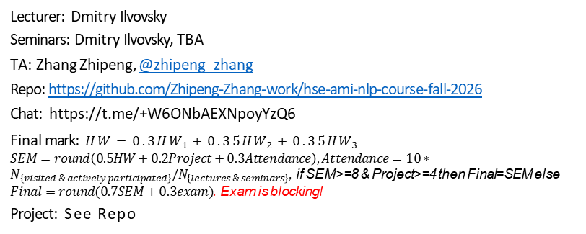
About this course
1
Lecturer: Dmitry Ilvovsky
Seminars: Dmitry Ilvovsky, TBA
TA: Zhang Zhipeng, @zhipeng_zhang
Repo: https://github.com/Zhipeng-Zhang-work/hse-ami-nlp-course-fall-2026
Chat: https://t.me/+W6ONbAEXNpoyYzQ6
Final mark: $HW=0.3HW_{1}+0.35HW_{2}+0.35HW_{3}$
$SEM=round\left(0.5HW+0.2Project+0.3Attendance\right), Attendance=10∗N_{\left\{visited \& actively participated\right\}}/N_{\left\{lectures \& seminars\right\}}$, if SEM>=8 & Project>=4 then Final=SEM else $Final=round(0.7SEM+0.3exam)$. Exam is blocking!
Project: See Repo
2
3
4
5
6
7

Slide 9
Our plan
Text preprocessing
Word embeddings Classic language modelling Masked language models Generative models
Advanced generative models Benchmarking for generative models
Advanced generative inference
Language resources Fact Checking
Graphs and NLP
TBA
1
2
3
4
5
6
7
8
9
10
11
12

Slide 10
Recent trends in NLP
Large Language Models
The ethics of AI
⁾ Fairness
⁾ Societal applications
Prompt-based learning
⁾ Zero-shot learning
⁾ Few-shot learning
Multiagent systems
Interpretable and Explainable AI

Slide 11
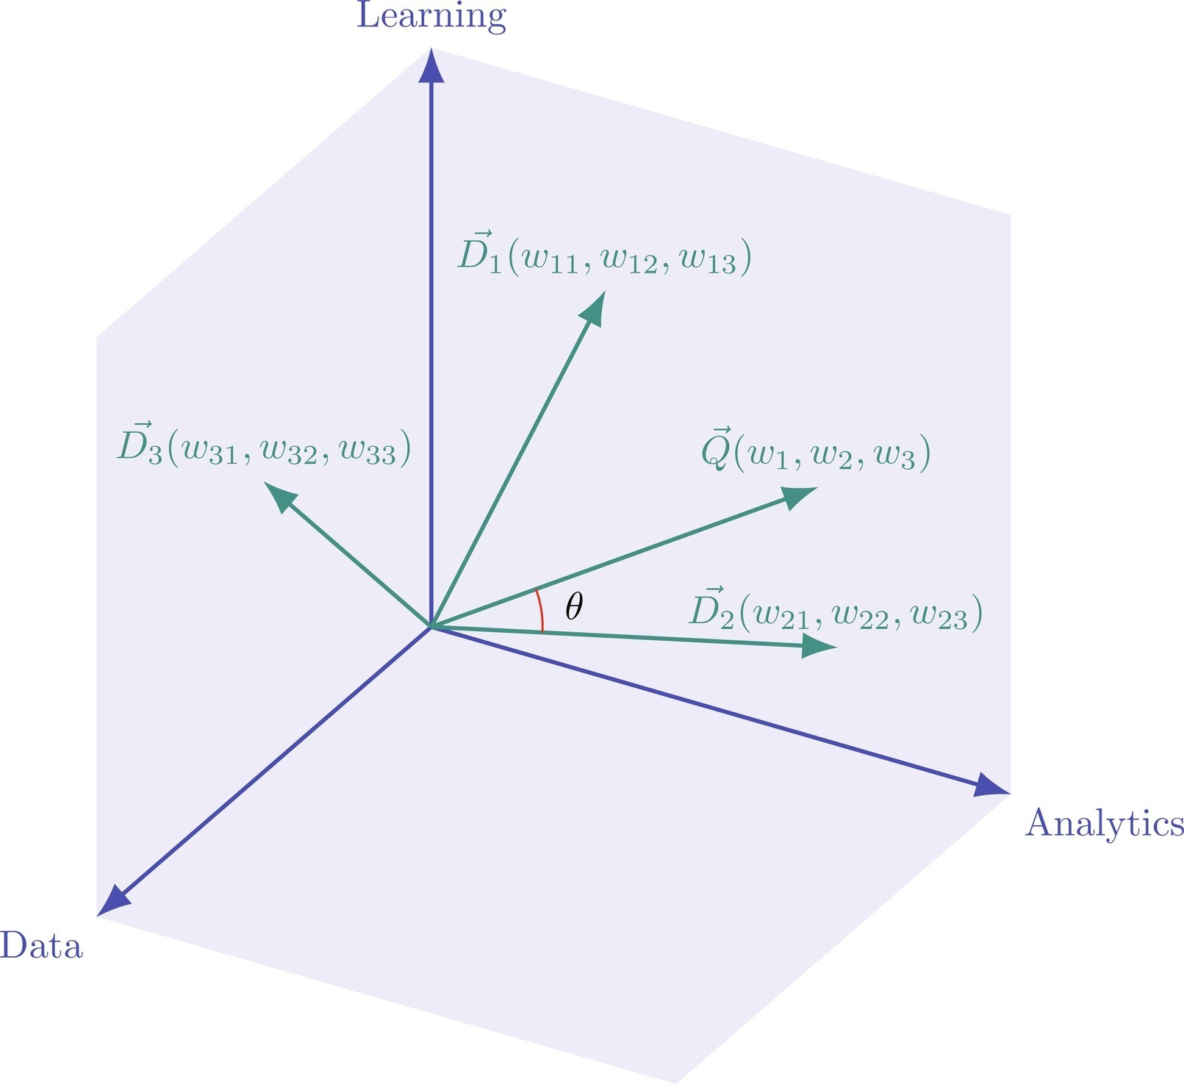
Vector space model [1]
Image source: Handbook of statistics

Slide 12
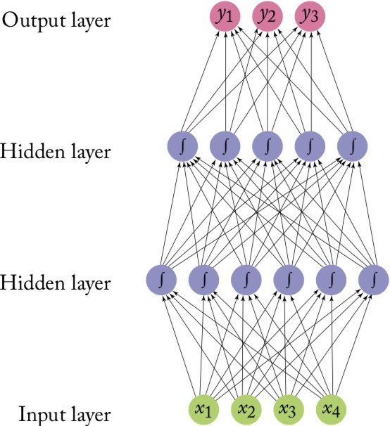
Feed forward network
Image source: NN Methods for NLP

Slide 13
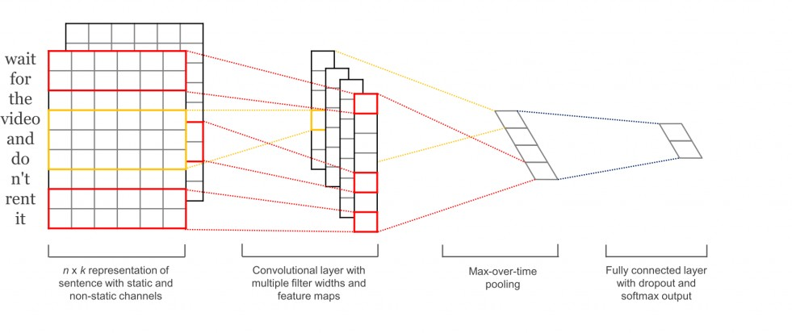
Convolutional network [2]

Slide 14
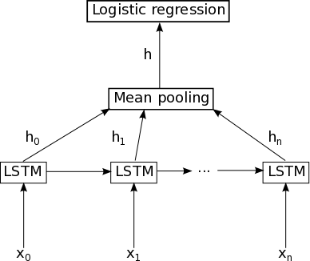
LSTM
Image source: deeplearning.net

Slide 15
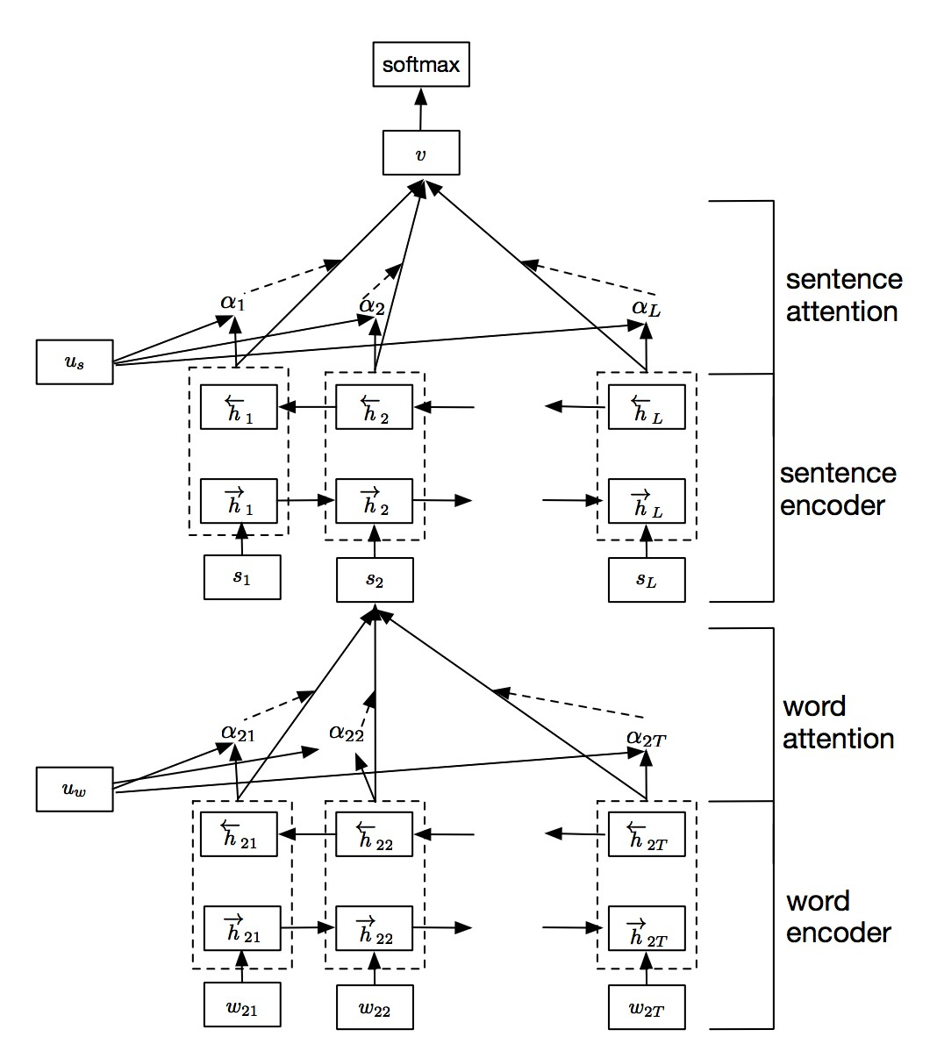
Hierarchical attention network [3]

Slide 16
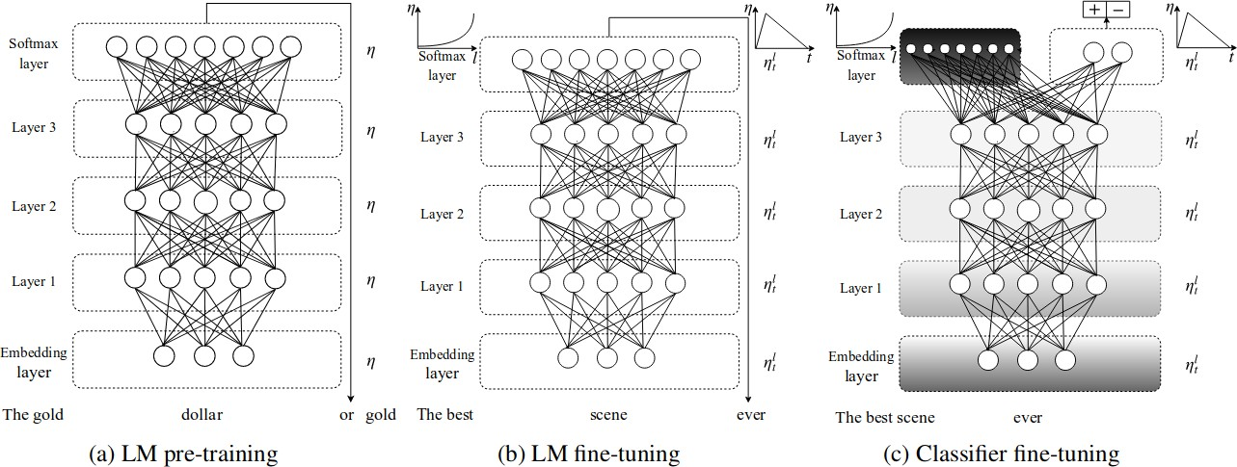
ULMFiT [4]

Slide 17
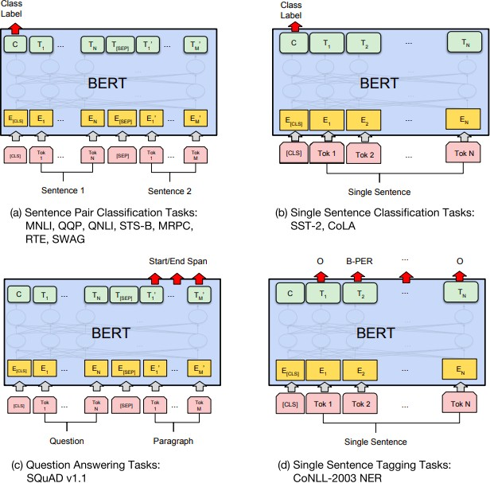
BERT [5]

Slide 18
Reading
Text classification algorithms: a survey [arXiv]
Speech and Language Processing. Daniel Jurafsky, James H. Martin, Ch. 2 [url]
Natural Language Processing. Jacob Eisenstein, Ch. 2-4, [GitHub]

Slide 19
Reference
G. Salton, A. Wong и C.-S. Yang, “A vector space model for automatic indexing”, Communications of the ACM, т. 18,
№ 11, с. 613—620, 1975.
Y. Kim, “Convolutional neural networks for sentence classification”, arXiv preprint arXiv:1408.5882, 2014.
Z. Yang, D. Yang, C. Dyer, X. He, A. Smola и E. Hovy, “Hierarchical attention networks for document classification”, в Proceedings of the 2016 conference of the North American chapter of the association for computational linguistics: human language technologies, 2016, с. 1480—1489.
J. Howard и S. Ruder, “Universal language model fine-tuning for text classification”, arXiv preprint arXiv:1801.06146, 2018.
J. Devlin, M.-W. Chang, K. Lee и K. Toutanova, “Bert: Pre-training of deep bidirectional transformers for language understanding”, arXiv preprint arXiv:1810.04805, 2018.

