Slide 1
Topic 1
CAB202 – Microprocessors and Digital Systems
Unit Coordinator: Lawrence Buckingham
Lecturer: Luis Mejias Alvarez

Slide 2

Acknowledgement of Traditional Owners
In keeping with the spirit of Reconciliation, we acknowledge the Traditional Owners of the lands where QUT now stands, and recognise that these have always been places of teaching and learning.
We wish to pay respect to their Elders - past, present and emerging - and acknowledge the important role Aboriginal and Torres Strait Islander people continue to play within the QUT community.

Slide 3
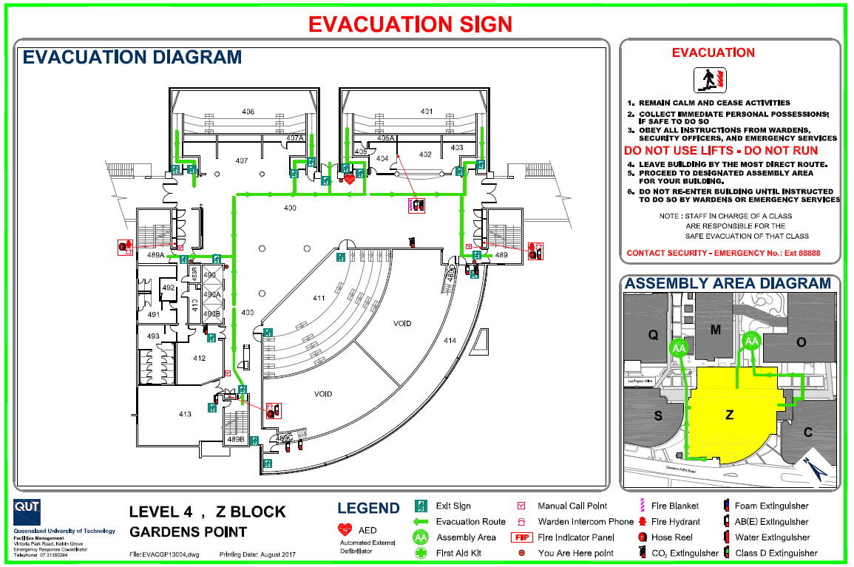

Slide 4
Conduct
At QUT, we strive to create an environment of respect – where everyone is welcome, comfortable participating, and free from harassment
This unit is governed by our code of conduct, and I want to thank you for doing your part towards building an inclusive community.
If you feel uncomfortable, or if there are any other issues that need addressing, please come and see me, or any other member of the teaching team – we're happy to assist.

Slide 5
about:today
Housekeeping
Organisation
Assessment
Where to go for help
Writing our first C programs
Character oriented I/O
Review structured programming
Sequence; Selection; iteration.

Slide 6
about:cab202
Delivery mode:
Lecture – 2hr, demonstration style
Tutorial – 2hr, guidance and feedback from tutor
Assessment:
Week 2 .. Week 11: Portfolio items; 30%; submit and graded via AMS.
Week 12, Sunday: Assignment; 40%; submit via Blackboard; graded by tutors.
Exam Period: Examination; 30%.

Slide 7
Workload
http://www.mopp.qut.edu.au/C/C_03_01.jsp#C_03_01.05.mdoc
“Using this guide, and recognising that actual time will vary for each student, a 12 credit unit is designed to take approximately 150 hours.”
Expect to invest about an hour per percentage point into each assessment item.
CAB202 is challenging but rewarding.
You need to exhibit responsibility, resourcefulness, initiative, and perseverance.
Prepare to teach yourself; don’t wait for us to tell you the “answer”.

Slide 8
AMS == Automated Marking System
A web-based unit testing framework.
Small, well defined specifications of programs that you will implement.
For given input, every correct implementation will produce the expected output. For the same input, incorrect implementations will produce actual output that is different from the expected output.
AMS runs my code to produce expected output. AMS runs your code on the same input data to produce actual output.
If the actual output does not match the expected output, then your program contains at least one error. AMS tells you about this and you can try again.

Slide 9
Why AMS?
AMS is specific and objective.
AMS helps you learn to program.
AMS gives you instant feedback.
AMS gives you plenty of attempts.
AMS lets you work at your own pace.
AMS helps you keep up with the workload.
First AMS exercises – 3% – open now; due midnight Sunday at the end of Week 2.

Slide 10
Slack Channel
Apart from tutorials, the Unit Slack channel is intended to be the primary point of interaction with other students, and with tutors outside class.
It is part of our shared digital workspace, so it must be treated as such:
Keep it safe, pleasant, respectful, and relevant.
Unhelpful, abusive, distracting or attention-seeking behaviour is not acceptable.
Use your QUT email and real name to sign up
The link to join Slack is available in Class Notices on BB.

Slide 11
References
Steve Oualline, Practical C Programming, 3rd Ed.
eBook: http://QUT.eblib.com.au/patron/FullRecord.aspx?p=741263
Byron Gottfried, Schaum's Outline of Programming With C, 2nd Ed.
Library has 4 copies.
eBook available for purchase from publisher and range of on-line vendors ~ USD20.00.
Deitel & Deitel, C: How To Program, 5th Ed.
Library has 3 copies http://libcat.library.qut.edu.au/record=b2129545~S8

Slide 12
Useful links
For everyday use:
C Standard Library Reference:
https://en.wikipedia.org/wiki/C_standard_library
http://www.cplusplus.com/
GDB Cheat Sheet:
http://www.yolinux.com/TUTORIALS/GDB-Commands.html
More detailed references:
GCC Reference:
https://gcc.gnu.org/onlinedocs/
ISO C Standard
http://www.open-std.org/JTC1/SC22/WG14/www/docs/n1570.pdf

Slide 13
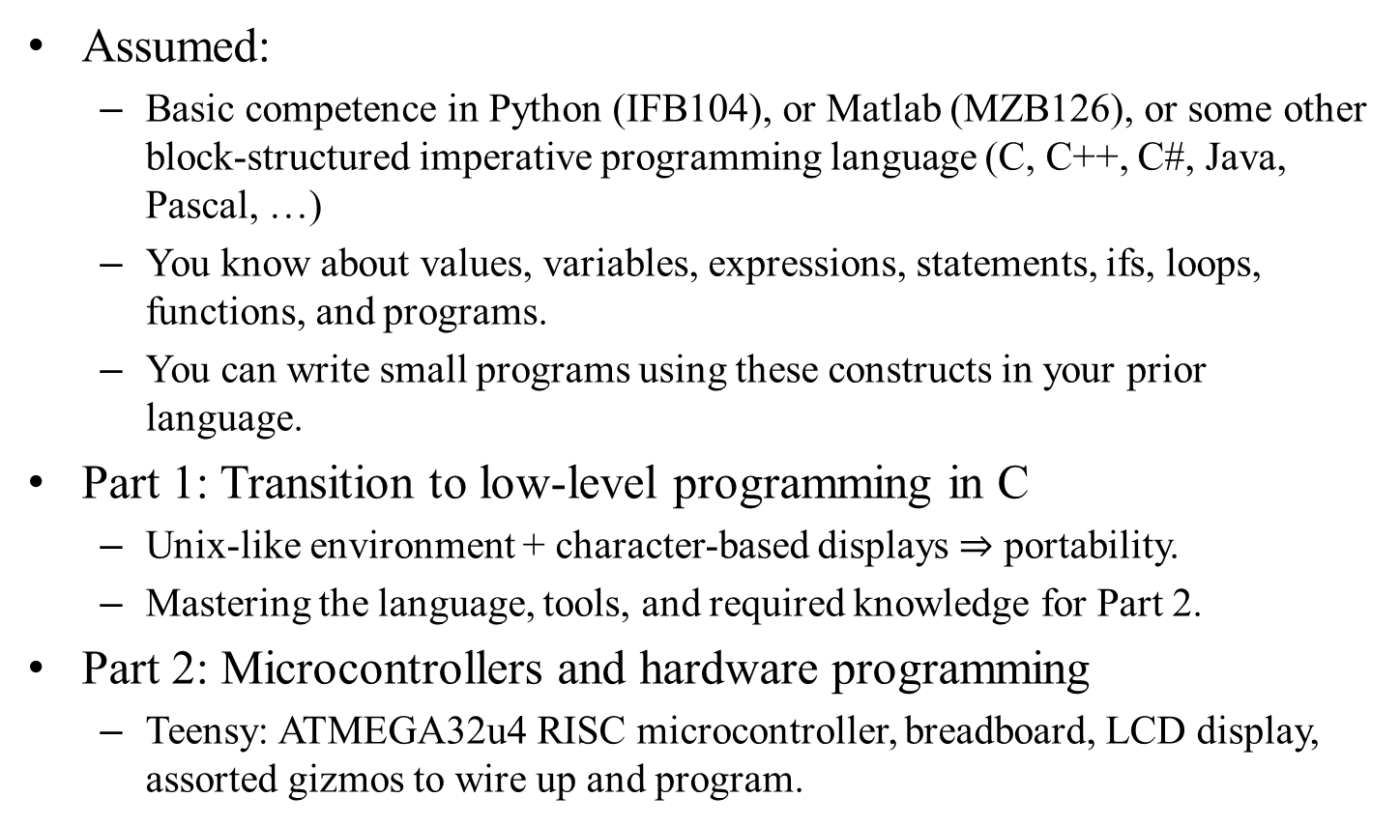
Unit overview
Assumed:
Basic competence in Python (IFB104), or Matlab (MZB126), or some other block-structured imperative programming language (C, C++, C#, Java, Pascal, …)
You know about values, variables, expressions, statements, ifs, loops, functions, and programs.
You can write small programs using these constructs in your prior language.
Part 1: Transition to low-level programming in C
Unix-like environment + character-based displays $⇒$ portability.
Mastering the language, tools, and required knowledge for Part 2.
Part 2: Microcontrollers and hardware programming
Teensy: ATMEGA32u4 RISC microcontroller, breadboard, LCD display, assorted gizmos to wire up and program.

Slide 14
Microprocessors and Digital Systems
Microprocessors and microcontrollers are ubiquitous
Digital devices are everywhere
Google: “what kind of products contain microcontrollers”
What is a microcontroller?
From the source of all human knowledge
“A microcontroller is a small computer (SoC) on a single integrated circuit containing a processor core, memory, and programmable input/output peripherals. Program memory in the form of Ferroelectric RAM, NOR flash or OTP ROM is also often included on chip, as well as a typically small amount of RAM. Microcontrollers are designed for embedded applications, in contrast to the microprocessors used in personal computers or other general purpose applications consisting of various discrete chips.”
What is a digital system?
Any system controlled by digital logic as distinct from mechanical “logic”.
Algorithms replace physical components (gears, cams).

Slide 15
Microcontrollers are usually part of larger electromechanical systems
We need to learn how to program for systems with tight resource limitations.
Teensy used in this unit has 32kB Flash memory and 2,500 bytes of RAM
Programs O(0.1) kloc to O(1) kloc
k = 1000, loc = lines of code
But some of us will be part of something much larger.
http://www.informationisbeautiful.net/visualizations/million-lines-of-code/
Some of what we’re doing has that in mind.

Slide 16
The remainder of the lesson
Eventually we will turn to Learning Resources for Topic 1…
Quick look at the tool set used in CAB202.
Build, run, & debug our first C programs.
See how to use AMS.
But first…

Slide 17
Programs = Algorithms + Data

Slide 18
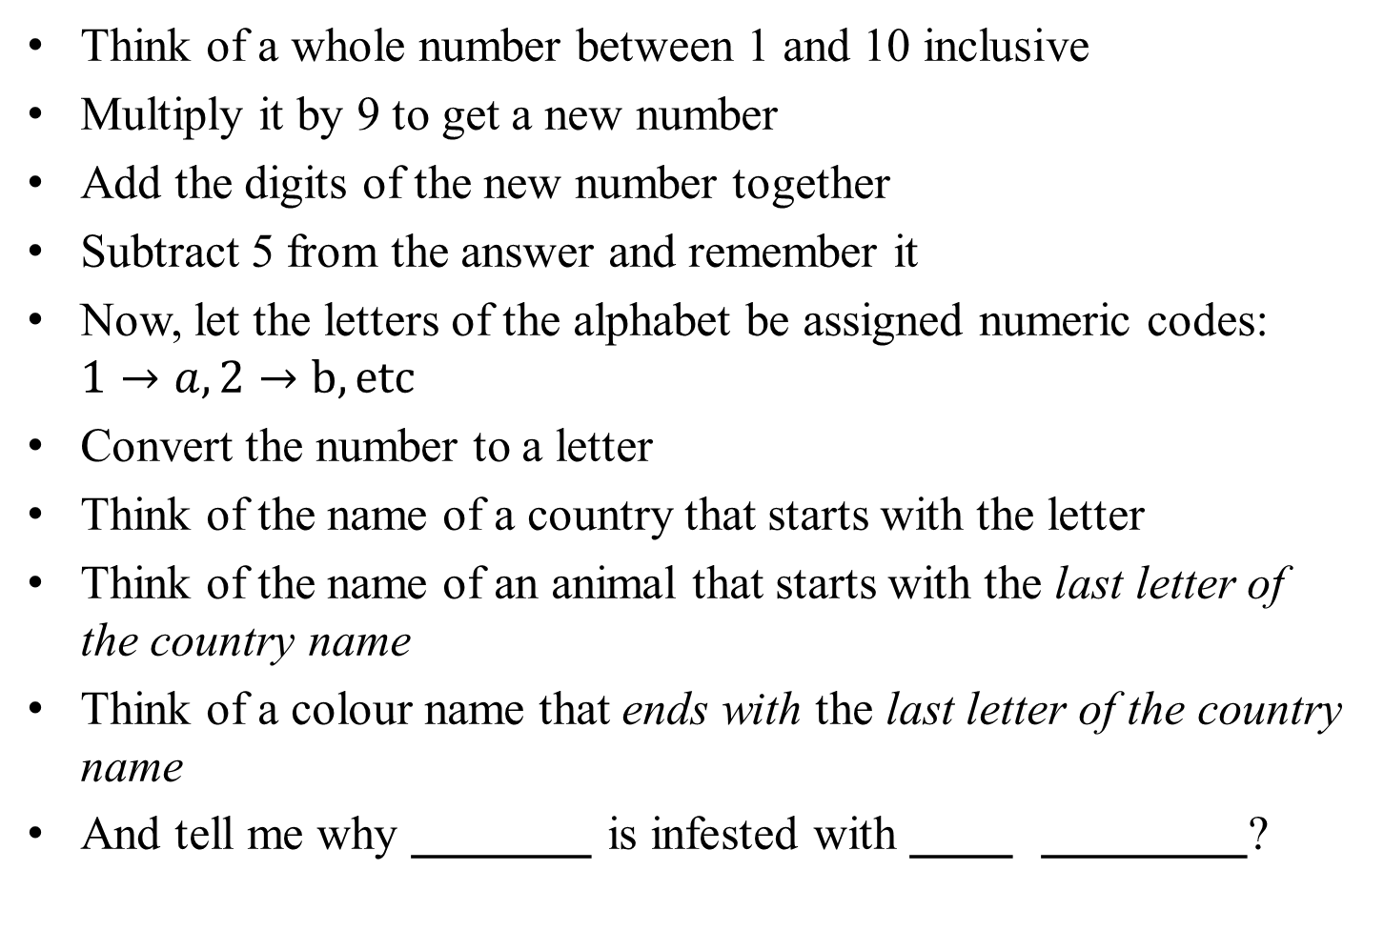
Be the Computer!
Think of a whole number between 1 and 10 inclusive
Multiply it by 9 to get a new number
Add the digits of the new number together
Subtract 5 from the answer and remember it
Now, let the letters of the alphabet be assigned numeric codes: $1→a, 2→b, etc$
Convert the number to a letter
Think of the name of a country that starts with the letter
Think of the name of an animal that starts with the last letter of the country name
Think of a colour name that ends with the last letter of the country name
And tell me why _______ is infested with ____ ________?

Slide 19
Is that an algorithm?
What might be the inputs; outputs; state; process? (Don't try to take this too seriously today.)
Notes:
Yup, a non-deterministic algorithm.

Slide 20
Hello from C

Slide 21
R R R
Reading
wRiting
aRithmetic

Slide 22
What are these?
1, 2, 3, 'p', 'q', 's', -17, -68, 127, 12345678, -5198985
Notes:
They're integer literals; some are formatted to look like characters.

Slide 23
echo_int, echo_char, echo_char

Slide 24
What are these?
1.0, 9.81, 6.67e-11, 3.14159265358979, 6.023e+23
Notes:
They're double precision floating point literals.

Slide 25
What are these?
+ - * / %
= += -= *= /= %=

Slide 26
Temperature Conversion

Slide 27
Area of a circle

Slide 28
More info:
C reference library: http://www.cplusplus.com/reference/cstdio/
Books.
Internet.

Slide 29
End

Slide 30
The rest is some old slides that I don't have the heart to delete today…

Slide 31
Software Development Life Cycle
Notes:
Analysis
Break problem down to components
Identify relationships/connections between components
Identify constraints on inputs, outputs, side effects; how inputs + state are related to outputs + side effects
Design
Figure out hardware and software designs for each component
Specify data types to model inputs and outputs, and any state that needs to be stored
Specify Procedures/Functions to transform inputs to outputs, updating state.
Implementation
Convert design to physical hardware and working software
Wire up; write code.
Test
Figure out a test plan for each component
Target every conceptual level
Tabulate input sequences/values/events and the expected output/side-effect

Slide 32
Software development life cycle
Iterate these processes:
Requirement definition
Overall statement of task: rules, constraints, considerations.
Analysis
Break the task down into pieces; figure out how each piece will have to work, and how the pieces to fit together.
Design
Design a set of algorithms and data structures to do each piece, and specify the way information needs to flow between these components.
Implementation
Implement each component using appropriate programming language(s), data storage, and communication technologies.
Test
Run the system, or possibly parts in isolation. Seek out bugs; make sure each part is good, that the parts fit together properly, and that your solution is fit for use.
Put the system into operation.
Encounter problems; experience change.
Go to 1

Slide 33
How we implement each part
Iterate the following steps
Edit source files
Create code.
Compile code
Produce a runnable program.
Run the program to carry out tests.
Identify defects
Gross defects, e.g. program crashes; non-termination.
Test runs produce incorrect results.
Debug program
Tracing and manual instrumentation.
Software assistance (debugger).
Go to 1.

Slide 34
What we will see:
Computers are machines that execute programs.
A program is a list of instructions, loaded into memory, along with data.
The instructions understood by a computer are called machine code: all numbers.
not written in languages like C, Python, or Matlab.
A computer runs a tight loop continuously:
Fetch a machine code instruction from memory
Decode the instruction
Do the operation defined by the instruction
Move on to next instruction.

Slide 35
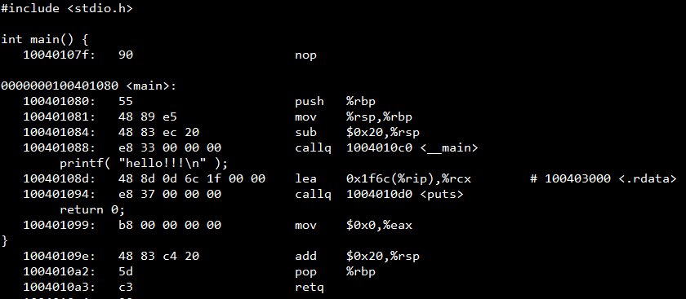
Machine code and assembly language
The hexadecimal numbers 55 48 89 e5 48 83 ec 20 e8 33 00 00 00 48 8d 0d 6c 1f etc are machine code.
The more readable mnemonics are assembly language (push %rbp; mov %rsp,%rbp; sub $0x20,%rsp …)

Slide 36
Languages
Machine code is numbers: hard for people to write and read, so we use formal languages that are easier for us to read and write, while retaining rigorous well defined mappings to machine language.
Examples:
Python, Matlab, C: look a lot like algebra
Assembly language: looks more like machine code
Python, Matlab are interpreted:
Another program (written in a language like C) reads the Python/Matlab instructions and executes them.
C, Assembly language are translated (compiled) to machine code:
Which is then executed directly by the computer.

Slide 37
Compiled languages
The program that translates C to machine code is called a compiler.
Compiled code is usually more efficient than interpreted code.
Interpreted code is translated at run time, which takes time.
Does not require the overhead of an interpreter to run.
The Python, Matlab, Java and .Net runtime environments are massive (gigabytes) in size.
So we can write programs for devices with tight resource constraints.
Small memory.
Slow clock speed.
Low power.
Often running for a long time in a hostile environment.

Slide 38
C programming
We use a text editor to write programs
Often part of an integrated development environment (IDE)
IDE also has advanced facilities to make us productive:
File manager
Revision control (Git)
Debugger
Terminal
Informational windows

Slide 39
Demonstration
Install CAB202 software.
Look at some programs.
hello.c and f2c.c will introduce the syntax of C

Slide 40
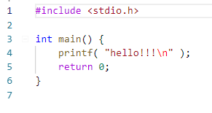
hello.c

Slide 41
hello.c
Read the contents of standard header file “stdio.h” and insert into program

Slide 42
hello.c
Begin the definition of a function called “main” which is not expecting to receive any arguments, and which promises to return an integer value.
Every C program has a function called “main”.

Slide 43
hello.c
The instructions that make up the body of main start here. This is the beginning of a block.
Every block is surrounded by paired braces.
A block is a list of statements, glued together to become a single logical instruction.

Slide 44
hello.c
The instructions that make up the body of main end here.

Slide 45
hello.c
When the program starts, this will be the first thing that happens.
It will send the text “hello!!!”, followed by a linefeed symbol, to the standard output stream.
Which might be the terminal.
printf means print formatted text.

Slide 46
hello.c
Finally, we send a “success code” back to the code that called us.
Fulfilling the promise to return an integer.

Slide 47
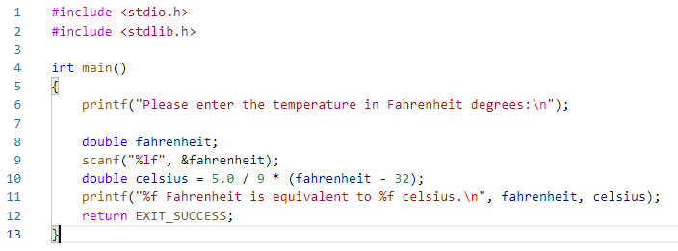
f2c_simple.c
Get a copy of “stdio.h” and insert it into our program.
Get us the declarations of printf and scanf
In C, we need to declare every variable, function, or data type, before we can use it.

Slide 48
f2c_simple.c
Get a copy of “stdlib.h” and insert it into our program.
Gets us the declaration of the symbolic constant EXIT_SUCCESS.
Which equals 0, but also conveys meaning.

Slide 49
f2c_simple.c
Ask the user to enter the temperature in Fahrenheit degrees.

Slide 50
f2c_simple.c
Declare a variable called fahrenheit, which will be able to store a floating point value.
Tells the compiler to set aside 8 bytes of memory someplace, and let us call it “fahrenheit”.

Slide 51
f2c_simple.c
The value of fahrenheit is initially undefined, because a value has not been assigned into fahrenheit yet.
We have to consider it to be garbage.

Slide 52
f2c_simple.c
Try to fetch a numeric value from the standard input stream
Which may be the keyboard.

Slide 53
f2c_simple.c
The first argument sent to scanf is a format string.
Tells scanf how to parse symbols from the input stream.
%lf means “long floating point”

Slide 54
f2c_simple.c
The next argument tells scanf the address of the place in memory where it should put the numeric result data.
& is “the address of”.
You can read this as “into fahrenheit”.

Slide 55
f2c_simple.c
We don’t know where fahrenheit is, and we don’t really care.
But scanf needs to know, so the compiler keeps track of where the variable is, and gives that address to scanf when we ask for its address.
&fahrenheit

Slide 56
f2c_simple.c
We don’t know where fahrenheit is, and we don’t really care.
But scanf needs to know, so the compiler keeps track of where the variable is, and gives that address to scanf when we ask for its address.
&fahrenheit

Slide 57
f2c_simple.c
Declare a variable called celsius, and initialise it by calculating a value.

Slide 58
f2c_simple.c
Send formatted text to standard output stream.
One format specifier for each value to be inserted into the string.
%f means “floating point”

Slide 59
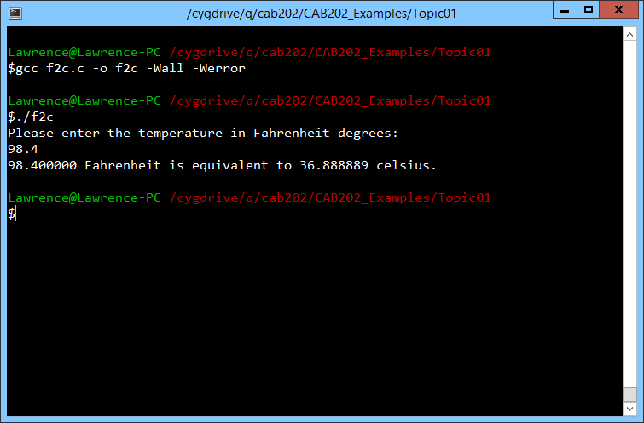
f2c_simple.c
Compile:
gcc f2c.c -o f2c -Wall -Werror
Run:
./f2c

Slide 60
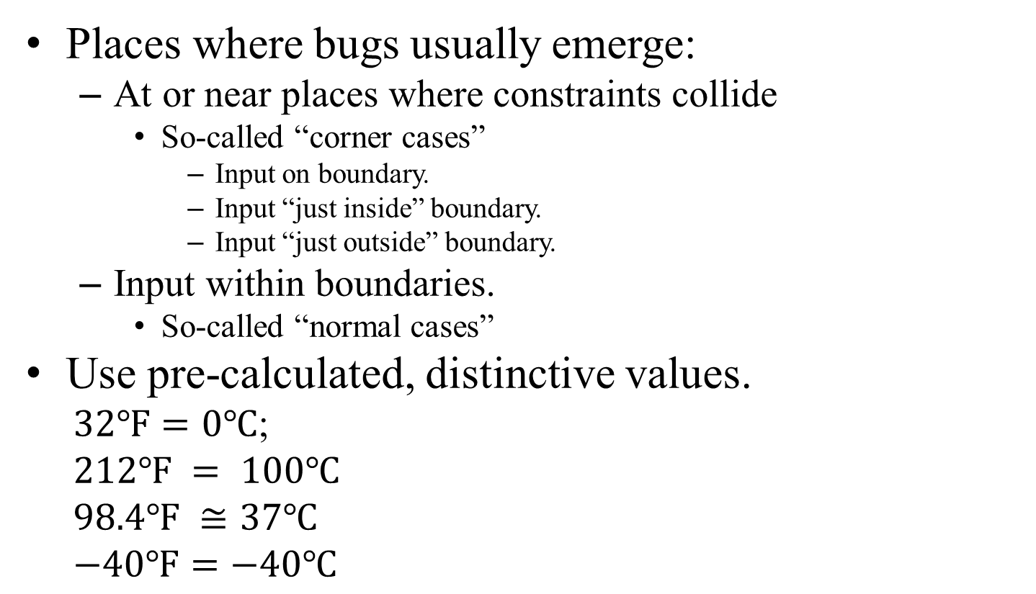
Test plan for f2c
Places where bugs usually emerge:
At or near places where constraints collide
So-called “corner cases”
Input on boundary.
Input “just inside” boundary.
Input “just outside” boundary.
Input within boundaries.
So-called “normal cases”
Use pre-calculated, distinctive values.
$32℉=0℃$;
$$212℉ = 100℃$$
$$98.4℉ ≅37℃$$
$$−40℉=−40℃$$
This program only has “normal cases”, unless you want to consider non-numeric input errors.
In a microcontroller, that is moot point, so we will by design (i.e. not by incompetence) deliberately ignore that class of “error” for now.

Slide 61
More info:
C reference library: http://www.cplusplus.com/reference/cstdio/
Books.
Internet.

Slide 62
End

