Slide 1
Intro to VAE
Group U8: Lake Yin, Zhiqi Wang

Slide 2
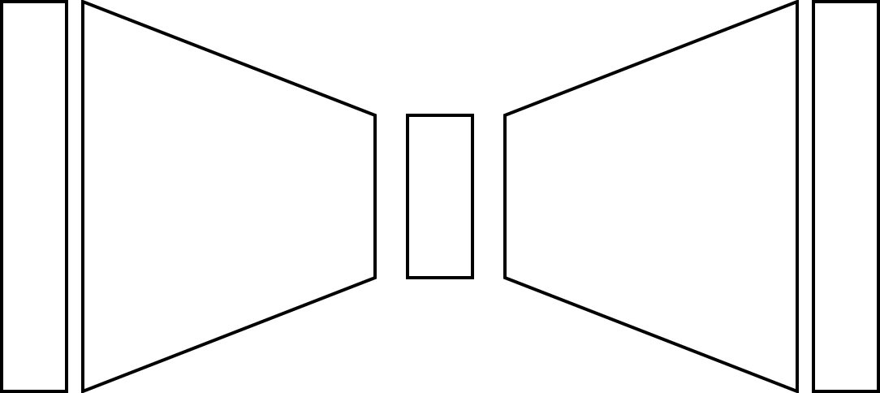




Recap on Autoencoder
$$x$$
$$\hat{x}$$
$x$is the input
$z$is latent representation of $x$ the network learns
$\hat{x}$ is the reconstruction from $x$
$$z$$

Slide 3
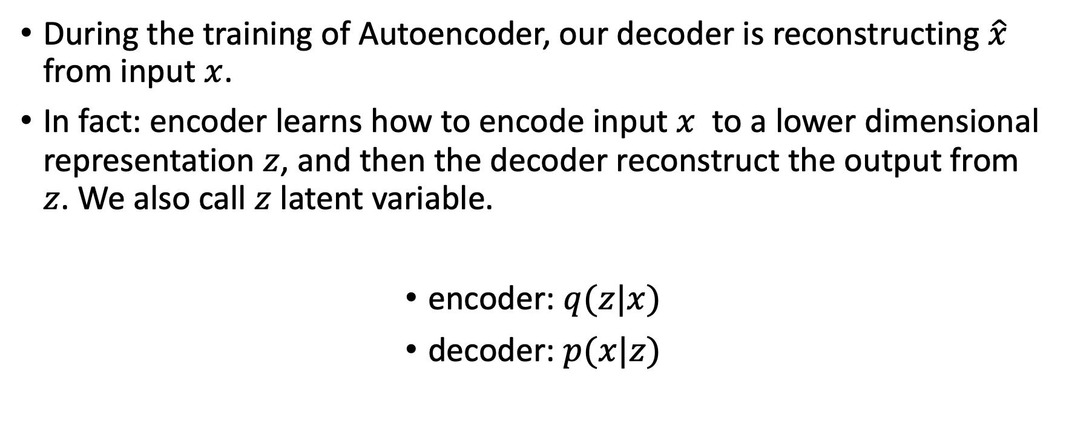
Latent Variable
During the training of Autoencoder, our decoder is reconstructing $\hat{x}$ from input $x$.
In fact: encoder learns how to encode input $x$ to a lower dimensional representation $z$, and then the decoder reconstruct the output from $z$. We also call $z$ latent variable.
encoder: $q(z|x)$
decoder: $p(x|z)$

Slide 4


Recap on Autoencoder
$$x$$
$$\hat{x}$$
$x$is the input
$z$is latent representation of $x$ the network learns
$\hat{x}$ is the reconstruction from $x$
$$z$$
encoder: $q(z|x)$
decoder: $p(x|z)$

Slide 5
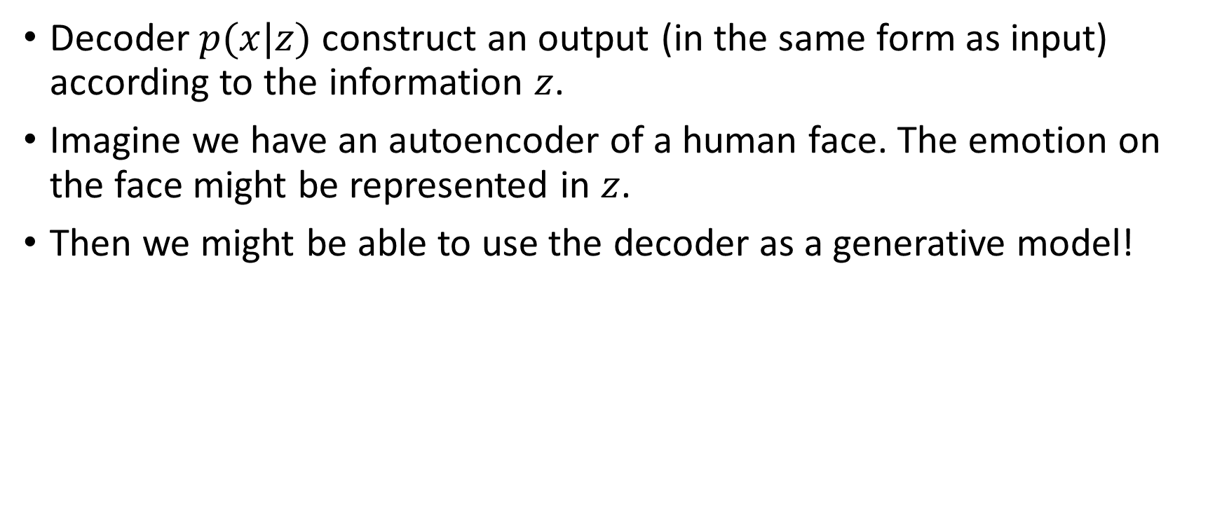
Decoder As a Generator
Decoder $p(x|z)$ construct an output (in the same form as input) according to the information $z$.
Imagine we have an autoencoder of a human face. The emotion on the face might be represented in $z$.
Then we might be able to use the decoder as a generative model!

Slide 6
Autoencoder Flaws
No latent representation distribution
Not guaranteed to be continuous
Difficult for generating new data

Slide 7
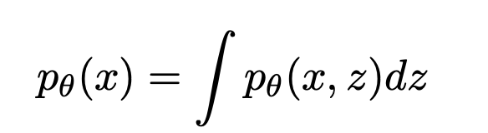
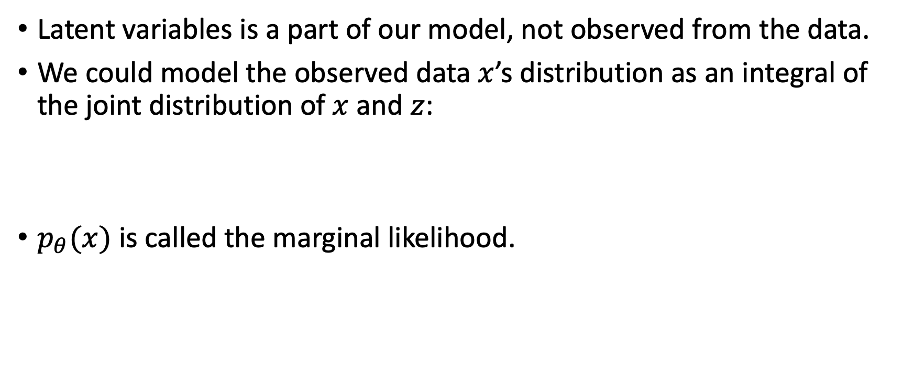
More on Latent Variables
Latent variables is a part of our model, not observed from the data.
We could model the observed data $x$’s distribution as an integral of the joint distribution of $x$ and $z$:
$p_{θ}(x)$ is called the marginal likelihood.

Slide 8


Goal
Our goal is to find $θ^{∗}$ such that .
In other word, we want to find the optimal parameter for our model to make good approximation of the input data’s distribution.

Slide 9
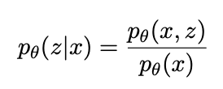

Intractability
To find the joint distribution:
This integral has no closed form. We can’t compute it / we can’t compute it efficiently.
Similarly, the posterior distribution
is also intractable, since is intractable.

Slide 10

We could use VAE to Model $p_{θ}(x)$

Slide 11
Variational Autoencoders
Paper: Auto-Encoding Variational Bayes
Diederik P. Kingma and Max Welling
International Conference on Learning Representations 2014
Proposed a method for estimating latent variables with intractable posterior distributions using stochastic gradient descent
Previous methods required analytical solutions
Demonstrated an application of this method for autoencoders, dubbed variational autoencoders

Slide 12
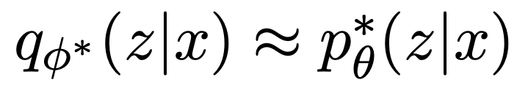
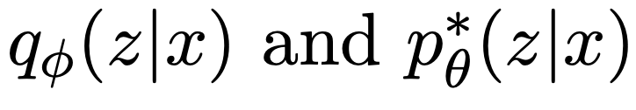
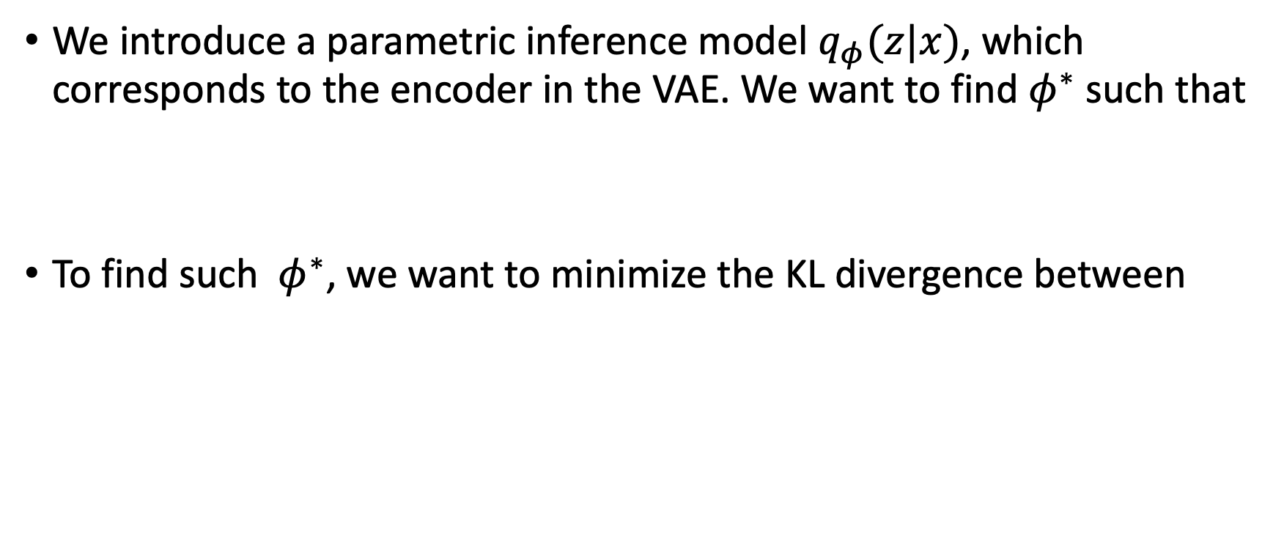
VAE’s Objective Function
We introduce a parametric inference model $q_{φ}(z|x)$, which corresponds to the encoder in the VAE. We want to find $φ^{∗}$such that
To find such $φ^{∗}$, we want to minimize the KL divergence between

Slide 13
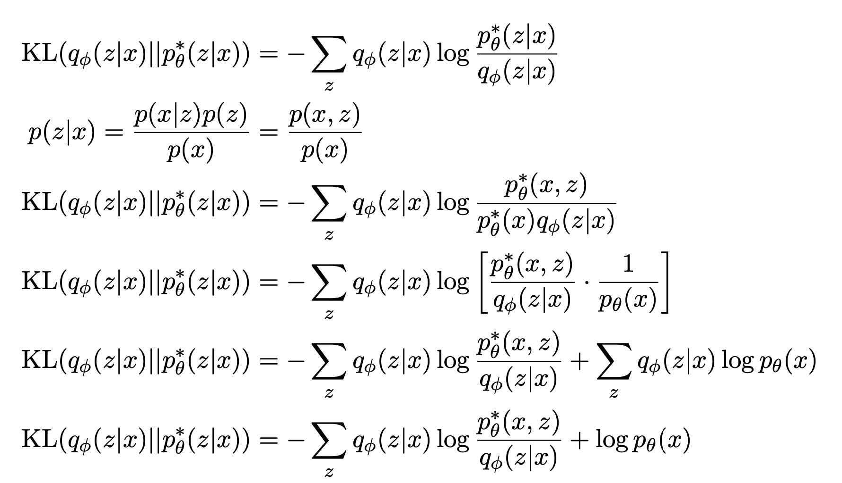

Slide 14
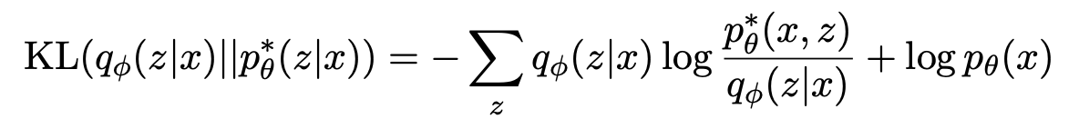

ELBO
The first term in RHS is the ELBO (Evidence Lower Bound)
The second term is the log likelihood.
Let’s rearrange this equation to:

Slide 15
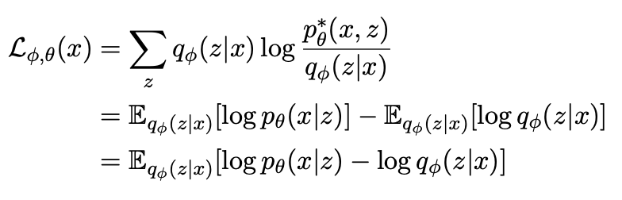
ELBO
By maximizing ELBO, we are also minimizing the KL divergence and maximizing the log likelihood.
We could also rewrite ELBO for SGD

Slide 16
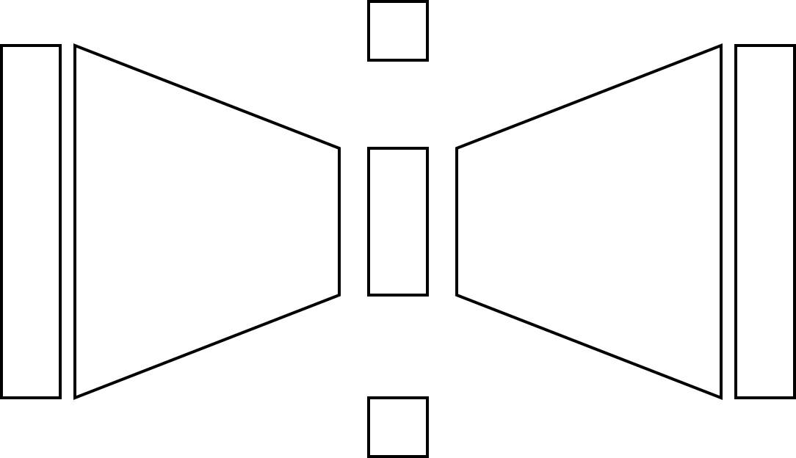


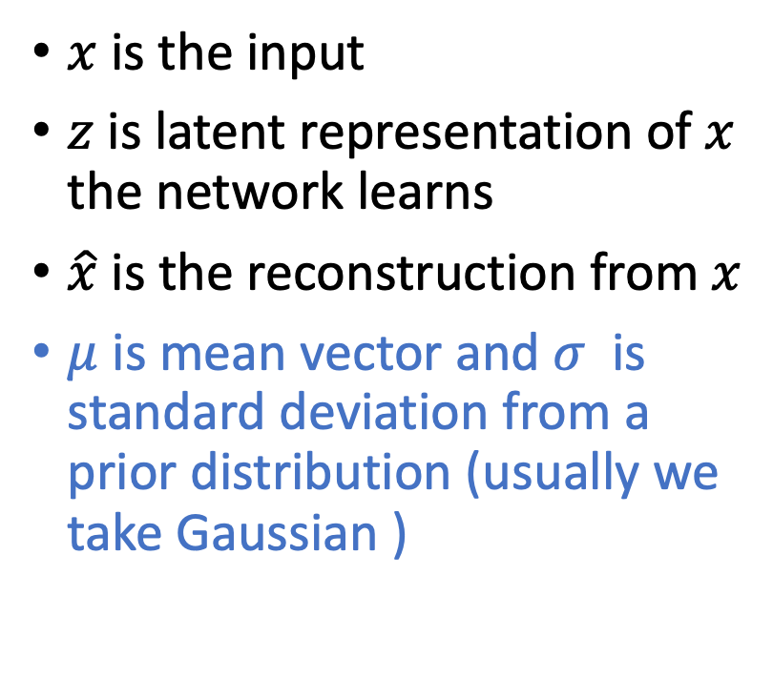


From Autoencoder to VAE
$μ$ – mean vector
$$x$$
$$\hat{x}$$
$x$is the input
$z$is latent representation of $x$ the network learns
$\hat{x}$ is the reconstruction from $x$
$μ$ is mean vector and $σ$ is standard deviation from a prior distribution (usually we take Gaussian )
$$z$$
encoder: $q_{φ}(z|x)$
decoder: $p_{θ}(x|z)$
$σ$– standard deviation

Slide 17
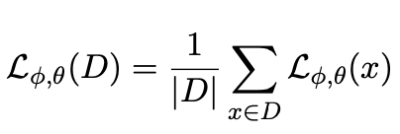

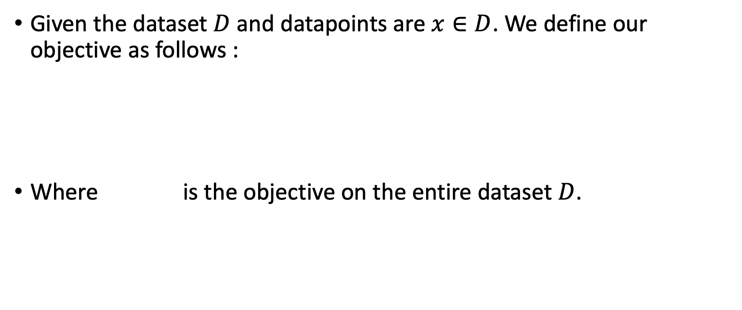
SGD
Given the dataset $D$ and datapoints are $x∈D$. We define our objective as follows :
Where is the objective on the entire dataset $D$.

Slide 18
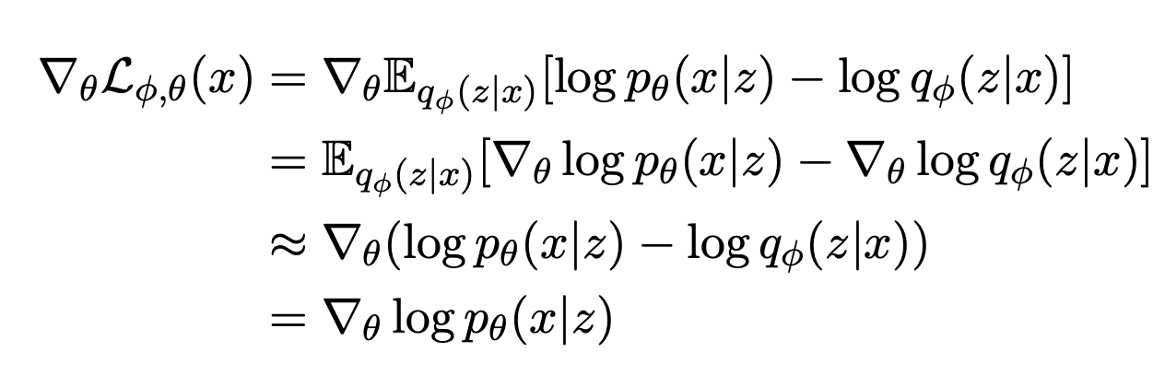

Gradient of ELBO
We first take the gradient of ELBO w.r.t. model parameter $θ$:

Slide 19
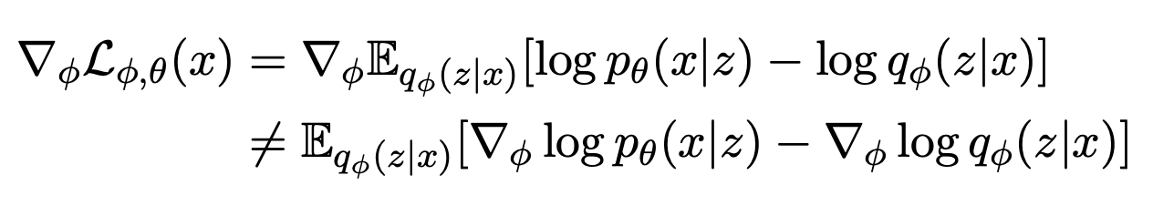
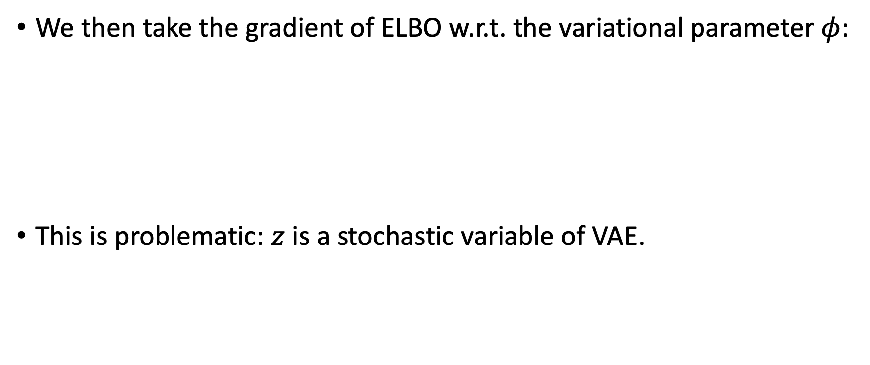
Gradient of ELBO
We then take the gradient of ELBO w.r.t. the variational parameter $φ$:
This is problematic: $z$ is a stochastic variable of VAE.

Slide 20

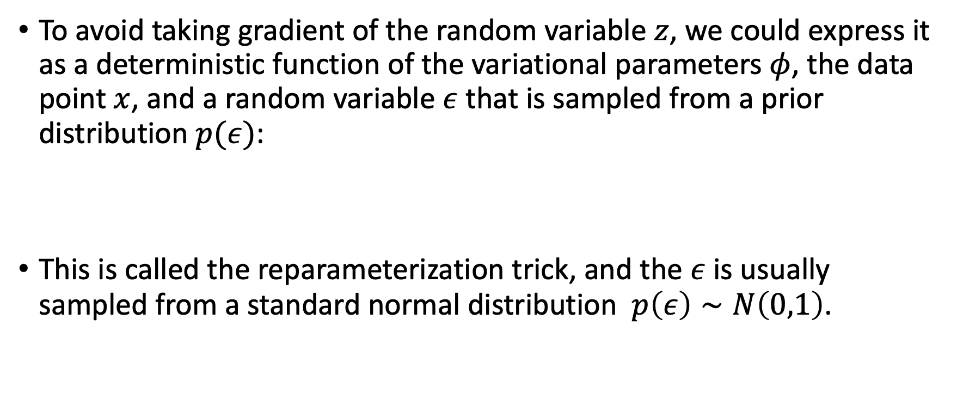
Reparameterization Trick
To avoid taking gradient of the random variable $z$, we could express it as a deterministic function of the variational parameters $φ$, the data point $x$, and a random variable $ε$ that is sampled from a prior distribution $p(ε)$:
This is called the reparameterization trick, and the $ε$ is usually sampled from a standard normal distribution $p\left(ε\right)∼N\left(0,1\right)$.

Slide 21
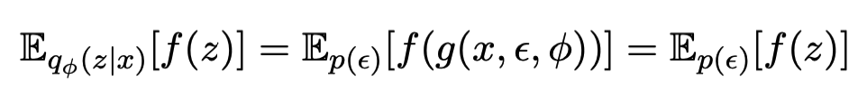
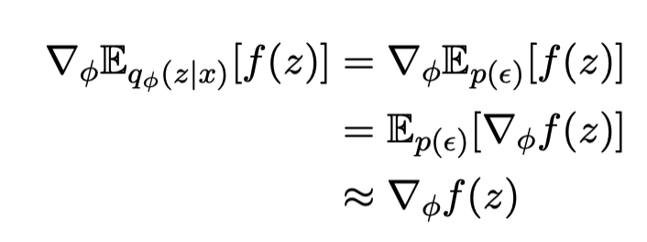
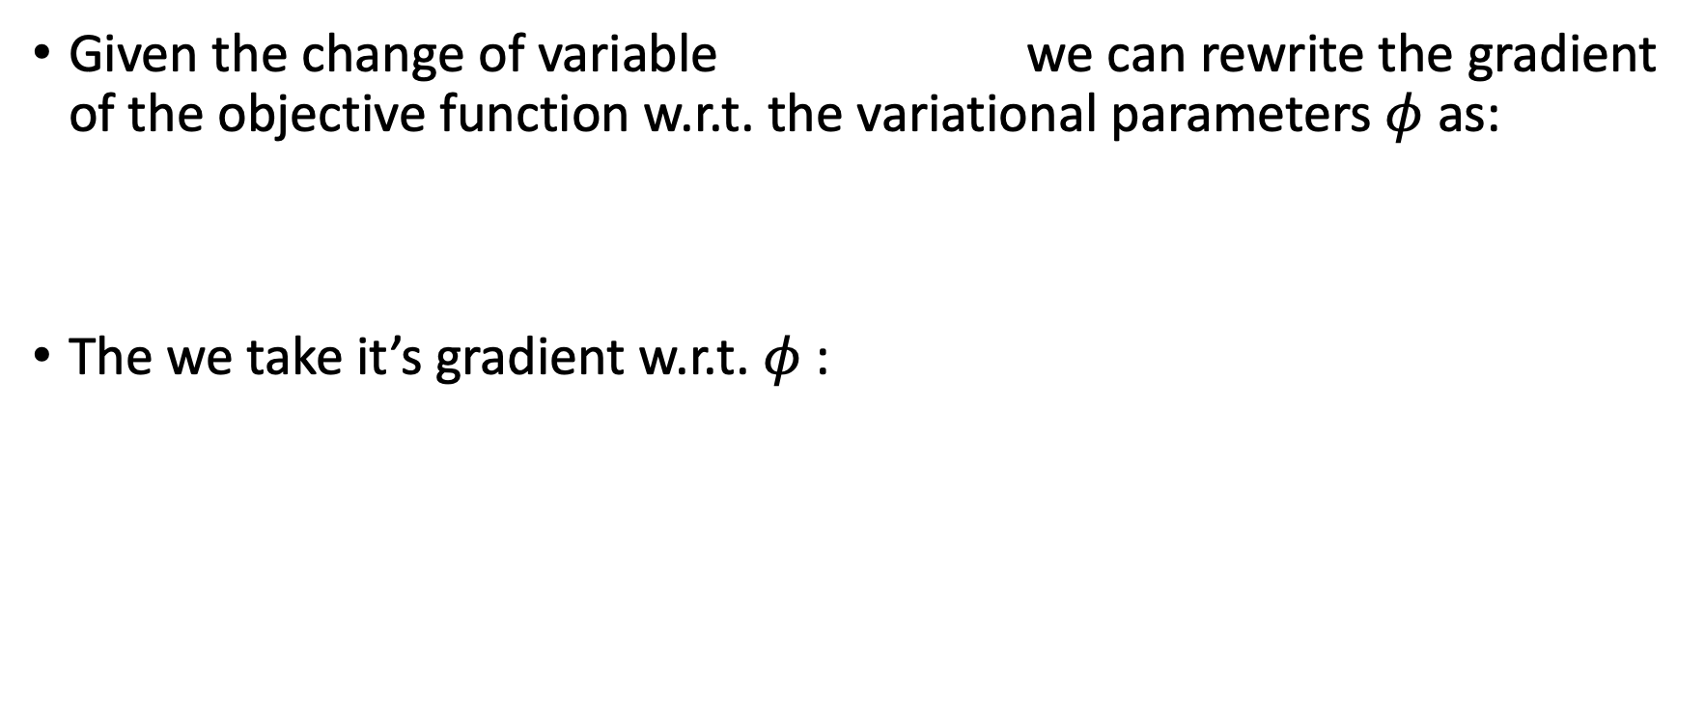
Gradient with Reparameterization Trick
Given the change of variable we can rewrite the gradient of the objective function w.r.t. the variational parameters $φ$ as:
The we take it’s gradient w.r.t. $φ$ :

Slide 22
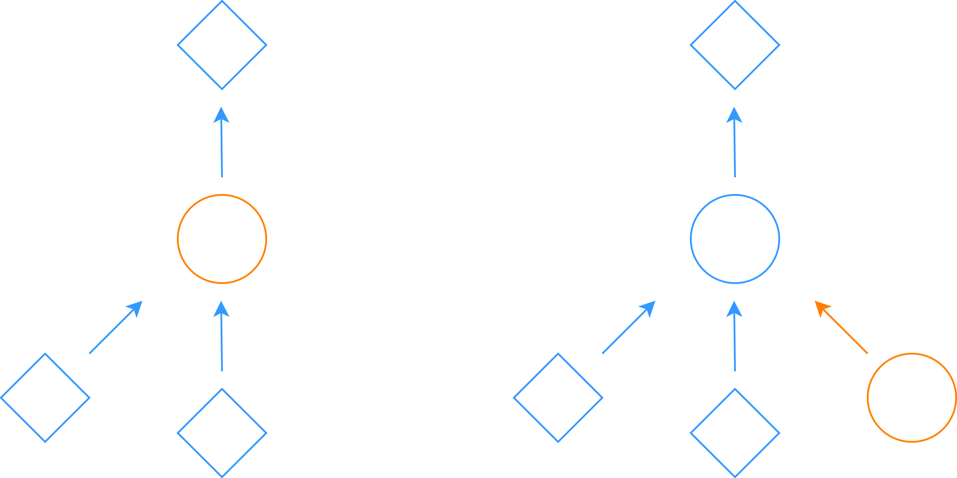









$$f$$
$$f$$
$$z∼q_{φ}(z|x) z$$
$$z z=g(x, ε, φ)$$
$$φ$$
$$φ$$
$$ε ε∼N(0, 1)$$
$$x$$
$$x$$
Original form Reparametrized form

Slide 23
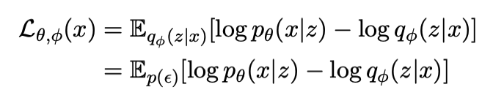
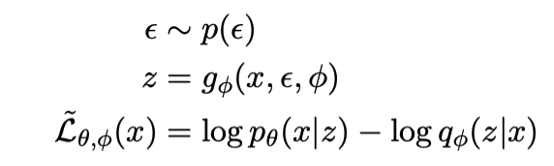
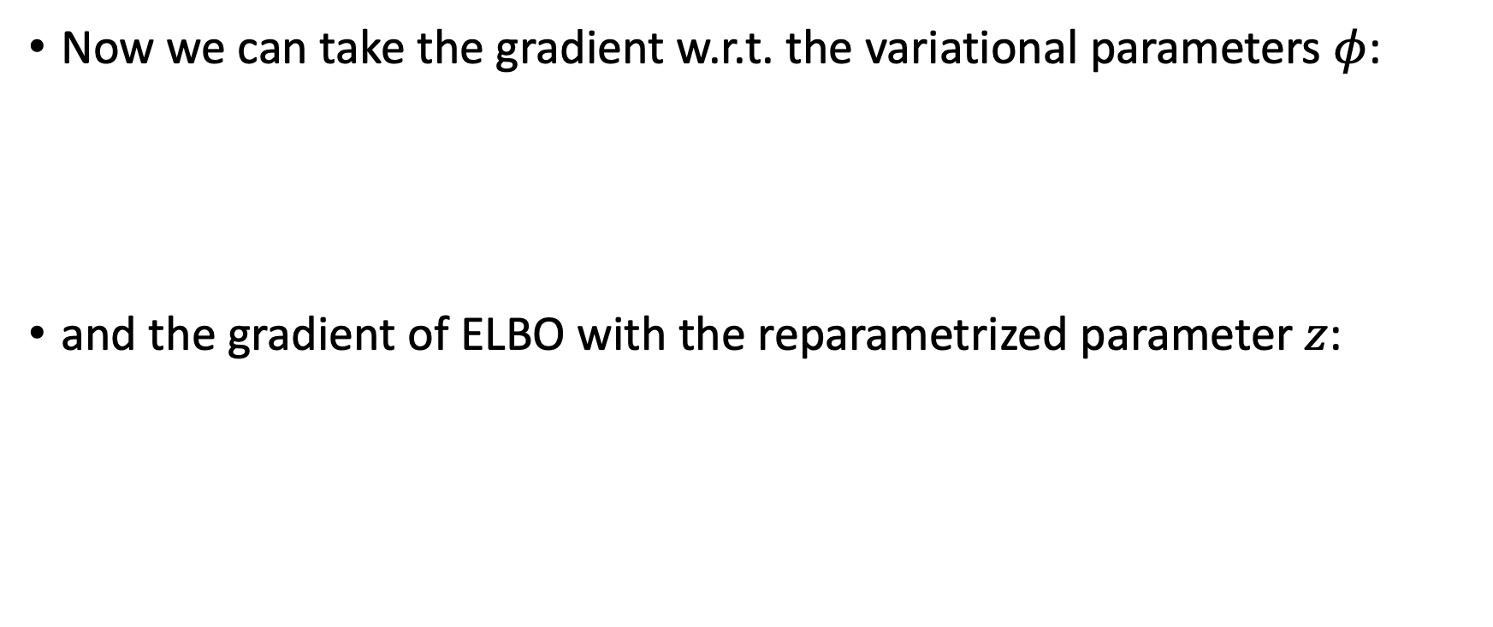
Gradient with Reparameterization Trick
Now we can take the gradient w.r.t. the variational parameters $φ$:
and the gradient of ELBO with the reparametrized parameter $z$:

