Slide 1


Water quality monitoring of Schelde using in-situ, remote sensing technology and artificial neural network
Zhiqi Wang
Promotor: Prof. Ann Van Griensven
Supervisors: F. Khorashadi Zadeh, A. Baltodano Martinez, A. Nkwasa
31.08.2022

Slide 2
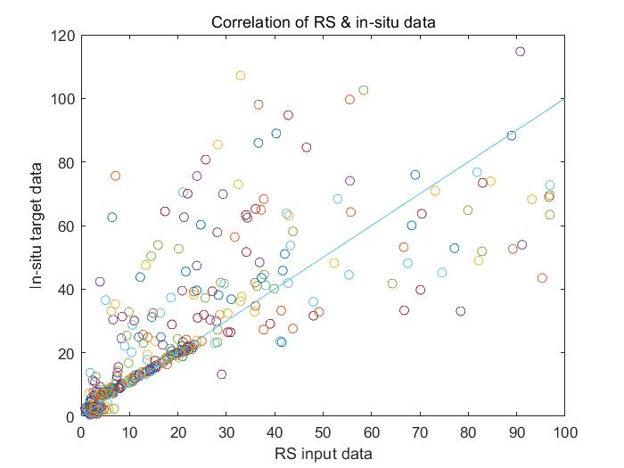
1. Introduction
Problem:
There is a big different between in-situ and RS of water quality data.
E.g. Beneden schelde - Estuary, Belgium
R=0.457
Notes:
Traditional insitu
RS Technologies emerging in recent years
Check water quality, look at in-situ and RS data, find difference, Reduce the different, highly the study parameters in the slides, mentioned study area

Slide 3



1. Introduction
Solution:
Remote sensing (RS):
Monitor larger area in short time, reducing costs.
Artificial neural network (ANN) model
ANN as a data-driving model requires less prior knowledge.
Faster calculations, can produce more accurate estimates.
Thesis question:
Can we use the ANN model to increase the agreement between the in-situ observation and remote sensing data?
Notes:
Traditional insitu
RS Technologies emerging in recent years
Check water quality, look at in-situ and RS data, find difference, Reduce the different, highly the study parameters in the slides, mentioned study area

Slide 4
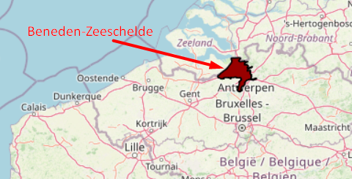
2. Material and methods 2.1 STUDY AREA
Study area: Beneden schelde, Belgium
Study period: 2019.4 – 2022.3 (data length: 152)
Parameters: turbidity, chlorophyll-a and water temperature
https://www.scheldemonitor.be/en/node/20
Notes:
Liefkenshoek which near the estuary was selected
All neurons are processed by a nonlinear transfer function, and after many experiments, the optimal number of neurons in the hidden layer is determined [8].

Slide 5
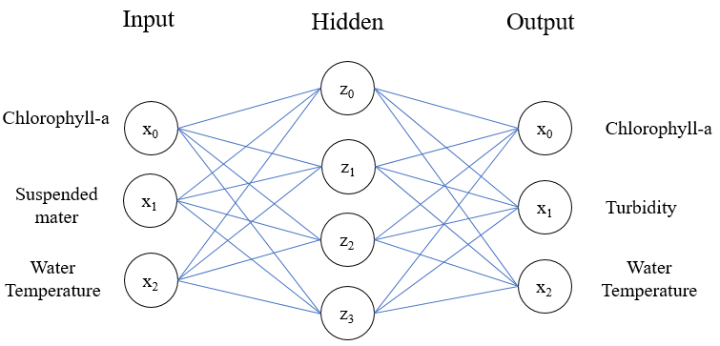
2. Material and methods 2.1 Experimental design
Modelling: ANN model , Satellite data is the input and in-situ data is the output.
Modelling software: MATLAB
Notes:
Liefkenshoek which near the estuary was selected
All neurons are processed by a nonlinear transfer function, and after many experiments, the optimal number of neurons in the hidden layer is determined [8].

Slide 6




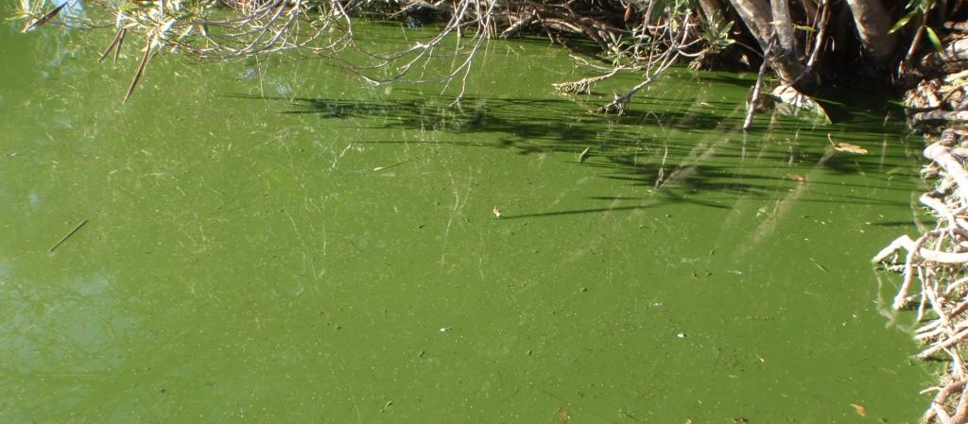

2. Material and methods 2.2 Interested parameters
a) Turbidity: represents the clarity of water [3].
c) Chlorophyll-a: important indicators to define the degree of eutrophication of water body.
b) Water temperature: can alter the water physicochemical properties [4].
Notes:
Select 3 parameter for montor water in scheld
1, monitor water quality
2. High correlation between RS and insitu, Easily to get data
Turbidity: represents the clarity of water, is an optical characteristic of water quality. It is the most direct evaluation of water quality by human senses [3].

Slide 7
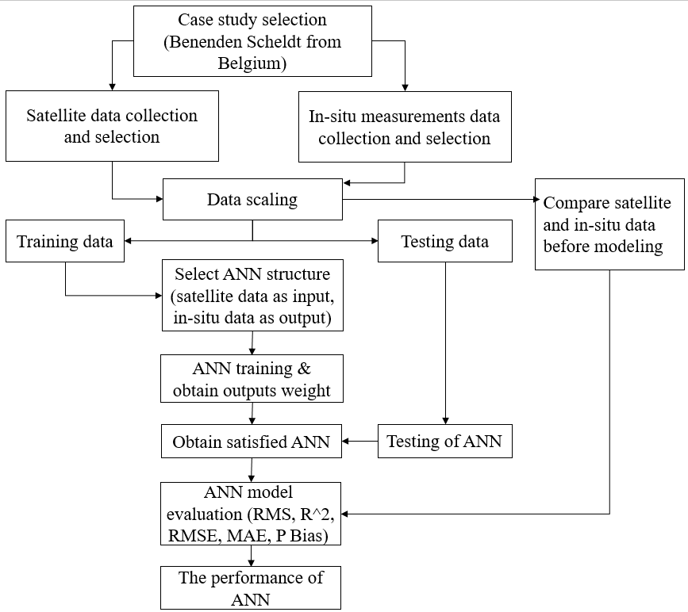
2. Material and methods 2.3 Modeling method
The modeling process divided into four stages:
The first stage: Collect in-situ data and satellite data, then do the scaling and normalization.
The second stage: the initiation of the model. Neural network constructed in MATLAB, set up the structure and parameters.
The third stage: Divide data sets, use training set and validation set to train and optimize model, then get desired model.
The fourth stage: model evaluation. Import testing set to get model simulated results, then 4 model indicators used to evaluate the accuracy and stability of model.
Notes:
-The second stage is the initiation of the model. the model was created as a shallow network with one hidden layer. Neuron numbers is crucial
-First, imported the training set to train the model to optimize the parameters of the model, which are the weights of the connection between the neurons and the value of the bias. Then, used the validation set to optimize the internal parameters to obtain the desired results.

Slide 8



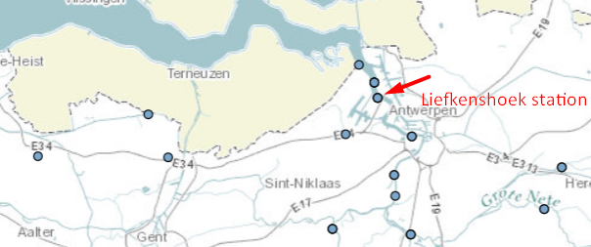
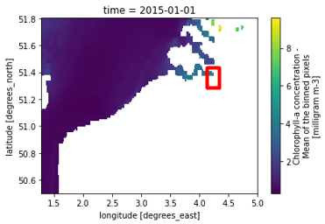
2. Material and methods 2.4 Data collection and SCALING
A. Data collection:
B. Data extraction:
In-situ data: open sources (Scheldt monitor, WaterInfo).
Remote sensing (RS) data from Marine Copernicus.
In-situ data: from Liefkenshoek station which near to Scheldt estuary.
RS data: extract the data from the pixel in the image that nearest to Liefkenshoek station.
Interpolated the resolution to 1km X 1km.
https://www.waterinfo.be/kaartencatalogus
Chlorophyll concentration map in 2015-01-01 by RS data
Notes:
It’s the first stage
ScheldeMonitor is a Flemish-Dutch knowledge and information portal on research and monitoring in the Scheldt estuary.
For the Global Ocean Satellite Observations, ACRI-ST company (Sophia Antipolis, France) is providing Chlorophyll-a and Optics products - present based on the Copernicus-GlobColour processor.Optics products refer to Suspended Matter (SPM)The spatial resolution is 4 km. For Chlorophyll, a 1 km is also available ;Products (Dailyare based on the merging of the sensors SeaWiFS, MODIS, MERIS, VIIRS-SNPP&JPSS1, OLCI-S3A&S3B.

Slide 9
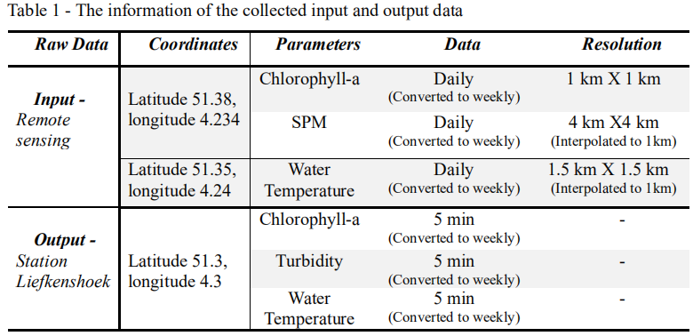

2. Material and methods 2.4 Data collection and SCALING
C. Data scaling:
In-situ data: 5min data from waterinfo converted to weekly data to keep the data homogeneous.
Fill the gap: use interpolation method (Kriging).
RS data: The daily data was extracted from RS image, then converted to weekly data.
SPM data: used to estimate the turbidity data (Gohin, 2011).
*: α is obtained by regression of turbidity on SPM, is 1.19.
Notes:
Firstly, this study is mainly looking at seasonal changes, very detailed data are not needed, and secondly, it helps to avoid missing data.
Based on this, this study compared the fitting results of two models, one that directly applied SPM data as one of the inputs, and the other that applied estimated turbidity as the input instead of SPM to the model. The table below lists information on the collected RS and in situ data (Table 1).
α is obtained by regression of turbidity on SPM, is 1.19.

Slide 10

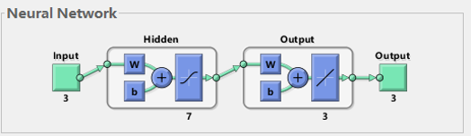
2. Material and methods 2.5 ANN model build up
Input
Model
Model Output
Chl-a,
SPM,
water T
ANN1
ANN
ANN Model structure
Iteration number
Chl-a,
Estimate turbidity, Water T
ANN2
Neuron number
Transfer function
Build and run model:
Normalized input data between 0-1
Use log transformation to initial target data
Create a shallow network with one hidden layer in MATLAB
Train function
Number of hidden layer
Notes:
It’s the second stage
Because there are two versions of the input RS dataset, The input values of the two
versions will be separately imported into the model with the same target value (output) for training,
the model simulated results are called ANN1 and ANN2
normalized input data between 0-1, to make sure all the input have same weight, and to accelarate the training.
use log transformation to initial target to make the data more uniform distributed, less centered around very low values
create a shallow network whith one hidden layer,

Slide 11

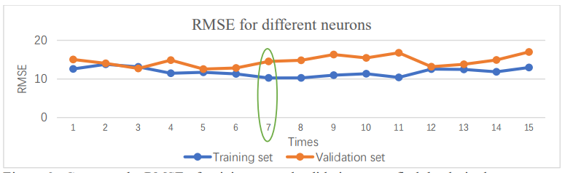
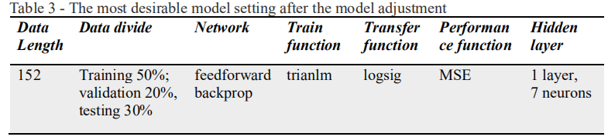
2. Material and methods 2.5 ANN model build up
Change model settings:
Compare the RMSE of training set and validation set to find the desirable ANN model structure.
Eg: To find desirable neuron numbers for hidden layer, run the model for different neurons, and see which number give the lowest RMSE.
The most desirable model setting
Notes:
Learning is geting the computer to find a valid setting for all the weights and biases so that it will actually solve the problem
eLU: higher efficiency and show better convergence performance than sigmoid

Slide 12
3. results 3.1 Compare RS and in-situ data before modeling
chl-a = 0.3312*RS chl-a
Turbidity = 1.19 (SPM+0.234 Chl^0.57)

Slide 13
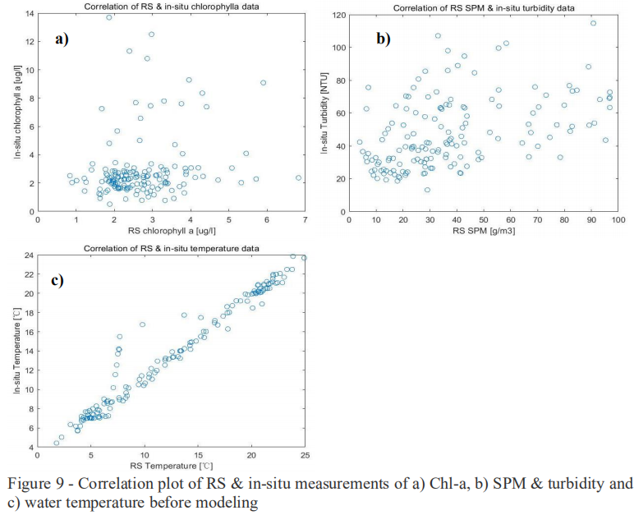
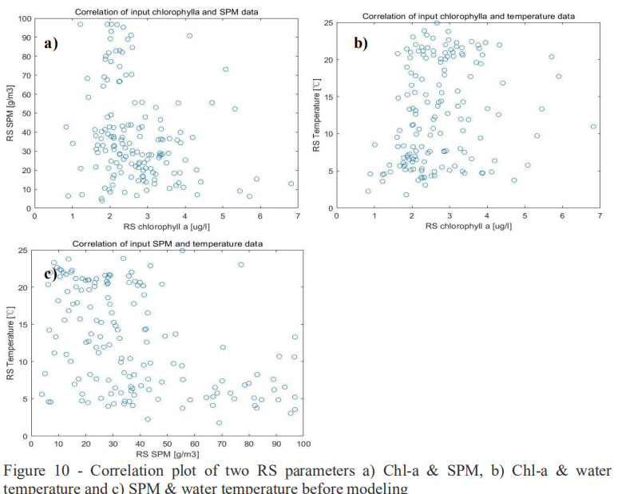
3. results 3.1 Compare RS and in-situ data before modeling
Correlation of RS & In-situ data | R
Chl-a | 0.185
SPM | 0.458
T | 0.980
Correlation within RS data sets | R
Chl-a & SPM | 0.231
Chl-a & T | 0.216
SPM & T | 0.453

Slide 14
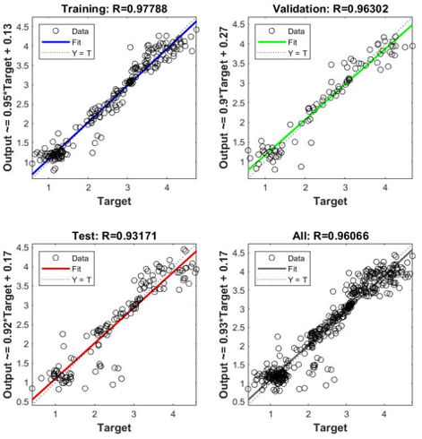
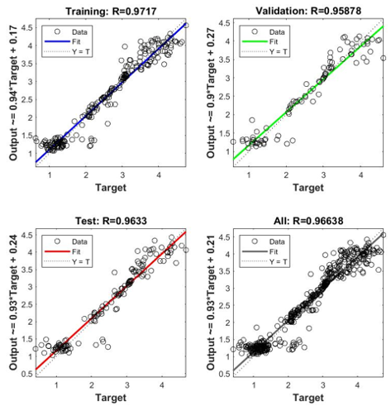

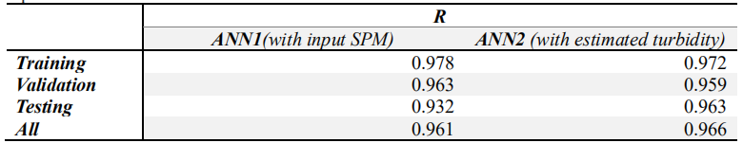
3. results 3.2 The ANN model performance visualization
ANN1
ANN2
The regression results shows in the following figs.
The regression results:
Notes:
The results of this research are expected to show that the ANN model can simulate the water quality indicator through the satellite data and show its potential in water quality modeling.
In addition, it is also expected to see if any pattern to show the different in dry or wet year.

Slide 15
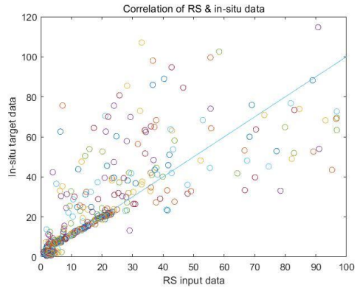
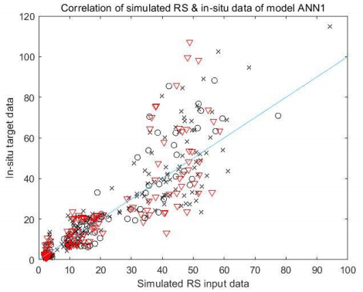
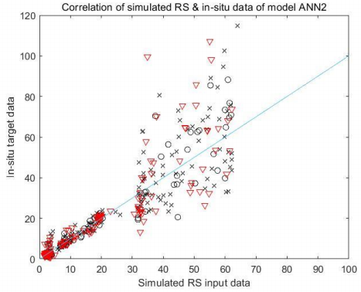
3. results 3.2 The ANN model performance visualization
Visualize the correlation plot of RS before modeling VS. RS after modeling:
“x” → training set,
“o” → validation set
“▽” →testing set.
VS
Before modeling
ANN1
ANN2
Correlation | Raw RS & Insitu data | ANN1 | ANN2
R | 0.457 | 0.961 | 0.966

Slide 16

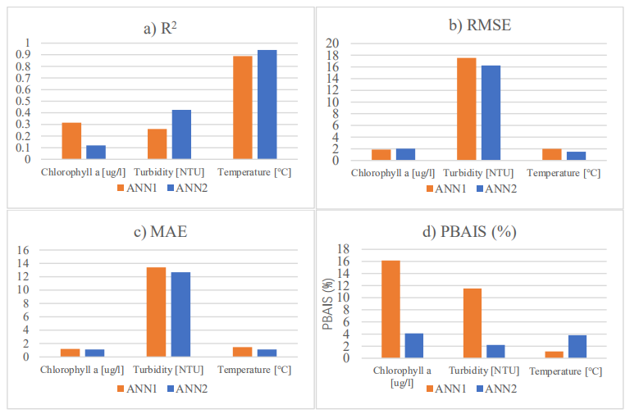
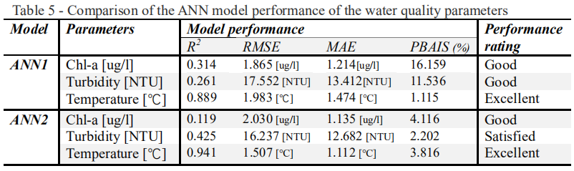
3. results 3.3 The ANN model evaluation
ANN model evaluation results (R^2, RMSE, MAE, PBais):
Notes:
The results of this research are expected to show that the ANN model can simulate the water quality indicator through the satellite data and show its potential in water quality modeling.
In addition, it is also expected to see if any pattern to show the different in dry or wet year.

Slide 17
4. Discussion
Phytoplankton
Weather
Season
Measure station
Parameters accuracy of RS measurement
water temperature
chlorophyll-a, turbidity
Well simulated
Underestimated
The performance of the ANN model
Sensitive to different input variables, especially the water turbidity.
More sensitive to the model parameter "number of neurons“.
Even ANN model can achieve high R2 values, but are limited by overly sensitive to high extremes and insensitive to additive scaling differences.
Notes:
Part of the underestimation of chl-a and turbidity can be explained by different phytoplankton in spring and summer, weather effects, and bias in RS data monitoring sites; it does not have much effect on the fitting of water temperature because water temperature does not have a spatial effect on the river obvious changes
Water turbidity is more sensitive to the model's transfer function than other parameters

Slide 18
5. Conclusion & Recommendations
Conclusion
Significant differences between in-situ monitoring and RS monitoring at estuaries (R=0.457).
ANN model improve the agreement between RS data and in-situ data in the estuary.
The future expectation
Data adoption
Data length and richness
More stations
Water quality parameters
Estuarine characteristics
Recommendation
Conditions to obtain better ANN model simulated data:
Water quality parameters
Data collection and preprocessing
Model input parameters
Construction and training of ANN models
RS products
More stable, higher resolution
Algorithms
Notes:
The results of this research are expected to show that the ANN model can simulate the water quality indicator through the satellite data and show its potential in water quality modeling.
In addition, it is also expected to see if any pattern to show the different in dry or wet year.
河口地区的浮游植物

Slide 19
Reference
[1] Ceyhun, Ö., & Yalçin, A. (2010). Remote sensing of water depths in shallow waters via artificial neural networks. Estuarine, Coastal and Shelf Science, 89(1), 89–96.
[2]Hameed, M., Saadi, •, Sharqi, S., Zaher, •, Yaseen, M., Haitham, •, Afan, A., Hussain, • Aini, & Elshafie, A. (n.d.). Application of artificial intelligence (AI) techniques in water quality index prediction: a case study in tropical region, Malaysia.
[3] Chang, C.-L., & Liao, C.-S. (2012). Parameter Sensitivity Analysis of Artificial Neural Network for Predicting Water Turbidity. International Journal of Environmental, Chemical, Ecological, Geological and Geophysical Engineering, 6(10), 657–660.
[4] Fondriest Environmental, Inc. “Water Temperature.” Fundamentals of Environmental Measurements. 7 Feb. 2014. Web. < https://www.fondriest.com/environmental-measurements/parameters/water-quality/water-temperature/ >.
[5] Wang, F., Wang, X., Chen, B., Zhao, Y., & Yang, Z. (2013). Chlorophyll a simulation in a lake ecosystem using a model with wavelet analysis and artificial neural network. Environmental Management, 51(5), 1044–1054.
[6] Huang, J., & Gao, J. (2017a). An ensemble simulation approach for artificial neural network: An example from chlorophyll a simulation in Lake Poyang, China. Ecological Informatics, 37, 52–58.
[7] https://www.kdnuggets.com/2018/10/simple-neural-network-python.html
[8] Chau, K. wing. (2006). A review on integration of artificial intelligence into water quality modelling. Marine Pollution Bulletin, 52(7), 726–733.
[9] Gohin, F.: Annual cycles of chlorophyll-a, non-algal suspended particulate matter, and turbidity observed from space and in-situ in coastal waters, Ocean Sci., 7, 705–732, https://doi.org/10.5194/os-7-705-2011, 2011.
[10] Kisi, O., Akbari, N., Sanatipour, M., Hashemi, A., Teimourzadeh, K., & Shiri, J. (2013). Modeling of dissolved oxygen in river water using artificial intelligence techniques. Journal of Environmental Informatics, 22(2), 92–101.

Slide 20
Q & A
Thank you for listening!

