Slide 1
Operating Point of Inverter System
Jiani He

Slide 2
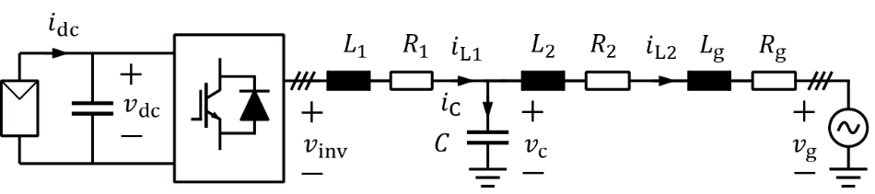






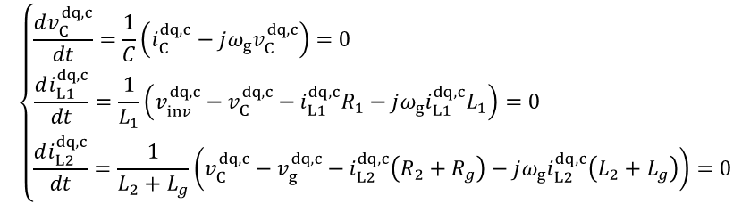


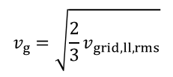










Operating Point Calculation
$$q^{c}$$
$$q$$
$$v_{C}$$
$$d^{c}$$
$$jω_{g}i_{L2}(L_{2}+L_{g})$$
$$v_{g}=\sqrt{\frac{2}{3}v_{grid,ll,rms}}$$
$$i_{L2}$$
$$v_{g}$$
$$d$$
Power balance: $P=V_{dc}I_{pv}=\frac{3}{2}i_{L2}^{d}v_{g}≈i_{L2}^{d,c}v_{g}$
$$i_{L2}(R_{2}+R_{g})$$
$$\left\{\begin{aligned}\frac{dv_{C}^{dq,c}}{dt}=\frac{1}{C}\left(i_{C}^{dq,c}−jω_{g}v_{C}^{dq,c}\right)=0 \\ \frac{di_{L1}^{dq,c}}{dt}=\frac{1}{L_{1}}\left(v_{inv}^{dq,c}−v_{C}^{dq,c}−i_{L1}^{dq,c}R_{1}−jω_{g}i_{L1}^{dq,c}L_{1}\right)=0 \\ \frac{di_{L2}^{dq,c}}{dt}=\frac{1}{L_{2}+L_{g}}\left(v_{C}^{dq,c}−v_{g}^{dq,c}−i_{L2}^{dq,c}\left(R_{2}+R_{g}\right)−jω_{g}i_{L2}^{dq,c}\left(L_{2}+L_{g}\right)\right)=0\end{aligned}\right.$$
$$⇒i_{L1}^{d,c}−i_{L2}^{d,c}=i_{C}^{d,c}=ω_{g}v_{C}^{q,c}$$
$$(1)$$
$$(2)$$
$$(3)$$
Because of PLL, $v_{C}^{q,c}=0$ $⇒$ $i_{L1}^{d,c}=i_{L2}^{d,c}$
$$i_{L1}^{d,c}=\frac{2V_{dc}I_{pv}}{3v_{g}}$$
$$i_{L1}^{q,c}=0$$
Suppose that $i_{L2}≈i_{L1}^{d,c}$, which aligns with $v_{g}$
$$v_{C}^{d,c}=\sqrt{{\left(v_{g}+i_{L1}^{d,c}\left(R_{2}+R_{g}\right)\right)}^{2}+{\left(ω_{g}i_{L1}^{d,c}\left(L_{2}+L_{g}\right)\right)}^{2}}$$

Slide 3







Operating Point Calculation
$$q^{c}$$
$$q$$
$$v_{inv}$$
$$i_{L1}$$
$$v_{C}$$
$$d^{c}$$
$$jω_{g}i_{L2}(L_{2}+L_{g})$$
$$v_{g}$$
$$d$$
$$i_{L2}$$
$$i_{L2}(R_{2}+R_{g})$$
$$\left\{\begin{aligned}i_{C}^{d,c}=ω_{g}v_{C}^{q,c} \\ i_{C}^{q,c}=ω_{g}v_{C}^{d,c}\end{aligned}\right.$$
$$\left(1\right)⇒$$
$$\left\{\begin{aligned}v_{inv}^{d,c}=v_{C}^{d,c}+i_{L1}^{d,c}R_{1}−ω_{g}i_{L1}^{q,c}L_{1}=v_{C}^{d,c}+i_{L1}^{d,c}R_{1} \\ v_{inv}^{q,c}=v_{C}^{q,c}+i_{L1}^{q,c}R_{1}+ω_{g}i_{L1}^{d,c}L_{1}=ω_{g}i_{L1}^{d,c}L_{1} \end{aligned}\right.$$
$$\left(2\right)⇒$$
$$θ_{pll}=\tan^{−1}\left(\frac{ω_{g}i_{L1}^{d,c}\left(L_{2}+L_{g}\right)}{v_{g}+i_{L1}^{d,c}\left(R_{2}+R_{g}\right)}\right)$$

