Slide 1
Operating Point of Inverter System
Zhiqing Yang

Slide 2
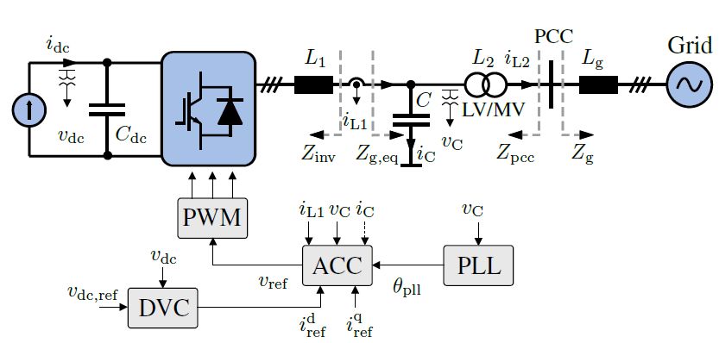







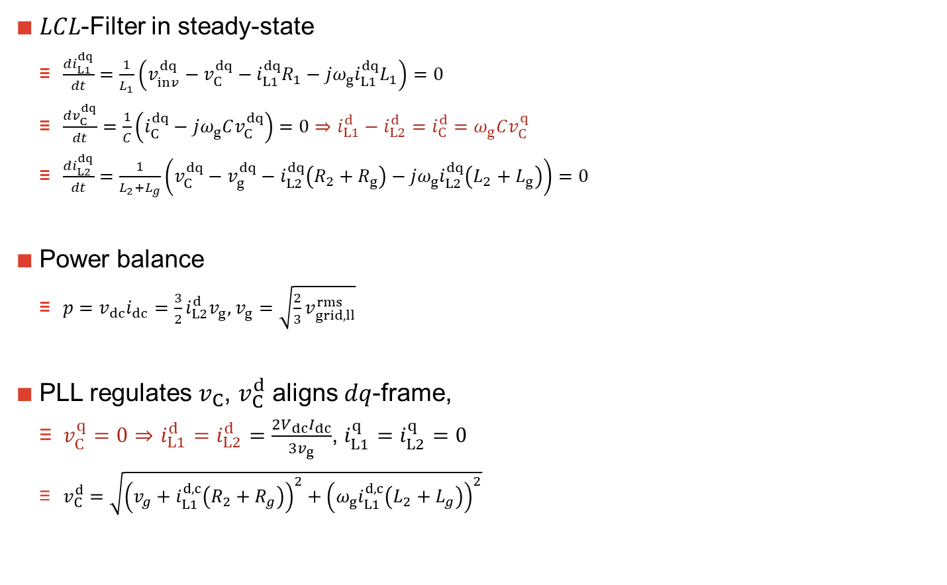


Operating Point Calculation
$LCL$-Filter in steady-state
$\frac{di_{L1}^{dq}}{dt}=\frac{1}{L_{1}}\left(v_{inv}^{dq}−v_{C}^{dq}−i_{L1}^{dq}R_{1}−jω_{g}i_{L1}^{dq}L_{1}\right)=0$
$\frac{dv_{C}^{dq}}{dt}=\frac{1}{C}\left(i_{C}^{dq}−jω_{g}Cv_{C}^{dq}\right)=0⇒i_{L1}^{d}−i_{L2}^{d}=i_{C}^{d}=ω_{g}Cv_{C}^{q}$
$\frac{di_{L2}^{dq}}{dt}=\frac{1}{L_{2}+L_{g}}\left(v_{C}^{dq}−v_{g}^{dq}−i_{L2}^{dq}\left(R_{2}+R_{g}\right)−jω_{g}i_{L2}^{dq}\left(L_{2}+L_{g}\right)\right)=0$
Power balance
$p=v_{dc}i_{dc}=\frac{3}{2}i_{L2}^{d}v_{g}$, $v_{g}=\sqrt{\frac{2}{3}v_{grid,ll}^{rms}}$
PLL regulates $v_{C}$, $v_{C}^{d}$ aligns $dq$-frame,
$v_{C}^{q}=0$ $⇒$ $i_{L1}^{d}=i_{L2}^{d}=\frac{2V_{dc}I_{dc}}{3v_{g}}$, $i_{L1}^{q}=i_{L2}^{q}=0$
$v_{C}^{d}=\sqrt{{\left(v_{g}+i_{L1}^{d,c}\left(R_{2}+R_{g}\right)\right)}^{2}+{\left(ω_{g}i_{L1}^{d,c}\left(L_{2}+L_{g}\right)\right)}^{2}}$
$$q$$
$$v_{inv}$$
$$jω_{g}i_{L1}^{d}L_{1}$$
$$i_{L1}^{d}$$
$$v_{C}$$
$$i_{L2}^{d}$$
$$d$$
$$−jω_{g}i_{L2}^{d}(R_{2}+R_{g})$$
$$−jω_{g}i_{L2}^{d}(L_{2}+L_{g})$$
$$v_{g}$$

Slide 3


Operating Point Calculation
$$v_{C}^{dq}−v_{g}^{dq}−i_{L2}^{dq}\left(R_{2}+R_{g}\right)−jω_{g}i_{L2}^{dq}\left(L_{2}+L_{g}\right)=0$$
$$v_{C}^{d}+jv_{C}^{q}=v_{g}^{d}+jv_{g}^{q}+i_{L2}^{d}\left(R_{2}+R_{g}\right)+ji_{L2}^{q}\left(R_{2}+R_{g}\right)+jω_{g}i_{L2}^{d}\left(L_{2}+L_{g}\right)−ω_{g}i_{L2}^{q}\left(L_{2}+L_{g}\right)$$
$$v_{g}^{d}=v_{C}^{d}−i_{L2}^{d}\left(R_{2}+R_{g}\right)−ω_{g}i_{L2}^{q}\left(L_{2}+L_{g}\right)$$
$$v_{C}^{d}=v_{g}^{d}+i_{L2}^{d}\left(R_{2}+R_{g}\right)−ω_{g}i_{L2}^{q}\left(L_{2}+L_{g}\right)⇒$$
$v_{C}^{q}=v_{g}^{q}+i_{L2}^{q}\left(R_{2}+R_{g}\right)+ω_{g}i_{L2}^{d}\left(L_{2}+L_{g}\right)$ $⇒$
$$v_{g}^{q}=−i_{L2}^{q}\left(R_{2}+R_{g}\right)−ω_{g}i_{L2}^{d}\left(L_{2}+L_{g}\right)$$
Since grid voltage in $DQ$-Frame remain unchanged, $v_{g}^{D}≡const$
$$v_{g}^{D}=\sqrt{{\left(v_{g}^{d}\right)}^{2}+{\left(v_{g}^{q}\right)}^{2}}=\sqrt{{\left(v_{C}^{d}−i_{L2}^{d}\left(R_{2}+R_{g}\right)−ω_{g}i_{L2}^{q}\left(L_{2}+L_{g}\right)\right)}^{2}+{\left(i_{L2}^{q}\left(R_{2}+R_{g}\right)+ω_{g}i_{L2}^{d}\left(L_{2}+L_{g}\right)\right)}^{2}}$$
Assume no resistive loss
$$v_{g}^{D}=\sqrt{{\left(v_{g}^{d}\right)}^{2}+{\left(v_{g}^{q}\right)}^{2}}=\sqrt{{\left(v_{C}^{d}−ω_{g}i_{L2}^{q}\left(L_{2}+L_{g}\right)\right)}^{2}+{\left(ω_{g}i_{L2}^{d}\left(L_{2}+L_{g}\right)\right)}^{2}}$$
Assume no reactive current $i_{L2}^{q}=0$
$$v_{g}^{D}=\sqrt{{\left(v_{g}^{d}\right)}^{2}+{\left(v_{g}^{q}\right)}^{2}}=\sqrt{{\left(v_{C}^{d}\right)}^{2}+{\left(ω_{g}i_{L2}^{d}\left(L_{2}+L_{g}\right)\right)}^{2}}$$
The same as vector diagram
With an increased value of $L_{g}$, $v_{C}^{d}$ decreases

Slide 4


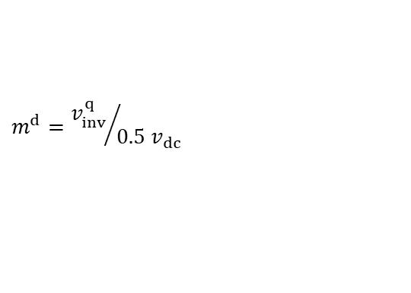

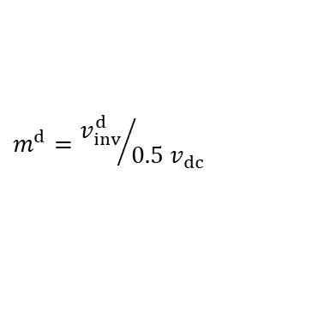



Operating Point Calculation
Step 1
Step 2
Step 3
Step 4
Step 5
$i_{L1}^{d}=i_{L2}^{d}=$ $i_{ref}^{d}$
$i_{L1}^{q}=i_{L2}^{q}=$ $i_{ref}^{q}=0$
$$v_{C}^{d}=\sqrt{{\left(v_{g}^{D}\right)}^{2}−{\left(i_{L2}^{q}\left(R_{2}+R_{g}\right)+ω_{g}i_{L2}^{d}\left(L_{2}+L_{g}\right)\right)}^{2}}+i_{L2}^{d}\left(R_{2}+R_{g}\right)+ω_{g}i_{L2}^{q}\left(L_{2}+L_{g}\right)$$
$$v_{C}^{q}=0$$
$i_{C}^{d}=$ ${ω_{g}Cv}_{C}^{q}=0$
$i_{C}^{q}=$ $−{ω_{g}Cv}_{C}^{d}$
Why minus sign in q axis?
$$v_{inv}^{d}=v_{C}^{d}+i_{L1}^{d}R_{1}−ω_{g}i_{L1}^{q}L_{1}$$
$$v_{inv}^{q}=v_{C}^{d}+i_{L1}^{q}R_{1}+ω_{g}i_{L1}^{d}L_{1}$$
$$m^{d}={v_{inv}^{d}}/{0.5 v_{dc}}$$
$$m^{d}={v_{inv}^{q}}/{0.5 v_{dc}}$$

Slide 5
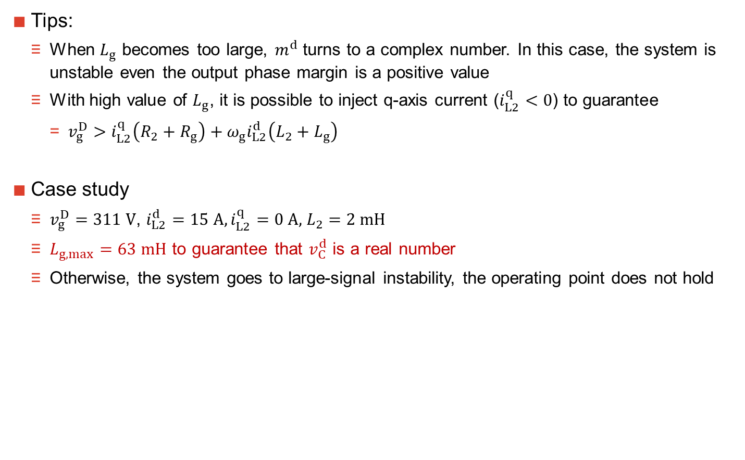
Operating Point Calculation
Tips:
When $L_{g}$ becomes too large, $m^{d}$ turns to a complex number. In this case, the system is unstable even the output phase margin is a positive value
With high value of $L_{g}$, it is possible to inject q-axis current ($i_{L2}^{q}<0$) to guarantee
$v_{g}^{D}>i_{L2}^{q}\left(R_{2}+R_{g}\right)+ω_{g}i_{L2}^{d}\left(L_{2}+L_{g}\right)$
Case study
$v_{g}^{D}=311 V$, $i_{L2}^{d}=15 A, i_{L2}^{q}=0 A,$ $L_{2}=2 mH$
$L_{g,max}=63 mH$ to guarantee that $v_{C}^{d}$ is a real number
Otherwise, the system goes to large-signal instability, the operating point does not hold

