Slide 1

Predicting Wine Rating
Group
Fanxi Chen, Sophie Guo, Zhiqing Sha, Yitong Zhao

Slide 2

Problem Statement
Goal: predict wine ratings with provided features
Prediction problem
Hypothesis: our model can predict wine ratings
At least one of the coefficients of our predictors is not zero

Slide 3
Background
Helps wine businesses learn about customer tastes and understand the wine market better
Some projects showed that models with certain features such as price and region have predicting power on wine ratings
Interest in learning how to choose wines
The majority is of similar prices
Usually put on the same shelves, hard to differentiate
But how about specific location index like longitude and latitude, as well as acidity?
How does predicting power differ across models?
Helps retailers predict sales and customer satisfaction with wine purchases
Helps promotion planning and other resource planning
Notes:
https://dscrashcourse.com/practice/wine/
Work on text review
https://www.kaggle.com/code/mahmoudelhusseni/spanish-wine-cleaning-eda-modeling/notebook
Limited use of models
https://cs229.stanford.edu/proj2017/final-reports/5217737.pdf
Work on text rating, only regression models
https://towardsdatascience.com/predicting-wine-quality-with-several-classification-techniques-179038ea6434
Chemical perspective, predict quality

Slide 4
Data Source
Variables | Meaning
wine | Winery name
winery | Name of the wine
year | Grape harvest year
body | Richness and weight of wine in mouth
num_reviews | Number of users of the reviews
price | Price in euros (€)
type | Wine variety
acidity | Wine's “pucker” or tartness
region | Region of the wines
rating | User provided rating on wine
latitude | Latitude of the region
longitude | Longitude of the region
Spanish Wine Quality dataset
Information of red wines in Spain
City dataset
Basic information about cities in Spain

Slide 5
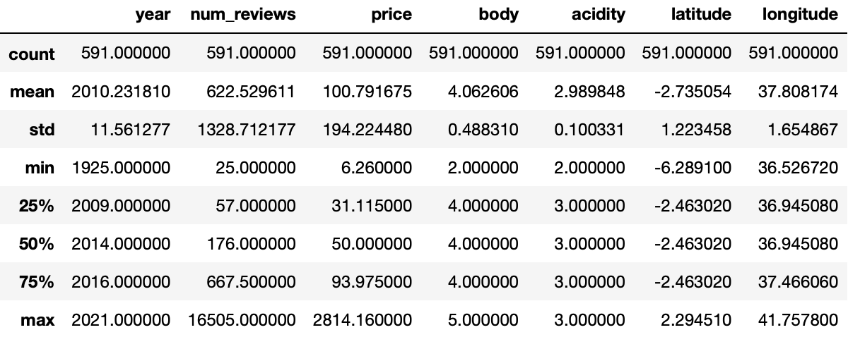
Data Summary
10 features
3 categorical features
591 data points
Continuous outcome

Slide 6
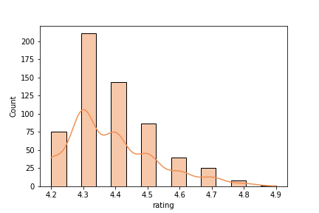
Data Summary
Feature | Correlation with Rating
year | -0.143659
num_reviews | -0.026018
price | 0.504651
body | 0.056816
acidity | -0.075150
latitude | -0.108462
longitude | 0.133121
Approximately normal

Slide 7
Method

Slide 8
What did we do to prepare the data for modeling?
Dataset Combination
Check two datasets to find the index for both datasets. ​
Join two datasets on "region" column. ​
Manage null values by dropping them​.
Drop Duplicates​.
Data preparation
Change categorical variables into dummies.
Check normality with histograms​.
Train-test split for predictors and outcomes.
Set wine names as index.
Data Cleaning

Slide 9
How did we combine data sources?
Finding an index in common, which is region.
Using merge() function to inner join two data sources on the region column.

Slide 10
What assumptions did we check?
Normality with histograms
Linear relationship between X & Y
Residuals are approximately normal
Constant variance
Independence between observations
Independence between variables
Variables measured without error

Slide 11
Why did we use these approaches?
Multiple Regression
Multiple regression analysis allows us to examine the various predictor variables more thoroughly.
It improves reliability by avoiding reliance on a single variable and utilizing multiple independent variables to support the event.
Neutral Network
Neural networks are gaining rapid momentum, with applications coming from a wide range of fields and an increasing ability to solve real-world problems.

Slide 12
Why did we use these approaches?
Decision Tree Regression
Decision trees is relatively easy to understand and are also very effective as a method for prediction.
Handle non-linear data.
Random Forest Regression
Reduced variance without large increases to the bias.
The random forest provides a higher level of accuracy in predicting outcomes over the decision tree.

Slide 13
What models did we fit?
Multiple regression
Check the assumptions
Train the model
Neutral Network
Pre-process data
Standardize Predictors
Build a deep network with two hidden layers
Apply Early Stopping
Evaluate performance based on MSE iteratively
Decision Tree / Random Forest
Train tree models with training set under several depth
Identify the optimal max depth of best cross-validation scores
Using test set to make prediction with the optimal max depth
Evaluate the prediction performance based on MSE and MAPE
Evaluate feature importance by using feature importance function
Make prediction on test set
Check the performance based on MSE and MAE

Slide 14
Results and Discussion

Slide 15
Results
How did the predictions perform?
 | Multiple Regression | Decision Tree | Random Forest | Neutral Network
MSE | 0.014 | 0.012 | 0.008 | 0.18
MAPE | 2.156% | 1.946% | 1.680% | 5.420%
R² | 0.491
Notes:
MSE (mean squared error) measures the amount of error in statistical models.
The mean absolute percentage error (MAPE) is the mean or average of the absolute percentage errors of forecasts. Error is defined as actual or observed value minus the forecasted value.

Slide 16
Results
Overall high accuracy
Among the models, the models trained using the Random Forest method yielded lowest MSE and MAPE values.
Lower MSE/MAPE = better prediction outcome
In addition to its highest accuracy, Random Forest allows for more flexible data input, which gives us more flexibility and convenience in adapting and analyzing the data in the future.

Slide 17
Discussion Were you surprised by what you found? Why or why not?
Initially thought that the influence of the acidity of a wine would be the most influential in the evaluation of a wine
Found that using different analyzing models presented different influences from variables
The fact that different models may evaluate different weights on variables and results in the training process
The fact that parameters may be tuned differently in distinct models, which may also lead to different results
The models we used all yielded relatively high accuracy
Grouping or feature selection methods could be used to reduce number of dummy columns

Slide 18

What are the uses for our results?
Reduces the time, effort and costs of predicting business outcomes
Serves as an analytical base for marketing, sales and customer service strategies in the wine industry
Helps better understand consumer needs
Helps forecast inventory or resource management processes

Slide 19

Thank you

Slide 20
References
https://github.com/jeffheaton/t81_558_deep_learning
https://scikit-learn.org/stable/modules/model_evaluation.html#scoring-parameter
INFO 574 - Foundations Of Analytics – Lectures & Slides
https://www.indeed.com/career-advice/career-development/predictive-modeling-types
https://www.srose.biz/machine-learning/decision-trees-in-python/
https://blog.csdn.net/weixin_26746401/article/details/108259999
https://towardsdatascience.com/random-forest-in-python-24d0893d51c0

