Slide 1

CGT620-Lab1
Zhiquan Wang
Instructor: Bedrich Benes

Slide 2
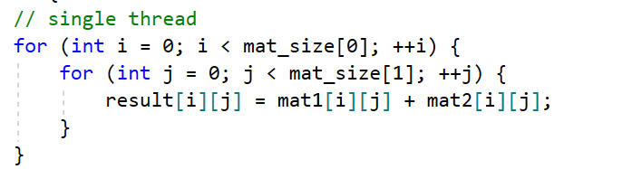
Matrix Addition
Single Thread

Slide 3
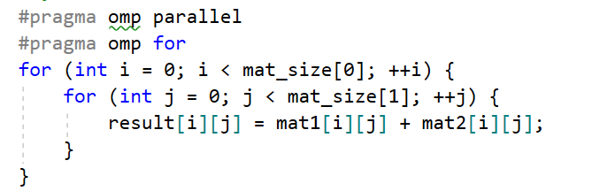
Matrix Addition (solution 1)
OpenMP

Slide 4
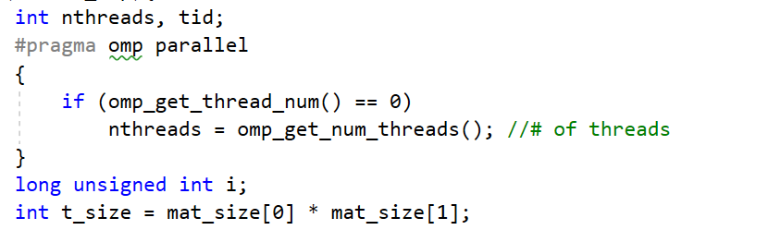
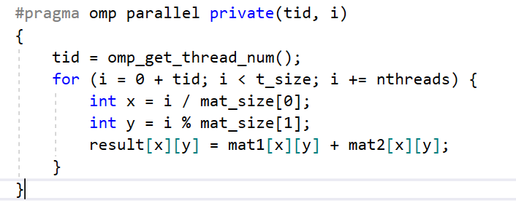
Matrix Addition (solution 2)
OpenMP

Slide 5
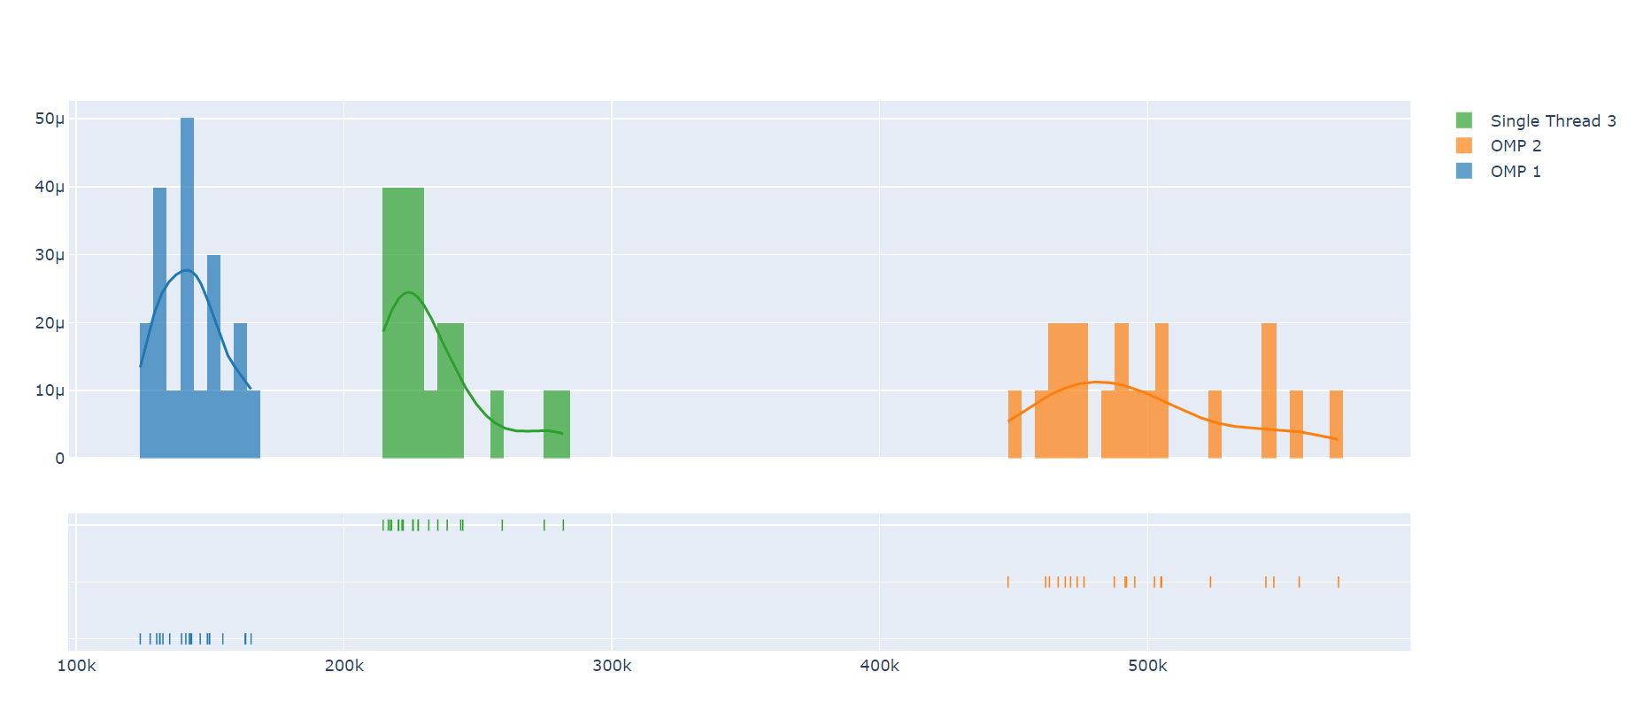
Comparison (20 times)

