Slide 1

Data 2050 Final Presentation
Zhirui Li

Slide 2
Introduction
Focus on reproducible research in public health
Replicate and extend a paper that involves public health using publicly available data
Identify a topic and several research papers related to that topic
Reproduce the model using publicly available datasets
Go beyond the scope of the original paper, conducting more visualizations and analyses

Slide 3
Paper of Interest
A forecast model for prevention of foodborne outbreaks of non-typhoidal salmonellosis
Multivariate regression time series + Generalized auto-regressive and moving average models (GARIMA)
Validated by analyzing the cases of Salmonella Enteritidis in Sydney Australia
GARIMA:
G: generalization
AR: autoregression
I: integration
MA: moving average

Slide 4
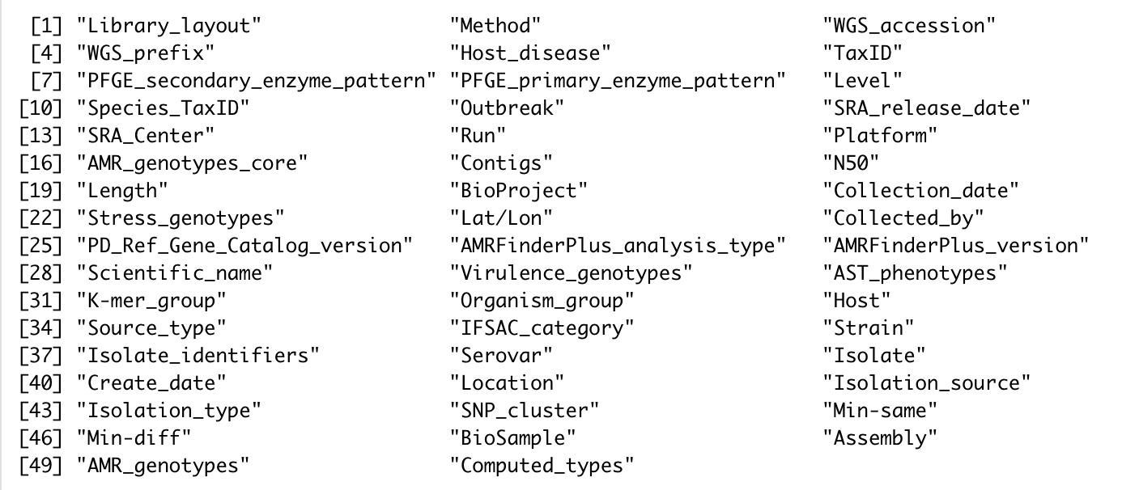
Listeria Monocytogenes Dataset
National Center for Biotechnology Information
Includes 51738 observations and 50 variables

Slide 5
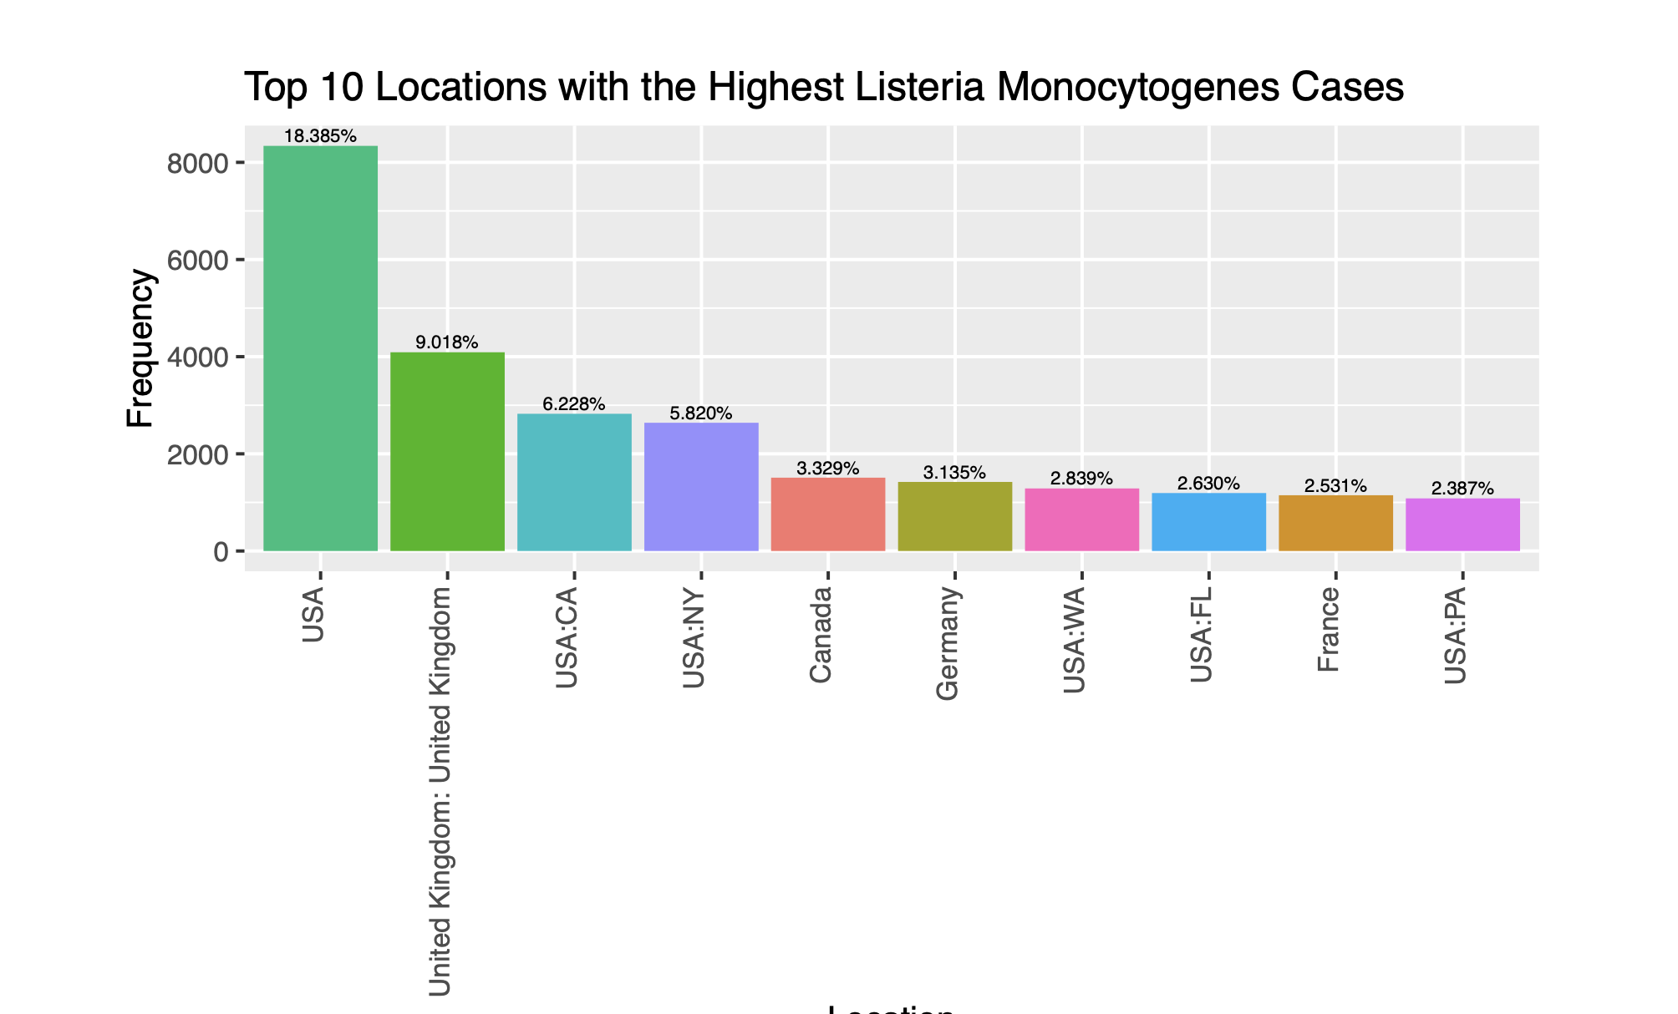
Variable “Location”

Slide 6
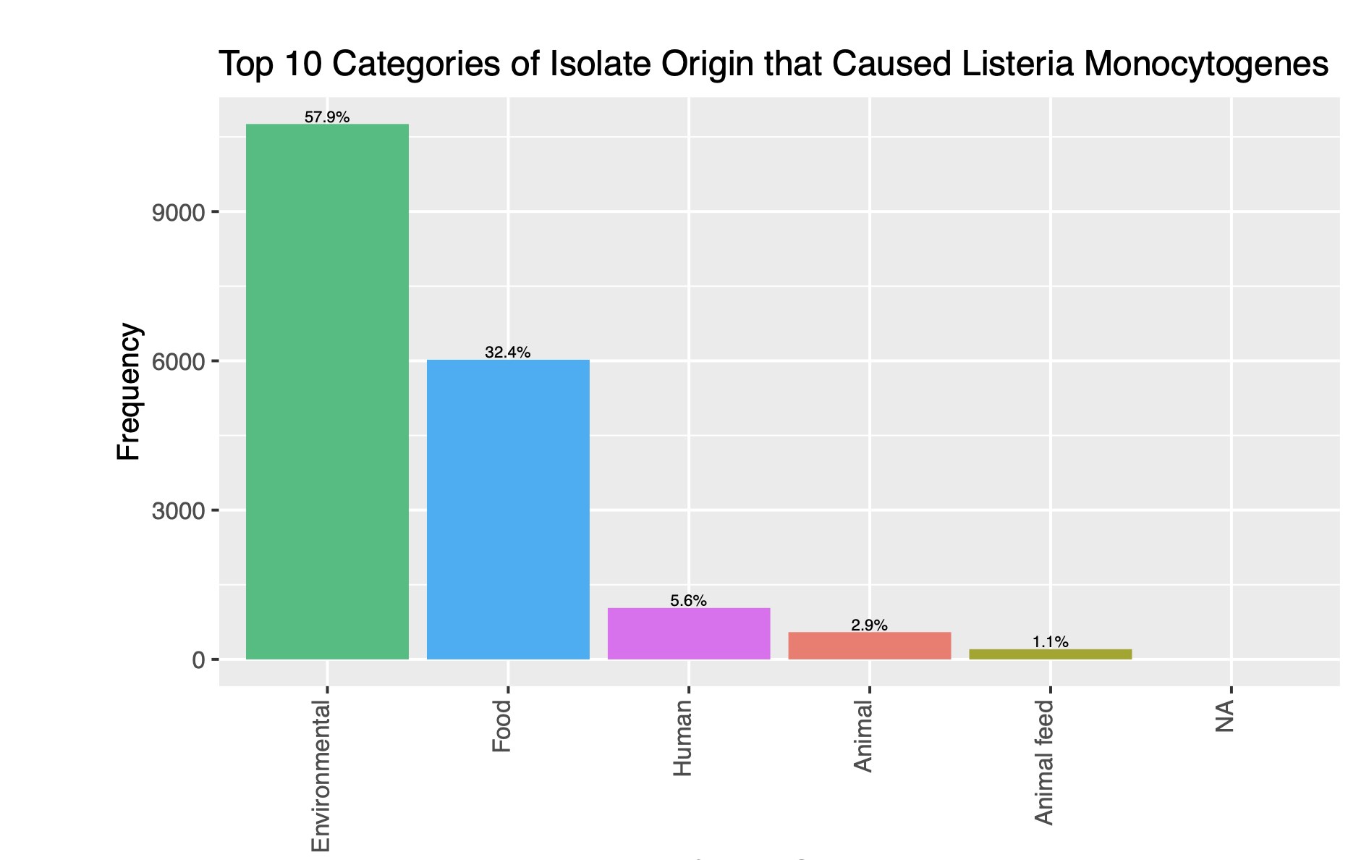
Variable “Source_type”

Slide 7
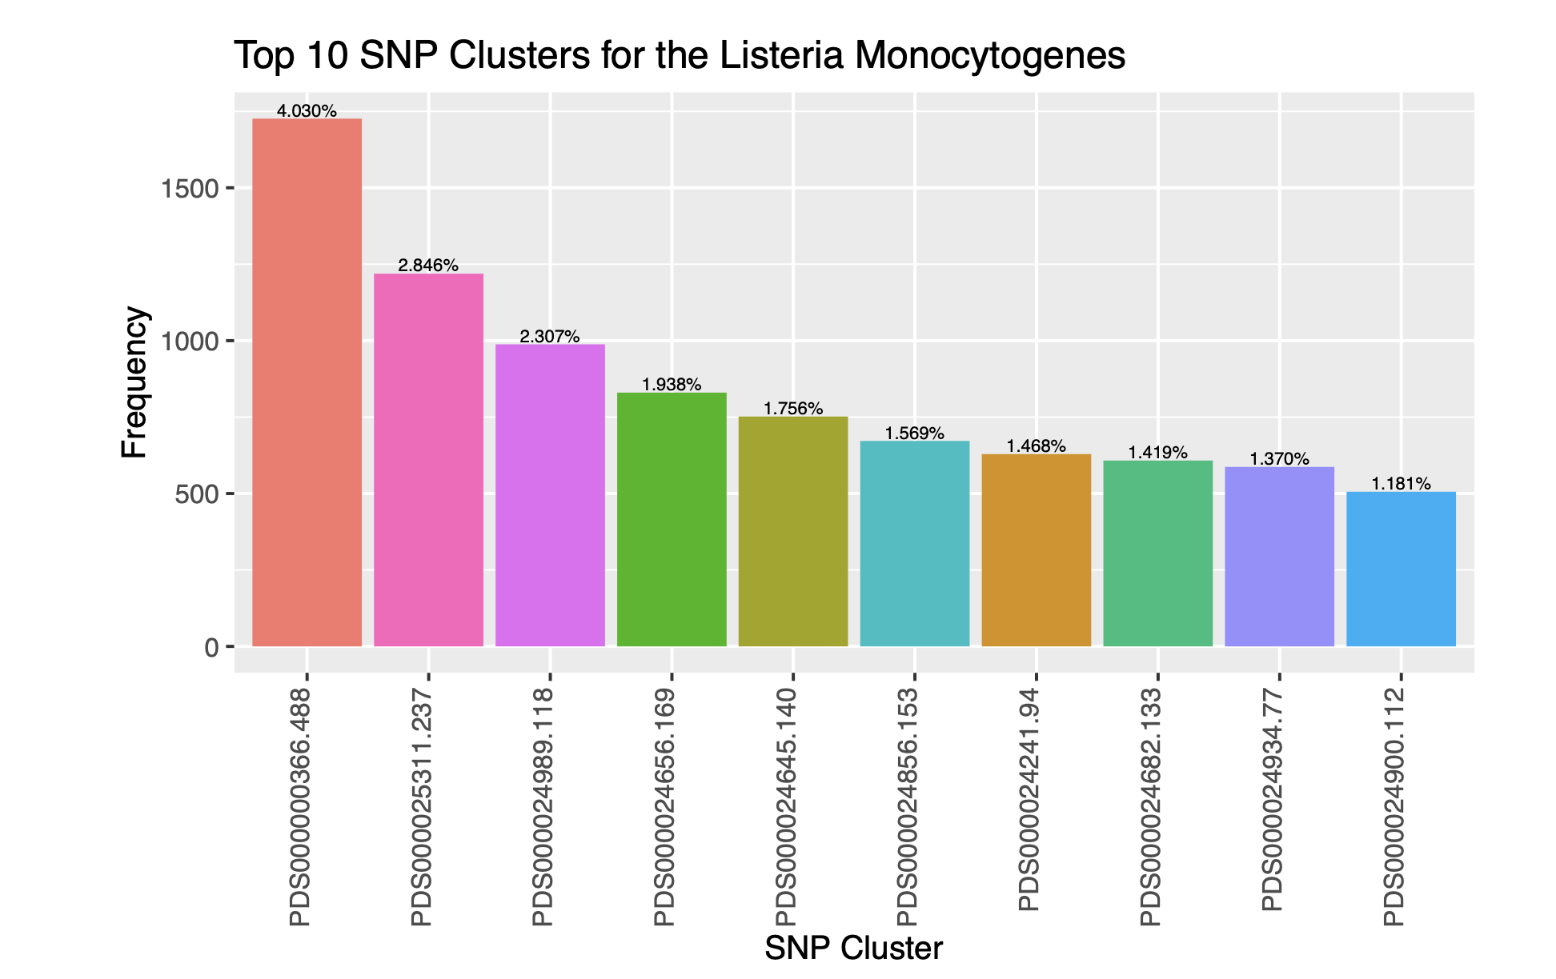
Variable “SNP_cluster”

Slide 8
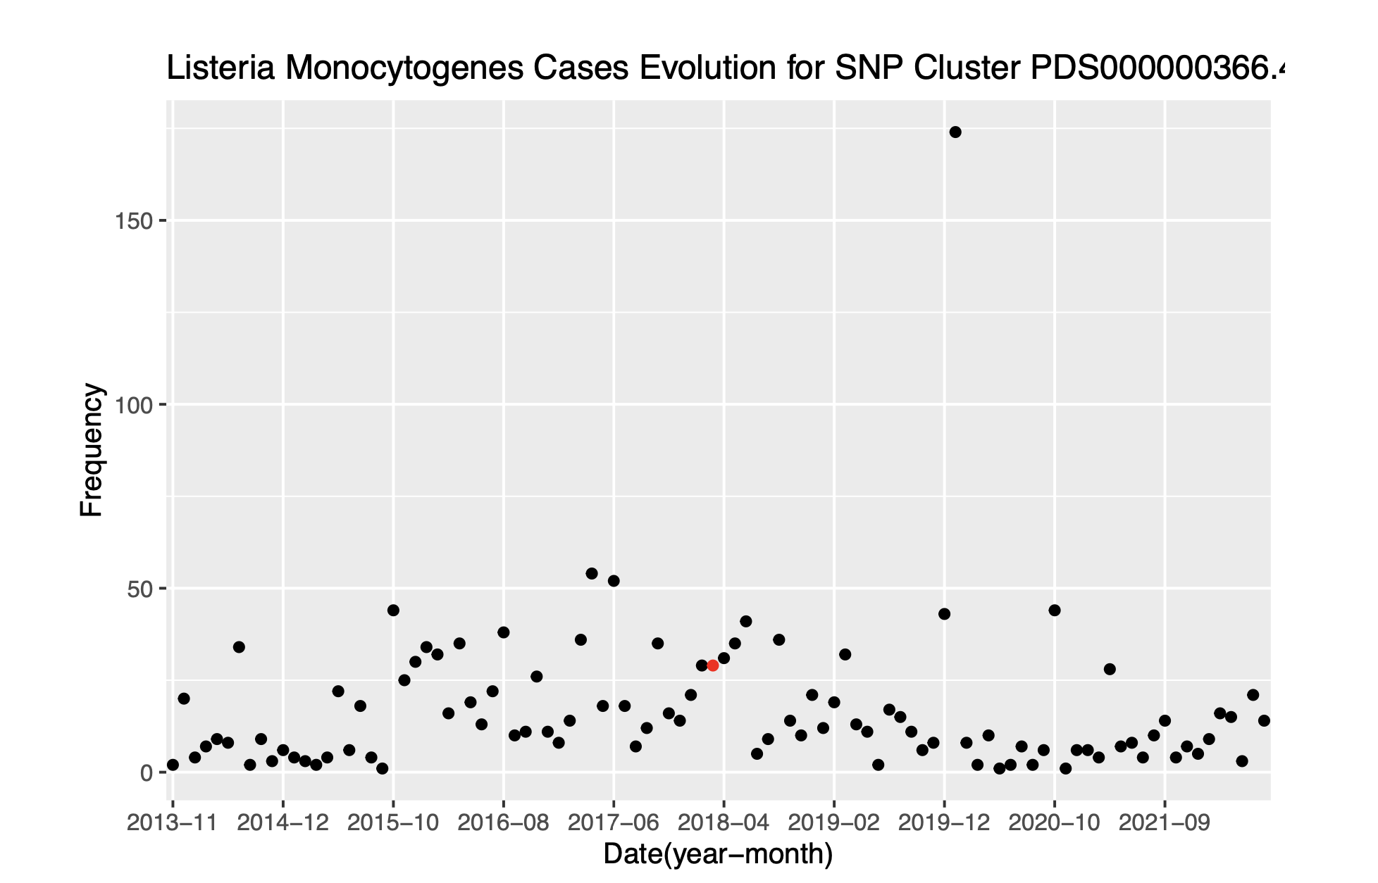
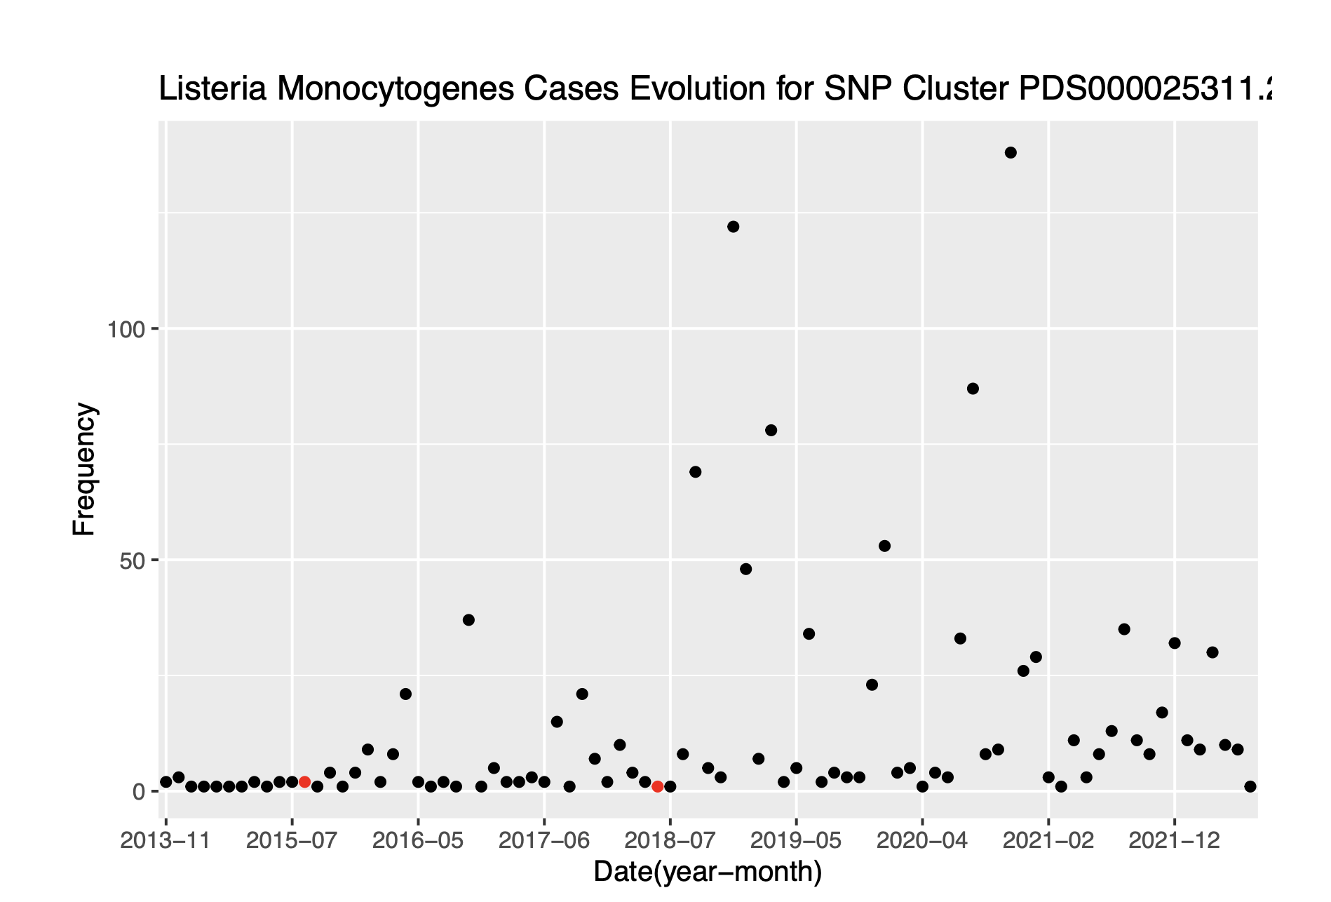
SNP Cluster Visualization by Month

Slide 9
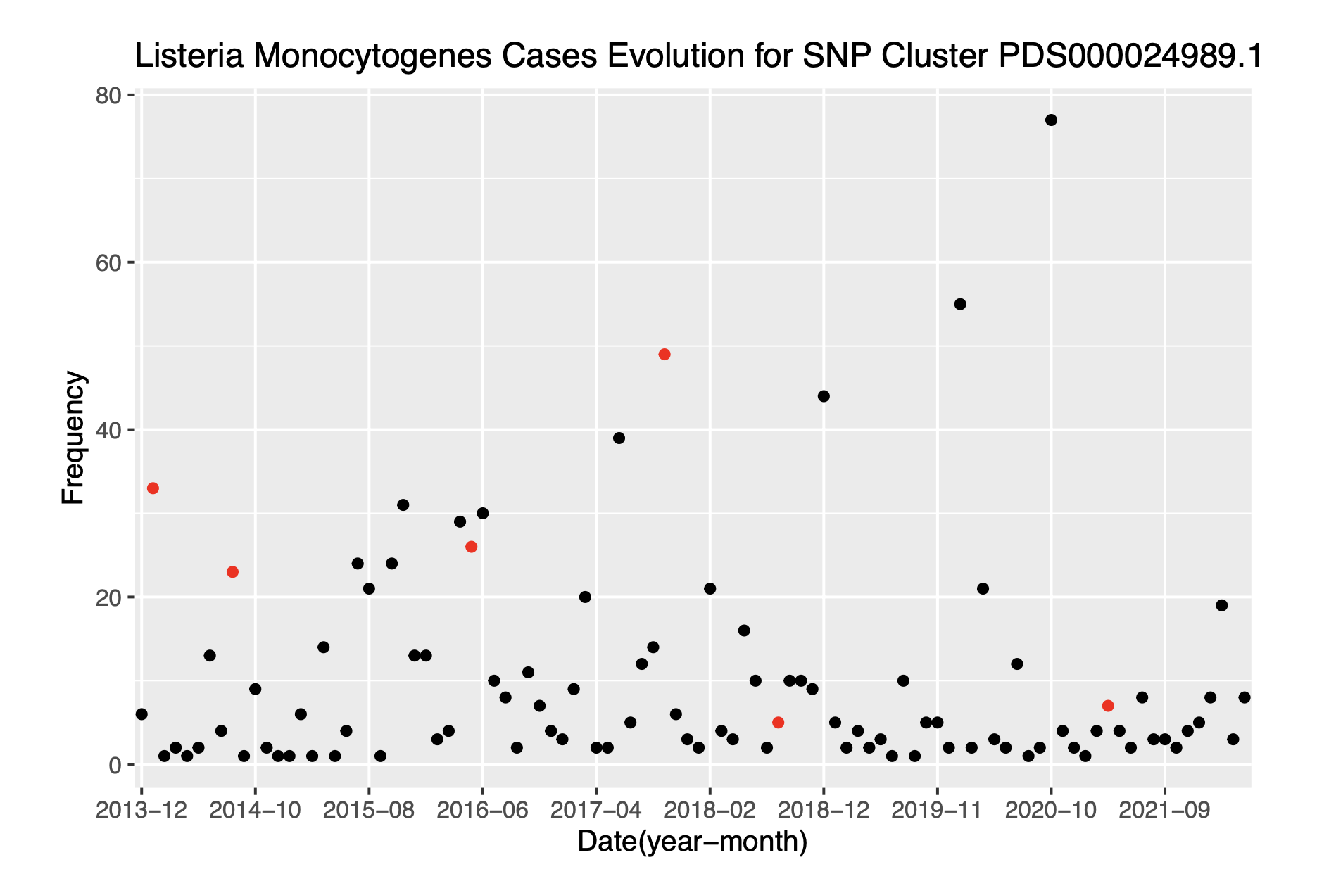
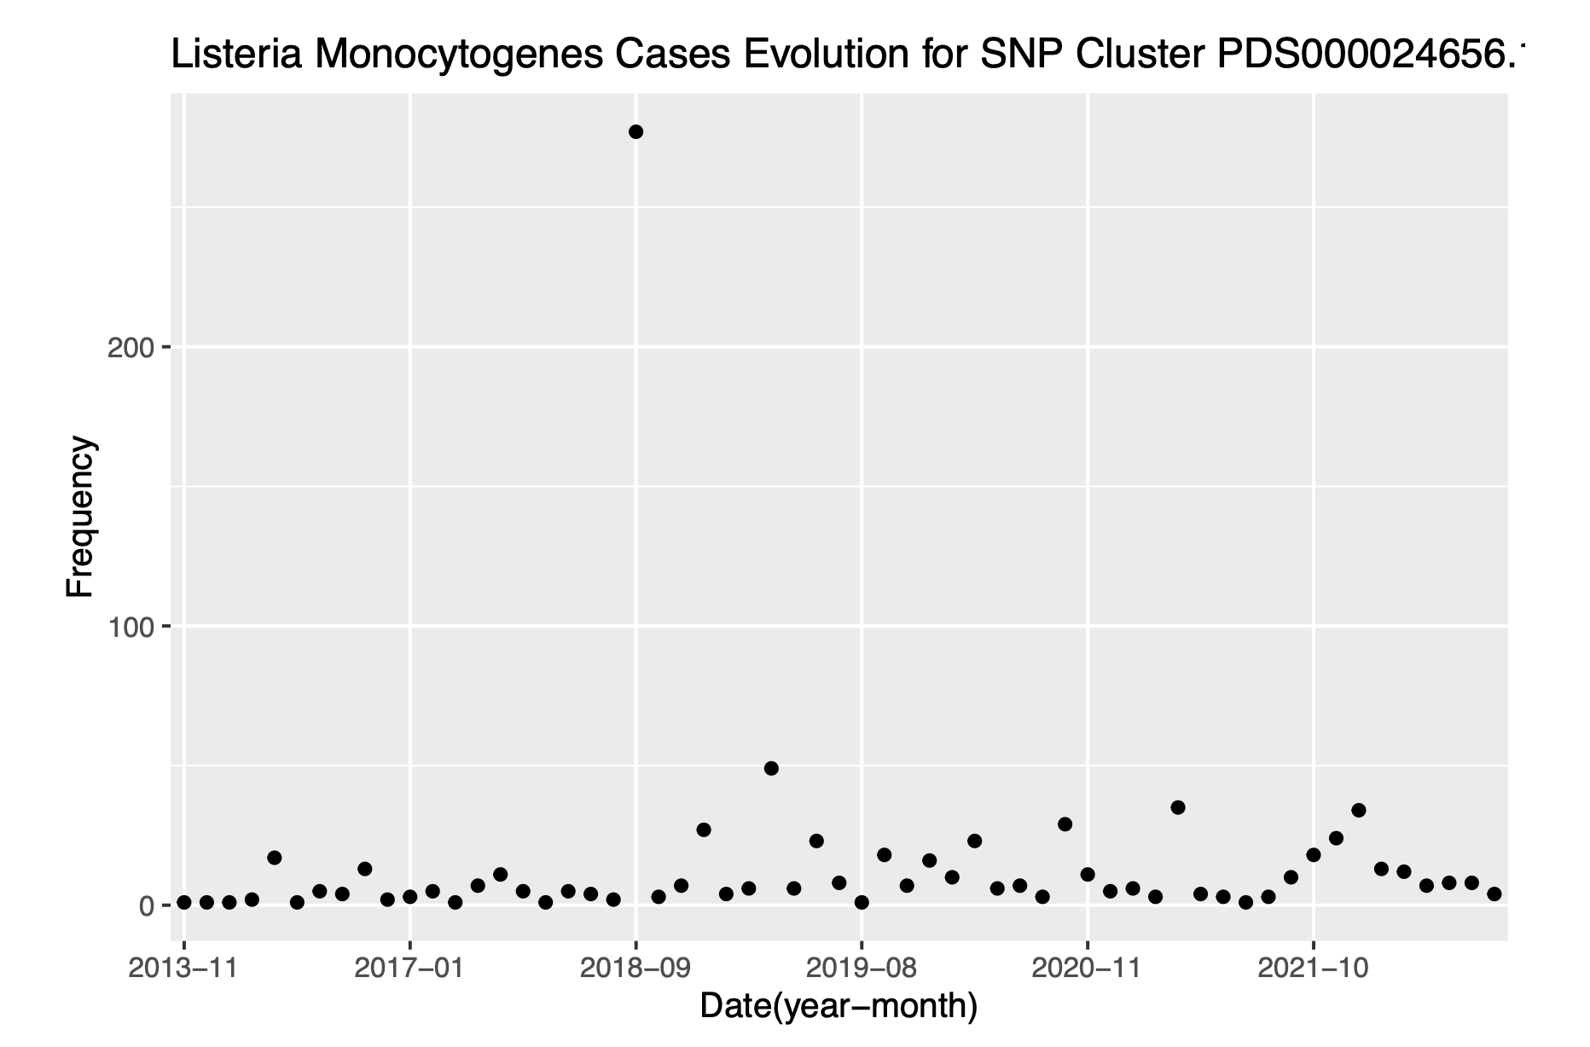
SNP Cluster Visualization by Month Continues

Slide 10
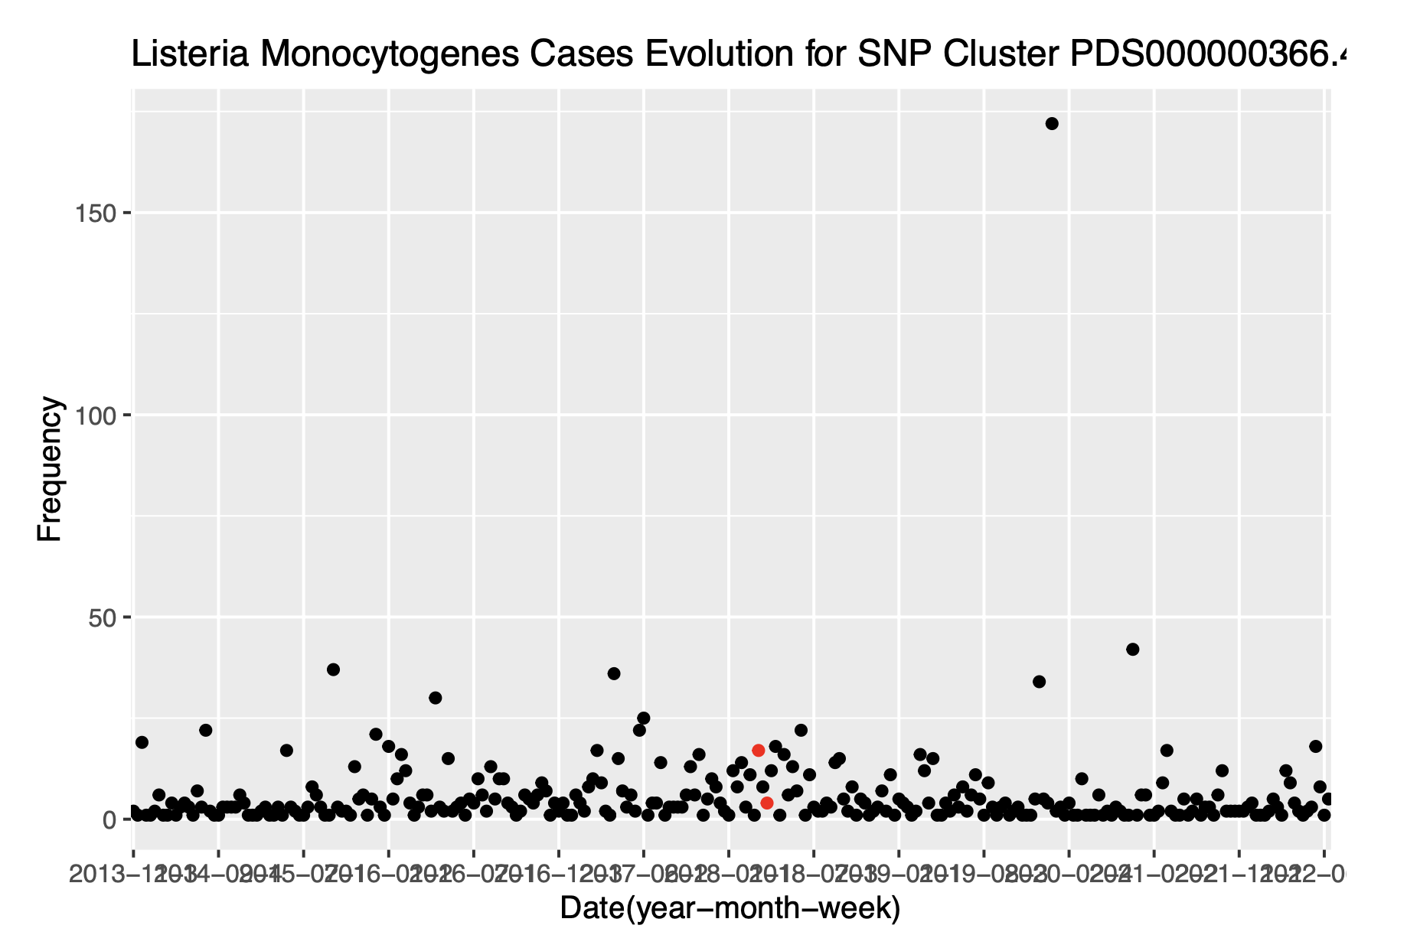
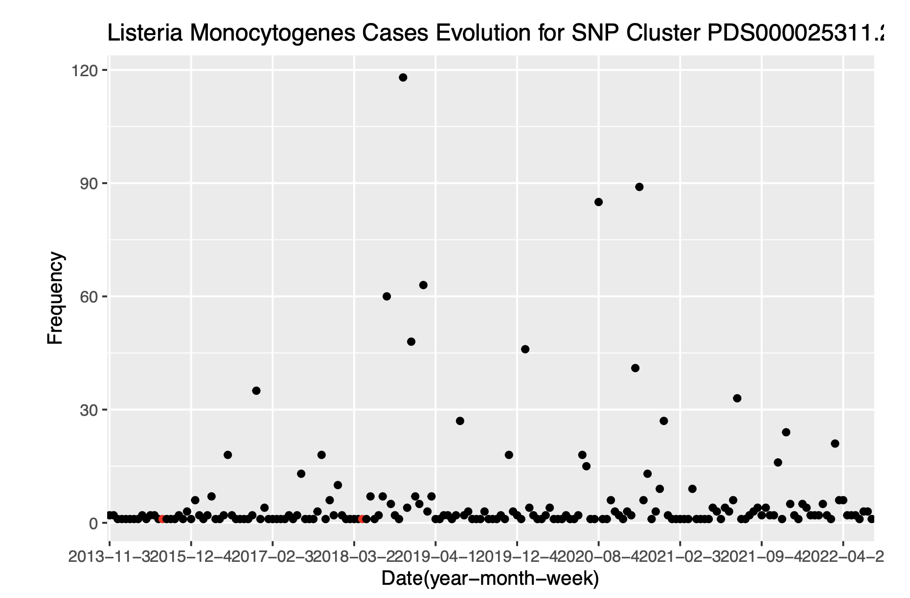
SNP Cluster Visualization by Week

Slide 11
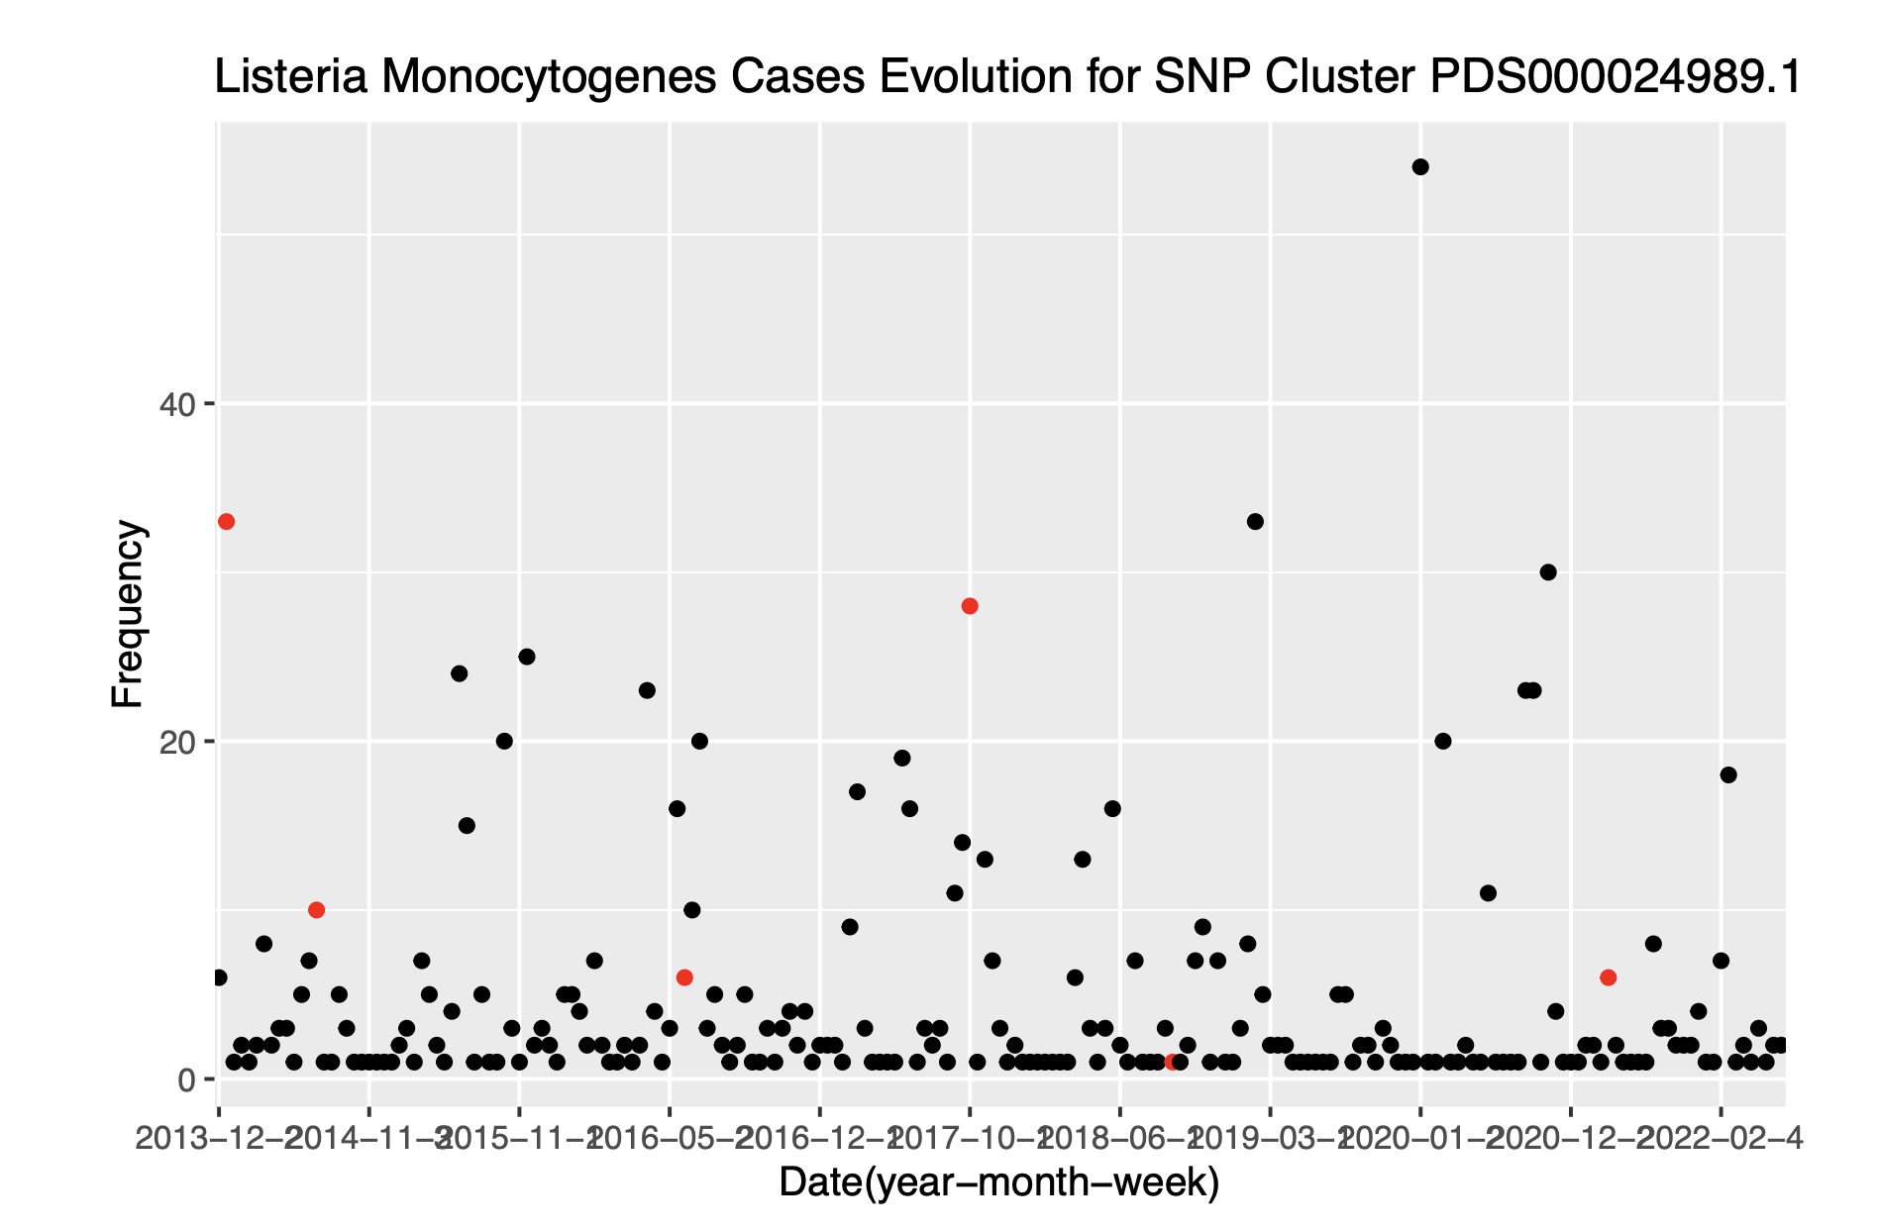
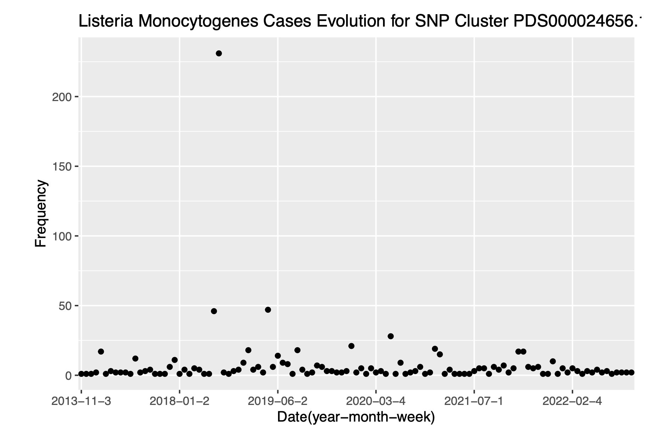
SNP Cluster Visualization by Week Continues

Slide 12
ARIMA and GARIMA
I am going to build ARIMA and GARIMA models for both the SNP cluster contains the most Listeriosis cases as well as using the whole dataset
In addition to using the largest SNP cluster and the whole dataset, I will use weekly count time series and monthly count time series to compare performance

Slide 13
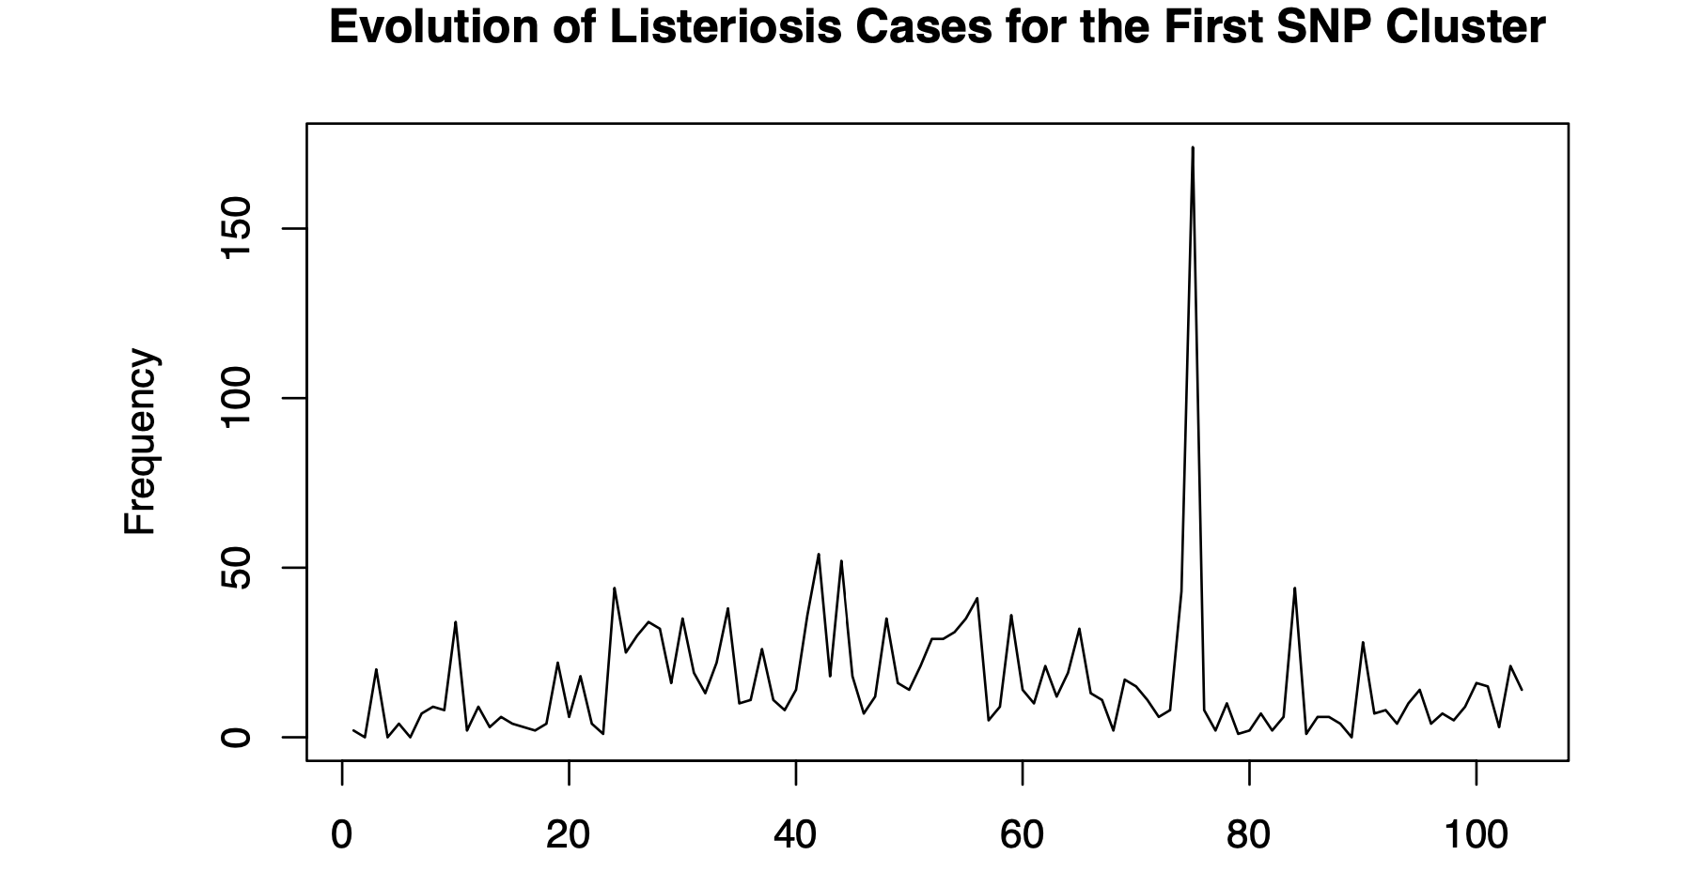
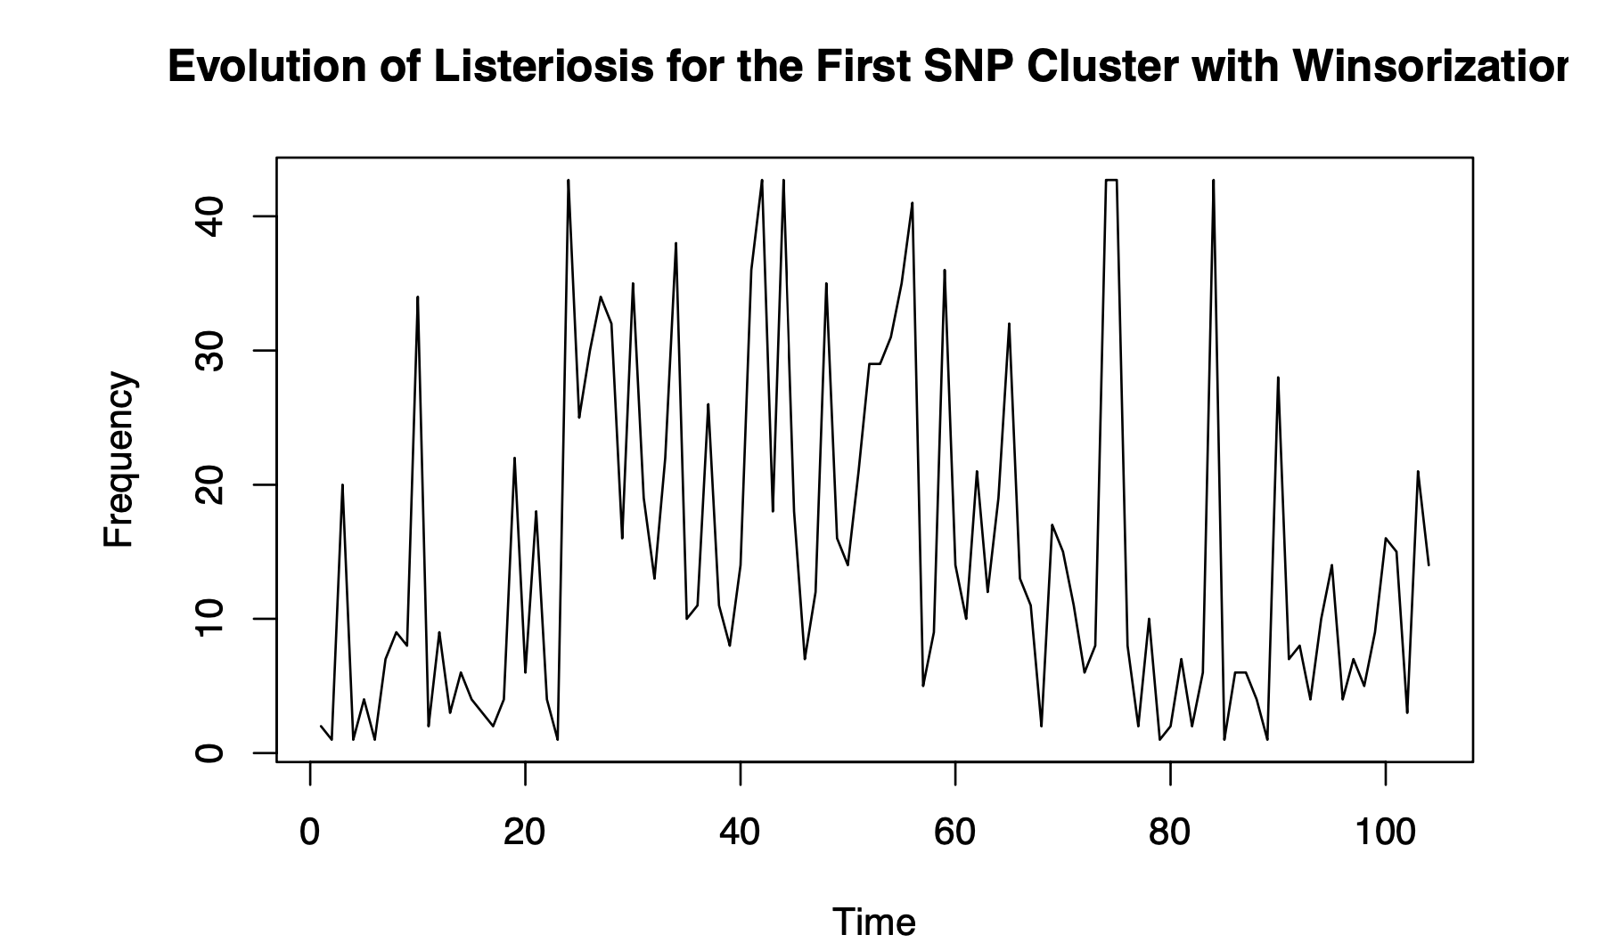
Winsorization

Slide 14
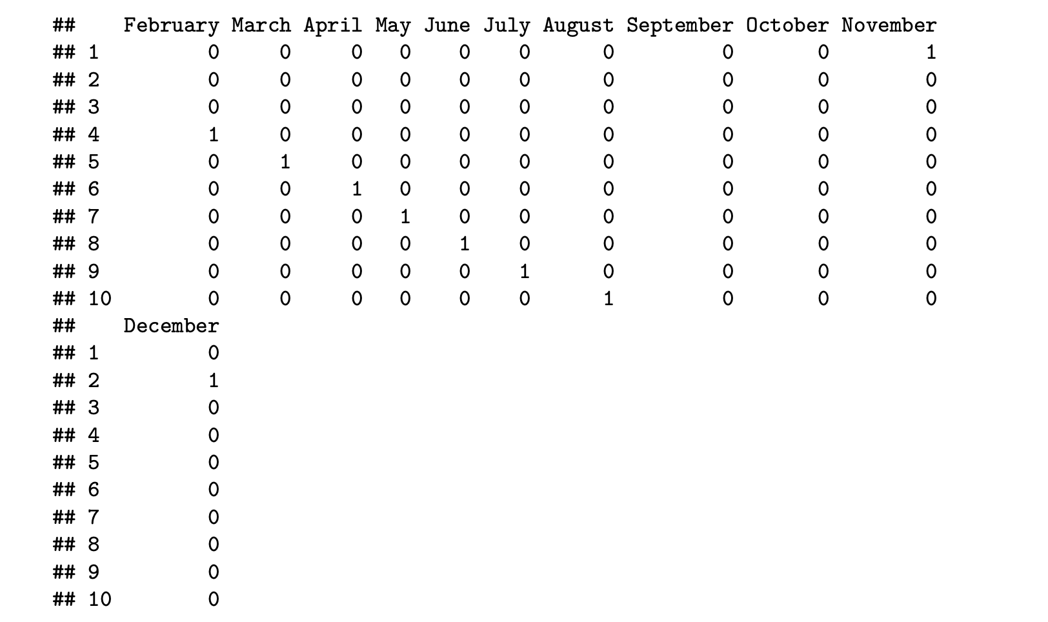
XREG Matrix

Slide 15

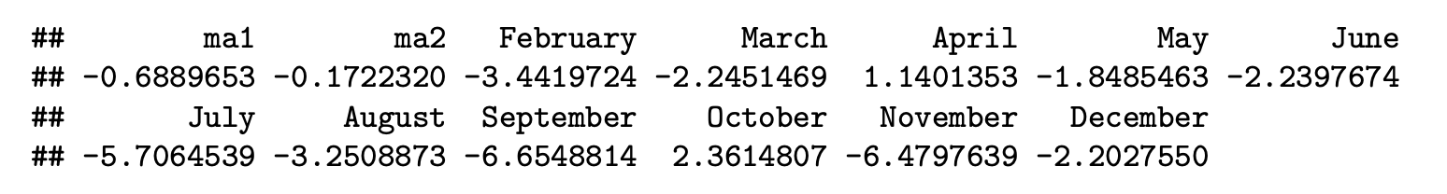
Time Series Analysis for the First SNP Cluster using Monthly Count Time Series (ARIMA)
Nested cross-validation + Grid search to choose the best hyperparameters (p, d, and q)
The best model with the lowest root-mean-square deviation (RMSD) is the model with p = 0, d = 1, and q = 2

Slide 16
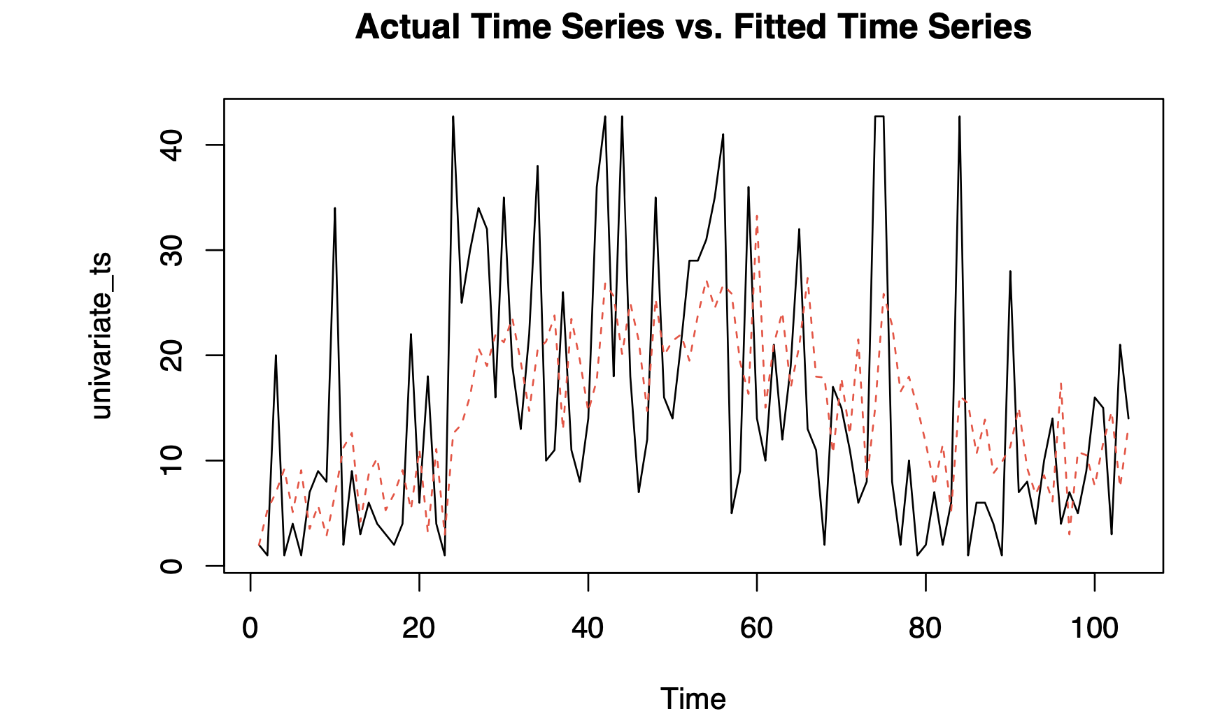
Time Series Analysis for the First SNP Cluster using Monthly Count Time Series (ARIMA) Continues

Slide 17

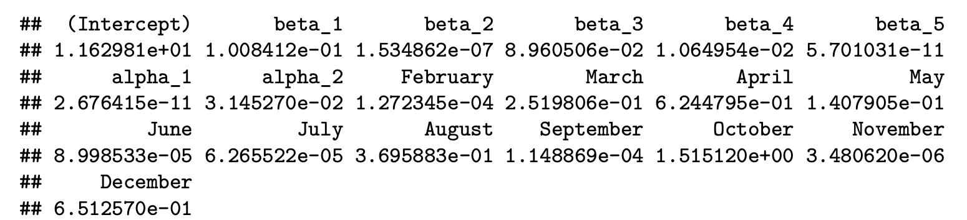
Time Series Analysis for the First SNP Cluster using Monthly Count Time Series (GARIMA)
The best model with the lowest root-mean-square deviation (RMSD) is the model with p = 5 and q = 2

Slide 18
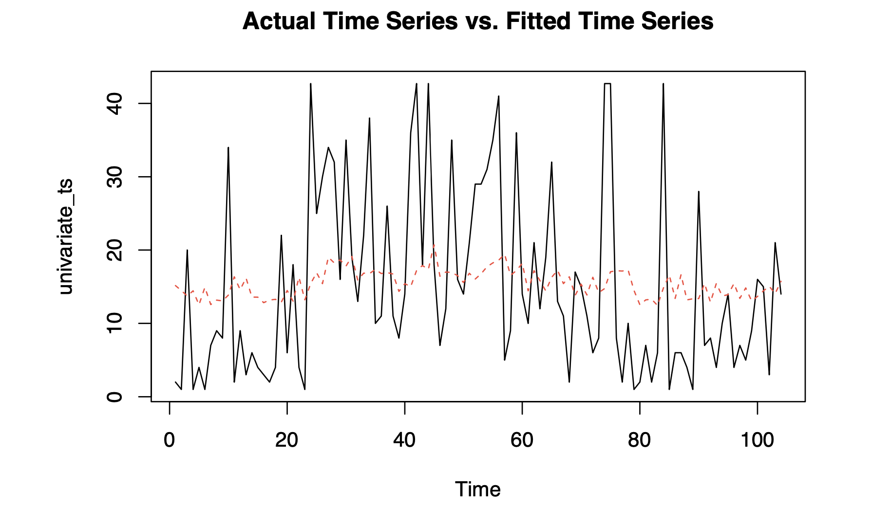
Time Series Analysis for the First SNP Cluster using Monthly Count Time Series (GARIMA) Continues

Slide 19
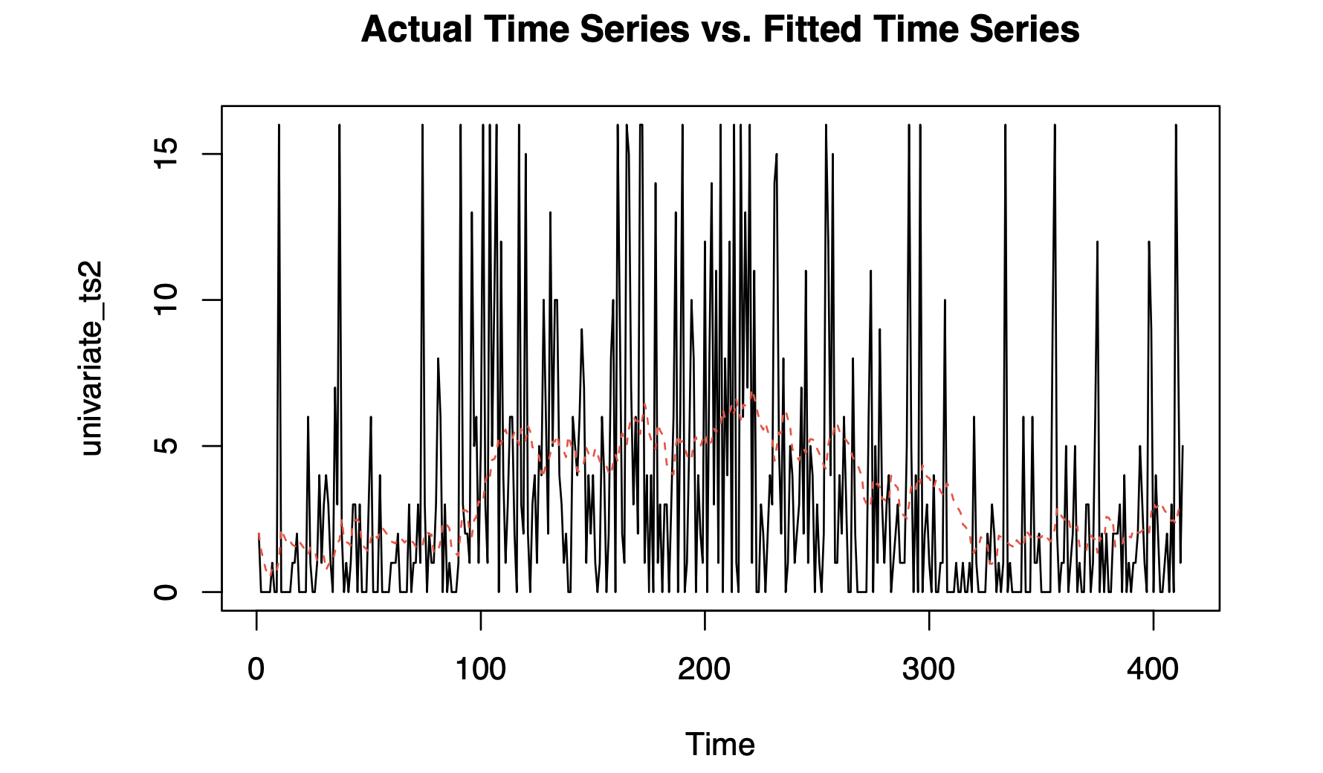
Time Series Analysis for the First SNP Cluster using Weekly Count Time Series (ARIMA)
p = 0
d = 1
q = 1

Slide 20
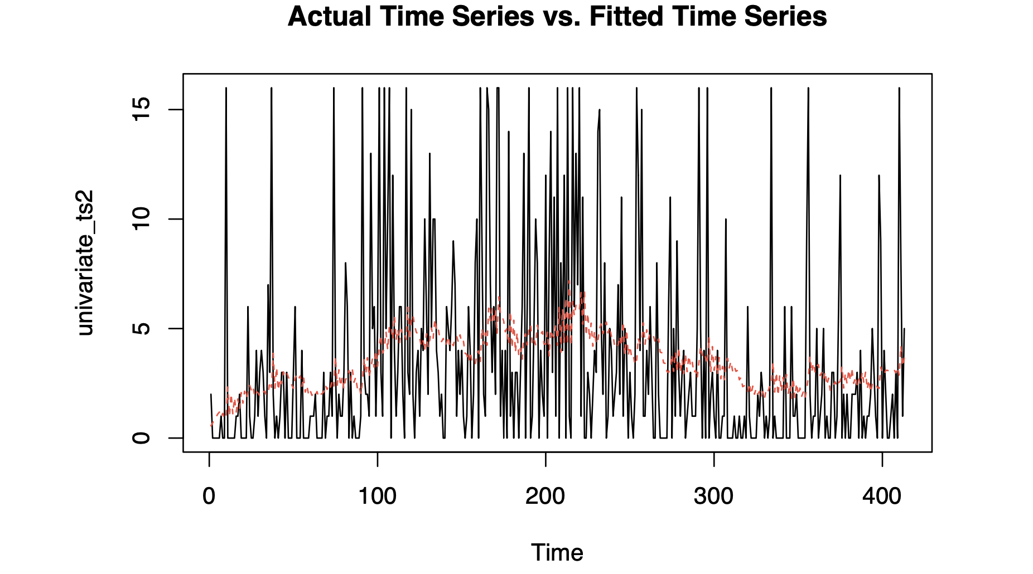
Time Series Analysis for the First SNP Cluster using Weekly Count Time Series (GARIMA)
p = 1
q = 3

Slide 21
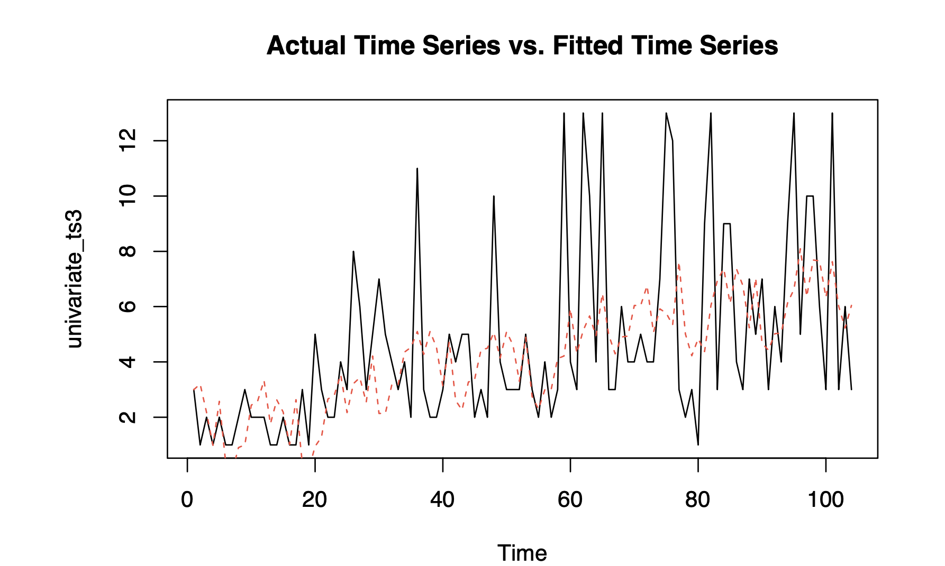
Time Series Analysis for the Whole Dataset using Monthly Count Time Series (ARIMA)
p = 0
d = 1
q = 1

Slide 22
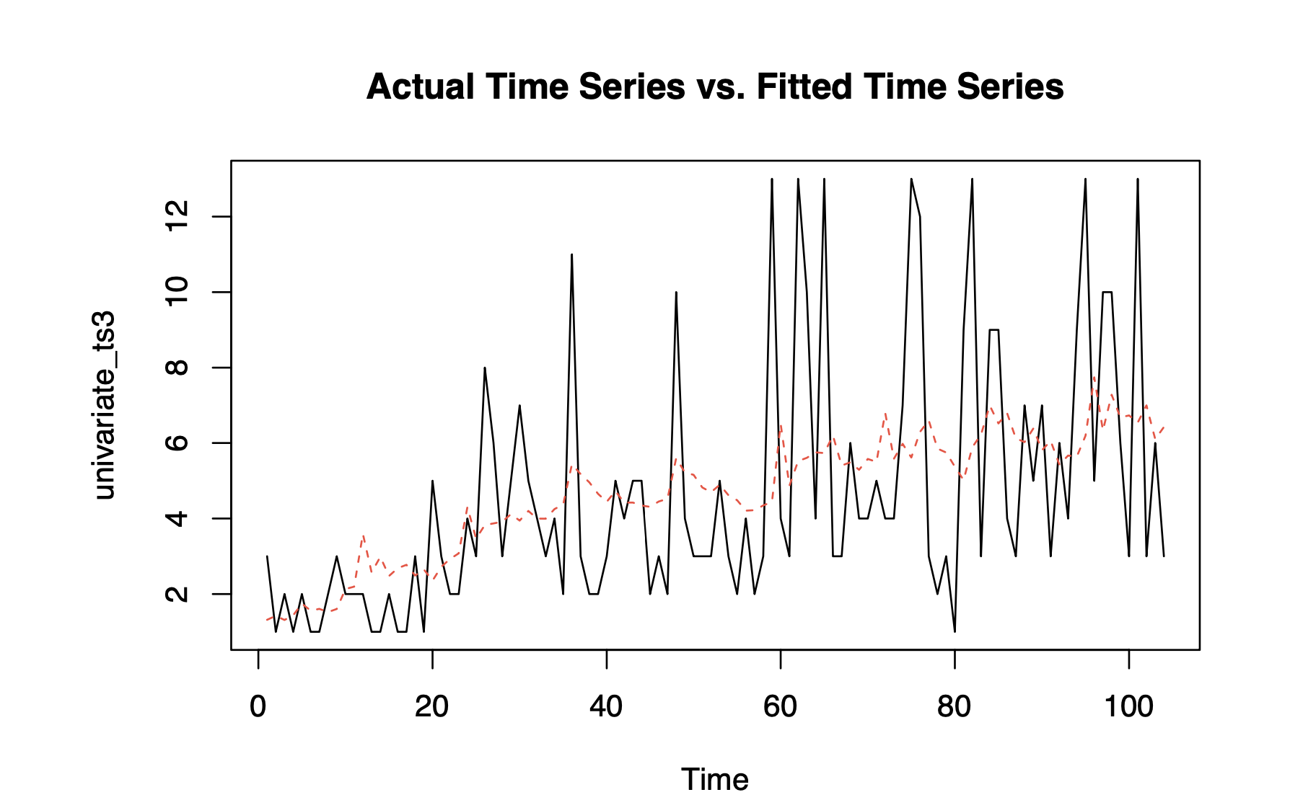
Time Series Analysis for the Whole Dataset using Monthly Count Time Series (GARIMA)
p = 1
q = 2

Slide 23
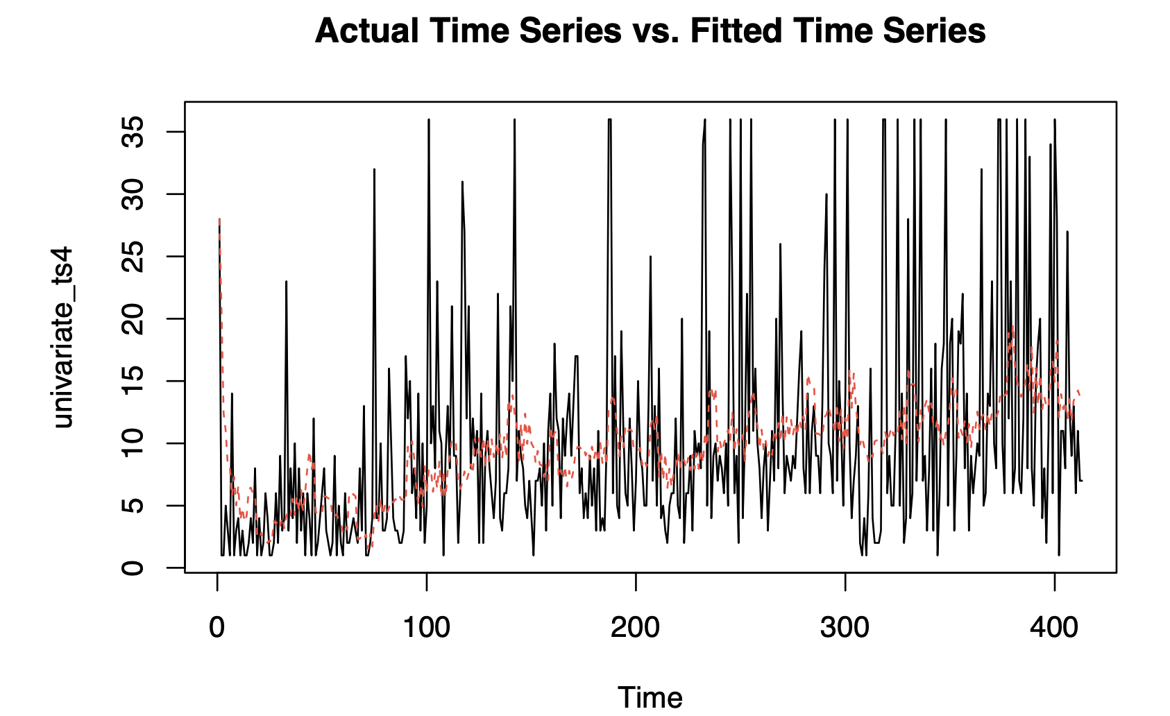
Time Series Analysis for the Whole Dataset using Weekly Count Time Series (ARIMA)
p = 1
d = 1
q = 3

Slide 24
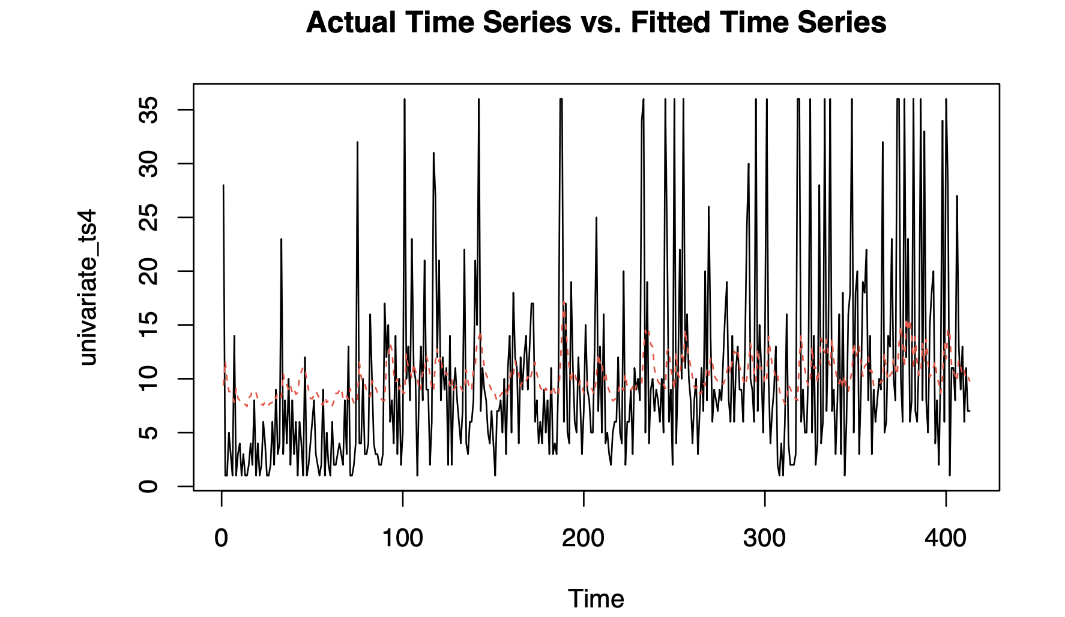
Time Series Analysis for the Whole Dataset using Weekly Count Time Series (GARIMA)
p = 2
q = 2

Slide 25
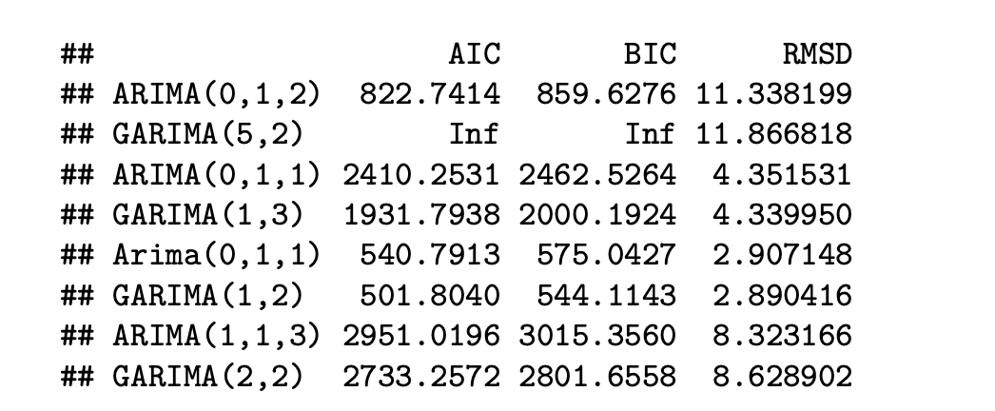
Summary

Slide 26

Thank you for watching!

