Slide 1
RAP
RAP
Hi RAP
RAP

Slide 2
RAP
RAP
Hi RAP
RAP

Slide 3
RAP

Slide 4
Hi Rap

Slide 5
RAP

Slide 6
Hi RAP

Slide 7
Big Logo
Heioray

Slide 8
Heioray
Studios
Welcome Page
Hi RAP
Enter

Slide 9


Slide 10
Heioray
Studios

Slide 11
Hi
Rap

Slide 12


Hi
Rap

Slide 13
Heioray
Studios

Slide 14

404 Page
404

Slide 15


404 Page
If you find me
take me home

Slide 16

404 Page
If you find me
take me home
If you find me
take me home

Slide 17

Project Page
Search
· My Projects
· All Projects Tree

Slide 18
InterFace Page
Interface Tree
Interface Detail
request records
response records

Slide 19
Detail Page
Interface Tree
Interface Detail
Operation Area
response records

Slide 20
Detail Page
Interface Tree
response records Area
Interface Detail

Slide 21
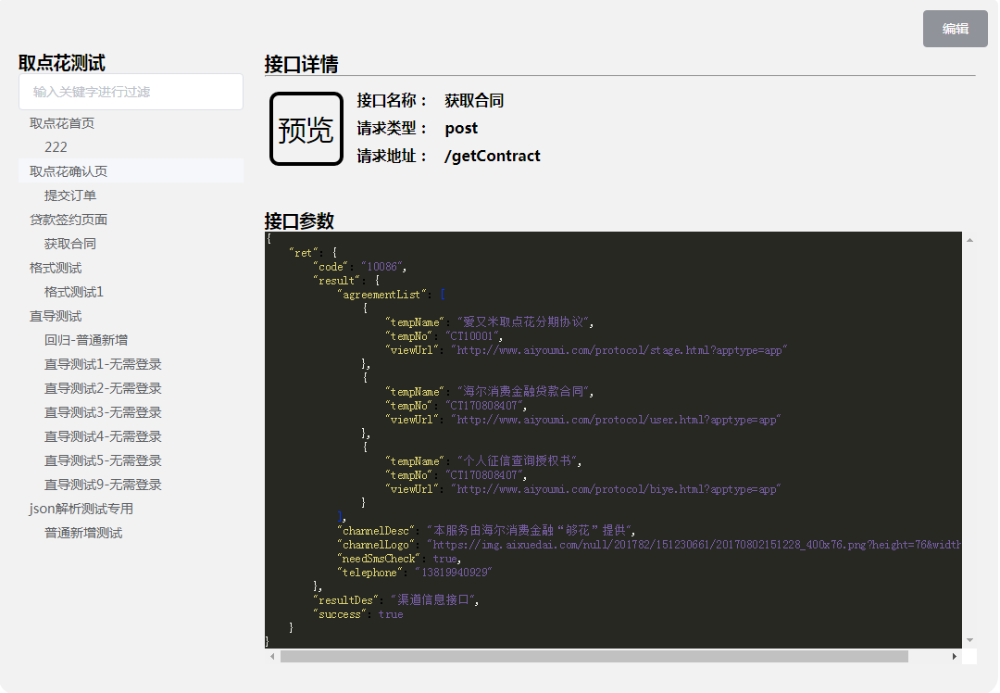

Slide 22
RequestShow Page
Interface Tree
Params Detail

Slide 23
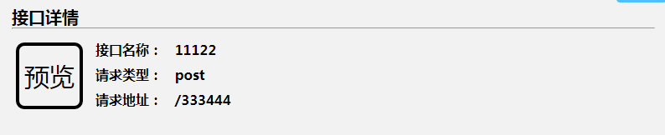
Interface Detail
name:
预览
method:
url:

Slide 24

Register Page
just dialog
login && register
flex
px2rem
Welcome
WELCOME

Slide 25
Register Page
just dialog
login && register
flex
px2rem
WELCOME

Slide 26
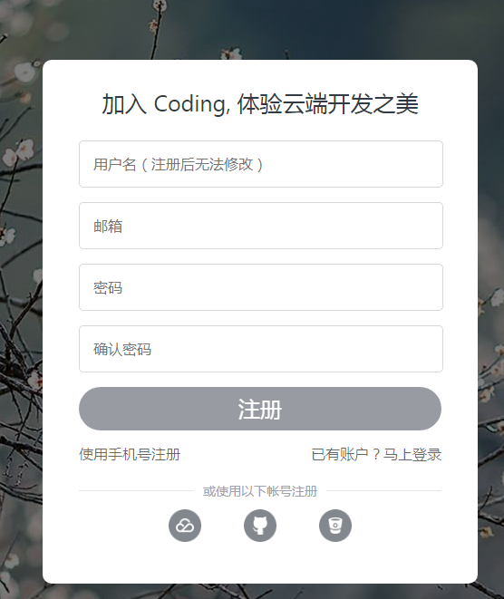
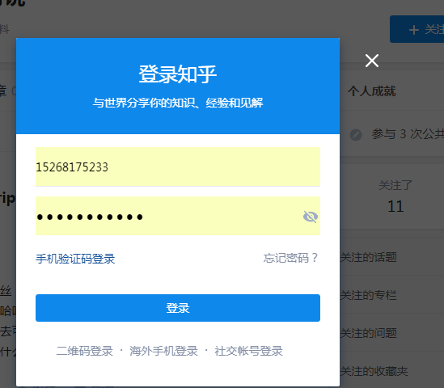
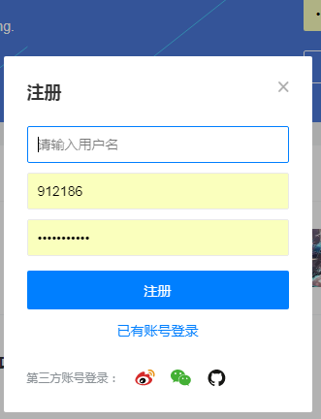
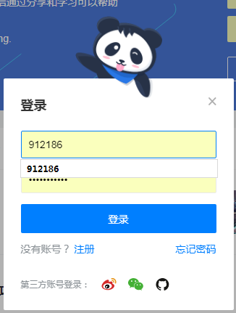
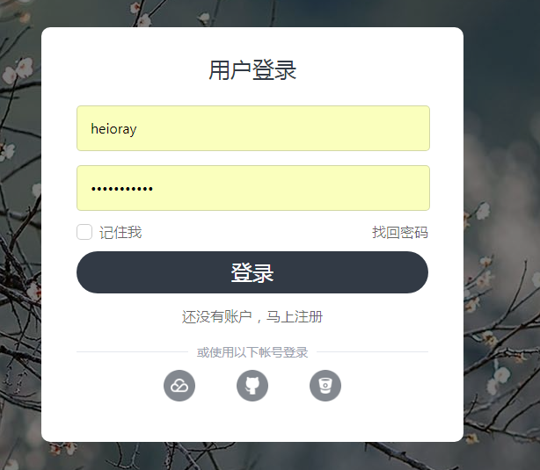
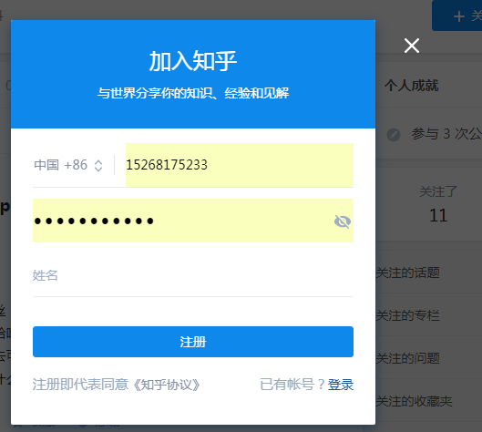
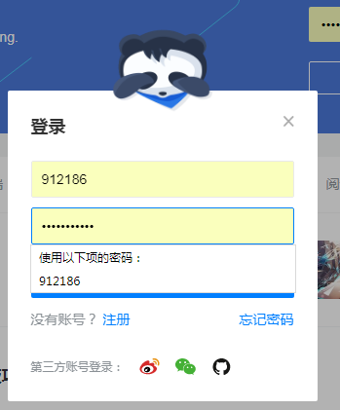
Register Page

Slide 27


250px
750px

Slide 28
请用flex布局解锁本书
内部尺寸自己算
我可是
要成为
啫喱之神
的男人
300PX
插个腰
这个嘛
牛B坏了
推下眼镜先
750PX

