Slide 1
RAP
RAP
Hi RAP
RAP

Slide 2
RAP

Slide 3
RAP

Slide 4
Hi RAP

Slide 5
Big Logo
Heioray

Slide 6
Heioray
Studios
Welcome Page
Hi RAP
Enter

Slide 7


Slide 8
Heioray
Studios

Slide 9
Heioray
Studios

Slide 10

404 Page
404

Slide 11


404 Page
If you find me
take me home

Slide 12

404 Page
If you find me
take me home
If you find me
take me home

Slide 13

Project Page
Search
· My Projects
· All Projects Tree

Slide 14
InterFace Page
Interface Tree
Interface Detail
request records
response records

Slide 15
Detail Page
Interface Tree
Interface Detail
Operation Area
response records

Slide 16
Detail Page
Interface Tree
response records Area
Interface Detail

Slide 17
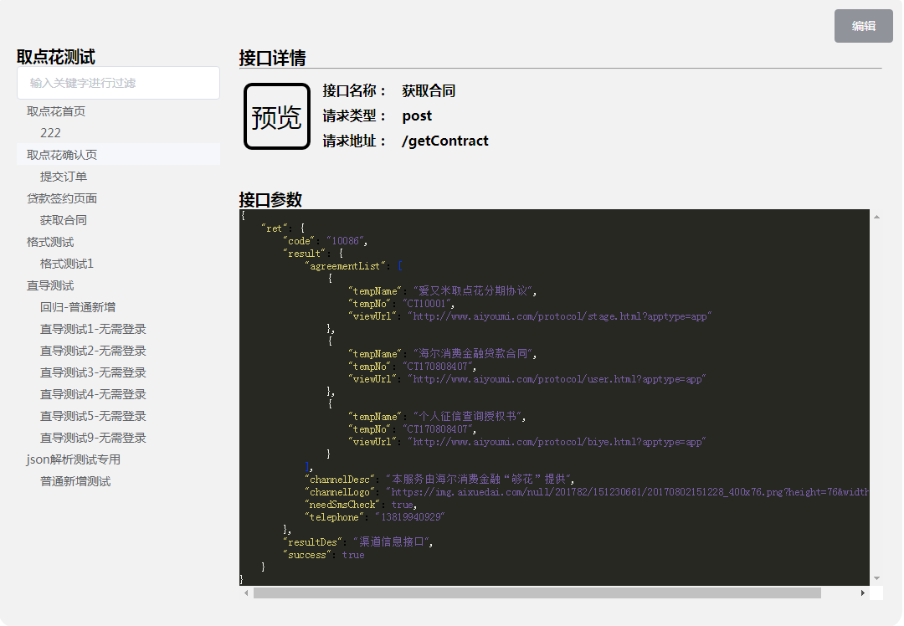

Slide 18
RequestShow Page
Interface Tree
Params Detail

Slide 19
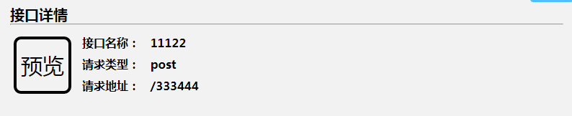
Interface Detail
name:
预览
method:
url:

Slide 20

Register Page
just dialog
login && register
flex
px2rem
Welcome
WELCOME

Slide 21
Register Page
just dialog
login && register
flex
px2rem
WELCOME

Slide 22
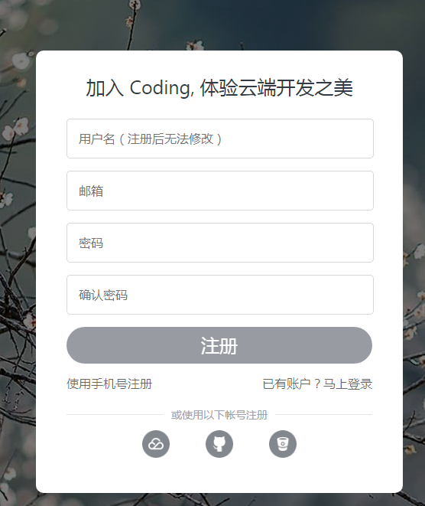
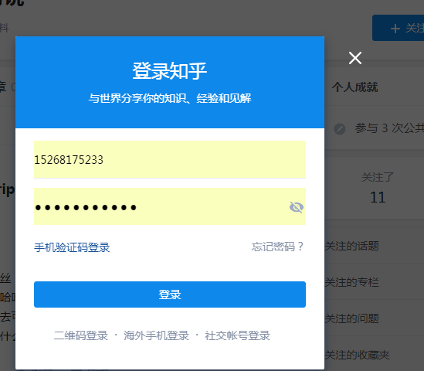
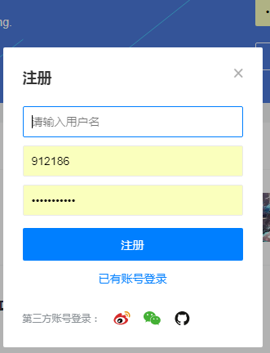
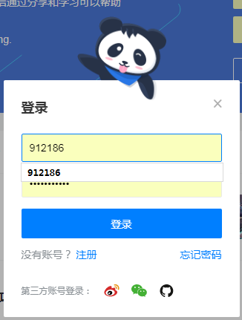
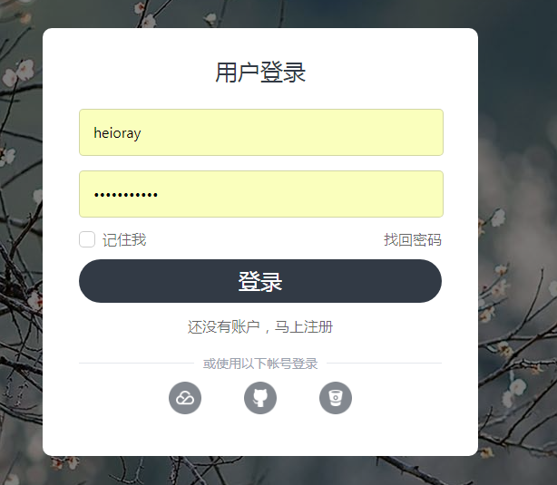
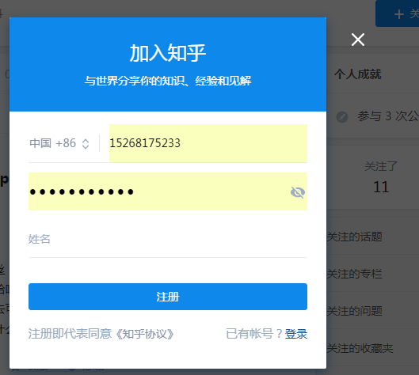
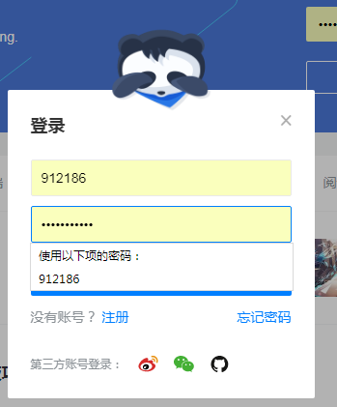
Register Page

