Slide 1
Quantitative Methoden 1
Tutorium 16/04/2021
Regression with multiple predictors
Model selection
Chapter exercise

Slide 2
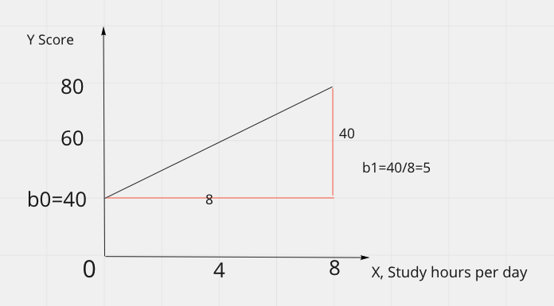
Review Linear model one predictor
Linear regression is the statistical method for fitting a line to data where the relationship between two variables x and y, can be modeled by a straight line with some error,
When we use x to predict y, we usually call x the predictor variable and we call y the outcome
Y = b0 + b1 x
b0: intercept, b1:slope
Y = 40 + 5 x
The steepness of a hill is called a slope
https://openintro-ims.netlify.app/summarizing-visualizing-data.html#chp2-review-exercises

Slide 3
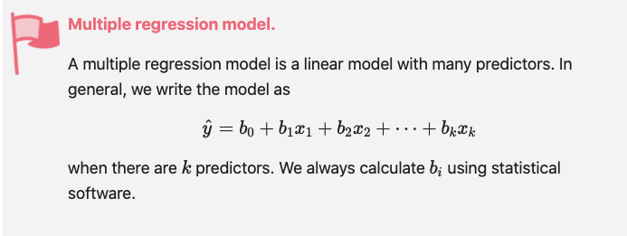
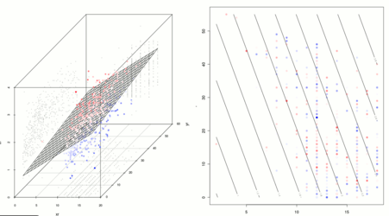
Model with multiple predictors
Multiple dimensional model
https://openintro-ims.netlify.app/multi-logistic-models.html#ind-and-cat-predictors
https://de.wikipedia.org/wiki/Regressionsanalyse

Slide 4
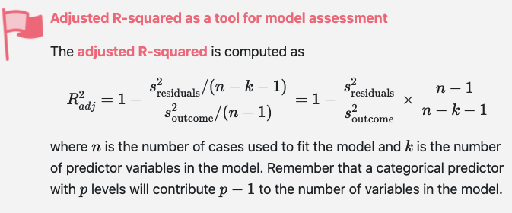
Adjusted R-squared, R-squared ?
When single predictor: R-squared is ok!
When multiple predictors: Adjusted R-squared is better!
https://openintro-ims.netlify.app/multi-logistic-models.html#many-predictors-in-a-model

Slide 5
Exercise time
IMS book 4.1.4.2, 4.1.4.3, 4.1.4.4

Slide 6
Model selection
Backward elimination: from full to step by step elimination
Forward selection: reverse
Common choose standard:
Larger adjusted R squared, smaller P value.
https://openintro-ims.netlify.app/multi-logistic-models.html#ind-and-cat-predictors

Slide 7
Exercise time
IMS book 4.2.3.1, 4.2.3.2, 4.2.3.3, 4.2.3.4

