Slide 1
Quantitative Methoden 1
Tutorium 26/03/2021
Skalenniveau / Type of Variables
Normalverteilung / Normal Distribution
R-Basic-System-Package

Slide 2
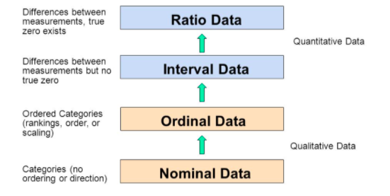
Skalenniveau / Type of Variables
❗️❗️Ratio data and Interval data can be also discrete or continues, these are just two ways of sayings.
More details : book: Ims 1.2.2
Price, Age
Year, IQ,EQ
Score: high, middle, low
Countries
Source from : https://www.graphpad.com/support/faq/what-is-the-difference-between-ordinal-interval-and-ratio-variables-why-should-i-care/

Slide 3
Online Quiz time❓
Click the quiz link and enter with the pin code sent in the chat, and start~
Tips:
Make sure that you have a stable internet connection.
If you for any reason leave the live quiz, you can rejoin using the PIN code.
Please don't leave your browser or app while the quiz is running.

Slide 4
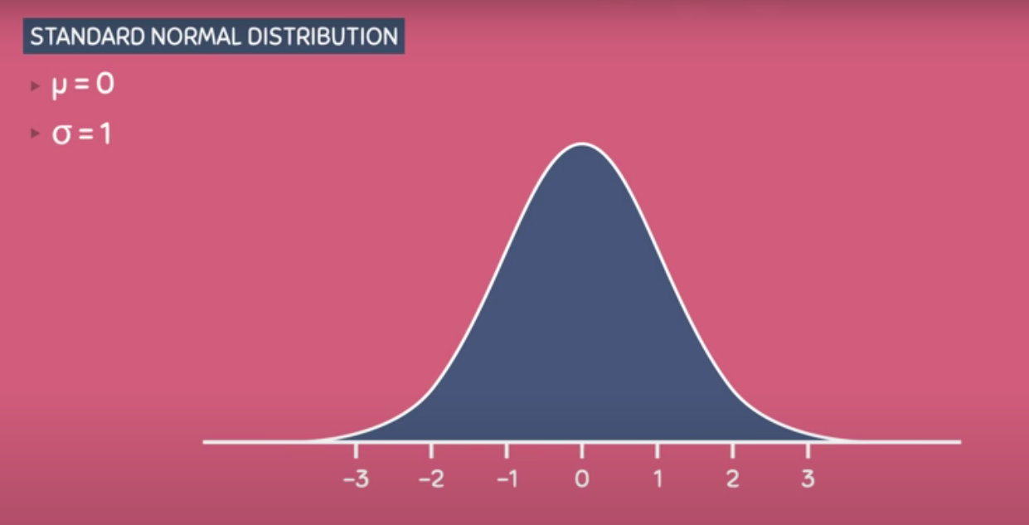
Normal Distribution
Density curve/Frequency distribution
Unimodel, symmetric
Describe the tendency for data to cluster around the central value, in fact the central value is the mean, and always located at the centrer of the curve
The SD determines how spred out the distribution will be.
❗️❗️❗️Some useful videos :
https://www.youtube.com/watch?v=mtbJbDwqWLE
https://www.youtube.com/watch?v=CjF_yQ2N638
https://www.youtube.com/watch?v=2tuBREK_mgE

Slide 5
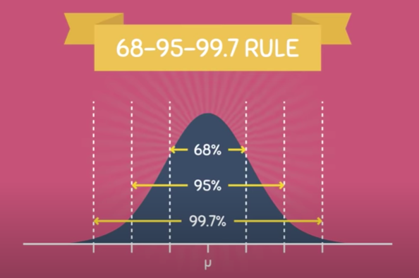
Normal Distribution
68-95-99.7 Rule, total area=total probability=1(always)
About 68% of values fall within one standard deviation of the mean. About 95% of the values fall within two standard deviations from the mean. Almost all of the values—about 99.7%—fall within three standard deviations from the mean
❗️❗️❗️Some useful videos :
https://www.youtube.com/watch?v=mtbJbDwqWLE
https://www.youtube.com/watch?v=CjF_yQ2N638
https://www.youtube.com/watch?v=2tuBREK_mgE
https://www.youtube.com/watch?v=mtbJbDwqWLE&t=209s

Slide 6
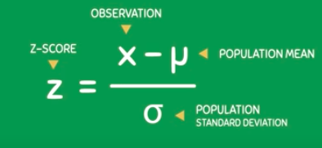
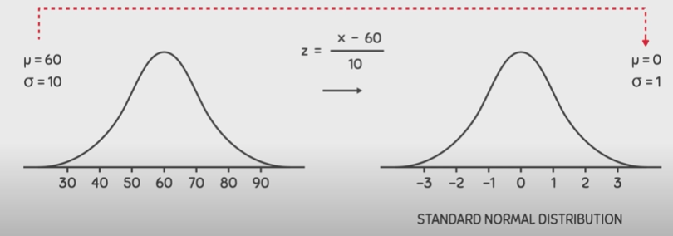
Normal Distribution
Z-Value
A important criteria for tidying data
The Z-score is defined as the number of standard deviations it falls above or below the mean.
If the observation is one standard deviation above the mean, its Z-score is 1. If it is 1.5 standard deviations below the mean, then its Z-score is -1.5.
❗️❗️❗️Some useful videos :
https://www.youtube.com/watch?v=mtbJbDwqWLE
https://www.youtube.com/watch?v=CjF_yQ2N638
https://www.youtube.com/watch?v=2tuBREK_mgE
https://www.openintro.org/book/os/

Slide 7
Online Quiz time❓
Tips:
Make sure that you have a stable internet connection.
If you for any reason leave the live quiz, you can rejoin using the PIN code.
Please don't leave your browser or app while the quiz is running.

Slide 8
R-Basic-Package
❗️Nicht vergessen:
Installieren Pakete muss man eine Software nur einmal.
Starten (laden)muss man die R-Pakete jedes Mal, wenn man sie vorher geschlossen hat und wieder nutzen möchte.
install.packages("ggplot2") DO THIS AT THE FIRST TIME!
library(ggplot2) DO THIS WHENEVER YOU USE IT!
Sauer, S. (2019). Moderne Datenanalyse mit R. Springer
https://www.springer.com/de/book/9783658215866

Slide 9
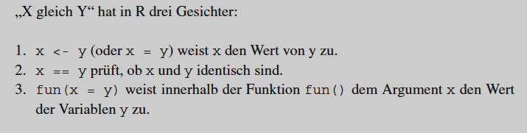
R-Basic-Syntax
<- and ==
<-: allocate the value
==: the values are exactly indentical
temperatur <- 9
Mit dem Operator <- (Zuweisungspfeil) weisen wir dem Behälter (der Variablen) mit dem Namen temperatur den Wert 9 zu;
Sauer, S. (2019). Moderne Datenanalyse mit R. Springer
https://www.springer.com/de/book/9783658215866

Slide 10
Online Quiz time❓
Tips:
Make sure that you have a stable internet connection.
If you for any reason leave the live quiz, you can rejoin using the PIN code.
Please don't leave your browser or app while the quiz is running.

Slide 11
A good website to recommend: post questions on there and wait…
https://stackoverflow.com/

Slide 12
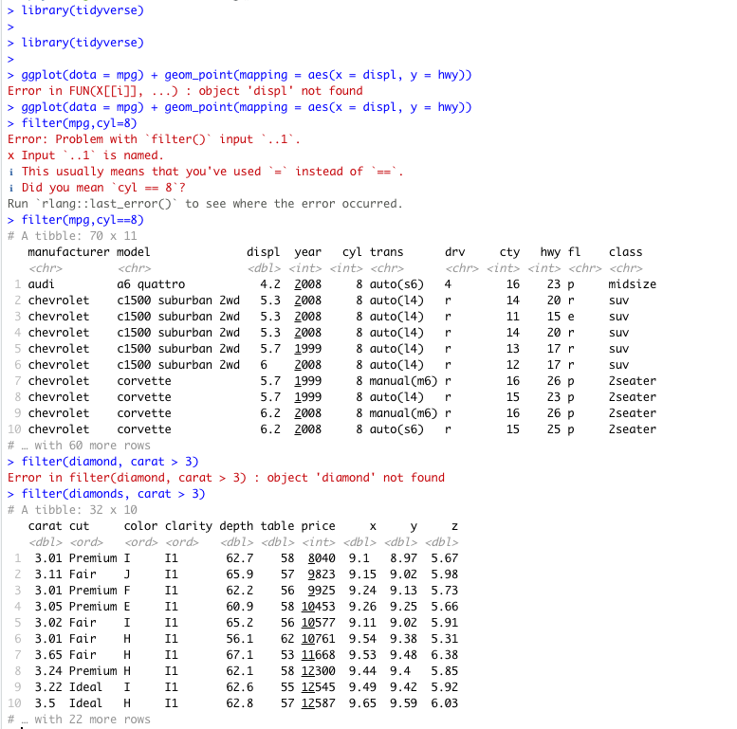
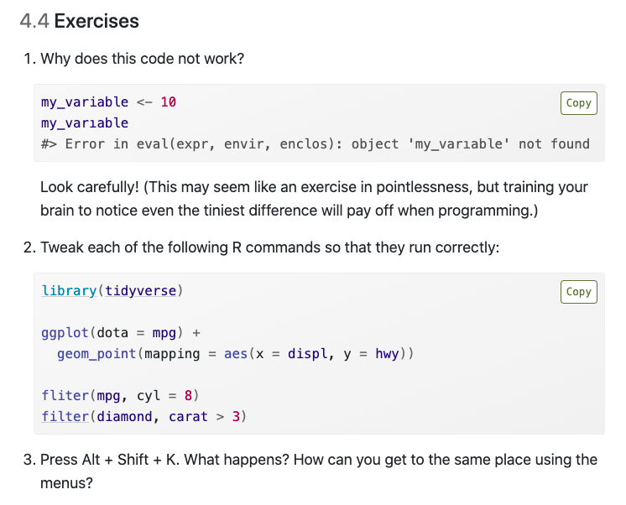
https://r4ds.had.co.nz/workflow-basics.html#exercises-7

